Slide 1
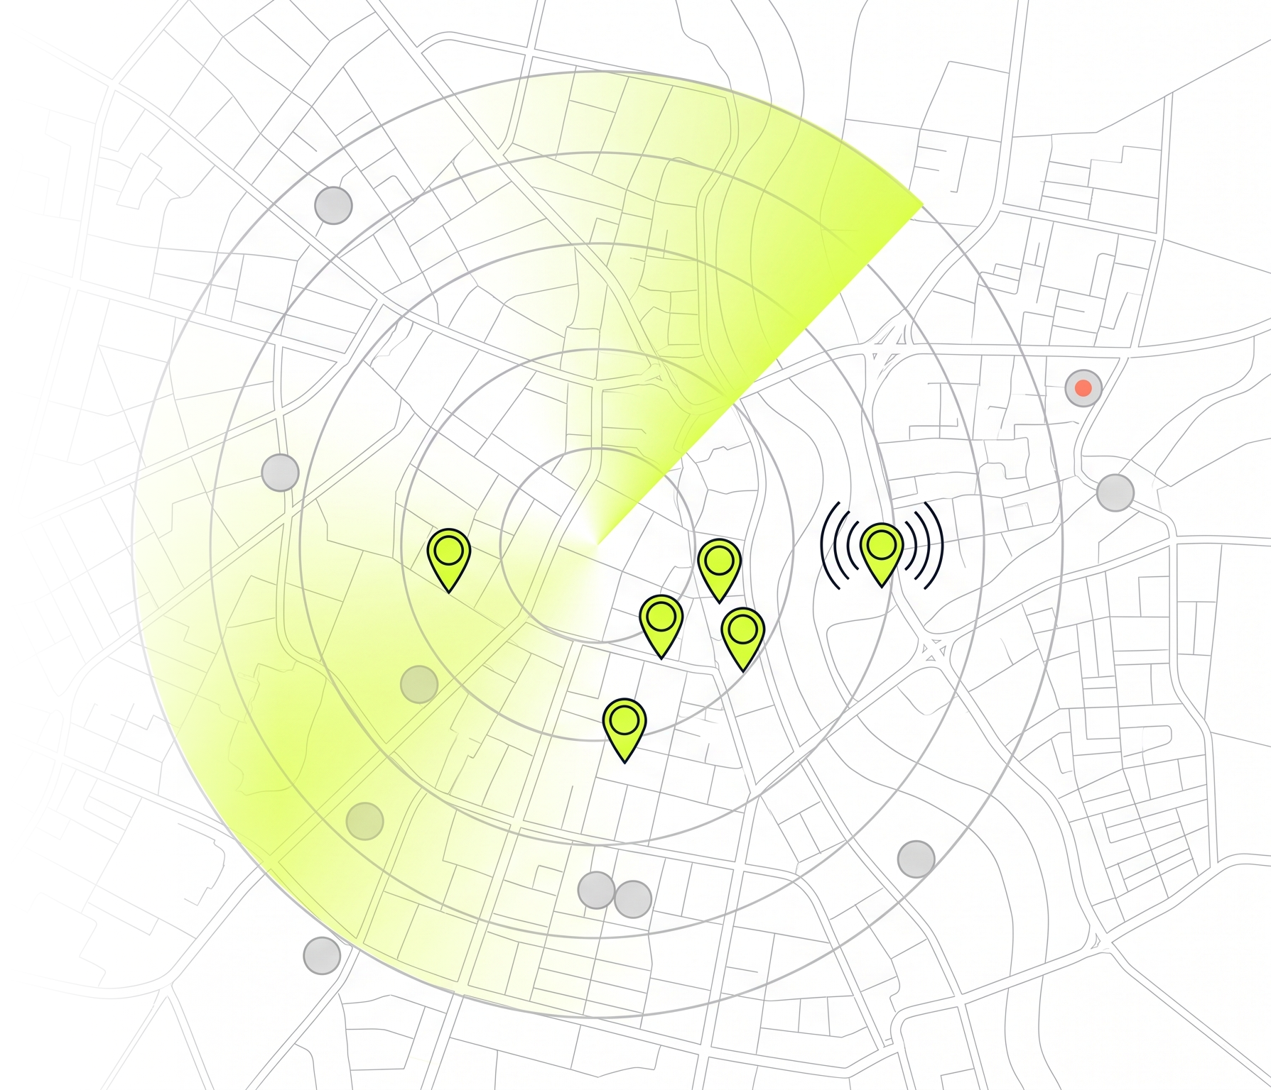
TECHVRUK · AI AGENTIC SYSTEM CHALLENGE
Prospector
An AI agent that finds your next customers.
Give it a goal in plain English. It plans, searches real maps and websites, recovers when a step fails, scores every lead with reasons, sets up a live AI receptionist you can call for the best ones, and learns what a good lead means to you.
Nilesh Patil Python · FastAPI · Next.js · Gemini · Gemini Live · OpenStreetMap
Notes:
Prospector is a lead-prospecting agent. You type a goal like 'find 15 physiotherapy clinics in Pune that would benefit from an AI phone receptionist'. The agent plans, uses real tools (OpenStreetMap and the businesses' own websites), recovers from failures, scores the leads with reasons, builds a live AI receptionist demo for the best ones, and improves its scoring from your feedback.

Slide 2
Every sales list today is either slow or made up.
THE PROBLEM
WHAT PROSPECTOR DID ON REAL RUNS IN PUNE
1
Slow
Someone searches Maps business by business, opens every website, and guesses who might buy.
50
real dental clinics found in one run, each one traced back to OpenStreetMap
2
Made up
3
failed tool calls recovered from in the physiotherapy run, still finished in 18 of 20 steps
Ask a chatbot for 30 leads and it invents clinics, phone numbers and doctors that do not exist.
3
Unconvincing
0
businesses or facts invented. Anything not observed is shown as "not observed"
A spreadsheet row does not show a business owner what an AI receptionist would do for them.
Notes:
Three problems: building a call list by hand is slow, asking a plain LLM for leads gives you businesses that do not exist, and a list alone does not sell anything. The numbers on the right come from real runs saved in the repo: a 50-clinic dental run, and a physiotherapy run where three tool calls failed and the agent recovered and still finished inside its step budget.

Slide 3
Plan, act, observe, re-plan: a real agent loop.
GOAL
PLAN
ACT
OBSERVE
DECIDE
RESPOND
"Find 15 physio clinics in Pune for an AI receptionist"
LLM turns the goal into place, niches, target count and steps
Calls one tool: search the map, fetch websites, score, write hooks
The tool result comes back as text. State is saved after every step
Enough leads? Did it fail? Re-plan, widen the area, or move on
Ranked leads with reasons, pitch hooks, a report and live receptionists
loops until the goal is met or the step budget runs out
TOOLS THE AGENT CAN CALL
geocode
search_businesses
widen_area
enrich
score
deep_research
write_hooks
prepare_receptionists
finish
No agent framework. No LangChain, no CrewAI. The loop, tool registry and rule validator are plain Python you can read.
Wrap-up guard. If searches stop finding new businesses, it stops searching and always finishes the pipeline.
Notes:
This is the core of the submission. One LLM call makes the plan. Then the agent picks one tool at a time, reads the result, and decides what to do next. Failures are observations, not crashes: when a map search times out it retries, widens the area, or moves on. State is written to disk after every step. I found and fixed a real issue during testing: on sparse niches the agent kept re-searching, so a wrap-up guard now forces it to finish the pipeline.

Slide 4
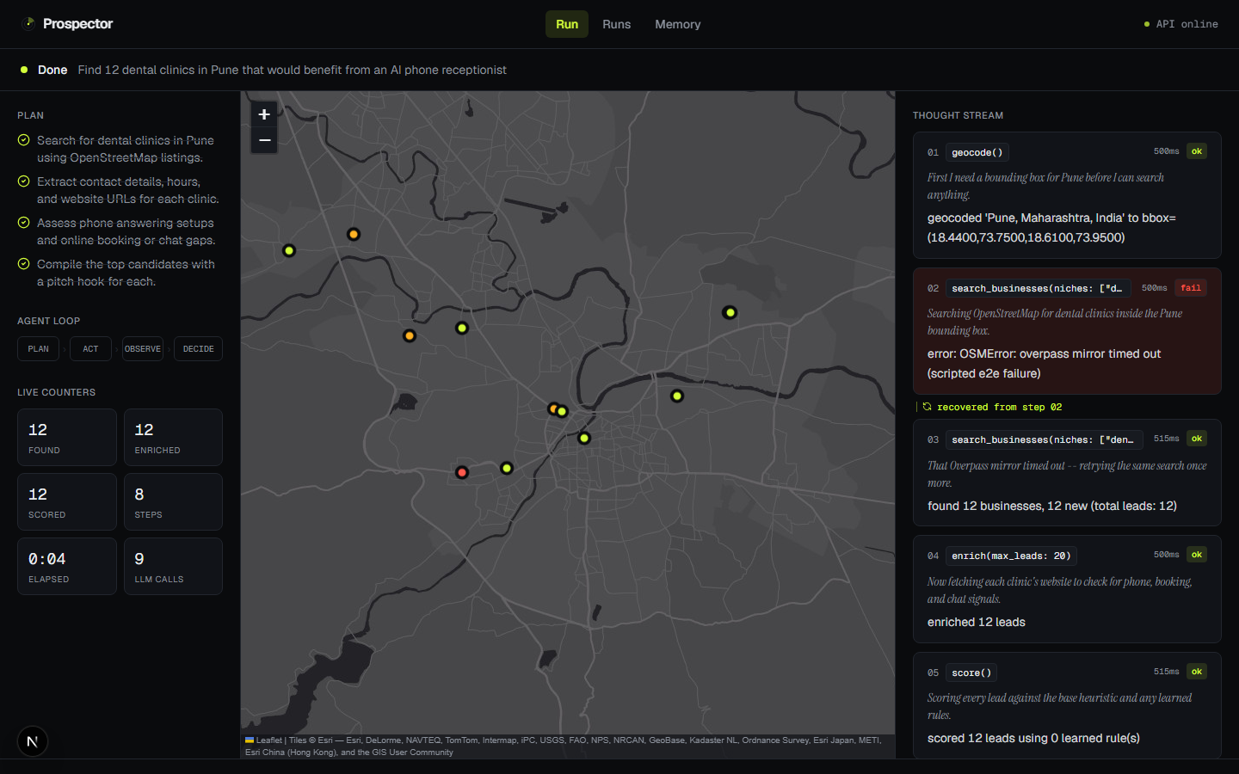
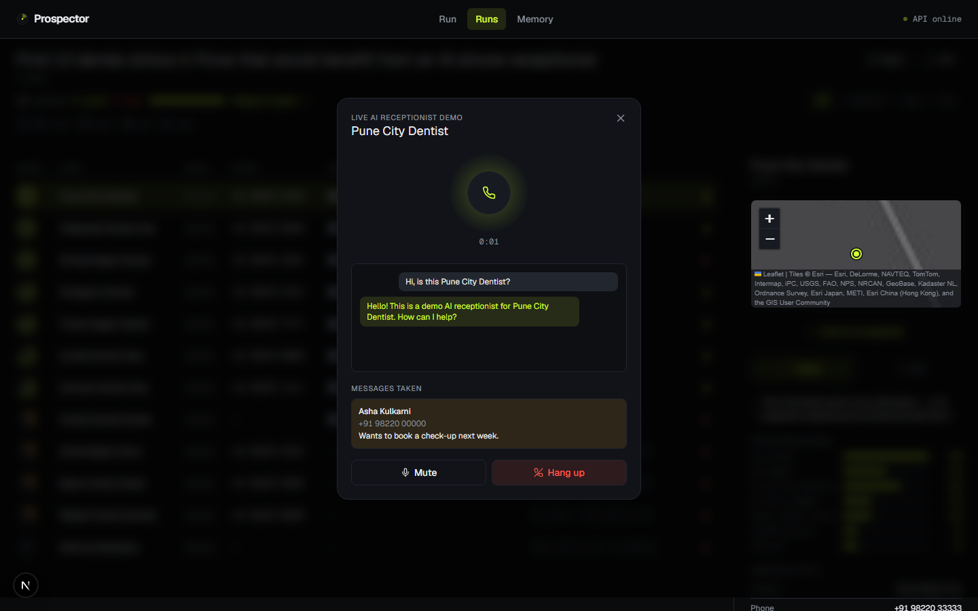
Watch it think. Then call the lead's AI receptionist.
Mission control
Live voice call with the Gemini Live API
A live map fills with pins, the plan ticks off, and every thought, tool call and failure streams in as it happens.
The persona uses only facts the agent observed. Barge-in, live captions, takes messages, and replies in Hindi or Marathi. The browser gets a one-use token; the API key never leaves the server.
Screenshots: the app running on the end-to-end test data set.
Notes:
Left: the run page. You can see the plan, the agent loop phase, and each step as a card. Right: the live call. For the top leads the agent writes a receptionist persona from what it actually found, like real opening hours. You click call and talk to it in the browser in real time. If it does not know something, like a doctor's name, it offers to take a message instead of making it up, and the message is saved on the lead.

Slide 5
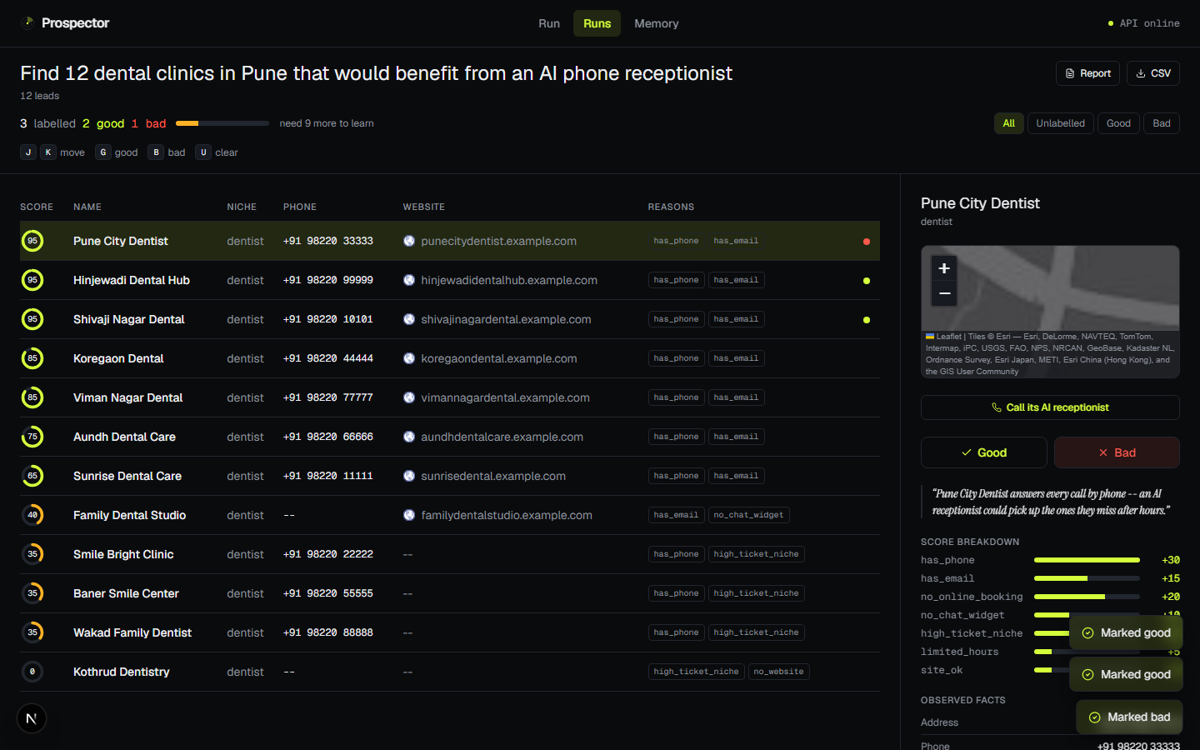
It learns what a good lead means to you, and proves it.
1
You label leads Good or Bad
One key per lead on the review page (G / B).
2
The LLM proposes new scoring rules
It reflects on the leads it scored wrong.
3
Each rule is tested on unseen leads
Rules are picked on one split and graded on a separate one.
4
Kept only if accuracy goes up
Otherwise rejected, and the reason is shown.
87
unit and
API tests
7
end-to-end
browser specs
Python
FastAPI
Next.js 16
Gemini
Gemini Live
OpenStreetMap
Screenshot: the app running on the end-to-end test data set.
Notes:
The agent gets better with use. You mark leads good or bad. The LLM suggests new scoring rules, but a suggestion is not trusted: every rule is tested on labeled leads it never saw, and only rules that raise accuracy are kept. The whole system is covered by 87 Python tests and 7 Playwright browser tests, including the live call flow.

