Slide 1

Machine Learning in web-browser

Slide 2
About Me
Nilesh Patra
Second Year student at NSIT
Data science and ML enthusiast
npatra974@gmail.com | github:nileshpatra

Slide 3
What is tf.js?
Javascript implementation on classic tensorflow library primarily used in python/R
Neural networks implemented in Javascript
Browser ready with node bindings which are being developed rapidly

Slide 4
The History of Its evolution
Tensorflow was open-sourced in 2015 under apache open source license
In 2017, a project called Deeplearn.js appeared, which aimed to enable ML/DL in JavaScript, without the hassles of API
March 2018 - DeepLearn.js team got joined the TensorFlow Family

Slide 5
Why run tensorflow on browser?
- Wide distribution
- Interactive
- Sensors
- Easy to us APIs
- Support for most common tensorflow Ops
- 32+ most commonly used tf/keras layers

Slide 6
Functionalities of tf.js
Has two APIs - core and layer.
Build models and process existing ones.
Uses WebGL - a browsers interface to OpenGL
Author Models directly in browser
Use pre-trained models

Slide 7
Comparison with tensorflow - python API
Tf.js automatically uses webGL to access and uses GPU - there is no hassle of configuring it , whereas we need to setup CUDA for tensorflow - python .
Tf .js is a lot slower than classic tensorflow python API due to its JS based backend .
Tf.js renders itself in a web-browser while a normal tensorflow python API can be run directly into the machine .

Slide 8
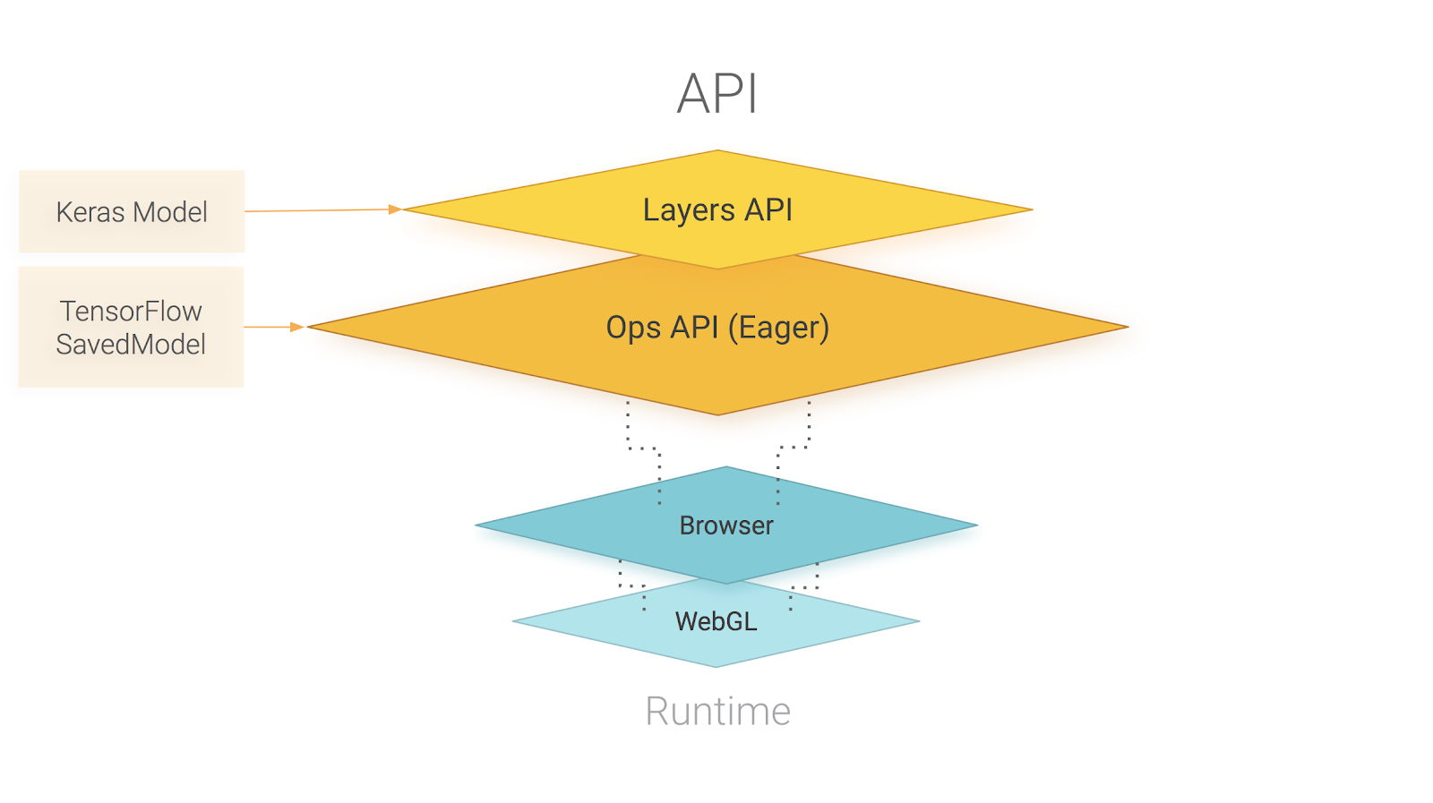
The Tensorflow.js APIs and Structure

Slide 9
Basic tf.js terminology
Tensor - the basic operation unit in tensorflow , they are n-dimensional matrices used for computations in a neural network .
Variable - tensor variable for storing data .
Layer - layers of neural net for performing machine learning task .
Model - the final model we have to serve on the web .

Slide 10
CORE API
Written in pure Javascript
API for Tensors which are Immutable in our program
Inspired from tensorflow-python API
Includes API support for Tensors , variables , and core API operations such as : tf.add() , tf.sub() , tf.mul() … etc.

Slide 11
Layers API
Higher Level abstraction for tensorflow.js
Support for neural networks for machine learning
Inspired by keras to emulate its function in javascript
Built on top of Core API

Slide 12
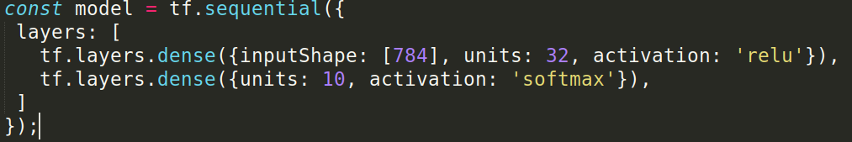
Layers API - using the model
- tf.sequential() - basically a linear stack of layers for creating a neural network.

Slide 13
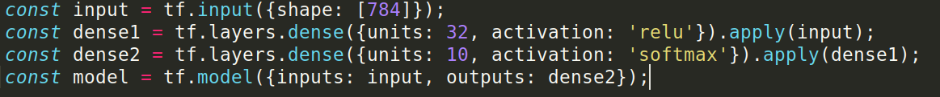
Layers API - using the model
tf.model() - allows you to create an arbitrary graph of layers, as long as they don't have cycles.

Slide 14
Layers API - adding layers and optimizers
There are various types of layers available for tf.js. Some of the common ones are :
Tf.layers.dense- used for dense layer
Tf.layers.conv2d - 2-D convolution layer in tfjs
Tf.layers.flatten - flatten the image in a CNN
Tf.layers.activation - used for applying an activation function
There are also a lot of optimizers available such as adam, sgd, rmsprop etc.

Slide 15
Using all the Layers API --code
Lets see an example of what we have seen so far
This is a very basic implementation of the classic XOR problem

Slide 16
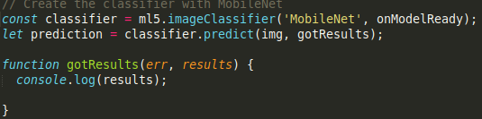
Similar libraries? -- ML5.JS
A library that provides access to machine learning algorithms and models in the browser, building on top of tf.js with no other external dependencies.
GPU-accelerated mathematical operations and memory management for machine learning algorithms

Slide 17
Further Reading
Playground.tensorflow.org
https://www.tensorflow.org/js/guide
https://js.tensorflow.org/api/0.12.0/
https://ml5js.org/
https://github.com/tensorflow/tfjs
https://processingfoundation.org/

Slide 18
THANK YOU!!

