Slide 1
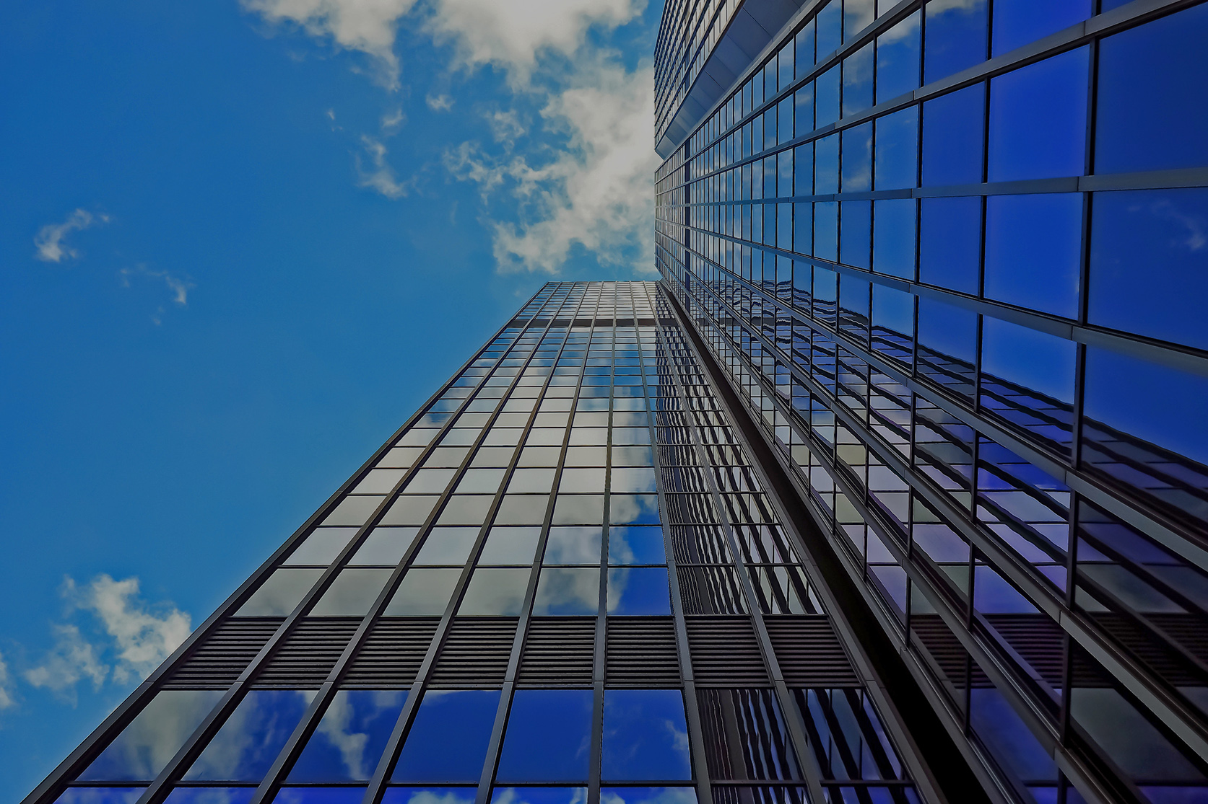
Face Recognition For Biometric Identification using VIT
Submitted by: Krish Kumar
Nilesh Pingale
NATIONAL INSTITUTE OF TECHNOLOGY,
SURATHKAL

Slide 2

OVERVIEW :-
INTRODUCTION
WHY FACE REGOGNITION ?
WHAT IS BIOMETRIC ?
STAGE OF IDENTIFICATION
Approach
SOFTWARE & MODULE
ADVANTAGE & DISADVANTAGE
APPLICATION
CONCLUSION

Slide 3

INTRODUCTION
Everyday action are increasingly being handled electronically instead of pencil and paper or face to face.
This growth in electronic transactions results in great demand for fast and accurate user IDENTIFICATION & AUTTHENTICATION….

Slide 4
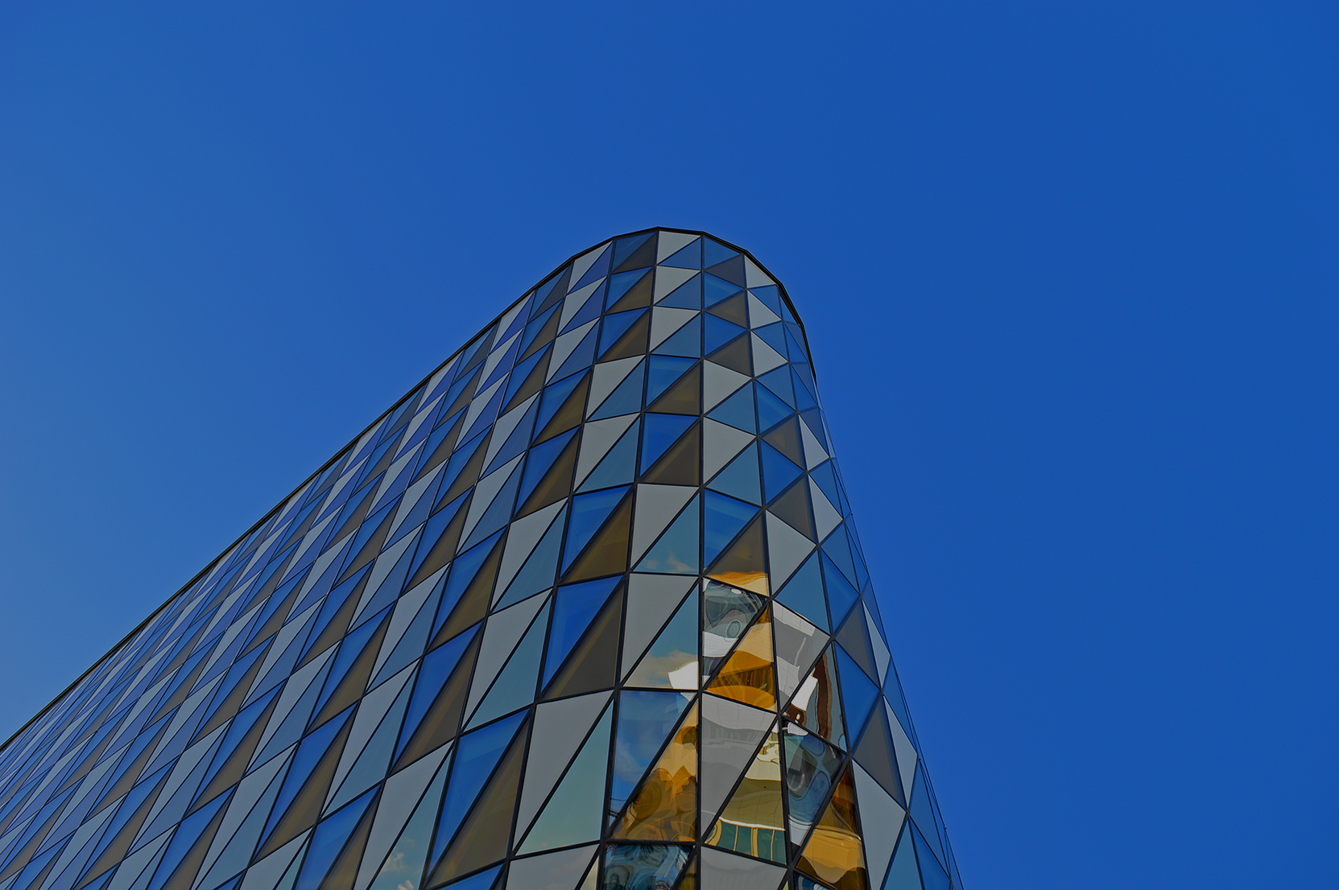
WHY Facial Recognition ??
It Requires no physical interaction on behalf of the user.
It is accurate & allows for high enrolment and verification rate.
It can use your existing hardware infrastructure , existing cameras and images captures Devices will work with no problem.

Slide 5
BIOMETRIC ?
A biometric is a unique, measurable characteristic of a human being that can be used to automatically recognize an individual or verify an individual’s identity
PHYSIOLOGICAL
BEHAVIORAL
Finger-scan
Facial Recognition
Iris-Scan
Retina-Scan
Hand-Scan
Voice-Scan
Signature-Scan
Keystroke-Scan

Slide 6
Stage Of Identification
Match/Non Match
CAPTURE
EXTRACTION
COMPARISON
Accept/Reject

Slide 7
4 stage of identification
Capture:- capture the behavioral sample
Extraction :- unique data is extracted from the sample and a template is created.
Comparison :- The template is compared with a new sample.
Match/Not Match :- the system decides whether a new samples are matched or not.

Slide 8
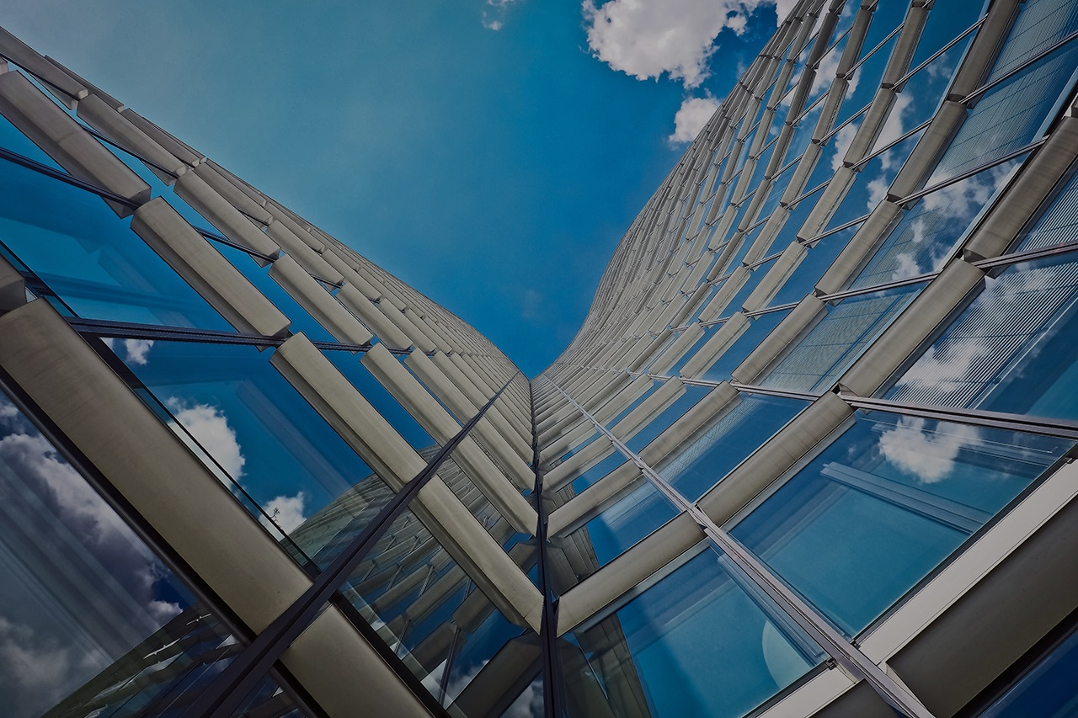
Approach:-(Three way step process)
First make a Data Set Creator script :- whenever the program capture the face will write that in folder . Before capturing the face we need to tell the scripts whose face it is. For that we need an identifier(ask from user for his/her User_Id ).Then it will capture face 20 times and write it in folder .
After taking the snapshots it will save the User info into the database.
For the database, used SqlLite3 Studio.
Train the recognizer :- For the trainer we need to extract the relative path where Data Set has been created. For the recognizer i used LBPH Face Recognizer Algorithm . Now if we run this code it will create a “ trainer.yml ” file inside the recognizer folder, We will use this file in our next post to actually recognize the faces that we trained the face recognizer to recognize.
Detector :- It will detect the user by fetching the data from the data base. If it match then its ok otherwise it will not detect it.

Slide 9
INNOVATION : Vision Transformer
Why vision Transformer?
1) pretrained of ImageNet-21k and JFT(large). {as dataset increased performance increase in case of ViT but not in CNN }. so using transfer learning in ViT is more efficient as compare to CNN.
2) do not include convolution layers
3) ViT provides high accuracy with less computation time for training.
4) treat image in the forms of tokens(1-D) rather working on pixels.
5) The primary idea behind the this model is Self-Attention(interdependence between inputs).
6) ViT models outperform CNNs by almost four times when it comes to computational efficiency and accuracy.
7) CNN fails to encode relative spatial instruction. CNN only looks for the features whether it is present or not in the image pixels. It does not care about the relative position of features. this problem is resolved by ViT.

Slide 10
Z0
Z1
Z2
Z3
Z4
Z5
Z6
Z7
Z8
Zn
….
EMBED
dense
dense
dense
dense
dense
dense
dense
dense
dense
[ CLS ]
x1
x2
x3
x4
x5
x6
x7
x8
xn
….

Slide 11
…. …. ….
Transformer
Encoder
Network
DENSE
MULTIHEAD SELF ATTENTION
Z0
Z1
Z2
Z3
Z4
Z5
Z6
Z7
Z8
Zn
….
EMBED
dense
dense
dense
dense
dense
dense
dense
dense
dense
[ CLS ]
x1
x2
x3
x4
x5
x6
x7
x8
xn
….

Slide 12
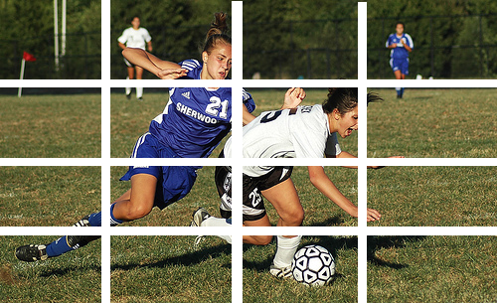















MLP
Transformer Encoder
Normalization
0
1
2
3
4
5
6
7
8
9
10
11
12
13
14
15
16
Multihead-Attention
Q K V
Linear Projection of Flattened Patches
Extra Learnable
[Class] Embedding
Normalization
Embaded-Patches

Slide 13
references:
https://www.etasr.com/index.php/ETASR/article/view/4735/2698
https://publisher.uthm.edu.my/ojs/index.php/jscdm/article/view/8791/4561
https://ieeexplore.ieee.org/abstract/document/9729845

Slide 14
Software and module :-
Language :- Python(3.6.9)
Module Used :-
a) Opencv-contrib-python 4.3.0.36
b) Opencv-python 4.3.0.36
c) pillow 7.2.0
d) Numpy 1.19.10
e) sqlite3
f) Pickleshare 0.7.5
Database :- SqLlite3 studio.

Slide 15
ADVANTAGE :-
Convenience and social acceptability
Easy to use
Inexpensive Biometric.

Slide 16
DISADVANTAGE :-
It can’t identify the identical twins.
Unable to capture if the facial expression is changing frequently.
Less effective in low light.

Slide 17
APPLICATIONS :-
Government Use :-
1) Law enforcement
2) Security/Counterterrorism
3) Immigration
Commercial Use :-
1) Day Care
2) Residential Security
3) Voter Verification
4) Banking Using ATM

Slide 18
CONCLUSION :-
Face recognition technologies have been associated generally with very costly top secure application. Today the core technology have evolved and the cost of equipment is going down dramatically due to integration.
For implementations where the biometric system must verify and identify users reliably over time, facial scan can be a very difficult, but not impossible, technology to implement successfully.

Slide 19
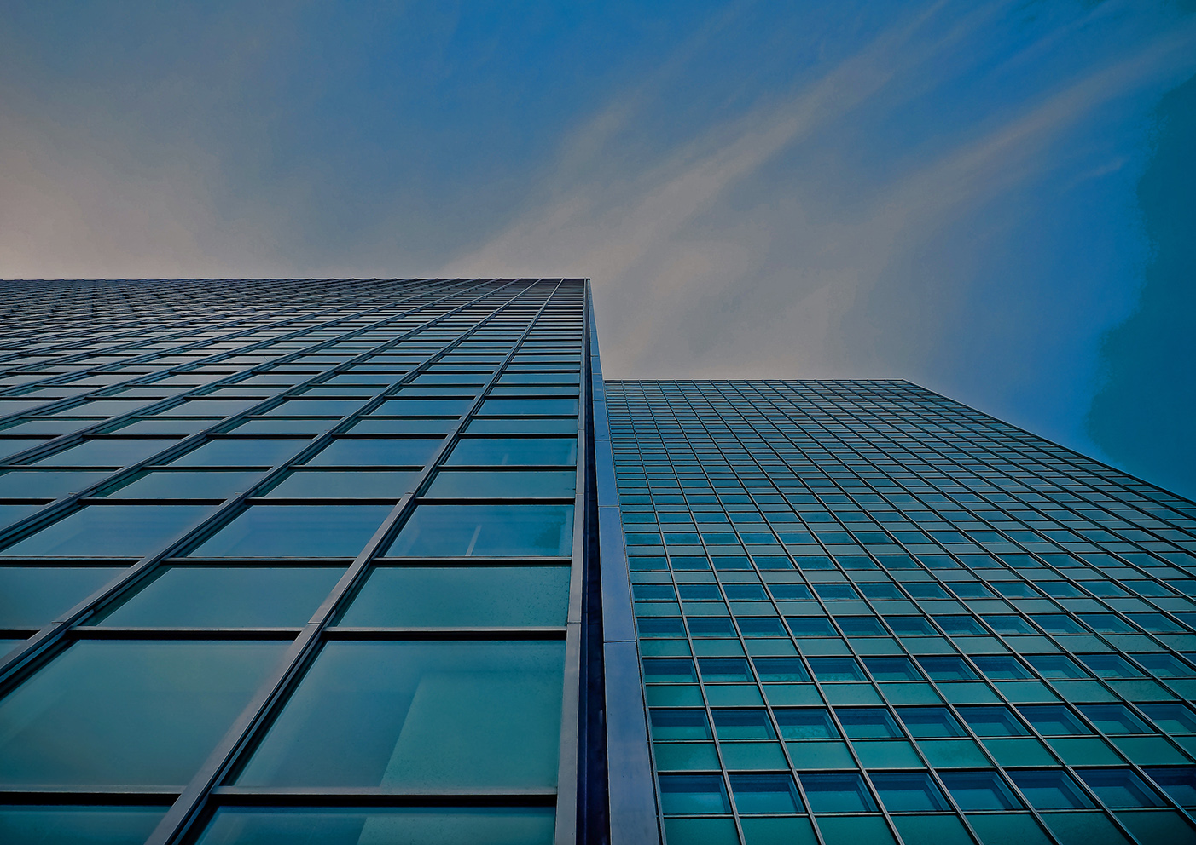
THANK YOU!

