Slide 1
Mortality Prediction in ICU Patients using ECG data

Slide 2
Problem Statement:
Predict the survival probability of ICU patients after y time.
Database: MIMIC-III [contains both clinical and waveform data]
Datatype: ECG Waveform + Time-series + Clinical Variables

Slide 3
Prior-Art Research

Slide 4
Machine Learning Models to Predict 30-Day Mortality in Mechanically Ventilated Patients
On-set of MV
30 days: Prediction Window
24 hrs Predictor Window
Variables: Traditional scores, Demographics, Comorbidity index, norepinephrine etc.
Traditional Methods
Method | AUC
APACHE--II | 0.67
ProVent | 0.69
Method | AUC
Extreme Gradient Boost | 0.79
Random Forest | 0.78
Dataset they are using?

Slide 5
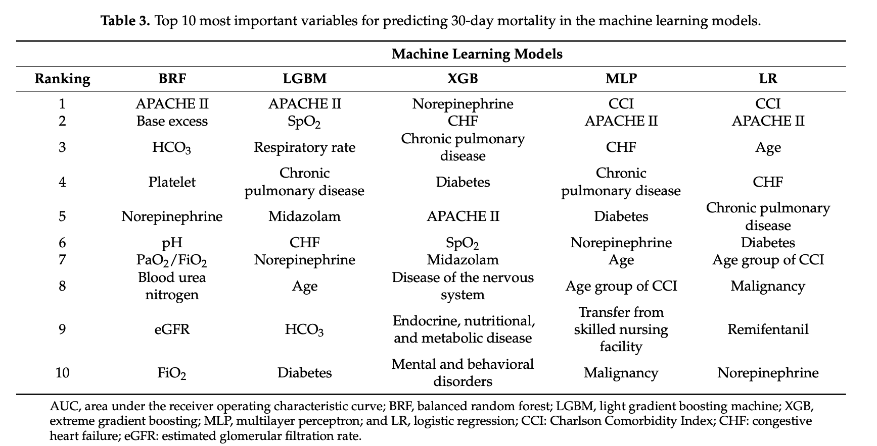

Slide 6
Limitations:
Framework doesn’t predict near future.
More relevant if we predict patient’s survival in 1, 2, 3 .. 6 hours.
Doesn’t use complex ECG signal data available.
There is scope for improvement!

Slide 7
ECG Data
Lots of work done for understanding ECG data to predict cardiovascular diseases. Ex: Arrhythmia Classification
Databases used: MIT-BIH Arrhythmia Database, AHA ECG Database, etc.

Slide 8
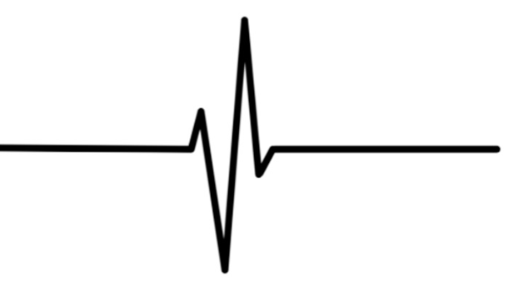
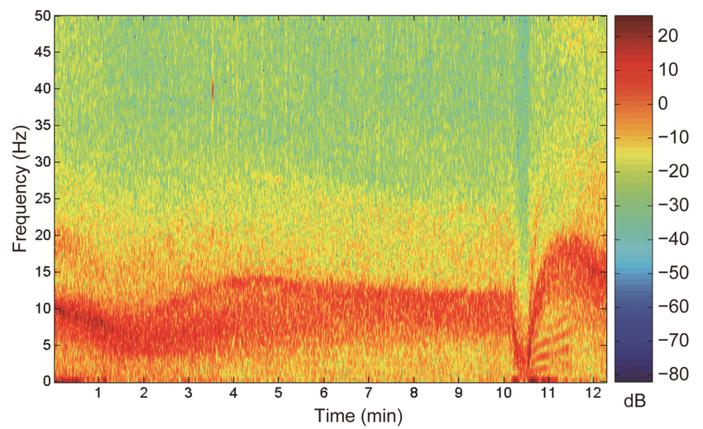
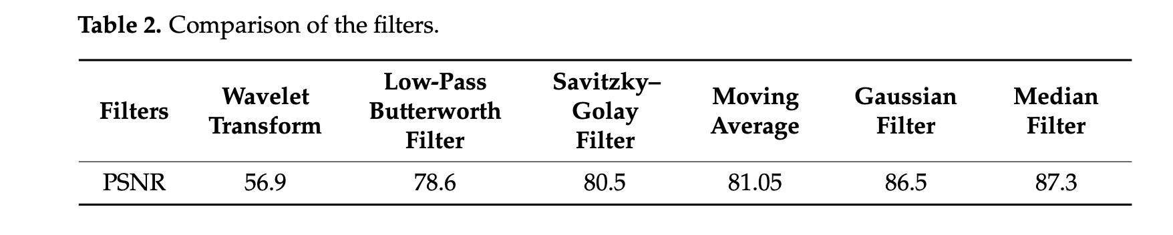
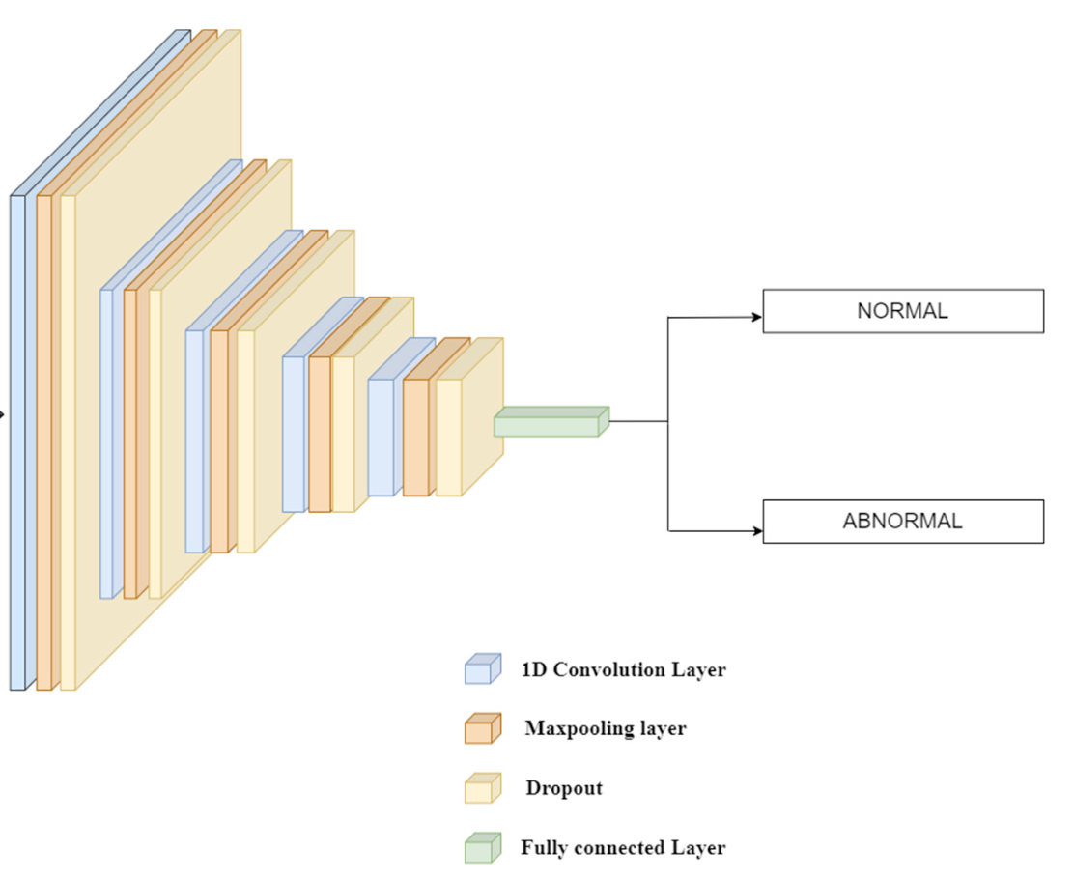
Methodology
Raw ECG Signal
Noise Removal
Spectral
Image
AI Models

Slide 9
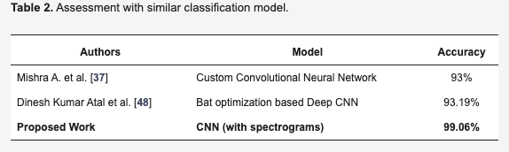
Results

Slide 10
Conclusion & Research Questions:
ECG Data has done wonders in the field of arrhythmia classification.
Feature Extraction using spectral images of ECG is promising.
No work done in utilizing ECG data for predicting Mortality.
Can ECG data predict mortality alone?
If not, can it help time-series and other clinical variables to boost their performance?

Slide 11
OUR WORK

Slide 12


Problem Design
x: Look Back/Predictor window
x: Look Back/Predictor window
x: Look Back/Predictor window
Several Models will be built

Slide 13
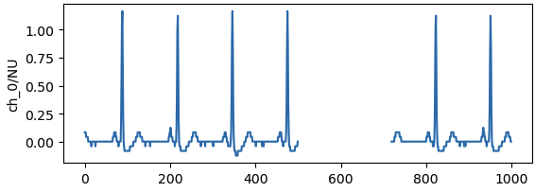
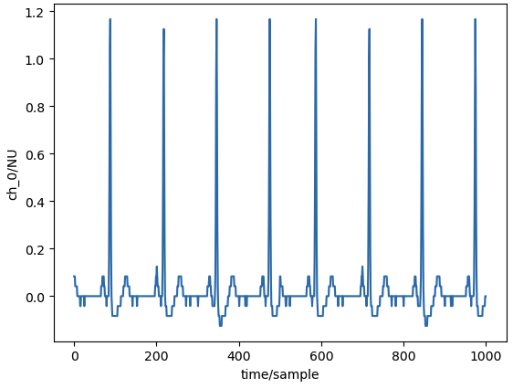



Methodology
Database: MIMIC-III
Missing Value Imputation
0
High/Low-pass Filter
1
Can ECG alone predict mortality?

Slide 14
Future Work
Can ECG data help time-series, demographics data and other clinical variables to boost their performance?
ECG
0: Survived
Time-Series
Eg: SP02, HR, BP etc
Model
1: Died
Features:
Demographics, Age,
Apache-II scores etc

Slide 15
Experiment & Results
X (secs) | Y(hrs) | Class Distribution | Preprocessing | Model | AUC
30 | 24 | 80 &

Slide 16
THANK YOU

Slide 19
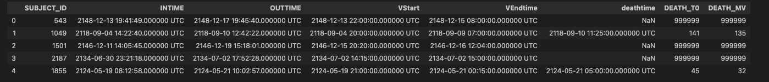
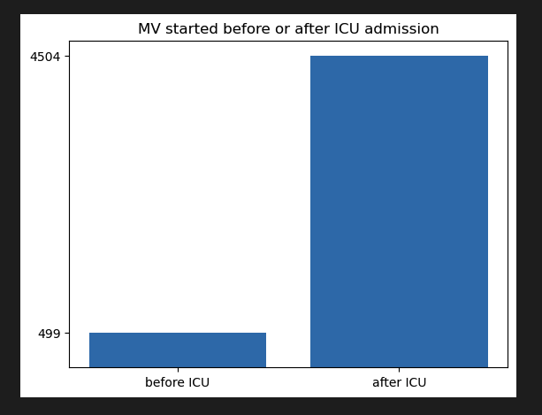
Given table:
Processing done:
1> Select the last ICU stay for each patient. (~23k patients)
2> Compute death w.r.t ICU intime, w.r.t MV start time.
3> Select patients which have waveform (~5k/23k patients)

Slide 20
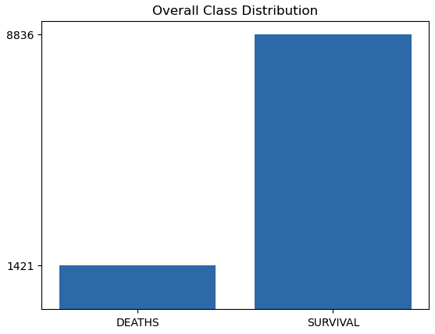
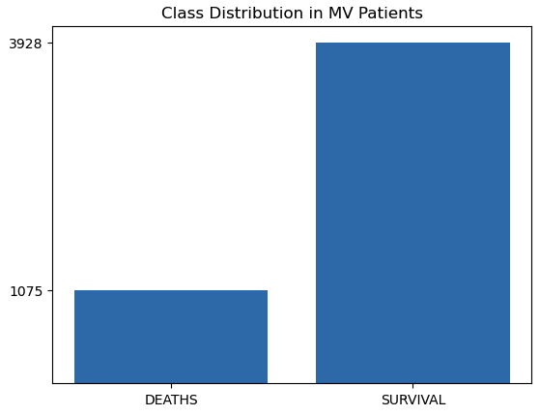
Class Distribution

Slide 21
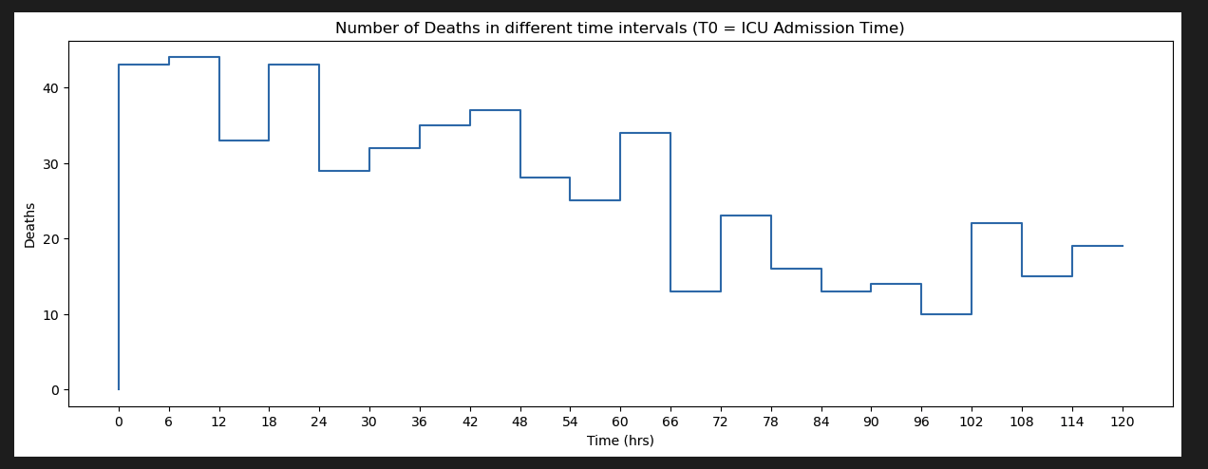
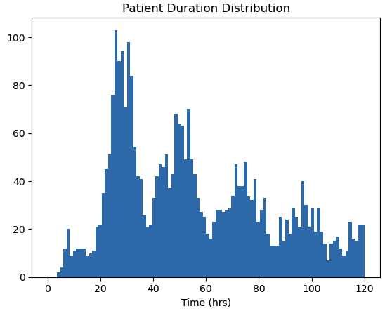
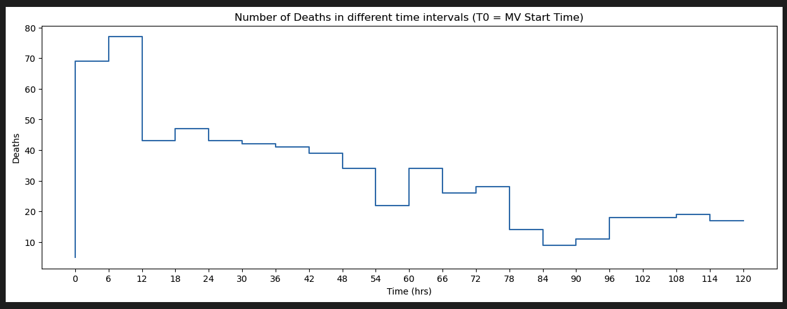

Slide 22
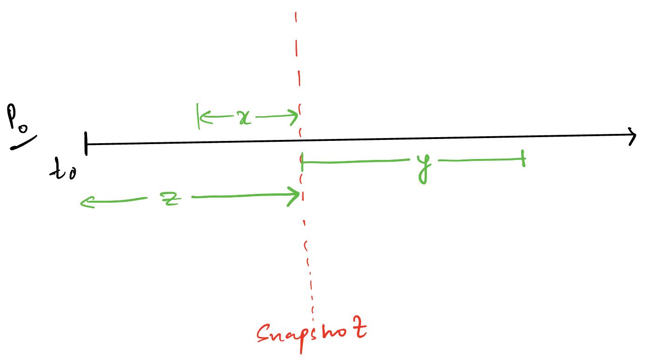
Define Problem:
(x, y, z) defines a unique model in 3-dimensional space.
z: Duration from the ICU admission time. Also defines the cohort to be analyzed.
x: Predictor window [Assumption: Closer to the event, more the information it carries]
y: Prediction window
Snapshot: defined by unique (z, y)

Slide 23



Updated Problem:
$$T_{MV0}$$
Y: Prediction Window
X: Predictor Window
$$T_{ICU0}$$
$$Z_{ICU0}$$

Slide 24
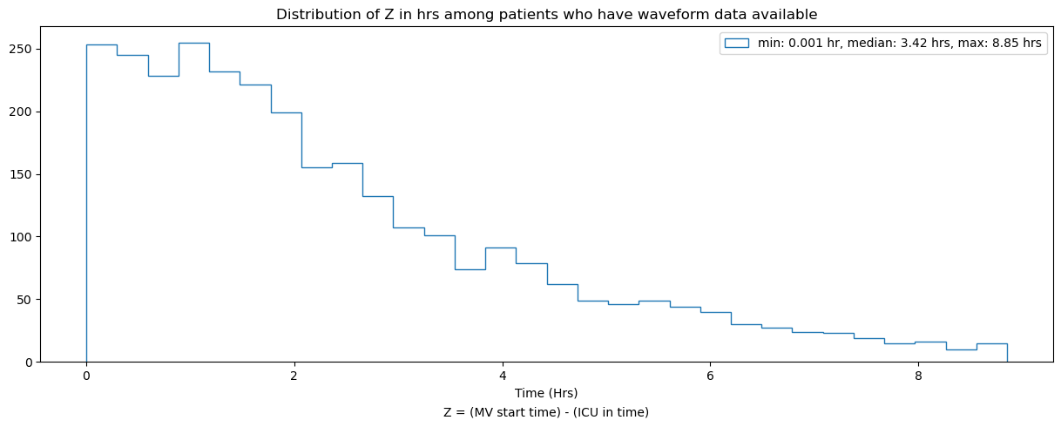
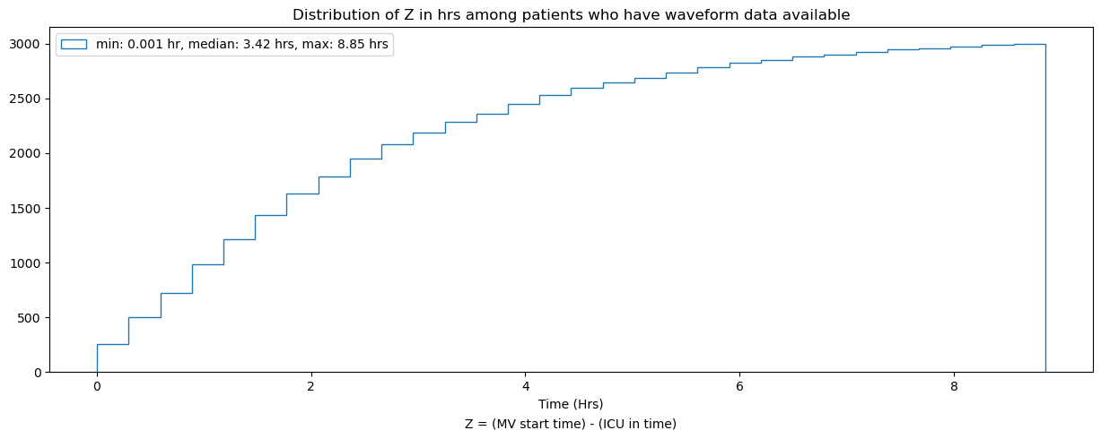

Slide 25
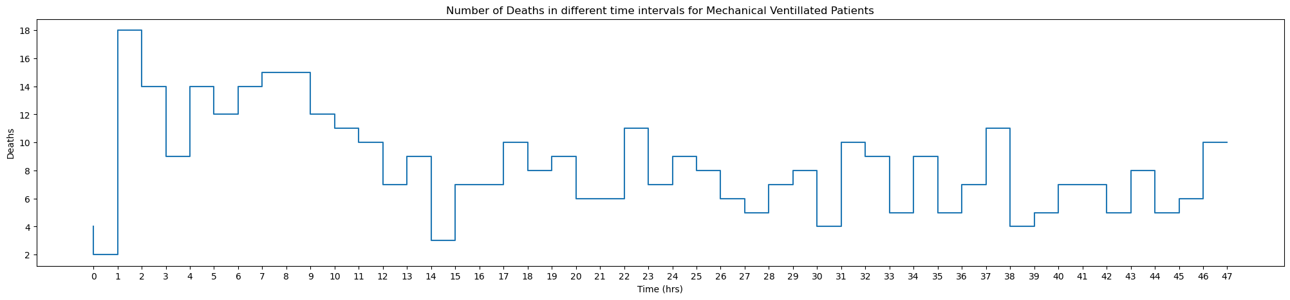
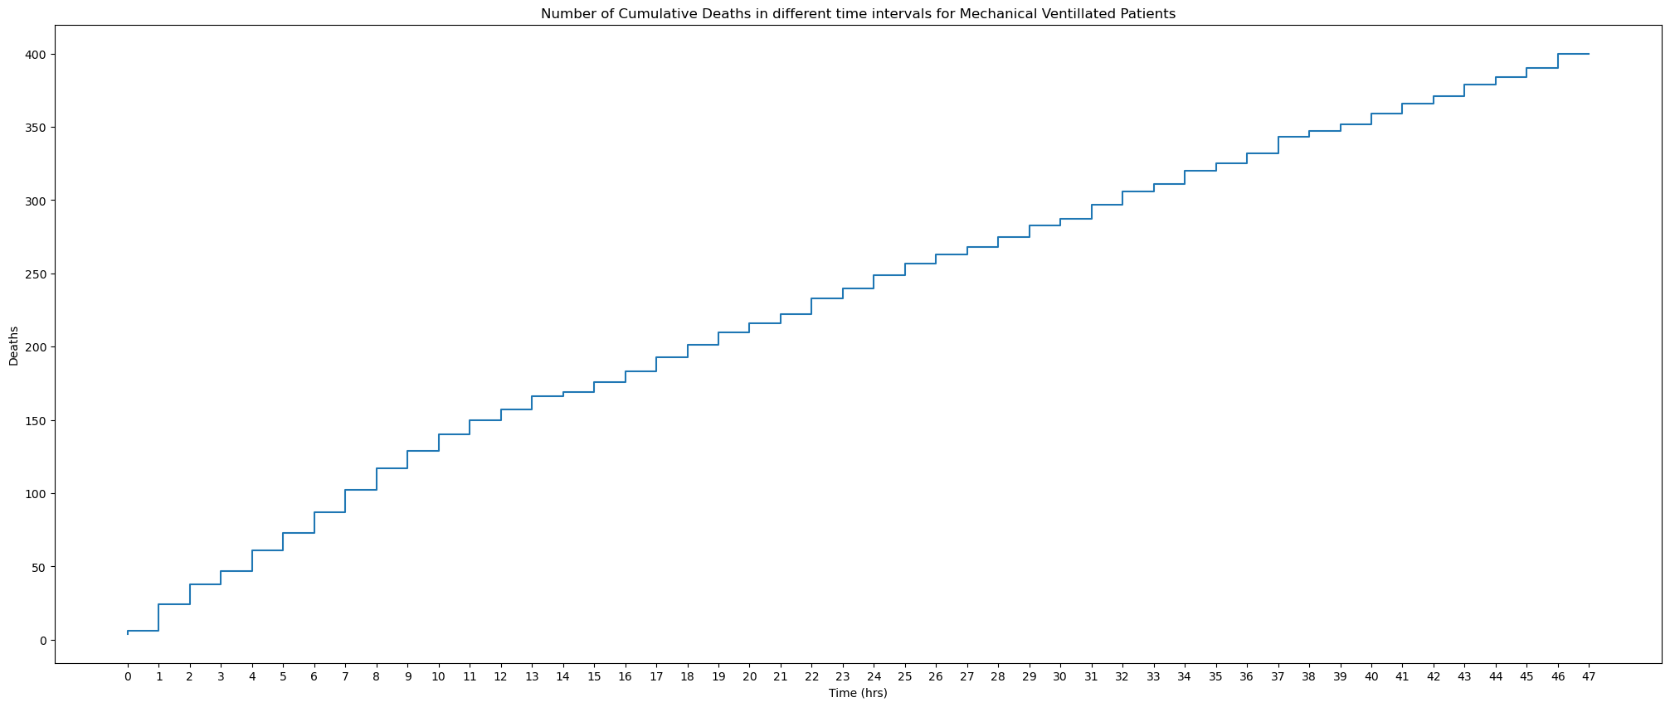

Slide 26
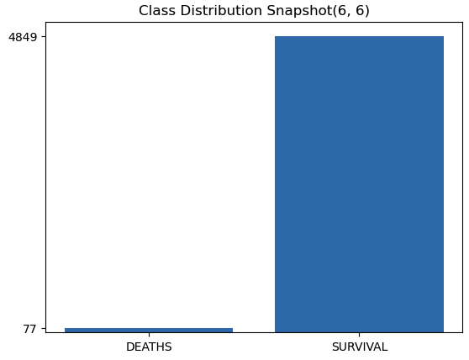
Snapshot Creation
Z = 6, y = 6
Class distribution:
After Stratify Split the data:
Training set: Number of deaths = 55
Test set: Number of deaths = 22
After removing patients with <50% waveform data in z window:
Training set: Number of deaths = 20
Test set: Number of deaths = 9

Slide 27
Imputation Experiment
Nearest Neighbour Imputation

Slide 28
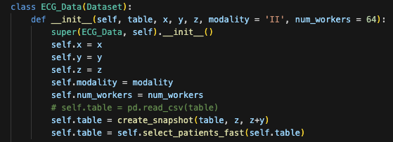
Current Status:
Completed DataSet creation.
I/p: table, x, y, z, modality
O/p: snapshot -> filter patients(missing value threshold)-> imputation -> spectrogram conversion -> preprocessing -> return in desire format.

Slide 29
Current problem:
Dataloading is taking too much time.
Solution:
Use multi-threaded GPU acceleration.
Optimize the dataloader further.

Slide 30
Future:
Decide on proper x, y, z values with sufficient class distribution.
Create Baseline Model
Compare spectrogram model with raw signal model.
Validate all the noise removal techniques, imputation techniques with the model.
Further, add different modalities to boost performance.

Slide 31
THANK YOU

