Slide 1
Ci/Cd Process in Snaplogic

Slide 2
Contents
1) Introduction
- what is CI/CD pipeline
- what is CI
- what is CD
2) Components and Tools
3) Process Overview
4) Setting up Git
- Creating GitHub Repository
- Link GitHub and Snaplogic
- Commit pipeline to GitHub
5) SonarQube Setup
- Creating a quality profile in SonarQube
- Adding custom rules to SonarQube quality profile
- Creating projects in SonarQube
- Creating custom quality gate
6) Jenkins Job
- Running the Jenkins jobs

Slide 3
Introduction
The purpose of the Presentation is to explain the various steps
To achieve Continuous Integration and Delivery in Snaplogic.
CI/CD is a process of Integrating Smaller chunks of code into core code quickly, automate testing and deliver continuous updates that in turn lead to faster application development.

Slide 4
Working of CI/CD
A CI/CD (Continuous Integration and Continuous Deployment) pipeline is a set of automated processes that integrate code changes, build and test software, and deploy it to production. The pipeline is designed to catch and fix errors as quickly as possible, leading to faster software releases with fewer bugs. The pipeline typically includes the following stages:
1) Code integration : Developers submit code changes to a shared repository.
2) Build and test : The code is built and tested automatically.
3) Deployment : If the build and tests are successful, the code is deployed to a staging or production environment.

Slide 5
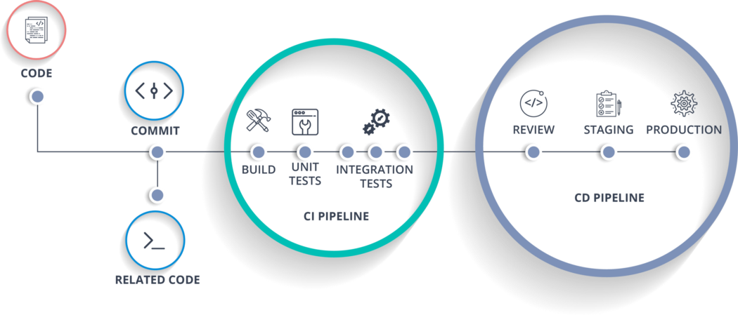
Working of CI/CD

Slide 6
Tools Use
Control System :
Control system is used to stored the most recent version of the code in the development.
Ex. GitHub, GitHub allows developers to manage their code. This makes it easy to track changes to the code, roll back to previous versions, and collaborate with other developers.
GitHub allows developers to submit pull requests to propose changes to the code. This makes it easy for others to review and approve the changes before they are merged into the main branch.
Continuous Integration Tool :
The entire process of CI/CD orchestrated using this Tool. Ex, Jenkins
Jenkins is a popular open-source automation server that can be used in a CI/CD pipeline to automate the process of building, testing, and deploying software.
Code Inspection Tool :
This tool is use to check code quality, bugs and errors in the developed code.
Ex, SonarQube
SonarQube can be integrated into a CI/CD pipeline to automatically scan the code it provides a web-based interface that allows developers to view the results of the code analysis, and drill down into specific issues to understand the problem and how to fix it.

Slide 7
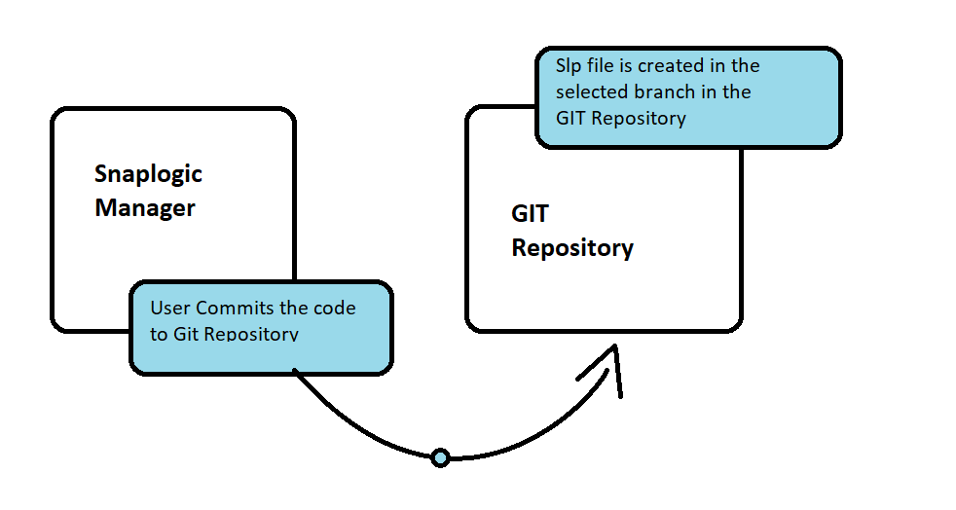
Process Overview
Once the user completes his development in the SapLogic designer the user will commit the code
To the Git repository from Snaplogic manager.

Slide 8
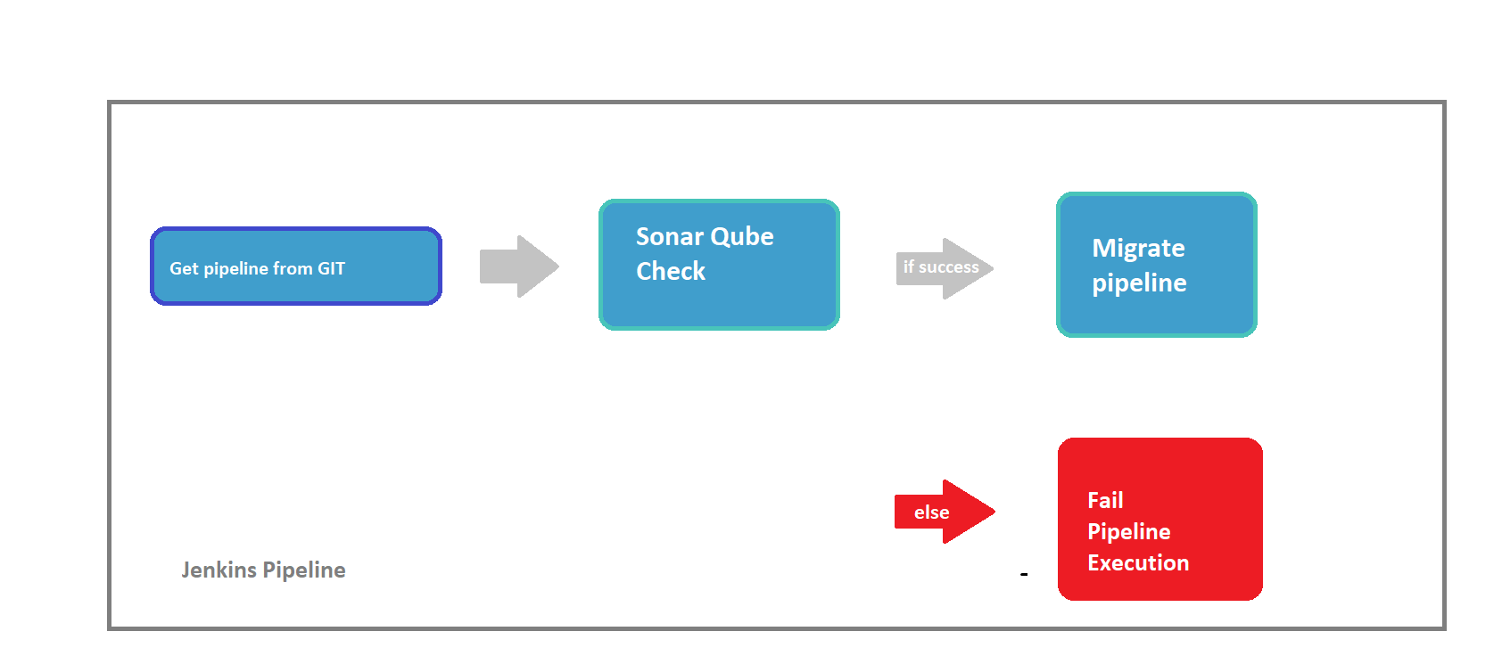
And when we get an intimation or approval through the suitable project management tool (Ex: JIRA) for migrating the pipeline. The Jenkins pipeline would be triggered which would pick the pipeline code from the GIT Repository, perform the SonarQube code check and if check is successful then migrate pipeline

Slide 9
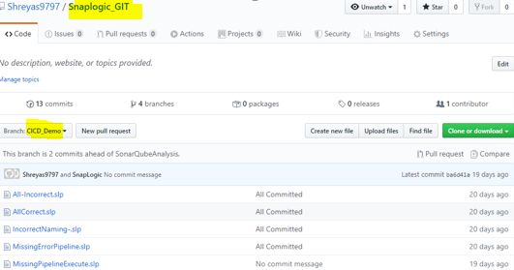
4. Setting up GIT
1.1 Creating GitHub repository
To set up GIT with Snap logic first a GitHub account needs to be created in the GitHub website (https://github.com). Then a repository and branch need to be created.
Ex: https://github.com/Shreyas9797/Snaplogic_GIT.git. In the above example a repository with the name Snaplogic_GIT has been created for the user Shreyas9797.
A branch then needs to be created for storing the pipelines from the respective Snaplogic project.

Slide 10
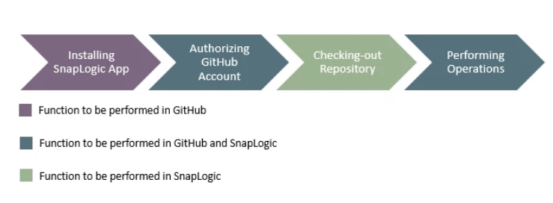
4.2 Link GitHub and Snaplogic
To link your snaplogic account with GitHub the Snaplogic app need to be installed for the GitHub account and the authorization to access the GitHub from snaplogic and vice versa has to be provided.
Please refer to the below link to setup the Snaplogic app:
https://docs-snaplogic.atlassian.net/wiki/spaces/SD/pages/543621397/ SnapLogic+App+Installation
4.3 Commit pipeline to GitHub
The below diagram depicts the workflow steps:

Slide 11
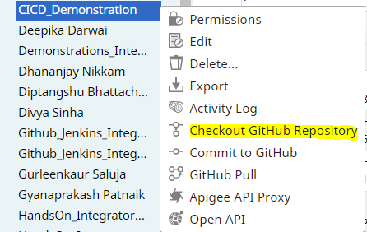
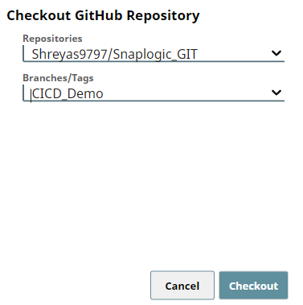
For checking out changes to the repository :
• Go to the Snaplogic Designer tab
•Right click on the project and select check out GitHub repository.
•Select the repository and the respective branch and then select checkout.

Slide 12
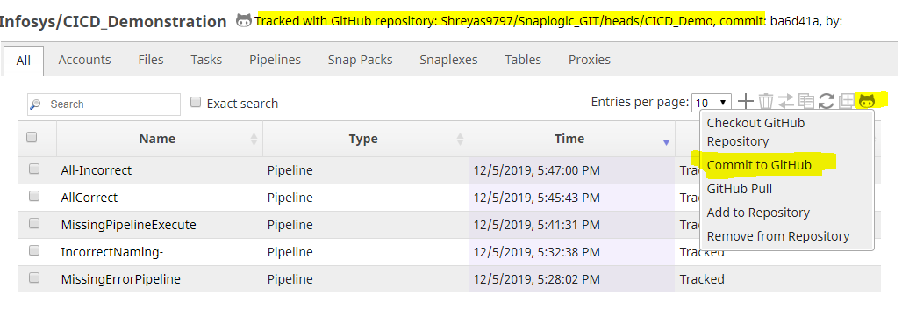
Once this is done the project changes will be tracked and you can commit individual pipelines to GitHub.

Slide 13
5.0 SonarQube Setup
SonarQube is a code inspection tool being used to evaluate the pipelines created. Each pipeline which is created in Snaplogic is exported as a JSON file with .slp extension. All the information regarding the pipeline is present in these pipelines. Currently as a part of this demo three parameters are being evaluated:
1. Common Error pipeline is being used for error handling.
2. Pipeline execute snap is being used for modularization (Used to call child pipelines performing a specific function).
3. Name of pipeline matches the naming convention.
The SonarQube has been set up in the pyramid server and can be accessed from http://piramid:9000.
5.1 Creating a Quality profile in SonarQube
To add the new rules a new Quality profile needs to be created in SonarQube. To create a new Quality profile:
(Note: To create a new Quality profile you need to be logged in as the administrator)
Go to the Quality profile tab -> JSON profile and select extend. And give a suitable name for the extended profile this will extend the existing rules of the default profile.
In the below snap a profile with name SnapLogic Way has been created this will extend the existing rules in SonarQube Way parent profile

Slide 14
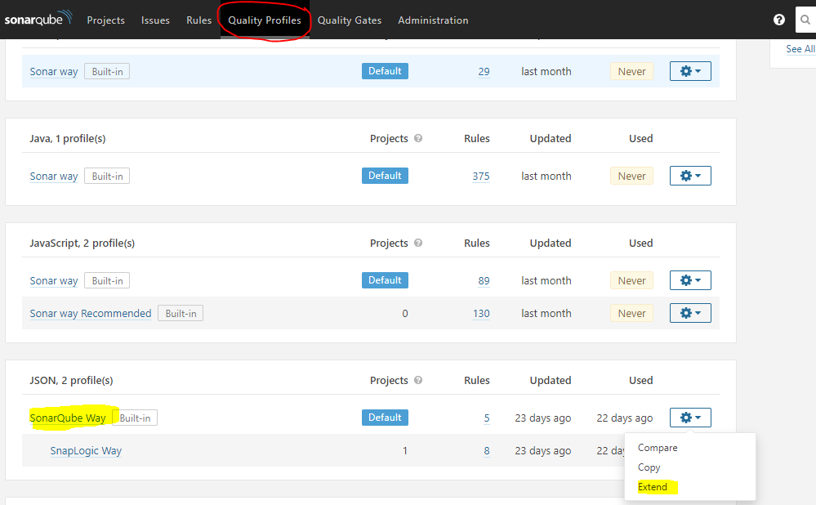
5.2 Adding custom rules to SonarQube Quality profile
To add Custom rules to the Quality profile:
1. Click on the newly created sonarQube Quality profile. It will take you to a new page, select activate more option.

Slide 15
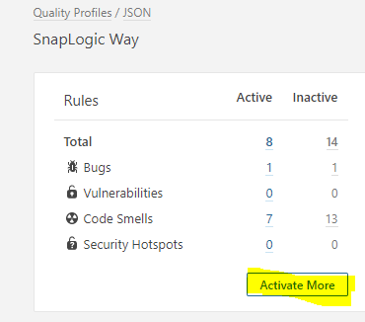
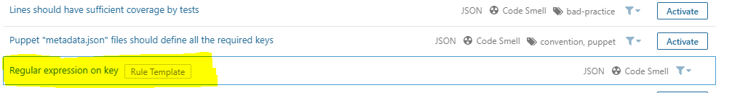

2. This will take you to a new page, select Regular expression on Key rule.

Slide 16
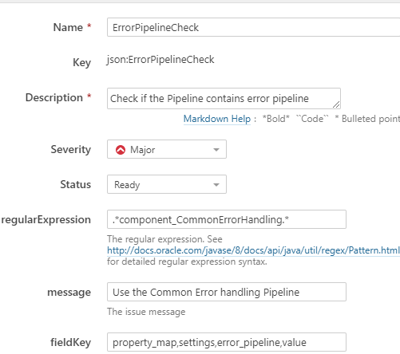
3. Click on create Custom rules.

Slide 17
Now a pop will appear where you need to give the following details: Name: name of the rule.
Description: briefly describing the rule.
Severity: Set a specific severity this will be later used in the custom quality gate that will be created to fail the check based on a condition.
Regular Expression: this will be matched against the value for the field key given.
Message: Error message whenever to be displayed the rule fails.
Field Key: Provide the hierarchy for the field separated by ','. To check all occurrences of the fieldKey use '*, fieldKey'.
Example: *, class_id: This will check the regular expression for all class Id.
property_map,settings,error_pipeline,value : This will check for the value field which is as per the specified field hierarchy.
MatchCheck (One/All): Provide the value as 'One' or 'All' to match the value against regular expression for 'All' the values of the specified fieldKey or 'One' among the values of the specified fieldKey.

Slide 18
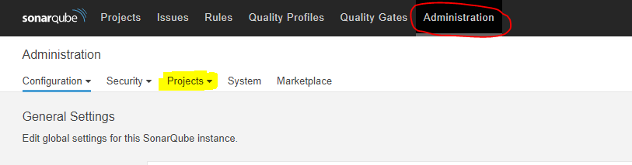
Rule Reference Links:
http://piramid:9000/coding_rules?activation=true&open=json%3APipelineExecuteCheck&qprofile=AW6n0AGhrsSETaXJ2fVm
http://piramid:9000/coding_rules?activation=true&open=json%3AErrorPipelineCheck&qprofile=AW6n0AGhrsSETaXJ2fVm
5.3 Creating Project in SonarQube
SonarQube project will be used to analyze the files. The Quality gate and the quality profile will be associated to this project. Based on the rules in the Quality profiles and the condition in the Quality gate the decision will be taken whether the SonarQube check was successful or not.
To create a new project:
1. Go to the Administration tab and there select Project-> Management.

Slide 19
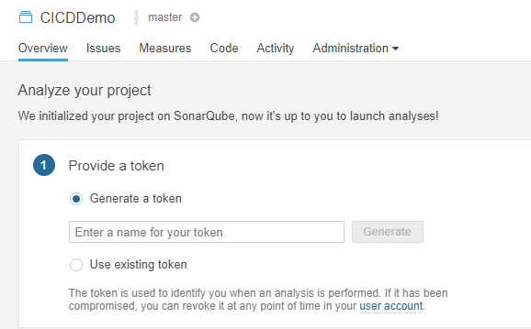
2. Select Create project and specify a name and key.
3. Click on the project created and a new token can be created or an existing can be used:

Slide 20
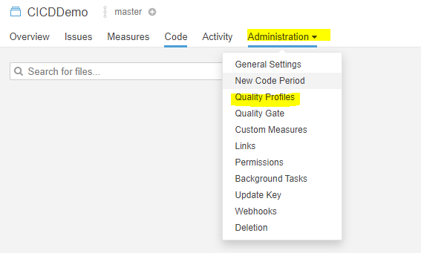

4. To associate the created quality profile in the previous step. Go to the Administration tab and select Quality profiles from the drop down.

Slide 21
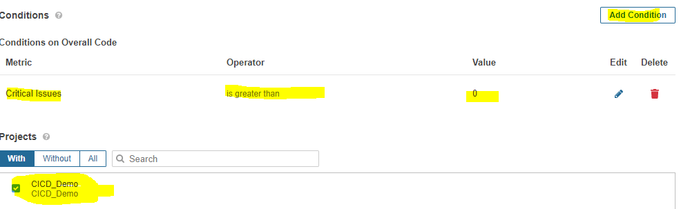
In the next page select the Quality profile created for JSON in the previous step.
5.4 Creating Custom Quality Gate
To indicate that if the rules are broken the SonarQube check need to be failed a custom Quality Gate needs to be created. As per the severity set in the rules the Quality Gate will be failed based on the condition specified. To create a new Quality gate:
1. Go to the Quality Gates tab.
2. Select create option and provide an appropriate name.
3. Add condition and associate this Quality Gate with created project.

Slide 22
6.0 Jenkins Job
To orchestrate the entire process of pipeline analysis in SonarQube and their Migration. A Jenkin Job is created of the type pipeline.
(http://piramid:8080/jenkins/job/Snaplogic_CICDDemo_Jenkins)
For the purpose of this demo the Jenkins, sonar scanner, sonarQube Service (Web application) installed in the Piramid server was used.
Links:
SonarQube: http://piramid:9000
Jenkins: http://piramid:8080/jenkins
The Jenkins job has the pipeline steps as mentioned below:
1. Get Files from GIT : In this step the pipelines that are committed by the developer as explained in the section 4.3 are retrieved. These pipelines (in .slp extension) get downloaded to the local Jenkins project workspace.
2. SonarQube run:
The sonar scanner which is installed on the server where Jenkins is running is used to run the analysis.
The SonarQube parameter the files in the local Jenkins project workspace are picked and analyzed parameters provided in the step.(Please refer the link: https://docs.sonarqube.org/latest/analysis/analysis-parameters/ )
The result is posted on the SonarQube service.

Slide 23
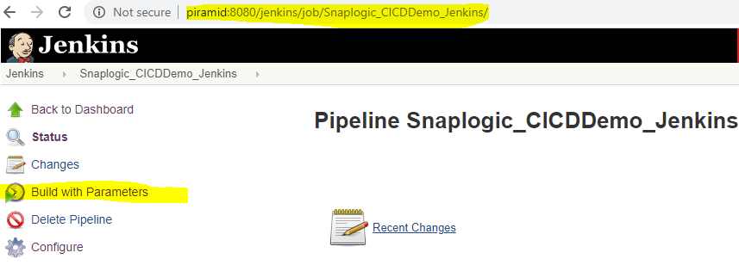
3. Determine SonarQube QualityGate Status: The result of analysis performed in the previous step is determined by the quality gate status of the SonarQube run. This is retrieved and based on the result the control is passed to the pipeline migration step. If the result is unsuccessful the migration is cancelled else the migration is carried out.
4. Pipeline Migration: in this step the pipeline is migrated from one org to the next org. This is performed by a Snaplogic pipeline which is created in the Dev org. A triggered task is created in the snaplogic designer for this pipeline and the API of this triggered task is called in this step.
6.1 Running the Jenkins Job
To run the Jenkins Job, select the Jenkins job and click build with parameters

Slide 24
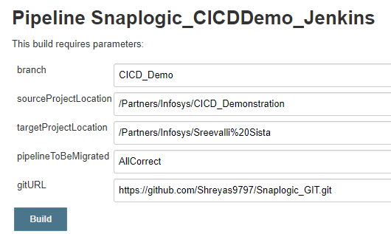
The below parameter need to be provided.

Slide 25
• branch: this is the branch in the GIT repository which contains the pipeline to be migrated.
• SourceProjectLocation: this is folder in Snaplogic Designer in which the pipeline to be migrated is present.
•TargetProjectLocation: this is folder in Snaplogic Designer to which the pipeline should be migrated to.
• PipelineToBeMigrated: name of the pipeline to be migrated.
• gitURL: URL of the GIT repository which contains the pipeline to be migrated.
Once the above details are provided click on build. The pipeline would be migrated if the the sonarQube result is successful.

Slide 26
Thank You
Vaishnavi Kenghe.
Ravikant Gambhire.

