Slide 1
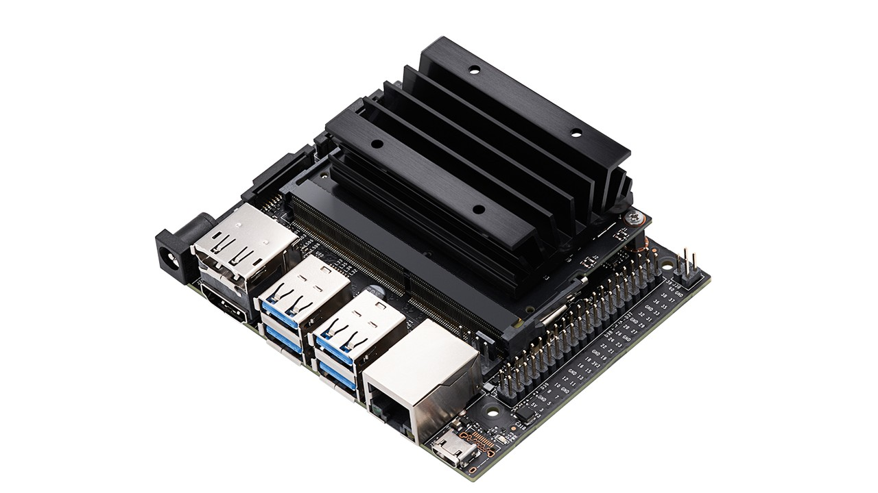
Language Models
on Jetson Nano
Jetson Nano 4GB
JetPack 4 / Ubuntu 18.04
Python 3.6
Notes:
Image: NVIDIA, https://www.nvidia.com/en-us/autonomous-machines/embedded-systems/jetson-nano/product-development/
Asset: https://www.nvidia.com/content/nvidiaGDC/us/en_US/autonomous-machines/embedded-systems/jetson-nano/product-development/_jcr_content/root/responsivegrid/nv_container_1169488117/nv_container_copy/nv_image.coreimg.jpeg/1710770678070/jetson-nano-2560x1440.jpeg
Photo is a product reference, not this user’s board. Code scope: docs/EXPERIMENTS.md in https://github.com/nileshsarkar-ai/JetsonNano-Demo. No physical-board performance claim.

Slide 2
Setup
Run in a terminal on the Nano.
git clone https://github.com/nileshsarkar-ai/JetsonNano-Demo.git
cd JetsonNano-Demo
bash scripts/run_demo.sh
1 Install dependencies and models
2 Check board status
02
Notes:
Code and menu: https://github.com/nileshsarkar-ai/JetsonNano-Demo/tree/master
Scope and names: docs/EXPERIMENTS.md. Presenter notes: Physical Nano execution unverified. Software tests use mocks. Models may hallucinate; prompt separation and self-critique are not security or accuracy guarantees. Check against visible source facts. Camera projects use object detections plus text generation, not a vision-language model. Default setup does not need audio or external training. Rehearse power, cooling, camera capture, latency and answer quality on the actual board. This is the current local programme, not the historical 72-topic idea catalogue.

Slide 3
Text Conversations
Menu 29
Menu 30
Socratic Study Partner
Mystery Character
Interview
Discuss a topic through successive
questions. Each reply uses the
previous conversation.
Ask a fictional character questions
and use the answers to identify
their profession.
Example topic: Why do objects float?
Use /guess followed by your answer.
03
Notes:
Code and menu: https://github.com/nileshsarkar-ai/JetsonNano-Demo/tree/master
Scope and names: docs/EXPERIMENTS.md. Presenter notes: Physical Nano execution unverified. Software tests use mocks. Models may hallucinate; prompt separation and self-critique are not security or accuracy guarantees. Check against visible source facts. Camera projects use object detections plus text generation, not a vision-language model. Default setup does not need audio or external training. Rehearse power, cooling, camera capture, latency and answer quality on the actual board. This is the current local programme, not the historical 72-topic idea catalogue.

Slide 4
Tools and Document Retrieval
MENU | EXPERIMENT | FUNCTION
15 | Mission Control: Tool-Planning Assistant | Select read-only tools and summarize the returned data.
16 | Document Detective: Answers with Evidence | Answer questions from retrieved exhibit passages.
9 | Persistent Memory Assistant | Save explicit facts and retrieve them in later sessions.
8 | Class Notes Retrieval and Grounded Answers | Index text documents and generate answers from retrieved passages.
3 | Offline Conversation Assistant | Generate responses using the preceding conversation.
04
Notes:
Code and menu: https://github.com/nileshsarkar-ai/JetsonNano-Demo/tree/master
Scope and names: docs/EXPERIMENTS.md. Presenter notes: Physical Nano execution unverified. Software tests use mocks. Models may hallucinate; prompt separation and self-critique are not security or accuracy guarantees. Check against visible source facts. Camera projects use object detections plus text generation, not a vision-language model. Default setup does not need audio or external training. Rehearse power, cooling, camera capture, latency and answer quality on the actual board. This is the current local programme, not the historical 72-topic idea catalogue.

Slide 5
Tokenization and Generation
MENU | EXPERIMENT | FUNCTION
4 | Ask the Local Language Model | Generate a response to a single prompt.
5 | Tokenization Microscope | Inspect token IDs for text, code and symbols.
6 | Structured Information Extraction | Turn text into constrained JSON fields.
14 | Sampling Playground | Compare greedy output with two seeded creative samples.
22 | Prompt Design Studio | Compare a minimal prompt with explicit audience instructions.
23 | Few-Shot Pattern Learner | Compare classification with zero examples and four examples.
05
Notes:
Code and menu: https://github.com/nileshsarkar-ai/JetsonNano-Demo/tree/master
Scope and names: docs/EXPERIMENTS.md. Presenter notes: Physical Nano execution unverified. Software tests use mocks. Models may hallucinate; prompt separation and self-critique are not security or accuracy guarantees. Check against visible source facts. Camera projects use object detections plus text generation, not a vision-language model. Default setup does not need audio or external training. Rehearse power, cooling, camera capture, latency and answer quality on the actual board. This is the current local programme, not the historical 72-topic idea catalogue.

Slide 6
Text Generation and Processing
MENU | EXPERIMENT | FUNCTION
17 | Story Director: Audience-Controlled Fiction | Generate a story and continue it using a supplied plot change.
10 | TinyStories Generator | Generate text with the TinyStories model.
24 | Message Triage Desk | Validate a model-proposed category before routing.
25 | Summary Fact Checker | Summarize a passage and compare it with a second model critique.
7 | Calculator Tool Assistant | Evaluate a validated arithmetic expression using a calculator tool.
06
Notes:
Code and menu: https://github.com/nileshsarkar-ai/JetsonNano-Demo/tree/master
Scope and names: docs/EXPERIMENTS.md. Presenter notes: Physical Nano execution unverified. Software tests use mocks. Models may hallucinate; prompt separation and self-critique are not security or accuracy guarantees. Check against visible source facts. Camera projects use object detections plus text generation, not a vision-language model. Default setup does not need audio or external training. Rehearse power, cooling, camera capture, latency and answer quality on the actual board. This is the current local programme, not the historical 72-topic idea catalogue.

Slide 7
Prompt Injection and Context
Menu 26
Prompt Injection Defense Lab
Compare an injected document with and without instruction separation.
Menu 27
Answer or Abstain: Hallucination Challenge
Ask one answerable question and one whose answer is deliberately missing.
Menu 28: Context Memory Challenge
Recall the same fact as irrelevant context grows.
07
Notes:
Code and menu: https://github.com/nileshsarkar-ai/JetsonNano-Demo/tree/master
Scope and names: docs/EXPERIMENTS.md. Presenter notes: Physical Nano execution unverified. Software tests use mocks. Models may hallucinate; prompt separation and self-critique are not security or accuracy guarantees. Check against visible source facts. Camera projects use object detections plus text generation, not a vision-language model. Default setup does not need audio or external training. Rehearse power, cooling, camera capture, latency and answer quality on the actual board. This is the current local programme, not the historical 72-topic idea catalogue.

Slide 8
Camera Applications
Keep the camera fixed between observations.
MENU | EXPERIMENT | FUNCTION
18 | Scene Memory Detective | Compare object classes, counts and positions across two observations.
19 | AI Visual Scavenger Hunt | Generate an object-finding task and score detections against its targets.
20 | Camera Change Journal | Record three observations and summarize the detected changes.
13 | Camera Perception Lab | Run detection, classification, pose estimation or segmentation.
Camera setup: menu 13, then install.
08
Notes:
Code and menu: https://github.com/nileshsarkar-ai/JetsonNano-Demo/tree/master
Scope and names: docs/EXPERIMENTS.md. Presenter notes: Physical Nano execution unverified. Software tests use mocks. Models may hallucinate; prompt separation and self-critique are not security or accuracy guarantees. Check against visible source facts. Camera projects use object detections plus text generation, not a vision-language model. Default setup does not need audio or external training. Rehearse power, cooling, camera capture, latency and answer quality on the actual board. This is the current local programme, not the historical 72-topic idea catalogue.

Slide 9
Performance and Evaluation
Menu 11
Menu 12
Language Model
Performance Benchmark
Reproducible
Prompt Evaluation
Run the upstream model benchmark
and inspect its saved measurements.
Supply JSONL questions and reference
answers. Inspect exact matches,
responses and latency.
09
Notes:
Code and menu: https://github.com/nileshsarkar-ai/JetsonNano-Demo/tree/master
Scope and names: docs/EXPERIMENTS.md. Presenter notes: Physical Nano execution unverified. Software tests use mocks. Models may hallucinate; prompt separation and self-critique are not security or accuracy guarantees. Check against visible source facts. Camera projects use object detections plus text generation, not a vision-language model. Default setup does not need audio or external training. Rehearse power, cooling, camera capture, latency and answer quality on the actual board. This is the current local programme, not the historical 72-topic idea catalogue.

Slide 10
Menu Controls
Run
Enter the experiment number.
Cancel
Ctrl+C stops the active demo and returns to the menu.
Exit
Enter 0.
Sequence
Enter 21 to run the prepared demonstrations.
10
Notes:
Code and menu: https://github.com/nileshsarkar-ai/JetsonNano-Demo/tree/master
Scope and names: docs/EXPERIMENTS.md. Presenter notes: Physical Nano execution unverified. Software tests use mocks. Models may hallucinate; prompt separation and self-critique are not security or accuracy guarantees. Check against visible source facts. Camera projects use object detections plus text generation, not a vision-language model. Default setup does not need audio or external training. Rehearse power, cooling, camera capture, latency and answer quality on the actual board. This is the current local programme, not the historical 72-topic idea catalogue.

