Slide 1

VISVESVARAYA TECHNOLOGICAL UNIVERSITY
DEPARTMENT OF C.S.E
MASTER OF COMPUTER APPLICATIONS
Project Title: Blockchain-based Cloud File Sharing System
Nilesh Satpute
2VX23MC097
Under the Guidance of
Prof. Saraswati R. Bhusanur
Asst. Prof. Dept. CSE,VTU, Belagavi

Slide 2
Contents:
Problem Statement
Introduction
Objectives
Literature review
Software Requirement Specification
Proposed methodology
References
Conclusion

Slide 3
Problem Statement
Traditional cloud file-sharing systems are vulnerable to data breaches, unauthorized access, and lack of user control due to their centralized nature.
There is a need for a secure, decentralized solution that ensures data integrity, confidentiality, and controlled access.

Slide 4
INTRODUCTION
The Blockchain-Based Cloud File Sharing System is a secure and decentralized platform designed to overcome the limitations of traditional cloud storage. In centralized systems, users often lose control over their data, raising concerns about privacy and integrity. This project integrates blockchain technology to ensure transparency, tamper-proof file storage, and role-based access control. By combining cloud storage with cryptographic encryption and smart contracts, the system allows users to safely upload, share, and manage files while maintaining full ownership and control.

Slide 5
Objectives
To develop a secure cloud-based file sharing platform using blockchain technology.
To ensure data integrity and confidentiality through encryption and access control.
To provide role-based user authentication and permission management.
To prevent unauthorized access and tampering of shared files.
To enable transparent file-sharing logs using blockchain's immutable ledger.

Slide 6
Literature Review
Existing Cloud Storage Systems:
Google Drive, Dropbox, OneDrive
Centralized, prone to security risks, and data breaches
Blockchain in Cloud Storage:
Use of decentralized ledger for secure file transactions
IPFS (InterPlanetary File System) for distributed storage
Smart contracts for automated permissions and security

Slide 7
Software Requirement Specification
Functional Requirements:
Users must be able to register, log in, and securely upload/download files.
Files are encrypted using AES before storage.
Smart contracts manage access control based on user roles.
Admin can monitor user activities, manage files, and view logs.
Non-Functional Requirements:
Security: Ensures confidentiality and integrity through AES encryption and blockchain hashing.
Scalability: Supports increasing users and file loads without performance degradation.
Usability: Clean, user-friendly interface for both users and admin.
Reliability: Maintains uptime and prevents single-point failure using decentralized storage.

Slide 8
Software Requirement Specification
Software Requirement
Visual Studio 2019
Database: Microsoft SQL Server
Frontend: ASP.NET
Backend: ADO.NET
Blockchain Integration: Ethereum

Slide 9
Proposed methodology
Requirement Analysis
Gather user requirements and system expectations.
System Design
Design system architecture including frontend, backend, blockchain, and database.
Implementation
Develop frontend using HTML, CSS, and JavaScript.
Backend logic using ASP.NET and C# for file handling and user operations.
Connect to MSSQL via ADO.NET and integrate AES encryption for secure file storage.
Blockchain Integration
Use Ethereum smart contracts for decentralized access control.
Store file hashes on blockchain to ensure immutability.
Testing and Evaluation
Validate encryption, blockchain functions, and file-sharing features.
Deployment
Deploy system on a test server.

Slide 10
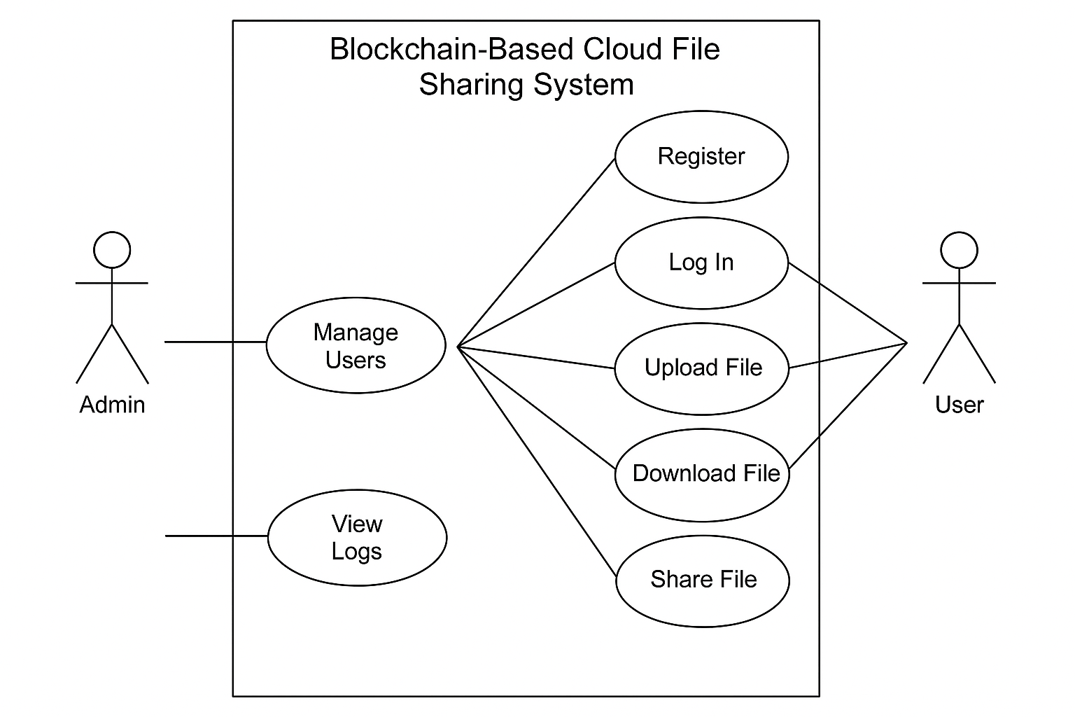
UML Diagram

Slide 11
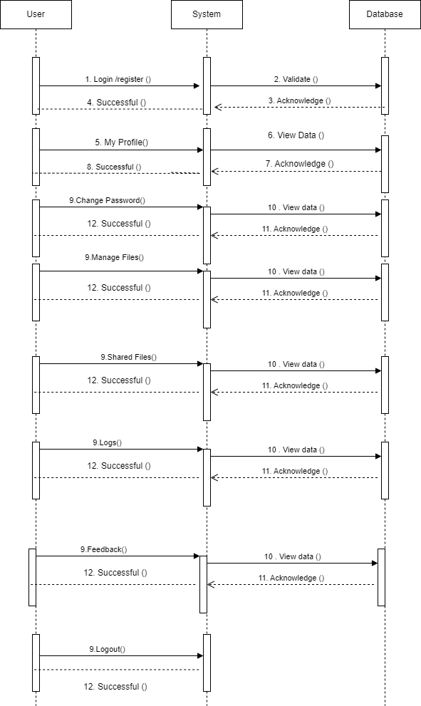
Sequence Diagram

Slide 12
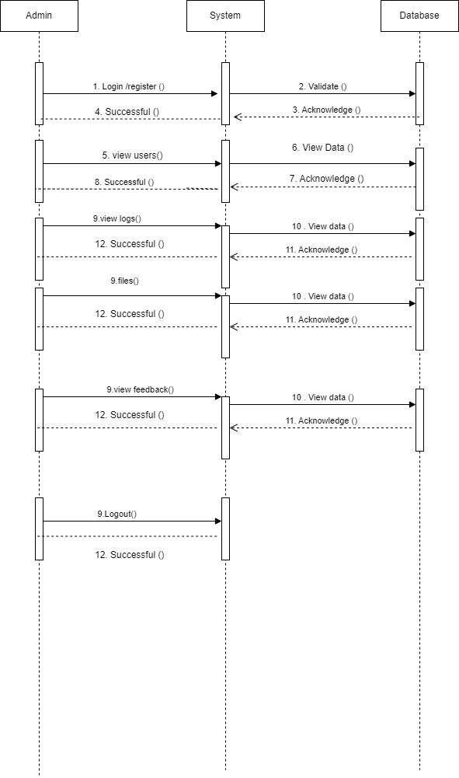
Sequence Diagram

Slide 13
References
Gopalan SH (2021) ZHRP-DCSEI, a novel hybrid routing protocol for mobile Ad-hoc networks to optimize energy using dynamic cuckoo search algorithm. Wireless PersCommun 118:3289–3301. https://doi.org/10.1007/s11277-021-08180-1
Vignesh V, Harihara Gopalan S, Mohan M, Ramya RS, Anan thakumar R (2021) A quantumbased blockchain approach to voting protocol using hyperledger sawtooth. J Phys: Conf Ser 1916:012088. https:// doi. org/ 10. 1088/ 1742- 6596/ 1916/1/ 012088
Nilabar Nisha U, Manikandan A, Venkataramanan C, Dhanapal R (2023) A score based link delay aware routing protocol to improve energy optimization in wireless sensor network. J Eng Res. https:// doi.org/10.1016/j.jer.2023.100115

Slide 14
Conclusion
In conclusion, the Blockchain-Based Cloud File Sharing System provides a secure, transparent, and efficient solution for modern file sharing needs. By leveraging blockchain's immutability and decentralization, along with AES encryption, the system ensures data integrity, privacy, and controlled access. It effectively addresses the shortcomings of traditional cloud platforms and demonstrates the potential of combining emerging technologies to build trustworthy digital solutions.

