Slide 1

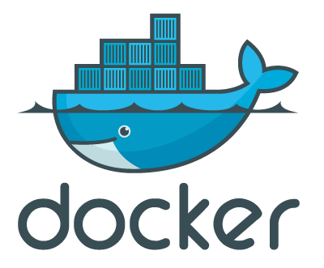

Introduction to Docker Containers
Umesh Worlikar
Notes:
https://github.com/oracle/cloud-native-devops-workshop/blob/master/containers/docker001/Prerequisites.md
https://github.com/oracle/cloud-native-devops-workshop/blob/master/containers/docker001/Participant-Guide.md#verify-docker-engine-hands-on-lab-environment
https://gist.github.com/benarch/fcd3d98eaa7f6abe951d4d4e7b78e6da
https://hub.docker.com/
1

Slide 2
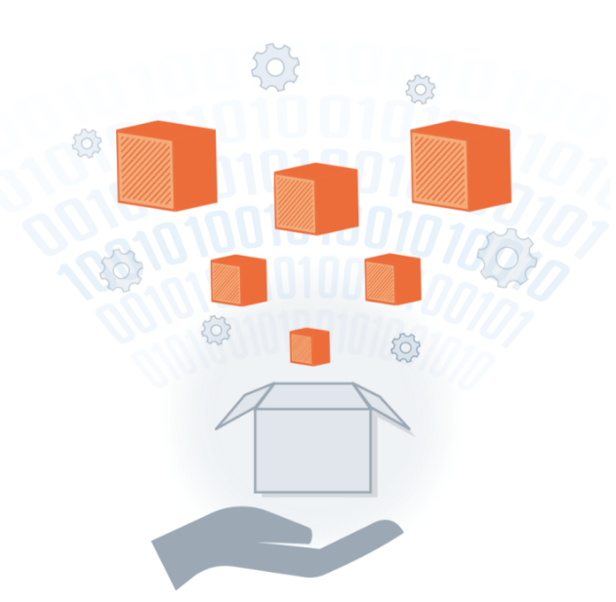
Agenda
1
Docker Introduction
Basic Architecture and comparison to VM’s
Why Docker is Hot
Create Docker image using Dockerfile /YAML
Docker DevOps LifeCycle
Q&A
1
2
2
3
3
4
4
5
5
6
6
Umesh Worlikar
Notes:
2

Slide 3
What is Docker!?
Docker is an Open platform for developers and sysadmins to build, ship and run distributed applications.
It can run on most Linux distributions, Windows and Mac OS running Docker Engine (Toolbox).
It is supported by most of cloud providers and provide a popular Dev/Test, CI & DevOps platform for many use cases.
Umesh Worlikar
Notes:
Intro to Basic Container Concepts
A container is a runtime instance of a Docker image.
https://docs.docker.com/engine/reference/glossary/#/container
Docker is the company and containerization technology.
https://docs.docker.com/engine/reference/glossary/#/docker
3

Slide 4
Docker History
2013-03: Releases as Open Source
2013-09: Red Hat collaboration (Fedora, RHEL, OpenShift)
2014-03: 34th most starred GitHub project
2014-05: JAX Innovation Award (most innovative open technology)
Umesh Worlikar

Slide 5
Run Platforms
Various Linux distributions (Ubuntu, Fedora, RHEL, Centos, openSUSE,…)
Cloud (Amazon EC2, Google Compute Engine, Rackspace)
2014-10: Microsoft way to integrate Docker with next release of Windows Server
5
Umesh Worlikar

Slide 6
Docker Flow:
Image
Image
Image
Run
Container
Operating System
Software
Application Code
Umesh Worlikar
5
5
Notes:
Docker Run
Containers have a main process
The containers stop when that process stops
Containers have names
6

Slide 7
Docker Flow:
DockerFile
Image
Run
Container
Build
Umesh Worlikar
6

Slide 8
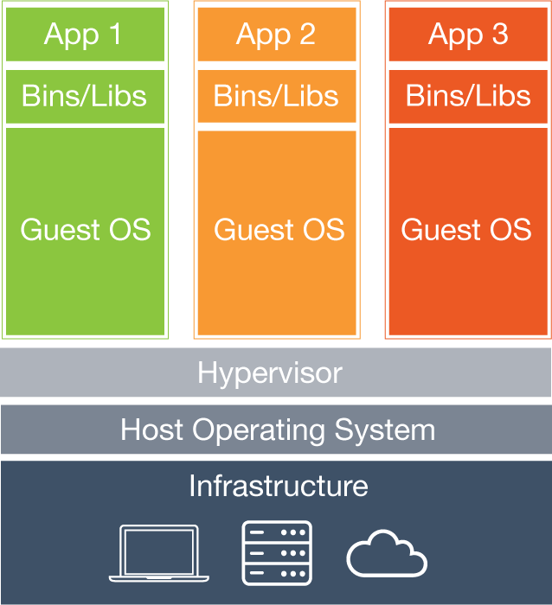
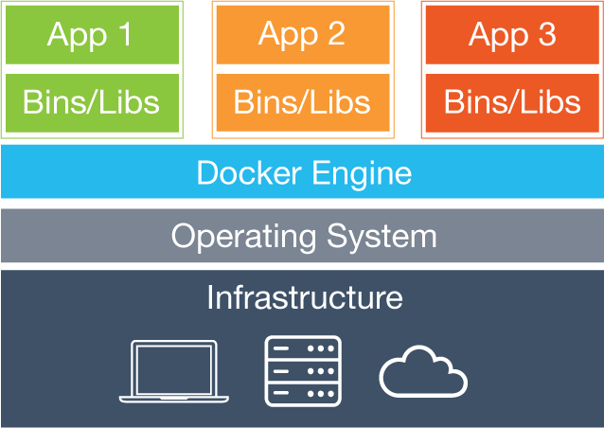
Virtual Machines vs. Containers
Containers
VMs
Virtual Machines
Each virtual machine (VM) includes the app, the necessary binaries and libraries and an entire guest operating system
Containers
Containers include the app & all of its dependencies, but share the kernel with other containers.
Run as an isolated process in userspace on the host OS
Not tied to any specific infrastructure – containers run on any computer, infrastructure and cloud.
Umesh Worlikar
Notes:
Now, let's look at how a virtual machine (VM) is different from a container.
While containers may sound like a VM, the two are distinct technologies. With VMs each virtual machine includes the application, the necessary binaries and libraries and the entire guest operating system.
Whereas, Containers include the application, all of its dependencies, but share the kernel with other containers and are not tied to any specific infrastructure, other than having the Docker engine installed on its host – allowing containers to run on almost any computer, infrastructure and cloud.
Note - at this time, Windows and Linux containers require that they run on their respective kernel base, therefore, Windows containers cannot run on Linux hosts and vice versa.

Slide 9
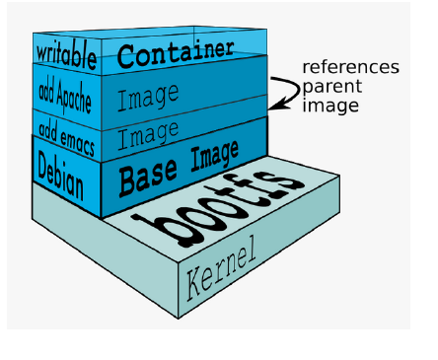
Docker Images
An image is a collection of files and some meta data
Images are comprised of multiple layers, multiple layers referencing/based on another image (Union File System)
Each image contains software you want to run
Every image contains a base layer
Layers are read only
Umesh Worlikar
Notes:
Docker images are a collection of files, which have everything needed to run the software application inside the container. However, they are ephemeral, meaning that any data that is written inside the container, while it is running, will not be retained.
If the container is stopped and restarted from its image, the container will run exactly the same as the first time, absent of any changes made during the last run cycle. Changes to the container either have to be made during the image creation process, using the Dockerfile that become part of the image, or data can be retained by mounting a persistent storage volume, from inside the container to the outside. This will be explored further in the HOL exercises below.
9

Slide 10
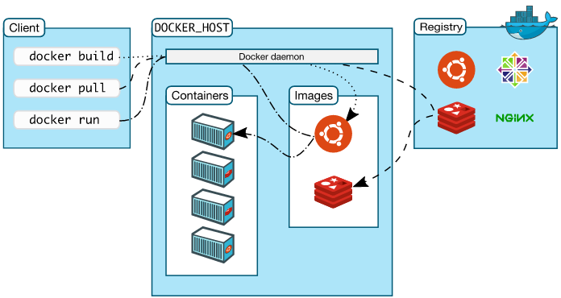
Docker Architecture
Docker client – Command Line Interface (CLI) for interfacing with the Docker
Dockerfile – Text file of Docker instructions used to assemble a Docker Image
Image – Hierarchies of files built from a Dockerfile, the file used as input to the docker build command
Container – Running instance of an Image using the docker run command
Registry – Image repository
Umesh Worlikar
Notes:
Jumping back a bit, there is a new nomenclature that Docker introduces, here are terms that you will need to be familiar with.
Each of these Docker technologies will be explored in this HOL. It's important to note that this core technology is open source. There are other technologies in the greater ecosystem, that could be open source, or licensed or even a hybrid, with a paid support option.
10

Slide 11
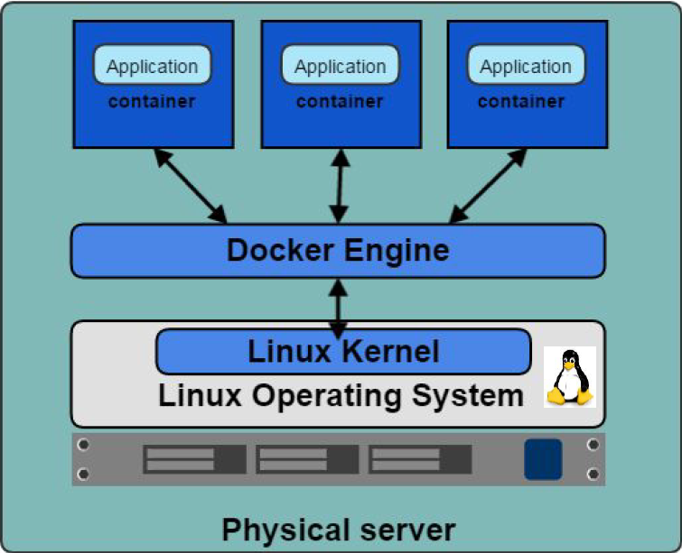
Docker Engine
Container execution and admin
Uses Linux Kernel namespaces and control groups
Namespaces provide for isolated workspace
Umesh Worlikar
Notes:
The Docker Engine is THE core piece of technology that allows you to run containers. In order for a container to run on any Linux host, at a minimum, the Docker Engine needs to be installed. Then the container can run on any Linux host where Docker Engine is installed, providing the benefit of portability, without doing any application specific configuration changes on each host.
11

Slide 12
Docker Features….
Light-Weight
Minimal overhead (cpu/io/network)
Based on Linux containers
Decrease storage consumption
Uses layered filesystem to save space (AUFS/LVM)
Portable
Run it Everywhere! - Linux, Mac OS or Windows operating system that has Docker installed.
Raspberry pi support.
Move from one environment to another by using the same Docker technology.
Self-sufficient
A Docker container contains everything it needs to run
Minimal Base OS
Libraries and frameworks
A Docker container should be able to run anywhere that Docker can run.
Umesh Worlikar

Slide 13
Common Terms and commands:
Docker Engine – Docker Deamon, Docker Registry, CLI.
Image – operating systems kernels supplied for a specific instance type / application.
Container – an application running from an image.
DockerFile – a text file with a list of steps to perform to create an image.
Docker Hub – Docker Registry and Repository used for download and share images.
Umesh Worlikar
Notes:
Docker Exec
Starts another process in an existing container
Great for debugging and DB administration
Can't add ports, volumes and so on
If I exit from an attached container it will kill the process that is open in other window as well.
Docker logs:
Keep the output of a containers
View with docker logs container_name
Don’t let the output get too large
Resource Constrains:
Memory Limits:
Docker run --memory [maximum-allowed-memory] [image-name] [command]
Example: docker run --memory Srv-001 bash
CPU Limits:
Docker run --cpu-shares (relative to other containers)
Docker run --cpu-quota int (to limit in general)
Orchestration:
Generally requires resource limiting
Recommendations:
Don’t let your container fetch dependencies with their start - make the container include their dependencies inside the container himself.
Don’t leave important things in stopped / unnamed container instances.
Network between containers:
Private Container networking:
Program in containers are isolated from the internet by default
You can group your containers into "Private" networks.
You explicitly choose who connect to whom.
This is done by "exposing" ports and "linking" containers.
Docker helps you find other exposed ports with compose services.
Exposing specific ports:
Exactly specifies which the port inside the container and outside.
Exposes as many ports as you want.
13

Slide 14
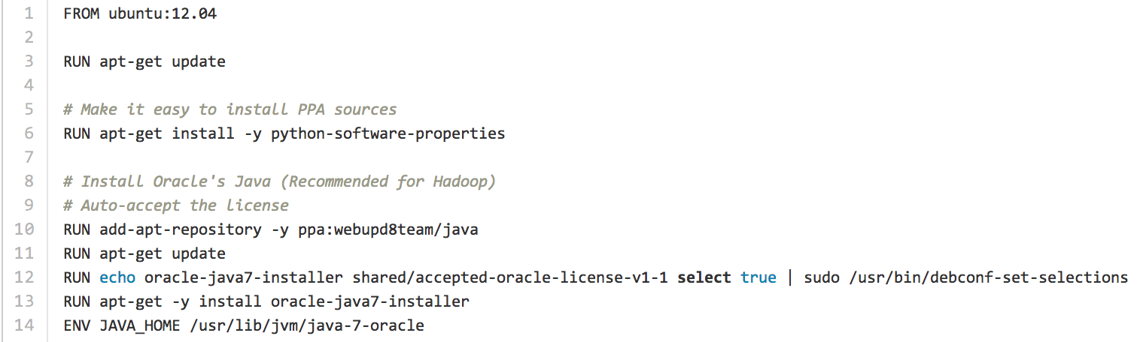
Dockerfile ……
• Like a Makefile (shell script with keywords)
• Extends from a Base Image
• Results in a new Docker Image
• Imperative, not Declarative
A Docker file lists the steps needed to build an images
• docker build is used to run a Docker file
Umesh Worlikar

Slide 15

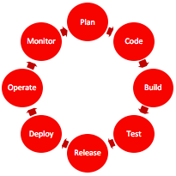

History and Multi-Dimensional Evolution of Computing
Development Process | Application Architecture | Deployment and Packaging | Application Infrastructure
Waterfall | Monolithic | Physical Server | Datacenter
Agile | N-Tier | Virtual Servers | Hosted
DevOps | Microservices | Containers | Cloud
Umesh Worlikar
16
Notes:
All of this is part of a transformation of technologies along a number of fronts, and is the basis for modern agile application development.
15

Slide 16
Dockerfile – Text file (recipe) used to create Docker images
Example Hello World Dockerfile
Docker build image CLI example
FROM nginx:1.10.1-alpine
Add index.html /usr/share/nginx/html/index.html
# Override the nginx start from the base container
COPY start.sh /start.sh
RUN chmod +x /start.sh
ENTRYPOINT ["/start.sh"]
$ docker build -t helloworld:1.0 .
NOTE: The “.” references Dockerfile in local directory
Umesh Worlikar
Notes:
16

Slide 17
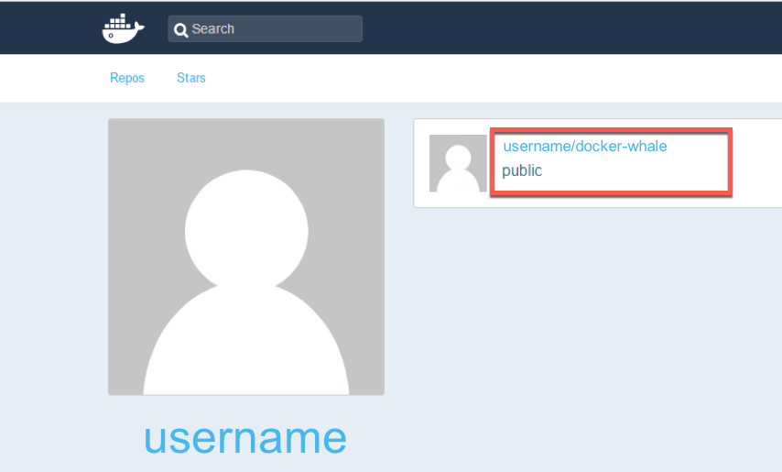
Docker Hub
Docker Inc.
Repository
public and private images
Enables images to be shared and moved off the laptop
Example usage:
$ docker tag docker-whale:latest username/docker-whale:latest
$ docker push username/docker-whale:latest
$ docker pull username/docker-whale:latest
Umesh Worlikar

Slide 18
Docker CLI – Common / Useful Commands
docker build : build docker image from Dockerfile
docker run : run docker image
docker logs : show log data for a running or stopped container
docker ps : list running docker containers (analogous to ps)
docker ps –a : list all containers including not running
docker images : list all images on the local volume
docker rm : remove/delete a container | docker rmi : remove/delete an image
docker tag : name a docker image
docker login : login to registry
docker push/pull : push or pull volumes to/from Docker Registries
docker inspect : return container run time configuration parameter metadata
Umesh Worlikar
Notes:
18

Slide 19
Docker Run
Pulls the image and runs it as a container
Examples:
-Simple:
$ docker run hello-world
-Complex:
$ docker run -d --restart=always -p=443:5000/tcp -e="REGISTRY_HTTP_TLS_CERTIFICATE=/certs/domain.crt" -e="REGISTRY_HTTP_TLS_KEY=/certs/registry.example.com.key" -e="REGISTRY_AUTH=htpasswd" -e="REGISTRY_AUTH_HTPASSWD_PATH=/auth/htpasswd" -e="REGISTRY_AUTH_HTPASSWD_REALM=Our Test Registry" -v=/home/opc/certs:/certs -v=/home/opc/auth:/auth -v /home/opc/registry:/var/lib/registry "registry:2"
Umesh Worlikar

Slide 20
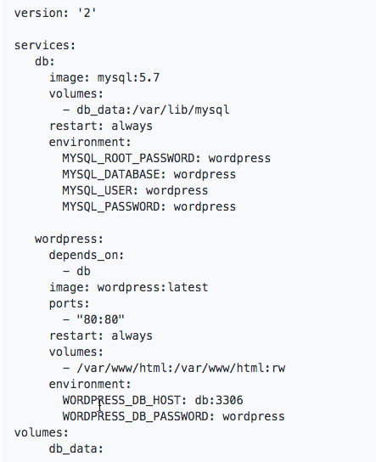
Docker Compose
Docker Compose
Docker Tool for defining and running multi-container Docker applications
Reference file defined in YAML
docker-compose.yml
$ docker-compose up -d
Umesh Worlikar
Notes:
Running multi container environment for multiple purposes:
Mail (Messaging) Server
Web Server + DB
Caching
Docker compose is written in YAML
Dingle command to manage all services
20

Slide 21
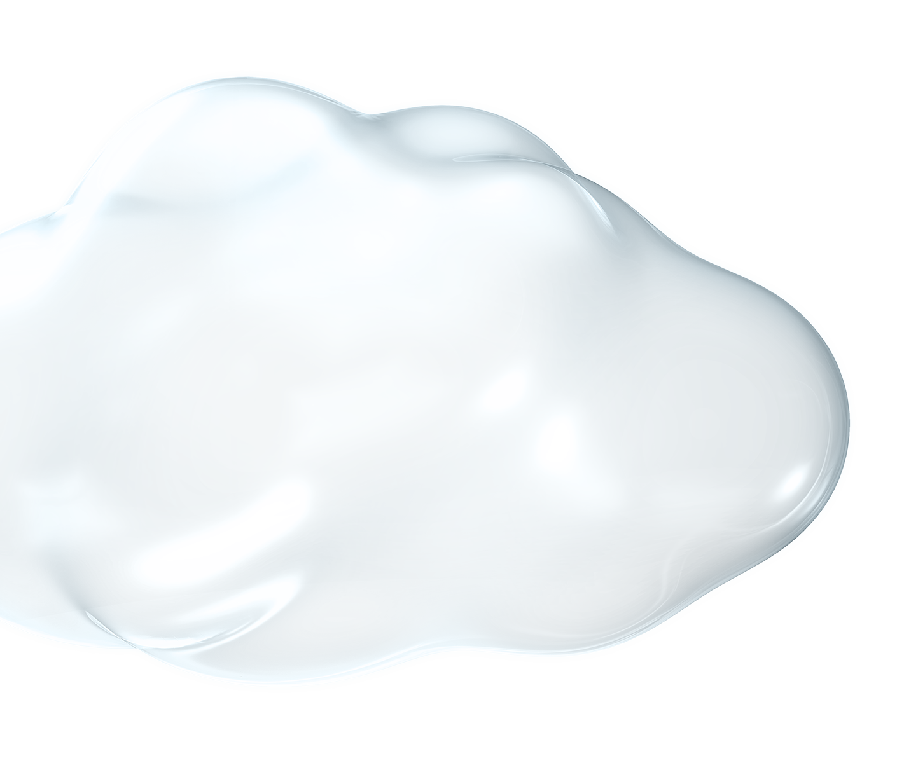
Why Docker is Hot – Its simple, Devs love it
Dev/Test of Legacy Apps
New App Dev (including parts of legacy apps)
Code Agility, CI/CD Pipeline, DevOps
Adoption of Open Source
Microservices & Cloud Native Apps
Umesh Worlikar
Notes:
Additionally, in speaking with hundreds of organizations that are exploring and using Docker, these are the core advantages that Docker brings.
21

Slide 22
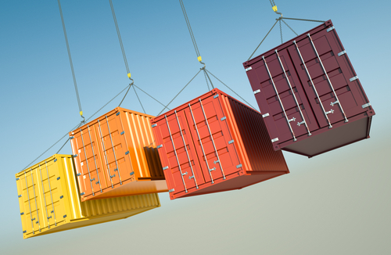
Why Containers?
IT cares because:
Improve speed and frequency of releases, reliability of deployments
Makes app lifecycle efficient, consistent and repeatable – configure once, run many times
Eliminate environment inconsistencies between development, test, production
Improve production application resiliency and scale out / in on demand
Developers care because:
Quickly create ready-to-run packaged applications, low cost deployment and replay
Automate testing, integration, packaging
Reduce / eliminate platform compatibility issues (“It works in dev!”)
Support next gen applications (microservices)
Umesh Worlikar
Notes:
Ok, so those are some of the mechanics of the technology, but why is Docker popular among all types of IT people? Let's look at these proof points from Developers and IT Ops.
22

Slide 23
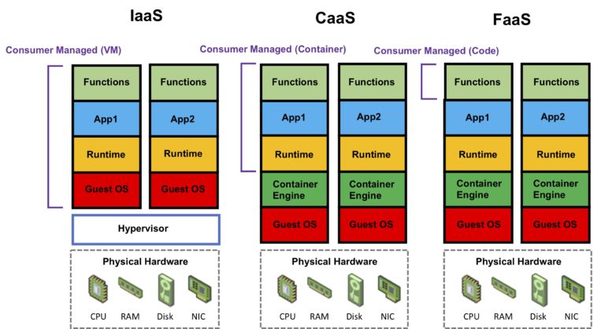
Cloud and Docker Containers
Umesh Worlikar

Slide 24

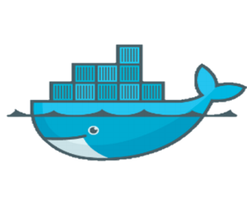
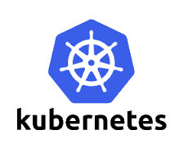
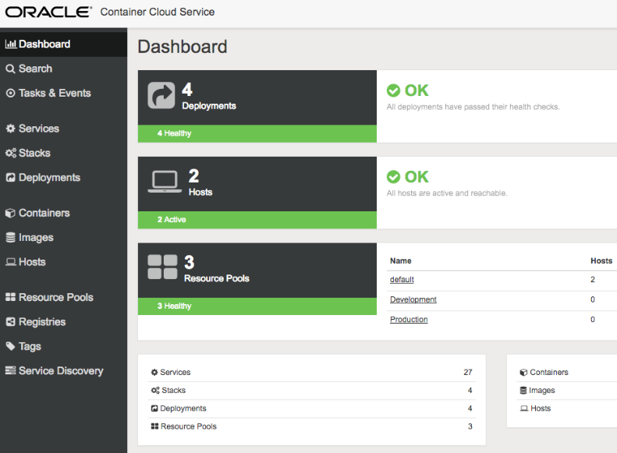
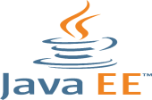


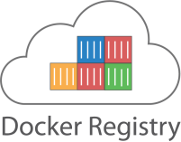
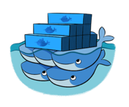




Cloud and Docker Containers
Compute CS
Container CS
Application Container CS
DIY Container Management
Oracle Managed Container Service
Docker-based Cloud Polyglot Platform
IaaS
CaaS
PaaS
Umesh Worlikar
Notes:
24

Slide 25
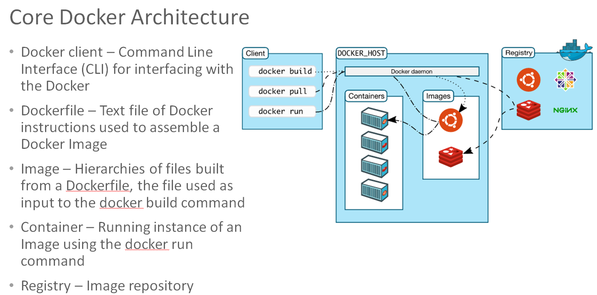
Containers are Portable, but How about Advanced Functions
Advanced Functions
Orchestration, Monitoring, Operations, Service Discovery
Docker Environment Provisioning
Fragmented Market Solutions
Kubernetes
Swarm, Docker Data Center, Docker Cloud
Consul, ETCD, Docker Networking
etc
+
Umesh Worlikar
Notes:
25

Slide 26
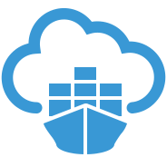
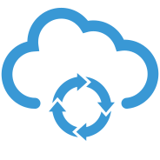
The Docker DevOps Cycle
Plan
OPC services featuring:
Oracle Developer Cloud Service
Now Includes Docker Image Build Function*
Oracle Container Cloud Service
Deploy, Operate, Monitor
Monitor
Code
Operate
Build
Container CS
Dev CS
Deploy
Test
Release
Umesh Worlikar
Notes:
26

Slide 27
Docker Container Lifecycle
Conception
BUILD an Image from a Dockerfile
Birth
RUN (create+start) a container
Reproduction
COMMIT (persist) a container to a new image
RUN a new container from an image
Sleep
KILL a running container
Wake
START a stopped container
Death
RM (delete) a stopped container
Extinction
RMI a container image (delete image)
Umesh Worlikar

Slide 28
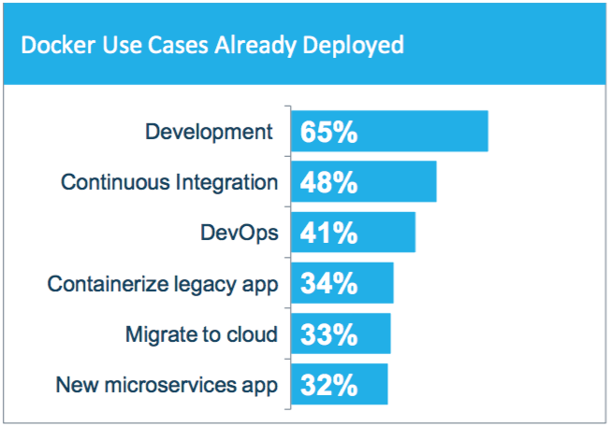
How Containers are Being Used – Survey Says:
Developer productivity a top use case today
Building out CI/CD pipelines
Consistent container image moves through pipeline
Preventing “it worked in dev” syndrome
Application modernization and portability are also key adoption drivers (Prem <-> cloud)
SOURCE: THE EVOLUTION OF THE MODERN SOFTWARE SUPPLY CHAIN, DOCKER SURVEY 2018
Umesh Worlikar
Notes:
28

Slide 29
References
https://pointful.github.io/docker-intro/#/
https://dzone.com/articles/introduction-to-docker-1
https://www.docker.com/blog/docker-101-introduction-docker-webinar-recap/
https://www.digitalocean.com/community/tutorials/how-to-install-and-use-docker-on-centos-7
https://linoxide.com/linux-how-to/install-jenkins-docker-container/
Umesh Worlikar
Notes:
29

Slide 30



Questions?
Umesh Worlikar
Notes:
30

