Slide 1
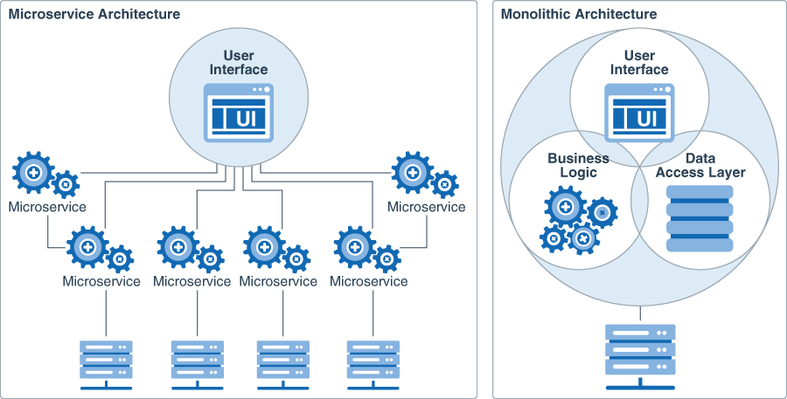

Microservices
Umesh Worlikar
Umesh Worlikar

Slide 2
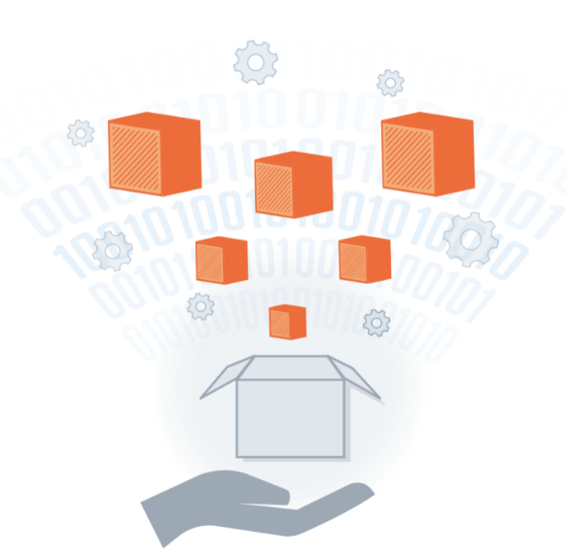
Agenda
1
Microservice Introduction
Microservice Architecture
Deployment Pattern
API Gateway
Service Discovery
Database Management
2
3
4
5
6
Umesh Worlikar
Notes:
2

Slide 3
What is a Microservices Architecture?
An SOA variation, Microservice architecture is an approach to developing a single application as a suite of small services. Each service:
Runs its own processes
Can be written in any programming language and is platform agnostic
Is independently deployable and replaceable
May use different storage technologies
Requires a minimum of centralized management
Large companies, such as Amazon, eBay, and Netflix, have already adopted microservice architecture as their main architecture.
Umesh Worlikar
Umesh Worlikar

Slide 4
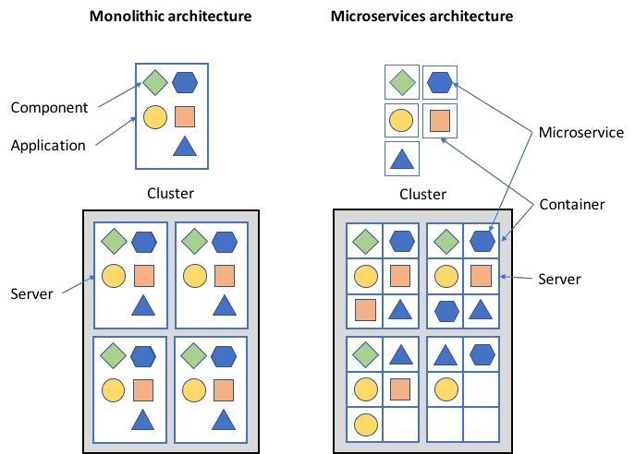
Visual Interpretation of Architecture Patterns
Traditional Monolithic Architecture Pattern
Microservice Architecture Pattern
“Monoliths and microservices are not a simple binary choice.
Both are fuzzy definitions that mean many systems would lie in a
blurred boundary area among the two”
Umesh Worlikar
Notes:
An approach to developing a single application as a suite of small services, each running in its own process and communicating with lightweight mechanisms. Each service is independent and can be written in different programming languages and use different data storage technologies. Services are built around business capabilities and are independently deployable using fully automated deployment and require a bare minimum of centralized management. https://martinfowler.com/articles/microservices.html
In a monolithic architecture, software components are tightly integrated as part of an application that is replicated across a server cluster to allow application scalability. In a microservices architecture, each software component is standalone and is loosely integrated with the other components. Each component is deployed independently across a server cluster and each component can be scaled independently across the cluster. This allows applications based on a microservice architecture to be reactive and adaptive to the user demand changes rapidly and without redesign.
Microservices architecture rely heavily on containerization, which allows microservices to be developed completely independently from each other using different languages and libraries. Only the external interfaces need to be standardized across all microservices.
4

Slide 5
Microservice Architecture Advantages
Auto-scaling - A cloud computing service feature that automatically adds or removes computing resources based on actual demand
Load balancing -The process of distributing workload evenly across computing resources in a cloud computing environment
Greater efficiencies as they are typically paired with auto-scalers and load balancers
Easily scalable in three ways:
by decomposition into simple functions (microservices)
by cloning microservices on demand
by partitioning data across a cluster
Services can be cloned or decommissioned based on user requests in real-time
Auto-scaling definition
A cloud computing service feature that automatically adds or removes compute resources depending upon actual usage
Umesh Worlikar
Notes:
Autoscaling definition source: http://searchcloudapplications.techtarget.com/definition/autoscaling
Load balancer definition source: http://searchcloudcomputing.techtarget.com/definition/cloud-load-balancing
5

Slide 6
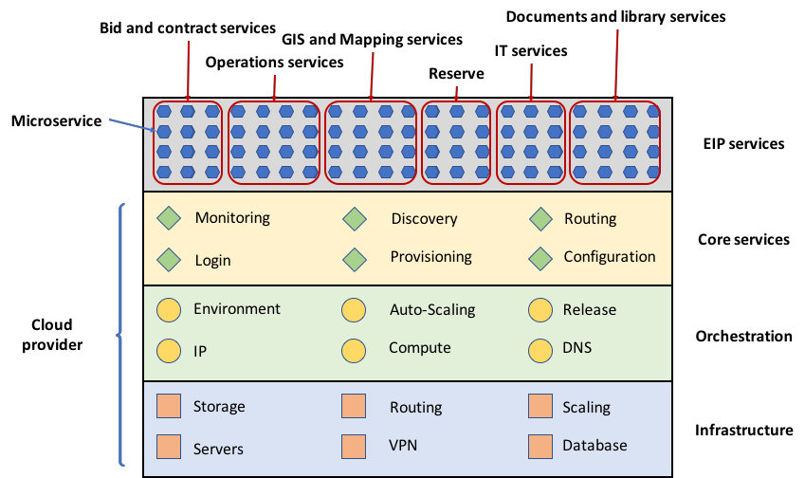
Microservice Implementation Example
IT teams shift from actively managing hardware and software to managing service layers in the microservice environment
Umesh Worlikar

Slide 7
Adopting a Microservice Architecture
Shifting to microservices architecture means
Reducing code complexity while increasing operational complexity
Distributing data across multiple processes while ensuring data consistency across processes
Simplifying individual services while raising the complexity of coordinating many services
Microservices impose a cost on productivity that can only be made up for in more complex systems.
Umesh Worlikar
Notes:
7

Slide 8
Fragmentation of business requirement
Services Development
- You build it AND
you run it.
Development is Platform and Language Agnostic
When Adopting a Microservice Architecture
Design for failure – applications must be designed and developed to tolerate the failures of other services or applications.
Single lifecycle ownership of the product – “You build it, you run it,” is the motto rather than the traditional practice of a software development team handing off a service to an IT operations team.
Exercise choice in platforms, language, & libraries that best suits the microservice functionality and team expertise rather than a single language or platform for the enterprise.
Umesh Worlikar
Notes:
Most microservices architecture pattern implementations rely on automated services to monitor, deploy, and manage their clusters. Scripting approaches have been developed to programmatically control the configuration and behavior of microservices clusters and allow them to be rapidly be modified or corrected.
The considerations noted on this slide all present challenges to agencies and IT staff, however the Guide provides information on the advantages of each of these approaches and why the benefits outweigh the challenges.
8

Slide 9
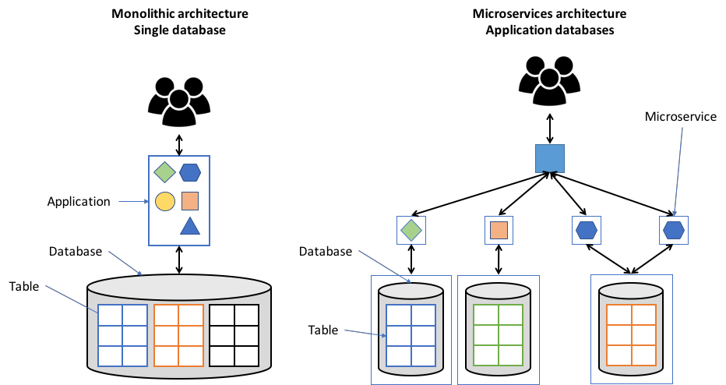
Fragmentation of business requirement
When Adopting a Microservice Architecture
Decentralized business and messaging rules – complex centralized message handling such as Enterprise Service Bus must give way to simple communications protocols. This is referred to as “smart endpoints, dumb pipes.”
Decentralized governance – minimize top down standards or technology sets and allow in-house open source model for sharing useful, tested code
Decentralized data management to service-level data management, often called polyglot persistence.
Microservices Distributed Database
Monolithic
Database
Umesh Worlikar
Notes:
Most microservices architecture pattern implementations rely on automated services to monitor, deploy, and manage their clusters. Scripting approaches have been developed to programmatically control the configuration and behavior of microservices clusters and allow them to be rapidly be modified or corrected.
The considerations noted on this slide all present challenges to agencies and IT staff, however the Guide provides information on the advantages of each of these approaches and why the benefits outweigh the challenges.
9

Slide 10
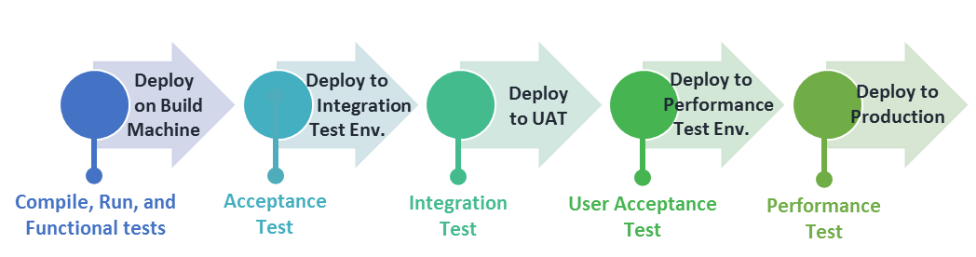
Fragmentation of Business Requirement
When Adopting a Microservice Architecture
Move beyond Continuous Integration to Continuous Delivery
Maintain tight integration requirements within the microservice while easing external integration requirements
Continuous Delivery means development teams build software so that the software can be released to production at any time and by anyone on the team
Organize teams around business capabilities not technology layer
cross functional teams by business capability are requisite
traditional technology layer based teams (e.g., a database applications team or a user interface team) means extensive cross-team collaboration and costly delays
Example of a Basic Automated Build Pipeline that Supports Continuous Integration
10
Umesh Worlikar
Notes:
10

Slide 11

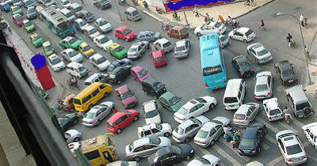
Microservices Challenges
Can lead to chaos if not designed right …
Umesh Worlikar

Slide 12
Deployment Pattern
Multiple Service Instances per Host - Deploy multiple service instances on a host
Service Instance per Host / VM - Deploy a single service instance on each host - A specialization of the Service Instance per Host pattern where the host is a VM
Service Instance per Container - A specialization of the Service Instance per Host pattern where the host is a container
Server-less Deployment -AWS Lambda is an example of server-less deployment technology. It supports Java, Node.js, and Python services
Umesh Worlikar
Notes:
12

Slide 13
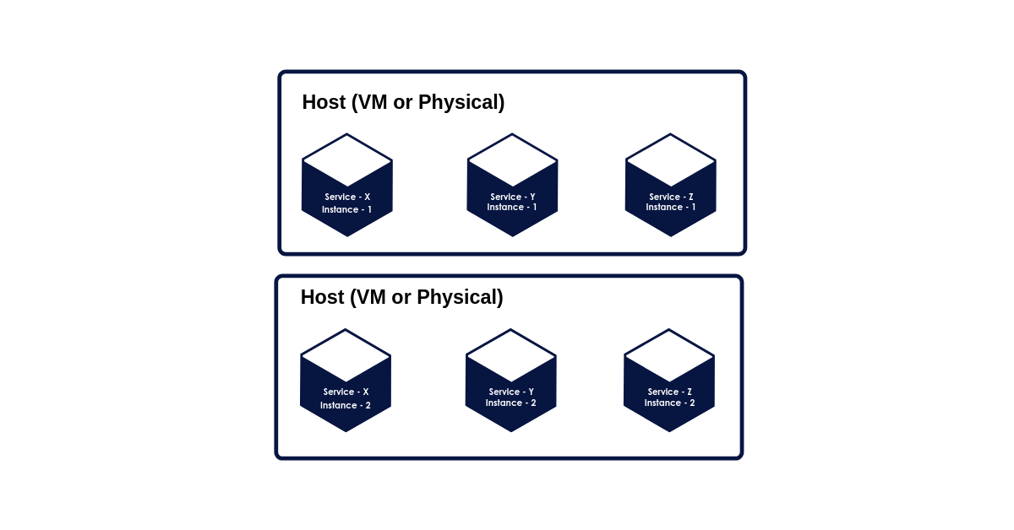
Multiple Service Instances per Host (VM / PHYSICAL)
In this pattern, software developers’ provision single or multiple physical or virtual hosts and run several service instances on each one. This pattern has few variants, including a variant for each service instance to be a process or run several service instances in the same process.
Umesh Worlikar
Notes:
13

Slide 14
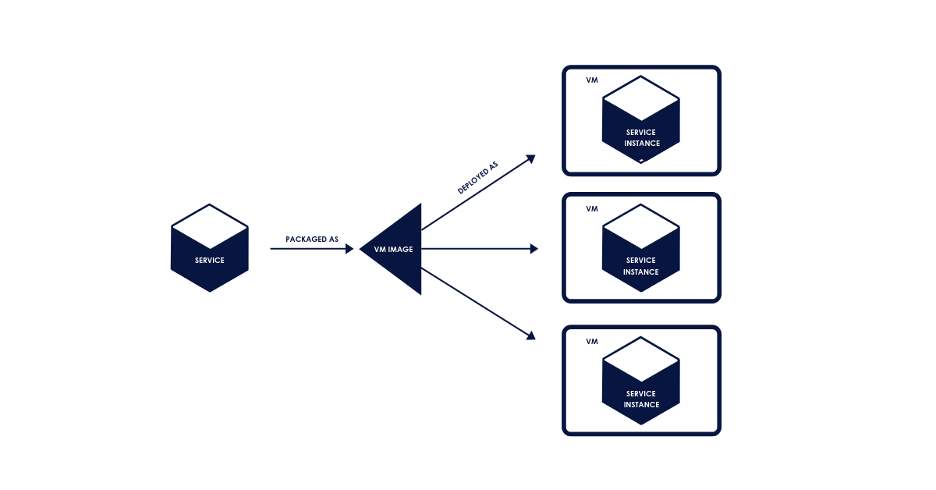
Service Instance per Host / VM
This allows you to run each instance separately on its host. This has two specializations: Service Instance per Virtual Machine and Service Instance per Container. Service Instance per Virtual Machine Pattern allows you to package each service as a virtual machine (VM) images like Amazon EC2 AMI. Each instance is a VM that is run using that VM image. One of the popular apps using this pattern is Netflix for its video streaming service.
Umesh Worlikar
Notes:
14

Slide 15
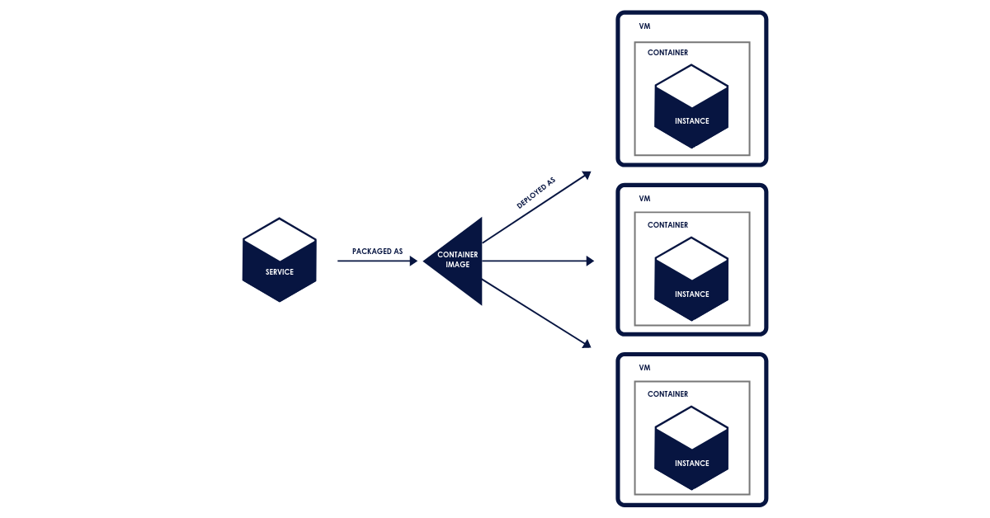
Service Instance per Container
In this pattern, each service instance operates in its respective container, which is a virtualization mechanism at the operating system level. Some of the popular container technologies are Docker and Solaris Zones
Umesh Worlikar
Notes:
15

Slide 16
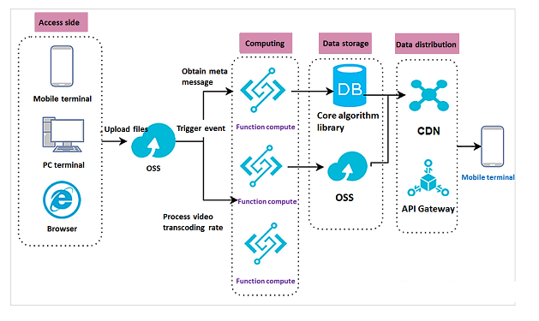
Server-less Deployment
Server-less deployment technology is another strategy for micro-services deployment and it supports Java, Node.js, and Python services. AWS Lambda is a popular technology used by developers around the world. In this pattern, you need to package the service as a ZIP file and upload it to the Lambda function, which is a stateless service.
Umesh Worlikar
Notes:
16

Slide 17
API GateWay
An API Gateway is a server that is the single entry point into the system.
The API Gateway encapsulates the internal system architecture and provides an API that is tailored to each client.
Umesh Worlikar
Notes:
17

Slide 18
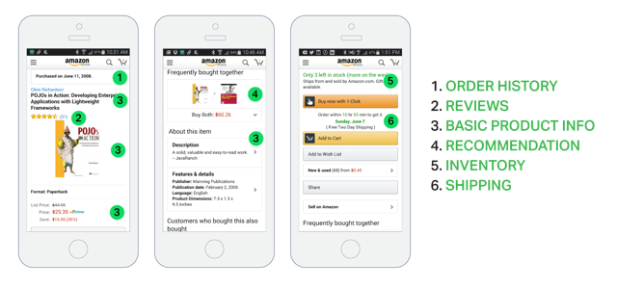
API GateWay
Product details in Amazon’s Android mobile application.
Umesh Worlikar
Notes:
18

Slide 19
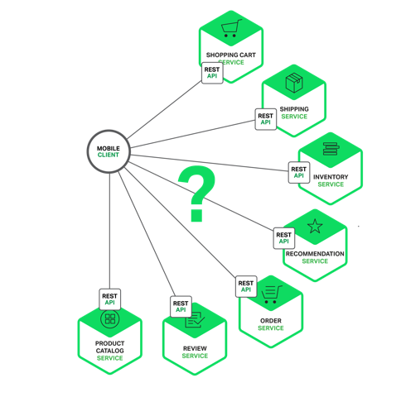
API GateWay
Problem:
How do the clients of a Microservices-based application access the individual services?
Umesh Worlikar
Notes:
19

Slide 20
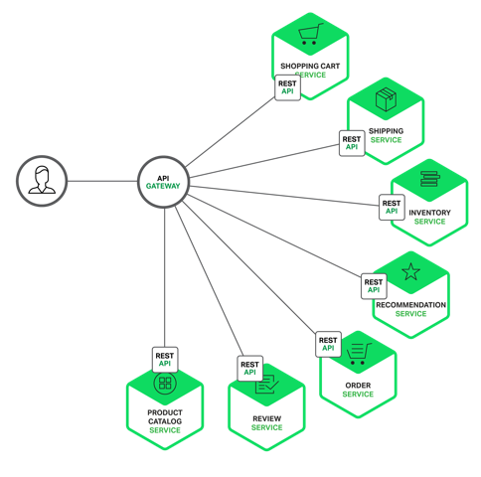
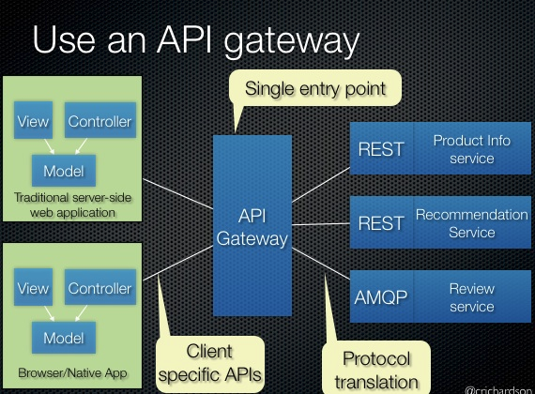
API GateWay
Solution : Using an API Gateway single entry point for all clients
Umesh Worlikar
Notes:
20

Slide 21
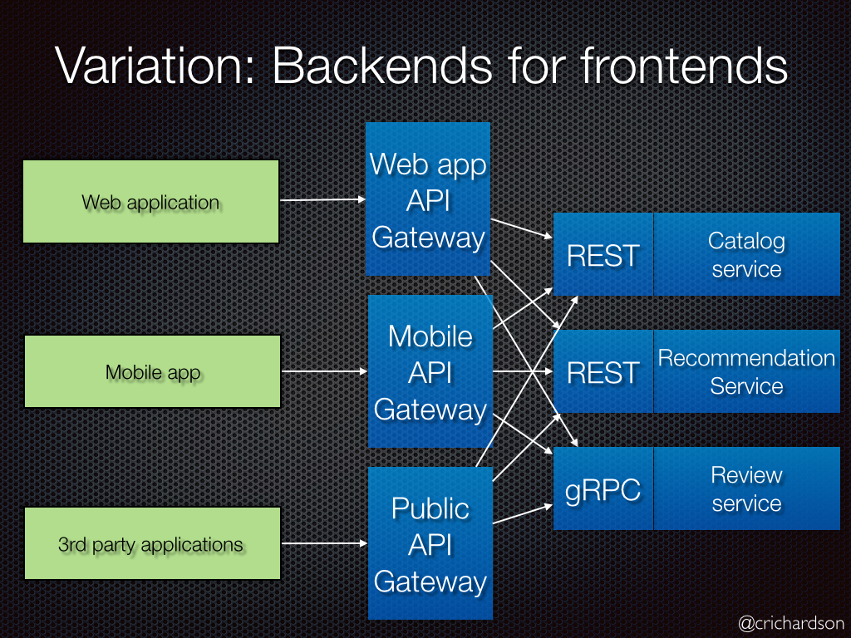
API GateWay
Umesh Worlikar
Notes:
21

Slide 22
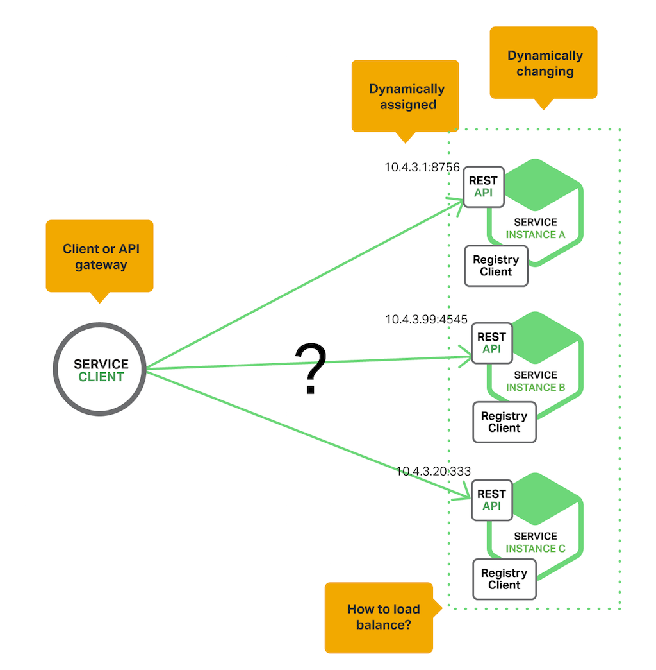
Service Discovery
Cloud Based Microservices
In order to make a request, your code needs to know the network location (IP address and port) of a service instance. In a traditional application running on physical hardware, the network locations of service instances are relatively static. Service instances have dynamically assigned network locations. Moreover, the set of service instances changes dynamically because of autoscaling, failures, and upgrades. Consequently, your client code needs to use a more elaborate service discovery mechanism.
Umesh Worlikar
Notes:
22

Slide 23
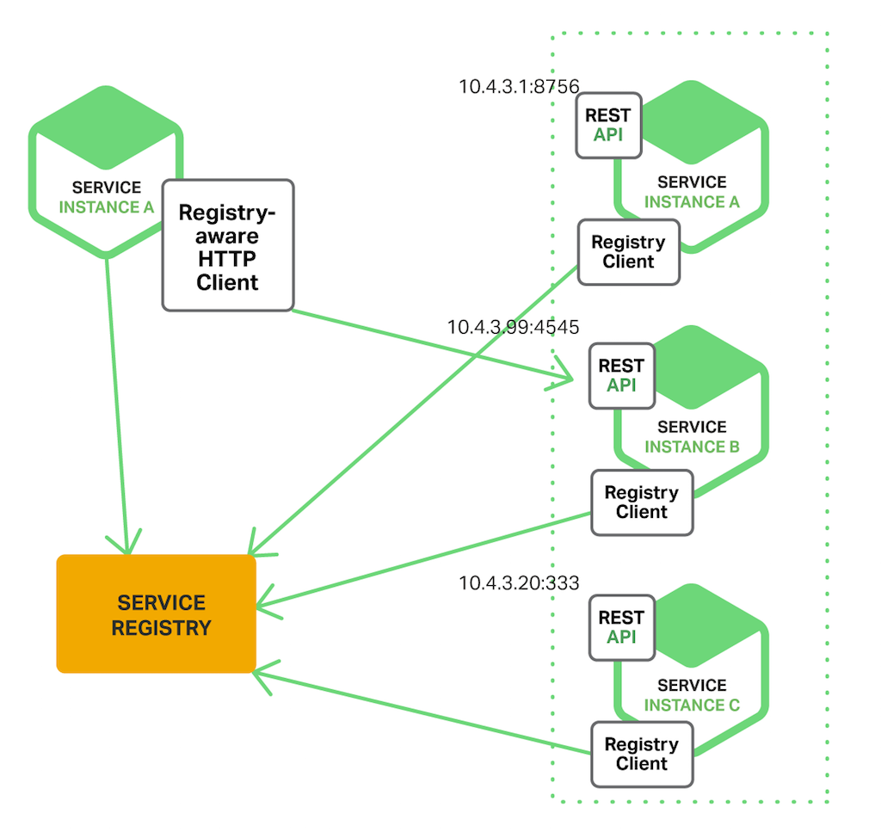
Service Discovery
The Client-Side Discovery Pattern
Umesh Worlikar
Notes:
23

Slide 24
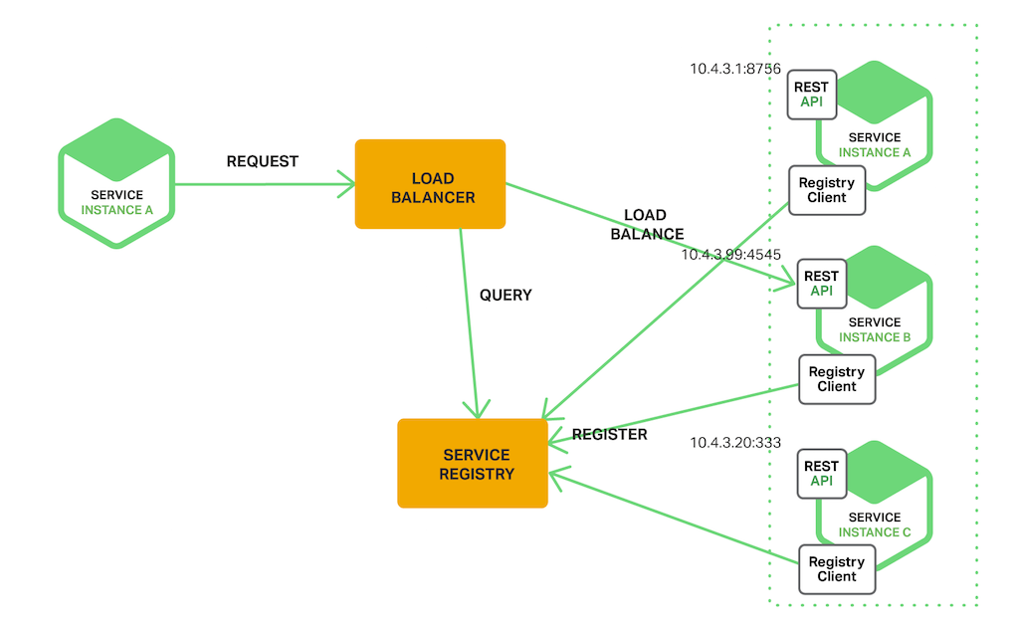
Service Discovery
The Server-Side Discovery Pattern
Umesh Worlikar
Notes:
24

Slide 25
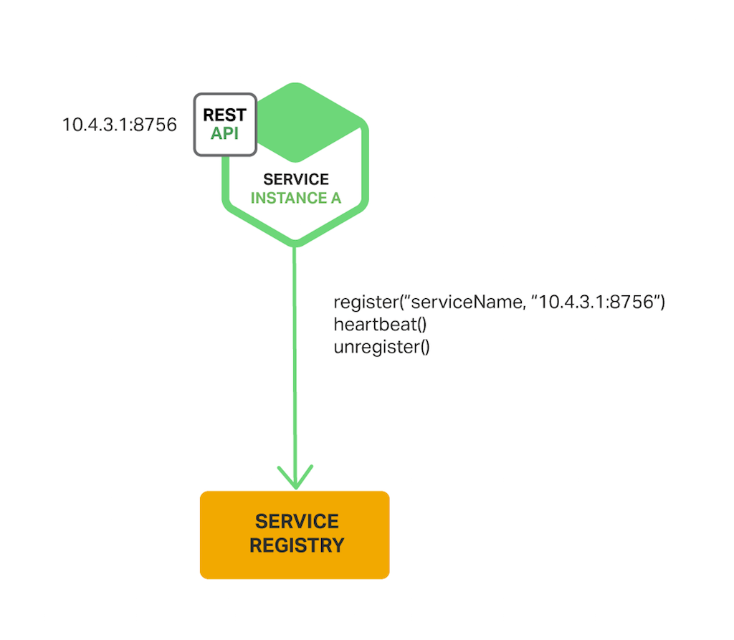
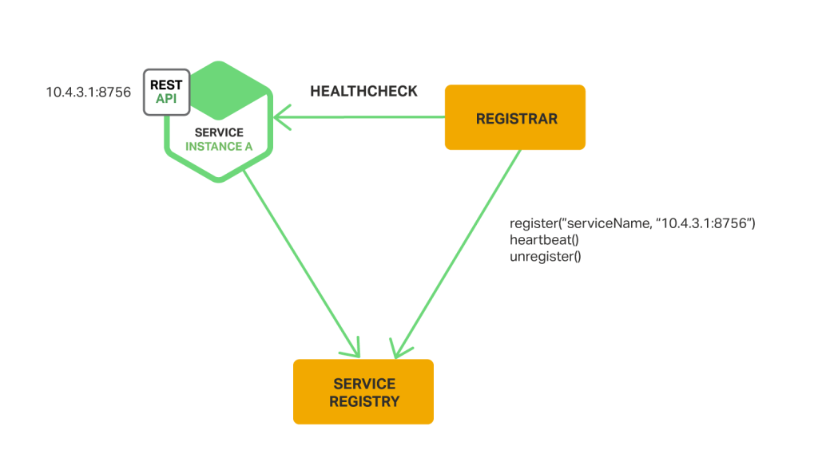
Service Discovery
The Service Registry Options
The Self-Registration Pattern The Third-Party Registration Pattern
Umesh Worlikar
Notes:
25

Slide 26
Distributed Data Management
A key benefit of using a relational database is that your application can use ACID transactions
Atomicity – Changes are made atomically
Consistency – The state of the database is always consistent
Isolation – Even though transactions are executed concurrently it appears they are executed serially
Durability – Once a transaction has committed it is not undone
Umesh Worlikar
Notes:
26

Slide 27
Distributed Data Management
Problem of Distributed Data Management in the Microservices
Data owned by each microservice is private to that can only be accessed via its API.
Encapsulating the data ensures that the microservices are loosely coupled and can evolve independently of one another.
If multiple services access the same data, schema updates require time consuming, coordinated updates to all of the services.
Umesh Worlikar
Notes:
27

Slide 28
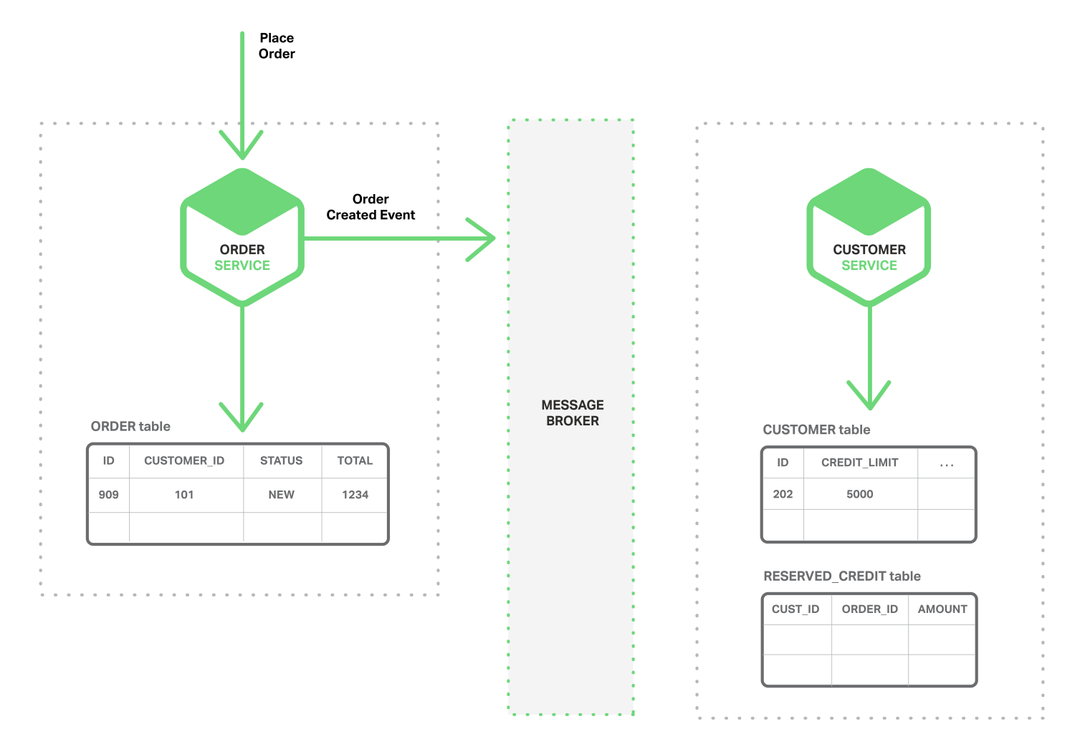
Distributed Data Management
Event-Driven Architecture In this architecture, a microservice publishes an event when something notable happens, such as when it updates a business entity. Other microservices subscribe to those events. When a microservice receives an event it can update its own business entities, which might lead to more events being published.
The Order Service creates an Order with status NEW and publishes an Order Created event.
Umesh Worlikar
Notes:
28

Slide 29
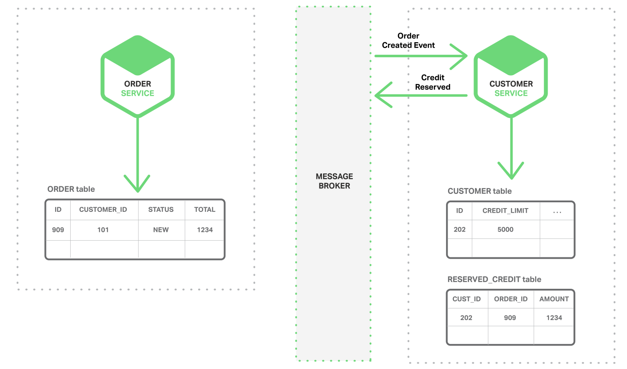
Distributed Data Management
Event-Driven Architecture In this architecture, a microservice publishes an event when something notable happens, such as when it updates a business entity. Other microservices subscribe to those events. When a microservice receives an event it can update its own business entities, which might lead to more events being published.
The Customer Service consumes the Order Created event, reserves credit for the order, and publishes a Credit Reserved event.
Umesh Worlikar
Umesh Worlikar
Notes:
29

Slide 30
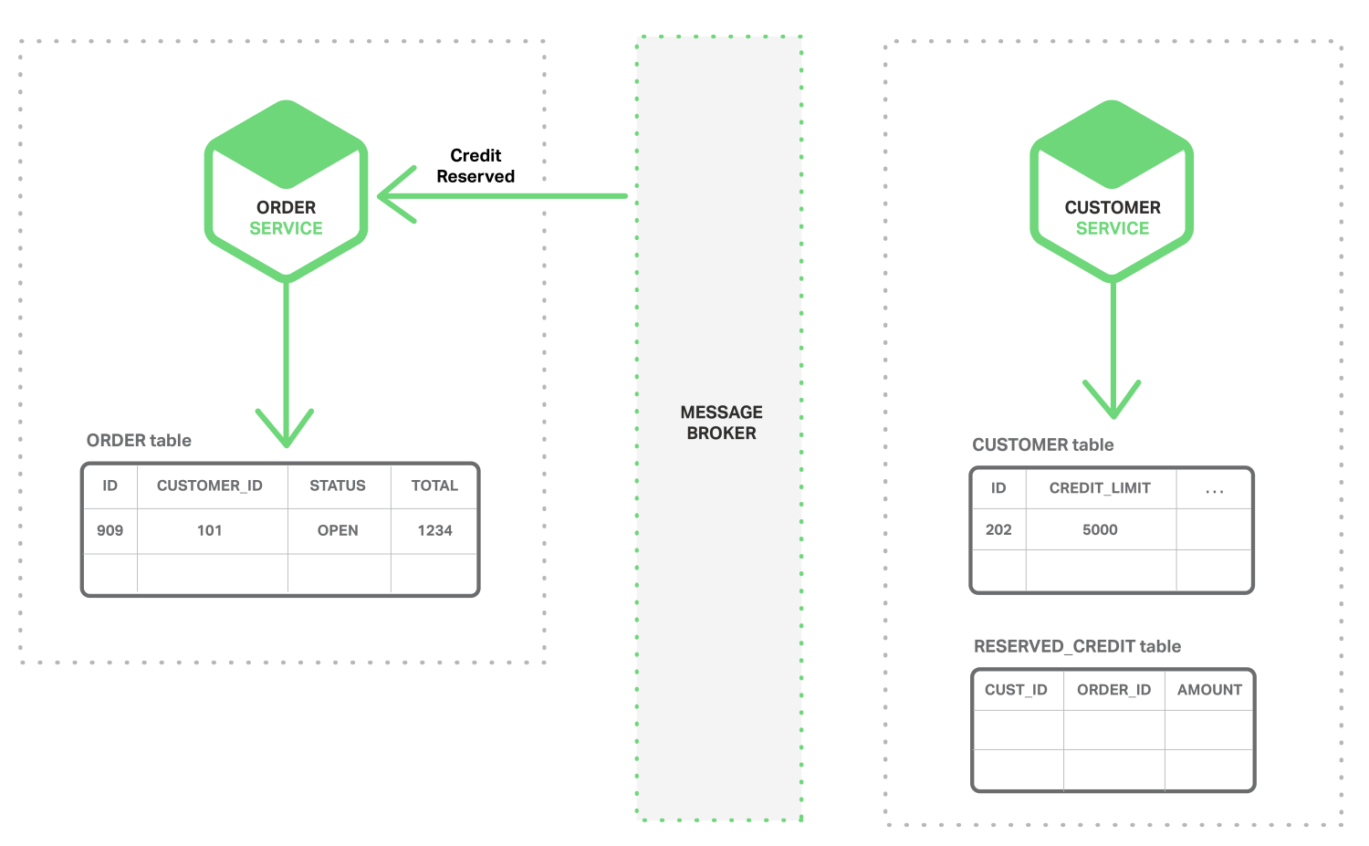
Distributed Data Management
Event-Driven Architecture In this architecture, a microservice publishes an event when something notable happens, such as when it updates a business entity. Other microservices subscribe to those events. When a microservice receives an event it can update its own business entities, which might lead to more events being published.
The Order Service consumes the Credit Reserved event, and changes the status of the order to OPEN.
Umesh Worlikar
Notes:
30

Slide 31
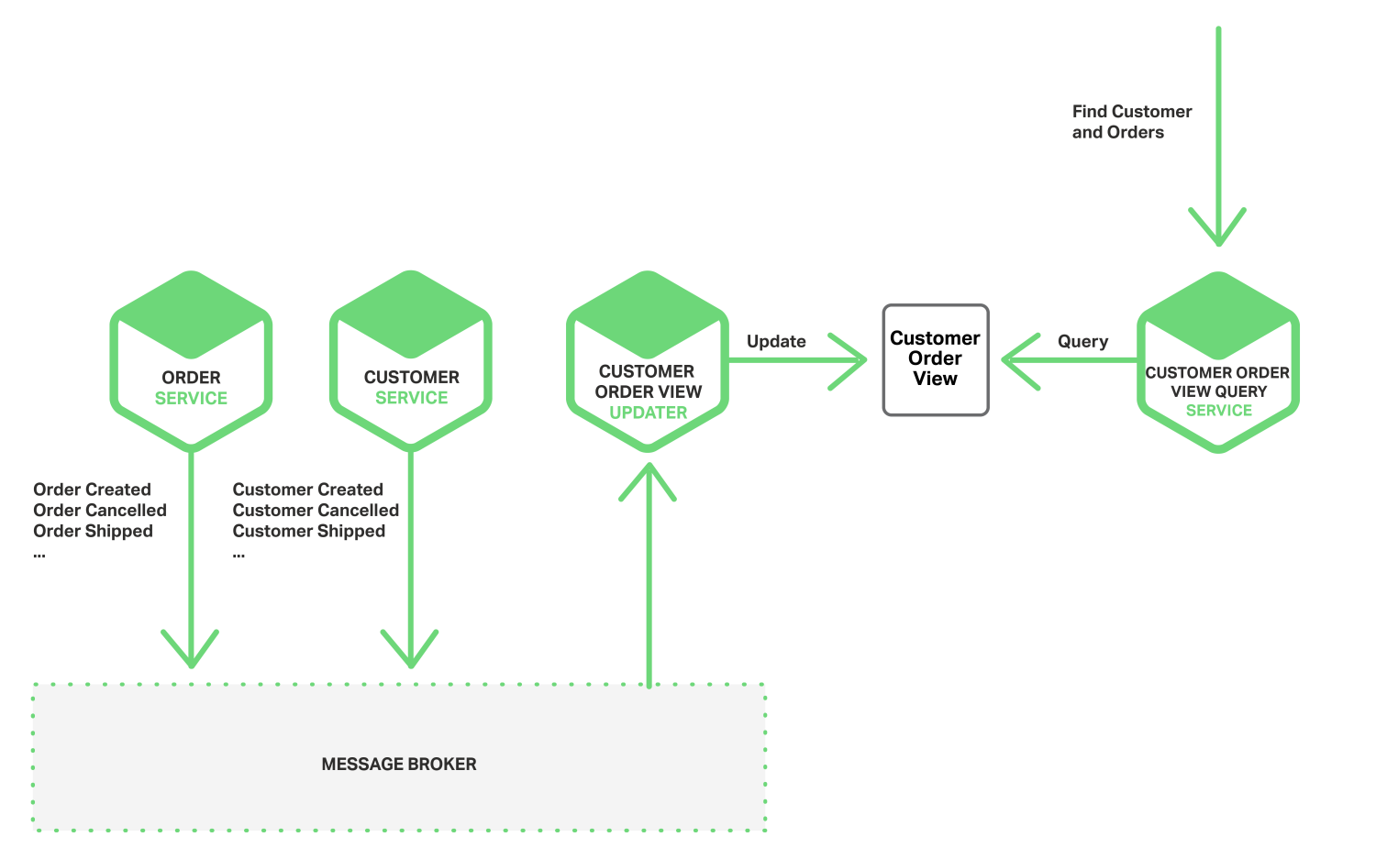
Distributed Data Management
Event-Driven Architecture In this architecture, a microservice publishes an event when something notable happens, such as when it updates a business entity. Other microservices subscribe to those events. When a microservice receives an event it can update its own business entities, which might lead to more events being published.
When the Customer Order View Updater Service receives a Customer or Order event, it updates the Customer Order View datastore
Umesh Worlikar
Notes:
31

Slide 32
References
https://microservices.io/patterns/apigateway.html
https://dzone.com/articles/deploying-microservices
https://microservices.io/microservices/news/2015/03/15/deployment-patterns.html
https://www.nginx.com/blog/building-microservices-using-an-api-gateway/
https://www.nginx.com/blog/service-discovery-in-a-microservices-architecture/
https://www.nginx.com/blog/event-driven-data-management-microservices/
Umesh Worlikar
Notes:
32

Slide 33



Questions?
Umesh Worlikar
Notes:
33

