Slide 1

DevOps Fundamentals Introduction to DevOps
Umesh Worlikar
Notes:
One Marketing Template
© 2013 Microsoft Corporation. All rights reserved. Microsoft, Windows, and other product names are or may be registered trademarks and/or trademarks in the U.S. and/or other countries.
The information herein is for informational purposes only and represents the current view of Microsoft Corporation as of the date of this presentation. Because Microsoft must respond to changing market conditions, it should not be interpreted to be a commitment on the part of Microsoft, and Microsoft cannot guarantee the accuracy of any information provided after the date of this presentation. MICROSOFT MAKES NO WARRANTIES, EXPRESS, IMPLIED OR STATUTORY, AS TO THE INFORMATION IN THIS PRESENTATION.
12/27/2019
1

Slide 2

Traditional Development and Operations
DEV
OPS
Umesh Worlikar

Slide 3

“DevOps is development and operations collaboration”
“DevOps is treating your infrastructure as code”
It’s DevOps!
“DevOps is using automation”
It’s DevOps!
It’s DevOps!
“DevOps is feature switches”
It’s DevOps!
“Kanban for Ops?”
“DevOps is small deployments”
Umesh Worlikar
Notes:
S4 Solution Specialist Sales Summit
© 2013 Microsoft Corporation. All rights reserved. Microsoft, Windows, and other product names are or may be registered trademarks and/or trademarks in the U.S. and/or other countries. The information herein is for informational purposes only and represents the current view of Microsoft Corporation as of the date of this presentation. Because Microsoft must respond to changing market conditions, it should not be interpreted to be a commitment on the part of Microsoft, and Microsoft cannot guarantee the accuracy of any information provided after the date of this presentation. MICROSOFT MAKES NO WARRANTIES, EXPRESS, IMPLIED OR STATUTORY, AS TO THE INFORMATION IN THIS PRESENTATION.
12/27/19 04:22 PM
3

Slide 4
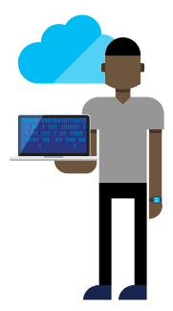




DevOps: the three stage conversation
DEV
OPS
1
People
2
Process
3
Products
Umesh Worlikar
Notes:
S4 Solution Specialist Sales Summit
© 2013 Microsoft Corporation. All rights reserved. Microsoft, Windows, and other product names are or may be registered trademarks and/or trademarks in the U.S. and/or other countries. The information herein is for informational purposes only and represents the current view of Microsoft Corporation as of the date of this presentation. Because Microsoft must respond to changing market conditions, it should not be interpreted to be a commitment on the part of Microsoft, and Microsoft cannot guarantee the accuracy of any information provided after the date of this presentation. MICROSOFT MAKES NO WARRANTIES, EXPRESS, IMPLIED OR STATUTORY, AS TO THE INFORMATION IN THIS PRESENTATION.
12/27/19 04:22 PM
4

Slide 5
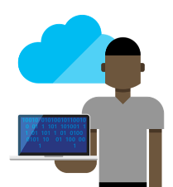






The consequences of inefficiency
40
%
… of implementations end up getting reworked because they don’t meet the users’ original requirements
IT drives business
success!
High IT performance correlates with strong business performance, helps boost productivity, market share and profit.
Outperforming teams are
collaborate
54
%
extensively
more likely to
41
%
… of development budgets for software, IT staff and external professional services will be consumed by poor requirements
with their
Collaboration blockers
counterparts
80
%
failure rate …
26.7% No executive support
56.7% Cultural inhibitors
43.3% Fragmented processes
… for companies that try to adapt their existing tools for DevOps practices
Developers
IT Ops
%
Business
70
o
f
CIOs
Would increase risk
1 in
6
It takes on average 200 minutes to diagnose and repair a production issue
IT decision makers is still unfamiliar with the term DevOps
to reduce IT costs
and accelerate business agility
3/4
of teams
DevOps was being initiated by more development teams than IT Ops teams by about a 40% to 33% margin
The average hourly cost of infrastructure failure is $100,000 per hour
A bug caught in production ends up costing
than if the same bug was found earlier in the development cycle
Responding to ongoing needs for efficiency and growth
100x more
have adopted
Agile methodologies
dual goals
Always keeping all systems safe and secure
Umesh Worlikar

Slide 6
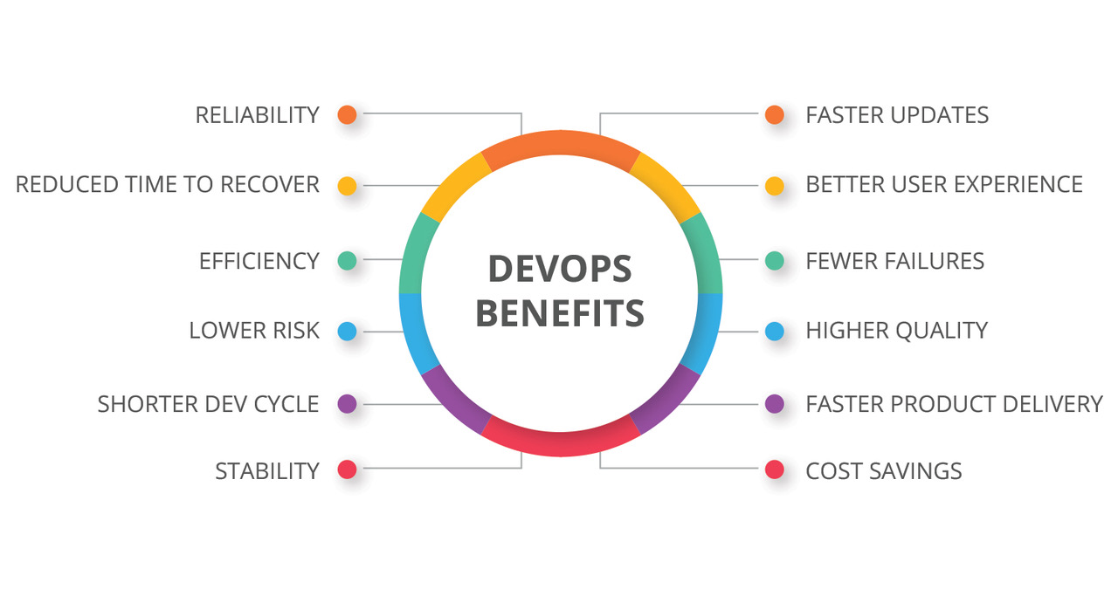
DevOps Benefits
Strong IT Performance is a competitive advantage
Deploy code 30x faster
Firms with high-performing IT organizations were 2x as likely to exceed their profitability, market share, and productivity goals
and with 200x shorter lead time as compared to their lower-performing peers
Have 60x fewer failures
DevOps Practices improve IT performance
and recover from failure 168x faster as compared to their lower-performing peers
Umesh Worlikar
Notes:
<Event Name Here>
© 2012 Microsoft Corporation. All rights reserved. Microsoft, Windows, and other product names are or may be registered trademarks and/or trademarks in the U.S. and/or other countries.
The information herein is for informational purposes only and represents the current view of Microsoft Corporation as of the date of this presentation. Because Microsoft must respond to changing market conditions, it should not be interpreted to be a commitment on the part of Microsoft, and Microsoft cannot guarantee the accuracy of any information provided after the date of this presentation. MICROSOFT MAKES NO WARRANTIES, EXPRESS, IMPLIED OR STATUTORY, AS TO THE INFORMATION IN THIS PRESENTATION.
12/27/2019
6

Slide 7
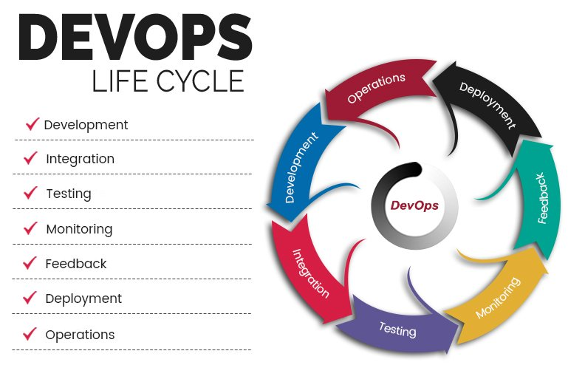
DevOps Phases
Umesh Worlikar
Notes:
One Marketing Template
© 2013 Microsoft Corporation. All rights reserved. Microsoft, Windows, and other product names are or may be registered trademarks and/or trademarks in the U.S. and/or other countries.
The information herein is for informational purposes only and represents the current view of Microsoft Corporation as of the date of this presentation. Because Microsoft must respond to changing market conditions, it should not be interpreted to be a commitment on the part of Microsoft, and Microsoft cannot guarantee the accuracy of any information provided after the date of this presentation. MICROSOFT MAKES NO WARRANTIES, EXPRESS, IMPLIED OR STATUTORY, AS TO THE INFORMATION IN THIS PRESENTATION.
12/27/2019
7

Slide 8
List of DevOps Practices
Infrastructure as Code (IaC)
Continuous Integration
Automated Testing
Continuous Deployment
Release Management
App Performance Monitoring
Load Testing & Auto-Scale
Availability Monitoring
Change/Configuration Management
Feature Flags
Automated Environment De- Provisioning
Self Service Environments
Automated Recovery (Rollback & Roll-Forward)
Hypothesis Driven Development
Testing in Production
Fault Injection
Usage Monitoring/User Telemetry
Umesh Worlikar
Notes:
One Marketing Template
© 2013 Microsoft Corporation. All rights reserved. Microsoft, Windows, and other product names are or may be registered trademarks and/or trademarks in the U.S. and/or other countries.
The information herein is for informational purposes only and represents the current view of Microsoft Corporation as of the date of this presentation. Because Microsoft must respond to changing market conditions, it should not be interpreted to be a commitment on the part of Microsoft, and Microsoft cannot guarantee the accuracy of any information provided after the date of this presentation. MICROSOFT MAKES NO WARRANTIES, EXPRESS, IMPLIED OR STATUTORY, AS TO THE INFORMATION IN THIS PRESENTATION.
12/27/2019
8

Slide 9
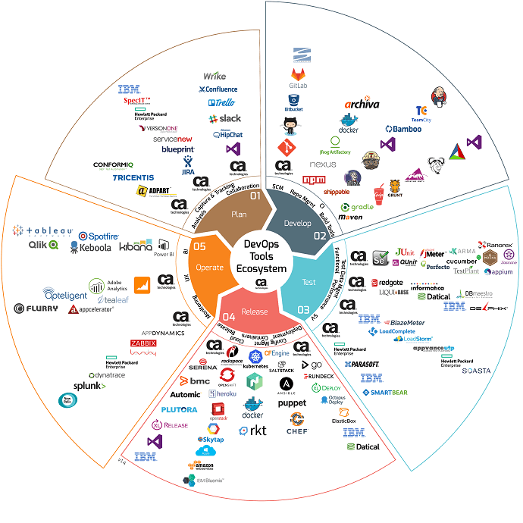
DevOps Tools EcoSystem
Umesh Worlikar
Notes:
One Marketing Template
© 2013 Microsoft Corporation. All rights reserved. Microsoft, Windows, and other product names are or may be registered trademarks and/or trademarks in the U.S. and/or other countries.
The information herein is for informational purposes only and represents the current view of Microsoft Corporation as of the date of this presentation. Because Microsoft must respond to changing market conditions, it should not be interpreted to be a commitment on the part of Microsoft, and Microsoft cannot guarantee the accuracy of any information provided after the date of this presentation. MICROSOFT MAKES NO WARRANTIES, EXPRESS, IMPLIED OR STATUTORY, AS TO THE INFORMATION IN THIS PRESENTATION.
12/27/2019
9

Slide 10
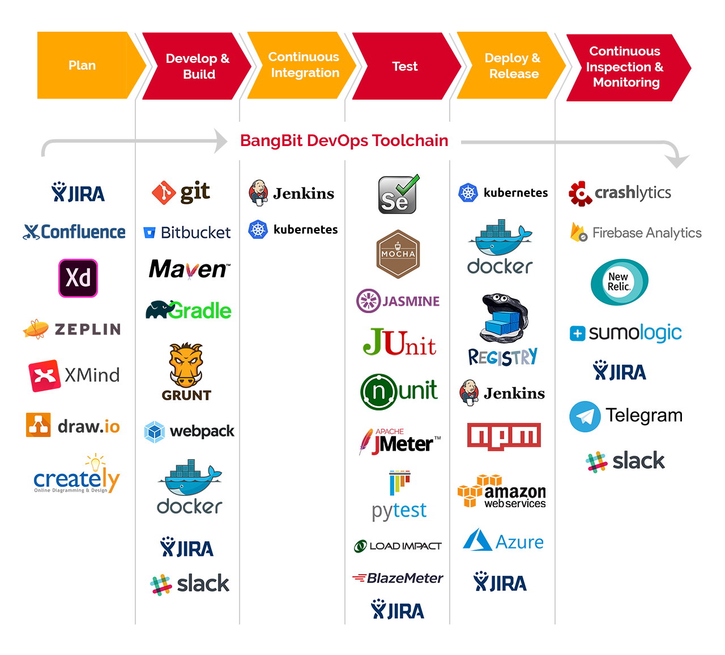
DevOps Tools Ecosystem
Umesh Worlikar
Notes:
One Marketing Template
© 2013 Microsoft Corporation. All rights reserved. Microsoft, Windows, and other product names are or may be registered trademarks and/or trademarks in the U.S. and/or other countries.
The information herein is for informational purposes only and represents the current view of Microsoft Corporation as of the date of this presentation. Because Microsoft must respond to changing market conditions, it should not be interpreted to be a commitment on the part of Microsoft, and Microsoft cannot guarantee the accuracy of any information provided after the date of this presentation. MICROSOFT MAKES NO WARRANTIES, EXPRESS, IMPLIED OR STATUTORY, AS TO THE INFORMATION IN THIS PRESENTATION.
12/27/2019
10

Slide 11




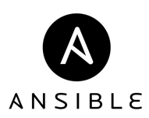

















Open + Flexible
Management
Hyper-scale
Open & flexible
Applications
Enterprise proven
App Frameworks
Hybrid
Databases & Middleware
Infrastructure
Linux
Umesh Worlikar
Notes:
12/27/2019
11
© 2014 Microsoft Corporation. All rights reserved. Microsoft, Windows, and other product names are or may be registered trademarks and/or trademarks in the U.S. and/or other countries. The information herein is for informational purposes only and represents the current view of Microsoft Corporation as of the date of this presentation. Because Microsoft must respond to changing market conditions, it should not be interpreted to be a commitment on the part of Microsoft, and Microsoft cannot guarantee the accuracy of any information provided after the date of this presentation. MICROSOFT MAKES NO WARRANTIES, EXPRESS, IMPLIED OR STATUTORY, AS TO THE INFORMATION IN THIS PRESENTATION.

Slide 12



Happy DevOps
DEV
OPS
Production
Umesh Worlikar

Slide 13
Questions?

