Slide 1



Continuous Integration Continuous Deployment
Umesh Worlikar

Slide 2
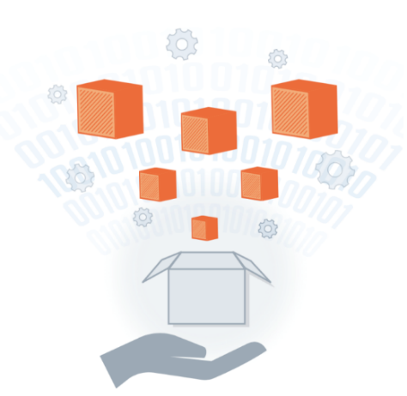
Agenda
1
Introduction to Delivery Pipeline
Introduction to Jenkins
Jenkins Management
Creating slave in Jenkins
Building a Delivery pipeline
Questions
1
2
2
3
3
4
4
5
5
6
6
Umesh Worlikar
Notes:
2

Slide 3
Continuous Integration
Continuous Integration is a software development practice where members of a team integrate their work frequently, usually each person integrates at least daily - leading to multiple integrations per day. Each integration is verified by an automated build (including test) to detect integration errors as quickly as possible.
Can help you go faster
Detect build breaks sooner
Report failing tests more clearly
Make progress more visible
Umesh Worlikar

Slide 4
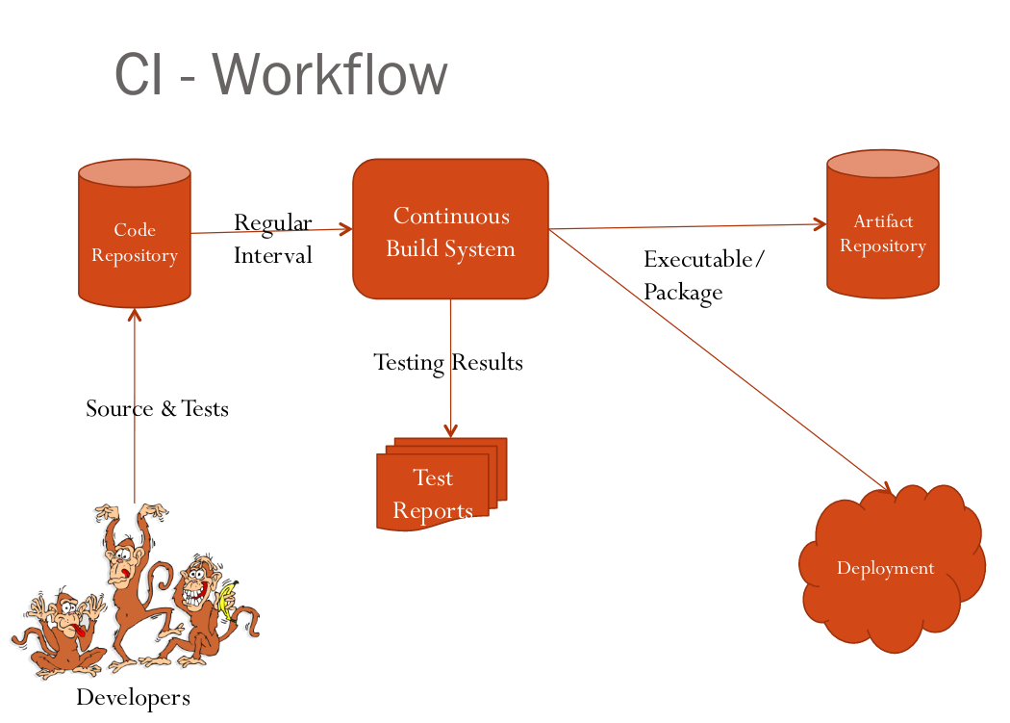
Continuous Integration Workflow
Umesh Worlikar

Slide 5
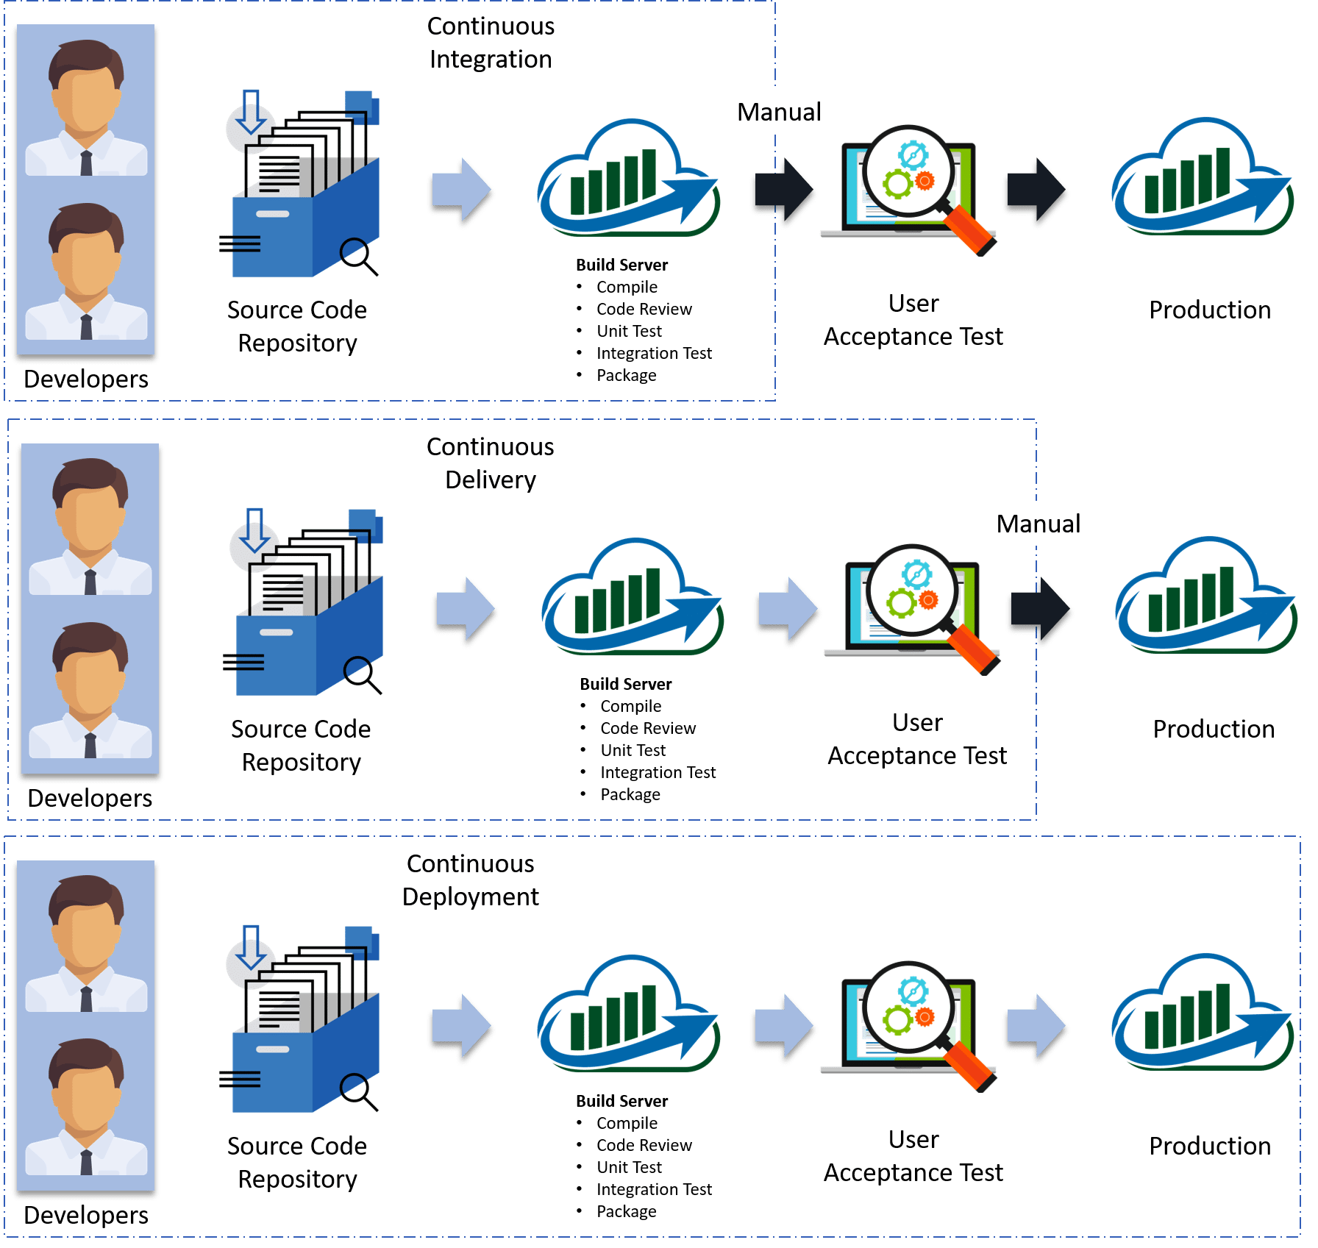
CI- CD Workflow
Umesh Worlikar

Slide 6
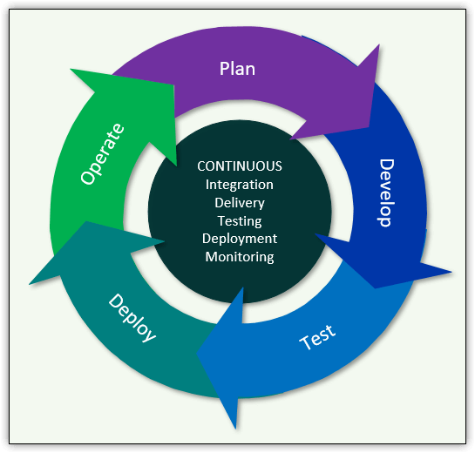
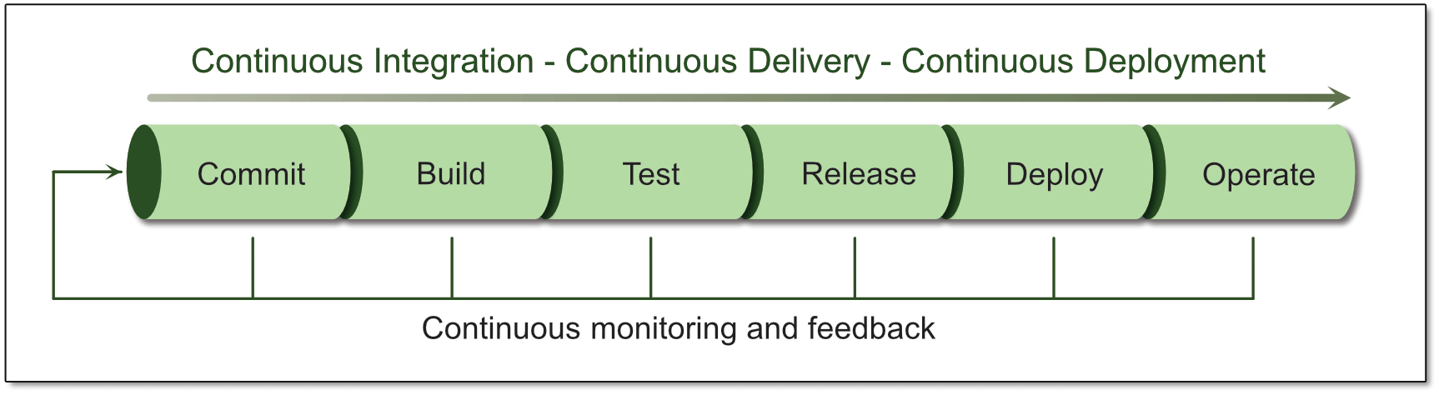
Introduction to Delivery Pipeline
DevOps unifies the application delivery process into a continuous flow that incorporates planning, development, testing, deployment and operations, with the goal of delivering applications more quickly and easily.
Delivery flow and its emphasis on continuous, integrated services.
The DevOps application delivery pipeline
Umesh Worlikar

Slide 7

Introduction of Jenkins
Jenkins - 2005 - Hudson was first release by Kohsuke Kawaguchi of Sun Microsystems 2010 – Oracle bought Sun Microsystems Due to a naming dispute, Hudson was renamed to Jenkins Oracle continued development of Hudson
Jenkins – open source continuous integration server
Jenkins (http://jenkins-ci.org/) is
Easy to install
Easy to use
Multi-technology
Multi-platform
Widely used
Extensible
Free
Umesh Worlikar

Slide 8
Jenkins for a Developer
Easy to install
Download one file – jenkins.war
Run one command – java –jar jenkins.war
Easy to use
Create a new job – checkout and build a small project
Checkin a change – watch it build
Create a test – watch it build and run
Fix a test – checkin and watch it pass
Multi-technology
Build C, Java, C#, Python, Perl, SQL, etc.
Test with Junit, Nunit, MSTest, etc.
Umesh Worlikar

Slide 9
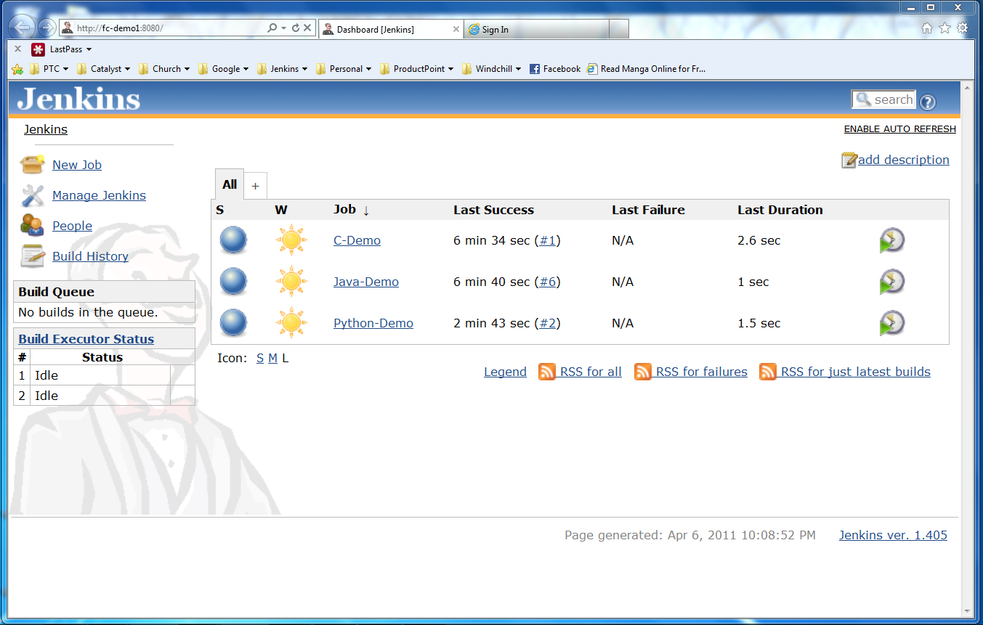
Jenkins User Interface
Actions
Nodes
Jobs
Umesh Worlikar

Slide 10
More Power – Jenkins Plugins
Jenkins has over 300 plugins
Software configuration management
Builders
Test Frameworks
Virtual Machine Controllers
Notifiers
Static Analyzers
Umesh Worlikar

Slide 11
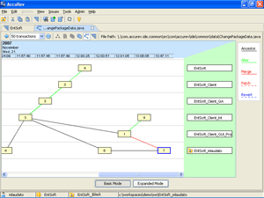

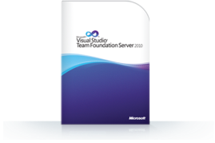
Jenkins Plugins - SCM
Version Control Systems
Accurev
Bazaar
BitKeeper
ClearCase
Darcs
Dimensions
Git
Harvest
MKS Integrity
PVCS
StarTeam
Subversion
Team Foundation Server
Visual SourceSafe
Umesh Worlikar

Slide 12
Jenkins Plugins – Build & Test
Build Tools
Ant
Maven
MSBuild
Cmake
Gradle
Grails
Scons
Groovy
Test Frameworks
Junit
Nunit
MSTest
Selenium
Fitnesse

Slide 13
Jenkins Plugins – Analyzers
Static Analysis
Checkstyle
CodeScanner
DRY
Crap4j
Findbugs
PMD
Fortify
Sonar
FXCop
Code Coverage
Emma
Cobertura
Clover
GCC/GCOV
Umesh Worlikar
Umesh Worlikar

Slide 14
Jenkins Plugins – Other Tools
Notification
Twitter
Campfire
Google Calendar
IM
IRC
Lava Lamp
Sounds
Speak
Authorization
Active Directory
LDAP
Virtual Machines
Amazon EC2
VMWare
VirtualBox
Xen
Libvirt
Umesh Worlikar

Slide 15
Jenkins for Teams
Multi-configuration jobs
Multi-stage jobs
Swarms to dynamically contribute capacity
Umesh Worlikar

Slide 16
Jenkins – Integration for You
Jenkins can help your development be
Faster
Safer
Easier
Smarter
Umesh Worlikar

Slide 17
References
http://jenkins-ci.org/
https://dzone.com/articles/building-a-continuous-delivery-pipeline-using-jenk
https://www.red-gate.com/simple-talk/sysadmin/devops/introduction-to-devops-the-application-delivery-pipeline/
https://www.vogella.com/tutorials/Jenkins/article.html
Umesh Worlikar
Notes:
17

Slide 18
Jenkins for Teams Demo here…
Install and config Jenkins
Adding Slave nodes
Build pipeline job to Jenkins
Umesh Worlikar

Slide 19



Questions?
Umesh Worlikar
Notes:
19

Slide 20
Thanking You!
Umesh Worlikar
Notes:
20

