Slide 1

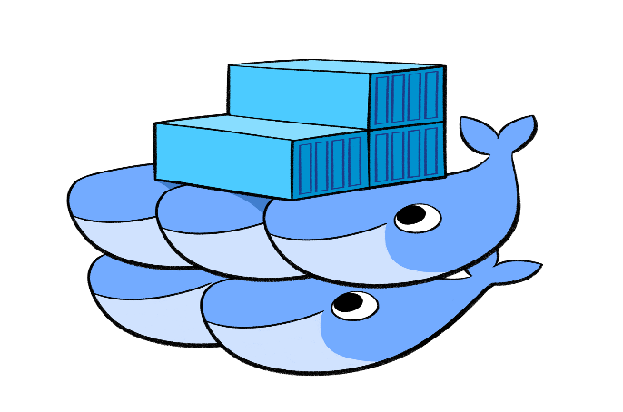


Containers Orchestration
Umesh Worlikar
Notes:
https://github.com/oracle/cloud-native-devops-workshop/blob/master/containers/docker001/Prerequisites.md
https://github.com/oracle/cloud-native-devops-workshop/blob/master/containers/docker001/Participant-Guide.md#verify-docker-engine-hands-on-lab-environment
https://gist.github.com/benarch/fcd3d98eaa7f6abe951d4d4e7b78e6da
https://hub.docker.com/
1

Slide 2
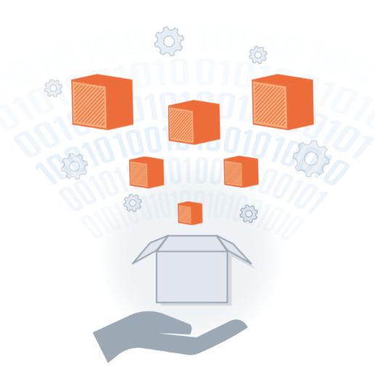
Agenda
1
Introduction YAML
Docker Swarm and Stack
Introduction Kubernetes
Creating Kubernetes cluster
Creating services in Kubernetes
Deploying application using dashboard
1
2
2
3
3
4
4
5
5
6
6
Umesh Worlikar
Notes:
2

Slide 3
Introduction to YAML
"YAML" stands for "Yet Another Markup Language", but it was later changed to the recursive acronym “Yet Ain't Markup Language"
YAML is a data-serialization language.
YAML 1.2 is in compliance with JSON as an official subset, meaning that most JSON documents can be parsed to YAML.
YAML achieves easy inspection of data's structures by using indentation-based scoping (similar to Python).
YAML documents are basically a collection of key-value pairs.
YAML is easily readable by humans.
Umesh Worlikar

Slide 4
YAML Basic Rules
YAML files should end in .yaml.
YAML is case sensitive.
YAML does not allow the use of tabs. Spaces are used instead as tabs are not universally supported.
YAML Basic Data Type
Mappings (hashes / dictionaries)
Sequences (arrays / lists)
Scalars (strings / numbers)
Umesh Worlikar

Slide 5
YAML Example
apiVersion: v1
kind: Service
metadata:
name: redis-master
labels:
app: redis
role: master
tier: backend
spec:
ports:
- port: 6379
targetPort: 6379
selector:
app: redis
role: master
tier: backend
Umesh Worlikar

Slide 6
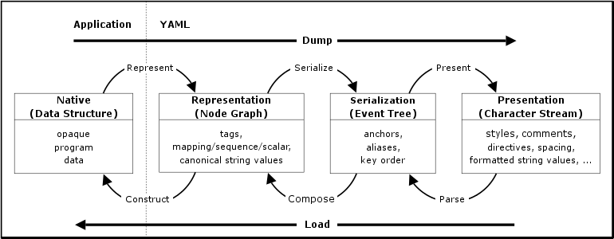
YAML Processing Overview
Umesh Worlikar

Slide 7
Introduction to Docker Swarm
A swarm is a group of docker hosts machines linked together into a cluster.
The swarm cluster consists of a swarm Manager and a set of Workers.
Swarm Managers are the only machines in a swarm that can execute your commands, or authorize other machines to join the swarm as Workers.
Workers are just there to provide capacity and do not have the authority to tell any other machine.
With Swarm, you can deploy and scale your applications to multiple hosts.
Swarm helps with managing, scaling, networking, service discovery, and load balancing between the nodes in the cluster.
Umesh Worlikar

Slide 8
Introduction to Docker Stack
A stack is a group of interrelated services that share dependencies, and can be orchestrated and scaled together.
A single stack is capable of defining and coordinating the functionality of an entire application
With the stack command, the Docker engine takes care of bringing up stacks of containers using docker stack deploy
Umesh Worlikar

Slide 9

What is Kubernets?
Kubernetes - Greek word for Pilot or helm
It runs containers
Service discovery and load balancing
Storage orchestration
Automated rollouts and rollbacks
Automatic bin packing
Self-healing
Secret and configuration management
Umesh Worlikar

Slide 10
What is Kubernets not?
Kubernetes is not a traditional, all-inclusive PaaS (Platform as a Service) system
Kubernetes is not monolithic
Additionally, Kubernetes is not a mere orchestration system.
Does not provide nor adopt any comprehensive machine configuration, maintenance, management, or self-healing systems
Does not dictate logging, monitoring, or alerting solutions
Umesh Worlikar

Slide 11
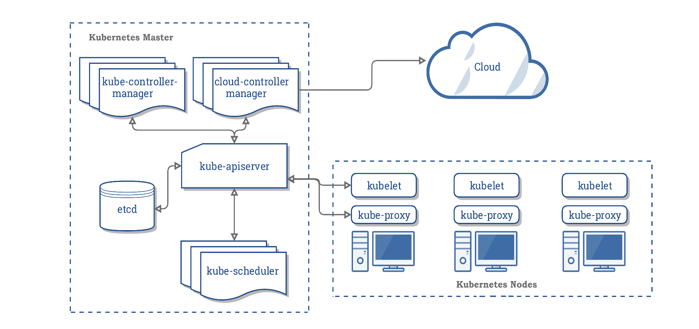
Kubernetes Components
Umesh Worlikar

Slide 12
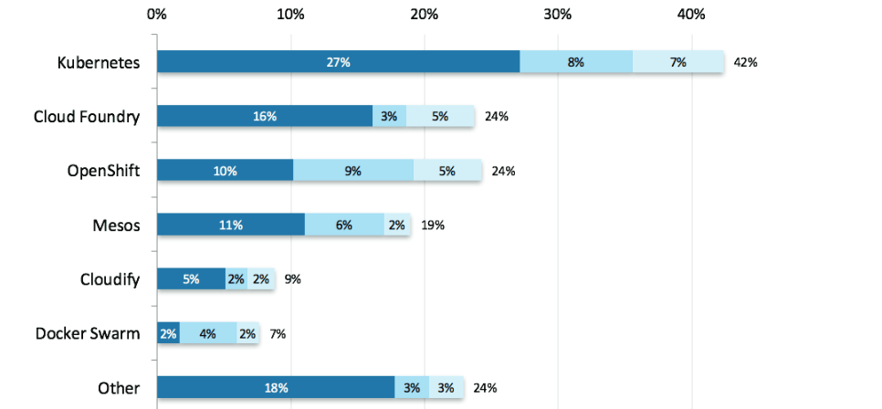
Kubernetes won the container orchestration war...
Source: Shippable.com http://blog.shippable.com/why-the-adoption-of-kubernetes-will-explode-in-2018
Umesh Worlikar

Slide 13



Every cloud supports Kubernetes
Umesh Worlikar

Slide 14
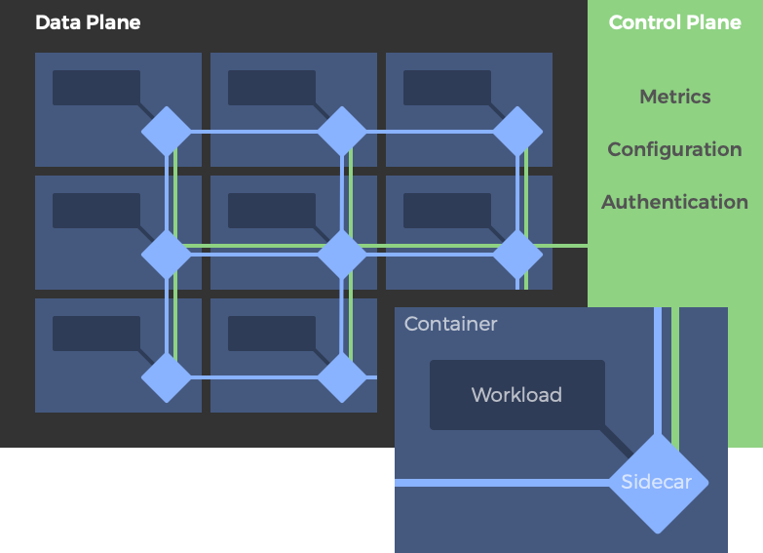
Introduction to Service Mesh
A service mesh is not a “mesh of services.” It is a mesh of API proxies that (micro)services can plug into to completely abstract away the network.
It is a “dedicated” infrastructure layer for making service-to-service communication safe, fast, and reliable.
Service meshes are designed to solve the many challenges developers face when talking to remote endpoints.
A typical service mesh architecture with data plane proxies deployed as sidecars and a separate control plane.
Umesh Worlikar

Slide 15
Istio Service Mesh
Istio is an open source Service Mesh designed to make it easier to connect, manage and secure traffic between, and obtain telemetry about microservices running in containers.
Istio is a collaboration between IBM, Google and Lyft. It was originally announced in May 2017, with a 1.0 version released in July of 2018.
Key Players: Envoy, Linkerd, Istio and Consul
Umesh Worlikar

Slide 16
References
https://kubernetes.io/docs/setup/
https://yaml.org/spec/1.2/spec.html#id2759768
https://kubernetes.io/docs/setup/production-environment/tools/kubeadm/create-cluster-kubeadm/
https://www.mirantis.com/blog/introduction-to-yaml-creating-a-kubernetes-deployment/
https://kubernetes.io/docs/tasks/tools/install-kubectl/#install-kubectl-on-linux
https://console.cloud.google.com/projectselector2/kubernetes/list?organizationId=0&supportedpurview=project
https://glasnostic.com/blog/what-is-a-service-mesh-istio-linkerd-envoy-consul
Umesh Worlikar
Notes:
16

Slide 17
Kubernets Engine on GCP
Creating Kubernetes cluster
Creating service in Kubernetes
Deploying an application using dashboard
Umesh Worlikar

Slide 18



Questions?
Umesh Worlikar
Notes:
18

