Slide 1

Architecture
Module 1
C2000™ Microcontroller Workshop
Copyright © 2019 Texas Instruments. All rights reserved.

Slide 2
Module Objectives
Review the F28004x block diagram and device features
Describe the F28004x bus structure and memory map
Identify the various memory blocks on the F28004x
Identify the peripherals available on the F28004x

Slide 3
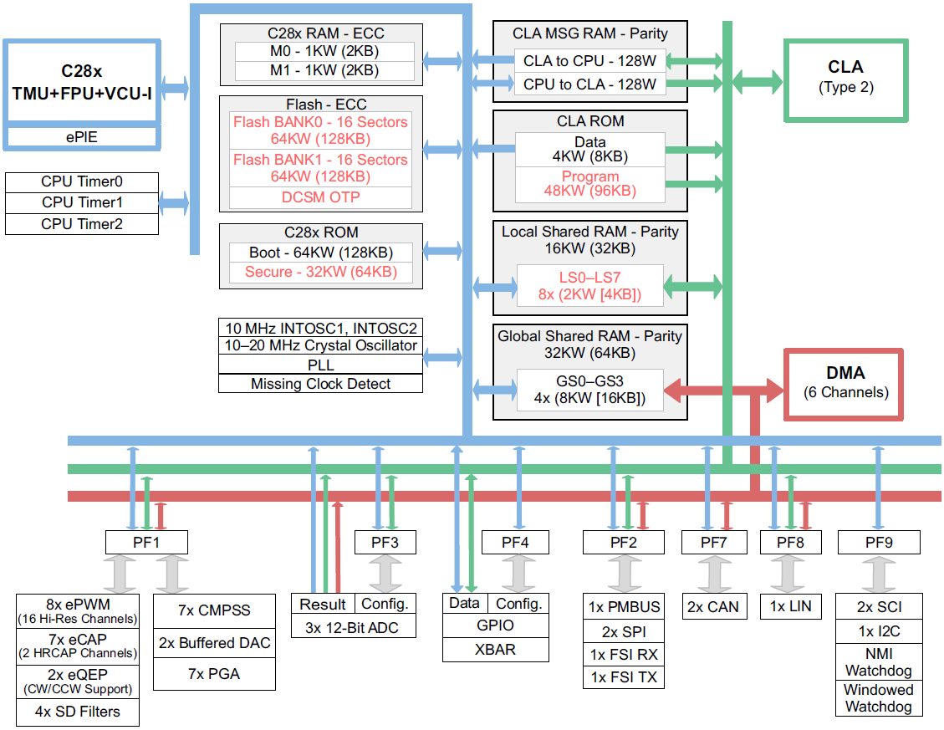
TMS320F28004x Block Diagram

Slide 4
C28x CPU Internal Bus Structure
Program
Program Address Bus (22)
PC
Program-read Data Bus (32)
Decoder
Program
Memory
Data-read Address Bus (32)
Data-read Data Bus (32)
Registers
Execution
Debug
R-M-W
Atomic
ALU
TMU
TR0-TR7
ARAU
MPY32x32
Real-Time
JTAG
Emulation
Data
Memory
SP
VCU
VR0-VR8
DP
@X
ALU
XAR0
to
XAR7
XT
FPU
R0H-R7H
P
CLA
MR0-MR3
ACC
Register Bus / Result Bus
Peripherals
Data/Program-write Data Bus (32)
Data-write Address Bus (32)

Slide 5
C28x CPU + FPU + VCU + TMU and CLA
MCU/DSP balancing code density & execution time
16-bit instructions for improved code density
32-bit instructions for improved execution time
32-bit fixed-point CPU + FPU
32x32 fixed-point MAC, doubles as dual 16x16 MAC
IEEE Single-precision floating point hardware and MAC
Floating-point simplifies software development and boosts performance
Viterbi, Complex Math, CRC Unit (VCU) adds support for Viterbi decode, complex math and CRC operations
Parallel processing Control Law Accelerator (CLA) adds IEEE Single-precision 32-bit floating point math operations
CLA algorithm execution is independent of the main CPU
Trigonometric operations supported by TMU
Fast interrupt service time
Single cycle read-modify-write instructions
Program Bus
CLA Bus
32x32 bit
Multiplier
FPU
R-M-W
Atomic
ALU
TMU
VCU
CLA
PIE
Register Bus
3
32-bit
Timers
CPU
Watchdog
Data Bus

Slide 6
C28x Atomic Read/Modify/Write
Atomic Instructions Benefits
Simpler programming
Smaller, faster code
Uninterruptible (Atomic)
More efficient compiler
LOAD
READ
Registers
CPU
ALU / MPY
Mem
WRITE
STORE
Standard Load/Store
Atomic Read/Modify/Write
DINT
EINT
AND *XAR2,#1234h
MOV AL,*XAR2
AND AL,#1234h
MOV *XAR2,AL
2 words / 1 cycles
6 words / 6 cycles
Note: Example shows non-atomic assembly instructions vs. atomic assembly instruction; Compiler intrinsics can be used for generating the atomic assembly instructions if the user needs guaranteed atomicity at the C level

Slide 7
C28x CPU Pipeline
8-stage pipeline
A
B
C
F₁ F₂ D₁ D₂ R₁ R₂ E
W
F₁ F₂ D₁ D₂ R₁ R₂ E
W
F₁ F₂ D₁ D₂ R₁ R₂ E
W
D
E
F
G
F₁ F₂ D₁ D₂ R₁ R₂ E
W
E & G Access
same address
F₁ F₂ D₁ D₂ R₁ R₂ E
W
F₁ F₂ D₁ D₂ R₁ R₂ E
W
F₁ F₂ D₁ D₂ R₁ R₂ E
R₁ R₂ E W
W
F₁ F₂ D₁ D₂ R₁ R₂ E
W
H
D₂ R₁ R₂ E W
F1: Instruction Address
F2: Instruction Content
D1: Decode Instruction
D2: Resolve Operand Addr
R1: Operand Address
R2: Get Operand
E: CPU doing “real” work
W: store content to memory
Protected Pipeline
Order of results are as written in source code
Programmer need not worry about the pipeline

Slide 8
C28x CPU + FPU + VCU + TMU Pipeline
Fetch
Decode
Read
Exe
Write
F28x Pipeline
F₁ F₂ D₁ D₂ R₁ R₂ E
W
FPU Instruction
D R E₁ E₂/W
VCU / TMU Instruction
D R E₁ E₂/W
Load
Store
0 delay slot instruction
1 delay slot instruction
Floating-point math operations, conversions between integer and floating-point formats, and complex MPY/MAC require 1 delay slot – everything else does not require a delay slot (load, store, max, min, absolute, negative, etc.)
Floating Point Unit, VCU and TMU has an unprotected pipeline
i.e. FPU/VCU/TMU can issue an instruction before previous instruction has written results
Compiler prevents pipeline conflicts
Assembler detects pipeline conflicts
Performance improvement by placing non-conflicting instructions in floating-point pipeline delay slots

Slide 9
Simplified F28004x Memory Map
0x000000
M0 RAM (1Kx16)
0x000400
0x00C000
M1 RAM (1Kx16)
GS0 – GS3 RAM (8Kx16 each)
0x000D00
PIE Vectors
(512x16)
LS0 – LS7 RAM
accessible by
CPU & CLA
0x049000
CAN A MSG RAM (2Kx16)
0x001480
0x04B000
CAN B MSG RAM (2Kx16)
CLA to CPU MSG RAM (128x16)
0x001500
GS0 – GS3 RAM
accessible by
DMA
CPU to CLA MSG RAM (128x16)
0x078000
TI / User OTP (4Kx16)
0x080000
0x008000
FLASH
(128Kx16)
LS0 – LS7 RAM (2Kx16 each)
0x3F8000
Boot ROM (32Kx16)
BROM Vectors (64x16)
0x3FFFC0

Slide 10
Dual Code Security Module
Prevents reverse engineering and protects valuable intellectual property
Z1_CSMPSWD0
Z1_CSMPSWD1
Z1_CSMPSWD2
Z1_CSMPSWD3
Z2_CSMPSWD0
Z2_CSMPSWD1
Z2_CSMPSWD2
Z2_CSMPSWD3
Various on-chip memory resources can be assigned to either zone 1 or zone 2
Each zone has its own password
128-bit user defined password is stored in OTP
128-bits = 2¹²⁸ = 3.4 x 10³⁸ possible passwords
To try 1 password every 8 cycles at 100 MHz, it would take at least 8.6 x 10²³ years to try all possible combinations!

Slide 11
C28x Fast Interrupt Response Manager
192 dedicated PIE vectors
No software decision making required
Direct access to RAM vectors
Auto flags update
Concurrent auto context save
Peripheral Interrupts 12x16 = 192
PIE
Register
Map
PIE module For 192 interrupts
28x CPU Interrupt logic
INT1 to INT12
C28x
CPU
192
12 interrupts
IFR
IER
INTM
Auto Context Save
T ST0
AH AL
PH PL
AR1 (L) AR0 (L)
DP ST1
DBSTAT IER
PC(msw) PC(lsw)

Slide 12
Viterbi / Complex Math Unit (VCU)
Extends C28x instruction set to support:
Viterbi operations
Decode for communications
Complex math
16-bit fixed-point complex FFT
used in spread spectrum communications, and many signal processing algorithms
Complex filters
used to improve data reliability, transmission distance, and power efficiency
Power Line Communications (PLC) and radar applications
Cyclic Redundancy Check (CRC)
Communications and memory robustness checks
Other: OFDM interleaving & de-interleaving, Galois Field arithmetic, AES acceleration
VCU execution registers
VSTATUS
Data path logic for VCU-II Instruction
General instructions
CRC instructions
Arithmetic instructions
Galois Field instructions
Complex FFT instructions
VR0
VR1
VR2
VR3
VSM0 to VSM63
VR4
VR5
VR6
VR7
VR8
VCU Control Logic
VT0
VT1
VCRC

Slide 13
Trigonometric Math Unit (TMU)
y
Adds instructions to FPU for calculating common Trigonometric operations
r
r = sqrt(x² + y²)
rad = atan(y/x)
y = r * sin(rad)
x
x = r * cos(rad)
Operation | Instruction | Exe Cycles | Result Latency | FPU Cycles w/o TMU
Z = Y/X | DIVF32 Rz,Ry,Rx | 1 | 5 | ~24
Y = sqrt(X) | SQRTF32 Ry,Rx | 1 | 5 | ~26
Y = sin(X/2pi) | SINPUF32 Ry,Rx | 1 | 4 | ~33
Y = cos(X/2pi) | COSPUF32 Ry,Rx | 1 | 4 | ~33
Y = atan(X)/2pi | ATANPUF32 Ry,Rx | 1 | 4 | ~53
Instruction To Support ATAN2 Calculation | QUADF32 Rw,Rz,Ry,Rx ATANPUF32 Ra,Rz ADDF32 Rb,Ra,Rw | 3 | 11 | ~90
Y = X * 2pi | MPY2PIF32 Ry,Rx | 1 | 2 | ~4
Y = X * 1/2pi | DIV2PIF32 Ry,Rx | 1 | 2 | ~4
Supported by natural C and C-intrinsics
Significant performance impact on algorithms such as:
• Park / Inverse Park • dq0 Transform & Inverse dq0
• Space Vector GEN • FFT Magnitude & Phase Calculations

Slide 14
Configurable Logic Block (CLB)
Collection of configurable logic tiles
Can be interconnected using software to implement custom digital logic functions
Enhances existing peripherals through a set of crossbar interconnections
Crossbars allow the CLB to be connected to external GPIO pins
Each tile contains the core reconfiguration logic
CPU interface can be used to exchange data with the rest of the device

Slide 15
On-Chip Safety Features
Memory Protection
ECC and parity enabled RAMs, shared RAMs protection
ECC enabled flash memory
Clock Checks
Missing clock detection logic
PLLSLIP detection
NMIWDs
Windowed watchdog
Write Register Protection
LOCK protection on system configuration registers
EALLOW protection
PIE vector address validity check
Annunciation
Single error pin for external signalling of error

Slide 16
Summary
High performance 32-bit CPU
32x32 bit or dual 16x16 bit MAC
IEEE single-precision floating point unit (FPU)
Hardware Control Law Accelerator (CLA)
Viterbi, complex math, CRC unit (VCU)
Trigonometric math unit (TMU)
Atomic read-modify-write instructions
Fast interrupt response manager
128Kw on-chip flash memory
Dual code security module (DCSM)
Control peripherals
Analog peripherals
Direct memory access (DMA)
Shared GPIO pins
Communications peripherals

Slide 17

C2000 Technical Training
www.ti.com/c2000

Slide 18
Notes for F28003x
F28003x does not have VCU, but has only VCRC.
F28003x has FINTDIV (fixed-point division) in FPU.
https://www.ti.com/lit/an/spracn6/spracn6.pdf?ts=1622433172943

Slide 19
Accelerators in F28004x/2x/3x

Slide 20
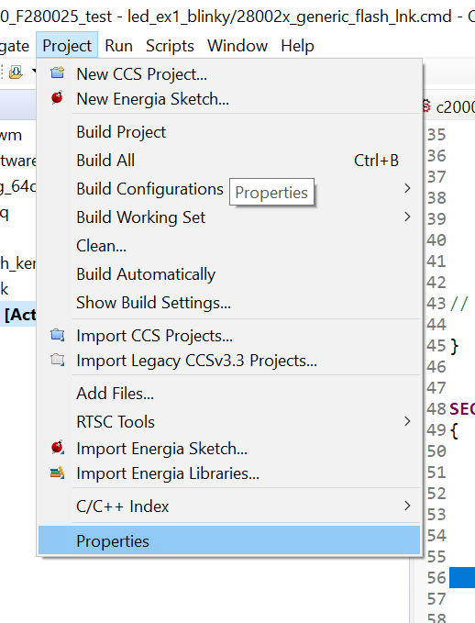
Enable TMU, FINTDIV on CCS – 1/3
To use TMU, FINTDIV on CCS, please follow below steps

Slide 21
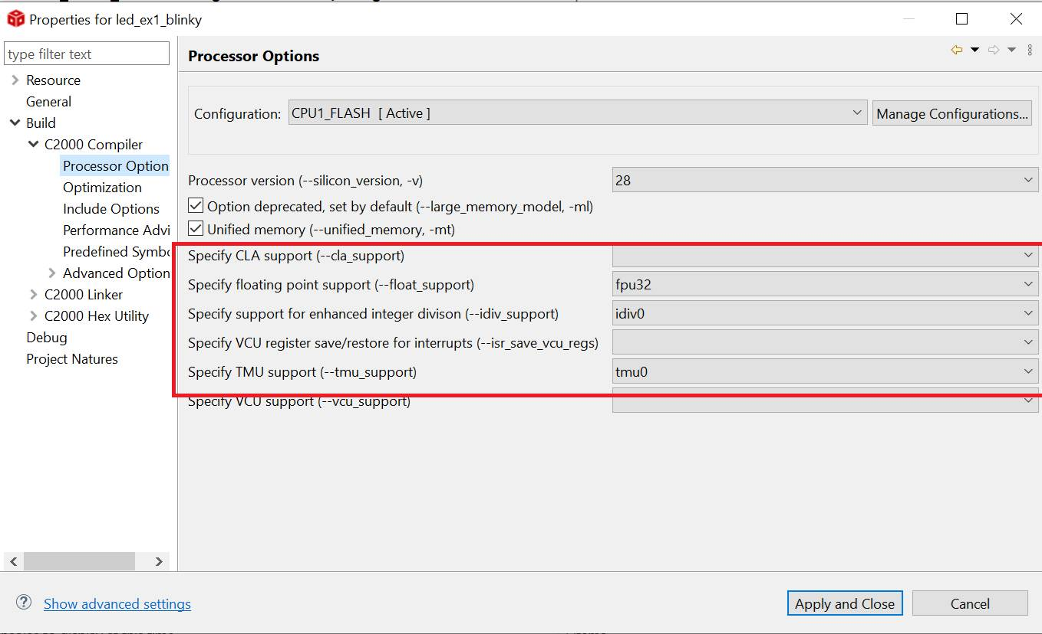
Enable TMU, FINTDIV on CCS – 2/3

Slide 22
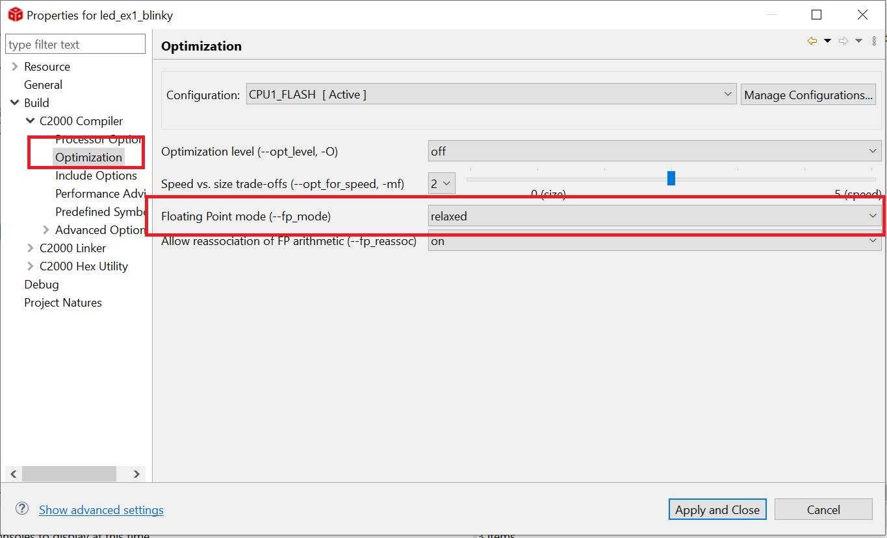
Enable TMU, FINTDIV on CCS – 3/3

