Slide 1

Programming Development Environment
Module 2
C2000™ Microcontroller Workshop
Copyright © 2019 Texas Instruments. All rights reserved.

Slide 2
Module Objectives
Use Code Composer Studio to:
Create a Project
Set Build Options
Create a user linker command file which:
Describes a system’s available memory
Indicates where sections will be placed in memory

Slide 3
Module Objectives
Use Code Composer Studio to:
Create a Project
Set Build Options
Create a user linker command file which:
Describes a system’s available memory
Indicates where sections will be placed in memory

Slide 4
Code Composer Studio
Build
Code
Simulator
Compile
lnk.cmd
Development
Tool
Asm
Link
Debug
Editor
External
Emulator
Libraries
Graphs,
Profiling
MCU
Board
Code Composer Studio includes:
Integrated Edit/Debug GUI
Code Generation Tools
TI-RTOS

Slide 5
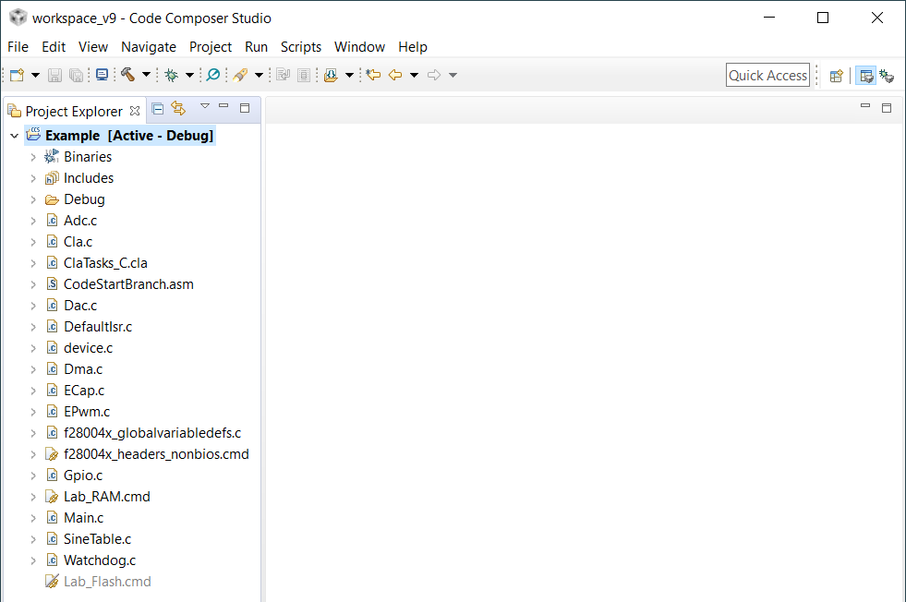
Code Composer Studio: IDE
Integrates: edit, code generation, and debug
Single-click access using buttons
Powerful graphing/profiling tools
Automated tasks using Scripts
Built-in access to RTOS functions
Based on the Eclipse open source software framework

Slide 6
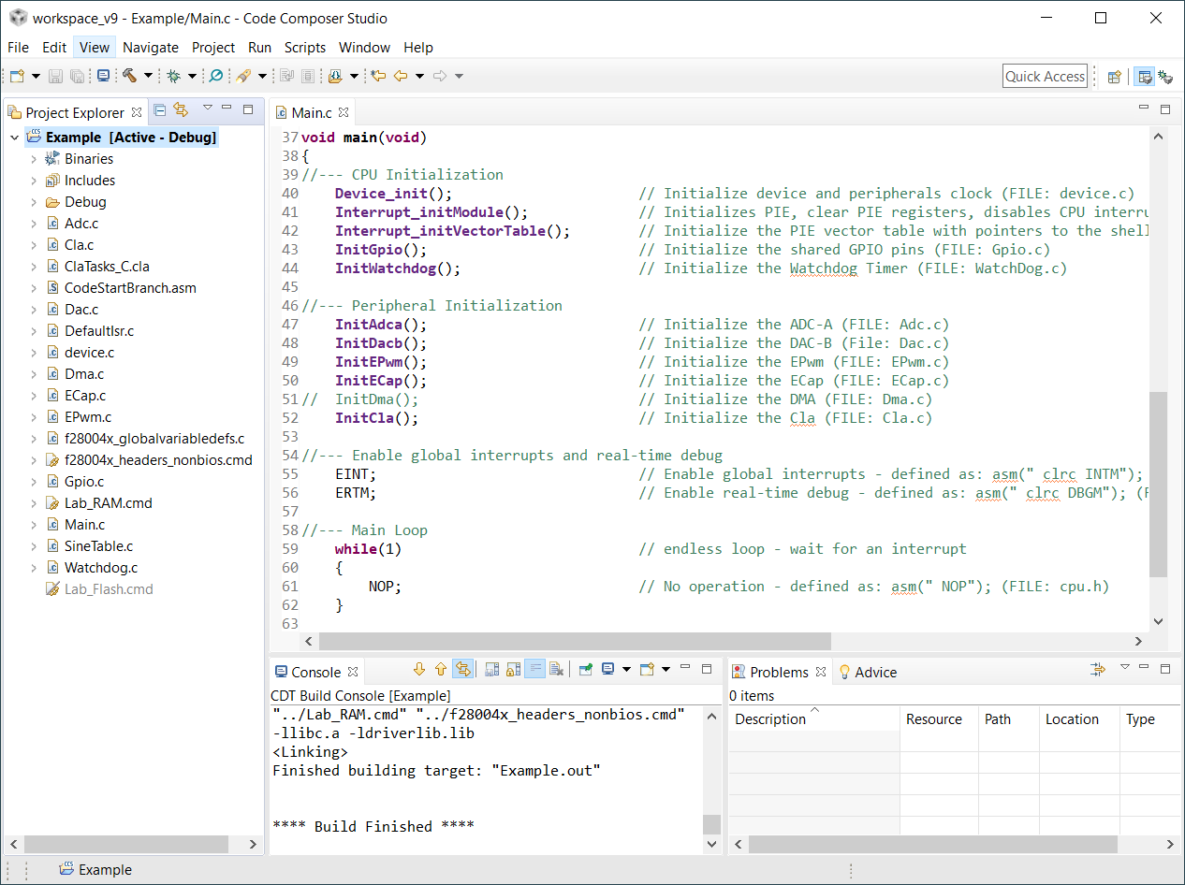
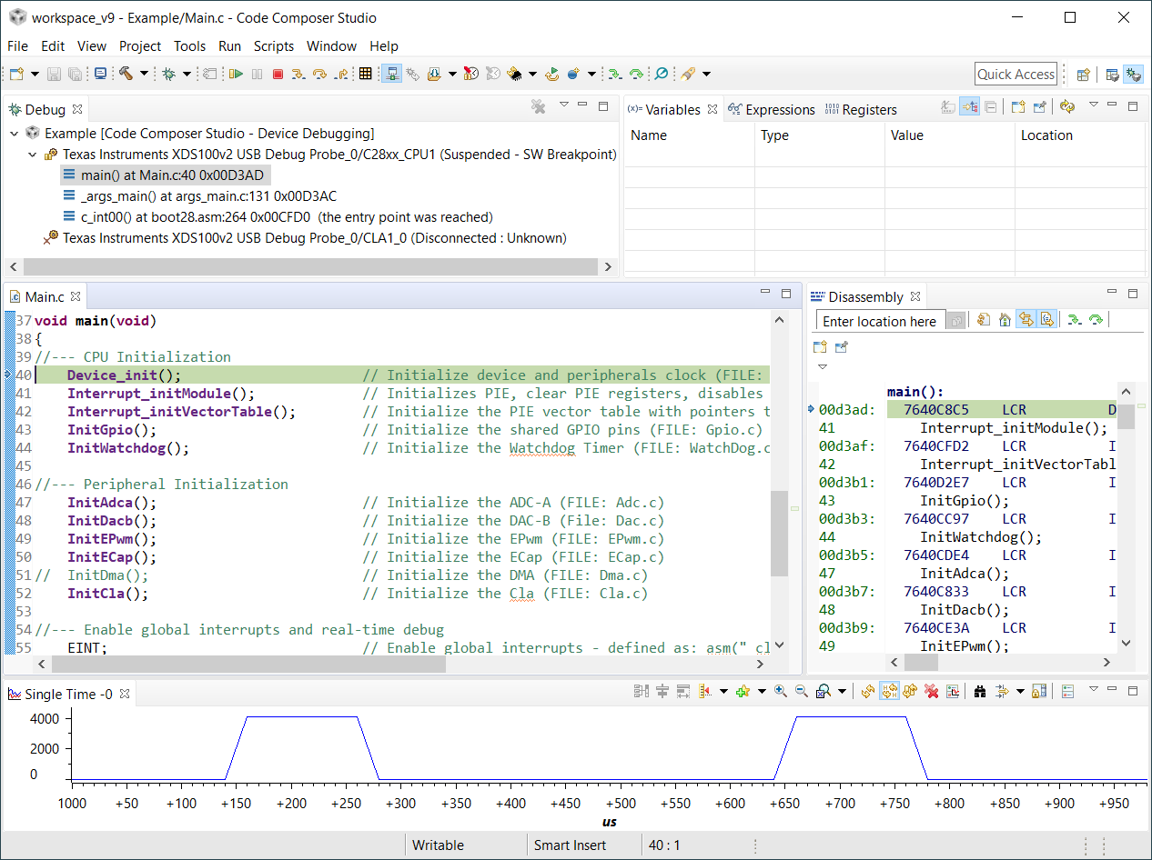
Edit and Debug Perspective (CCSv9)
Each perspective provides a set of functionality aimed at accomplishing a specific task
Edit Perspective
Displays views used during code development
C/C++ project, editor, etc.
Debug Perspective
Displays views used for debugging
Menus and toolbars associated with debugging, watch and memory windows, graphs, etc.

Slide 7
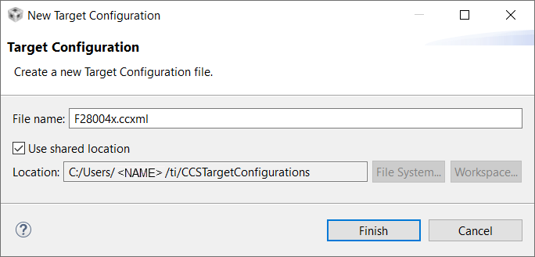
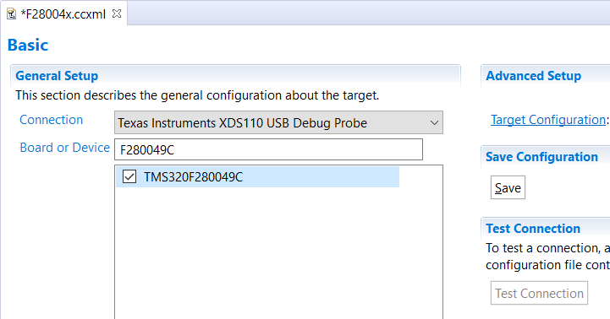
Creating a Target Configuration
File → New → Target Configuration File
Select connection type
Select device
Save configuration

Slide 8
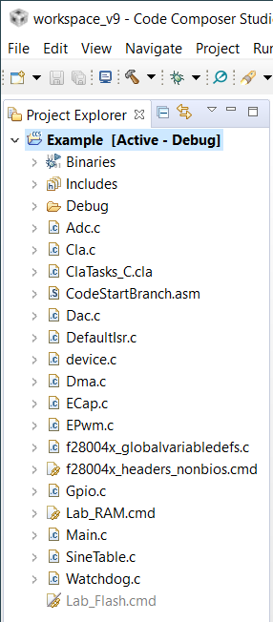
CCSv9 Project
Project files contain:
List of files:
Source (C, assembly)
Libraries
Linker command files
TI-RTOS configuration file
Project settings:
Build options (compiler, assembler, linker, and TI-RTOS)
Build configurations

Slide 9
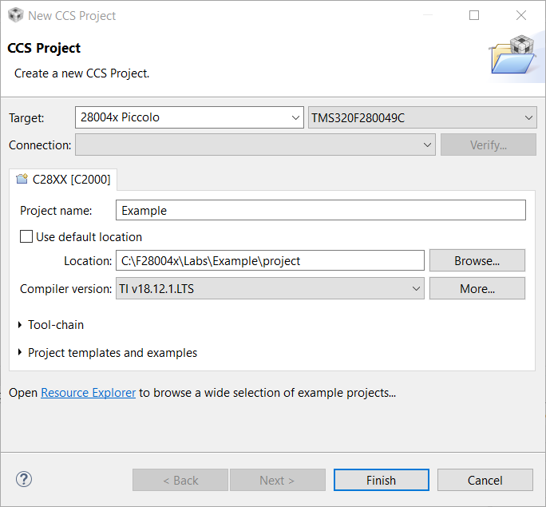
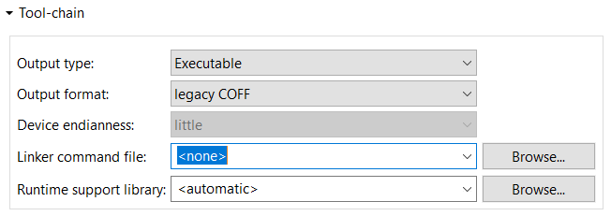
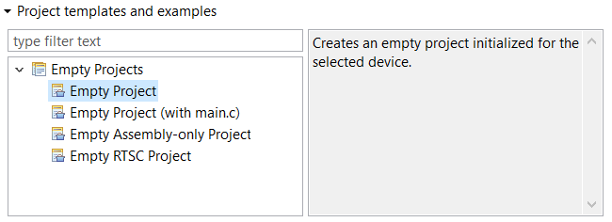
Creating a New CCSv9 Project
1. Project Name, Location, and Device
File → New → CCS Project
2. Tool-chain
3. Project templates and examples

Slide 10
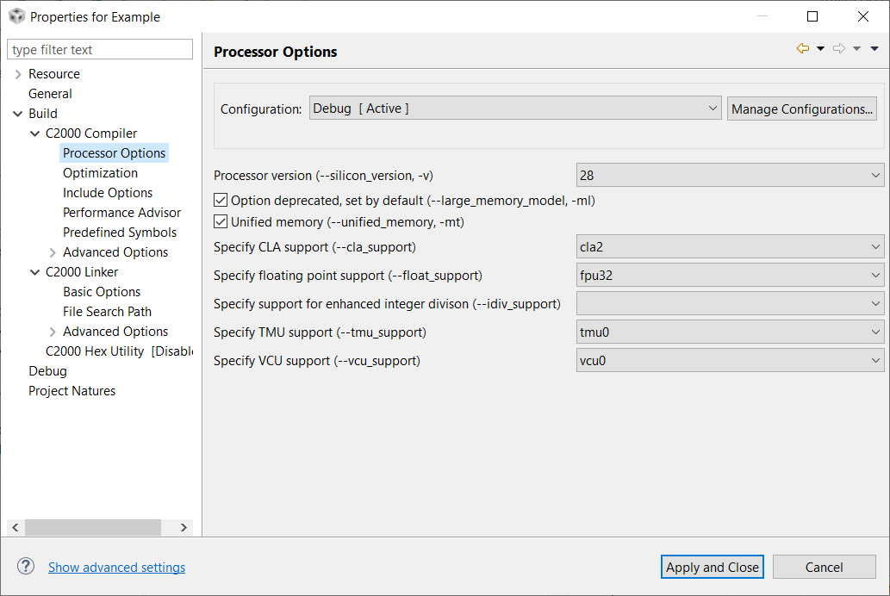
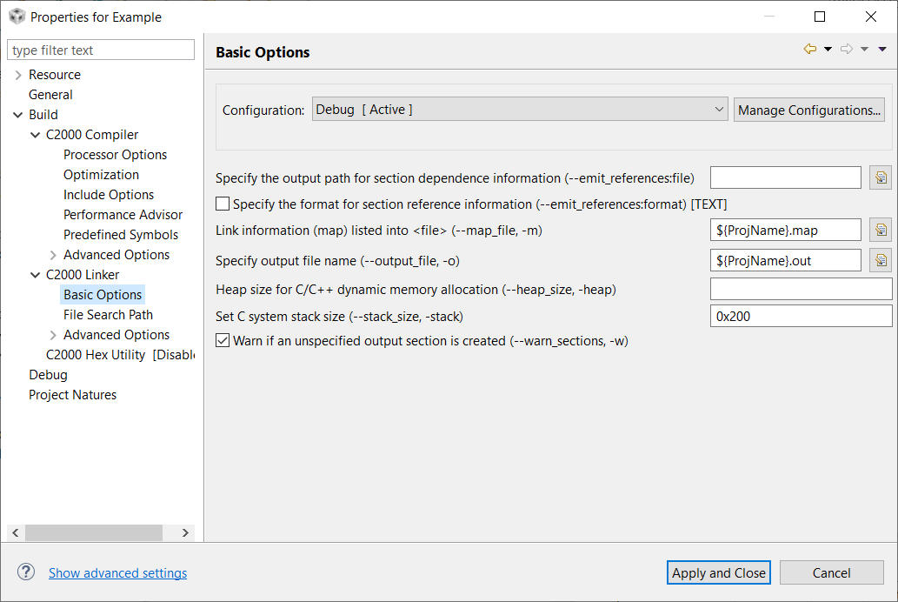
CCSv9 Build Options – Compiler / Linker
Compiler
22 categories for code generation tools
Controls many aspects of the build process, such as:
Optimization level
Target device
Compiler / assembly / link options
Linker
9 categories for linking
Specify various link options
${PROJECT_ROOT} specifies the current project directory

Slide 11
Module Objectives
Use Code Composer Studio to:
Create a Project
Set Build Options
Create a user linker command file which:
Describes a system’s available memory
Indicates where sections will be placed in memory

Slide 12
Sections
Global vars (.ebss)
Init values (.cinit)
All code consists of different parts called sections
All default section names begin with “.”
The compiler has default section names for initialized and uninitialized sections
int x = 2;
int y = 7;
void main(void)
{
long z;
z = x + y;
}
Local vars (.stack)
Code (.text)

Slide 13
Compiler Section Names
Initialized Sections
Name Description Link Location
.text code FLASH
.cinit initialization values for FLASH
global and static variables
.econst constants (e.g. const int k = 3;) FLASH
.switch tables for switch statements FLASH
.pinit tables for global constructors (C++) FLASH
Uninitialized Sections
Name Description Link Location
.ebss global and static variables RAM
.stack stack space low 64Kw RAM
.esysmem memory for far malloc functions RAM
Note: During development initialized sections could be linked to RAM since the emulator can be used to load the RAM

Slide 14
Placing Sections in Memory
Memory
Sections
0x00 0000
RAMM0
(0x400)
.ebss
0x00 0400
RAMM1
(0x400)
.stack
0x08 0000
.cinit
FLASH
(0x40000)
.text

Slide 15
Linking
Memory description
How to place s/w into h/w
Link.cmd
.obj
Linker
.out
.map

Slide 16
Linker Command File
MEMORY
{
PAGE 0: /* Program Memory */
FLASH: origin = 0x080000, length = 0x40000
PAGE 1: /* Data Memory */
RAMM0: origin = 0x000000, length = 0x400
RAMM1: origin = 0x000400, length = 0x400
}
SECTIONS
{
.text:> FLASH PAGE = 0
.ebss:> RAMM0 PAGE = 1
.cinit:> FLASH PAGE = 0
.stack:> RAMM1 PAGE = 1
}

Slide 17
Linker Command File Summary
Memory Map Description
Name
Location
Size
Sections Description
Directs software sections into named memory regions
Allows per-file discrimination
Allows separate load/run locations

Slide 18
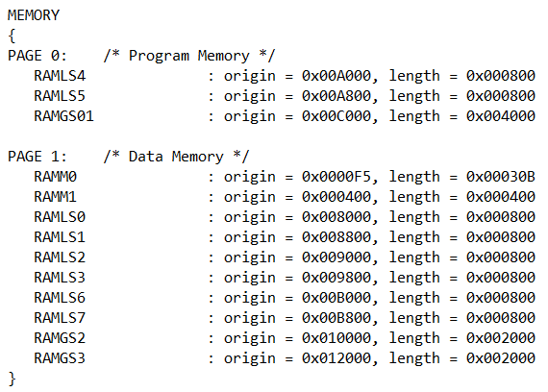
Lab 2: Linker Command File
Memory
on-chip memory
F28004x
System Description:
TMS320F28004x
All internal RAM
blocks allocated
Placement of Sections:
.text into RAM Block RAMGS01 on PAGE 0 (program memory)
.cinit into RAM Block RAMGS01 on PAGE 0 (program memory)
.ebss into RAM Block RAMM0 on PAGE 1 (data memory)
.stack into RAM Block RAMM1 on PAGE 1 (data memory)

Slide 19

C2000 Technical Training
www.ti.com/c2000

