Slide 1

Peripheral Register Programming
Module 3
C2000™ Microcontroller Workshop
Copyright © 2019 Texas Instruments. All rights reserved.

Slide 2
Module Objectives
Review register programming model
Understand the usage of the F28004x Driverlib and associated files
Program an application using Driverlib
Discuss Driverlib optimization

Slide 3
Register Programming Model
Driverlib
C functions automatically set register bit fields
Common tasks and peripheral modes supported
Reduces learning curve and simplifies programming
Bit Field Header Files
C structures – Peripheral Register Header Files
Register access whole or by bits and bit fields are manipulated without masking
Ease-of-use with CCS IDE
Direct
User code (C or assembly) defines and access register addresses
Software
Driverlib
Bit Fields
Hardware Abstraction
Direct
Registers and Addresses
Hardware

Slide 4
Programming Model Comparison
Register addresses # defined individually
User must compute bit-field masks
Not easy-to-read
Direct
*CMPR1 = 0x1234;
Header files define all registers as structures
Bit-fields directly accessible
Easy-to-read
Bit Field Header Files
EPwm1Regs.CMPA.bit.CMPA = EPwm1Regs.TBPRD * duty;
Driverlib performs low-level register manipulation
Easy-to-read
Highest abstraction level
Driverlib
EPWM_setCounterCompareValue(EPWM1_BASE, EPWM_COUNTER_COMPARE_A, duty);
The device support package includes documentation and examples showing how to use the Bit Field Header Files or Driverlib
Device support packages located at: C:\ti\c2000\C2000Ware\device_support\
C:\ti\c2000\C2000Ware\driverlib\
C2000Ware can be downloaded at www.ti.com/tool/c2000ware

Slide 5
Driver Library (Driverlib)
Driverlib “APIs” provide many advantages and benefits:
Require less detailed knowledge of the hardware
Produce code that is easy-to-write and easy-to-read
Generally require less development time
Provide portability across other C2000 devices
Optimize well; remove overhead and speed up code execution
If needed, “direct register access” can be used to create custom Driverlib functions
Requires detailed knowledge of:
Operation of each register and bit field
Interactions and sequencing required for proper peripheral operation
Can result in smaller and more efficient code
Both APIs and direct register access can be used independently or combined

Slide 6

Driverlib File Structure
Software driver (Driverlib API)
Contains source code for drivers
.c files and .h files
Direct register access
Contains peripheral, interrupt, and register access header files
hw_*.h
One per peripheral / memmap device function
Defines all registers and bit fields within the registers for each peripheral
Used by driver API to access a peripheral
Can be used to bypass driverlib API
hw_memmap.h
Defines base address for each peripheral
hw_ints.h
Defines interrupt numbers (used with interrupt.c)
hw_types.h
Defines type definitions

Slide 7
Construction of a Driverlib Function
Driverlib API functions are built on top of the direct register access model
Useful to understand for debugging or when needing to directly access a register or bit field
Uses a similar traditional #define approach
Naming convention used in header files macros:
Values that end in _BASE are module instance base addresses
Values that contain an _O_ are register address offsets
Values that end in _M are mask for multi-bit field register
Values that end in _S are the number of bits to shift
hw_types.h contains the follow macros:
HWREG(x) are 32-bit accesses
HWREGH(x) are 16-bit accesses (or upper/lower 32-bit word)
HWREGB(x) are 8-bit accesses
HWREGBP(x) are used with byte peripherals
where x is the address to be accessed

Slide 8
Driverlib Function Example
user.c – user source file
// Configure EPWM clock prescaler to TBCLK = EPWMCLK
EPWM_setClockPrescaler(EPWM2_BASE, EPWM_CLOCK_DIVIDER_1, EPWM_HSCLOCK_DIVIDER_1);
hw_memmap.h
epwm.h
#define EPWM2_BASE 0x00004100U // EPWM2
Contains typedef enum values for:
EPWM_CLOCK_DIVIDER (_1 = 0)
EPWM_HSCLOCK_DIVIDER (_1 = 0)
epwm.h – EPWM Driver
static inline void EPWM_setClockPrescaler(uint32_t base,
EPWM_ClockDivider prescaler,
EPWM_HSClockDivider highSpeedPrescaler)
{
ASSERT(EPWM_isBaseValid(base));
// write to CLKDIV and HSPCLKDIV bit
HWREGH(base + EPWM_O_TBCTL) =
((HWREGH(base + EPWM_O_TBCTL) &
~(EPWM_TBCTL_CLKDIV_M | EPWM_TBCTL_HSPCLKDIV_M))|
(((uint16_t)prescaler << EPWM_TBCTL_CLKDIV_S) |
((uint16_t)highSpeedPrescaler << EPWM_TBCTL_HSPCLKDIV_S)));
}
hw_epwm.h
Contains #define for all:
EPWM_xxx values in epwm.h
Note: CCS ‘F3’ will open declaration

Slide 9
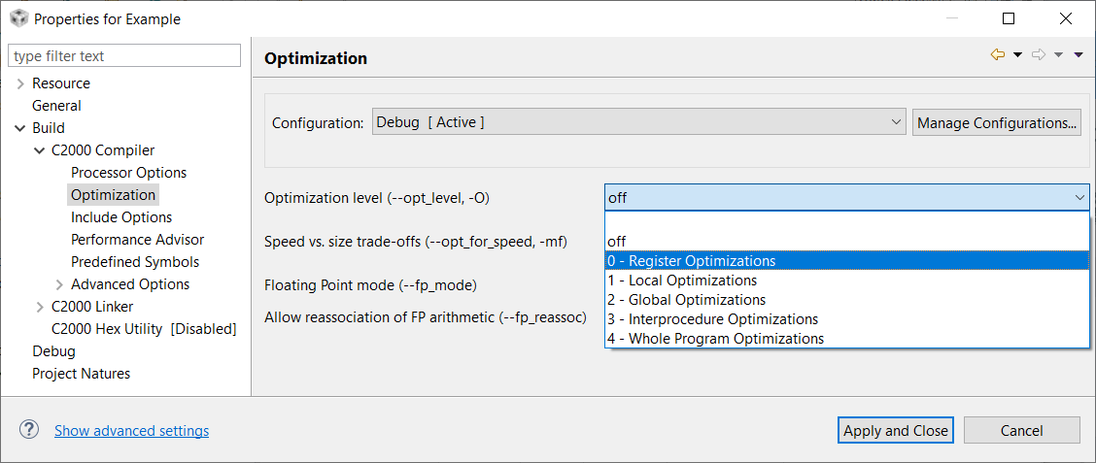
Driverlib Optimization
In general, software abstraction can come at the cost of performance
However, Driverlib’s low-level abstraction and optimization-conscious design makes it efficient
Most functions have been declared as inline functions
Allows the compiler to treat functions like macros when optimizer is turned on
Removes the overhead of function calls and speeds up code execution
Use compiler option --opt_level set to 0 or higher

Slide 10
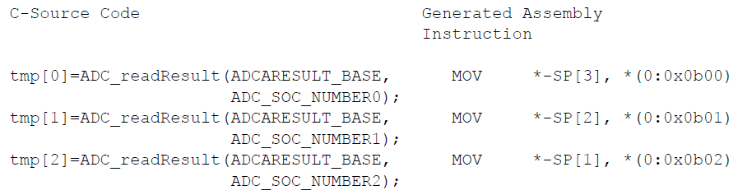
Optimization Example
Read ADC conversion results
Optimization level of -O2
Single MOV instruction is generated for each function call
When compiled with:
Optimization level of -O2
Turn off inlining (--disable_inlining)
Results:
22 words of code
4 words for ADC_readResult() and 18 words for the calling functions
53 cycles to execute

Slide 11
Driverlib API Functions
ADC | DMA | Interrupt
ASysCtl | ECAP | LIN
CAN | EPWM | MemCfg
CLA | EQEP | PGA
CLAPROMCRC | Flash | PMBus
CMPSS | FSI | SCI
CPU Timer | GPIO | SDFM
DAC | HRCAP | SPI
DCC | HRPWM | SysCtrl
DCSM | I2C | X-BAR
See the F28004x Peripheral Driver Library User’s Guide for details

Slide 12
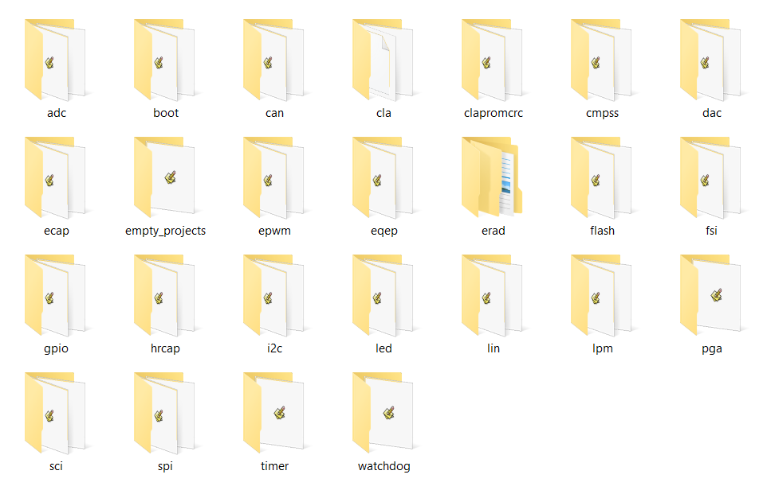
Driverlib Examples
Example projects are helpful for getting started
C:\ti\c2000\C2000Ware_<version>\driverlib\f28004x\examples

Slide 13
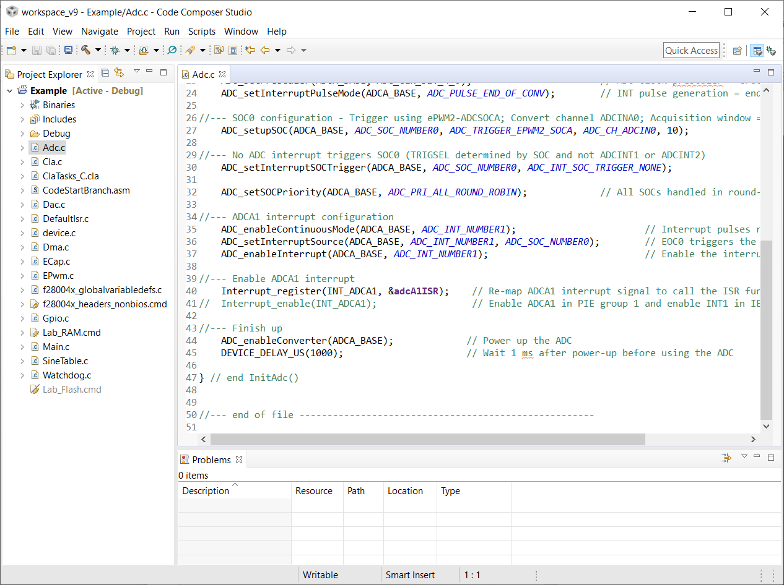
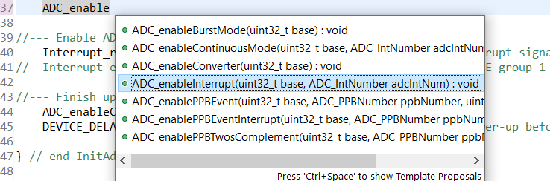
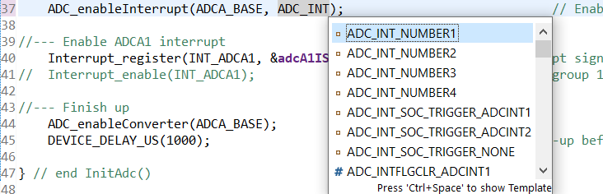
Content Assist
Activate by: Ctrl + Space

Slide 14
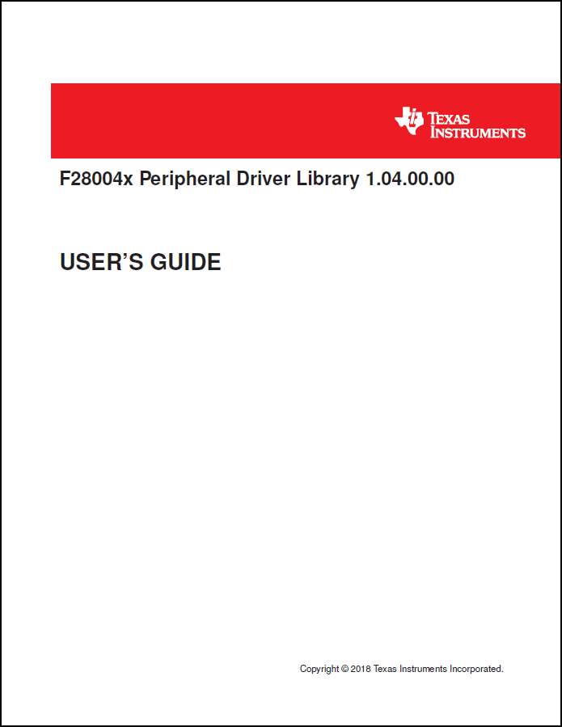
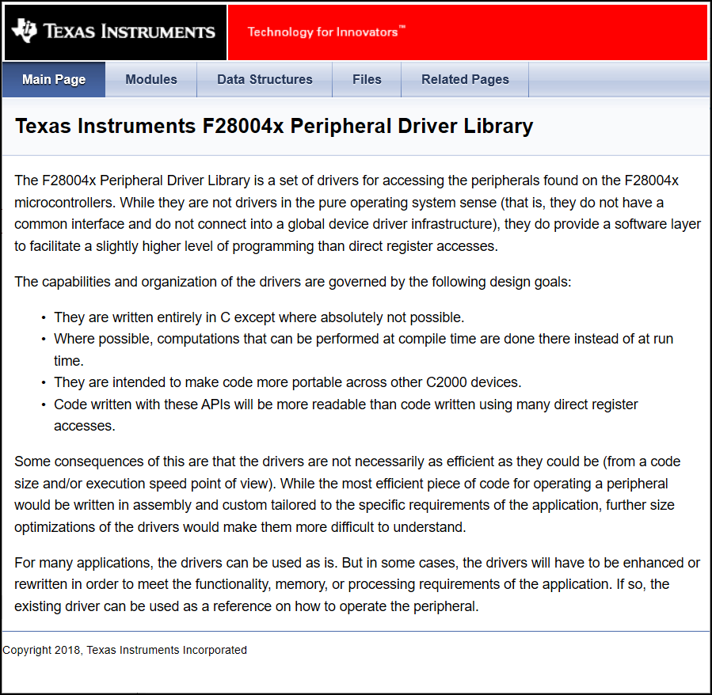
Driverlib Documentation
Available in .pdf or .html formats
C:\ti\c2000\C2000Ware_<version>\device_support\f28004x\docs

Slide 15
Driverlib Summary
Easier code development
Easy to use
Has been written to be optimized well
CCS – hover over function to view description
Compatible with Bit Field Header Files
TI has already done all the work!
Use the correct Driverlib package for your device:
F28004x | F2807x | F2837xS | F2837xD
Go to http://www.ti.com and enter “C2000Ware” in the keyword search box

Slide 16
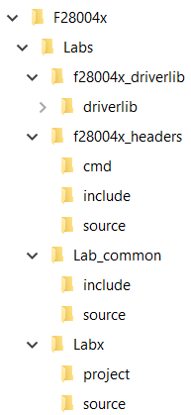
Lab File Directory Structure
Supporting Files
Easier to make projects portable
${PROJECT_ROOT} provides an anchor point for paths to files that travel with the project
Easier to maintain and update supporting files
Project Source Files
All modified files are in the Project Folder
Other Source Files that are “Added” to the Project Folder
Source files for multiple part lab exercises
Note: CCSv9 will automatically add ALL files contained in the folder where the project is created

Slide 17

C2000 Technical Training
www.ti.com/c2000

