Slide 1

Reset and Interrupts
Module 4
C2000™ Microcontroller Workshop
Copyright © 2019 Texas Instruments. All rights reserved.

Slide 2
Module Objectives
Reset Sources
Enhanced Boot Modes
Peripheral Reset
Interrupt Source and Interrupt Structure
Peripheral Interrupt Expansion
Initialize Interrupt Module
Event Sequence of an Interrupt

Slide 3
Reset Sources
Missing Clock Detect
CPU
Watchdog Reset
Power-on Reset
XRS
NMI WD Reset
XRS pin active
To XRS pin
Logic shown is functional representation, not actual implementation
POR – Power-on Reset generates a device reset during power-up conditions
RESC – Reset Cause register contains the cause of the last reset (sticky bits maintain state with multiple resets)
NMI WD Reset – module detects hardware errors and triggers a reset if the CPU does not respond to an error within a user-specified amount of time

Slide 4
Enhanced Boot Modes
The enhanced boot modes provide for the:
Ability to move, reduce, or eliminate boot mode select pins
BOOTPIN-CONFIG register selects boot pins to be used
Emulation Boot Mode: EMU-BOOTPIN-CONFIG register
Stand-Alone Boot Mode: Z1-OTP-BOOTPIN-CONFIG register
BOOTDEF register determines boot mode option and assignment of peripheral GPIO pins or flash/RAM entry point
Emulation Boot Mode: EMU-BOOTDEF-LOW/HIGH register
Stand-Alone Boot Mode: Z1-OTP-BOOTDEF-LOW/HIGH register

Slide 5
Reset – Bootloader
Reset
ENPIE = 0
INTM = 1
Reset vector fetched from boot ROM
0x3F FFC0
YES
Emulator Connected ?
NO
Emulation Boot
Boot determined by
EMU-BOOTPIN-CONFIG
EMU-BOOTDEF-LOW
EMU-BOOTDEF-HIGH
Stand-alone Boot
Boot determined by
GPIO pins
Z1-OTP-BOOTPIN-CONFIG
Z1-OTP-BOOTDEF-LOW
Z1-OTP-BOOTDEF-HIGH
EMU BOOT registers located in PIE RAM starting at 0x000D00
Z1 OTP BOOT registers located in DCSM OTP starting at 0x05F008

Slide 6
Emulation Boot Mode
Emulator Connected
EMU-BOOTPIN-CONFIG Register
Emulation Boot
Boot determined by
EMU-BOOTPIN-CONFIG
31–24
23–16
15–8
7–0
KEY
BMSP2
BMSP1
BMSP0
If the BOOTPIN_CONFIG is invalid, the “wait” boot mode is used. The value can then be modified using the debugger and a reset issued to restart the boot process.
BOOTPIN_CONFIG
Key = 0x5A or 0xA5?
NO
Boot Mode
Wait
YES
BOOTPIN_CONFIG
Key = 0xA5?
BMSP2 | BMSP1 | BMSP0
0xFF | 0xFF | 0xFF
0xFF | 0xFF | GPIO
0xFF | GPIO | 0xFF
GPIO | 0xFF | 0xFF
0xFF | GPIO | GPIO
GPIO | 0xFF | GPIO
GPIO | GPIO | 0xFF
GPIO | GPIO | GPIO
0 BMSP
1 Boot Mode
YES
NO
1 BMSP
2 Boot Modes
(0x5A)
BOOTDEF
EMU-BOOTDEF-LOW
EMU-BOOTDEF-HIGH
Emulate
Stand-alone
Boot Mode
2 BMSP
4 Boot Modes
Reads OTP for boot pins and boot mode.
3 BMSP
8 Boot Modes
0xFF = BMSP field not used
GPIO = use valid GPIO pin (0-254)

Slide 7
Stand-alone Boot Mode
Emulator Not Connected
Z1-OTP-BOOTPIN-CONFIG Register
Stand-alone Boot
Boot determined by
GPIO pins
Z1-OTP-BOOTPIN-CONFIG
31–24
23–16
15–8
7–0
KEY
BMSP2
BMSP1
BMSP0
BMSP1 BMSP0
GPIO24 GPIO32
0 0
0 1
1 0
1 1
Boot Mode
Parallel I/O
SCI / Wait
CAN
Flash
BOOTPIN_CONFIG
Key = 0x5A ?
NO
YES
BMSP2 | BMSP1 | BMSP0
0xFF | 0xFF | 0xFF
0xFF | 0xFF | GPIO
0xFF | GPIO | 0xFF
GPIO | 0xFF | 0xFF
0xFF | GPIO | GPIO
GPIO | 0xFF | GPIO
GPIO | GPIO | 0xFF
GPIO | GPIO | GPIO
0 Pins
1 Boot Mode
1 Pin
2 Boot Modes
BOOTDEF
Z1-OTP-BOOTDEF-LOW
Z1-OTP-BOOTDEF-HIGH
2 Pins
4 Boot Modes
3 Pins
8 Boot Modes
0xFF = pin not used
GPIO = use valid GPIO pin (0-254)

Slide 8
Boot Mode Definition
Provides flexibility to move or eliminate boot select pins
63 - 56
55 - 48
47- 40
39- 32
BOOTDEF-HIGH
BOOT_DEF7
BOOT_DEF6
BOOT_DEF5
BOOT_DEF4
31 - 24
23 - 16
15 - 8
7 - 0
BOOTDEF-LOW
BOOT_DEF3
BOOT_DEF2
BOOT_DEF1
BOOT_DEF0
Parallel I/O
Wait
Options
Mode
Value | D0 – D7 | DSP Ctrl | Host Ctrl
0x00 | GPIO0-7 | GPIO16 | GPIO11
Value | WD Status
0x04 | Enabled
0x24 | Disabled
RAM
SCI
Value | Entry Point
0x05 | 0x0000000
Value | SCIATX | SCIARX
0x01 | GPIO29 | GPIO28
0x21 | GPIO16 | GPIO17
0x41 | GPIO8 | GPIO9
0x61 | GPIO48 | GPIO49
0x81 | GPIO24 | GPIO25
Flash
Value | Boot Mode
0 | Parallel I/O
1 | SCI / Wait
2 | CAN
3 | Flash
4 | Wait
5 | RAM
6 | SPI
7 | I2C
8 | PLC
Value | Entry Point
0x03 | 0x0080000
0x23 | 0x008EFF0
0x43 | 0x0090000
0x63 | 0x009EFF0
I2C
Value | SDAA | SCLAA
0x07 | GPIO32 | GPIO33
0x47 | GPIO26 | GPIO27
0x67 | GPIO42 | GPIO43
SPI
CAN
Value | SPIA_SIMO | SPIA_SOMI | SPIA_CLK | SPIA_STE
0x26 | GPIO8 | GPIO10 | GPIO9 | GPIO11
0x46 | GPIO54 | GPIO55 | GPIO56 | GPIO57
0x66 | GPIO16 | GPIO17 | GPIO56 | GPIO57
0x86 | GPIO8 | GPIO17 | GPIO9 | GPIO11
Value | CANTXA | CANRXA
0x02 | GPIO32 | GPIO33
0x22 | GPIO4 | GPIO5
0x42 | GPIO31 | GPIO30
0x62 | GPIO37 | GPIO35

Slide 9
Reset Code Flow - Summary
0x000000
M0 RAM (1Kw)
0x000000
0x080000
FLASH (128Kw)
0x080000
0x08EFF0
0x090000
0x09EFF0
0x3F8000
Boot ROM (32Kw)
Execution entry
determined by
Emulation Boot Mode or
Stand-Alone Boot Mode
Boot Code
InitBoot
•
•
•
•
BROM vector (64w)
RESET
0x3FFFC0
* reset vector
Bootloading
Routines
(SCI, SPI, I2C,
CAN, Parallel I/O)
* reset vector = 0x3FC7A5

Slide 10
After reset how do we get to main()?
At the code entry point, branch to _c_int00()
Part of compiler run-time support library
Sets up compiler environment
Calls main()
.sect “codestart”
LB _c_int00
CodeStartBranch.asm
MEMORY
{
PAGE 0:
BEGIN_M0 : origin = 0x000000, length = 0x000002
}
SECTIONS
{
codestart : > BEGIN_M0, PAGE = 0
}
Linker .cmd
Note: the above example is for boot mode set to RAMM0; to run out of Flash, the “codestart” section would be linked to the entry point of the Flash memory block

Slide 11
Peripheral Software Reset
Peripheral Software
Reset Signal
Peripheral
SOFTPRESx
Register
Driverlib function used to reset a peripheral:
SysCtl_resetPeripheral(peripheral);
peripheral parameter values:
SYSCTL_PERIPH_RES_CLA1 | SYSCTL_PERIPH_RES_ADCx (x = A to C)
SYSCTL_PERIPH_RES_EPWMx (x = 1 to 8) | SYSCTL_PERIPH_RES_CMPSSx (x = 1 to 7)
SYSCTL_PERIPH_RES_ECAPx (x = 1 to 7) | SYSCTL_PERIPH_RES_PGAx (x = 1 to 7)
SYSCTL_PERIPH_RES_EQEPx (x = 1 or 2) | SYSCTL_PERIPH_RES_DACx (x = A or B)
SYSCTL_PERIPH_RES_SD1 | SYSCTL_PERIPH_RES_FSITXA
SYSCTL_PERIPH_RES_SCIx (x = A or B) | SYSCTL_PERIPH_RES_FSIRXA
SYSCTL_PERIPH_RES_SPIx (x = A or B) | SYSCTL_PERIPH_RES_LINA
SYSCTL_PERIPH_RES_I2CA | SYSCTL_PERIPH_RES_PMBUSA
SYSCTL_PERIPH_RES_CANx (x = A or B)

Slide 12
Interrupt Sources
Timer0
TINT0
NMI
NMI
NMI
LPM Logic
LPMINT
WAKEINT
CPU
Watchdog
WDINT
INPUT4
XINT1
PIE
(Peripheral
Interrupt
Expansion)
INT1
to
INT12
GPIO0
GPIO1
GPIOx
INPUT5
XINT2
Input
X-BAR
INPUT6
●
XINT3
●
INPUT13
XINT4
●
INPUT14
XINT5
Timer1
TINT1
INT13
Peripheral
Interrupts
Timer2
TINT2
INT14

Slide 13
Maskable Interrupt Processing Conceptual Core Overview
Core
Interrupt
Line
(IFR)
Interrupt Flag Register
(IER)
Interrupt Enable Register
(INTM)
Global Interrupt Mask
INT1
1
INT2
0
C28x
CPU
INT14
1
If an interrupt signal is recognized, the corresponding IFR_{Bit} is set and latched
If the IER_{Bit} is set and the INTM is clear, the CPU receives the interrupt
Compiler generates atomic instructions (non-interruptible) for setting/clearing IFR
IFR_{Bit} is cleared when interrupt is acknowledged by CPU
The IFR register is cleared on reset

Slide 14
Interrupt Enable Register (IER)
15
14
13
12
11
10
9
8
RTOSINT
DLOGINT
INT14
INT13
INT12
INT11
INT10
INT9
7
6
5
4
3
2
1
0
INT8
INT7
INT6
INT5
INT4
INT3
INT2
INT1
Enable: Set IER _{Bit} = 1
Disable: Clear IER _{Bit} = 0
Driverlib function used to modify IER:
Interrupt_enableInCPU(cpuInterrupt);
Interrupt_disableInCPU(cpuInterrupt);
cpuInterrupt parameter is a logical OR of the values:
INTERRUPT_CPU_INTx
where x is the interrupt number between 1 and 14
INTERRUPT_CPU_DLOGINT
INTERRUPT_CPU_RTOSINT
IER register is cleared on reset

Slide 15
Interrupt Global Mask Bit
Bit 0
ST1
INTM
INTM is used to globally enable/disable interrupts:
Enable: INTM = 0
Disable: INTM = 1 (reset value)
Driverlib function used to modify INTM:
Interrupt_enableMaster();
Interrupt_disableMaster();
Alternatively the following macros can be used:
EINT; //defined as - asm(" clrc INTM");
DINT; //defined as - asm(" setc INTM");

Slide 16
Peripheral Interrupt Expansion - PIE
PIE module for 192 Interrupts
Interrupt Group 1
PIEIFR1
PIEIER1
INT1.y interrupt group
INT1.1
1
INT2.y interrupt group
INT1.2
0
INT3.y interrupt group
INT1
•
•
INT4.y interrupt group
•
•
•
•
INT5.y interrupt group
INT1.16
1
INT6.y interrupt group
Peripheral Interrupts 12 x 16 = 192
192
INT7.y interrupt group
Core Interrupt logic
INT8.y interrupt group
INT9.y interrupt group
INT1 – INT12
INT10.y interrupt group
C28x
CPU
12 Interrupts
IFR
IER
INTM
INT11.y interrupt group
INT12.y interrupt group
INT13
(TINT1)
INT14
(TINT2)
NMI

Slide 17
F28004x PIE Assignment Table - Lower
INTx.8
INTx.7
INTx.6
INTx.5
INTx.4
INTx.3
INTx.2
INTx.1
INT1
WAKE
(WDOG)
TIMER0
XINT2
XINT1
ADCC1
ADCB1
ADCA1
INT2
EPWM8_
TZ
EPWM7_
TZ
EPWM6_
TZ
EPWM5_
TZ
EPWM4_
TZ
EPWM3_
TZ
EPWM2_
TZ
EPWM1_
TZ
INT3
EPWM8
EPWM7
EPWM6
EPWM5
EPWM4
EPWM3
EPWM2
EPWM1
INT4
ECAP7
ECAP6
ECAP5
ECAP4
ECAP3
ECAP2
ECAP1
INT5
EQEP2
EQEP1
INT6
SPIB_TX
SPIB_RX
SPIA_TX
SPIA_RX
INT7
DMA_CH6
DMA_CH5
DMA_CH4
DMA_CH3
DMA_CH2
DMA_CH1
INT8
I2CA_
FIFO
I2CA
INT9
CANB_1
CANB_0
CANA_1
CANA_0
SCIB_TX
SCIB_RX
SCIA_TX
SCIA_RX
INT10
ADCB4
ADCB3
ADCB2
ADCB_
EVT
ADCA4
ADCA3
ADCA2
ADCA_
EVT
INT11
CLA1_8
CLA1_7
CLA1_6
CLA1_5
CLA1_4
CLA1_3
CLA1_2
CLA1_1
INT12
FPU_UND
ERFLOW
FPU_OV
ERFLOW
XINT5
XINT4
XINT3
Note: above label names proceed with INT_ and #defines are located in driverlib/inc/hw_ints.h

Slide 18
F28004x PIE Assignment Table - Upper
INTx.16
INTx.15
INTx.14
INTx.13
INTx.12
INTx.11
INTx.10
INTx.9
INT1
INT2
INT3
INT4
ECAP7_2
ECAP6_2
INT5
SDFM1
DR4
SDFM1
DR3
SDFM1
DR2
SDFM1
DR1
SDFM1
INT6
INT7
DCC
CLA1PR
OMCRC
FSIRXA_
INT2
FSIRXA_
INT1
FSITXA_
INT2
FSITXA_
INT1
INT8
PMBUSA
LINA_1
LINA_0
INT9
INT10
ADCC4
ADCC3
ADCC2
ADCC_
EVT
INT11
INT12
CLA_UND
ERFLOW
CLA_OV
ERFLOW
SYS_PLL
_SLIP
RAM_ACC
_VIOL
FLASH_CO
RR_ERR
RAM_CO
RR_ERR
Note: above label names proceed with INT_ and #defines are located in driverlib/inc/hw_ints.h

Slide 19
PIEIER and PIEACK Registers
PIEIERx register (x = 1 to 12)
15
14
13
12
11
10
9
8
7
6
5
4
3
2
1
0
INTx.16
INTx.15
INTx.14
INTx.13
INTx.12
INTx.11
INTx.10
INTx.9
INTx.8
INTx.7
INTx.6
INTx.5
INTx.4
INTx.3
INTx.2
INTx.1
PIE Interrupt Acknowledge register (PIEACK)
15 - 12
11
10
9
8
7
6
5
4
3
2
1
0
reserved
PIEACKx
NOTE: These Driverlib functions modify BOTH the PIEIER and core IER registers:
Interrupt_enable(interruptNumber);
Interrupt_disable(interruptNumber);
interruptNumber values are supplied in driverlib/inc/hw_ints.h
Driverlib function used to acknowledge PIE group:
Interrupt_clearACKGroup(group);
group parameter is a logical OR of the values:
INTERRUPT_ACK_GROUPx
where x is the interrupt number between 1 and 12
Acknowledges group and clears any interrupt flag within group
Required to receive further interrupts in PIE group (done in ISR)

Slide 20
Initialize Interrupt Module and PIE Block
Main.c
interrupt.c
// CPU Initialization
Set INTM (disable)
Clear CPU IER
Clear CPU IFR
Clear PIEIER registers
Clear PIEIFR registers
Enable vector fetching from PIE block
•
•
•
Interrupt_initModule();
Interrupt_initVectorTable();
•
•
•
interrupt.c
Memory Map
*** Initialize PIE Vectors ***
Set all vector locations to:
Interrupt_defaultHandler()
Set NMI vector location to:
Interrupt_nmiHandler()
Set ITRAP vector location to:
Interrupt_illegalOperationHandler()
PIE RAM
Vectors
512w
(ENPIE = 1)
Default PIE vectors are then remapped to call user ISR:
Interrupt_register(interruptNumber, &userNameISR);
interruptNumber values located in driverlib/inc/hw_ints.h
Boot ROM
Reset Vector
Note: interrupt.c is located in \driverlib folder

Slide 21
PIE Initialization Code Flow - Summary
RESET
<0x3F FFC0>
Reset Vector
<reset vector> = Boot Code
Boot option determines code execution entry point
CodeStartBranch.asm
.sect “codestart”
M0 RAM Entry Point
<0x00 0000> = LB _c_int00
Flash Entry Point
<0x08 0000> = LB _c_int00
OR
_c_int00:
CALL main()
rts2800_fpu32.lib
•
Interrupt
•
•
PIE Vector Table
512 Word RAM
0x00 0D00 – 0EFF
Main.c
Initialization()
{
Load PIE Vectors
Enable the PIE
Enable PIEIER
Enable CPU IER
Enable INTM
}
main()
{ initialization();
}
DefaultIsr.c
•
•
interrupt void name(void)
{
}
•
•
•
•

Slide 22
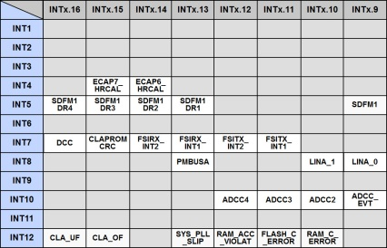
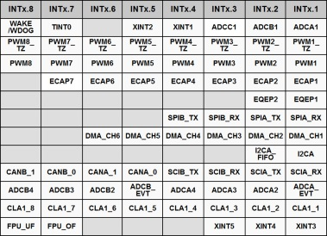
Interrupt Signal Flow – Summary
Peripheral Interrupt Expansion (PIE) – Interrupt Group x
PIEIFRx
PIEIERx
Peripheral
Interrupt
INTx.y
1
Interrupt_enable(interruptNumber);
Core Interrupt Logic
Core
INTx
IFR
IER
INTM
1
EINT;
or: Interrupt_enableMaster();
PIE Vector Table
DefaultIsr.c
interrupt void name(void)
{
}
•
•
•
INTx.y → name
(For peripheral interrupts where x = 1 to 12, and y = 1 to 16)

Slide 23
Interrupt Response - Hardware Sequence
CPU Action Description
Registers → stack 14 Register words auto saved
0 → IFR (bit) Clear corresponding IFR bit
0 → IER (bit) Clear corresponding IER bit
1 → INTM/DBGM Disable global ints/debug events
Vector → PC Loads PC with int vector address
Clear other status bits Clear LOOP, EALLOW, IDLESTAT
Note: some actions occur simultaneously, none are interruptible
T ST0
AH AL
PH PL
AR1 AR0
DP ST1
DBSTAT IER
PC(msw) PC(lsw)

Slide 24
Interrupt Latency
Latency
ext. interrupt occurs here
Internal interrupt occurs here
Assumes ISR in internal RAM
cycles
2
4
3
3
1
3
Sync ext. signal
(ext. interrupt only)
Recognition delay (3), SP alignment (1), interrupt placed in pipeline
Get vector and place in PC (3 reg. pairs saved)
F1/F2/D1 of ISR instruction (3 reg. pairs saved)
Save return address
D2/R1/R2 of ISR instruction
ISR instruction executed on next cycle
Minimum latency (to when real work occurs in the ISR):
Internal interrupts: 14 cycles
External interrupts: 16 cycles
Maximum latency:
Depends on wait states, INTM, etc.

Slide 25

C2000 Technical Training
www.ti.com/c2000

Slide 26
Nesting Interrupt
By default, there is no nesting interrupt in ISR.
The user may use SW to enable nesting interrupt.
See doc in
~C2000Ware\docs\c28x_interrupt_nesting
See examples in
~C2000ware\driverlib\f28003x\examples\interrupt\interrupt_ex3_sw_prioritization.c

Slide 27
Nesting Interrupt 具體說明
硬體的INT優先順序是指，若這些interrupt flag同時被拉起（或是這些flag在pending），會由INTx，x愈小的先執行，也就是先進其ISR。
然而，預設上，一旦進入ISR後，就無法被其它的interrupt中斷，直到這個ISR執行完。
但若要用nesting ISR的話，必須要使用軟體來實現，因為是用軟體的關係，沒有層數的限制。
利用軟體，也可以自由設定使得原本硬體上低的優先權來中斷硬體上高的優先權ISR

Slide 28
若ISR不多，可以直接在該ISR內，選擇那些其它的ISR可以中斷這個ISR，也就是允許其它的ISR可以中斷這個ISR。
// // C28x ISR Code // // Enable nested interrupts // // interrupt
void EPWM1_TZINT_ISR(void)
{
uint16_t TempPIEIER;
TempPIEIER = PieCtrlRegs.PIEIER2.all; // Save PIEIER register for later
IER |= 0x002; // Set global priority by adjusting IER
IER &= 0x002;
PieCtrlRegs.PIEIER2.all &= 0x0002;
// Set group priority by adjusting PIEIER2 to allow INT2.2 to interrupt current ISR
PieCtrlRegs.PIEACK.all = 0xFFFF; // Enable PIE interrupts
asm(" NOP"); // Wait one cycle
EINT; // Clear INTM to enable interrupts
//
// Insert ISR Code here.......
// for now just insert a delay
//
for(i = 1; i <= 10; i++) {}
//
// Restore registers saved:
//
DINT;
PieCtrlRegs.PIEIER2.all = TempPIEIER;
}

Slide 29
若ISR較多，較系統性的寫法，使用TI 的sw_prioritized_isr_levels.h裡面的mask來實現。
首先在你的ISR中，加上下面的blue的部份。
M_INT2, MINT2, MG21要改成你這個ISR的對應的group和M_INTx, MINTx, MGxy
// // C28x ISR Code //
// Enable nested interrupts using masks defined
// in the software prioritization example code //
// Connected to PIEIER2_1 (use MINT2 and MG21 masks) //
interrupt void EPWM1_TZINT_ISR(void) // EPWM1 Trip Zone
{
uint16_t TempPIEIER;
TempPIEIER = PieCtrlRegs.PIEIER2.all;
IER |= M_INT2;
IER &= MINT2; // Set "global" priority
PieCtrlRegs.PIEIER2.all &= MG2_1; // Set "group" priority
PieCtrlRegs.PIEACK.all = 0xFFFF; // Enable PIE interrupts
asm(" NOP"); // Wait one cycle
EINT; // Clear INTM to enable interrupts
//
// Insert ISR Code here.......
// for now just insert a delay
//
for(i = 1; i <= 10; i++) {}
//
// Restore registers saved:
//
DINT;
PieCtrlRegs.PIEIER2.all = TempPIEIER;
}

Slide 30
再一個例子，以driverlib為例 ~C2000ware\driverlib\f28003x\examples\interrupt\interrupt_ex3_sw_prioritization.c
__interrupt void
cpuTimer0ISR(void)
{
// Save IER register on stack
volatile uint16_t tempPIEIER = HWREGH(PIECTRL_BASE + PIE_O_IER1);
// Set the global and group priority to allow CPU interrupts with higher priority
IER |= M_INT1;
IER &= MINT1;
HWREGH(PIECTRL_BASE + PIE_O_IER1) &= MG1_7;
// Enable Interrupts
Interrupt_clearACKGroup(0xFFFFU);
__asm(" NOP");
EINT;
// Insert ISR code here
cpuTimer0IntCount++;
// Disable interrupts and restore registers saved:
DINT;
HWREGH(PIECTRL_BASE + PIE_O_IER1) = tempPIEIER;
}

Slide 31
注意的是，Timer1/2 ISR trigger 直接進入CPU，並不需要用PIE。因此，不需處理PIEIER
__interrupt void
cpuTimer1ISR(void)
{
// Set the global priority to allow CPU interrupts with higher priority
IER &= MINT13;
EINT;
// Insert ISR code here
cpuTimer1IntCount++;
// Disable Interrupts
DINT;
}

Slide 32
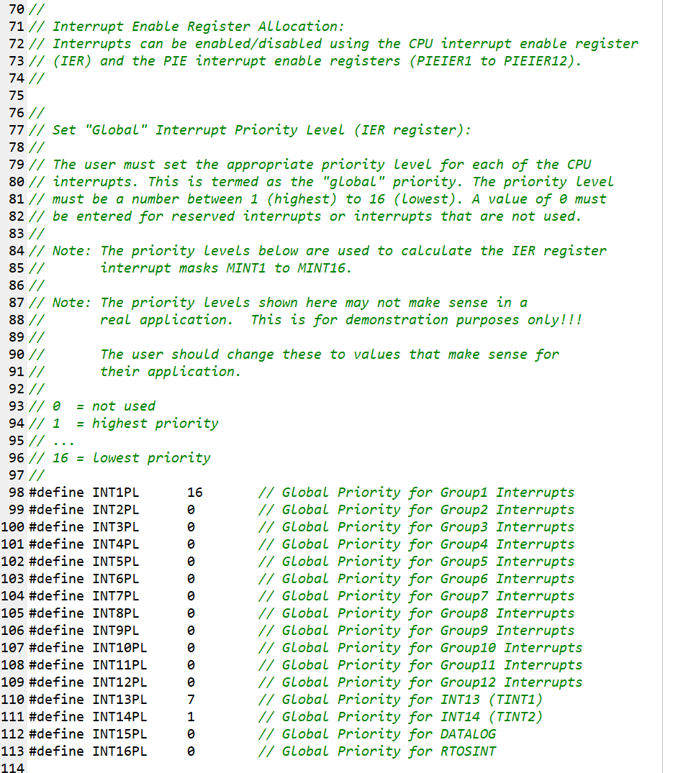
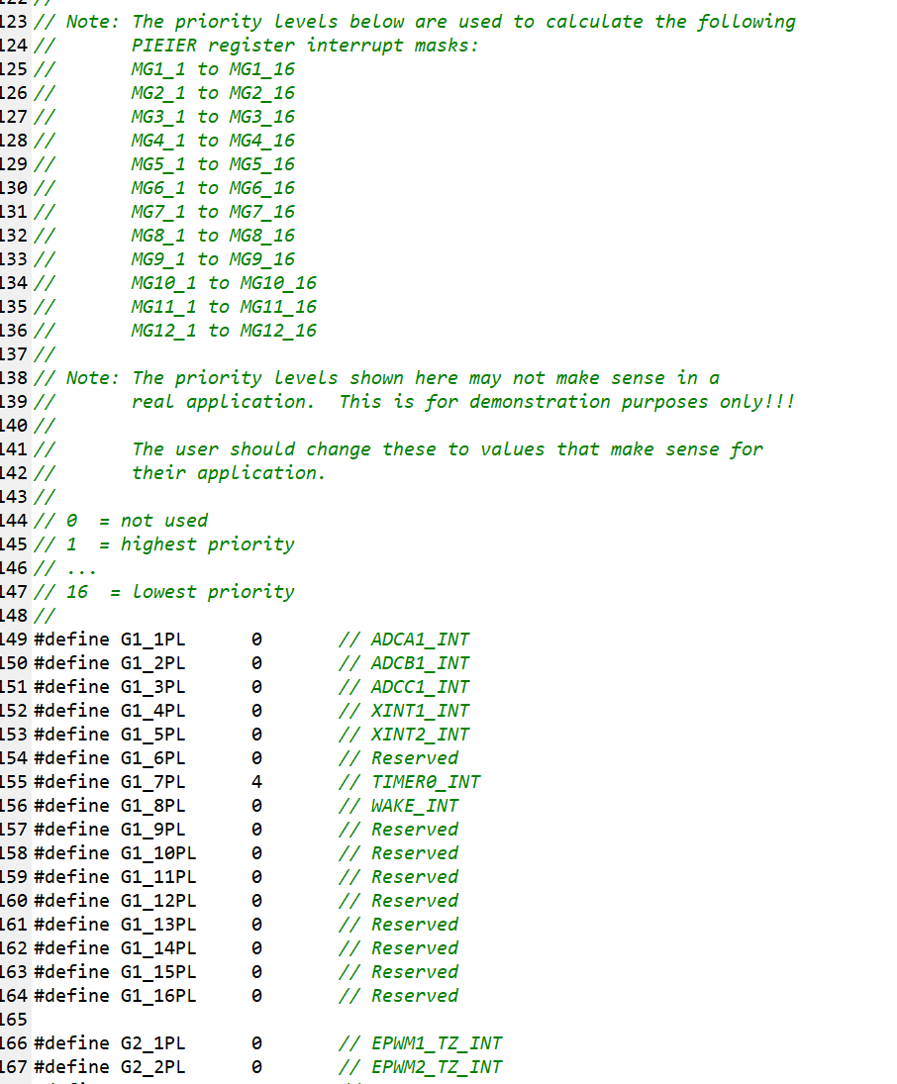
然後，你需要在下面的.h，改優先順序
~C2000ware\driverlib\f28003x\examples\interrupt\sw_prioritized_isr_levels.h
0是不使用，數字愈小，優先權愈高。

