Slide 1

System Initialization
Module 5
C2000™ Microcontroller Workshop
Copyright © 2019 Texas Instruments. All rights reserved.

Slide 2
Module Objectives
OSC/PLL Clock Module
Watchdog Timer
General Purpose I/O
External Interrupts
Low Power Modes
Register Protection

Slide 3
Module Objectives
OSC/PLL Clock Module
Watchdog Timer
General Purpose I/O
External Interrupts
Low Power Modes
Register Protection

Slide 4
Oscillator / PLL Clock Module
Internal
OSC 1
(10 MHz)
OSC1CLK
WDCLK
CLKSRCCTL1
SYSPLLCTL1
Internal
OSC 2
(10 MHz)
OSC2CLK
1x
00*
01
OSCCLK
SYSCLKDIVSEL
(PLL bypass)
0*
MUX
1/n
PLLSYSCLK
XCLKIN
(X2 n.c.)
X1
PLL
PLLCLK
1
XTAL
XTAL OSC
XTAL
SYSPLLMULT
SYSCLK
CPU
X2
CPUCLK
One per SYSCLK peripheral
PCLKCRx
PERxSYSCLK
One per LSPCLK peripheral
PCLKCRx
PERxLSPCLK
LOSPCP
LSPCLK
One per CAN module
CLKSRCCTL2
0*
1
CAN bit Clock
* default

Slide 5
PLL and LOSPCP
INTOSC1
INTOSC2
XTAL
1x
00*
01
OSCCLK
(PLL bypass)
0*
1/n
PLLSYSCLK
CPU
SYSCLK
PLL
PLLCLK
1
LOSPCP
LSPCLK
SYSCTL_PLL_ENABLE
SYSCTL_PLL_DISABLE
SYSCTL_OSCSRC_OSC1
SYSCTL_OSCSRC_OSC2
SYSCTL_OSCSRC_XTAL
SYSCTL_SYSDIV(x)
where x is either 1 or an even value up to 126
SYSCTL_FMULT_0
SYSCTL_FMULT_1_4
SYSCTL_FMULT_1_2
SYSCTL_FMULT_3_4
SYSCTL_IMULT(x)
where x is a value from 1 to 127
SYSCTL_LSPCLK_PRESCALE_x
where x is 1, 2, 4, 6, 8, 10, 12, 14
SysCtl_setClock(config);
SysCtl_setLowSpeedClock( );
The config parameter is the OR of several different values, many of which are grouped into sets where only one can be chosen
LSPCLK = SYSCLK / 4 (default)

Slide 6
Initializing Clock Modules
Main.c
device.c
// CPU Initialization
void Device_init(void)
{
// Set up PLL control and clock dividers
SysCtl_setClock(DEVICE_SETCLOCK_CFG)
SysCtl_setLowSpeedClock(SYSCTL_LSPCLK_PRESCALE_4);
// Turn on all peripherals
Device_enableAllPeripherals()
}
void Device_enableAllPeripherals(void
{
SysCtl_enablePeripheral(SYSCTL_PERIPH_CLK_<name>);
}
Device_init();
•
•
•
;
sysctl.h
Contains values that can be passed to:
SysCtl_setClock()
SysCtl_setLowSpeedClock()
SysCtl_enablePeripheral()
;
)
•
•
•
•
•
•
device.h
100 MHz SYSCLK frequency based on DEVICE_SETCLOCK_CFG
PLLSYSCLK = 20MHz (XTAL_OSC) * 10 (IMULT) * 1 (FMULT) / 2 (PLLCLK_BY_2)
#define DEVICE_SETCLOCK_CFG (SYSCTL_OSCSRC_XTAL |
SYSCTL_IMULT(10) |
SYSCTL_FMULT_NONE |
SYSCTL_SYSDIV(2) |
SYSCTL_PLL_ENABLE)

Slide 7
Peripheral Clock Enable / Disable
SYSCLK
Peripheral
PCLKCRx
Register
Driverlib function used to enable / disable peripheral:
SysCtl_[enable|disable]Peripheral(peripheral);
peripheral parameter values:
SYSCTL_PERIPH_CLK_CLA1 | SYSCTL_PERIPH_CLK_ADCx (x = A to C)
SYSCTL_PERIPH_CLK_EPWMx (x = 1 to 8) | SYSCTL_PERIPH_CLK_CMPSSx (x = 1 to 7)
SYSCTL_PERIPH_CLK_ECAPx (x = 1 to 7) | SYSCTL_PERIPH_CLK_PGAx (x = 1 to 7)
SYSCTL_PERIPH_CLK_EQEPx (x = 1 or 2) | SYSCTL_PERIPH_CLK_DACx (x = A or B)
SYSCTL_PERIPH_CLK_SD1 | SYSCTL_PERIPH_CLK_FSITXA
SYSCTL_PERIPH_CLK_SCIx (x = A or B) | SYSCTL_PERIPH_CLK_FSIRXA
SYSCTL_PERIPH_CLK_SPIx (x = A or B) | SYSCTL_PERIPH_CLK_LINA
SYSCTL_PERIPH_CLK_I2CA | SYSCTL_PERIPH_CLK_PMBUSA
SYSCTL_PERIPH_CLK_CANx (x = A or B) | SYSCTL_PERIPH_CLK_DCC0

Slide 8
Module Objectives
OSC/PLL Clock Module
Watchdog Timer
General Purpose I/O
External Interrupts
Low Power Modes
Register Protection

Slide 9
Watchdog Timer
Resets the device if the CPU crashes
Watchdog counter runs independently of CPU
If counter overflows, a reset or interrupt is triggered (user selectable)
CPU must write correct data key sequence to reset the counter before overflow
Watchdog must be serviced or disabled within 131,072 WDCLK cycles after reset
This translates to 13.11 ms with a 10 MHz WDCLK

Slide 10
Watchdog Timer Module
WDPRECLKDIV
WDPS
WDOVERRIDE
WDCLK
Watchdog
Pre-divider
Watchdog
Pre-scaler
WDDIS
WDCNTR
8-bit Watchdog
Counter
CLR
CNT
System
Reset
WDRST
Output
Pulse
WDWCR
WDCNTR less than WDWCR
WDINT
55 + AA
Detector
window minimum
Good Key
Watchdog
Reset Key
Register
WDCHK
3
/
/
Bad WDCHK Key
WDKEY
3
1 0 1

Slide 11
Watchdog Pre-divider and Pre-scaler
WDPRECLKDIV
WDPS
WDCLK
Watchdog
Pre-divider
Watchdog
Pre-scaler
SysCtl_setWatchdogPredivider(SYSCTL_WD_PREDIV_x);
where x is 2, 4, 8, 16, 32, 64, 128, 256, 512, 1024, 2048, or 4096
default = 512 (providing backwards compatibility)
SysCtl_setWatchdogPrescaler(SYSCTL_WD_PRESCALE_x);
where x is 1, 2, 4, 8, 16, 32, or 64
default = 1
Remember: Watchdog starts counting immediately after reset is released!
Reset default with WDCLK = 10 MHz computed as
(1/10 MHz) * 512 * 1 * 256 = 13.11 ms

Slide 12
Watchdog Driverlib Functions
WDDIS – disable / enable
Functions only if WDOVERRIDE is not cleared
SysCtl_disableWatchdog();
SysCtl_enableWatchdog();
WDOVERRIDE (clear only to protect – reset device to disable)
SysCtl_clearWatchdogOverride();
Watchdog Mode – reset / interrupt
SysCtl_setWatchdogMode(mode);
mode parameter values:
SYSCTL_WD_MODE_RESET
SYSCTL_WD_MODE_INTERRUPT
Watchdog Minimum Window
SysCtl_setWatchdogWindowValue(value);
value parameter sets a minimum delay between counter resets (0 = disabled)

Slide 13
Resetting the Watchdog
Driverlib functions:
SysCtl_serviceWatchdog(); // resets the watchdog
SysCtl_enableWatchdogReset(); // writes 0x55 WDKEY
SysCtl_resetWatchdog(); // writes 0xAA WDKEY
WDKEY write values:
0x55 - counter enabled for reset on next 0xAA write
0xAA - counter set to zero if reset enabled
Writing any other value has no effect
Watchdog should not be serviced solely in an ISR
If main code crashes, but interrupt continues to execute, the watchdog will not catch the crash
Could put the 0x55 WDKEY in the main code, and the 0xAA WDKEY in an ISR; this catches main code crashes and also ISR crashes

Slide 14
WDKEY Write Results
Sequential
Step
1
2
3
4
5
6
7
8
9
10
11
12
13
14
Value Written
to WDKEY
0xAA
0xAA
0x55
0x55
0x55
0xAA
0xAA
0x55
0xAA
0x55
0x23
0xAA
0x55
0xAA
Result
No action
No action
WD counter enabled for reset on next AAh write
WD counter enabled for reset on next AAh write
WD counter enabled for reset on next AAh write
WD counter is reset
No action
WD counter enabled for reset on next AAh write
WD counter is reset
WD counter enabled for reset on next AAh write
No effect; WD counter not reset on next AAh write
No action due to previous invalid value
WD counter enabled for reset on next AAh write
WD counter is reset

Slide 15
Module Objectives
OSC/PLL Clock Module
Watchdog Timer
General Purpose I/O
External Interrupts
Low Power Modes
Register Protection

Slide 16
GPIO Grouping Overview
GPIO Port A Group
Mux1 Register
(GPAGMUX1)
[GPIO 0 to 15]
GPIO Port A Mux1
Register
(GPAMUX1)
[GPIO 0 to 15]
GPIO Port A
Direction Register
(GPADIR)
[GPIO 0 to 31]
Input
Qual
GPIO Port A
GPIO Port A Group
Mux2 Register
(GPAGMUX2)
[GPIO 16 to 31]
GPIO Port A Mux2
Register
(GPAMUX2)
[GPIO 16 to 31]
GPIO Port B Group
Mux1 Register
(GPBGMUX1)
[GPIO 32 to 47]
GPIO Port B Mux1
Register
(GPBMUX1)
[GPIO 32 to 47]
GPIO Port B
Direction Register
(GPBDIR)
[GPIO 32 to 63]
Internal Bus
Input
Qual
GPIO Port B
GPIO Port B Group
Mux2 Register
(GPBGMUX2)
[GPIO 48 to 63]
GPIO Port B Mux2
Register
(GPBMUX2)
[GPIO 48 to 63]
[GPIO 224 to 255]
Input
Inverter
Input
Qual
Analog
Port H

Slide 17
GPIO Pin Block Diagram
CLA
CPU
Input
X-BAR
00:00
00:01
00:10
00:11
01:00
01:01
01:10
01:11
10:xx
11:xx
unused
GPyDAT(R)
GPyDAT(R)
Peripheral 1
Peripheral 2
Peripheral 3
Input
Qualification
unused
CPU
Peripheral 5
GPyCSEL1-4
Peripheral 6
0 1
GPyQSEL1/2
GPyCTRL
Peripheral 7
GPyDAT(W)
GPyDAT(W)
CPU
00
01
10
11
Peripherals 9-11
CPU
GPySET
GPyCLEAR
GPyTOGGLE
GPyINV
GPySET
GPyCLEAR
GPyTOGGLE
CLA
reserved
Peripherals 13-15
CPU
reserved
CPU
CPU
00:00
00:01
00:10
00:11
01:00
01:01
01:10
01:11
10:xx
11:xx
GPIO
GPyDIR
GPyODR
Peripheral 1
0 = Input
1 = Output
0 = Normal
1 = Open Drain
Peripheral 2
GPyG:GPy
Peripheral 3
GPyGMUX1/2
GPIO
GPyMUX1/2
Peripheral 5
CPU
Peripheral 6
GPyPUD
Internal Pull-Up
0 = enable
1 = disable
(default GPIO 0-xx)
Peripheral 7
CPU
GPIO & Peripherals 9-11
Pin
GPIO & Peripherals 13-15
y = A or B

Slide 18
Configuring GPIO Pins using Driverlib
Configure peripheral multiplexing
GPIO_setPinConfig(pinConfig);
pinConfig is defined in pin_map.h (GPIO_#_value)
Configure pin properties
GPIO_setPadConfig(pin, pinType);
pin is the GPIO pin number
pinType can be the following values:
GPIO_PIN_TYPE_STD
GPIO_PIN_TYPE_PULLUP
GPIO_PIN_TYPE_OD
GPIO_PIN_TYPE_INVERT
INVERT may be OR-ed with STD or PULLUP
Set direction for pins configured as GPIO
GPIO_setDirectionMode(pin, pinIO);
pin is the GPIO pin number
pinIO can be following values:
GPIO_DIR_MODE_IN
GPIO_DIR_MODE_OUT

Slide 19
GPIO Input Qualification
Input
Qualification
to GPIO and peripheral modules
pin
SYSCLK
Input qualification available on ports A, B, and H
Individually selectable per pin
no qualification (peripherals only)
sync to SYSCLK only
qualify 3 samples
qualify 6 samples
QUALPRD = SYSCLKOUT/n
where n can be 1 or an even value between 2 and 510 inclusive
samples taken
T
T
T
T = qual period

Slide 20
Input Qualification Driverlib Functions
Qualification Mode
GPIO_setQualificationMode(pin, qualification);
pin is the GPIO pin number
qualification values are:
GPIO_QUAL_SYNC
GPIO_QUAL_3SAMPLE
GPIO_QUAL_6SAMPLE
GPIO_QUAL_ASYNC
Qualification Period
GPIO_setQualificationPeriod(pin, divider);
pin is the GPIO pin number
divider is the value by which the frequency of SYSCLKOUT is divided and it can be 1 or an even value between 2 and 510 inclusive

Slide 21
GPIO Core Select
Selects which core’s GPIODAT/SET/CLEAR/TOGGLE registers are used to control a pin
Each pin individually controlled
31
0
31
0
31
0
31
0
GPxCSEL4
GPxCSEL3
GPxCSEL2
GPxCSEL1
A: GPIO31-24 GPIO23-16 GPIO15-8 GPIO7-0
B: GPIO63-56 GPIO55-48 GPIO47-40 GPIO39-32
Driverlib function used to select core:
GPIO_setMasterCore(pin, core);
pin is the GPIO pin number
core parameter values:
GPIO_CORE_CPU1
GPIO_CORE_CPU1_CLA1

Slide 22
Driverlib GPIO Data Control Functions
Pin Functions
GPIO_readPin(pin);
GPIO_writePin(pin, outVal);
GPIO_togglePin(pin);
pin is the GPIO pin number
outVal parameter is the value written to the pin
Port Functions
GPIO_readPortData(port);
GPIO_writePortData(port, outVal);
GPIO_setPortPins(port, pinMask);
GPIO_clearPortPins(port, pinMask);
GPIO_togglePortPins(port, pinMask);
port is the GPIO port: GPIO_PORT_x where x is the port letter
outVal parameter is bit-packed value (32 pins) written to the port
pinMask parameter is a bit-packed value (32 pins) masking the port

Slide 23
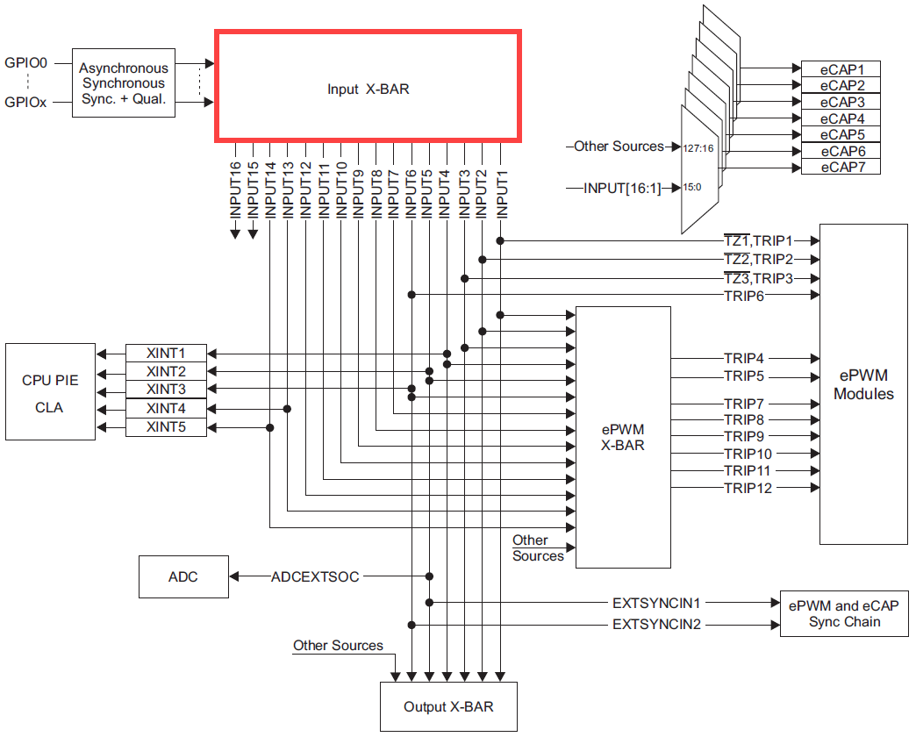
GPIO Input X-BAR

Slide 24
GPIO Input X-BAR Architecture
GPIO 0
This block diagram is replicated 16 times
INPUTx
GPIO n
XBAR_setInputPin(input, pin);
input | Destinations (pin is the GPIO pin number)
XBAR_INPUT1 | eCAPx, ePWM X-BAR, ePWM[TZ1, TRIP1], Output X-BAR
XBAR_INPUT2 | eCAPx, ePWM X-BAR, ePWM[TZ2, TRIP2], Output X-BAR
XBAR_INPUT3 | eCAPx, ePWM X-BAR, ePWM[TZ3, TRIP3], Output X-BAR
XBAR_INPUT4 | eCAPx, ePWM X-BAR, XINT1, Output X-BAR
XBAR_INPUT5 | eCAPx, ePWM X-BAR, XINT2, ADCEXTSOC, EXTSYNCIN1, Output X-BAR
XBAR_INPUT6 | eCAPx, ePWM X-BAR, XINT3, ePWM[TRIP6], EXTSYNCIN2, Output X-BAR
XBAR_INPUT7 | eCAPx, ePWM X-BAR
XBAR_INPUT8 | eCAPx, ePWM X-BAR
XBAR_INPUT9 | eCAPx, ePWM X-BAR
XBAR_INPUT10 | eCAPx, ePWM X-BAR
XBAR_INPUT11 | eCAPx, ePWM X-BAR
XBAR_INPUT12 | eCAPx, ePWM X-BAR
XBAR_INPUT13 | eCAPx, ePWM X-BAR, XINT4
XBAR_INPUT14 | eCAPx, ePWM X-BAR, XINT5
XBAR_INPUT15 | eCAPx
XBAR_INPUT16 | eCAPx

Slide 25
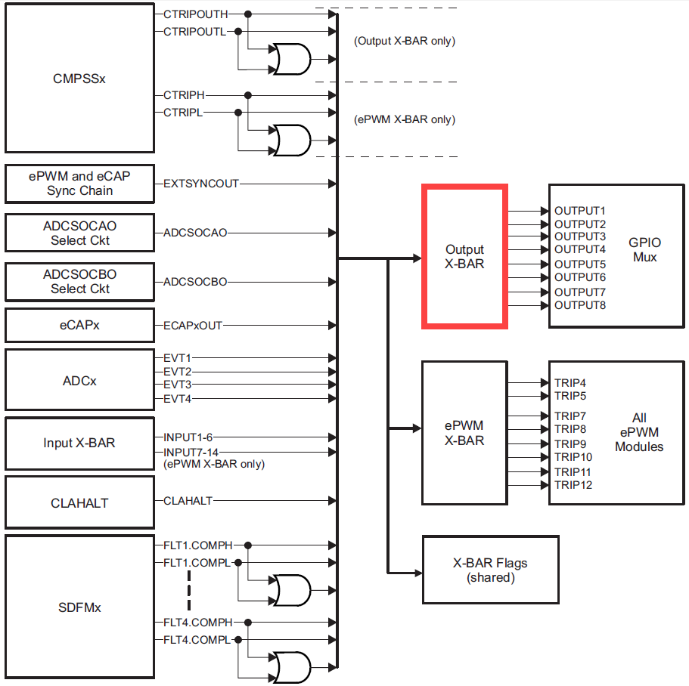
GPIO Output X-BAR

Slide 26
GPIO Output X-BAR Architecture
0.0
XBAR_enableOutputMux(output, muxes);
0.1
0
0.2
0.3
XBAR_setOutputLatchMode(output, enable);
This block diagram is replicated 8 times
1.0
1.1
1
1.2
OUTPUTx
1.3
Latch
Muxed with Peripheral GPIO Pins
31.0
31.1
31
31.2
31.3
XBAR_invertOutputSignal(output, invert);
XBAR_setOutputMuxConfig(output, muxConfig);
MUX | 0 | 1 | 2 | 3
0 | CMPSS1.CTRIPOUTH | CMPSS1.CTRIPOUTH_OR_CTRIPOUTL | ADCAEVT1 | ECAP1OUT
1 | CMPSS1.CTRIPOUTL | INPUTXBAR1 |  | ADCCEVT1
2 | CMPSS2.CTRIPOUTH | CMPSS2.CTRIPOUTH_OR_CTRIPOUTL | ADCAEVT2 | ECAP2OUT
3 | CMPSS2.CTRIPOUTL | INPUTXBAR2 |  | ADCCEVT2
4 | CMPSS3.CTRIPOUTH | CMPSS3.CTRIPOUTH_OR_CTRIPOUTL | ADCAEVT3 | ECAP3OUT
5 | CMPSS3.CTRIPOUTL | INPUTXBAR3 |  | ADCCEVT3
6 | CMPSS4.CTRIPOUTH | CMPSS4.CTRIPOUTH_OR_CTRIPOUTL | ADCAEVT4 | ECAP4OUT
7 | CMPSS4.CTRIPOUTL | INPUTXBAR4 |  | ADCCEVT4
8 | CMPSS5.CTRIPOUTH | CMPSS5.CTRIPOUTH_OR_CTRIPOUTL | ADCBEVT1 | ECAP5OUT
9 | CMPSS5.CTRIPOUTL | INPUTXBAR5
10 | CMPSS6.CTRIPOUTH | CMPSS6.CTRIPOUTH_OR_CTRIPOUTL | ADCBEVT2 | ECAP6OUT
11 | CMPSS6.CTRIPOUTL | INPUTXBAR6
12 | CMPSS7.CTRIPOUTH | CMPSS7.CTRIPOUTH_OR_CTRIPOUTL | ADCBEVT3 | ECAP7OUT
13 | CMPSS7.CTRIPOUTL | ADCSOCAO
14 |  |  | ADCBEVT4 | EXTSYNCOUT
15 |  | ADCSOCBO
MUX | 0 | 1 | 2 | 3
16 | SD1FLT1.COMPH | SD1FLT1.COMPH_OR_COMPL
17 | SD1FLT1.COMPL |  |  | CLAHALT
18 | SD1FLT2.COMPH | SD1FLT2.COMPH_OR_COMPL
19 | SD1FLT2.COMPL
20 | SD1FLT3.COMPH | SD1FLT3.COMPH_OR_COMPL
21 | SD1FLT3.COMPL
22 | SD1FLT4.COMPH | SD1FLT4.COMPH_OR_COMPL
23 | SD1FLT4.COMPL
24
25
26
27
28
29
30
31

Slide 27
Module Objectives
OSC/PLL Clock Module
Watchdog Timer
General Purpose I/O
External Interrupts
Low Power Modes
Register Protection

Slide 28
External Interrupts
5 external interrupt signals
XINT1, XINT2, XINT3, XINT4 and XINT5
Each external interrupt can be mapped to any of the GPIO pins via the X-BAR Input architecture
XINT1-5 are sources for Input X-BAR signals 4, 5, 6, 13, and 14 respectively
XINT1, XINT2, and XINT3 also have a free-running 16-bit counter which measures the elapsed time between interrupts
Counter resets to zero each time the interrupt occurs
Driverlib function used to read counter value:
GPIO_getInterruptCounter(extIntNum);
extIntNum parameter is: GPIO_INT_XINTx (x = 1, 2, or 3)

Slide 29
Configuring External Interrupts
Configuring external interrupts is a multi-step process:
Select GPIO pin, set polarity, and enable interrupt
GPIO_setInterruptPin(pin, extIntNum);
GPIO_setInterruptType(extIntNum, intType);
GPIO_[enable|disable]Interrupt(extIntNum);
pin is the GPIO pin number
extIntNum parameter specifies the external interrupt
GPIO_INT_XINT1
GPIO_INT_XINT2
GPIO_INT_XINT3
GPIO_INT_XINT4
GPIO_INT_XINT5
intType parameter specifies the type of interrupt trigger
GPIO_INT_TYPE_FALLING_EDGE
GPIO_INT_TYPE_RISING_EDGE
GPIO_INT_TYPE_BOTH_EDGES

Slide 30
Module Objectives
OSC/PLL Clock Module
Watchdog Timer
General Purpose I/O
External Interrupts
Low Power Modes
Register Protection

Slide 31
Low Power Modes
Low Power Mode | CPU Logic Clock | Peripheral Logic Clock | Watchdog Clock | PLL | INTOSC 1/2 | XTAL
Normal Run | on | on | on | on | on | on
IDLE | off | on | on | on | on | on
HALT | off | off | off | off | on | on
HALT
INTOSC – not automatically powered down; software configurable
XTAL – can be powered down by software at any time
STANDBY is not supported but can be emulated – see device Technical Reference Manual
See device data sheet for each low power mode power consumption

Slide 32
Low Power Mode Exit
Exit
Interrupt
GPIO
0 - 63 Signal
Any Enabled Interrupt
Watchdog
Interrupt
Reset
Low Power
Mode
IDLE
HALT
yes
yes
no
yes
yes
no / yes
yes
no

Slide 33
Low Power Mode Driverlib Functions
Configuring low power mode
SysCtl_enterIdleMode(); //enter IDLE mode
SysCtl_enterHaltMode(); //enter HALT mode
Set pin to wake up device from HALT mode
SysCtl_enableLPMWakeupPin(pin);
SysCtl_disableLPMWakeupPin(pin);
pin is the GPIO pin number (numerical value 0-63)
Run watchdog while in HALT mode
SysCtl_enableWatchdogInHalt();
SysCtl_disableWatchdogInHalt();

Slide 34
Module Objectives
OSC/PLL Clock Module
Watchdog Timer
General Purpose I/O
External Interrupts
Low Power Modes
Register Protection

Slide 35
LOCK Protection Registers
“LOCK” registers protects several system configuration registers from spurious CPU writes
Once the LOCK Driverlib functions are set the respective locked registers can no longer be modified by software:
ASysCtl_lockTemperatureSensor | ASysCtl_lockCMPHNMux | PGA_lockRegisters
ASysCtl_lockANAREF | ASysCtl_lockCMPLNMux | SysCtl_lockAccessControlRegs
ASysCtl_lockVMON | ASysCtl_lockVREG | SysCtl_lockSyncSelect
ASysCtl_lockDCDC | DAC_lockRegister | XBAR_lockInput
ASysCtl_lockPGAADCINMux | EPWM_lockRegisters | XBAR_lockOutput
ASysCtl_lockCMPHPMux | HRPWM_lockRegisters | XBAR_lockEPWM
ASysCtl_lockCMPLPMux | MemCfg_commitConfig
The following Driverlib functions can be locked/unlocked:
FSI_lockTxCtrl | GPIO_lockPortConfig | MemCfg_lockConfig
FSI_lockRxCtrl | GPIO_unlockPortConfig | MemCfg_unlockConfig
SysCtl_lockExtADCSOCSelect

Slide 36
EALLOW Protection (1 of 2)
EALLOW stands for Emulation Allow
Code access to protected registers allowed only when EALLOW = 1 in the ST1 register
The emulator can always access protected registers
EALLOW bit controlled by assembly level instructions
‘EALLOW’ sets the bit (register access enabled)
‘EDIS’ clears the bit (register access disabled)
EALLOW bit cleared upon ISR entry, restored upon exit

Slide 37
EALLOW Protection (2 of 2)
Driverlib functions automatically take care of EALLOW and EDIS protection
The following registers are protected:
Device Configuration & Emulation
Flash
Code Security Module
PIE Vector Table
DMA, CLA, SD, EMIF, X-Bar (some registers)
CANA/B (control registers only; mailbox RAM not protected)
ePWM, CMPSS, ADC, DAC (some registers)
GPIO (control registers only)
System Control
See device data sheet and Technical Reference Manual for detailed listings

Slide 38
Lab 5: Procedure - System Initialization
LAB5 files have been provided as a starting point
Use watchdog to generate a reset and interrupt:
Part 1
Perform processor system initialization
Test operation with watchdog disabled
Configure the watchdog to generate a reset
Learn about reset process
Part 2
Initialize the peripheral interrupt expansion (PIE) vectors
Configure the watchdog to generate an interrupt
Learn about the interrupt process

Slide 39

C2000 Technical Training
www.ti.com/c2000

Slide 40
Internal crystal accuracy

Slide 41
Pinmux GUI tools
Online
Sysconfig in dev.ti.com
Offline Sysconfig on CCS
~C2000ware\driverlib\f28003x\examples\pinmux

