Slide 1

Analog Subsystem
Module 6
C2000™ Microcontroller Workshop
Copyright © 2019 Texas Instruments. All rights reserved.

Slide 2
Module Objectives
Understand the operation of the:
Analog-to-Digital Converter (ADC)
Comparator Subsystem (CMPSS)
Programmable Gain Amplifier (PGA)
Digital-to-Analog Converter (DAC)
Analog Subsystem Interconnect
Use the ADC to perform data acquisition

Slide 3
Analog System Peripherals
Three 12-bit Analog-to-Digital Converters (ADCs)
3.45 MSPS each (up to 10.35 MSPS per system)
Selectable internal reference of 2.5 V or 3.3 V
Ratiometric external reference set by VREFHI/VREFLO
Seven Comparator Subsystems (CMPSS)
Each contains:
Two analog comparators
Two programmable 12-bit reference DACs
One ramp generator and two digital glitch filters
Seven Programmable Gain Amplifiers (PGAs)
Each features:
Four programmable gain modes: 3x, 6x, 12x, 24x
Programmable output filtering
Two 12-bit Buffered Digital-to-Analog Converter Outputs (DACs)
Selectable reference voltage source

Slide 4
ADC Module Block Diagram
ADCIN0
ADCIN1
ADCRESULT0
ADCIN2
ADCRESULT1
ADCIN3
S/H
12-bit
A/D
Converter
Result
MUX
Post Processing Blocks
MUX
ADCRESULT2
ADCIN14
SOCx
ADCIN15
ADCRESULT15
ADC full-scale input range is V_{REFLO} to V_{REFHI}
CHSEL
ADC
Generation
Logic
EOCx
ADC
Interrupt
Logic
ADCINT1-4
SOCx Signal
ADCINT1
ADCINT2
SOC0 TRIGSEL CHSEL ACQPS
SOC1 TRIGSEL CHSEL ACQPS
SOC2 TRIGSEL CHSEL ACQPS
SOC3 TRIGSEL CHSEL ACQPS
SOC15 TRIGSEL CHSEL ACQPS
Software
SOCx Triggers
CPU1 Timer (0,1,2)
EPWMxSOCA/C (x = 1 to 8)
EPWMxSOCB/D (x = 1 to 8)
External Pin(GPIO/ADCEXTSOC)
SOCx Configuration Registers
*** Multiple ADC modules allow for simultaneous sampling or independent operation ***

Slide 5
ADC SOCx Functional Diagram
TINT0 (CPU1 Timer 0)
TINT1 (CPU1 Timer 1)
TINT2 (CPU1 Timer 2)
ADCEXTSOC (GPIO)
SOCA/C (ePWM1)
SOCB/D (ePWM1)
SOCA/C (ePWM8)
SOCB/D (ePWM8)
ADC_setupSOC(base, socNumber, trigger, channel, sampleWindow);
T
r
i
g
g
e
r
ADCINT1
ADCINT2
ADCINT3
ADCINT4
Channel
Select
Sample
Window
Result
Register
S
O
C
x
E
O
C
x
ADC_readResult(resultBase, socNumber);
Software Trigger
ADC_setInterruptSource(base, adcIntNum, socNumber);
ADC_[enable|disable]Interrupt(base, adcIntNum);
ADCINT1
ADCINT2
Re-Trigger
ADC_setInterruptSOCTrigger(base, socNumber, trigger);
ADC_forceSOC(base, socNumber);
This block diagram is replicated 16 times
EOC Int Pulse: ADC_setInterruptPulseMode(base, pulseMode);
(generation at beginning of conversion or one cycle prior to results)

Slide 6
ADC SOC Driverlib Function
Configure a start-of-conversion (SOC)
ADC_setupSOC(base, socNumber, trigger, channel, sampleWindow);
base is the ADC base address: ADCx_BASE (x = A to C)
socNumber values are:
ADC_SOC_NUMBERx (x = 0 to 15)
trigger values are:
ADC_TRIGGER_SW_ONLY
ADC_TRIGGER_CPU1_TINTx (x = 0 to 2)
ADC_TRIGGER_GPIO
ADC_TRIGGER_EPWMx_SOCA (x = 1 to 8)
ADC_TRIGGER_EPWMx_SOCB (x = 1 to 8)
channel values are:
ADC_CH_ADCINx (x = 0 to 15)
sampleWindow parameter is the acquisition window duration in SYSCLK cycles: value between 1 and 512 cycles inclusive

Slide 7
ADC Driverlib Functions
Configure an interrupt start-of-conversion trigger
ADC_setInterruptSOCTrigger(base, socNumber, trigger);
Set EOC source for an ADC interrupt
ADC_setInterruptSource(base, adcIntNum, socNumber);
ADC_[enable|disable]Interrupt(base, adcIntNum);
Force an SOC conversion (software trigger)
ADC_forceSOC(base, socNumber);
Configure ADC EOC interrupt pulse generation
ADC_setInterruptPulseMode(base, pulseMode);
Read ADC result register
ADC_readResult(resultBase, socNumber);
base is the ADC base address: ADCx_BASE (x = A to C)
socNumber is: ADC_SOC_NUMBERx (x = 0 to 15)
Trigger value is:
ADC_INT_SOC_TRIGGER_NONE
ADC_INT_SOC_TRIGGER_ADCINTx (x = 1 or 2)
adcIntNum value is: ADC_INT_NUMBERx (x = 1 to 4)
pulseMode value is: ADC_PULSE_END_OF_x (x = ACQ_WIN or CONV)
resultBase value is: ADCxRESULT_BASE (x = A to C)

Slide 8
Example – ADC Triggering
Sample A1 → A3 → A5 when ePWM1 SOCB/D is generated and then generate ADCINT1:
SOCB/D (ETPWM1)
SOC0
Channel
A1
Sample
20 cycles
no interrupt
Result0
SOC1
Channel
A3
Sample
26 cycles
no interrupt
Result1
SOC2
Channel
A5
Sample
22 cycles
ADCINT1
Result2
Sample A2 → A4 → A6 continuously and generate ADCINT2:
Software Trigger
no interrupt
Sample
22 cycles
Channel
A2
SOC3
Result3
no interrupt
Sample
28 cycles
Channel
A4
SOC4
Result4
ADCINT2
ADCINT2
Sample
24 cycles
Channel
A6
SOC5
Result5
Note: setting ADCINT2 flag does not need to generate an interrupt

Slide 9
Example – ADC Ping-Pong Triggering
Sample all channels continuously and provide Ping-Pong interrupts to CPU/system:
Software Trigger
SOC0
Channel
B0
Sample
20 cycles
Result0
no interrupt
ADCINT2
SOC1
Channel
B1
Sample
20 cycles
Result1
no interrupt
SOC2
Channel
B2
Sample
20 cycles
ADCINT1
Result2
ADCINT1
SOC3
Channel
B3
Sample
20 cycles
no interrupt
Result3
SOC4
Channel
B4
Sample
20 cycles
no interrupt
Result4
SOC5
Channel
B5
Sample
20 cycles
ADCINT2
Result5

Slide 10
ADC Conversion Priority
When multiple SOC flags are set at the same time – priority determines the order in which they are converted
Round Robin Priority (default)
No SOC has an inherent higher priority than another
Priority depends on the round robin pointer
High Priority
High priority SOC will interrupt the round robin wheel after current conversion completes and insert itself as the next conversion
After its conversion completes, the round robin wheel will continue where it was interrupted
Round Robin Burst Mode
Allows a single trigger to convert one or more SOCs in the round robin wheel
Uses BURSTTRIG instead of TRIGSEL for all round robin SOCs (not high priority)

Slide 11
Conversion Priority Functional Diagram
SOC0
SOC Priority
Determines cutoff point
for high priority and
round robin mode
SOC1
High Priority
SOC2
SOC3
SOC4
SOC5
SOCPRIORITY
SOC6
ADC_setSOCPriority(base, priMode);
SOC7
SOC8
RRPOINTER
SOC9
Round Robin Pointer
Points to the last converted
round robin SOCx and
determines order
of conversions
Round Robin
SOC10
SOC11
SOC12
SOC13
SOC14
SOC15
base is the ADC base address: ADCx_BASE (x = A to C)
priMode values are:
ADC_PRI_ALL_ROUND_ROBIN
ADC_PRI_ALL_HIPRI
ADC_PRI_SOCx_HIPRI (x = 0 to 14)

Slide 12
Round Robin Priority Example
SOCPRIORITY configured as 0; RRPOINTER configured as 15; SOC0 is highest RR priority
SOC
15
SOC
0
SOC
1
SOC7 trigger received
SOC
14
SOC
2
SOC7 is converted; RRPOINTER now points to SOC7; SOC8 is now highest RR priority
SOC
13
SOC
3
RRPOINTER
SOC
12
SOC
4
SOC2 & SOC12 triggers received simultaneously
SOC
11
SOC
5
SOC12 is converted; RRPOINTER points to SOC12; SOC13 is now highest RR priority
SOC
10
SOC
6
SOC
9
SOC
7
SOC
8
SOC2 is converted; RRPOINTER points to SOC2; SOC3 is now highest RR priority

Slide 13
High Priority Example
SOCPRIORITY configured as 4; RRPOINTER configured as 15; SOC4 is highest RR priority
SOC
4
SOC
15
SOC
5
SOC7 trigger received
High Priority
SOC
0
SOC
14
SOC7 is converted; RRPOINTER points to SOC7; SOC8 is now highest RR priority
SOC
6
SOC
1
RRPOINTER
SOC
13
SOC
7
SOC2 & SOC12 triggers received simultaneously
SOC
2
SOC
12
SOC
8
SOC2 is converted; RRPOINTER stays pointing to SOC7
SOC
3
SOC
11
SOC
9
SOC
10
SOC12 is converted; RRPOINTER points to SOC12; SOC13 is now highest RR priority

Slide 14
Round Robin Burst Mode Diagram
ADC_[enable|disable]BurstMode(base);
Burst Enable
Disables/enables burst mode
BURSTEN
BURSTSIZE
SOC Burst Size
Determines how many SOCs are converted per burst trigger
BURSTTRIGSEL
Software, CPU1 Timer0-2
ePWM1 ADCSOCA/C – B/D → ePWM8 ADCSOCA/C – B/D
SOC Burst Trigger Source Select
Determines which trigger starts a burst conversion sequence
ADC_setBurstModeConfig(base, trigger, burstSize);
base is the ADC base address: ADCx_BASE (x = A to C)
trigger parameter uses the same values as the ADC_setupSOC() API
burstSize parameter is a value between 1 and 16 inclusive

Slide 15
Round Robin Burst Mode with High Priority Example
SOCPRIORITY configured as 4; RRPOINTER configured as 15; SOC4 is highest RR priority
SOC
4
SOC
15
SOC
5
BURSTTRIG trigger received
High Priority
SOC
0
SOC
14
SOC4 & SOC5 is converted; RRPOINTER points to SOC5; SOC6 is now highest RR priority
SOC
6
SOC
1
RRPOINTER
SOC
13
SOC
7
BURSTTRIG & SOC1 triggers received simultaneously
SOC
2
SOC
12
SOC
8
SOC1 is converted; RRPOINTER stays pointing to SOC5
SOC
3
SOC
11
SOC
9
SOC
10
SOC6 & SOC7 is converted; RRPOINTER points to SOC7; SOC8 is now highest RR priority
Note: BURSTEN = 1, BURSTSIZE = 1

Slide 16
Purpose of the Post Processing Block
Offset Correction
Remove an offset associated with an ADCIN channel possibly caused by external sensors and signal sources
Zero-overhead; saving cycles
Error from Set-point Calculation
Subtract out a reference value which can be used to automatically calculate an error from a set-point or expected value
Reduces the sample to output latency and software overhead
Limit and Zero-Crossing Detection
Automatically perform a check against a high/low limit or zero-crossing and can generate a trip to the ePWM and/or an interrupt
Decreases the sample to ePWM latency and reduces software overhead; trip the ePWM based on an out of range ADC conversion without CPU intervention
Trigger-to-Sample Delay Capture
Capable of recording the delay between when the SOC is triggered and when it begins to be sampled
Allows software techniques to reduce the delay error

Slide 17
Post Processing Block - Diagram

Slide 18
Post Processing Block Interrupt Event
Each ADC module contains four Post Processing Blocks
Each Post Processing Block can be associated with any of the 16 ADCRESULTx registers

Slide 19
ADC Clocking Flow
SysCtl_setClock(SYSCTL_OSCSRC_XTAL | SYSCTL_IMULT(10) | SYSCTL_FMULT_NONE | SYSCTL_SYSDIV(2) | SYSCTL_PLL_ENABLE );
XTAL
(20 MHz)
PLLCLK
(200 MHz)
SYSCLK
(100 MHz)
IMULT/FMULT
(x10.00)
SYSCLKDIV
(/2)
To CPU
SysCtl_enablePeripheral(SYSCTL_PERIPH_CLK_ADCA);
PRESCALE
(/2)
ADCCLK (50 MHz)
To ADC core
ADC_setPrescaler(ADCA_BASE, ADC_CLK_DIV_2_0);
sampling window
ACQPS
(7+1)
ADC_setupSOC(…, …, …, …, 8);
sampling window = (ACQPS + 1)*(1/SYSCLK)

Slide 20
ADC Timing
SYSCLK = 100 MHz (10 ns period)
ADCCLK = 50 MHz (20 ns period)
Latch
Sample
Convert
Write
2 cycles
8 cycles
10.5 ADCCLK cycles = 21 SYSCLK cycles
2 cycles
ADCINTCYCLE
Generate Early
Interrupt
Generate Late
Interrupt
SYSCLK
ADCCLK
Sample + Hold (sampling window) time = 80 ns
Conversion time = 210 ns
Sampling rate = 80 ns + 210 ns = 290 ns → 3.45 MSPS
Above timing using ADCINTCYCLE = 0 (default)
Maximum Sample Rate: 3.45 MSPS – see data sheet for details

Slide 21
ADC Conversion Result Registers
ADC_readResult(resultBase, socNumber);
MSB
LSB
15 14 13 12 11 10 9 8 7 6 5 4 3 2 1 0
ADCINx Voltage | Digital Results | AdcnResultRegs. ADCRESULTx
3.3 V | 0xFFF | 0000|1111|1111|1111
1.65 V | 0x7FF | 0000|0111|1111|1111
0.00081 V | 0x1 | 0000|0000|0000|0001
0 V | 0x0 | 0000|0000|0000|0000
Selectable internal reference of 2.5 V or 3.3 V
Ratiometric external reference set by VREFHI/VREFLO
resultBase value is: ADCxRESULT_BASE (x = A to C)
socNumber is: ADC_SOC_NUMBERx (x = 0 to 15)
Note: above table based on internal reference of 3.3 V; for external reference VREFHI is VDDA maximum, however VREFHI is typically selected as 2.5 V or 3.0 V

Slide 22
How Can We Handle Signed Input Voltages?
Example: -1.65 V ≤ V_{in} ≤ +1.65 V
R
R
R
ADCA
1) Add 1.65 volts to the analog input
V_{in}
R
-
-
1.65V
+
+
ADCIN0
R
VREFLO
GND
2) Subtract “1.65” from the digital result
#include “Lab.h”
#define offset 0x07FF
void main(void)
{
int16 value; // signed
value = ADC_readResult(resultBase, socNumber) – offset;
}

Slide 23
Built-In ADC Calibration
TI reserved OTP contains device specific calibration data for the ADC, internal oscillators and buffered DAC
The Boot ROM contains a Device_cal() routine that copies the calibration data to their respective registers
Device_cal() must be run to meet the specifications in the datasheet
The Bootloader automatically calls Device_cal() such that no action is normally required by the user
If the Bootloader is bypassed (e.g. during development) Device_cal() should be called by the application:
#define Device_cal (void (*)(void))0x70280
void main(void)
{
(*Device_cal)(); // call Device_cal()
}

Slide 24
Analog Subsystem External Reference
Reference Generation
ADC
VREFHIA
VREFLOA
VREFHIB
VREFLOB
VREFHIC
VREFLOC
Non-Inverting Buffers
Voltage
Reference
REF3230
REF3225
REF3030
REF3025
(or similar)
C_{A}
C_{B}
C_{C}

Slide 25
Comparator Subsystem
Each CMPSS consists of:
Two analog comparators
Two programmable reference 12-bit DACs
Two digital filters and one ramp generator
Each comparator generates a digital output
Indicates if voltage on positive input is greater than the voltage on the negative input
Positive input can be driven from an external pin or PGA
Negative input can be driven by an external pin or 12-bit DAC
Each comparator output can be digitally filtered to remove spurious trip signals (majority vote)
Ramp generator used for peak current mode control
Ability to synchronize with EPWMSYNCO event, SYSCLK, and a clear signal with EPWMBLANK
DAC reference voltage can be either VDDA or VDAC

Slide 26
Comparator Subsystem Block Diagram
DAC Reference
Comparator Truth Table
DACxVALA * DACREF
4096
Voltages Output
Voltage A < Voltage B 0
Voltage A > Voltage B 1
A
+
-
V_{DACx} =
Output
B

Slide 27
Programmable Gain Amplifier (PGA)
Amplifies small input signals to increase the dynamic range of the downstream ADC and CMPSS modules
Reduces cost and design effort over external standalone amplifiers
On-chip integration ensures compatible with ADC and CMPSS
Internally powered by VDDA and VSSA
Adaptable to various performance needs
Software selectable gain and filter settings
Four programmable gain modes: 3x, 6x, 12x, 24x
Embedded series resistors for RC filtering
Hardware-based offset and gain trimming reduces offset and gain errors
Instead of software post-processing

Slide 28
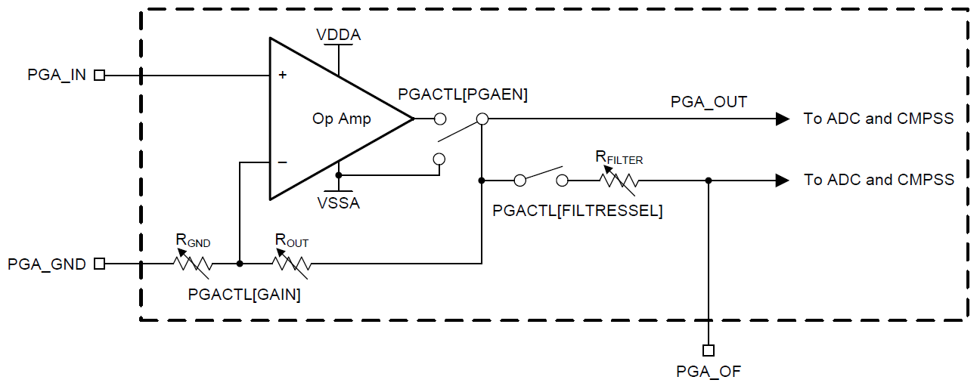
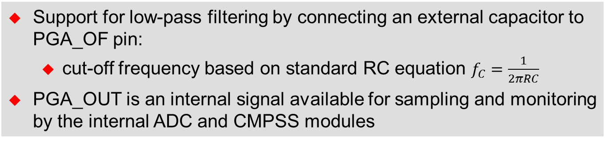
PGA Block Diagram
PGA Input can be used as a regular ADC/CMPSS pin
To ADC and CMPSS
Four Programmable Gain Modes:
3x, 6x, 12x, 24x
Filtered and non-filtered paths to ADC and CMPSS
PGA Output Filter pin can be used as a regular ADC/CMPSS pin
Support for low-pass filtering by connecting an external capacitor to PGA_OF pin:
cut-off frequency based on standard RC equation $f_{C}=\frac{1}{2πRC}$
PGA_OUT is an internal signal available for sampling and monitoring by the internal ADC and CMPSS modules

Slide 29
Digital-to-Analog Converter
12-bit DAC provides a programmable reference output voltage
Analog output buffer is capable of driving an external load
Selectable reference voltage
Can be used as a general-purpose DAC for generating a DC voltage and AC waveforms (e.g. sine, square, triangle, etc.)
Ability to be synchronized with EPWMSYNCPER events

Slide 30
Buffered DAC Block Diagram
DAC_setReferenceVoltage(base, source);
Internal
Reference
Circuit
VDAC
0
1
1.65 V
0
1
1
DACREF
2.5 V
0
VREFHI
DAC_[enable|disable]Output(base);
DAC_setShadowValue(base, value);
SYSCLK
VDDA
DAC
VALS
D Q
0
1
DAC
VALA
12-bit
DAC
AMP
(x1 or x2)
DACOUT
D Q
VSSA
EPWM1SYNCPER
0
1
6
7
EPWM2SYNCPER
VSSA
DAC_setGainMode(base, mode);
EPWM7SYNCPER
DAC_setLoadMode(base, mode);
EPWM8SYNCPER
DAC_setPWMSyncSignal(base, signal);
DAC internal reference: 2.5 V and 3.3 V option
3.3 V option outputs 1.65 V and then use 2x mode on DAC
2.5 V option outputs 2.5 V and then use 1x mode on DAC
Ideal Output
DACOUT =
DACVALA * DACREF
4096

Slide 31
DAC Driverlib Functions
Set the DAC reference voltage
DAC_setReferenceVoltage(base, source);
Set the DAC gain mode
DAC_setGainMode(base, mode);
Set the DAC load mode
DAC_setLoadMode(base, mode);
Set DAC shadow value
DAC_setShadowValue(base, value);
Enable / disable DAC output
DAC_[enable|disable]Output(base);
Set DAC PWMSYNC signal
DAC_setPWMSyncSignal(base, signal);
base is the ADC base address: DACx_BASE (x = A or B)
source value is: DAC_REF_VDAC or DAC_REF_ADC_VREFHI
mode (gain) value is: DAC_GAIN_ONE or DAC_GAIN_TWO
mode (load) value is: DAC_LOAD_SYSCLK or DAC_LOAD_PWMSYNC
value is the 12-bit code to be loaded into the active value register
signal is the selected PWM signal (e.g. 2 selects PWM sync signal 2)

Slide 32
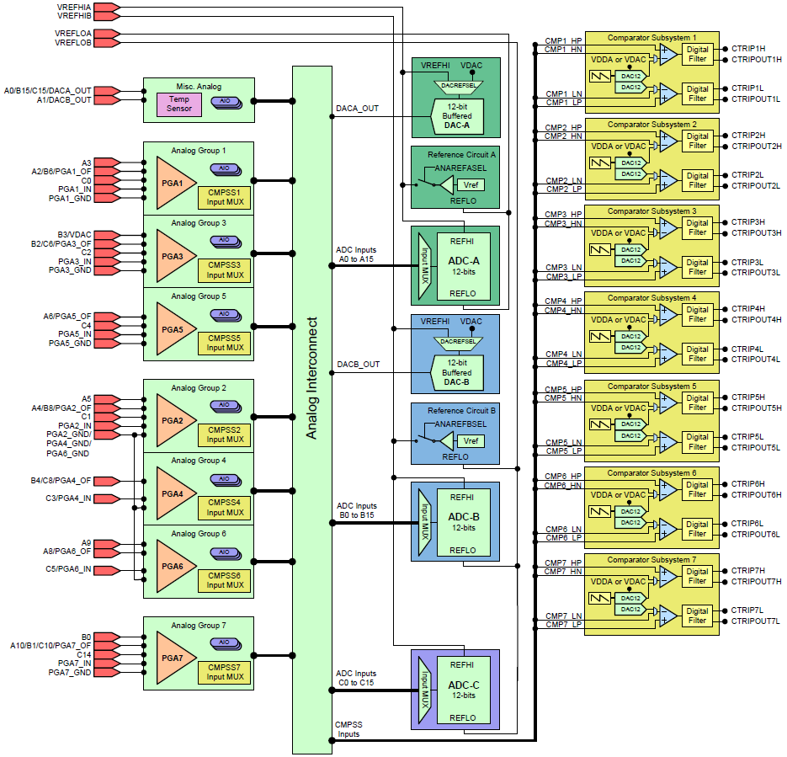
Analog Subsystem Interconnect
Pins shared for:
PGA functions
ADC inputs
DAC outputs
CMPSS inputs
AIO’s
Analog functions for:
PGA inputs and outputs
ADC inputs
CMPSS inputs
are grouped into functional units by PGAs
Note: AIO input functionality only (name used to match legacy devices)

Slide 33
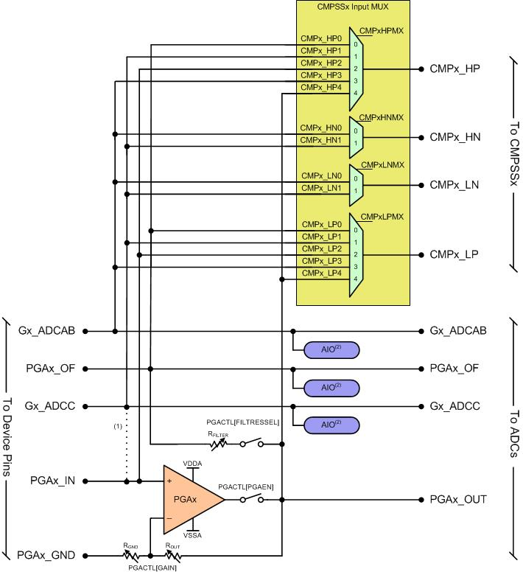

Generic Analog Group Structure
Determines routing of the analog pins interconnect
Analog Group x

Slide 34
Analog Group Connections Gx_ADCAB & GxADCC
General-purpose ADC input that connects to:
Gx_ADCA or Gx_ADCB
Gx_ADCC
Connects to positive comparator input multiplexers
Gx_ADCAB at position ‘3’
Gx_ADCC at position ‘1’
Connects to negative comparator input multiplexers
Gx_ADCAB at position ‘0’
Gx_ADCC at position ‘1’
Connects to AIO
Used for lower pin-count packages
Gx_ADCC is combined with the PGA input to allow ADC, CMPSS, or AIO to be use if PGA is not used

Slide 35
Analog Group Connections PGAx_IN & PGAx_OUT & PGA_OF
PGAx_IN
Input to PGAx
Connects to positive comparator input multiplexer at position ‘2’
PGAx_OUT
Output to PGAx (to ADCs)
Connects to positive comparator input multiplexer at position ‘4’
PGAx Filtered Output
Connects to ADCs and positive comparator input multiplexer at position ‘0’ by passing PGA output through switch + resistor with an external capacitor on the PGAx_OF pin
Connects to AIO
If switch is open, PGAx_OF pin can be used as general-purpose ADC input or AIO

Slide 36
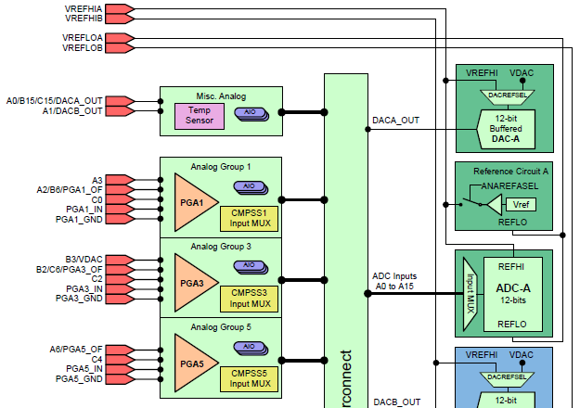
Analog Group Connections - Example
Determine the connections in Analog Group 1 for the 100 PZ package

Slide 37
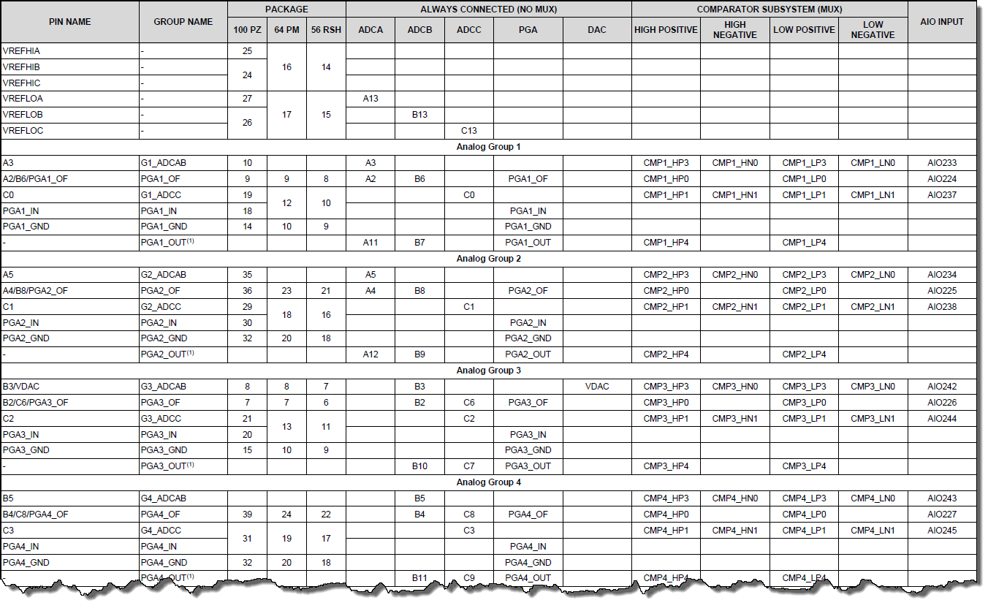
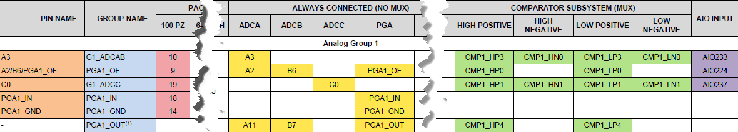
Analog Pins and Internal Connections

Slide 38
Analog Group Connections - Example
Pin Name
Group Name
Pin #
‘A3’ (10)
A3
AIO233
‘A2/B6/PGA1_OF’ (9)
A2, B6
AIO224
‘C0’ (19)
C0
AIO237
‘PGA1_IN’ (18)
A11, B7
‘PGA1_GND’ (14)

Slide 39
Lab 6: ADC Sampling
+3.3 V
(GPIO59)
Toggle
(GPIO25)
GND
data
memory
ADC-A
CPU copies result
to buffer during
ADC ISR
jumper
wire
RESULT0
ADCINA0
pointer rewind
...
DAC-B
ePWM2 triggering
ADC on period match using SOCA trigger every 20 µs (50 kHz)
View ADC buffer PWM samples
Sine
Table
Code Composer
Studio
ePWM2

Slide 40
Lab 6: Code Flow Diagram
Start
General Initialization
PLL and clocks
Watchdog configure
GPIO setup
PIE initialization
ADC interrupt
Main Loop
while(1)
{
}
ADC ISR
read the ADC result
write to result buffer
adjust the buffer pointer
toggle the GPIO pin
return from interrupt
ADC Initialization
convert channel A0 on
ePWM2 period match
send interrupt on EOC
to trigger ADC ISR
setup a results buffer
in memory
return
ePWM2 Initialization
clear counter
set period register
set to trigger ADC on
period match
set the clock prescaler
enable the timer

Slide 41

C2000 Technical Training
www.ti.com/c2000

Slide 42
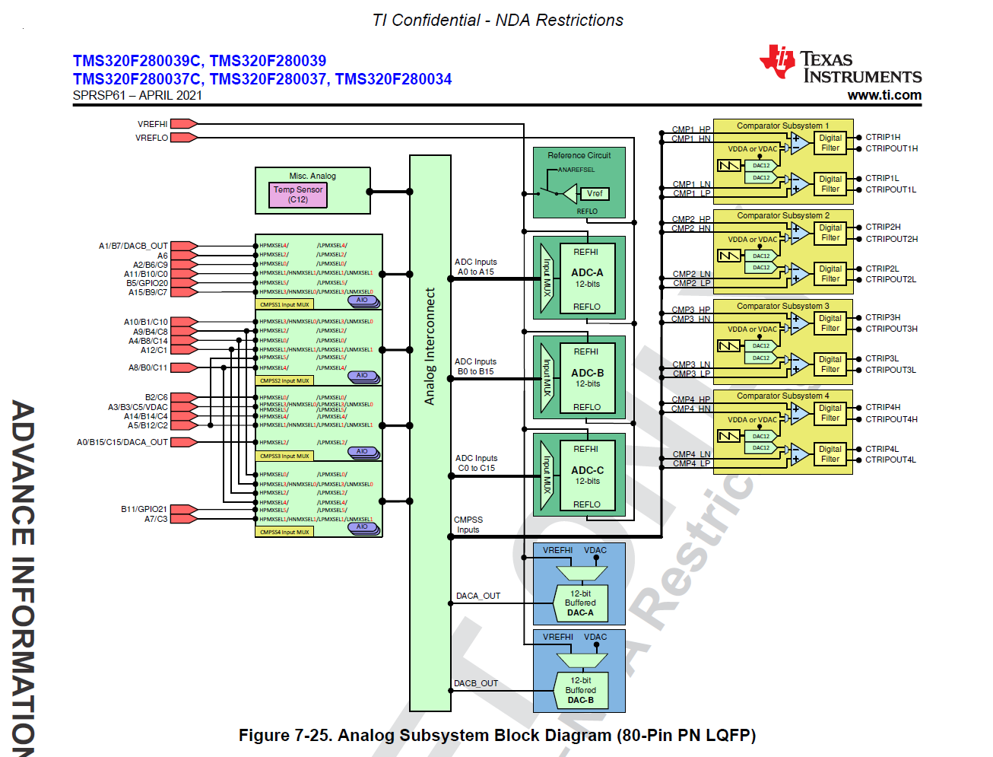
Analog Group Connection on F28003x Similar to F28004x’s except for no PGA See Sec 7.13 of F28003x datasheet

Slide 43
See Sec 7.13 of F28003x datasheet

Slide 44
See Sec 7.13 of F28003x datasheet

Slide 45
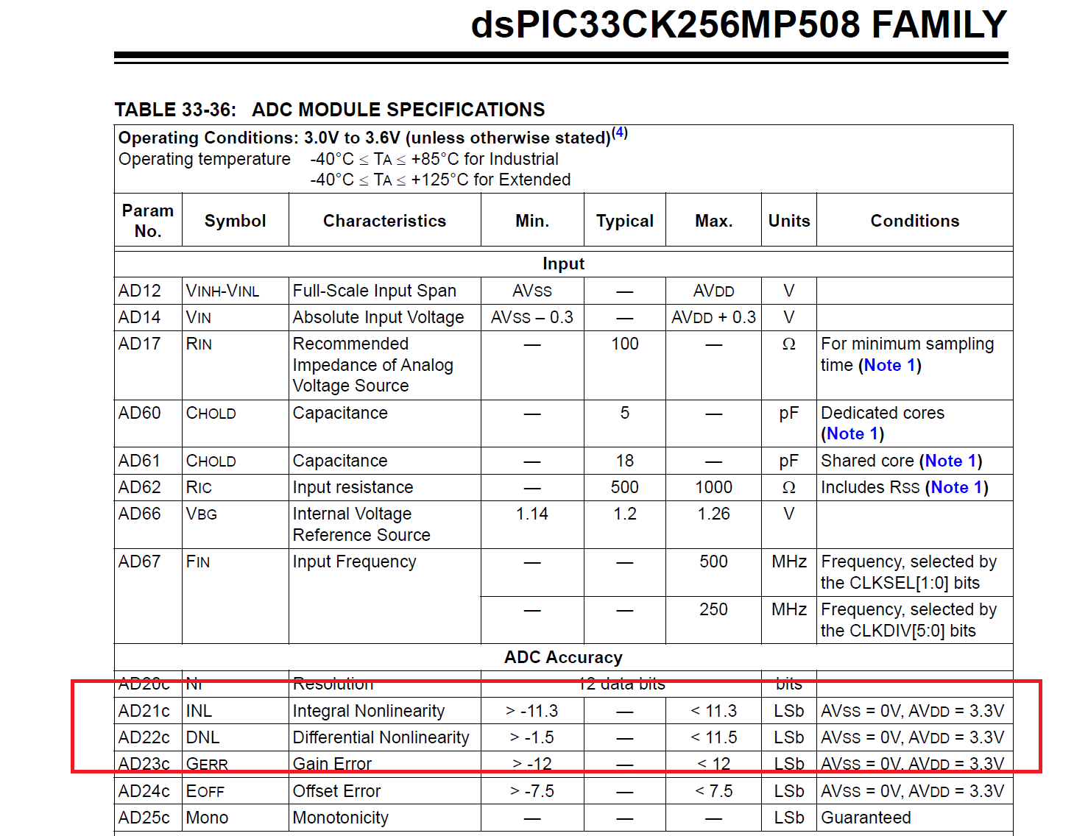
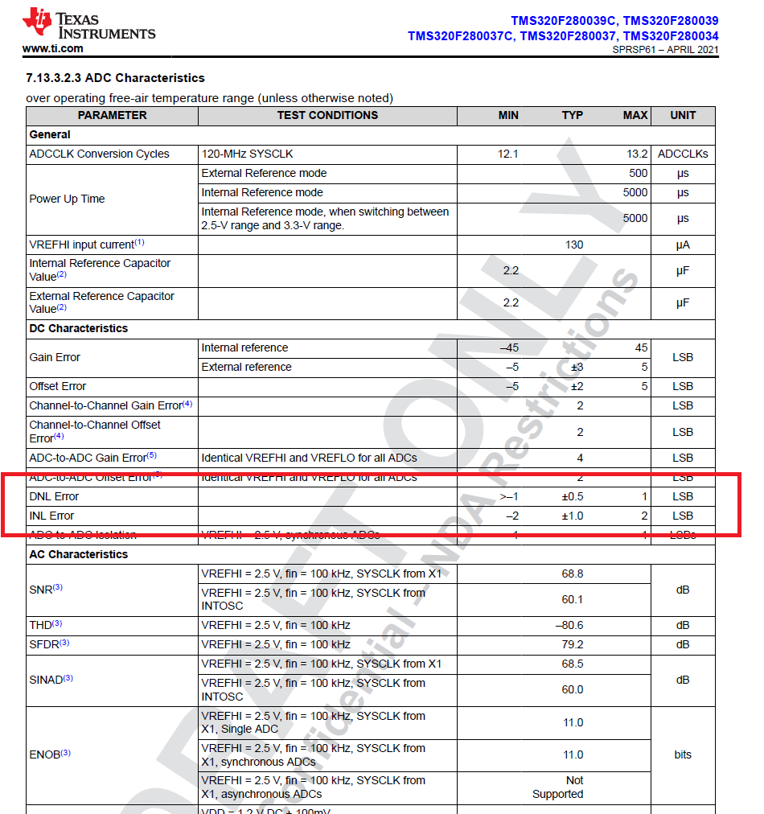
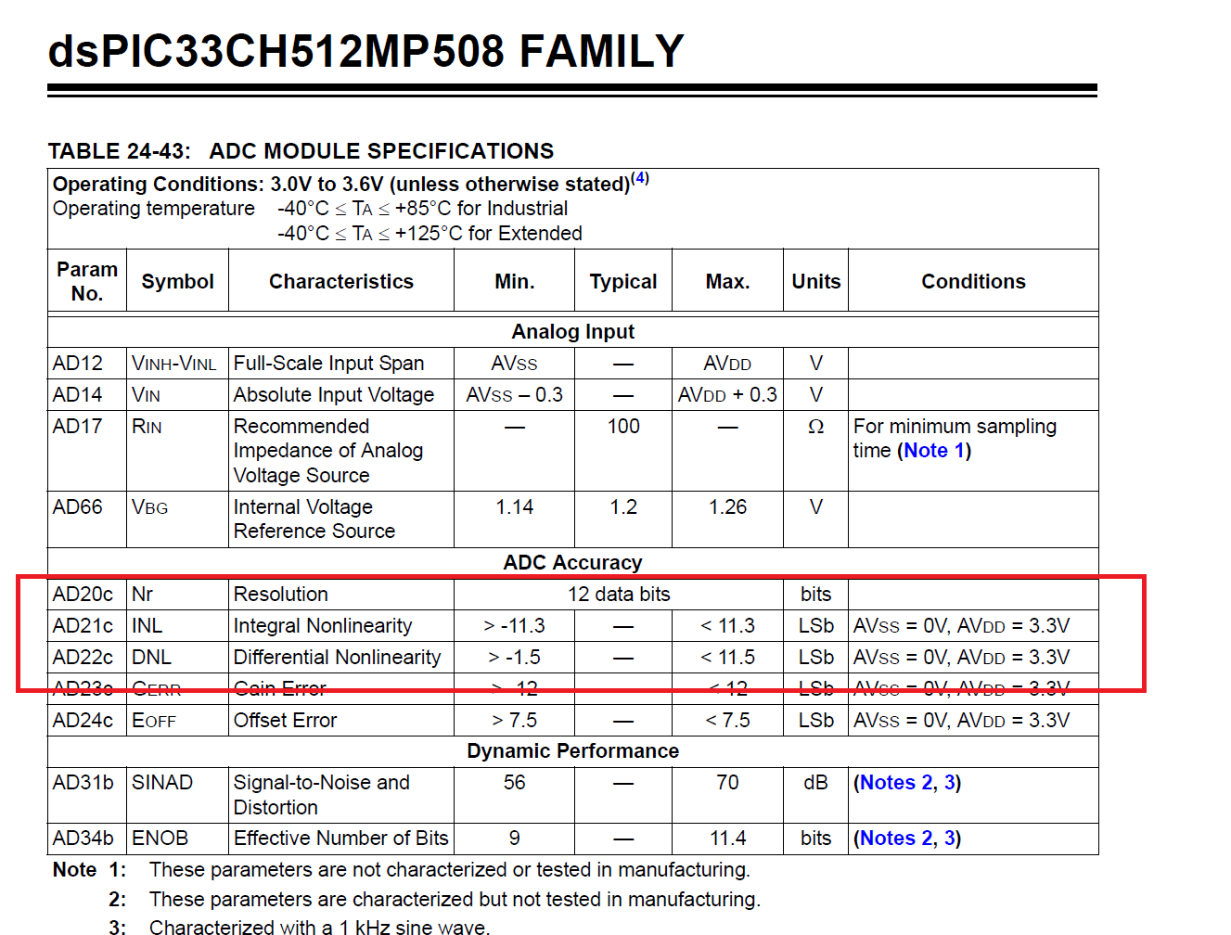
Accuracy (refer to each datasheet)
F28003x INL/DNL are much better than dsPIC33CK/CH

Slide 46
Open/Short Detection

Slide 47
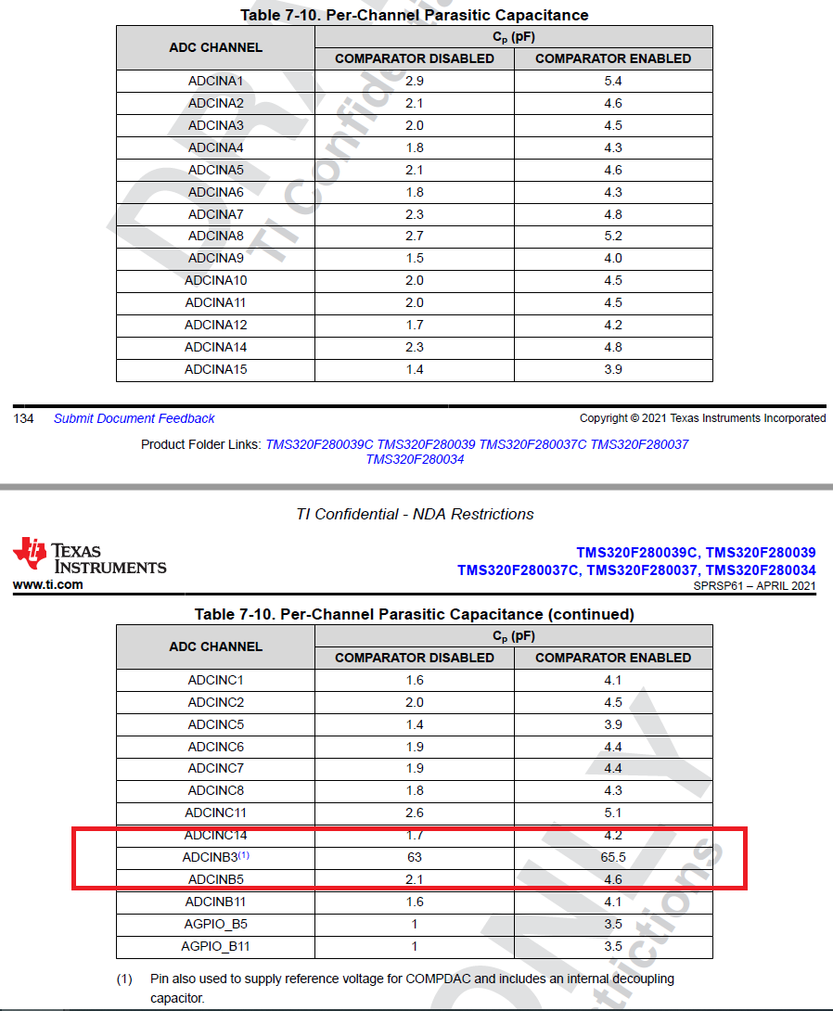
Input Model
Input impedance is as small as possible to have fastest S/H (ACQPS) .
If Comparators are enabled, Cp is little affected.
ADCINB3 is of larger Cp and not recommended for fast sampling.

Slide 48
16.13.1 (TRM) Ensuring Synchronous Operation (1/3)

Slide 49
16.13.1 (TRM) Ensuring Synchronous Operation (2/3)

Slide 50
16.13.1 (TRM) Ensuring Synchronous Operation (2/3)
BAD example because of asynchronous between ADC modules.

Slide 51
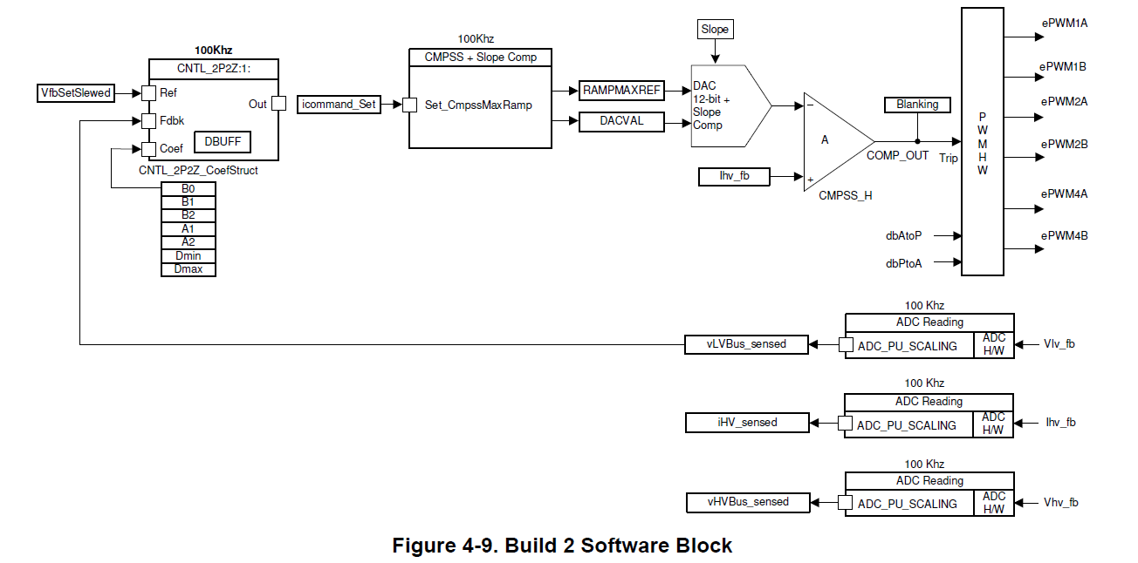
DAC Ramp for High Comparator can Realize Peak Current Mode with Slope Compensation
See
TIDM-02000 for PSFB DC/DC
TIDM-DC-DC-BUCK for Buck DC/DC

