Slide 1

Control Peripherals
Module 7
C2000™ Microcontroller Workshop
Copyright © 2019 Texas Instruments. All rights reserved.

Slide 2
Module Objectives
Pulse Width Modulation (PWM) review
Generate a PWM waveform with the Pulse Width Modulator Module (ePWM)
Use the Capture Module (eCAP) to measure the width of a waveform
Explain the function of Quadrature Encoder Pulse Module (eQEP)
Describe the purpose of the Sigma Delta Filter Module (SDFM)

Slide 3
What is Pulse Width Modulation?
PWM is a scheme to represent a signal as a sequence of pulses
fixed carrier frequency
fixed pulse amplitude
pulse width proportional to instantaneous signal amplitude
PWM energy ≈ original signal energy
t
t
T
Original Signal
PWM representation

Slide 4
Why use PWM with Power Switching Devices?
Desired output currents or voltages are known
Power switching devices are transistors
Difficult to control in proportional region
Easy to control in saturated region
PWM is a digital signal ⇒ easy for MCU to output
DC Supply
DC Supply
?
PWM
Desired
signal to
system
PWM approx.
of desired signal
Unknown Gate Signal
Gate Signal Known with PWM

Slide 5
ePWM Module Signals and Connections
ePWMx-1
EPWMxSYNCI
EPWMxTZINT
INPUT
X-Bar
PIE
CLA
EPWMxINT
EQEPERR – TZ4
EPWMxA
eQEP
ePWMx
GPIO
MUX
CLOCKFAIL – TZ5
EPWMxB
SYSCTRL
EMUSTOP – TZ6
CPU
EPWMxSOCA
ePWM
X-Bar
EPWMxSOCB
ADC
EPWMxSYNCO
ePWMx+1
Note: the order in which the ePWM modules are connected is determined by the device synchronization scheme

Slide 6
ePWM Synchronization Scheme
EXTSYNCIN1
EXTSYNCIN2
ePWM1
EPWM1
SYNCOUT
ePWM2
EPWM4
SYNCOUT
EXT
SYNCOUT
ePWM3
ePWM4
EPWM7
SYNCOUT
ePWM5
ePWM7
ECAP1
SYNCOUT
ePWM6
ePWM8
eCAP1
SYNCOUT
ECAP4
SYNCOUT
eCAP2
eCAP4
EPWM4SYNCIN
EPWM7SYNCIN
eCAP3
eCAP5
eCAP6
ECAP1SYNCIN
eCAP7
ECAP4SYNCIN
ECAP6SYNCIN

Slide 7
ePWM Block Diagram

Slide 8
ePWM Time-Base Sub-Module

Slide 9
Time-Base Count Modes
TBCTR
TBPRD
Asymmetrical
Waveform
Count Up Mode
TBCTR
TBPRD
Asymmetrical
Waveform
Count Down Mode
TBCTR
TBPRD
Symmetrical
Waveform
Count Up and Down Mode

Slide 10
ePWM Phase Synchronization Example
Ext. SyncIn
EPWM_[enable|disable]PhaseShiftLoad(base);
EPWM_setPhaseShift(base, phaseCount);
SyncIn
Phase
En
.
φ=0°
o
o
EPWM1A
o
CTR=zero
o
CTR=CMPB *
o
o
EPWM1B
X
o
SyncOut
To eCAP1
SyncIn
SyncIn
Phase
En
.
φ=120°
o
o
EPWM2A
φ=120°
o
CTR=zero
o
CTR=CMPB *
o
o
EPWM2B
X
o
SyncOut
SyncIn
Phase
En
.
φ=120°
φ=240°
o
o
EPWM3A
o
CTR=zero
o
CTR=CMPB *
o
o
EPWM3B
X
o
SyncOut
φ=240°
* Extended selection for CMPC and CMPD available
EPWM_setSyncOutPulseMode(base, mode);

Slide 11
Time-Base Functional Diagram
EPWM_setClockPrescaler(base, prescaler, highSpeedPrescaler);
EPWM_setTimeBasePeriod(base, periodCount);
EPWM_setPeriodLoadMode(base, loadMode);
Shadow
Period
Register
EPWMCLK
Clock
Prescaler
TBCLK
16-Bit
Counter
TB Signals
EPWMSYNCI
EPWMSYNCO
EPWM_setTimeBaseCountMode(base, counterMode);
TBCLK = EPWMCLK / (HSPCLKDIV * CLKDIV)
Clock Prescaler = HSPCLKDIV * CLKDIV

Slide 12
Time-Base Driverlib Functions
Set Time-Base clock (HSPCLKDIV and CLKDIV)
EPWM_setClockPrescaler(base, prescaler, highSpeedPrescaler);
Set Time-Base count mode
EPWM_setTimeBaseCountMode(base, counterMode);
Set Time-Base period value and period load mode
EPWM_setTimeBasePeriod(base, periodCount);
EPWM_setPeriodLoadMode(base, loadMode);
Set EPWMSYNC out pulse event
EPWM_setSyncOutPulseMode(base, mode);
base is the ePWM base address: EPWMx_BASE (x = 1 to 8)
prescaler value is: EPWM_CLOCK_DIVIDER_x (x = 2^n where n is 0 to 7)
highSpeedPrescaler value is: EPWM_HSCLOCK_DIVIDER_x (x = 1 or an even value between 2 and 14 inclusive)
counterMode value is: EPWM_COUNTER_MODE_x (x = UP, DOWN, UP_DOWN, or STOP_FREEZE )
periodCount can have a maximum value of 0xFFFF
loadMode value is: EPWM_PERIOD_x (x = SHADOW_LOAD or DIRECT_LOAD)
mode value is: EPWM_SYNC_OUT_PULSE_ON_x (x = SOFTWARE, COUNTER_ZERO, COUNTER_COMPARE_y (y = B, C, or D), or EPWM_SYNC_OUT_PULSE_DISABLED)

Slide 13
ePWM Counter Compare Sub-Module

Slide 14
Counter Compare Event Waveforms
.
TBCTR
= compare events are fed to the Action Qualifier Sub-Module
.
.
.
TBPRD
.
.
.
.
.
.
CMPA
Asymmetrical
Waveform
CMPB
.
.
.
.
Count Up Mode
TBCTR
.
.
.
TBPRD
.
.
.
CMPA
.
.
.
.
.
.
.
Asymmetrical
Waveform
CMPB
Count Down Mode
TBCTR
.
.
TBPRD
.
.
.
.
CMPA
.
.
.
.
.
.
.
Symmetrical
Waveform
CMPB
Count Up and Down Mode
CMPC and CMPD available for use as event triggers

Slide 15
Counter Compare Functional Diagram
EPWM_setCounterCompareValue(base, compModule, compCount);
Function applies to Compare A, B, C, and D
Shadow
Shadow
Compare A
Compare B
If shadow mode disabled
TB Signals
Counter Compare
Signals to
AQ & ET
Compare C
Compare D
Shadow
Shadow
Functions apply to Shadow A, B, C, and D
EPWM_setCounterCompareShadowLoadMode(base, compModule, loadMode);
Shadow mode – the compare register is double buffered
EPWM_disableCounterCompareShadowLoadMode(base, compModule);
Immediate mode – the shadow register is not used

Slide 16
Counter Compare Driverlib Functions
Set Counter Compare value
EPWM_setCounterCompareValue(base, compModule, compCount);
Enable and set Counter Compare shadow load mode
EPWM_setCounterCompareShadowLoadMode(base, compModule, loadMode);
Disable Counter Compare shadow load mode
EPWM_disableCounterCompareShadowLoadMode(base, compModule);
base is the ePWM base address: EPWMx_BASE (x = 1 to 8)
compModule value is: EPWM_COUNTER_COMPARE_x (x = A, B, C, or D)
compCount can have a maximum value of 0xFFFF)
loadMode value is:
EPWM_COMP_LOAD_ON_CNTR_x (x = ZERO, PERIOD, or ZERO_PERIOD)
EPWM_COMP_LOAD_FREEZE
EPWM_COMP_LOAD_ON_SYNC_CNTR_x (x = ZERO, PERIOD, or ZERO_PERIOD)
EPWM_COMP_LOAD_ON_SYNC_ONLY

Slide 17
ePWM Action Qualifier Sub-Module

Slide 18
ePWM Action Qualifier Actions for EPWMA and EPWMB
Time-Base Counter equals:
Trigger Events:
EPWM
Output
Actions
S/W
Force
Zero
CMPA
CMPB
TBPRD
T1
T2
SW
X
Z
X
CA
X
CB
X
P
X
T1
X
T2
X
Do Nothing
SW
↓
Z
↓
CA
↓
CB
↓
P
↓
T1
↓
T2
↓
Clear Low
SW
↑
Z
↑
CA
↑
CB
↑
P
↑
T1
↑
T2
↑
Set High
SW
T
Z
T
CA
T
CB
T
P
T
T1
T
T2
T
Toggle
Tx Event Sources = DCAEVT1, DCAEVT2, DCBEVT1, DCBEVT2, TZ1, TZ2, TZ3, EPWMxSYNCIN

Slide 19
Count Up Asymmetric Waveform with Independent Modulation on EPWMA / B
TBCTR
.
.
TBPRD
.
.
CMPA
.
.
CMPB
.
.
.
Z
↑
P
X
CB
X
CA
↓
Z
↑
P
X
CB
X
CA
↓
Z
↑
P
X
EPWMA
Z
↑
P
X
CB
↓
CA
X
Z
↑
P
X
CB
↓
CA
X
Z
↑
P
X
EPWMB
Notes:
The next few figures show how the action qualifier uses the compare matches to modulate the output pins. Notice that the output pins for EPWMA and EPWMB are completely independent. Here, on the EPWMA output, the waveform will be set high on zero match and clear low on compare A match. On the EPWMB output, the waveform will be set high on zero match and clear low on compare B match.

Slide 20
Count Up Asymmetric Waveform with Independent Modulation on EPWMA
TBCTR
.
.
TBPRD
.
.
CMPB
.
.
CMPA
.
.
.
CA
↑
CB
↓
CA
↑
CB
↓
EPWMA
Z
T
Z
T
Z
T
EPWMB
Notes:
This figure has the EPWMA output set high on compare A match and clear low on compare B match, while the EPWMB output is configured to toggle on zero match.

Slide 21
Count Up-Down Symmetric Waveform with Independent Modulation on EPWMA / B
TBCTR
.
.
TBPRD
.
.
.
.
CMPB
.
.
.
.
CMPA
.
.
.
CA
↑
CA
↓
CA
↑
CA
↓
EPWMA
CB
↑
CB
↓
CB
↑
CB
↓
EPWMB
Notes:
Here you can see that we can have different output actions on the up-count and down-count using a single compare register. So, for the EPWMA and EPWMB outputs, we are setting high on the compare A and B up-count matches and clearing low on the compare A and B down-down matches.

Slide 22
Count Up-Down Symmetric Waveform with Independent Modulation on EPWMA
TBCTR
.
.
TBPRD
.
.
CMPB
.
.
CMPA
.
.
.
CA
↑
CB
↓
CA
↑
CB
↓
EPWMA
Z
↓
P
↑
Z
↓
P
↑
EPWMB
Notes:
And finally, again using different output actions on the up-count and down-count, we have the EPWMA output set high on the compare A up-count match and clear low on the compare B down-count match. The EPWMB output will clear low on zero match and set high on period match.

Slide 23
Action Qualifier Driverlib Functions
Configure Action Qualifier output on ePWMA or ePWMB
EPWM_setActionQualifierAction(base, epwmOutput, output, event);
Set Action Qualifier trigger source for event T1 or T2
EPWM_setActionQualifierT1TriggerSource(base, trigger);
EPWM_setActionQualifierT2TriggerSource(base, trigger);
base is the ePWM base address: EPWMx_BASE (x = 1 to 8)
epwmOutput value is: EPWM_AQ_OUTPUT_x (x = A or B)
output value is: EPWM_AQ_OUTPUT_x (x = NO_CHANGE, LOW, HIGH, or TOGGLE)
event value is:
EPWM_AQ_OUTPUT_ON_TIMEBASE_x (x = ZERO, PERIOD, UP_CMPA, DOWN_CMPA, UP_CMPB, or DOWN_CMPB)
EPWM_AQ_OUTPUT_ON_T1_x (x = COUNT_UP or COUNT_DOWN)
EPWM_AQ_OUTPUT_ON_T2_x (x = COUNT_UP or COUNT_DOWN)
trigger value is: EPWM_AQ_TRIGGER_EVENT_TRIG_x (x = DCA_1, DCA_2, DCB_1, DCB_2, TZ_1, TZ_2, TZ_3, or EPWM_SYNCIN)

Slide 24
Action Qualifier Driverlib Functions
Enable and set Action Qualifier shadow load mode
EPWM_setActionQualifierShadowLoadMode(base, aqModule, loadMode);
Disable Action Qualifier shadow load mode
EPWM_disableActionQualifierShadowLoadMode(base, aqModule);
base is the ePWM base address: EPWMx_BASE (x = 1 to 8)
aqModule value is: EPWM_ACTION_QUALIFIER_x (x = A or B)
loadMode value is:
EPWM_AQ_LOAD_ON_CNTR_x (x = ZERO, PERIOD, or ZERO_PERIOD)
EPWM_AQ_LOAD_FREEZE
EPWM_AQ_LOAD_ON_SYNC_CNTR_x (x = ZERO, PERIOD, or ZERO_PERIOD)
EPWM_AQ_LOAD_ON_SYNC_ONLY

Slide 25
Action Qualifier Driverlib Functions
Trigger continuous software forced output on ePWM (A or B) EPWM_setActionQualifierContSWForceAction(base, epwmOutput, output);
Set continuous software force shadow reload mode EPWM_setActionQualifierContSWForceShadowMode(base, mode);
Set one time software forced action output and force action
EPWM_setActionQualifierSWAction(base, epwmOutput, output*);
EPWM_forceActionQualifierSWAction(base, epwmOutput);
base is the ePWM base address: EPWMx_BASE (x = 1 to 8)
epwmOutput value is: EPWM_AQ_OUTPUT_x (x = A or B)
output value is: EPWM_AQ_x (x = SW_DISABLED, OUTPUT_LOW, or OUTPUT_HIGH)
mode value is:
EPWM_AQ_SW_SH_LOAD_ON_x (x = CNTR_ZERO, CNTR_PERIOD, or CNTR_ZERO_PERIOD)
EPWM_AQ_SW_IMMEDIATE_LOAD
output* value is: EPWM_AQ_OUTPUT_x (x = NO_CHANGE, LOW, HIGH, or TOGGLE)

Slide 26
Symmetric PWM Computation Example
Determine TBPRD and CMPA for 100 kHz, 25% duty symmetric PWM from a 100 MHz time base clock
f_{PWM} = 100 kHz
(T_{PWM} = 10 μs)
Period
.
.
Compare
CA
↑
CA
↓
Counter
f_{TBCLK} = 100 MHz
(T_{TBCLK} = 10 ns)
PWM Pin
1
f_{TBCLK}
1
100 MHz
TBPRD =
.
=
.
= 500
2
f_{PWM}
2
100 kHz
CMPA = (100% - duty cycle)*TBPRD = 0.75*500 = 375

Slide 27
Asymmetric PWM Computation Example
Determine TBPRD and CMPA for 100 kHz, 25% duty asymmetric PWM from a 100 MHz time base clock
f_{PWM} = 100 kHz
(T_{PWM} = 10 μs)
.
Period
.
Compare
Counter
CA
↑
P
↓
f_{TBCLK} = 100 MHz
(T_{TBCLK} = 10 ns)
PWM Pin
f_{TBCLK}
100 MHz
TBPRD =
- 1 =
- 1 = 999
f_{PWM}
100 kHz
CMPA = (100% - duty cycle)*(TBPRD+1) - 1 = 0.75*(999+1) - 1 = 749

Slide 28
ePWM Dead-Band Sub-Module

Slide 29
Motivation for Dead-Band
supply rail
gate signals are
complementary PWM
to power switching device
Transistor gates turn on faster than they shut off
Short circuit if both gates are on at the same time!
Original EPWM
Shadow
RED
EPWMxA
Dead
Band
EPWMxA
Rising Edge Delay
EPWMxB
EPWMxB
FED
Falling Edge Delay

Slide 30
Dead-Band Block Diagram
.
PWMxA
.
Rising Edge Delay
In Out
(14-bit counter)
0
°
S4
0
°
0
°
S1
0
°
.
°
S2
RED
°
°
S6
PWMxA
1
°
°
°
°
°
1
°
1
1
0
DEDB_
MODE
°
°
.
S8
°
0
1
S7
PWMxB
0
°
.
S3
1
°
1
°
FED
S0
°
0
°
S8
Falling Edge Delay
In Out
(14-bit counter)
°
°
1
.
°
S5
°
°
°
°
°
°
1
°
°
0
0
1
POLSEL
OUT_MODE
OUTSWAP
IN_MODE
.
HALFCYCLE
PWMxB
See the F28004x Driver Library User’s Guide for available functions

Slide 31
ePWM Chopper Sub-Module

Slide 32
Purpose of the PWM Chopper
Allows a high frequency carrier signal to modulate the PWM waveform generated by the Action Qualifier and Dead-Band modules
Used with pulse transformer-based gate drivers to control power switching elements

Slide 33
Chopper Waveform
EPWMxA
EPWMxB
CHPFREQ
EPWMxA
EPWMxB
Programmable
Pulse Width
(OSHTWTH)
With One-Shot Pulse on EPWMxA and/or EPWMxB
OSHT
EPWMxA
Sustaining
Pulses
See the F28004x Driver Library User’s Guide for available functions

Slide 34
ePWM Trip-Zone and Digital Compare Sub-Modules

Slide 35
Trip-Zone Features
Trip-Zone has a fast, clock independent logic path to high-impedance the EPWMxA/B output pins
Interrupt latency may not protect hardware when responding to over current conditions or short-circuits through ISR software
Supports: #1) one-shot trip for major short circuits or over current conditions
#2) cycle-by-cycle trip for current limiting operation
Over
Current
Sensors
CPU
core
P
W
M
O
U
T
P
U
T
S
Digital
Compare
EPWMxA
EPWMxTZINT
ePWM X-Bar
Cycle-by-Cycle
Mode
TZ1 – TZ3
INPUT X-Bar
TZ4
EQEP1ERR
EPWMxB
eQEP1
One-Shot
Mode
TZ5
CLOCKFAIL
SYSCTRL
TZ6
EMUSTOP
CPU
See ‘Trip-Zone Submodule Mode Control Logic’ figure in F28004x TRM for details

Slide 36
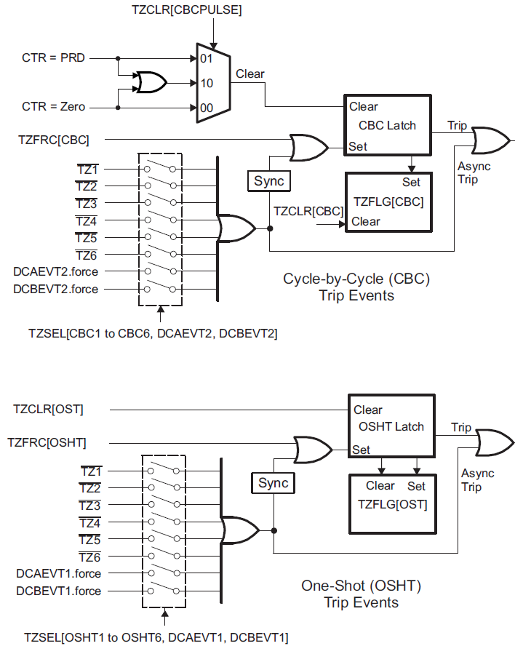
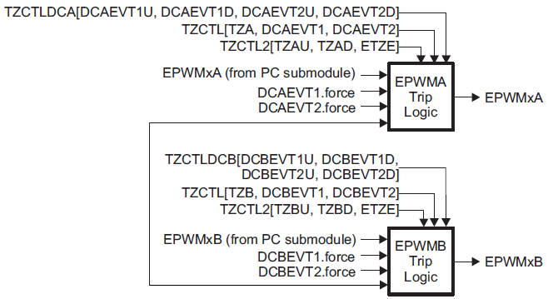

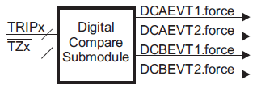
Trip-Zone Sub-Module Control Logic

Slide 37
Trip-Zone Driverlib Functions
Enable / disable Trip-Zone signals
EPWM_[enable|disable]TripZoneSignals(base, tzSignal);
Set Trip-Zone Action
EPWM_setTripZoneAction(base, tzEvent, tzAction);
Enable / disable Trip-Zone interrupts
EPWM_[enable|disable]TripZoneInterrupt(base, tzInterrupt);
base is the ePWM base address: EPWMx_BASE (x = 1 to 8)
tzSignal is logical OR values of:
EPWM_TZ_SIGNAL_CBCx (x = 1 to 6)
EPWM_TZ_SIGNAL_x (x = DCAEVT2 or DCBEVT2) <CBC>
EPWM_TZ_SIGNAL_OSHTx (x = 1 to 6)
EPWM_TZ_SIGNAL_x (x = DCAEVT1 or DCBEVT1) <OSHT>
tzEvent value is: EPWM_TZ_ACTION_EVENT_x (x = TZA, TZB, DCAEVT1, DCAEVT2, DCBEVT1, or DCBEVT2)
tzAction value is: EPWM_TZ_ACTION_x (x = HIGH_Z, HIGH, LOW, or DISABLE)
tzInterrupt is logical OR values of: EPWM_TZ_INTERRUPT_x (x = CBC, OST, DCAEVT1, DCAEVT2, DCBEVT1, or DCBEVT2)

Slide 38
Digital Compare Trip Inputs
GPIO
MUX
INPUT
X-BAR
TRIPIN1 & TZ1
Digital
Compare
Sub-
Module
TRIPIN2 & TZ2
TRIPIN3 & TZ3
TRIPIN6
TRIPIN4
TRIPIN5
ePWM
X-BAR
TRIPIN7
TRIPIN8
TRIPIN9
TRIPIN10
TRIPIN11
TRIPIN12
TRIPIN14 (ECCDBLERR)
TRIPIN15 (PIEERR)
TRIPIN15
TRIPIN14
TRIPIN1 & TZ1
TRIPIN2 & TZ2
TRIPIN3 & TZ3
TRIPIN6
TRIPIN4
TRIPIN5
TRIPIN7
TRIPIN8
TRIP COMBO
TRIPIN9
TRIPIN10
TRIPIN11
TRIPIN12

Slide 39
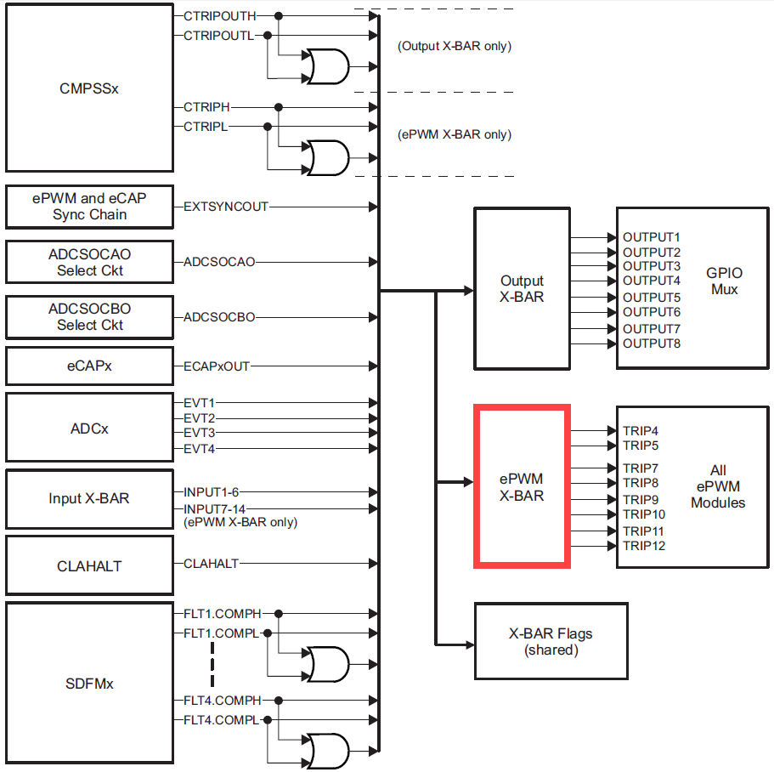
ePWM X-BAR

Slide 40
ePWM X-Bar Architecture
0.0
XBAR_enableEPWMMux(trip, muxes);
0.1
0
XBAR_disableEPWMMux(trip, muxes);
0.2
0.3
This block diagram is replicated 8 times
1.0
1.1
1
TRIPINx
1.2
1.3
XBAR_invertEPWMSignal(trip, invert);
31.0
31.1
31
31.2
31.3
XBAR_setEPWMMuxConfig(trip, muxConfig);
MUX | 0 | 1 | 2 | 3
0 | CMPSS1.CTRIPH | CMPSS1.CTRIPH_OR_CTRIPL | ADCAEVT1 | ECAP1OUT
1 | CMPSS1.CTRIPL | INPUTXBAR1 |  | ADCCEVT1
2 | CMPSS2.CTRIPH | CMPSS2.CTRIPH_OR_CTRIPL | ADCAEVT2 | ECAP2OUT
3 | CMPSS2.CTRIPL | INPUTXBAR2 |  | ADCCEVT2
4 | CMPSS3.CTRIPH | CMPSS3.CTRIPH_OR_CTRIPL | ADCAEVT3 | ECAP3OUT
5 | CMPSS3.CTRIPL | INPUTXBAR3 |  | ADCCEVT3
6 | CMPSS4.CTRIPH | CMPSS4.CTRIPH_OR_CTRIPL | ADCAEVT4 | ECAP4OUT
7 | CMPSS4.CTRIPL | INPUTXBAR4 |  | ADCCEVT4
8 | CMPSS5.CTRIPH | CMPSS5.CTRIPH_OR_CTRIPL | ADCBEVT1 | ECAP5OUT
9 | CMPSS5.CTRIPL | INPUTXBAR5
10 | CMPSS6.CTRIPH | CMPSS6.CTRIPH_OR_CTRIPL | ADCBEVT2 | ECAP6OUT
11 | CMPSS6.CTRIPL | INPUTXBAR6
12 | CMPSS7.CTRIPH | CMPSS7.CTRIPH_OR_CTRIPL | ADCBEVT3 | ECAP7OUT
13 | CMPSS7.CTRIPL | ADCSOCA
14 |  |  | ADCBEVT4 | EXTSYNCOUT
15 |  | ADCSOCB
MUX | 0 | 1 | 2 | 3
16 | SD1FLT1.COMPH | SD1FLT1.COMPH_OR_COMPL
17 | SD1FLT1.COMPL | INPUT7 |  | CLAHALT
18 | SD1FLT2.COMPH | SD1FLT2.COMPH_OR_COMPL
19 | SD1FLT2.COMPL | INPUT8
20 | SD1FLT3.COMPH | SD1FLT3.COMPH_OR_COMPL
21 | SD1FLT3.COMPL | INPUT9
22 | SD1FLT4.COMPH | SD1FLT4.COMPH_OR_COMPL
23 | SD1FLT4.COMPL | INPUT10
24
25 |  | INPUT11
26
27 |  | INPUT12
28
29 |  | INPUT13
30
31 |  | INPUT14

Slide 41
Purpose of the Digital Compare Sub-Module
Generates ‘compare’ events that can:
Trip the ePWM
Generate a Trip interrupt
Sync the ePWM
Generate an ADC start of conversion
Digital compare module inputs are:
Input X-Bar
ePWM X-Bar
Trip-zone input pins
A compare event is generated when one or more of its selected inputs are either high or low
Optional ‘Blanking’ can be used to temporarily disable the compare action in alignment with PWM switching to eliminate noise effects

Slide 42
Digital Compare Sub-Module Signals
EPWM_setTripZoneDigitalCompareEventCondition(base, dcType*, dcEvent);
Time-Base Sub-Module
DCAH
DCAEVT1
Generate PWM Sync
Digital Trip
Event A1
Compare
TRIPIN1 & TZ1
Event-Trigger Sub-Module
TRIPIN2 & TZ2
blanking
Generate SOCA
TRIPIN3 & TZ3
Digital Trip
Event A2
Compare
Trip-Zone Sub-Module
TRIPIN4
DCAL
Trip PWMA Output
Generate Trip Interrupt
●
DCAEVT2
●
●
Time-Base Sub-Module
DCBH
DCBEVT1
Generate PWM Sync
TRIPIN12
Digital Trip
Event B1
Compare
Event-Trigger Sub-Module
TRIPIN14
Generate SOCB
TRIPIN15
blanking
Digital Trip
Event B2
Compare
Trip-Zone Sub-Module
TRIP COMBO
DCBL
Trip PWMB Output
Generate Trip Interrupt
DCBEVT2
EPWM_selectDigitalCompareTripInput(base, tripSource, dcType);
EPWM_[enable|disable]DigitalCompareTripCombinationInput(base, tripInput, dcType);

Slide 43
Digital Compare Events
The user selects the input for each of DCAH, DCAL, DCBH, DCBL
Each A and B compare uses its corresponding DCyH/L inputs (y = A or B)
The user selects the signal state that triggers each compare from the following choices:
DCyH → low DCyL → don’t care
DCyH → high DCyL → don’t care
iii. DCyL → low DCyH → don’t care
iv. DCyL → high DCyH → don’t care
v. DCyL → high DCyH → low
EPWM_setTripZoneDigitalCompareEventCondition(base, dcType, dcEvent);

Slide 44
Digital Compare Driverlib Functions
Select Digital Compare trip inputs
EPWM_selectDigitalCompareTripInput(base, tripSource, dcType);
Enable / disable Digital Compare trip combination inputs
EPWM_[enable|disable]DigitalCompareTripCombinationInput( base, tripInput, dcType);
Set Digital Compare conditions which cause Trip-Zone events
EPWM_setTripZoneDigitalCompareEventCondition(base, dcType*, dcEvent);
base is the ePWM base address: EPWMx_BASE (x = 1 to 8)
tripSource value is:
EPWM_DC_TRIP_TRIPINx (x = 1 to 12, 14, 15)
EPWM_DC_TRIP_COMBINATION - selects trip signals enabled by the
EPWM_enableDigitalCompareTripCombinationInput() function
dcType value is: EPWM_DC_TYPE_x (x = DCAH, DCAL, DCBH , or DCBL)
tripInput value is: EPWM_DC_COMBINATIONAL_TRIPINx (x = 1 to 12, 14, 15)
dcType* value is: EPWM_TZ_DC_OUTPUT_x (x = A1, A2, B1, or B2)
dcEvent value is: EPWM_TZ_EVENT_x (x = DC_DISABLED, DCyH_LOW, DCyH_HIGH, DCyL_LOW, DCyL_HIGH, or DCyL_HIGH_DCyH_LOW) → where y in DCyH/DCyL represents DCAH/DCAL or DCBH/DCBL

Slide 45
Digital Compare Driverlib Functions
Time-Base Sub-Module
DCxEVT1
Generate PWM Sync
Event-Trigger Sub-Module
Generate SOCx
(x = A or B)
Trip-Zone Sub-Module
Trip PWMx Output
DCxEVT2
Generate Trip Interrupt
Enable / disable Digital Compare Sync Event
EPWM_[enable|disable]DigitalCompareSyncEvent(base, dcModule);
Enable / disable Digital Compare ADC trigger
EPWM_[enable|disable]DigitalCompareADCTrigger(base, dcModule);
Enable / disable Trip-Zone signals and Trip-Zone interrupts
See Trip-Zone Driverlib Functions:
EPWM_[enable|disable]TripZoneSignals(base, tzSignal);
EPWM_[enable|disable]TripZoneInterrupt(base, tzInterrupt);
base is the ePWM base address: EPWMx_BASE (x = 1 to 8)
dcModule value is: EPWM_DC_MODULE_x (x = A or B)

Slide 46
ePWM Event-Trigger Sub-Module

Slide 47
Event-Trigger Interrupts and SOC
.
.
TBCTR
.
.
.
.
TBPRD
.
.
.
.
CMPD
.
.
.
.
CMPC
.
.
.
.
CMPB
.
.
.
CMPA
CTR = 0
CTR = PRD
CTR = 0 or PRD
CTRU = CMPA
CTRD = CMPA
CTRU = CMPB
CTRD = CMPB
CTRU = CMPC
CTRD = CMPC
CTRU = CMPD
CTRD = CMPD
DCAEVT1.soc / DCBEVT1.soc generates EPWMxSOCA/B pulse (x = 1 to 8)

Slide 48
Event-Trigger Driverlib Functions
Enable / disable Event-Trigger ADC SOC
EPWM_[enable|disable]ADCTrigger(base, adcSOCType);
Set Event-Trigger ADC SOC source
EPWM_setADCTriggerSource(base, adcSOCType, socSource);
Set Event-Trigger ADC SOC prescale
EPWM_setADCTriggerEventPrescale(base, adcSOCType, preScaleCount);
base is the ePWM base address: EPWMx_BASE (x = 1 to 8)
adcSOCType value is: EPWM_SOC_x (x = A or B)
socSource value is:
EPWM_SOC_DCxEVT1 (x = A or B)
EPWM_SOC_TBCTR_x (x = ZERO, PERIOD, ZERO_OR_PERIOD)
EPWM_SOC_TBCTR_U_CMPx (x = A, B, C, or D)
EPWM_SOC_TBCTR_D_CMPx (x = A, B, C, or D)
preScaleCount value is: 1 to 15 (0 disables the prescale)

Slide 49
Event-Trigger Driverlib Functions
Enable / disable Event-Trigger interrupt
EPWM_[enable|disable]Interrupt(base);
Set Event-Trigger interrupt source
EPWM_setInterruptSource(base, interruptSource);
Set Event-Trigger interrupt event counts
EPWM_setInterruptEventCount(base, eventCount);
base is the ePWM base address: EPWMx_BASE (x = 1 to 8)
interruptSource value is:
EPWM_INT_TBCTR_x (x = ZERO, PERIOD, ZERO_OR_PERIOD)
EPWM_INT_TBCTR_U_CMPx (x = A, B, C, or D)
EPWM_INT_TBCTR_D_CMPx (x = A, B, C, or D)
eventCount maximum value is: 15 (Determines the number of events that have to occur before an interrupt is issued)

Slide 50
High-Resolution PWM (HRPWM)
PWM Period
Regular PWM Step
(i.e. 10 ns)
Device Clock
(i.e. 100 MHz)
HRPWM divides a clock cycle into smaller steps
called Micro Steps
(Step Size ~= 150 ps)
Calibration Logic tracks the number of Micro Steps per clock to account for variations caused by Temp/Volt/Process
ms
ms
ms
ms
ms
ms
Calibration Logic
HRPWM
Micro Step (~150 ps)
Significantly increases the resolution of conventionally derived digital PWM
Uses 8-bit extensions to Compare registers (CMPxHR), Period register (TBPRDHR) and Phase register (TBPHSHR) for edge positioning control
Typically used when PWM resolution falls below ~9-10 bits which occurs at frequencies greater than ~200 kHz (with system clock of 100 MHz)
Not all ePWM outputs support HRPWM feature (see device datasheet)

Slide 51
HRPWM block diagram

Slide 52
HRPWM Registers

Slide 53
Limitations – Minimum duty (1/2)
Minimum 3 PWM cycles for HR duty if HRPCTL[HRPE]=0
Minimum 6 PWM cycles for HR duty if HRPCTL[HRPE]= 1
Minimum 7 PWM cycles for HR Deadband (DBREDHR or DBFEDHR)

Slide 54
Limitations – Minimum duty (2/2)

Slide 55
Limitations – HR Period and Sync
When high-resolution period mode is enabled, an EPWMxSYNC pulse will introduce +/- 1 - 2 cycle jitter to the PWM
When EPWMxSYNCI is EPWMxSYNCO source, a software synchronization pulse should be issued only once during high-resolution period initialization.
Refer to TIDM-02002 CLLLC, which uses HR period at PWM resonant 500 KHz.

Slide 56
Advanced Features on Type-4 PWM
PWM (Type-4) Features | C2000 devices Gen 3 | System benefit
High-Resolution on PWM output capability (on period, enables frequency modulated PWM strategies, dead-band capabilities) | Y | Enables better performance high-frequency power conversion. Achieve cleaner waveforms and avoid oscillations/limit cycle at output.
CMPC & CMPD (enables generation ADC SOC and INT anywhere in PWM period) | Y | Trigger ADC conversion at any point. Enables highly accurate oversampling.
Load on SYNC (support for shadow-to-active load on a SYNC event) | Y | Enables variable frequency applications (allows LLC control in power conversion).
Simultaneous register writes across multiple PWM modules | Y | Enables complex, high frequency power control (interleaved, LLC topologies). Especially applicable in time-critical applications
Action qualifier registers (shadowing of AQCTLA and AQCTLB registers) | Y | Cleanly disable and re-enable 1 PWM phase. Needed to implement Peak Current Mode Control (PCMC)
Delayed trip functionality (dead-band insertion capability on a trip event) | Y | Enables Zero Voltage Switching (ZVS) which leads to higher efficiencies. Achieve PSFB, PCMC, transition mode PFC topologies/implementations
Global load (from shadow to active registers) | Y | Enables control of interleaved LLC topologies at high frequencies
Valley switching (ability to switch PWM output at valley point) | Y | Enables improvement in Power Factor (PF) and Total Harmonic Distortion (THD), especially relevant in PFC applications. Enables light load efficiency.

Slide 57
Delayed trip
Useful for peak current mode for buck, boost, phase-shift full bridge

Slide 58
Peak Current Mode Control – Sync Buck
Peak current mode control of a synchronous DC-DC buck converter.

Slide 59
Peak Current Mode Control – PSFB
Peak current mode control of a Phase Shifted Full-Bridge (PSFB) DC-DC converter.

Slide 60
ePWM Action Qualifier Actions for EPWMA and EPWMB
Can be used from trip events
S/W
Force
Time-Base Counter equals:
Trigger Events:
EPWM
Output
Actions
Zero
CMPA
CMPB
TBPRD
T1
T2
SW
X
Z
X
CA
X
CB
X
P
X
T1
X
T2
X
Do Nothing
SW
↓
Z
↓
CA
↓
CB
↓
P
↓
T1
↓
T2
↓
Clear Low
SW
↑
Z
↑
CA
↑
CB
↑
P
↑
T1
↑
T2
↑
Set High
SW
T
Z
T
CA
T
CB
T
P
T
T1
T
T2
T
Toggle
Tx Event Sources = DCAEVT1, DCAEVT2, DCBEVT1, DCBEVT2, TZ1, TZ2, TZ3, EPWMxSYNCIN

Slide 61
Simultaneous Writes One Shot & Global Reload Capability
Useful for variable frequency topologies like LLC resonant

Slide 62
Shadow to Active Load on SYNC (Variable Frequency Application)

Slide 63
Simultaneous Writes to Shadow Registers Between Modules by EPWMXLINK (Variable Frequency Application)

Slide 64
One Shot & Global Reload
One shot reload usage
Initialization
Enable global reload
Link GLDCTL2 registers
Run Time
Update all registers
Write ‘1’ to GLDCTL2[OSHTLD]
Write ‘1’ to GLDCTL2[GFRCLD], if desired
For all registers that have this mode enabled, shadow to active loads occur at the same event defined by GLDCTL[GLDMODE]
Global reload pulse pre-scalar provides capability to choose transfers to happen once in ‘N’ occurrences of selected event

Slide 65
Valley Switching
Useful for DCM like PFC light loads

Slide 66
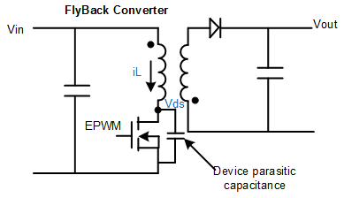
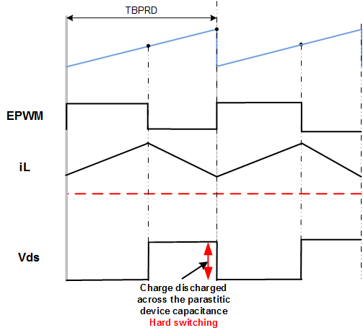
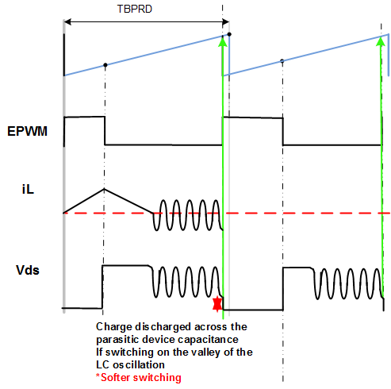
Need for Valley Switching - Flyback in DCM and CCM mode
CCM Mode of operation
DCM Mode of operation
DCM Mode is typically encountered at light load, where efficiency standards are hard to meet and any savings reflect a larger percentage and under high input line condition

Slide 67
What is Valley Switching ?
Soft-switching technique that improves system efficiency
Switch should be turned ON at the valley point of the voltage across it
Results is slight variance of the frequency
Where is it used ?
AC/DC, DC/DC for Server, Telecom rectifiers, data storage and general digital power
Challenges ?
Resonant oscillations are dependent on circuit parasitics and typically in the MHz
Need for programmable number of valleys
Dependence on dedicated external circuit

Slide 68
Valley Switching Enhancements
A hardware mechanism to precisely control PWM ON/OFF time instants to implement valley switching
Captures time period of oscillations to accurately delay PWM switching instant
Ability to add software programmable offset to captured delay
Programmable number of edges before the delay takes effect
Multiple choices of triggers and events
Allows easy adaptability for optimum performance under changing system/operating conditions

Slide 69
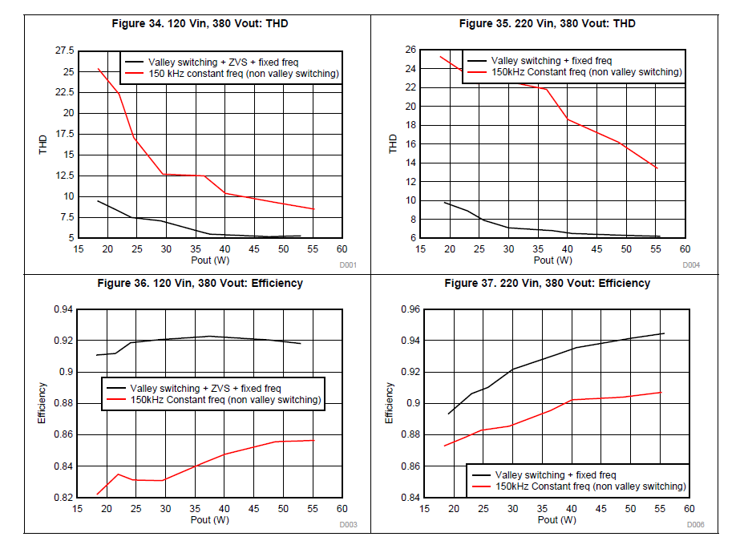
Valley Switching Result on TIDM-1022 (Load < 10%, 750W)

Slide 70
Backup

Slide 71
Capture Module (eCAP)
Timer
Trigger
pin
Timestamp
Values
The eCAP module timestamps transitions on a capture input pin
Can be used to measure the time width of a pulse
Auxiliary PWM generation
t₁
t₂

Slide 72
eCAP Module Block Diagram – Capture Mode
ECAP_enableCaptureMode(base);
Delta Mode
Capture 1
Register
Event Qualifier
Polarity
Select 1
Other
Sources
Reset
Capture 2
Register
Polarity
Select 2
[127:16]
32-Bit
Time-Stamp
Counter
Event
Prescale
Capture 3
Register
Polarity
Select 3
[15:0]
Input
X-BAR
Hi-Res
Capture
Capture 4
Register
Polarity
Select 4
DMA
Trigger
PIE
(ECAPx)
Continuous / One-shot
Capture Control

Slide 73
eCAP Module Block Diagram – APWM Mode
ECAP_enableAPWMMode(base);
Shadowed
Period
Register
(CAP3)
Period
Register
(CAP1)
shadow
mode
immediate
mode
32-Bit
Time-Stamp
Counter
PWM
Compare
Logic
Output
X-BAR
Compare
Register
(CAP2)
immediate
mode
Compare
Register
(CAP4)
shadow
mode
Shadowed

Slide 74
eCAP Driverlib Function
Enable capture or APWM mode
ECAP_enableCaptureMode(base);
ECAP_enableAPWMMode(base);
Select eCAP input signal
ECAP_selectECAPInput(base, input);
Stop / start time stamp counter
ECAP_[stop|start]Counter(base);
base is the eCAP base address: ECAPx_BASE (x = 1 to 7)
input value is:
ECAP_INPUT_INPUTXBARx (x = 1 to 16)
ECAP_INPUT_CANx_INT0 (x = A or B)
ECAP_INPUT_ECAP_DELAY_CLOCK
ECAP_INPUT_OUTPUTXBARx (x = 1 to 8)
ECAP_INPUT_ADC_y_EVENTx (x = 1 to 4) (y = A, B, or C)
ECAP_INPUT_SDFM1_FLTx_COMPARE_y (x = 1 to 4) (y = LOW, HIGH, or HIGH_OR_LOW)
ECAP_INPUT_CMPSSx_CTRIP_y (x = 1 to 7) (y = LOW, HIGH, or HIGH_OR_LOW)

Slide 75
eCAP Driverlib Function
Enable / disable load of time stamp on capture event (CAP1 –CAP4)
ECAP_[enable|disable]TimeStampCapture(base);
Set capture mode (continuous/wrap or one-shot/stop mode)
ECAP_setCaptureMode(base, mode, event);
Sets the capture event polarity (rising or falling edge)
ECAP_setEventPolarity(base, event, polarity);
Enable / disable counter reset on event (delta / absolute time stamp)
ECAP_[enable|disable]CounterResetOnEvent(base, event);
Set and enable / disable capture event interrupt source
ECAP_[enable|disable]Interrupt(base, intFlags);
Set eCAP input event filter prescale counter
ECAP_setEventPrescaler(base, preScalerValue);
base is the eCAP base address: ECAPx_BASE (x = 1 to 7)
mode value is: ECAP_CONTINUOUS_CAPTURE_MODE or ECAP_ONE_SHOT_CAPTURE_MODE
event value is: ECAP_EVENT_x (x = 1 to 4)
polarity value is: ECAP_EVNT_RISING_EDGE or ECAP_EVNT_FALLING_EDGE
intFlags value is: ECAP_ISR_SOURCE_CAPTURE_x (x = EVENT_1, EVENT_2, EVENT_3, EVENT_4, OVERFLOW, PERIOD, COMPARE)
preScalerValue value is: 1, 2, …31 (divide is 2x - i.e. 5 is /10; 1 = no prescale)

Slide 76
What is an Incremental Quadrature Encoder?
A digital (angular) position sensor
photo sensors spaced θ/4 deg. apart
slots spaced θ deg. apart
θ/4
light source (LED)
θ
Ch. A
Ch. B
shaft rotation
Incremental Optical Encoder
Quadrature Output from Photo Sensors

Slide 77
How is Position Determined from Quadrature Signals?
Position resolution is θ/4 degrees
increment
counter
decrement
counter
(00)
(11)
(A,B) =
10
(10)
(01)
Ch. A
Illegal Transitions; generate phase error interrupt
00
11
Ch. B
01
Quadrature Decoder
State Machine

Slide 78
eQEP Module Block Diagram
Measure the elapsed time between the unit position events; used for low speed measurement
Quadrature
Capture
Generate periodic interrupts for velocity calculations
Direction -count mode
Quadrature -clock mode
Monitors the quadrature clock to indicate proper operation of the motion control system
Quadrature
Decoder
EQEPxA/XCLK
32-Bit Unit
Time-Base
EQEPxB/XDIR
QEP
Watchdog
EQEPxI
CPUx.SYSCLK
EQEPxS
Position/Counter
Compare
Generate the direction and clock for the position counter in quadrature count mode
Generate a sync output and/or interrupt on a position compare match
See the F28004x Driver Library User’s Guide for available functions

Slide 79
eQEP Module Connections
Ch. A
Quadrature
Capture
Ch. B
Quadrature
Decoder
EQEPxA/XCLK
32-Bit Unit
Time-Base
EQEPxB/XDIR
QEP
Watchdog
EQEPxI
Index
CPUx.SYSCLK
EQEPxS
Strobe
from homing sensor
Position/Counter
Compare

Slide 80
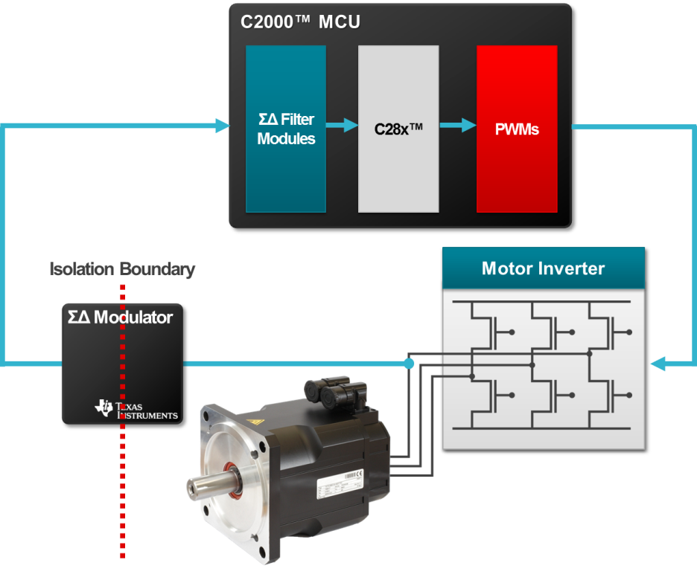
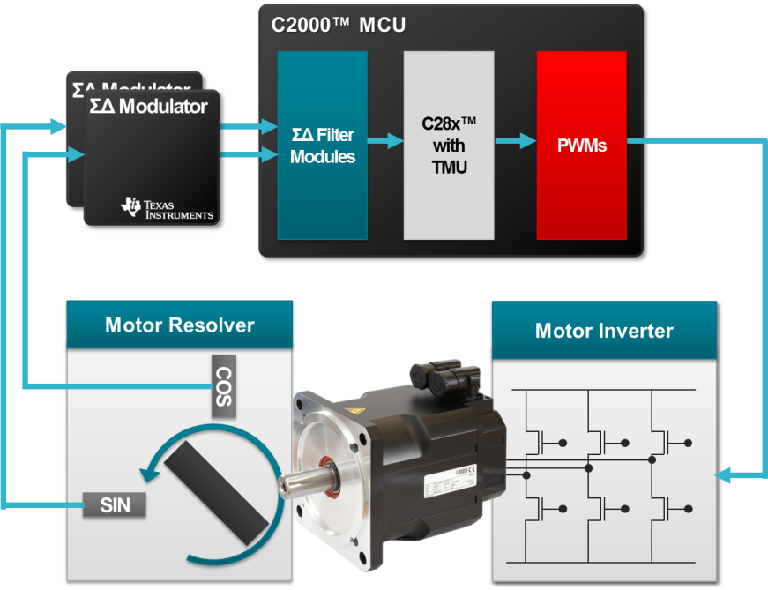

Sigma Delta Filter Module (SDFM)
Isolation Boundary
Digital
Isolator
0100111010…
Digital
Isolator
SDFM is a four-channel digital filter designed specifically for current measurement and resolver position decoding in motor control applications
Each channel can receive an independent modulator bit stream
Bit streams are processed by four individually programmable digital decimation filters
Filters include a fast comparator for immediate digital threshold comparisons for over-current monitoring
Filter-bypass mode available to enable data logging, analysis, and customized filtering

Slide 81
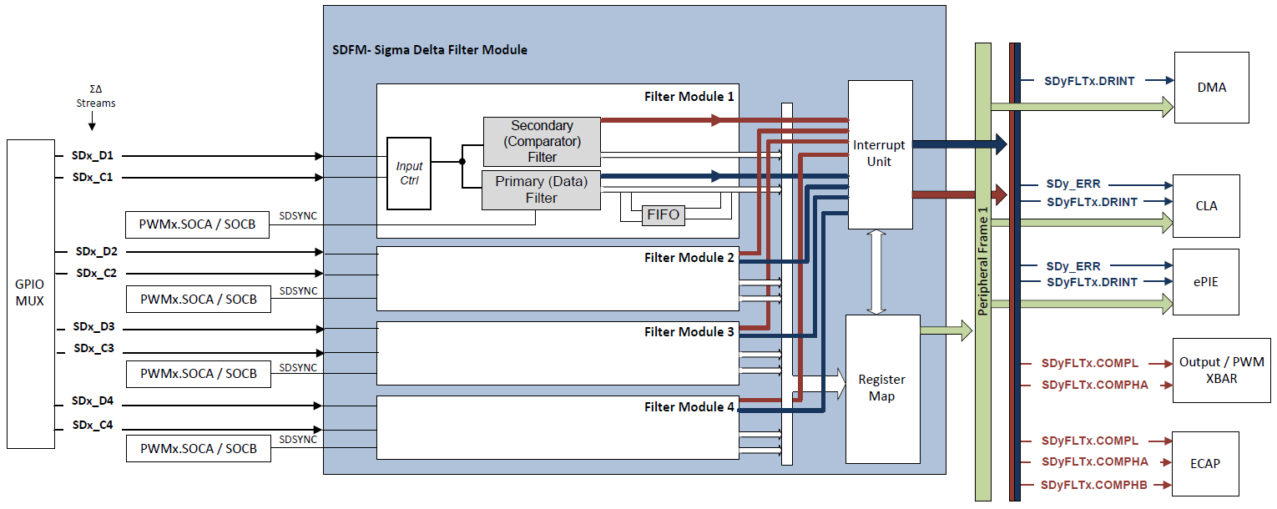
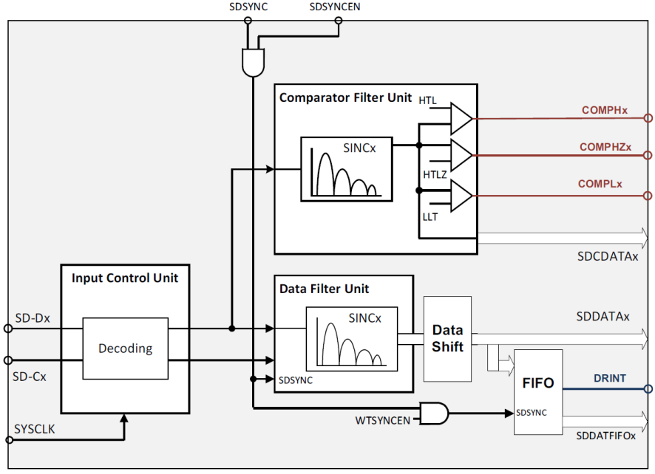
SDFM Block Diagram

Slide 82
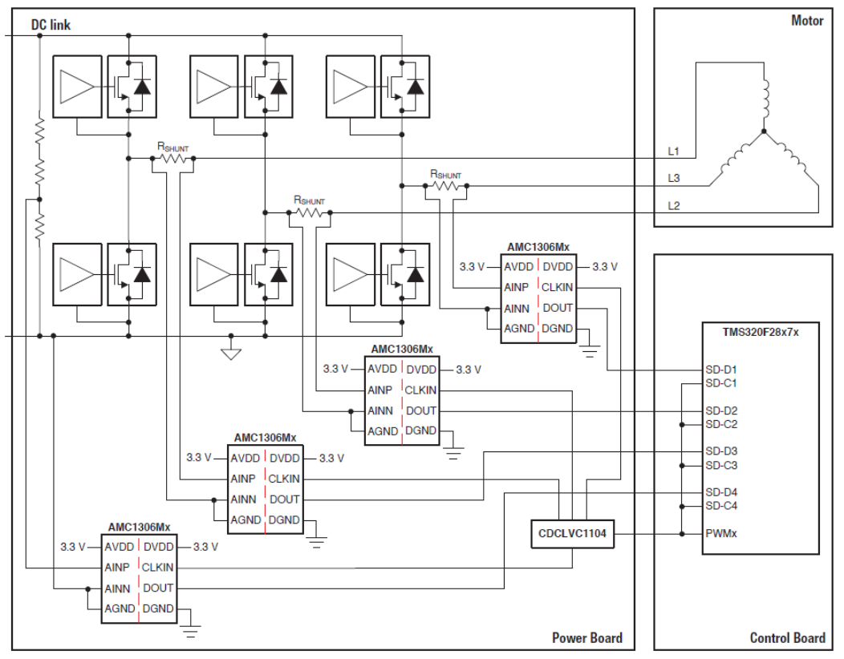
Isolated Phase Current-Sense Example
TMS320F28004x
SDFM enables galvanic isolation when utilized in conjunction with isolated sigma delta modulators

Slide 83
Lab 7: Control Peripherals
ePWM1
TB Counter
Compare
Action Qualifier
data
memory
jumper
wire
ADC
CPU copies
result to
buffer during
ADC ISR
RESULT0
Input X-BAR
Capture 1 Register
ADC-
INA0
pointer rewind
...
Capture 2 Register
Capture 3 Register
Capture 4 Register
eCAP1
View ADC buffer PWM samples
ePWM2 triggering
ADC on period match using SOCA trigger every 20 µs (50 kHz)
ePWM2
Code Composer
Studio
Notes:
This foil describes the lab flow.
Connector wire: used to select the desired input to the ADC.
GP Timer 2: used to auto-trigger the ADC at a 50kHz rate.
The ADC will send an interrupt to the CPU when each conversion is done. Note that we are taking an ADC interrupt on every conversion (IM=0 in ADCTRL2), rather than on every other conversion. We could have written the code to do the later if we had wanted to, and saved some CPU interrupt overhead.
In the ADC ISR, the CPU will read the ADC result FIFO, and write the result into the data memory allocated for use as the results buffer. The CPU will then increment the pointer into the buffer, and check to see if the end of the buffer has been reached. If so, the pointer is rewound to the beginning of the buffer.
The contents of the buffer will be plotted in Code Explorer.

Slide 84

C2000 Technical Training
www.ti.com/c2000

