Slide 1

Control Law Accelerator
Module 9
C2000™ Microcontroller Workshop
Copyright © 2019 Texas Instruments. All rights reserved.

Slide 2
Module Objectives
Explain the purpose and operation of the Control Law Accelerator (CLA)
Describe the CLA initialization procedure
Review the CLA registers, instruction set, and programming flow

Slide 3
Control Law Accelerator (CLA)
ADC
C28x CPU
PWM
CLA
The CLA is a 32-bit floating-point processor that responds to peripheral triggers and executes code independent of the main CPU
Designed for fast trigger response and oriented toward math computations
Direct access to ePWM, HRPWM, eCAP, eQEP, ADC, DAC, CMPSS, PGA, SDFM, SPI, LIN, FSI, PMBus, CLB, and GPIO
Frees up the CPU for other tasks (communications, systems, and diagnostics)

Slide 4
CLA Block Diagram
Task Triggers
(Peripheral Interrupts)
Task1 Trigger
Task2 Trigger
Task3 Trigger
Task4 Trigger
Task5 Trigger
Task6 Trigger
Task7 Trigger
Task8 Trigger
CLA
Control & Execution
Registers
PIE
C28x
CPU
CLA_INT1-8
LVF, LUF
INT11
INT12
MPERINT1-8
CLA Program Bus
CLA Data Bus
Program
RAM
Data
RAM
MSG RAMs
CPU to CLA
CLA to CPU
Registers
ePWM
HRPWM
CMPSS
SDFM
eCAP
eQEP
DAC
PGA
ADC
SPI
LIN
FSI
GPIO
PMBus
CLB

Slide 5
CLA Tasks
Task Triggers
(Peripheral Interrupts)
Task1 Trigger
Task2 Trigger
Task3 Trigger
Task4 Trigger
Task5 Trigger
Task6 Trigger
Task7 Trigger
Task8 Trigger
CLA
Control & Execution
Registers
PIE
C28x
CPU
CLA_INT1-8
LVF, LUF
INT11
INT12
MPERINT1-8
A Task is similar to an interrupt service routine
CLA supports 8 tasks (Task1-8)
A task is started by a peripheral interrupt trigger
Triggers are enabled in the CLA1TASKSRCSELx register
When a trigger occurs the CLA begins execution at the associated task vector entry (MVECT1-8)
Once a task begins it runs to completion (no nesting)
Capable of running a continuous background task

Slide 6
CLA Memory and Register Access
CLA Program Memory
Message RAMs
Contains CLA program code
Mapped to the CPU at reset
Initialized by the CPU
Used to pass data between the CPU and CLA
Always mapped to both the CPU and CLA
LS0 – LS7 RAM
LS0 – LS7 RAM
PF1, PF2, PF3, and PF8
Program
RAM
Data
RAM
MSG RAMs
CPU to CLA
CLA to CPU
Registers
ePWM
HRPWM
CMPSS
SDFM
eCAP
eQEP
DAC
PGA
ADC
SPI
LIN
FSI
GPIO
PMBus
CLB
(2Kw each)
(2Kw each)
(128w/128w)
CLA Data Memory
Contains variables and coefficients used by the CLA program code
Mapped to the CPU at reset
Initialized by CPU
Peripheral Register Access
Provides direct access to peripherals

Slide 7
CLA Control and Execution Registers
CLA1TASKSRCSELx
MIFR
MIER
Task
Source
Triggers
•
•
•
•
1
•
•
CLA_INT1-8
LVF, LUF
C28x
CPU
PIE
CLA
Core
INT11
INT12
•
•
•
•
0
•
•
MR0
MR1
MR2
MR3
MIFRC
S/W Trigger
MAR0
MAR1
MVECTBGRNDACTIVE
MVECTBGRND
MPC
MVECT1-8
Program
Memory
Data
Memory
CLA Program Bus
CLA Data Bus
LSxCLAPGM
CLA1TASKSRCSELx – Task Interrupt Source Select (Task 1-8)
MVECT1-8 – Task Interrupt Vector (MVECT1/2/3/4/5/6/7/8)
MVECTBGRND – Background Task Vector
LSxCLAPGM – Memory Map Configuration (LS0 – LS7 RAM)
MPC – 16-bit Program Counter (initialized by appropriate MVECTx register or MVECTBGRND)
MVECTBGRNDACTIVE – saves return address
MR0-3 – CLA Floating-Point Result Registers (32 bit)
MAR0-1 – CLA Auxiliary Registers (16 bit)

Slide 8
Task Trigger Driverlib Functions
CLA1TASKSRCSELx
MIFR
MIER
Task
Source
Triggers
•
•
•
•
1
•
•
CLA Core
•
•
•
•
0
•
•
MIFRC
S/W Trigger
Configure the CLA task trigger source (CLA1TASKSRCSELx)
CLA_setTriggerSource(taskNumber, trigger);
Enable / disable CLA task(s) interrupt(s) (configures MIER)
CLA_[enable|disable]Tasks(base, taskFlags);
taskNumber parameter indicates which task is being configured:
CLA_TASK_x (x = 1 to 8)
trigger parameter is the interrupt trigger source – see next slide
base is the CLA base address: CLA1_BASE
taskFlags parameter value is the bitwise OR of:
CLA_TASKFLAG_x (x = 1 to 8) or CLA_TASKFLAG_ALL

Slide 9
Task Interrupt Trigger Sources
CLA_setTriggerSource(taskNumber, trigger);
CLA_TRIGGER_SOFTWARE | CLA_TRIGGER_ADCCEVT | CLA_TRIGGER_TINT1 | CLA_TRIGGER_SDFM1DRINT2
CLA_TRIGGER_ADCA1 | CLA_TRIGGER_XINT1 | CLA_TRIGGER_TINT2 | CLA_TRIGGER_SDFM1DRINT3
CLA_TRIGGER_ADCA2 | CLA_TRIGGER_XINT2 | CLA_TRIGGER_ECAP1INT | CLA_TRIGGER_SDFM1DRINT4
CLA_TRIGGER_ADCA3 | CLA_TRIGGER_XINT3 | CLA_TRIGGER_ECAP2INT | CLA_TRIGGER_PMBUSAINT
CLA_TRIGGER_ADCA4 | CLA_TRIGGER_XINT4 | CLA_TRIGGER_ECAP3INT | CLA_TRIGGER_SPITXAINT
CLA_TRIGGER_ADCAEVT | CLA_TRIGGER_XINT5 | CLA_TRIGGER_ECAP4INT | CLA_TRIGGER_SPIRXAINT
CLA_TRIGGER_ADCB1 | CLA_TRIGGER_EPWM1INT | CLA_TRIGGER_ECAP5INT | CLA_TRIGGER_SPITXBINT
CLA_TRIGGER_ADCB2 | CLA_TRIGGER_EPWM2INT | CLA_TRIGGER_ECAP6INT | CLA_TRIGGER_SPIRXBINT
CLA_TRIGGER_ADCB3 | CLA_TRIGGER_EPWM3INT | CLA_TRIGGER_ECAP7INT | CLA_TRIGGER_LINAINT1
CLA_TRIGGER_ADCB4 | CLA_TRIGGER_EPWM4INT | CLA_TRIGGER_EQEP1INT | CLA_TRIGGER_LINAINT0
CLA_TRIGGER_ADCBEVT | CLA_TRIGGER_EPWM5INT | CLA_TRIGGER_EQEP2INT | CLA_TRIGGER_CLA1PROMCRC
CLA_TRIGGER_ADCC1 | CLA_TRIGGER_EPWM6INT | CLA_TRIGGER_ECAP6INT2 | CLA_TRIGGER_FSITXAINT1
CLA_TRIGGER_ADCC2 | CLA_TRIGGER_EPWM7INT | CLA_TRIGGER_ECAP7INT2 | CLA_TRIGGER_FSITXAINT2
CLA_TRIGGER_ADCC3 | CLA_TRIGGER_EPWM8INT | CLA_TRIGGER_SDFM1INT | CLA_TRIGGER_FSIRXAINT1
CLA_TRIGGER_ADCC4 | CLA_TRIGGER_TINT0 | CLA_TRIGGER_SDFM1DRINT1 | CLA_TRIGGER_FSIRXAINT2
Select ‘CLA_TRIGGER_SOFTWARE’ if task is unused or software triggered (default value)

Slide 10
Software Triggering a Task
Tasks can also be started by a software trigger using the CPU
Method #1: Write to Interrupt Force Register (MIFRC)
CLA_forceTask(base, taskFlags);
base is the CLA base address: CLA1_BASE
taskFlags value is the bitwise OR of the tasks:
CLA_TASKFLAG_x (x = 1 to 8) or CLA_TASKFLAG_ALL
15 - 8
7
6
5
4
3
2
1
0
reserved
INT8
INT7
INT6
INT5
INT4
INT3
INT2
INT1
Method #2: Use IACK instruction
CLA_[enable|disable]IACK(base);
Then trigger the task with the assembly instruction:
asm(" IACK #<Task>");
For example, to trigger TASK4:
asm(" IACK #0x0008");
More efficient – function does not require EALLOW

Slide 11
Background Task
Option to run 8 tasks or 7 tasks and 1 background task
Task 8 can be set to be the background task
While Tasks 1-7 service peripheral triggers in the foreground
Runs continuously until disabled or device/soft reset
Can be triggered by a peripheral or software
Tasks 1 - 7 can interrupt background task in priority order (Task1 is highest, Task7 is lowest)
Can make portions of background task uninterruptible, if needed
Background Task Uses:
Run continuous functions such as communications and clean-up routines

Slide 12
Background Task Registers
MVECTBGRND register contains the background task vector
Branch return address is saved to MVECTBGRNDACTIVE register
Address gets popped to the MPC when execution returns
MVECTBGRNDACTIVE
MVECTBGRND
CLA
Core
MPC
MVECT1-8
Program
Memory
CLA Program Bus
Enable / disable background task
CLA_[enable|disable]BackgroundTask(base);
Start the background task (provided there are no other pending tasks)
CLA_startBackgroundTask(base);
Enable / disable background task hardware trigger
CLA_[enable|disable]HardwareTrigger(base);
Trigger source for the background task selected by CLA1TASKSRCSELx
base is the CLA base address: CLA1_BASE

Slide 13
Background Task Interrupts
By default background tasks are interruptible
Highest priority pending task executes first
When task completes, and there are no other pending interrupt, execution returns to the background task
Sections of background task can be made uninterruptible
Using compiler intrinsics:
__disable_interrupts(); // MSETC BGINTM
__enable_interrupts(); // MCLRC BGINTM
//-------------------------------------------------------------------------
// Task 8 - Background Task
//-------------------------------------------------------------------------
__attribute__((interrupt("background"))) void Cla1Task8 ( void )
{
//
// Code below is interruptible
//
CODE GOES HERE...
//
// Make this portion un-interruptible
//
__disable_interrupts();
CODE GOES HERE...
__enable_interrupts();
//
// Code below is interruptible
//
CODE GOES HERE...
}
Specifies that this is a “background” task instead of a regular interrupt

Slide 14
Memory Config Driverlib Functions
Program
Memory
CLA
Core
Data
Memory
CLA Program Bus
CLA Data Bus
LSxCLAPGM
Set the LSx memory RAM configuration (CPU only or CPU & CLA)
MemCfg_setLSRAMMasterSel(ramSection, masterSel);
Set the CLA memory RAM configuration type (LSx = Data or Program)
MemCfg_setCLAMemType(ramSections, claMemType);
ramSection parameter value is:
MEMCFG_SECT_LSx (x = 0 to 7)
masterSel value is RAM section dedicated to the CPU or shared between the CPU and the CLA:
MEMCFG_LSRAMMASTER_CPU_ONLY
MEMCFG_LSRAMMASTER_CPU_CLA1
ramSections parameter value is an OR of:
MEMCFG_SECT_LSx (x = 0 to 7)
claMemType value is RAM section is configured as CLA data memory or CLA program memory:
MEMCFG_CLA_MEM_DATA or MEMCFG_CLA_MEM_PROGRAM

Slide 15
Task Vector Driverlib Functions
Task interrupt vector registers (MVECT1 to MVECT8) contain the start address for each task
MVECTBGRNDACTIVE
MVECTBGRND
CLA
Core
MPC
MVECT1-8
Program
Memory
CLA Program Bus
Map CLA task interrupt vector (MVECTx)
CLA_mapTaskVector(base, claIntVect, claTaskAddr);
Map CLA background task interrupt vector (MVECTBGRND)
CLA_mapBackgroundTaskVector(base, claTaskAddr);
base is the CLA base address: CLA1_BASE
claIntVect parameter is the CLA interrupt vector value:
CLA_MVECT_x (x = 1 to 8)
claTaskAddr is the start address of the task code

Slide 16
CLA Initialization
Performed by the CPU during software initialization
Copy CLA task code from flash to CLA program RAM
Initialize CLA data RAMs, as needed
Populate with data coefficients, constants, etc.
Configure the CLA registers
Enable the CLA clock – SysCtl_enablePeripheral(SYSCTL_PERIPH_CLK_CLA1);
Populate the CLA task interrupt vectors (MVECT1-8 registers)
Select the desired task interrupt sources (CLA1TASKSRCSELx registers)
If desired, enable IACK instruction to start tasks using software
Map CLA program RAM and data RAMs to CLA space
Configure desired CLA task completion interrupts in the PIE
Enable CLA task triggers in the MIER register
Initialize the desired peripherals to trigger the CLA tasks
Data can passed between the CLA and CPU via message RAMs or allocated CLA Data RAM

Slide 17
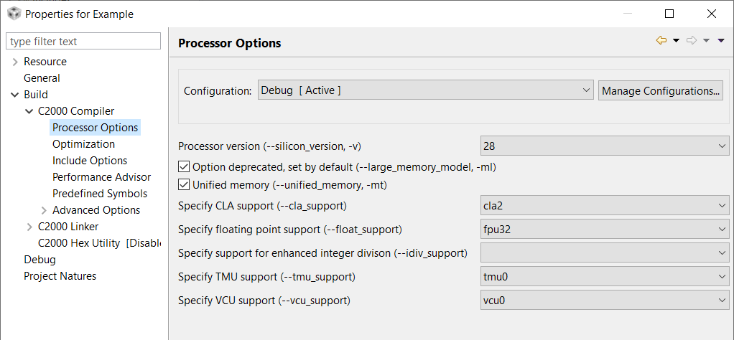
Enabling CLA Support in CCS
Set the “Specify CLA support” project option to ‘cla2’
When creating a new CCS project, choosing a device variant that has the CLA will automatically select this option, so normally no user action is required

Slide 18
CLA Task C Programming Language Implementation
Supports C only (no C++ or GCC extension support)
Different data type sizes than C28x CPU and FPU
CLA architecture is designed for 32-bit data types
16-bit computations incur overhead for sign-extension
16-bit values mostly used to read/write 16-bit peripheral registers
There is no SW or HW support for 64-bit integer or floating point
TYPE | CPU and FPU | CLA
char | 16 bit | 16 bit
short | 16 bit | 16 bit
int | 16 bit | 32 bit
long | 32 bit | 32 bit
long long | 64 bit | 32 bit
float | 32 bit | 32 bit
double | 32 bit | 32 bit
long double | 64 bit | 32 bit
pointers | 32 bit | 16 bit

Slide 19
CLA Task C Language Restrictions (1 of 2)
No initialization support for global and static local variables
int16_t x; // valid
int16_t x=5; // not valid
Initialized global variables should be declared in a .c file instead of the .cla file
.c file: .cla file:
int16_t x=5; extern int16_t x;
For initialized static variables, easiest solution is to use an initialized global variable instead
No recursive function calls
No function pointers

Slide 20
CLA Task C Language Restrictions (2 of 2)
No support for certain fundamental math operations
integer division: z = x/y;
modulus (remainder): z = x%y;
unsigned 32-bit integer compares
uint32_t i; if(i < 10) {…} // not valid
int32_t i; if(i < 10) {…} // valid
uint16_t i; if(i < 10) {…} // valid
int16_t i; if(i < 10) {…} // valid
float32_t x; if(x < 10) {…} // valid
No standard C math library functions, but TI provides some function examples (next slide)

Slide 21
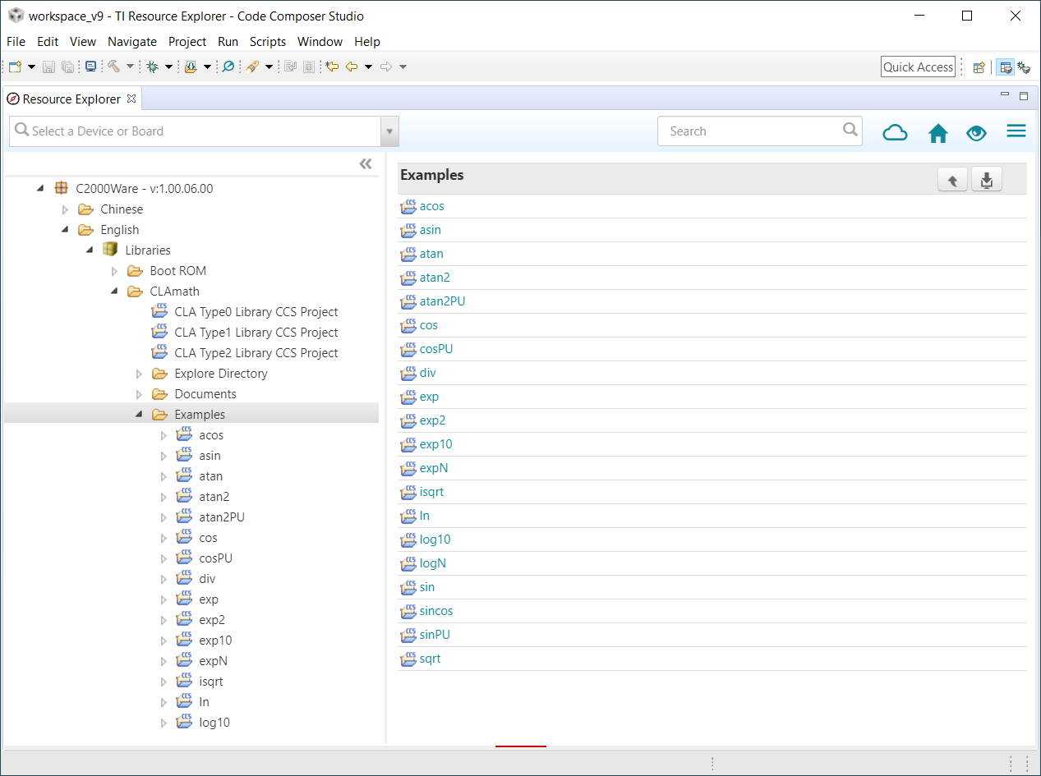
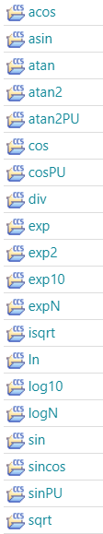
C2000Ware™ - CLA Software Support
TI provides some examples of floating-point math CLA functions
Resource Explorer
CLAmath
Examples

Slide 22
CLA Compiler Scratchpad Memory Area
For local and compiler generated temporary variables
Static allocation, used instead of a stack
Defined in the linker command file
Lab.cmd
MEMORY
{
}
SECTIONS
{
/*** CLA Compiler Required Sections ***/
.scratchpad : > RAMLS0, PAGE = 1
}

Slide 23
CLA Initialization Code Example
Defines data types and special registers specific to the CLA
Defines register bit field structures
CLA task prototypes are prefixed with the ‘interrupt’ keyword
CLA task symbols are visible to all C28x CPU and CLA code
Lab.h
#include “driverlib.h" // cla.h
#include “f28004x_device.h"
extern interrupt void Cla1Task1();
extern interrupt void Cla1Task2();
extern interrupt void Cla1Task8();
Cla.c
#include "Lab.h"
// Initialize CLA task interrupt vectors
CLA_mapTaskVector(CLA1_BASE, CLA_MVECT_1, (uint16_t)&Cla1Task1);
CLA_mapTaskVector(CLA1_BASE, CLA_MVECT_2, (uint16_t)&Cla1Task2);
CLA_mapTaskVector(CLA1_BASE, CLA_MVECT_7, (uint16_t)&Cla1Task7);
CLA_mapTaskVector(CLA1_BASE, CLA_MVECT_8, (uint16_t)&Cla1Task8);

Slide 24
CLA Task C Code Example
ClaTasks_C.cla
#include "F28004x_device.h"
#include "Lab.h"
;-------------------------------------
interrupt void Cla1Task1 (void)
{
__mdebugstop1();
xDelay[0] = (float32_t)AdcaResultRegs.ADCRESULT0;
Y = coeffs[4] * xDelay[4];
xDelay[4] = xDelay[3];
xDelay[1] = xDelay[0];
Y = Y + coeffs[0] * xDelay[0];
ClaFilteredOutput = (uint16_t)Y;
}
;-------------------------------------
interrupt void Cla1Task2 (void)
{
}
;-------------------------------------
.cla extension causes the c2000 compiler to invoke the CLA compiler
Bit Field peripheral address definitions
All code within this file is placed in the section “Cla1Prog”
C Peripheral Register Header File references can be used in CLA C and assembly code
Closing braces are replaced with MSTOP instructions when compiled

Slide 25
CLA Code Debugging
The CLA and CPU are debugged from the same JTAG port
You can halt, single-step, and run the CLA independent of the CPU
Insert a breakpoint in the CLA code
Insert a MDEBUGSTOP instruction(s) in the code where desired then rebuild/reload
In C code, can use asm(“ MDEBUGSTOP”) or intrinsic “__mdebugstop();” or use CCS software debug breakpoint
When the debugger is not connected, the MDEBUGSTOP1 acts like an MNOP
Connect to the CLA target in CCS
This enables CLA breakpoints
Run the CPU target
CLA task will trigger (via peripheral interrupt or software)
CLA executes instructions until MDEBUGSTOP1 is hit
Load the code symbols into the CLA context in CCS
This allows source-level debug
Needs to be done only once per debug session unless the .out file changes
Debug the CLA code
Can single-step the code, or run to the next MDEBUGSTOP1 or to the end of the task
If another task is pending, it will start at the end of the previous task
Disconnect the CLA target to disable CLA breakpoints, if desired
Note: when using the legacy MDEBUGSTOP instruction, a CLA single step executes one pipeline cycle, whereas a CPU single step executes one instruction (and flushes the pipeline); see TRM for details

Slide 26
Lab 9: CLA Floating-Point FIR Filter
ADC
CLA
Cla1Task1
Cla1Task2
Cla1Task8
ePWM1
TB Counter
Compare
Action Qualifier
RESULT0
ADCINA0
jumper
wire
ePWM2 triggering ADC on period match using SOCA trigger every 20 µs (50 kHz)
data
memory
ePWM2
CPU copies
result to
buffer during
CLA ISR
pointer rewind
...
Display using CCS

Slide 27

C2000 Technical Training
www.ti.com/c2000

Slide 28
Just-in-time ADC reading (1/3)
CLA interrupt latency is 6 cycle.
The max SYSCLK on F28003x is 120 MHz and ADCCLK is 60 MHz. ADC conversion takes 21 SYSCLK (10.5 ADCCLK).
Therefore, when the task enters user should not read ADC result at least for 21 - 6 - 2 = 13 cycles.
If the CLA task needs to read the ADC result immediately after task starts, then the ADCINTCYCLE can be set to 13 so the hardware will delay generating the task trigger/interrupt by 13 cycles.

Slide 29
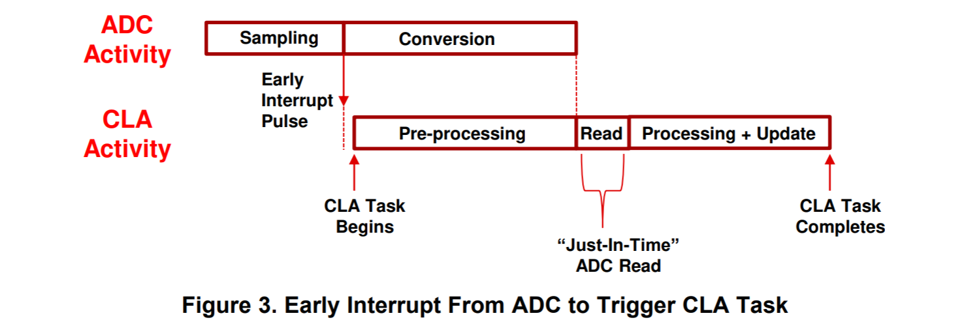
Just-in-time ADC reading (2/3)

Slide 30
Just-in-time ADC reading (3/3)
The user can do other things in these 13 cycles.
We have app notes and example codes to discuss this in more detail.
App notes - Chapter 3
https://www.ti.com/lit/an/spracs0/spracs0.pdf
Example codes
~C2000ware\driverlib\f28003x\examples\cla\cla_ex5_adc_just_in_time.c
Showcase pre-processing in CLA and/or ADCINTCYCLE

Slide 31
Resources
C2000™ CLA Software Development Guide
https://software-dl.ti.com/C2000/docs/cla_software_dev_guide/index.html

