Slide 1

Communications
Module 11
C2000™ Microcontroller Workshop
Copyright © 2019 Texas Instruments. All rights reserved.

Slide 2
Module Objectives
Serial Peripheral Interface (SPI)
Serial Communication Interface (SCI)
Local Interconnect Network (LIN)
Inter-Integrated Circuit (I2C)
Controller Area Network (CAN)
Power Management Bus (PMBus)
Fast Serial Interface (FSI)

Slide 3
Module Objectives
Serial Peripheral Interface (SPI)
Serial Communication Interface (SCI)
Local Interconnect Network (LIN)
Inter-Integrated Circuit (I2C)
Controller Area Network (CAN)
Power Management Bus (PMBus)
Fast Serial Interface (FSI)

Slide 4
SPI Data Flow
Simultaneous transmits and receive
SPI Master provides the clock signal
SPI Device #1 - Master
SPI Device #2 - Slave
shift
shift
SPI Shift Register
SPI Shift Register
clock

Slide 5
SPI Block Diagram
C28x - SPI Master Mode Shown
SPISIMO
RX FIFO_15
RX FIFO_0
SPIRXBUF.15-0
MSB
SPIDAT.15-0
LSB
SPISOMI
SPITXBUF.15-0
TX FIFO_0
TX FIFO_15
LSPCLK
baud
rate
clock
polarity
clock
phase
SPICLK

Slide 6
SPI Data Character Justification
Programmable data length of 1 to 16 bits
Transmitted data of less than 16 bits must be left justified
MSB transmitted first
Received data of less than 16 bits are right justified
User software must mask-off unused MSB’s
SPIDAT - Processor #1
11001001XXXXXXXX
SPIDAT - Processor #2
XXXXXXXX11001001

Slide 7
SPI Summary
Synchronous serial communications
Two wire transmit or receive (half duplex)
Three wire transmit and receive (full duplex)
Software configurable as master or slave
C28x provides clock signal in master mode
Data length programmable from 1-16 bits
125 different programmable baud rates

Slide 8
Module Objectives
Serial Peripheral Interface (SPI)
Serial Communication Interface (SCI)
Local Interconnect Network (LIN)
Inter-Integrated Circuit (I2C)
Controller Area Network (CAN)
Power Management Bus (PMBus)
Fast Serial Interface (FSI)

Slide 9
SCI Pin Connections
(Full Duplex Shown)
TX FIFO_15
TX FIFO_0
TX FIFO_15
TX FIFO_0
Transmitter-data
buffer register
Transmitter-data
buffer register
8
8
Transmitter
shift register
SCITXD
SCITXD
Transmitter
shift register
Receiver
shift register
SCIRXD
SCIRXD
Receiver
shift register
8
8
Receiver-data
buffer register
Receiver-data
buffer register
RX FIFO_0
RX FIFO_15
RX FIFO_0
RX FIFO_15
SCI Device #1
SCI Device #2

Slide 10
SCI Data Format
NRZ (non-return to zero) format
Start
LSB
2
3
4
5
6
7
MSB
Addr/
Data
Parity
Stop 1
Stop 2
This bit present only in Address-bit mode
Communications Control Register (SCICCR)
7
6
5
4
3
2
1
0
Stop
Bits
Even/Odd
Parity
Parity
Enable
Loopback
Enable
Addr/Idle
Mode
SCI
Char2
SCI
Char1
SCI
Char0
0 = 1 Stop bit
1 = 2 Stop bits
0 = Disabled
1 = Enabled
0 = Idle-line mode
1 = Addr-bit mode
# of data bits = (binary + 1)
e.g. 110b gives 7 data bits
0 = Odd
1 = Even
0 = Disabled
1 = Enabled

Slide 11
SCI Data Timing
Start bit valid if 4 consecutive SCICLK periods of zero bits after falling edge
Majority vote taken on 4th, 5th, and 6th SCICLK cycles
Majority
Vote
SCICLK
(Internal)
1 2 3 4 5 6 7 8 1 2 3 4 5 6 7 8 1 2
SCIRXD
Start Bit
LSB of Data
Falling Edge Detected
Note: 8 SCICLK periods per data bit

Slide 12
Multiprocessor Wake-Up Modes
Allows numerous processors to be hooked up to the bus, but transmission occurs between only two of them
Idle-line or Address-bit modes
Sequence of Operation
1. Potential receivers set SLEEP = 1, which disables RXINT except when an address frame is received
2. All transmissions begin with an address frame
3. Incoming address frame temporarily wakes up all SCIs on bus
4. CPUs compare incoming SCI address to their SCI address
5. Process following data frames only if address matches

Slide 13
Idle-Line Wake-Up Mode
Idle time separates blocks of frames
Receiver wakes up when SCIRXD high for 10 or more bit periods
Two transmit address methods
Deliberate software delay of 10 or more bits
Set TXWAKE bit to automatically leave exactly 11 idle bits
Idle periods
of less than
10 bits
Block of Frames
SCIRXD/
SCITXD
Last Data
SP
ST
Addr
SP
ST
Data
SP
ST
Last Data
SP
ST
Addr
SP
Idle
Period
10 bits
or greater
Address frame
follows 10 bit
or greater idle
1st data frame
Idle
Period
10 bits
or greater

Slide 14
Address-Bit Wake-Up Mode
All frames contain an extra address bit
Receiver wakes up when address bit detected
Automatic setting of Addr/Data bit in frame by setting TXWAKE = 1 prior to writing address to SCITXBUF
Block of Frames
SCIRXD/
SCITXD
Last Data
0
SP
ST
Addr
1
0
1
SP
ST
Data
SP
ST
Last Data
0
SP
ST
Addr
SP
First frame within
block is Address.
ADDR/DATA
bit set to 1
1st data frame
Idle Period
length of no
significance
no additional
idle bits needed
beyond stop bits

Slide 15
SCI Summary
Asynchronous communications format
65,000+ different programmable baud rates
Two wake-up multiprocessor modes
Idle-line wake-up & Address-bit wake-up
Programmable data word format
1 to 8 bit data word length
1 or 2 stop bits
even/odd/no parity
Error Detection Flags
Parity error; Framing error; Overrun error; Break detection
Transmit FIFO and receive FIFO
Individual interrupts for transmit and receive

Slide 16
Module Objectives
Serial Peripheral Interface (SPI)
Serial Communication Interface (SCI)
Local Interconnect Network (LIN)
Inter-Integrated Circuit (I2C)
Controller Area Network (CAN)
Power Management Bus (PMBus)
Fast Serial Interface (FSI)

Slide 17
Local Interconnect Network (LIN)
A broadcast serial network
One master, up to sixteen addressable slaves
Serial link layer similar to UART (e.g., start, data, stop bits)
Single wire (plus ground)
12V bus (originally desiged for automotive apps)
No bus arbitration or collision detection
Master initiates all communication
A single slave responds
Configurable Baud Rate up to 20 Kbits/s
C2000 LIN module
Compliant with the LIN spec 2.1
Can be used as an SCI (UART), if desired

Slide 18
LIN Module Block Diagram
8
RD7
RD6
RD5
RD4
RD3
RD2
RD1
RD0
Checksum
Calculator
Parity
Calculator
Bit
Monitor
LINRX
Mask
Filter
SCIRXSHF
Synchronizer
LINTX
SCITXSHF
TD0
TD1
TD2
TD3
TD4
TD5
TD6
TD7

Slide 19
LIN Message Frame
Message Frame
Master Sends
Slave Responds
1 to 8 Data Fields
Sync
Break
Sync
Field
ID
Field
Data
Field
Data
Field
Data
Field
Data
Field
Data
Field
Check
Sum
Field
In-Frame Space
Interbyte Spaces
Sync Break – beginning of a message
Sync Field – bit rate synchronizing occurs
ID Field
Identifier: 6-bit ID, 2-bit parity
Message (optional): 2, 4, or 8 bytes
Data Field – 1-bit start, 8-bit data, 1-bit stop bit
Checksum Field – 1-bit start, 8-bit checksum, 1-bit stop
In-Frame & Inter-byte Spaces – can be 0

Slide 20
LIN Data Timing
To make a determination of the bit value, 16 samples of each bit are taken with majority vote on samples 8, 9, and 10
Majority
Vote
Majority
Vote
Majority
Vote
LM_CLK
(Internal)
LINRX

Slide 21
LIN Bus Connections
12 V
1 KΩ
(master node only)
LIN bus
12 V
Vdd (e.g., 3.3 V)
LIN Transceiver
~5 KΩ
Vdd
TX
RX
LIN Controller
(F28004x)
Notes:
TI transceiver: SN75LBC031
- interfaces the single ended CAN controller with the differential CAN bus.
- transmission rate up to 1Mbit/s
2 states on the bus:
recessive: CAN_H = CAN_L = 2.5V
dominant: CAN_H = 3.5V and CAN_L = 1.5V

Slide 22
LIN Summary
Functionally compatible with standalone SCI of C28x devices
Identification masks for filtering
Automatic master header generation
2³¹ programmable transmission rates with 7 fractional bits
Automatic wakeup support
Error detection (bit, bus, no response, checksum, synchronization, parity)
Multi-buffered receive/transmit units

Slide 23
Module Objectives
Serial Peripheral Interface (SPI)
Serial Communication Interface (SCI)
Local Interconnect Network (LIN)
Inter-Integrated Circuit (I2C)
Controller Area Network (CAN)
Power Management Bus (PMBus)
Fast Serial Interface (FSI)

Slide 24
Inter-Integrated Circuit (I2C)
NXP Semiconductors I2C-bus specification compliant, version 2.1
Data transfer rate from 10 kbps up to 400 kbps
Each device can be considered as a Master or Slave
Master initiates data transfer and generates clock signal
Device addressed by Master is considered a Slave
Multi-Master mode supported
Standard Mode – send exactly n data values (specified in register)
Repeat Mode – keep sending data values (use software to initiate a stop or new start condition)
.
.
V_{DD}
Pull-up
Resistors
28x
I2C
I2C
Controller
.
.
.
.
.
Serial Data (SDA)
.
.
.
.
.
Serial Clock (SCL)
I2C
EPROM
28x
I2C

Slide 25
I2C Block Diagram
I2CXSR
I2CDXR
TX FIFO
SDA
RX FIFO
I2CRSR
I2CDRR
Clock
Circuits
SCL

Slide 26
I2C Operating Modes
Operating Mode Description
Slave-receiver mode Module is a slave and receives data from a master
(all slaves begin in this mode)
Slave-transmitter mode Module is a slave and transmits data to a master
(can only be entered from slave-receiver mode)
Master-receiver mode Module is a master and receives data from a slave
(can only be entered from master-transmit mode)
Master-transmitter mode Module is a master and transmits to a slave
(all masters begin in this mode)

Slide 27
I2C Serial Data Formats
7-Bit Addressing Format
1
7
1
1
n
1
n
1
1
S
Slave Address
R/W
ACK
Data
ACK
Data
ACK
P
10-Bit Addressing Format
1
7
1
1
8
1
n
1
1
S
11110AA
R/W
ACK
AAAAAAAA
ACK
Data
ACK
P
Free Data Format
1
n
1
n
1
n
1
1
S
Data
ACK
Data
ACK
Data
ACK
P
R/W = 0 – master writes data to addressed slave
R/W = 1 – master reads data from the slave
n = 1 to 8 bits
S = Start (high-to-low transition on SDA while SCL is high)
P = Stop (low-to-high transition on SDA while SCL is high)

Slide 28
I2C Arbitration
Arbitration procedure invoked if two or more master-transmitters simultaneously start transmission
Procedure uses data presented on serial data bus (SDA) by competing transmitters
First master-transmitter which drives SDA high is overruled by another master-transmitter that drives SDA low
Procedure gives priority to the data stream with the lowest binary value
SCL
Device #1 lost arbitration and switches to slave-receiver mode
Data from device #1
1
0
Data from device #2
Device #2 drives SDA
1
0
0
1
0
1
SDA
1
0
0
1
0
1

Slide 29
I2C Summary
Compliance with Philips I2C-bus specification (version 2.1)
7-bit and 10-bit addressing modes
Configurable 1 to 8 bit data words
Data transfer rate from 10 kbps up to 400 kbps
Transmit FIFO and receive FIFO

Slide 30
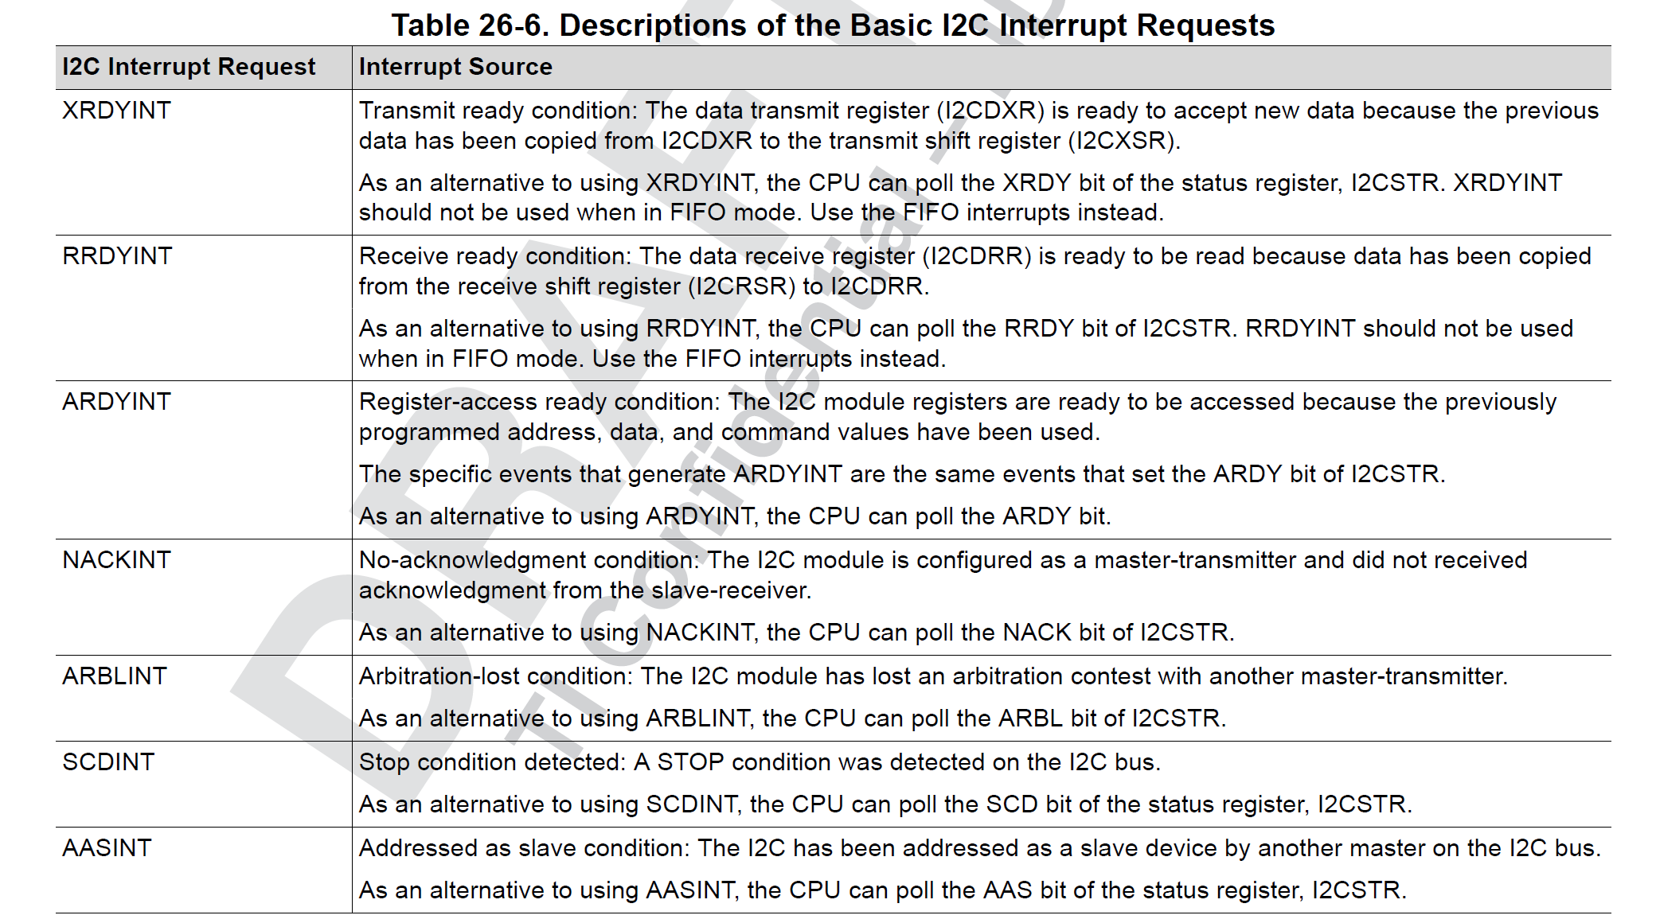
I2C Interrupt/polling Flags

Slide 31
I2C Additional Modes

Slide 32
Module Objectives
Serial Peripheral Interface (SPI)
Serial Communication Interface (SCI)
Local Interconnect Network (LIN)
Inter-Integrated Circuit (I2C)
Controller Area Network (CAN)
Power Management Bus (PMBus)
Fast Serial Interface (FSI)

Slide 33
Controller Area Network (CAN) A Multi-Master Serial Bus System
CAN 2.0B Standard
High speed (up to 1 Mbps)
Add a node without disturbing the bus (number of nodes not limited by protocol)
Less wires (lower cost, less maintenance, and more reliable)
Redundant error checking (high reliability)
No node addressing (message identifiers)
Broadcast based signaling
A
B
C
D
E

Slide 34
CAN Bus
Two wire differential bus (usually twisted pair)
Max. bus length depend on transmission rate
40 meters @ 1 Mbps
CAN
NODE A
CAN
NODE B
CAN
NODE C
CAN_H
120Ω
120Ω
CAN_L

Slide 35
CAN Node Wired-AND Bus Connection
CAN_H
120Ω
120Ω
CAN_L
CAN Transceiver
(e.g. TI SN65HVD23x)
TX
RX
CAN Controller
(TMS320F28004x)

Slide 36
Principles of Operation
Data messages transmitted are identifier based, not address based
Content of message is labeled by an identifier that is unique throughout the network
(e.g. rpm, temperature, position, pressure, etc.)
All nodes on network receive the message and each performs an acceptance test on the identifier
If message is relevant, it is processed (received); otherwise it is ignored
Unique identifier also determines the priority of the message
(lower the numerical value of the identifier, the higher the priority)
When two or more nodes attempt to transmit at the same time, a non-destructive arbitration technique guarantees messages are sent in order of priority and no messages are lost

Slide 37
Non-Destructive Bitwise Arbitration
Bus arbitration resolved via arbitration with wired-AND bus connections
Dominate state (logic 0, bus is high)
Recessive state (logic 1, bus is low)
Start
Bit
Node A
Node A wins arbitration
Node B
Node C
CAN Bus
Node B loses arbitration
Node C loses arbitration

Slide 38
CAN Message Format
Data is transmitted and received using Message Frames
8 byte data payload per message
Standard and Extended identifier formats
Standard Frame: 11-bit Identifier (CAN v2.0A)
Arbitration
Field
Control
Field
Data Field
S
O
F
11-bit
Identifier
R
T
R
I
D
E
E
O
F
r0
DLC
0…8 Bytes Data
CRC
ACK
Extended Frame: 29-bit Identifier (CAN v2.0B)
Control
Field
Arbitration Field
Data Field
S
O
F
11-bit
Identifier
S
R
R
I
D
E
18-bit
Identifier
R
T
R
E
O
F
r1
r0
DLC
0…8 Bytes Data
CRC
ACK

Slide 39
CAN Block Diagram
To ePIE
DMA
CPU Bus
(8, 16 or 32-bit)
CAN
Message
RAM
32
Message
Objects
(mailboxes)
Module Interface
Test Modes Only
Message
RAM
Interface
Register and Message
Object Access (IFx)
Message Handler
CAN Core
CAN_TX
CAN_RX
SN65HVD23x
3.3 V CAN Transceiver
CAN Bus

Slide 40
CAN Summary
Fully compliant with CAN standard v2.0B
Supports data rates up to 1 Mbps
Thirty-two message objects
Configurable as receive or transmit
Configurable with standard or extended identifier
Programmable receive mask
Uses 32-bit time stamp on messages
Programmable interrupt scheme (two levels)
Programmable alarm time-out
Programmable wake-up on bus activity
Two interrupt lines
Self-test mode

Slide 41
MCAN
F28003x has one CAN (DCAN) and one MCAN, but they are not compatible.
MCAN supports both classic CAN and CAN FD protocols.
In CAN FD, the frame/message ID uses the 29-bits format used in the Extended ID version of classic CAN (Standard ID is 11 bits long).
The message payload size has been increased up to 64 bytes of data in each CAN-frame / message, compared to only 8-bytes in the classic CAN frame.
CAN FD (5 Mbps) is ~5x times faster than classic CAN (1 Mbps)
CAN FD can handle CAN frames/messages with 11-bit ID as well.

Slide 42
Module Objectives
Serial Peripheral Interface (SPI)
Serial Communication Interface (SCI)
Local Interconnect Network (LIN)
Inter-Integrated Circuit (I2C)
Controller Area Network (CAN)
Power Management Bus (PMBus)
Fast Serial Interface (FSI)

Slide 43
Power Management Bus (PMBus)
Provides an interface between the MCU and devices compliant with the SMI Forum PMBus Specification:
Part I version 1.0 and Part II version 1.1
Enables a standard 2-wire communications protocol between power supply components
Based on SMBus and supports I2C mode
uses a similar physical layer to I2C
Support for master and slave modes
Support for three speeds:
Standard Mode: Up to 100 kHz
Fast Mode: 400 kHz
Fast Mode+: 1000 kHz
Applicable to module operating in I2C mode with input clock at 20 MHz
Four-byte transmit and receive buffers
Packet error checking (PEC)

Slide 44
Conceptual Block Diagram
SYSCLK
GPIO
MUX
ALERT
DMA
DIV
PMBCTRL
Registers
CTL
Bit Clock
CPU
SDA
Shift Register
PMBTXBUF
PMBRXBUF
SCL
PMBUSA_INT
PIE
PMBus Module
SCL is the bus clock
Normally controlled by the master; can be held low by a slave to delay a transaction (to allow more time for processing)
SDA is the bidirectional data line
CONTROL is a slave input that can trigger an interrupt
Can be used to tell a slave device to shut down
ALERT is a slave output/master input
Allows a slave to request attention from the master

Slide 45
PMBus Connections
F28004x
PMBus
Module
Alert
DEVICE
#1
Control
Data
Clock
Write
Protect
Physical
Address
Alert
DEVICE
#2
Control
Data
Clock
Write
Protect
Physical
Address
Alert
DEVICE
#N
Control
Data
Clock
Write
Protect
Physical
Address

Slide 46
PMBus Summary
Provides a standard and flexible means for digital power management
SDA and SCL timings derived from SYSCLK
To comply with the PMBus timing specifications the bit clock must be set to 10 MHz or less
Four-byte Transmit Data Buffer
Four-byte Receive Data Buffer
Clock high and low time-outs
CONTROL and ALERT signals

Slide 47
Module Objectives
Serial Peripheral Interface (SPI)
Serial Communication Interface (SCI)
Local Interconnect Network (LIN)
Inter-Integrated Circuit (I2C)
Controller Area Network (CAN)
Power Management Bus (PMBus)
Fast Serial Interface (FSI)

Slide 48
Fast Serial Interface (FSI)
Ensure reliable high-speed serial communication across an isolation barrier
Provides galvanic isolation where different circuits do not have common power and ground connections
Consists of independent transmitter (FSITX) and receiver (FSIRX) cores
Each cores is configured and operated independently
Point-to-point (single master/single slave)
Fast transfer: 50 MHz
Dual data rate (100 Mbps @ 50 MHz clock)
Single or dual data lines
Programmable data length
Hardware- or software-calculated CRC
Frame error detection
Two interrupts per FSI core

Slide 49
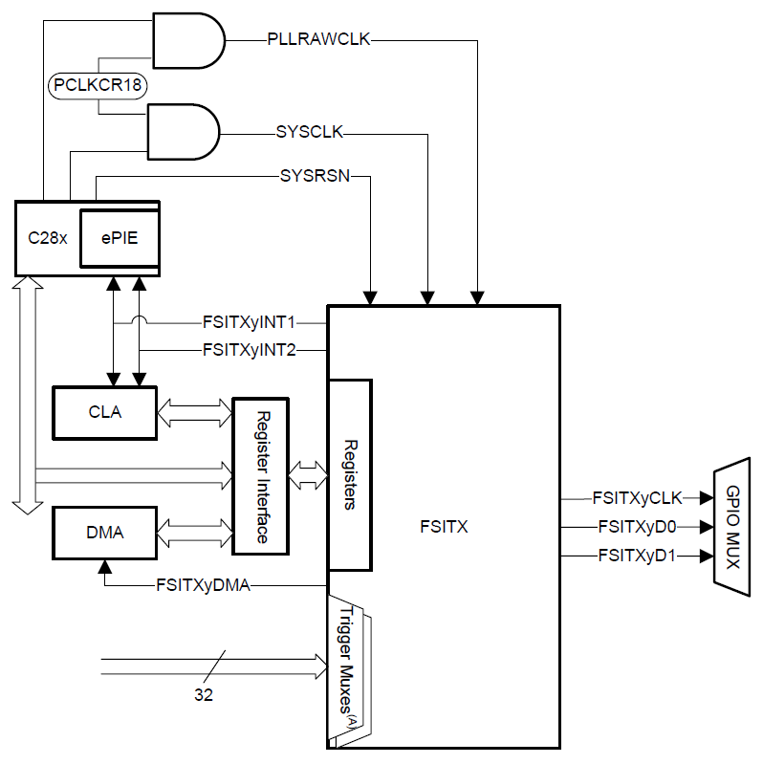
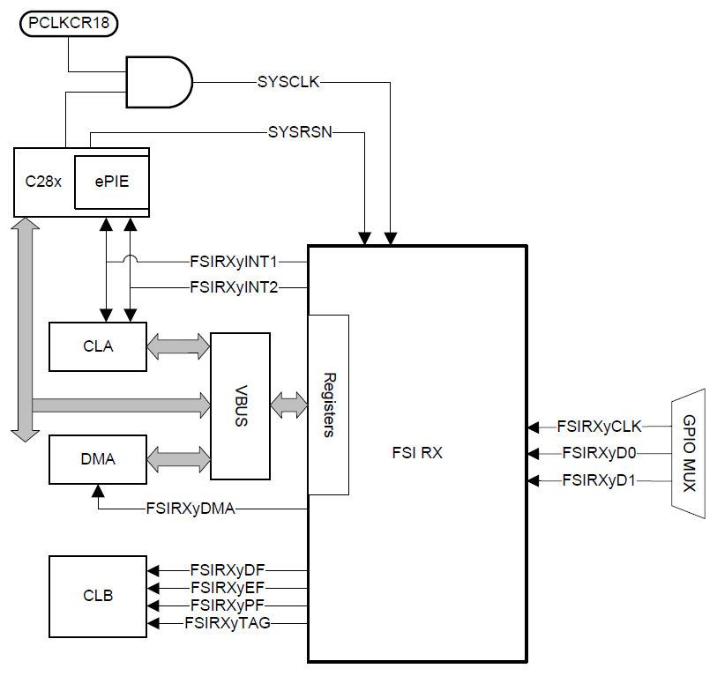
Transmitter / Receiver CPU Interface
FSI Transmitter
FSI Receiver
Core Signals
Core Signals

Slide 50
Transmitter / Receiver Core Signals
Transmitter Core Signal
Receiver Core Signal
TXCLK – Transmit clock
TXD0 – Primary data output line for transmission
For multi-lane transmission:
Contains all the even numbered bits of the data and CRC bytes
Other frame fields will be transmitted in full
TXD1 – Additional data output line for transmission
Configured for multi-lane transmission:
Contain all the odd numbered bits of the data and CRC bytes
Applies only to the data words and the CRC bytes
RXCLK – Receive clock
Connected to the TXCLK of the transmitting FSI module
RXD0 – Primary data input line for reception
Connected to the TXD0 of the transmitting FSI module
RXD1 – Additional data input line for reception
Connected to the TXD1 of the transmitting FSI module if multi-lane transmission is used

Slide 51
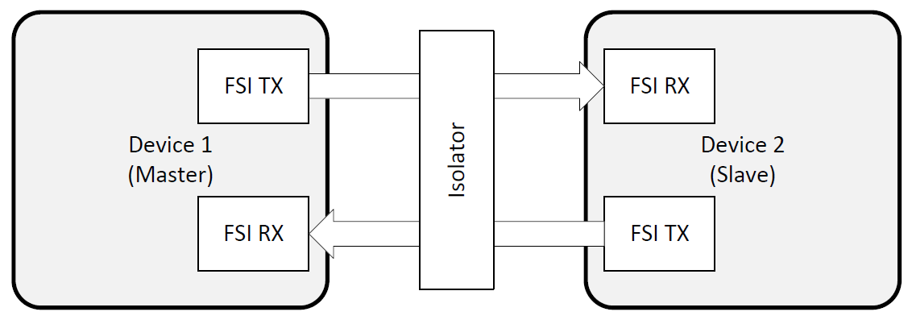
Point to Point Connection
Note: while there is no true concept of a master or a slave node in the FSI protocol, this example uses this nomenclature as a simple way to describe the data flow

Slide 52
FSI Summary
Highly reliable high-speed serial peripheral for communicating over an isolation barrier
High-speed data rate and low channel count
Increases the amount of information transmitted and reduce the costs
Separate transmit and receive modules
Point-to-point communication protocol
FSI transmitter core communicates directly to a single FSI receiver core
Skew compensation for signal delay due to isolation
Line break detection

Slide 53
Lab 11: SCI Echoback Example
Download and install C2000Ware
Import and run a project from C2000Ware
Driverlib SCI echoback example
Each character received by the SCI port is sent back to the host
Use CCS terminal feature to view the data
Terminal settings
Choose terminal: Serial Terminal
Serial Port: (from COM port number X)
Baud rate: 9600
Data size: 8
Parity: None
Stop bits: 1
Encoding: Default (ISO-8859-1)

Slide 54

C2000 Technical Training
www.ti.com/c2000

