Slide 1

Development Support
Module 12
C2000™ Microcontroller Workshop
Copyright © 2019 Texas Instruments. All rights reserved.

Slide 2
Module Objectives
C2000 MCU Device Workshops Website
Documentation Resources
C2000Ware™
TI Development Tools
Additional Resources
Product Information Center
On-line support

Slide 3
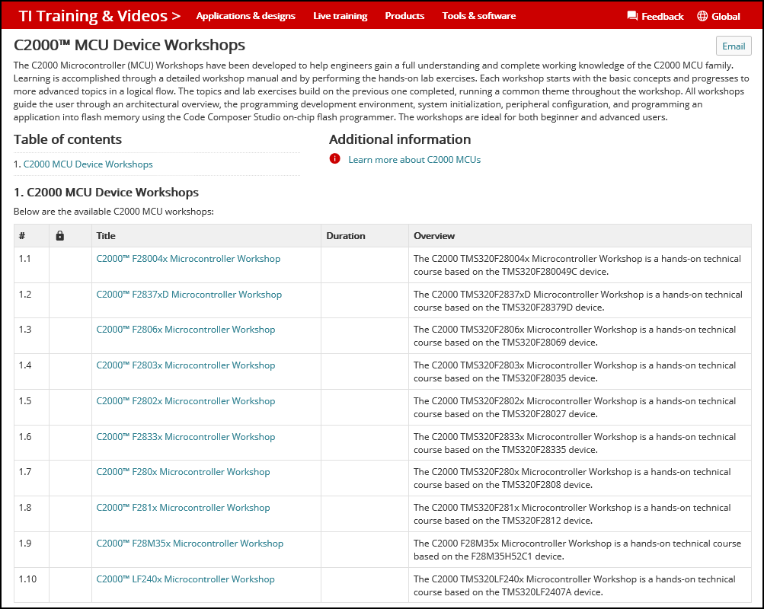
C2000 MCU Device Workshops Website
https://training.ti.com/c2000-mcu-device-workshops

Slide 4
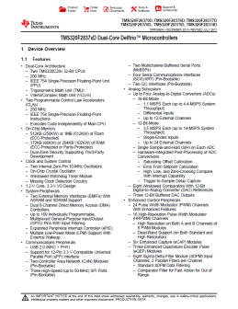
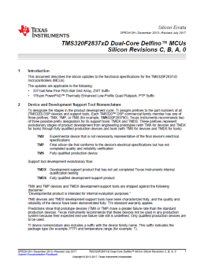
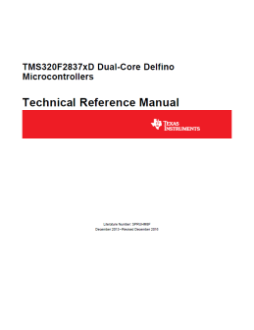
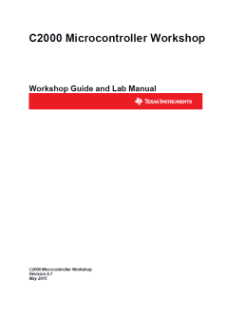
Documentation Resources
Data Sheet
Contains device electrical characteristics and timing specifications
Key document for hardware engineers
Silicon Errata
Contains deviations from original specifications
Includes silicon revision history
Technical Reference Manual (TRM)
Contains architectural descriptions and register/bit definitions
Key document for firmware engineers
Workshop Materials
Hands-on device training materials
For hardware and software engineers
Documentation resources can be found at www.ti.com/c2000

Slide 5
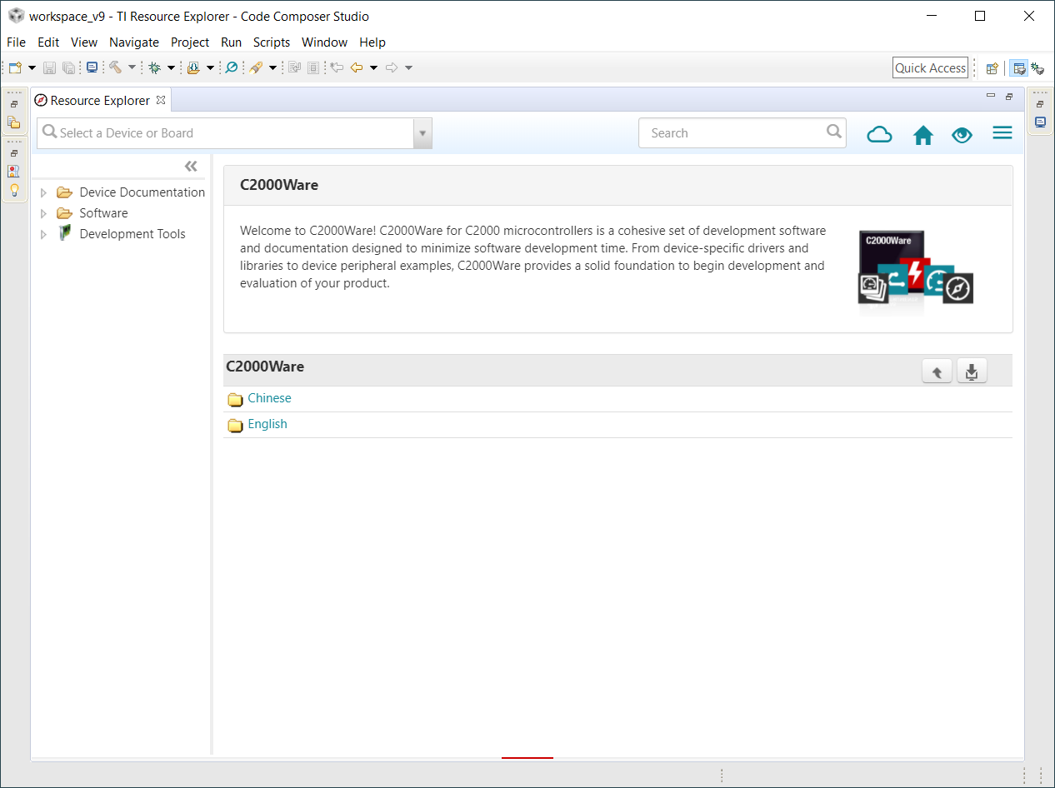
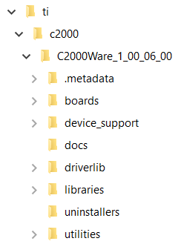
C2000Ware™
Resource Explorer
Directory Structure

Slide 6
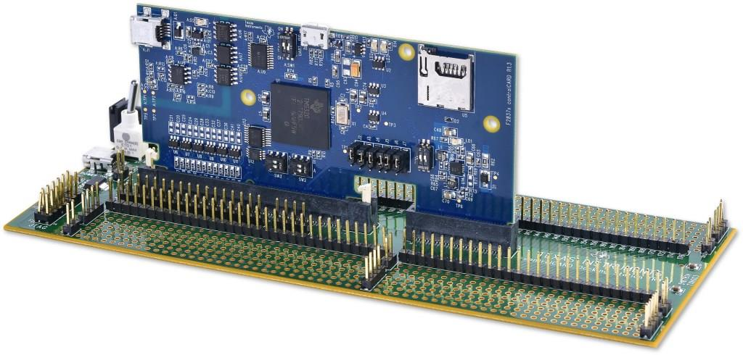
C2000 Experimenter Kit
Experimenter Kits include
controlCARD
USB docking station
C2000 applications software with example code and full hardware details available in C2000Ware
Code Composer Studio (download)
Docking station features
Access to controlCARD signals
Breadboard areas
On-board USB JTAG debug probe
JTAG debug probe not required
controlCARDs are also available separately
Available through TI authorized distributors and the TI store
Part Number:
TMDSDOCK280049C
TMDSDOCK28379D
TMDSDOCK28069
TMDSDOCK28035
TMDSDOCK28027
TMDSDOCK28335
TMDSDOCK2808
TMDSDOCKH52C1
JTAG debug probe required for:
TMDSDOCK28343
TMDSDOCK28346-168

Slide 7
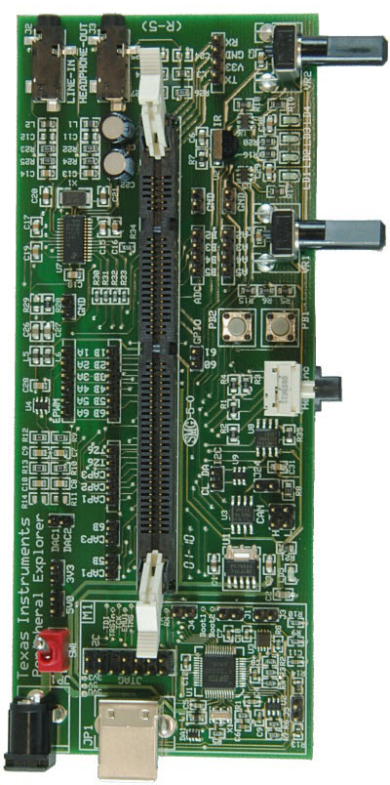
F28335 Peripheral Explorer Kit
Experimenter Kit includes
F28335 controlCARD
Peripheral Explorer baseboard
C2000 applications software with example code and full hardware details available in C2000Ware
Code Composer Studio (download)
Peripheral Explorer features
ADC input variable resistors
GPIO hex encoder & push buttons
eCAP infrared sensor
GPIO LEDs, I2C & CAN connection
Analog I/O (AIC+McBSP)
On-board USB JTAG debug probe
JTAG debug probe not required
Available through TI authorized distributors and the TI store
TMDSPREX28335

Slide 8
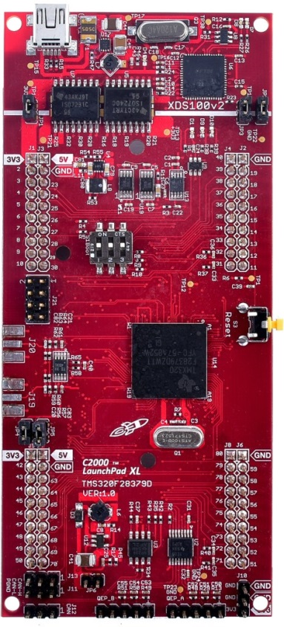
C2000 LaunchPad Evaluation Kit
Low-cost evaluation kit
F28027 and F28379D standard versions
F28027F version with InstaSPIN-FOC
F28069M version with InstaSPIN-MOTION
Various BoosterPacks available
On-board JTAG debug probe
JTAG debug probe not required
Access to LaunchPad signals
C2000 applications software with example code and full hardware details in available in C2000Ware
Code Composer Studio (download)
Available through TI authorized distributors and the TI store
Part Number:
LAUNCHXL-F28027
LAUNCHXL-F28027F
LAUNCHXL-F28069M
LAUNCHXL-F28379D
LAUNCHXL-F280049C

Slide 9
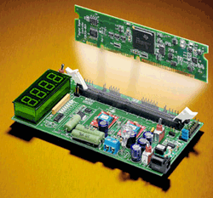
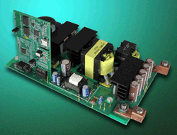
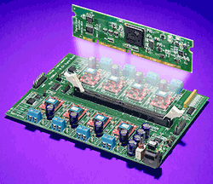
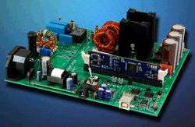
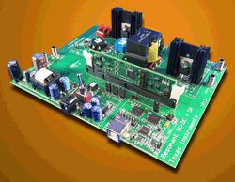
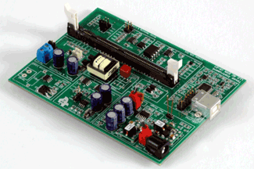
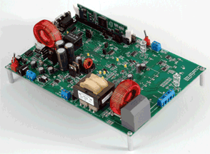
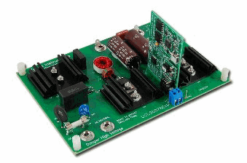
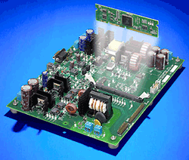
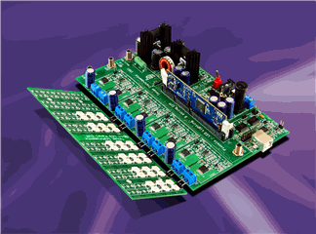
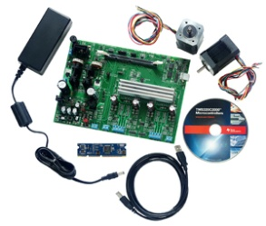
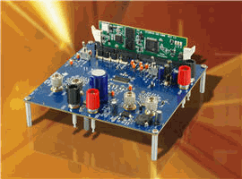
C2000 controlCARD Application Kits
Developer’s Kit for – Motor Control, Digital Power, etc. applications
Kits includes
controlCARD and application specific baseboard
Code Composer Studio (download)
Software download includes
Complete schematics, BOM, gerber files, and source code for board and all software
Quickstart demonstration GUI for quick and easy access to all board features
Fully documented software specific to each kit and application
See www.ti.com/c2000 for other kits and more details
Available through TI authorized distributors and the TI store

Slide 10
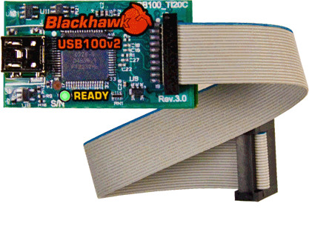
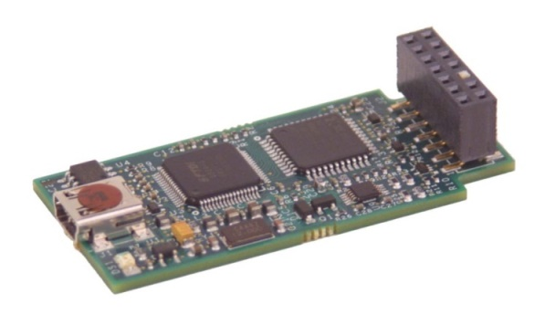
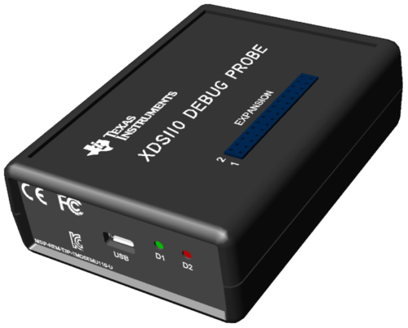
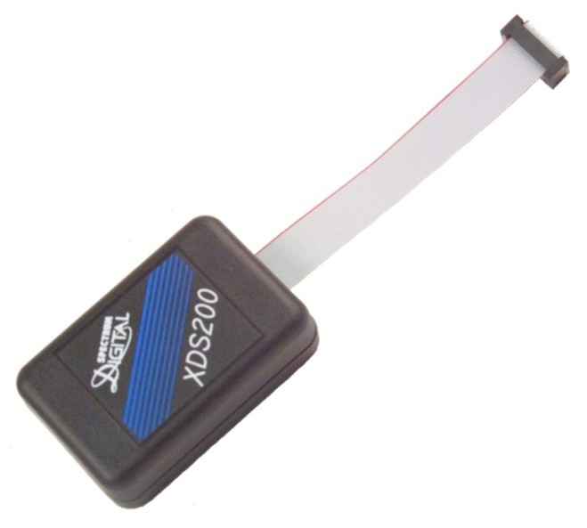
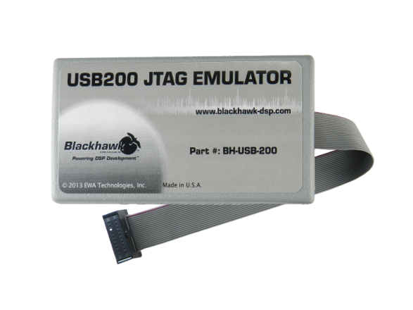
XDS100 / XDS110 / XDS200 Class JTAG Debug Probes
Blackhawk
USB100v2
Spectrum Digital
XDS100v2
Texas Instruments
XDS110
Blackhawk
USB200
Spectrum Digital
XDS200
www.blackhawk-dsp.com
www.ti.com
www.spectrumdigital.com

Slide 11
For More Information . . .
USA – Product Information Center (PIC)
Phone: +1-703-344-7012
TI E2E Community
http://e2e.ti.com
Embedded Processor Wiki
http://processors.wiki.ti.com
TI Training
http://training.ti.com
TI store
http://store.ti.com
TI website
http://www.ti.com

Slide 12

C2000 Technical Training
www.ti.com/c2000

