Slide 1
Configurable Logic Block (CLB) Architecture, Configuration Tool Training

Slide 2
CLB Overview
Notes:
Hello, and welcome to the C2000 Configurable Logic Block Training. In this part we will provide an overview of the CLB Subsystem Architecture

Slide 3
What is CLB?
Custom logic built from a small palette of blocks that is connected and configured in any desired manner – not CPLD/FPGA.
Gives ability to build logic around existing IPs like ePWM, eCAP, eQEP, GPIOs and other IPs.
Enables C2000 customers to develop their own unique IPs such as custom communication peripherals.
Why CLB?
FPGAs are area inefficient compared to ASIC logic (FPGAs take 20x to 30x more area).
Architecture specifically targeted to enhance the existing MCUs capabilities.
Much smaller than logic built using FPGAs by leveraging existing peripherals to build new functions
CLB with existing peripherals and CPU/CLA enables implementation of complex logic
Notes:
The C2000 CLB consists of a small group of reconfigurable logic blocks with user-defined conectivity and logic function.
These blocks enable the customization of existing IPs such as the PWM, Capture, and QEP blocks. They also enable
users to create other unique functions such as those in safety or serial comms. The CLB subsystem is currently available
on 2837x Delfino and 2807x Piccolo devices.

Slide 4
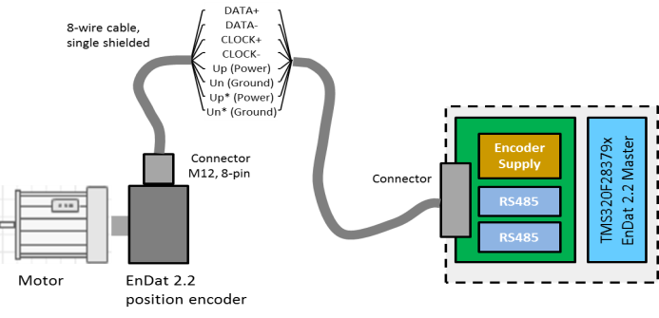
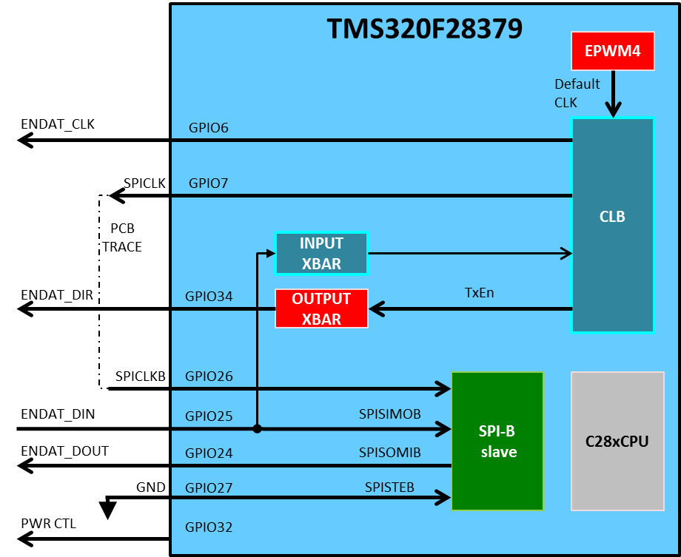
Target Applications
Few areas listed as examples below
Industrial Drives
Position encoder interfaces
PTO (Pulse Train Output)
Automotive
Advanced PWM Protection
Digital Power/Solar
Multi-level inverters
Burst Mode PWM
PWM periodic blanking of pulses (thinning)
General Purpose
Filters
Signal conditioning
Task profiling / Time threshold monitoring
Complex sequence detection on signals (beyond ECAP)

Slide 5
CLB Architecture
Notes:
Hello, and welcome to the C2000 Configurable Logic Block Training. In this part we will provide an overview of the CLB Subsystem Architecture

Slide 6
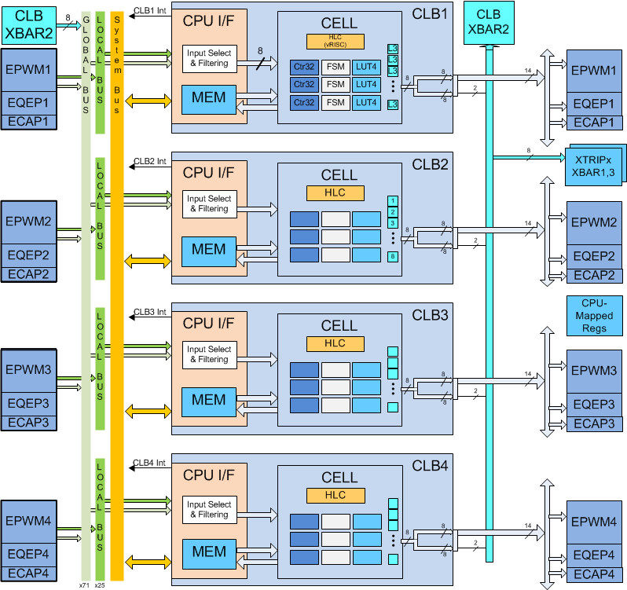
CLB System Architecture
GPIOs, Trips
4 independent CLBs
High connectivity to: ePWM, eQEP, eCAP, Trip Events, GPIOs
100MHz
Simplified Timing Closure
Standard Cell Gate construct (not a hard macro)
Global & Local Input Bus
CLB1
CLB XBAR + Output Bus
CLB2
CLB3
CLB4
Notes:
This diagram shows the CLB Subsystem as present on the F2837x and F2807x Delfino and Piccolo devices.
The Subsystem consists of 4 independent CLB blocks as highlighted here. (click)
Each CLB is highly interconnected with internal signals from selected peripherals including the PWM, event capture, and QEP blocks. (click)
A Global Input bus provides for connection to all CLBs from a broader set of peripherals and the GPIOs.
The CLB operates at a maximum of ½ the CPU System Frequency and is a timing closed subsystem. This
means that no timing-closure loop is needed during CLB development.
and Finally, the CLB uses the same robust design flows and standard cell libraries as the Host MCU device.
This means that no additional DFT efforts are required for this block.

Slide 7
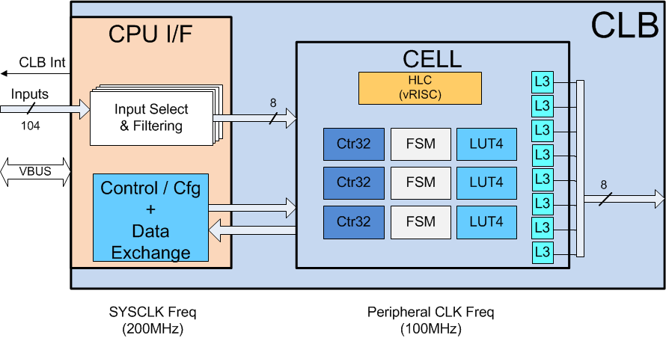
CLB Structure
CPU Interface
memory-mapped interface
Interrupt Gen,
Data Exchange
Programmation
L3: OUTLUT(0-7) (3-inputs, 1-output)
LUT4: LUT(0-2) (4-inputs, 1-output)
FSM: FSM(0-2) Finite state machine
Ctr32: CNT(0-2) Counter module
HLC: High level controller
Notes:
Each CLB cell consists of 2 main parts-
1. The CPU Interface, (click) which operates at the CPU (System) Clock frequency (which is a maximum of 200MHz in the ‘2837x/2807x’ family) This block is responsible for Interrupt Generation, Data exchange with the rest of the MCU device, and programmation of the CLB logic Cell through a memory-mapped interface shown here. The interface is also responsible for input selection from the Local and Global input buses, and for input filtering.
The 2nd part is The CELL, which contains all of the configurable logic and has 8 logic inputs, 8 unique logic outputs, and a data bus for communicating interrupt information as well as allowing memory-mapped access to selected registers.

Slide 8
4-input LUT (LUT4)
LUT4
Look Up Table
4 inputs and one output
Any function of 4 inputs (or less) can be realized.
C syntax
4 input AND O = i1 & i2 & i3 & i0
3 input OR O = i1 | i2 | i0
More complex O = (!i2 & (i1 | i0))
i0
Any combinational function of upto 4 inputs can be realized by this block.
i1
O
i2
i3
Notes:
Those familiar with FPGA or other configurable logic will recognize the standard 4-input Look-Up-Table, or LUT.
These blocks can implement any logical function of 4 inputs or less. The logic function is specified using
C-like syntax to describe an output as a function of inputs i0 through i3. Common AND and OR functions or
more complicated logic can be easily described this way.

Slide 9
FSM
FSM
FSM Block
Allows implementing Finite State Machines (FSM) of up to 4 states. An FSM can be
One 4-state FSM or
Two 2-state FSMs
E0 and E1: Two inputs control FSM_OUT or either of the states S0 and S1.
S0 and S1 are two state bits that have independent state control equations.
XE0
XE1
Output
LUT
FSM_OUT
E1
E0
S0
next state
LUT
DS0
S1
next state
LUT
DS1
D Q
S0
FSM_S0
D Q
S1
FSM_S1
FSM Created by writing Boolean equations of E0,E1, S0,S1 i.e. S0 = E0 | (S0 & !E1)
Notes:
The Finite State Machine or FSM blocks consists of
4 inputs (2 “event” inputs + 2 additional inputs)
3 outputs (1 FSM-out plus the 2 state-indicating outputs S0 and S1)
2 “state” flip-flops (S0,S1)
2 LUT4s for generating next-state information and
An output LUT4 for generating an output for the FSM.
Note that in this block thatThe two S0/S1 state inputs can be replaced with additional external inputs
(Extra_Ext_IN0/1). This allows the FSM block to serve as an additional LUT4 when not being used for state machines.

Slide 10
FSM
FSM
Using FSM
16-bit S0 equation (E0, E1, S1, S0) decides the next state of S0 (depicted below)
16-bit S1 equation (E0, E1, S1, S0) decides the next state of S1.
16-bit output equation defines a function (E0, E1, S1, S0) decides the output value of FSM_LUT_OUT.
Eqn_s0
S1
S0
S0
NEXT STATE LUT
S0
S0
FSM_S0
E0
CLK
E1
Notes:
The Finite State Machine or FSM blocks consists of
4 inputs (2 “event” inputs + 2 additional inputs)
3 outputs (1 FSM-out plus the 2 state-indicating outputs S0 and S1)
2 “state” flip-flops (S0,S1)
2 LUT4s for generating next-state information and
An output LUT4 for generating an output for the FSM.
Note that in this block thatThe two S0/S1 state inputs can be replaced with additional external inputs
(Extra_Ext_IN0/1). This allows the FSM block to serve as an additional LUT4 when not being used for state machines.

Slide 11
FSM
FSM
Using FSM as 4-input LUT
An additional level of configurability is provided such that FSM_LUT_OUT can use extra inputs in case the states S0 and S1 are unused.
Two combinational inputs available for both outputs and State transitions.
Optional use of Extra inputs (XE0/1) to utilize FSM as a pure combinational LUT4
Configuration
CLB_FSM_EXTRA_IN1
eqn_out
CLB_FSM_EXTRA_IN0
XE1
S1
XE0
S0
FSM
OUTPUT
LUT
FSM_S0
E0
E1
Notes:
The Finite State Machine or FSM blocks consists of
4 inputs (2 “event” inputs + 2 additional inputs)
3 outputs (1 FSM-out plus the 2 state-indicating outputs S0 and S1)
2 “state” flip-flops (S0,S1)
2 LUT4s for generating next-state information and
An output LUT4 for generating an output for the FSM.
Note that in this block thatThe two S0/S1 state inputs can be replaced with additional external inputs
(Extra_Ext_IN0/1). This allows the FSM block to serve as an additional LUT4 when not being used for state machines.

Slide 12
Programming the FSM
FSM
Provide Boolean equations for the state transitions and the output.
State equations are slightly different compared to pure combinational boolean equations.
Equation for S0/S1 will also contain S0/S1.
Output equation is a simple boolean equation of S0,S1, E0 and E1
Notes:
The FSM is programmed by defining state equations for each of the LUT4s in the same manner as described for the
the other LUTs. Logic for a dedicated output LUT can also be defined if needed in the application. We’ll now go
through a simple example to show how the FSM can be used.

Slide 13
Counter Block
Counter block
Counter Block
32bit
Add/Sub
L/RShift
Load
Compare
These outputs can be connected as inputs to other blocks
These inputs can be connected to the outputs of other blocks
RESET
ZERO
MODE_1
MATCH1
MODE_0
MATCH2
EVENT
MATCH1 REF
COUNTER VALUE
MATCH2 REF
LOAD VALUE
Misc static controls for
add/sub/shift and direction
Mode1: 1= up or left
0= dn or right
Mode0: enable for counter
Notes:
The complex counter block can implement 32bit counters, shifters, and other functions. The primary
uses for this block will likely be as up/down counters or left/right shifters. These behaviors are controlled
by the Mode, Reset, and Event inputs shown on the left.
Additional inputs are available for Loading the counter or Adding or Shifting by a given amount, as defined by
the LOAD input, whenever the EVENT input is asserted. This input can be driven by any of the other internal
signals with the given CLB.
The Counter has 3 outputs for supporting various count functions, include a ZERO compare (asserted when the
counter reaches Zero), and 2 MATCH outputs, which will be asserted when the counter’s value matches the
reference values provided on the left. The MATCH Reference values and the Load value, are statically defined
by the MCU Host during configuration. The MATCH References may also be modified by the HLC High-Level
Controller, which we’ll discuss next.
The COUNTER value is also output, and can be read by the HLC.

Slide 14
Counter Block
Counter block
Counter Block Inputs
RESET : (synchronous reset input) If this input is high, the counter will reset to 0 on the next clock cycle.
MODE_0 : (Counter enable) counting operation only when this input is high. If this input is low, then no up or down counting will take place.
MODE_1 : (Counter direction) High → counter will increment on every clock cycle. Low → Decrements for every clock cycle.
EVENT : Triggering actions on rising edge of the EVENT input. Following actions can be selected
Load a predefined 32-bit value “LOAD VALUE”
Right/Left shift the contents
Add/subtract a predefined 32-bit value
Counter Block outputs
ZERO : This output goes high whenever the counter value is 0.
MATCH1 : This output goes high whenever the counter value equals the MATCH1 reference value
MATCH2 : This output goes high whenever the counter value equals the MATCH2 reference value
MATCH1 and MATCH2 reference values can be set statically through the CPU interface logic or it can be dynamically modified by the HLC while operating.

Slide 15
Counter Operating Modes
EVENT | MODE0 | MODE1 | COUNT_EVENT_CTRL | COUNT_ADD_SHIFT | COUNT_DIR | Action on CNTVAL
0 | 0 | 0 | X | X | X | No Change
0 | 0 | 1 | X | X | X | No Change
0 | 1 | 0 | X | X | X | Count Down (CNTVAL-1)
0 | 1 | 1 | X | X | X | Count Up (CNTVAL+1)
1 | X | X | 0 | X | X | Load
1 | X | X | 1 | 0 | 0 | Shift Right
1 | X | X | 1 | 0 | 1 | Shift Left
1 | X | X | 1 | 1 | 0 | Subtract
1 | X | X | 1 | 1 | 1 | Add
Load: CNTVAL = EVENT_LOAD_VAL
Shift right: CNTVAL = CNTVAL >> EVENT_LOAD_VAL
Shift left: CNTVAL = CNTVAL << EVENT_LOAD_VAL
Subtract: CNTVAL = CNTVAL - EVENT_LOAD_VAL
Add: CNTVAL = CNTVAL + EVENT_LOAD_VAL
Note - The effect of a rising edge on the EVENT input only lasts for one cycle. On the very next cycle, the counter operation will continue based on the MODE_0, MODE_1 and RESET inputs

Slide 16
HLC Architecture (High-Level-Controller)
HLC
HLC
Instructions
Mov <src>,<dst>
Mov_T1 <src>,<dst>
Mov_T2 <src>,<dst>
ADD <src>,<dst>
Sub <src>,<dst>
PUSH <src>
PULL <src>
INTR <const:6>
Where <src/dst> =
R0-R3 (HLC Regs)
C0-C2 (Counter values)
Instruction Mem
Event 0
Event processing Block
Event 1
Interrupt
Event 2
Event 3
Push to Shared Mem
R0
R2
Outputs of all Cell components
R1
R3
Pull from
Shared Mem
Host MCU Bus Interface
(HLC Registers are write-only)
Notes:
The High-Level-Controller, or HLC, is an Event-processing block that can respond to up to 4 Event
inputs, which are routed from any of the other block outputs, such as the FSMs, LUTs, and counters,
within the same CLB.(Click) HLC block I/O also includes a Host Bus interface for configuration or
real-time interaction with the Host, plus an interrupt line to the Host CPU. Data can also be passed
back and forth from the CPU through a pair of Push/Pull Data Exchange buffers.
(Click) The HLC contains four 32-bit registers and a 32-word instruction memory that can be written by the Host CPU
during CLB configuration.

Slide 17
HLC (High Level Controller)
Provides a means of communication and data exchange with the CPU system interface.
Provides an event based programmable action system which includes both computation and data movement.
4 events – each has a dedicated address from which instructions are executed.
Event 0 is the highest priority and Event 3 is the lowest priority.
Instruction memory supports up to 8 instructions per event.
Each instruction sequence gets triggered on the rising edge of the corresponding event

Slide 18
Instruction Details
MOV <Src> <Dest>: This instruction moves <Src> to <Dest>. Both <Src> and <Dest>
MOV_T1 <Src> <Dest>: This instruction moves <Src> specifically to the Match1 register of the <Dest> counter.
MOV_T2 <Src> <Dest>: This instruction moves <Src> specifically to the Match2 register of the <Dest> counter.
ADD <Src> <Dest>: <Dest> = <Dest> + <Src> .
<Src> can be any of R0 to R3 and C0 to C2, but <Dest> can only be R0 to R3. The addition is an unsigned 32-bit addition.
SUB <Src> <Dest>: <Dest> = <Dest> - <Src> .
<Src> can be any of R0 to R3 and C0 to C2, but <Dest> can only be R0 to R3.
PUSH <Src>: This instruction transfers data from <Src> to the data exchange push memory buffer in the CPU interface. The term PUSH is used as seen from the High Level controller and a PUSH operation pushes data into a FIFO.
PULL <Dest>: This instruction transfers data from to the data exchange pull memory buffer in the CPU interface to the <Dest> register. The term PULL is used as seen from the High Level controller and a PULL operation reads(pulls) data from a FIFO
INTR <6-bit constant>: This instruction will flag an interrupt through the CPU interface. Additionally, the 6-bit constant will be stored in the interrupt flag regsiter (CLB_INTR_TAG) in the CPU interface.

Slide 19
HLC Event Selection
Bit position | Signal connection
0 | Always ‘0’
1 | COUNTER_0 MATCH2
2 | COUNTER_0 ZERO
3 | COUNTER_0 MATCH1
4 | FSM_0 STATE_BIT_0
5 | FSM_0 STATE_BIT_1
6 | FSM_0 LUT output
7 | LUT4_0 output
8 | Always ‘1’
9 | COUNTER_1 MATCH2
10 | COUNTER_1 ZERO
11 | COUNTER_1 MATCH1
12 | FSM_1 STATE_BIT_0
13 | FSM_1 STATE_BIT_1
14 | FSM_1 LUT output
15 | LUT4_1 output
16 | Always ‘0’
17 | COUNTER_2 MATCH2
18 | COUNTER_2 ZERO
19 | COUNTER_2 MATCH1
20 | FSM_2 STATE_BIT_0
21 | FSM_2 STATE_BIT_1
22 | FSM_2 LUT output
23 | LUT4_2 output
24 | External Input 0
25 | External Input 1
26 | External Input 2
27 | External Input 3
28 | External Input 4
29 | External Input 5
30 | External Input 6
31 | External Input 7
HLC_EVENTx_SEL: 5 bit select value for EVENTx of the High Level Controller

Slide 20
Static Switch block
Load values for the counter blocks
Counter
Block
High Level controller and sequencer
(HLC)
Complex
Block
Complex
Block
LUT-3
LUT-3
LUT-3
LUT-3
LUT-3
LUT-3
8 Outputs
LUT-3
LUT-4
LUT-3
LUT-4
LUT-4
Static switch block
8 External inputs
FSM
FSM
FSM
Inputs for the various blocks

Slide 21
CONFIG
CLB_INTR
CONFIG
CONFIG
DATA
CONFIG
pg 7-23-19
ONE CLB TILE
8
CELL_INP
(7 : 0)
R3
R2
R1
R0
ADDR
31
30
…
1
0
31
30
…
2
1
0
INSTR MEMORY
OUTLUT0
4 EVENTS
triggered on
rising edges
EVENT
3
EVENT
2
EVENT
1
EVENT
0
CLB_OUT
(0)
DATA
HLC
31
30
…
1
0
DATA MEMORY
STRB
OUTLUT1
CLB_OUT
(1)
31
30
…
1
0
8
‘0’
31
30
…
2
1
0
31
30
…
2
1
0
31
30
…
2
1
0
OUTLUT2
CLB_OUT
(2)
CTR_0
C0
LUT_0
FSM_0
31
30
…
1
0
OUTLUT3
CLB_OUT
(3)
31
30
…
1
0
8
‘1’
31
30
…
2
1
0
31
30
…
2
1
0
31
30
…
2
1
0
OUTLUT4
CLB_OUT
(4)
CTR_1
C1
LUT_1
FSM_1
31
30
…
1
0
OUTLUT5
CLB_OUT
(5)
31
30
…
1
0
8
‘0’
31
30
…
2
1
0
31
30
…
2
1
0
31
30
…
2
1
0
OUTLUT6
CLB_OUT
(6)
CTR_2
C2
LUT_2
FSM_2
31
30
…
1
0
OUTLUT7
CLB_OUT
(7)
32
CONFIG
CONFIG
CONFIG
CONFIG

Slide 22
CLB Connectivity
Notes:
Hello, and welcome to the C2000 Configurable Logic Block Training. In this part we will provide an overview of the CLB Subsystem Architecture

Slide 23

CLB Connections
Local (input) Bus has dedicated connections to specific instances of EPWM,EQEP,ECAP
Output bus (duplicated from 8 to 16) has direct connections to these same peripherals, plus CLB (system) crossbar
Global (input) Bus has connections to many peripherals, including system crossbars
Notes:
The connections to the CLB Cells consist of a Local Input Bus, which connects to each CLB individually,
a Global Input Bus, which connects to all CLBS, and the Output Bus which comes out of each CLB.
NOTE that the 8 outputs from each CLB are replicated to form a 16-bit output bus.

Slide 24

CLB Input Connections
Global
Local
The Local Bus connects 1 CLB to multiple signals within one instance of the ePWM, eQEP, and eCAP blocks.
Each CLB is connected to a unique peripheral instance.
Examples: PWM Digital Compare events, eCAP Capture event inputs, QEP A/B and Index/Strobe outputs.
The GLOBAL Bus connects to ALL CLBs and passes various signals of PWMs 1-4 and the CLB Xbar.
The Muxes for both buses are contained in the Input Select block, which also contains input latching/filtering functions
Notes:
The CLB Local Input Bus Provides connections from multiple signals inside one instance of the PWM, the QEP, and the eCAP block to each
of the 8 CLB inputs. Each CLB is connected to an associated instance on the local bus. For example, CLB1 is connected to EPWM1, EQEP1, and
ECAP1. CLB2 will be connected to EPWM2, and so on.
The Local bus also provides a pass-through connection from the Global Bus, which brings in signals from other peripherals (click)
and from the CLB Xbar. Note that the Global Bus connects the same set of signals to all CLBs.
The muxing for both the Local and Global Buses is contained in the Input Select and Filtering Block (click). This block also has latching, synchronizing,
and filtering functions, as well as a direct software-writable input.
A complete listing of the signals for both the Global and Local Input Buses is shown in the following slides and can also be found in Appendix D of the CLB User’s Guide.

Slide 25
CLB Output Connections
The 8 CLB outputs are copied to yield an additional 8 outputs: CLB_OUT8 = CLB_OUT0 CLB_OUT9 = CLB_OUT1, etc.
Notes:
The CLB CELL’s 8 outputs are copied to create 8 additional outputs for a total of 16.
The outputs are copied in order, so that Output 8 is the same as output 0, and output
9 is equivalent to output 1, and so on.
Two of the outputs of each CLB are fed to the CLB Xbar, whose outputs are routed back
to the CLB input buses. This allows the construction of multiple-CLB designs by enabling
one CLB’s outputs to drive anothers inputs.

Slide 26
CLB Xbar Connections
Notes:
This diagram and the table on the following slide show the range of inputs that are available from
peripherals in the F2837x and F2807x devices Delfino and Piccolo devices which can be passed
on to the CLBs.
Some of the inputs in this crossbar (click) have built-in logic to OR several Tripzone inputs together and
thus eliminate the need for logic to combine similar trip events inside the CLB.

Slide 27
Using CLB to Implement External Glue Logic
C2000 MCU
CPU
CLB3
CLB XBAR
INPUT XBAR
GPIO MUX
Pins
Pins
PERIPHERAL
OUTPUT XBAR

Slide 28
PERIPHERALS SHOWN WITH THE CLB
pg 7-19-19
CLB XBAR
OUTPUT XBAR
GPIO MUX
EQEP1
(1 of 2)
ECAP1
(1 of 4)
EPWM1
(1 of 4)
CLB SUBSYSTEM
CLB INPUT SELECTION
CLB
TILE
1
CLB
TILE
2
CLB
TILE
3
CLB
TILE
4
PERIP OUT MUX_1
PERIP OUT MUX_2
…
MUX_3
PERIP OUT MUX_4
PIE, CLA
CLA HALT
SDFMx
EPWM SYNC
ADC
SOC
CMPSS
EPWM XBAR
INPUT XBAR

Slide 29
SysConfig Based CLB Tool

Slide 30
CLB Tool Architecture
Check Simulation Correctness
Check Configuration Correctness
CLB Connection View .dot
Graph Viewer
CLB SysCfg
Configuration and Stimulus
SysCfg
Compiler
CLB SystemC
Connections
(.cpp)
Host C++
Compiler
CLB SystemC
executable
CLB Simulation
(.vcd)
VCD Viewer
SysCfg GUI
CLB Syscfg
Metacode
CLB SystemC Simulation Input (.cpp)
CLB SystemC
Model
CLB Header for Target Project
Export to Application Project
Host Tools
(3rd Party)
Host Tools
(CCS)
CLB Content
(C2000Ware)
Generated Files
CLB Project files

Slide 31
CLB Tool Components
Based on the “SysConfig” tool in CCS
“.dot” file
shows sub-module inter-connections as a diagram
Used to verify the design visuvally
Converted to HTML format in CCS post-build steps
“clb_sim.cpp” file
CPP file, along with other CLB simulation models, is compiled using a GCC compiler.
Output of the compilation is an “.exe” file which generates a “.vcd” file.
“.vcd” to check waveform functional and timing
“clb_config.h” file
configuration is encoded in the generated C header
clb_config.c functions to load the configuration
functions in the “clb_config.c” file must be called during the device initialization steps

Slide 32
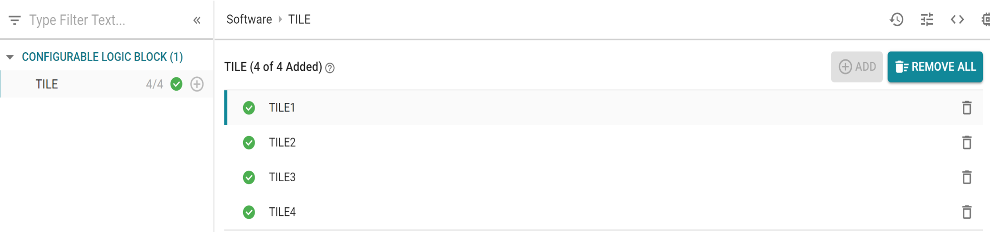
Top-level TILE addition/deletion
Click on + for adding tiles
Delete Tile
Add tiles as needed, delete unused tiles
Tile numbers can be changed
Enter name here

Slide 33
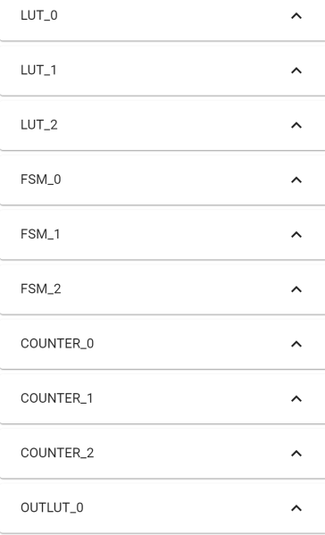
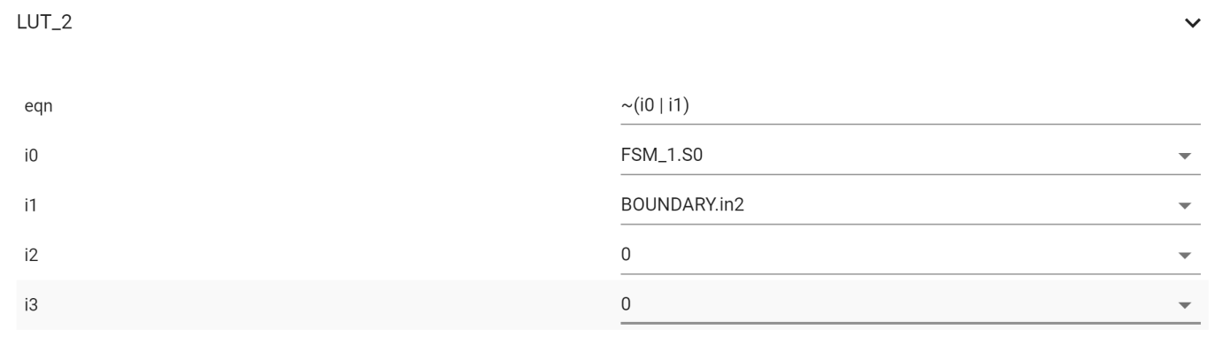
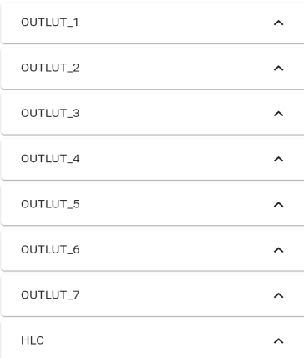
Configuration View - LUT
Click to expand
Input Equation Here
Select Inputs

Slide 34
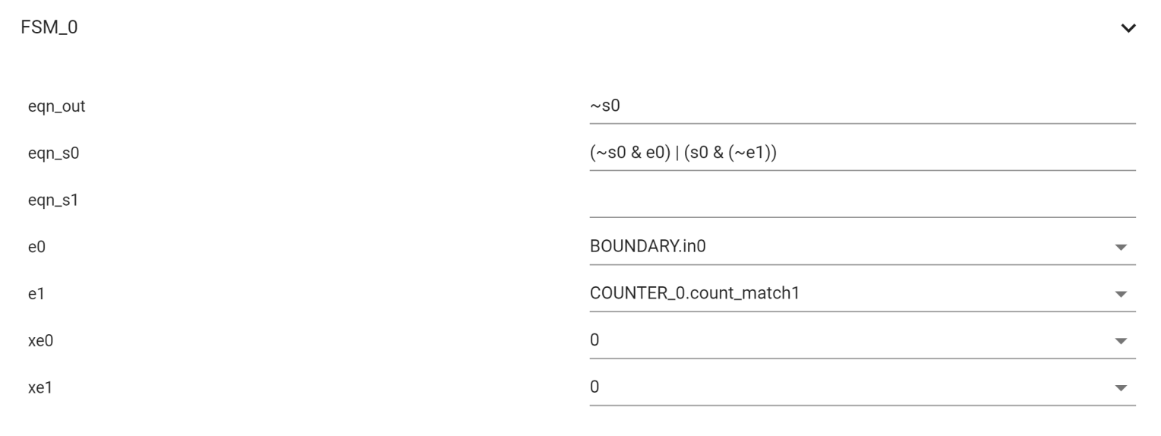
Configuration View - FSM
Click to expand
Input Equations Here
Select Inputs

Slide 35
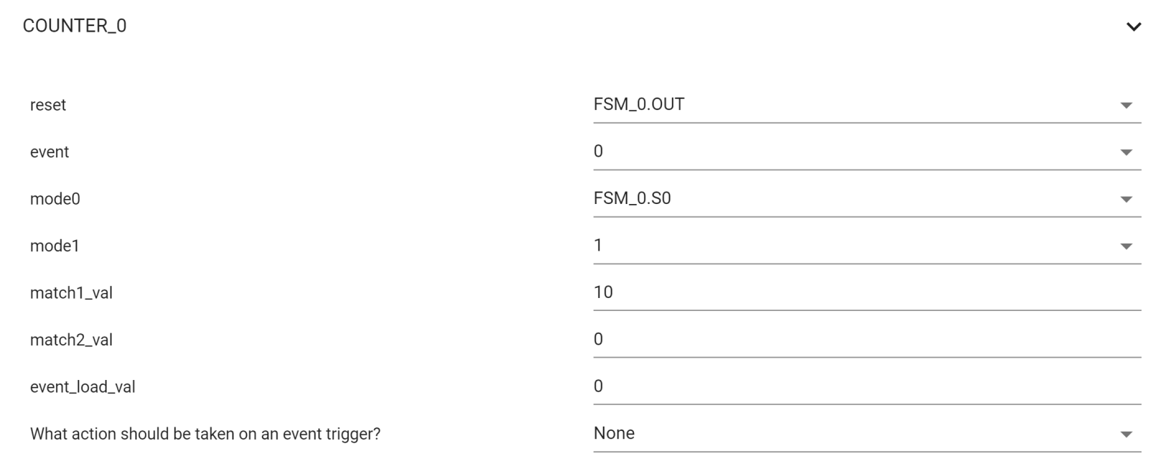
Configuration View - COUNTER
Click to expand
Select Inputs
Input Match Values
Set Mode
(Mode=None for normal counter operation)

Slide 36
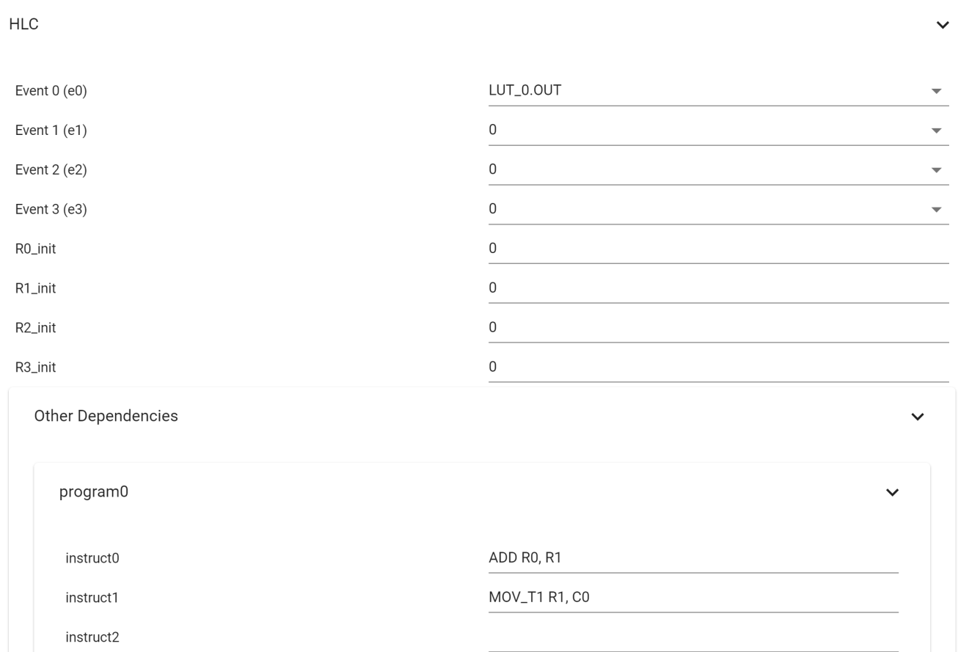
Configuration View – HLC
Select Event Trigger
Input register init Values, if needed
Expand Other Dependencies
Click to expand
Input HLC instructions here

Slide 37
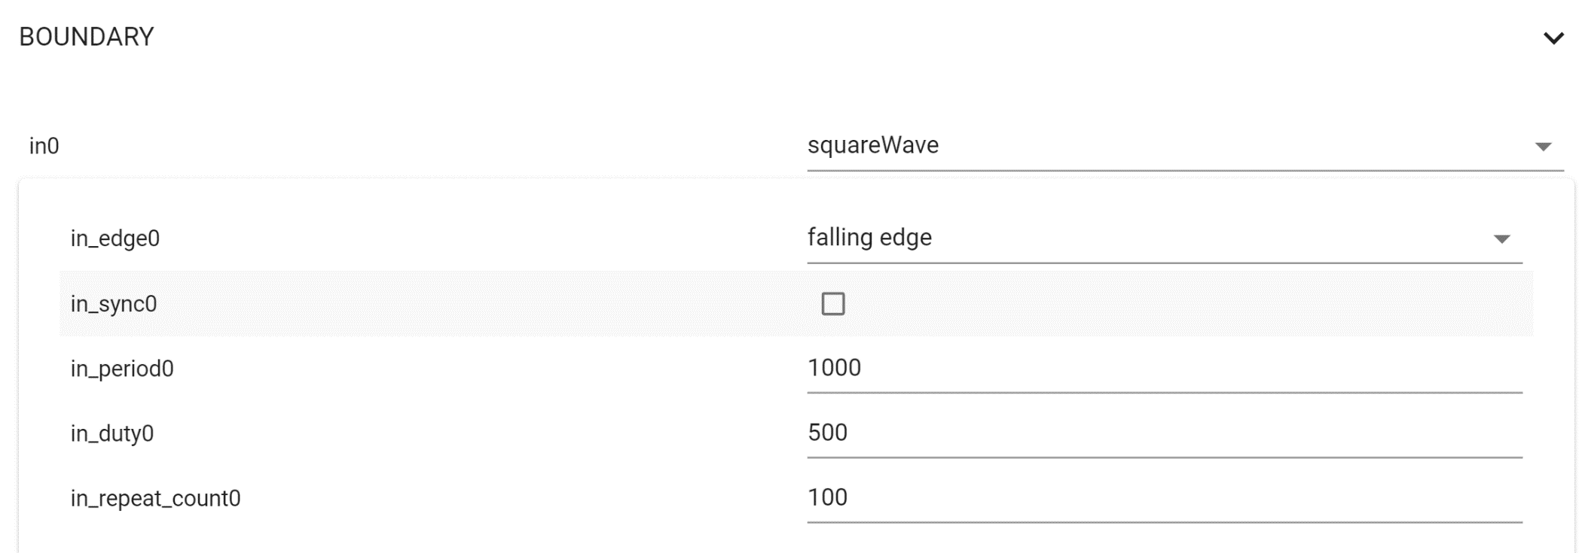
Configuration View – Boundary Inputs For Simulation Only
Click to expand
Select input for simulation
Optional input filter
Waveform Period (in simulation clk cycles)
Waveform On-Time(in simulation clk cycles)
Waveform Repeat Count

Slide 38
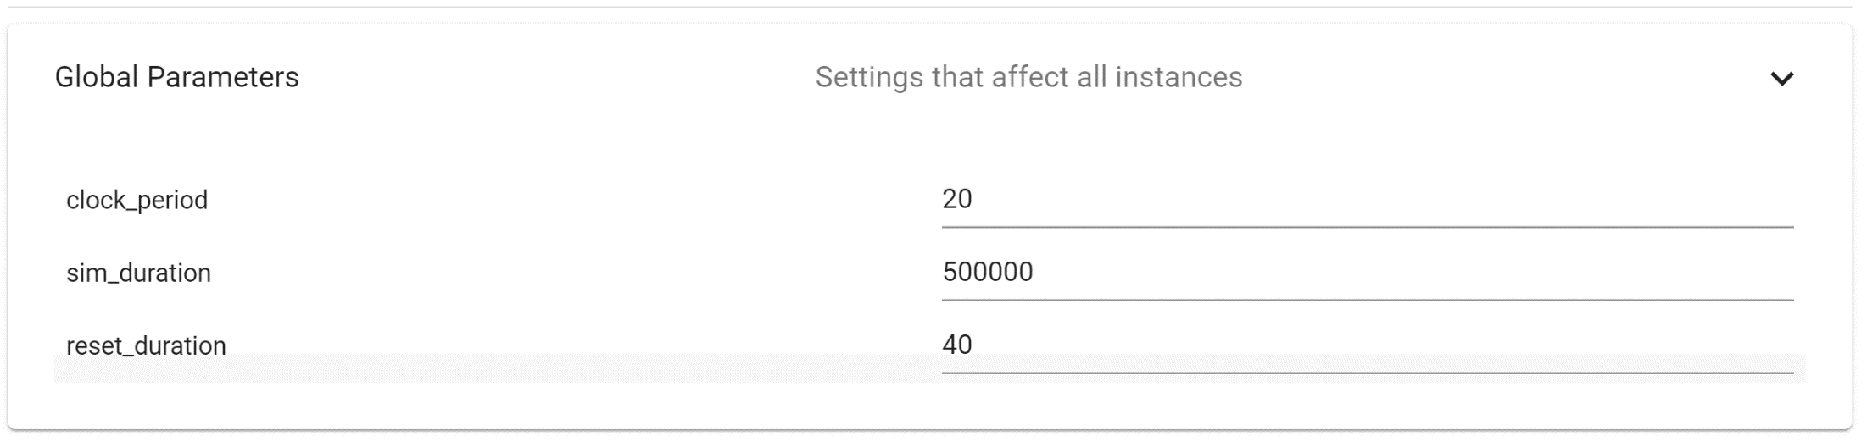
Configuration View – Boundary Inputs For Simulation Only
Clock Period for simulation (in nanoseconds)
Duration of simulation (in nanoseconds)
Duration for which reset is held active initially (in nanoseconds)

Slide 39
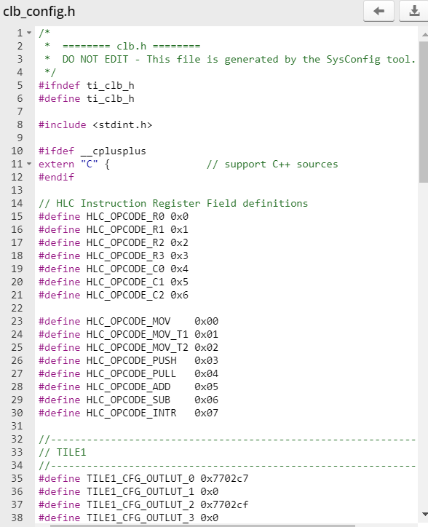
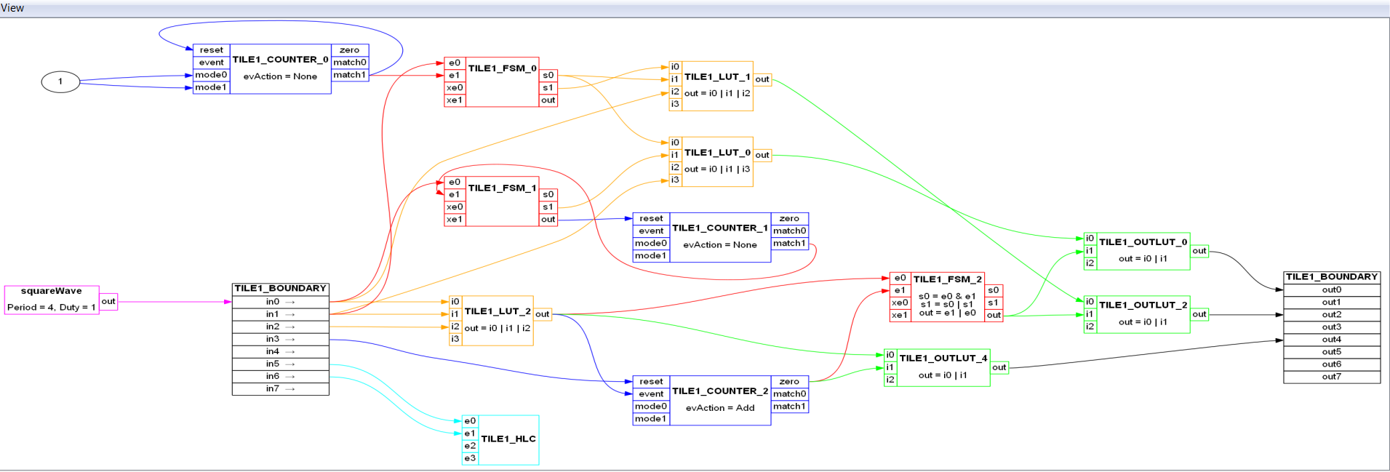
Generated Files

Slide 40
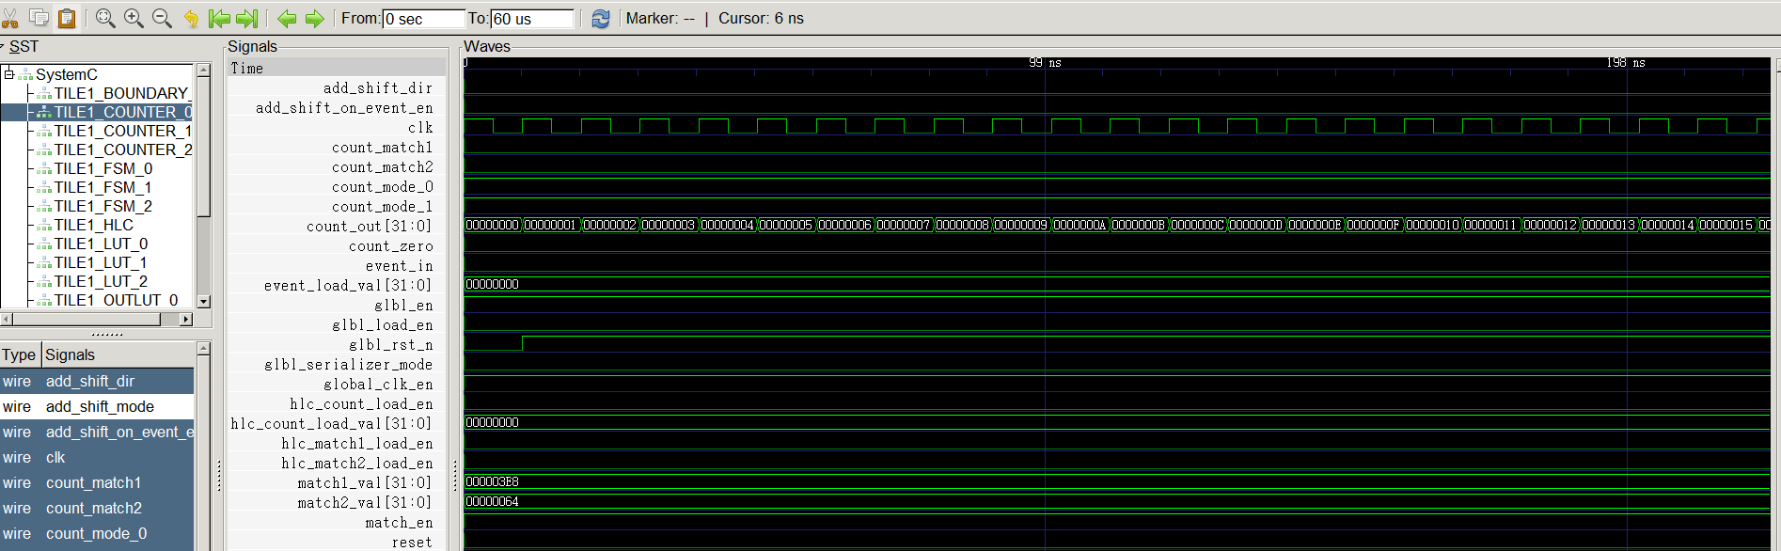
Simulation Output (vcd)

