Slide 1
APM Software Architecture of OBC_6K6_2in1 project
Snaku
2022/07/27

Slide 2
Agenda
SW Block Diagram of APM
Architecture and Interface
Development Tools
Operation Mode of APM
Bootloader Introduction

Slide 3

SW Block Diagram of APM (1/2)
In progress
Not develop yet
Application Firmware [80%]
Bootloader [60%]
CLI tool [70%]
Timer Scheduler [100%]
APM State Machine [100%]
Diagnostic
Stack [50%]
OBC State Machine [100%]
Security [90%]
Diagnostic service [60%]
Timer counting
ON / OFF
Soft Start
ON / OFF
Key Mgmt.
session
reflash appl.
Sleep
Fault
SHE API
Timer trigger
access cali. data
DID
Data Interface [100%]
Flash Driver [100%]
Fault Memory Mgmt. [70%]
APM Power Derating [100%]
DTC
Erase/Program
access conf. data
current limit for thermal / voltage
Get
Set
assign AES Key
EEPROM, snapshot.
security
Verify
routine
MCU Safety Mechanism [10%]
UART comm. [0%]
reflash DSP
Cali. & Conf. Data [100%]
J1772 Handling [60%]
Load
Verify
Read
CP/PP
S2
ISO-TP
core
other
DSP BootROM
File I/O [100%]
Signal Measurement
[100%]
Output V/I setting [100%]
CAN Comm. [100%]
SPI Communication [60%]
CAN Comm. [50%]
YMAL / S19 / BIN
Network Mgmt.
Diagnostic
stack
PWM duty update
SBC Initial
UDS Library TP Library
ADC
UART comm. [100%]
Interaction message
Petting watchdog
CAP
SPI Comm. [100%]
GPIO
DSP BootROM
CAN msg. forwarding
SBC Safety
SBC Initial
PCAN driver
MCU Driver layer
PC

Slide 4
SW Block Diagram of APM (2/2)
Application Firmware repo: \\FLS106\evps_rd\Repo_hg\OBC6K6_LV_APPL_v2
Bootloader
CLI tool
repo: \\FLS106\evps_rd\Repo_hg\OBC6K6_LV_BOOT_v2
repo: \\FLS106\evps_rd\Repo_hg\OBC6K6_CLI_v2
Timer Scheduler
timer.c
pTimers[ ]
sTimerRun( )
APM State Machine
housekeep.c
sStateMachine( )
Diagnostic
Stack
.\source\uds_stack
uds_app.c
UDS_MainFun( )
uds_app_cfg.c gs_astUDSService[]
can_tp.c
CANTP_MainFun( )
OBC State Machine
obc.c
sObcTask( )
Security
she.c
sbSheBootModeSet( )
sbSheMemoryUpdate()
Diagnostic service
cli.py
readCalibrationData()
readConfigurationData()
clearCalibrationData()
download(cali_bin_file)
download(conf_bin_file)
Fault Memory Mgmt. dtcmgr.c, DTC_Handle( )
eeprom.c, sEEP_Task( )
APM Power Derating housekeep.c
sPowerDeratingSet( )
Data Interface if.c
sbIfSet( )
sbIfGet( )
Flash Driver
flash_api.bin
Cali. & Conf. Data [100%]
nvm.c
sNvmXxxxDataRead( )
sNvmXxxxDataWrite( )
J1772 Handling
evse.c
sEvseTask( )
MCU Safety Mechanism safetyMeasure.c
sTestTask( )
UART comm.
none
Signal Measurement
adc.c
sAdcTask( )
gpio.c
sGpioTask( )
Output V/I setting
pwm.c
sPwmLvdcVoltUpdate()
sPwmLvdcCurrUpdate()
CAN Comm.
networkManagement.c
sNmTask( )
can.c
sCan0Task( )
sCan2Task( )
SPI Communication
sbc.c
sSBCInitial( )
safetyMeasure.c
FS45_WD_Refresh( )
CAN Comm.
.\source\stack
uds_app.c
uds_app_cfg.c can_tp.c
File I/O
ObcCali.yaml
ObcConf.yaml
UDS/TP Library
UART comm.
obc.c
sObcBootromXfer( )
SPI Comm.
sbc.c
sSBCInitial( )
PCAN driver
MCU Driver Config and Generate by NXP’s ProcessorExpert
Driver
PC

Slide 5
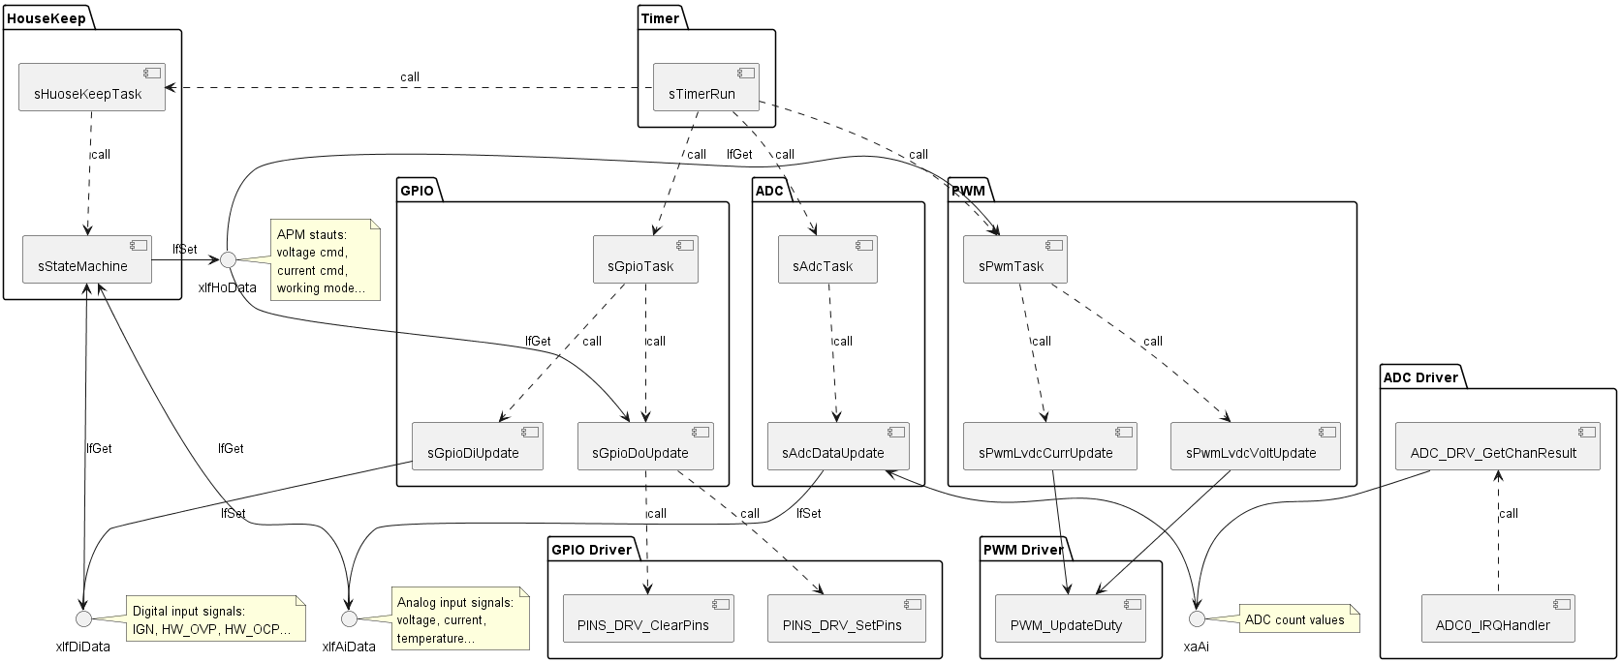
SW Architecture -- APM Control part

Slide 6
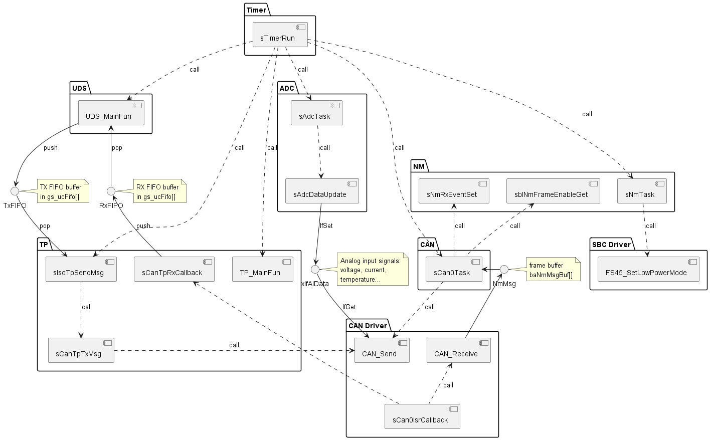
SW Architecture -- External CAN Communication part

Slide 7
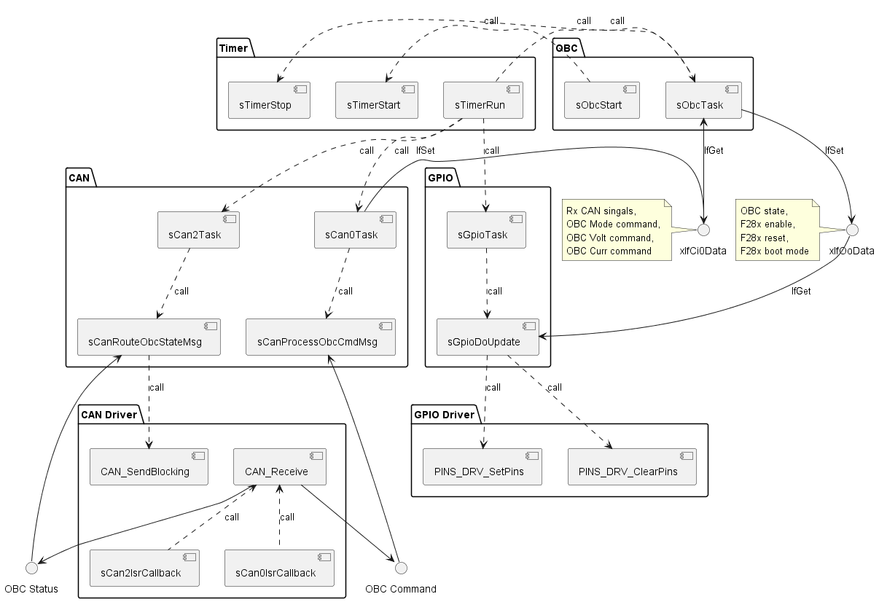
SW Architecture -- Internal CAN Communication part

Slide 8
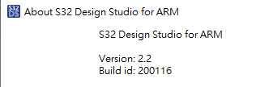
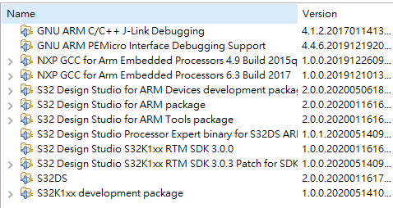
SW Development tools
S32K44 Firmware
CLI tool
repo: \\FLS106\evps_rd\Repo_hg\OBC6K6_LV_APPL_v2
repo: \\FLS106\evps_rd\Repo_hg\OBC6K6_CLI_v2
repo: \\FLS106\evps_rd\Repo_hg\OBC6K6_LV_BOOT_v2
Python 3.7.4
Package Version
--------------- -----------
bincopy 16.9.1
bitstruct 8.10.0
can-isotp 1.5
canmatrix 0.9.1
cantools 35.1.0
crccheck 0.6
cryptography 3.4.7
PyInstaller 3.6
python-can 3.3.2
pywin32-ctypes 0.2.0
PyYAML 5.3.1
udsoncan 1.10
…

Slide 9
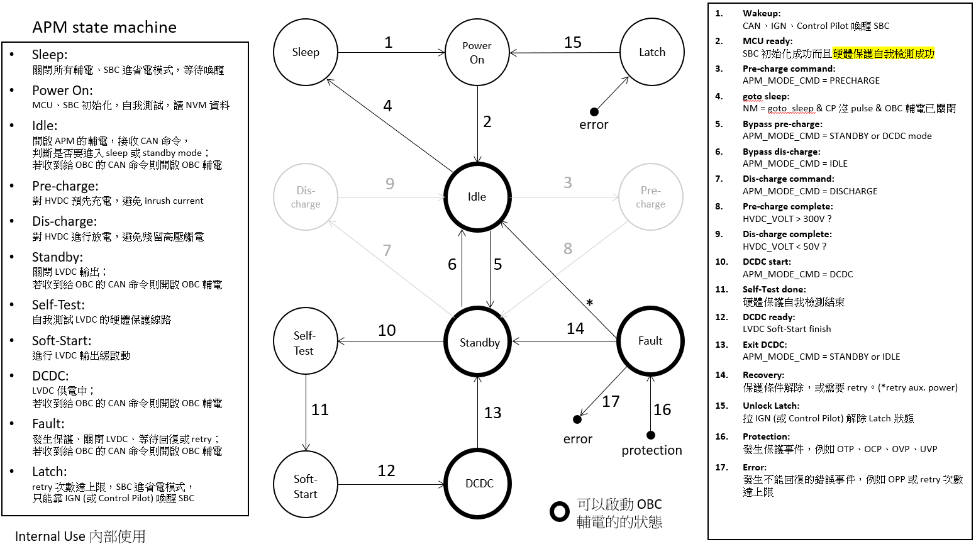

Slide 10
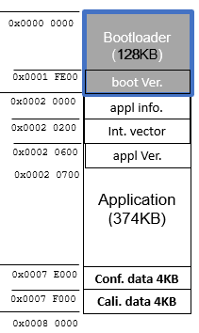
OBC 6.6KW Bootloader Introduction (1/4)
OBC 6.6KW S32K144 bootloader is modify from NXP Unified Bootloader V1.0 (2020.Q1)
UDS (ISO14229), TP (ISO1765-2/CAN, ISO17987-2/LIN)
Flash driver download from host (i.e., flash_api.bin )
App validity check in bootloader
APP and bootloader control signal reside in RAM
Using reset (watchdog) switch to APP or bootloader
CRC, software AES
NXP has released V2.0 Unified Bootloader (2022.Q1) it supports S32K3, S32K1, and S12Z I don’t merge the code change of V2 to our code base

Slide 11
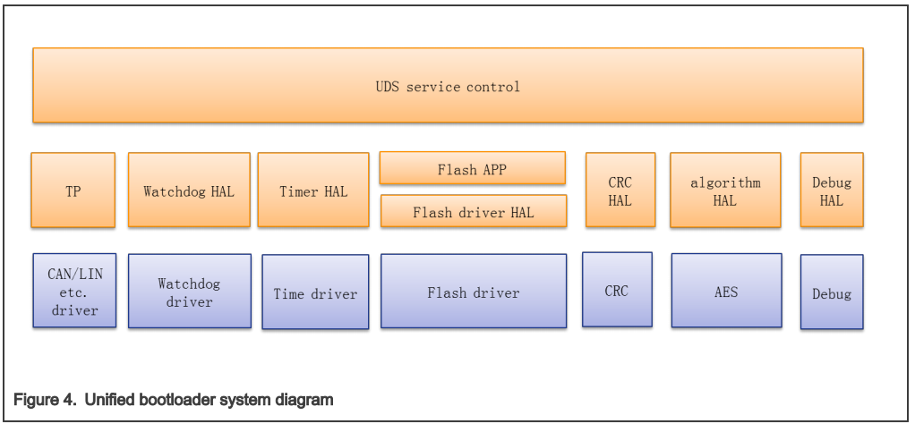
OBC 6.6KW Bootloader Introduction (2/4)
I add CSEc module,
for AES computation,
KEY access, random
number generation

Slide 12
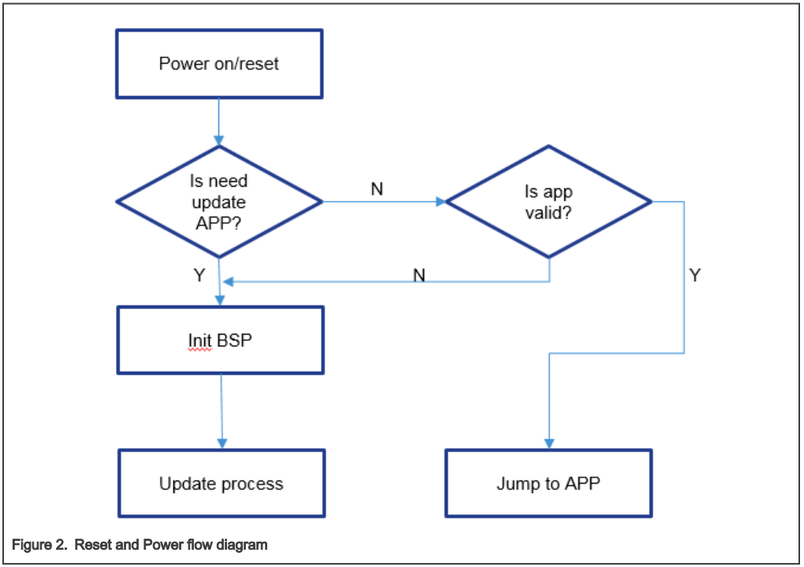
OBC 6.6KW Bootloader Introduction (3/4)
Unified bootloader reset/power on process
The following checks are performed by bootloader during the power on/reset. 1. Check update APP flag [ in SRAM ] 2. Check APP validity [ flags in flash ]
IsRequestEnterBootloader():
SRAM[ 0x2006FF1 ] == 0x5A ?
Boot_IsAPPValid():
IsFlashProgramSuccessful() and
IsFlashEraseSuccessful() and
IsFlashStructValid()

Slide 13
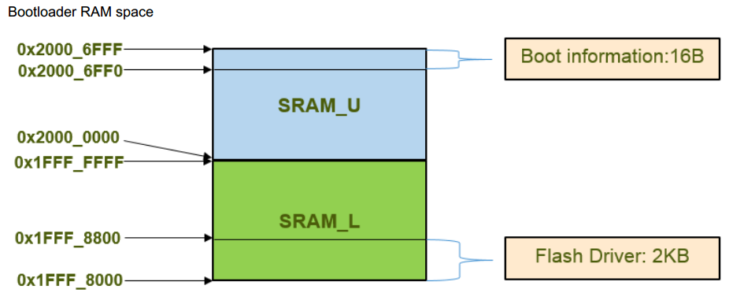
OBC 6.6KW Bootloader Introduction (4/4)
application code will update this information when it get request to download request
flash_api.bin, which is
download via CAN before start erase routine

Slide 14
SW Block ID for Bootloader
S32K144 P-Flash sector size : 4KB
Secure Boot
check area
0x0000 0000
Bootloader
(128KB)
0x0001 FE00
boot Ver.
0x0002 0000
Application
(374KB)
SW Block ID for update:
ID 0 : flash driver (in SRAM) ID 1 : application ID 2 : configuration ID 3 : calibration
appl info.
0x0002 0200
Int. vector
Software Blocks
can be updated
by bootloader
0x0002 0600
appl Ver.
0x0002 0700
1
0x0007 E000
Conf. data 4KB
2
0x0007 F000
Cali. data 4KB
3
0x0008 0000

Slide 15
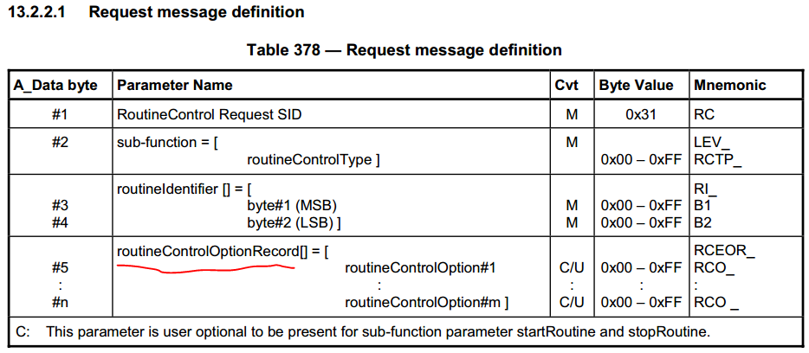
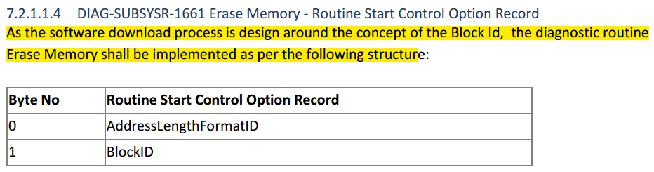
Erase Routine
add an option as Block ID in Routine Control request
ID 0 : flash driver ID 1 : application ID 2 : configuration ID 3 : calibration
= 0x41
= { 0 | 1 | 2 | 3 }

Slide 16
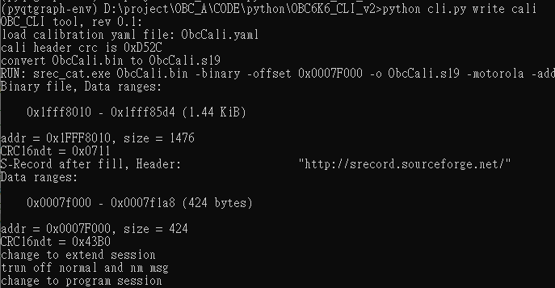
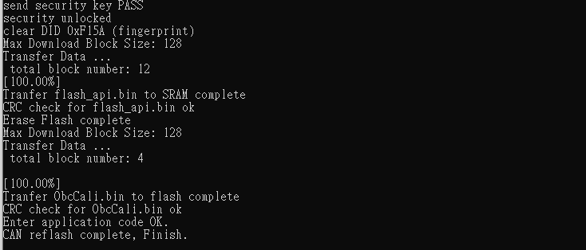
Download calibration data by CLI tool: ‘obc.exe write cali’
YAML to S19
S19 to BIN
enter prog. session
to start bootloader
download flash driver i.e., flash_api.bin
to SRAM
download cali. data i.e., ObcCali.bin
to P_Flash

Slide 17
CAN log (1/3)
;-------------------------------------------------------------------------------
; Message Time Type ID Rx/Tx
; Number Offset | [hex] | Data Length
; | [ms] | | | | Data [hex] ...
; | | | | | | |
;---+-- ------+------ +- --+----- +- +- +- +- -- -- -- -- -- -- --
1 6253.431 DT 07E0 Rx 8 02 10 03 AA AA AA AA AA // ext. session
2 6255.064 DT 07E8 Rx 8 02 50 03 00 00 00 00 00
3 6355.184 DT 07E0 Rx 8 03 28 03 03 AA AA AA AA // comm. control
4 6356.724 DT 07E8 Rx 8 02 68 03 00 00 00 00 00
5 6456.985 DT 07E0 Rx 8 02 10 02 AA AA AA AA AA // prog. session
6 6458.695 DT 07E8 Rx 8 03 7F 10 78 00 00 00 00
7 6478.368 DT 07E8 Rx 8 02 50 02 00 00 00 00 00
8 6558.508 DT 07E0 Rx 8 02 27 01 AA AA AA AA AA // req. seed
9 6564.766 DT 07E8 Rx 8 10 12 67 01 31 F4 38 75
10 6609.382 DT 07E0 Rx 8 30 00 00 AA AA AA AA AA
11 6610.160 DT 07E8 Rx 8 21 32 6D 64 D2 00 00 00
12 6610.580 DT 07E8 Rx 8 22 00 00 00 00 00 00 00
13 6664.138 DT 07E0 Rx 8 10 12 27 02 6B 77 CC AB // reply key, key = AES128_Ectrypt(seed)
14 6664.921 DT 07E8 Rx 8 30 00 01 00 00 00 00 00
15 6677.021 DT 07E0 Rx 8 21 78 32 F3 00 A5 19 73
16 6679.091 DT 07E0 Rx 8 22 B0 10 12 9F 13 AA AA
17 6681.731 DT 07E8 Rx 8 02 67 02 00 00 00 00 00
18 6780.899 DT 07E0 Rx 8 05 2E F1 5A 55 55 AA AA // clear sw fp.
19 6781.819 DT 07E8 Rx 8 03 6E F1 5A 00 00 00 00
20 6882.550 DT 07E0 Rx 8 10 08 34 00 41 00 00 00 // req. download
21 6883.359 DT 07E8 Rx 8 30 00 01 00 00 00 00 00 // addr = 0,
22 6895.533 DT 07E0 Rx 8 21 05 C4 AA AA AA AA AA // size = 1476
23 6900.473 DT 07E8 Rx 8 04 74 20 00 80 00 00 00 // max block = 128
24 6997.273 DT 07E0 Rx 8 10 82 36 01 79 04 00 00 // tx data, seq=1
...

Slide 18
CAN log (2/3)
;-------------------------------------------------------------------------------
; Message Time Type ID Rx/Tx
; Number Offset | [hex] | Data Length
; | [ms] | | | | Data [hex] ...
; | | | | | | |
;---+-- ------+------ +- --+----- +- +- +- +- -- -- -- -- -- -- --
...
266 8663.245 DT 07E0 Rx 8 2A 40 AA AA AA AA AA AA
267 8666.177 DT 07E8 Rx 8 04 76 0C 07 44 00 00 00
268 8765.083 DT 07E0 Rx 8 01 37 AA AA AA AA AA AA // transfer exit
269 8766.149 DT 07E8 Rx 8 01 77 00 00 00 00 00 00
270 8866.807 DT 07E0 Rx 8 10 08 31 01 02 02 00 00 // checksum routine
271 8867.743 DT 07E8 Rx 8 30 00 01 00 00 00 00 00
272 8879.690 DT 07E0 Rx 8 21 07 11 AA AA AA AA AA
273 8880.713 DT 07E8 Rx 8 03 7F 31 78 00 00 00 00
274 8882.933 DT 07E8 Rx 8 05 71 01 02 02 00 00 00
275 8981.499 DT 07E0 Rx 8 06 31 01 FF 00 41 03 AA // erase routine
276 8985.294 DT 07E8 Rx 8 03 7F 31 78 00 00 00 00 // block ID = 3
277 9000.172 DT 07E8 Rx 8 05 71 01 FF 00 00 00 00
278 9083.232 DT 07E0 Rx 8 10 08 34 00 41 03 00 00 // req. download
279 9084.196 DT 07E8 Rx 8 30 00 01 00 00 00 00 00 // addr(block) = 3
280 9096.117 DT 07E0 Rx 8 21 01 A8 AA AA AA AA AA // size = 424
281 9100.850 DT 07E8 Rx 8 04 74 20 00 80 00 00 00 // reply max size = 128
282 9197.913 DT 07E0 Rx 8 10 82 36 01 55 AA 30 00 // tx data, seq=1
283 9198.861 DT 07E8 Rx 8 30 00 01 00 00 00 00 00
284 9210.786 DT 07E0 Rx 8 21 01 E6 07 03 0F 0D 07
...

Slide 19
CAN log (3/3)
;-------------------------------------------------------------------------------
; Message Time Type ID Rx/Tx
; Number Offset | [hex] | Data Length
; | [ms] | | | | Data [hex] ...
; | | | | | | |
;---+-- ------+------ +- --+----- +- +- +- +- -- -- -- -- -- -- --
...
343 9541.910 DT 07E0 Rx 8 22 00 00 00 00 00 AA AA
344 9550.072 DT 07E8 Rx 8 04 76 03 00 00 00 00 00
345 9643.776 DT 07E0 Rx 8 10 2A 36 04 00 00 00 00 // tx data, final
346 9644.745 DT 07E8 Rx 8 30 00 01 00 00 00 00 00
347 9656.575 DT 07E0 Rx 8 21 00 00 00 00 00 00 80
348 9658.586 DT 07E0 Rx 8 22 3F 00 00 00 00 00 00
349 9660.595 DT 07E0 Rx 8 23 00 00 00 00 00 00 00
350 9662.714 DT 07E0 Rx 8 24 00 00 00 00 00 00 00
351 9664.526 DT 07E0 Rx 8 25 00 00 80 3F 00 00 00
352 9666.580 DT 07E0 Rx 8 26 00 AA AA AA AA AA AA
353 9674.005 DT 07E8 Rx 8 04 76 04 00 00 00 00 00
354 9768.375 DT 07E0 Rx 8 01 37 AA AA AA AA AA AA // transfer exit
355 9769.408 DT 07E8 Rx 8 01 77 00 00 00 00 00 00
356 9870.160 DT 07E0 Rx 8 10 08 31 01 02 02 00 00 // checksum routine
357 9871.131 DT 07E8 Rx 8 30 00 01 00 00 00 00 00
358 9882.967 DT 07E0 Rx 8 21 3E 7A AA AA AA AA AA
359 9883.989 DT 07E8 Rx 8 03 7F 31 78 00 00 00 00
360 9885.971 DT 07E8 Rx 8 05 71 01 02 02 00 00 00
361 9984.798 DT 07E0 Rx 8 02 11 01 AA AA AA AA AA // reset ECU
362 9985.910 DT 07E8 Rx 8 03 7F 11 78 00 00 00 00
363 10005.726 DT 07E8 Rx 8 02 51 01 00 00 00 00 00

