Slide 1
6.6 KW OBC system state diagram
IGN = high or CAN signal or
J1772 Pilot
喚醒來源
IDLE
Sleep
IGN = low
and CAN no signal
IGN = high or CAN = Standby
IGN = low and
CAN = IDLE
初期韌體不允許三個state直接跳轉
必須先回 standby 才能換別的模式
Standby
(off)
IGN = high and
CAN = DCDC
CAN = Charging
CAN = Standby
or EVSE disconnect
IGN = low or CAN = Standby
Charging State
IGN = high and CAN = Charging_DCDC
IGN = low or
CAN = Standby
IGN = high and
CAN = DCDC
IGN = high and
CAN = Charging_DCDC
DCDC
State
CAN = Charging
CAN = Charging
Charging & DCDC
IGN = high and CAN = Charging_DCDC
IGN = high and ( CAN = DCDC or EVSE disconnect )

Slide 2
6.6 KW LV MCU state diagram
Idle State
Fault State
Power On
DUMMY_EN = high (on)
LVDC_EN = high (off)
HVDC_EN = high (req . off)
EEP_WP = high (read only)
ORING_EN = low (off)
send Cali data to HV & AC MCU
DUMMY_EN = high (on)
LVDC_EN = high (off)
HVDC_EN = high (req. off)
AUX_EN = high (on)
ORING_EN = low (off)
Write Fault Code to EEPROM
send Cali data if not finish
Start
fault
clear
Any fault
detected
1. AUX_EN = high (on)
2. Delay 0.5 sec
( CAN = Standby | ACDC | DCDC | OBCDC
or IGN = high )
and Calibration Data Ready
IGN = low
and CAN = IDLE
IGN = low and
CAN no signal
Sleep State
CAN = Standby | ACDC | DCDC | OBCDC
or IGN = high
CAN0_STB = high (off)
EEP_WP = low (writable)
Delay 1 sec
AUX_EN = low (off)
send sleep command to SBC
Standby State
DUMMY_EN = high (on)
LVDC_EN = high (off)
HVDC_EN = high (req . off)
AUX_EN = high (on)
ORING_EN = low (off)
EV_READY = low
VENT_REQ = low
Charger Coupler Task
1. Monitor Polit and Proximity signals
2. If EVSE Coupler depressed
or Pilot state != (C or D)
or ACDC fault →
HVDC_EN = high (off)
Else HVDC_EN = low (on)
IGN = high and CAN = DCDC
CAN = ACDC
EVSE disconnect
or CAN = IDLE | Standby
or OtherSideOff
IGN = low or CAN = IDLE | Standby or OtherSideOff
IGN = high and CAN = OBCDC
IGN = low or CAN = IDLE | Standby or OtherSideOff
AC-DC state
Pilot State = C | D
DUMMY_EN = high (on)
LVDC_EN = high (off)
ORING_EN = low (off)
wait slave MCU state = ACDC
DC-DC state
CAN = ACDC
CAN = ACDC
OBC-DC state
Pilot State = B
DUMMY_EN = low (off)
HVDC_EN = high (off)
LVDC_EN = low (on)
ORING_EN = high (on)
Delay 0.5s
wait slave MCU state = DCDC
check LV_UVP
IGN = high and
CAN = DCDC
Pilot State = C | D
DUMMY_EN = high (on)
LVDC_EN = low (on)
ORING_EN = high (on)
Delay 0.5s
wait slave MCU state = OBCDC
check LV_UVP
IGN = high and CAN = OBCDC
IGN = high and (CAN = DCDC or EVSE disconnect )
IGN = high and CAN = OBCDC

Slide 3
6.6 KW HV MCU state diagram
Power On
Idle State
Fault State
Start
fault
clear
Any fault
detected
HVDC_PWM_EN = high (off)
BYPASS_ON = low (off)
HVCB_ON = low (off)
HVDC_PWM_EN = high (off)
BYPASS_ON = low (off)
HVCB_ON = low (off)
Delay 0.5 sec
UART != IDLE
UART = IDLE
Standby State
HVDC_PWM_EN = high (off)
BYPASS_ON = low (off)
HVCB_ON = low (off)
UART = IDLE | Standby or EVSE disconnect
or OtherSideOff
or PFC_OK = low
or HVDC_EN# = high
or CP_STATE = B
UART = ACDC
and HVDC_EN# = low
UART= IDLE | Standby or OtherSideOff or PFC_OK = low
or HVDC_EN# = high or CP_STATE = B
IGN = high and UART = DCDC
UART = IDLE | Standby or OtherSideOff
IGN = high and UART = OBCDC
and HVDC_EN# = low
AC-DC state
wait PFC_OK == high (on)
delay 0.01s
HVDC_PWM_EN = low (on)
delay 0.5s
HvUvpCheck = true
DC-DC state
UART = ACDC
UART = ACDC
OBC-DC state
HvUvpCheck = true
HVDC_PWM_EN = high (off)
wait HV > UV threshold
IGN = high and UART = DCDC
wait PFC_OK == high (on)
delay 0.01s
HVDC_PWM_EN = low (on)
delay 0.5s
HvUvpCheck = true
IGN = high and UART = OBCDC
IGN = high and (UART = DCDC or EVSE disconnect )
UART = OBCDC

Slide 4
6.6 KW AC MCU state diagram
Idle State
Fault State
PFC_EN = high (off)
RLY_DRV = low (off)
PFC_OK = low (off)
EN_L & EN_N = high (on)
VBULK_380V_EN = high (off)
PFC_EN = high (off)
RLY_DRV = low (off)
PFC_OK = low (off)
EN_L & EN_N = high (on)
VBULK_380V_EN = high (off)
Start
Power On
fault
clear
Any fault
detected
Delay 0.01 sec
UART != IDLE
UART = IDLE
ADC ISR
InrushSwitchCtrl()
Standby State
Sample ADC half channels …
EN_L & EN_N = high (on)
PFC_EN = high (off)
PFC_OK = low (off)
RLY_DRV = low (off)
VBULK_380V_EN = high (off)
暫時取消 Zero Crossing Ctrl EN_N = high
EN_L = high
Timer
Event (10KHz)
If RLY_DRV = low (off) if Vbulk > Vac_rms * 1.414 * BulkThreshold
RLY_DRV = high (on) Else:
RLY_DRV = low (off)
Port Check Task
AC_Level_Select( )
UART = IDLE | Standby or EVSE disconnect
or OtherSideOff
or CP_STATE = B
1. If VBus < 350v & AC/OBC-DC state →
PFC_OK = low (off)
Else
If 395 < Vbus < 405 →
PFC_OK = high (on)
2. AC_Level_Select( )
If Vac_rms < 160v: AC_LINE_select = high (110v)
PKLMT_select = high (110v)
BulkThreshold = 0.8
If Vac_rms > 165v:
AC_LINE_select = low (220v)
PKLMT_select = low (220v)
BulkThreshold = 0.9
UART = DCDC and IGN = high
UART = ACDC
UART= IDLE or OtherSideOff or CP_STATE = B
UART = IDLE | Standby or OtherSideOff
AC-DC state
InrushSwitchCtrl()
wait RLY_DRV = high (on) →
delay 0.02s
PFC_EN = low (on)
wait PFC_OK = high (on)
delay 0.7s
GridCheck = true
BusUvpCheck = true
UART = OBCDC and IGN = high
DC-DC state
UART = ACDC
UART = ACDC
OBC-DC state
PFC_EN = high (off)
PFC_OK_P = low (off)
RLY_DRV = low (off)
UART = DCDC and IGN = high
UART = OBCDC
InrushSwitchCtrl()
wait RLY_DRV = high (on)
delay 0.02s
PFC_EN = low (on)
wait PFC_OK_P = high (on)
delay 0.7s
GridCheck = true
BusUvpCheck = true
IGN = high and (UART = DCDC or EVSE disconnect )
UART = OBCDC

Slide 5
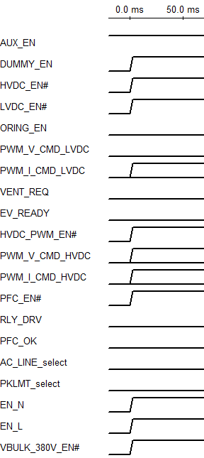
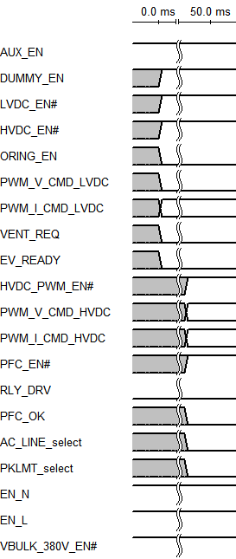
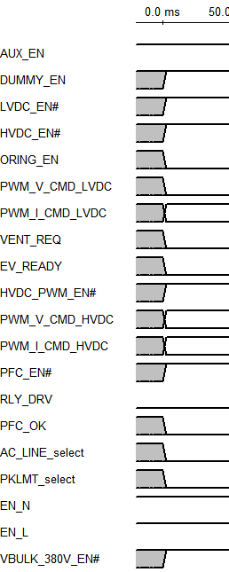
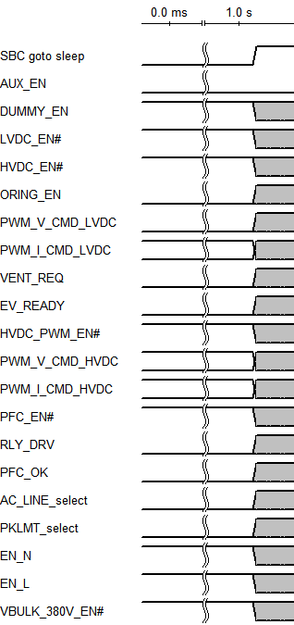
6.6KW off timing
Sleep state
Idle state
Standby state
Fault state
190A
190A
190A
190A
300V
300V
300V
300V
24A
24A
24A
24A

Slide 6
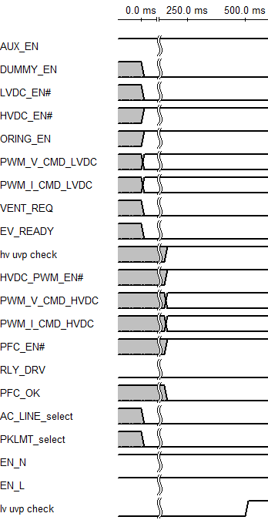
6.6KW DC-DC state timing
Standby state
DC-DC state
CAN Voltage command, soft-start, 0.1V/ms
190A
Current limit
300V
300V
24A
24A

Slide 7
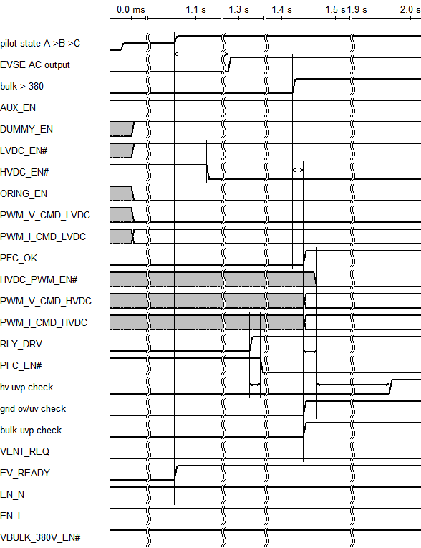
6.6KW AC-DC state timing
AC-DC state
3s
Max
Standby state
10ms
190A
190A
CAN command
Current limit
300V
10ms
24A
500ms
20ms

Slide 8
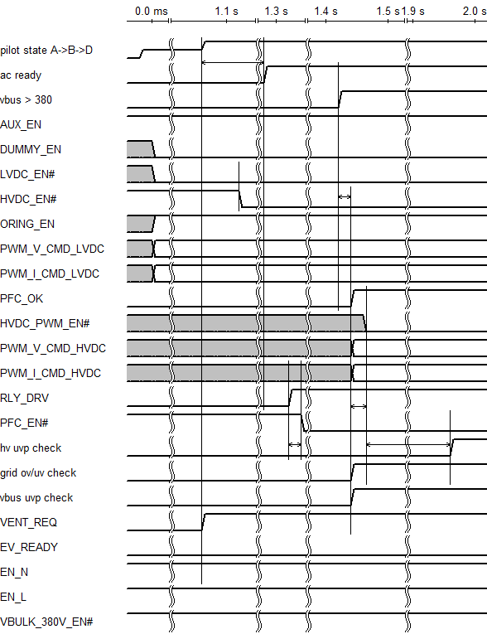
6.6KW OBC-DC state timing
OBC-DC state
3s
Max
Standby state
10ms
CAN command with soft-start
Current limit
190A
CAN command
Current limit
300V
10ms
24A
500ms
20ms

Slide 9
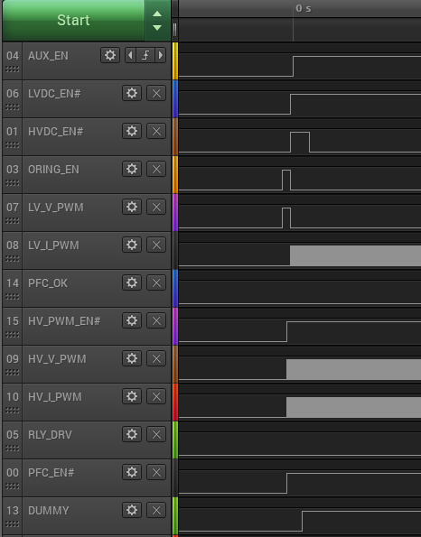
6.6KW Power on → Standby

Slide 10
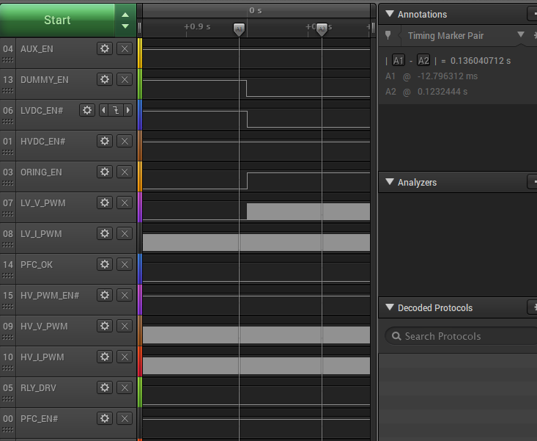
6.6KW Standby→ DC-DC
Soft-Start
↗ Duty : 0.1V / ms ↗
CAN Command with Soft-Start
190A
CAN command

Slide 11
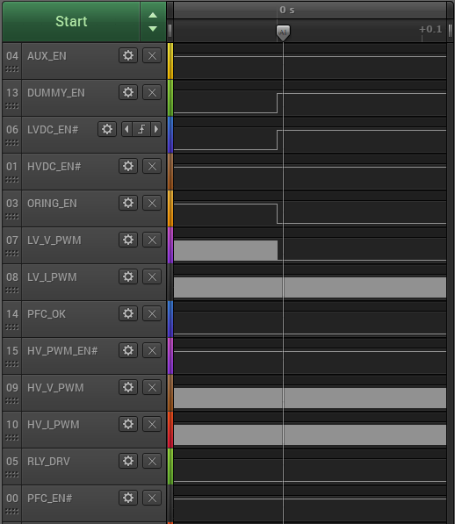
6.6KW DC-DC → Standby
CAN Command
CAN command
190A
先 disable 才改變 duty

Slide 12
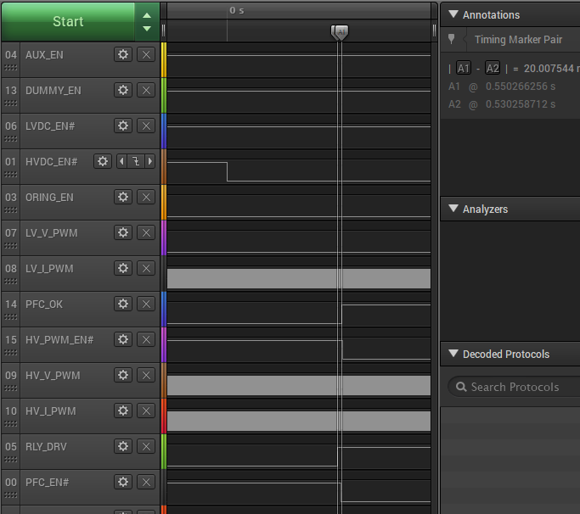
6.6KW Standby→AC-DC
0. 53s
190A
CAN Command
CAN command

Slide 13
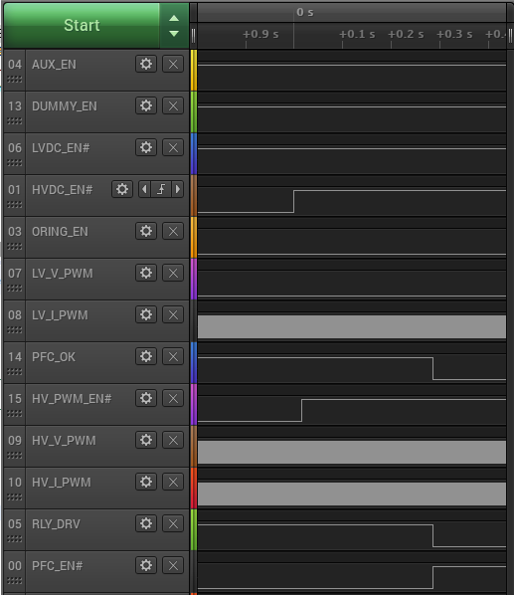
6.6KW AC-DC→Standby
CAN Command
CAN command
先關 HV 才關 PFC

Slide 14
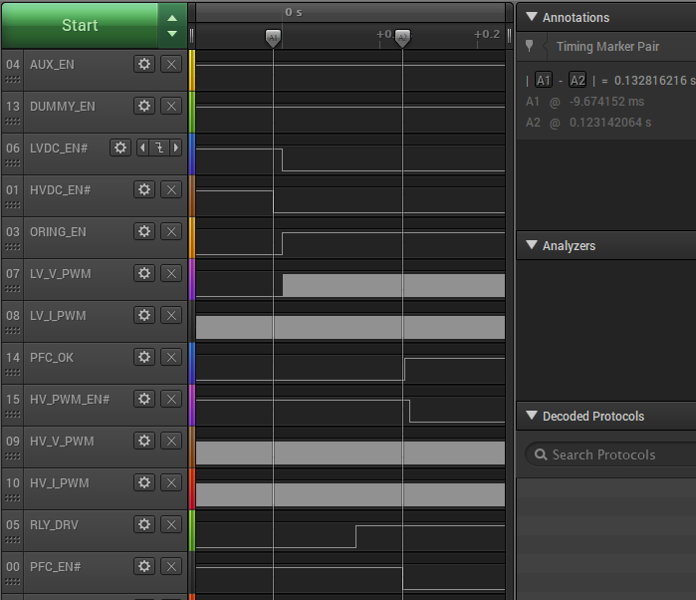
6.6KW Standby→OBC-DC
Soft-Start
190A
CAN command
CAN command
CAN Command

Slide 15
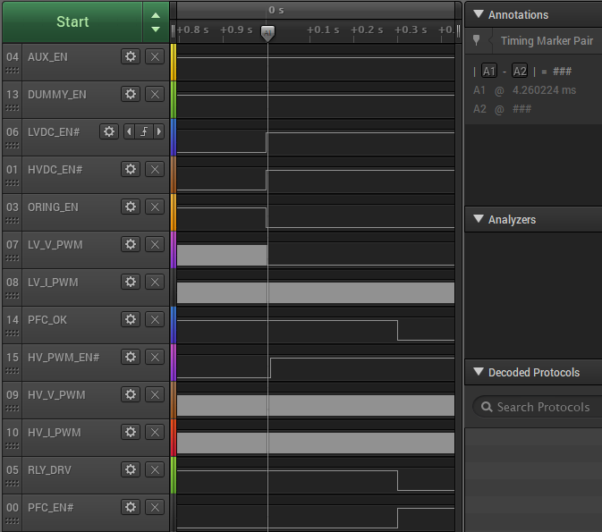
6.6KW OBC-DC →Standby
CAN Command
先 disable 才改變 duty
CAN command
190A
CAN command
CAN Command

Slide 16
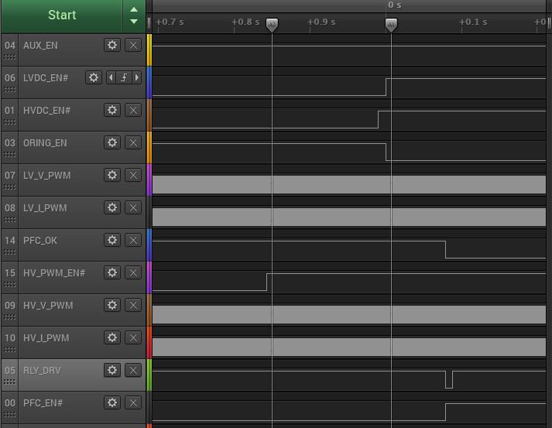
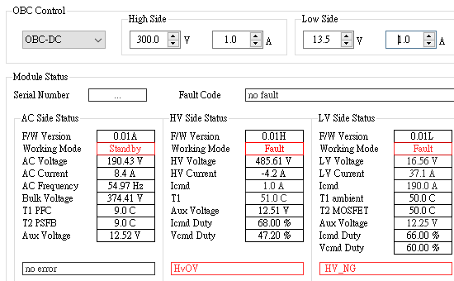
6.6KW HV OVP when OBC-DC after fix LV MCU re-start issue
CAN Command
13.5V
CAN command
190A
CAN command
300V
CAN Command
24A

Slide 17
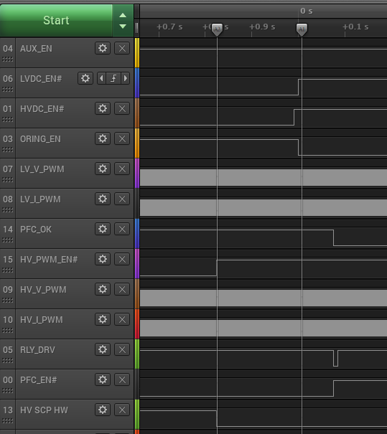
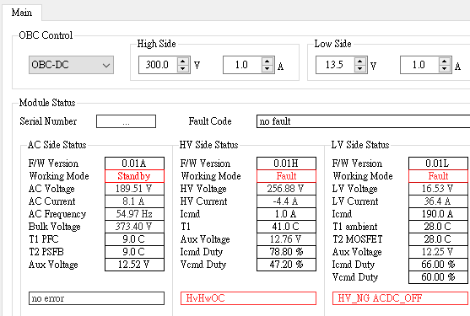
6.6KW HV OCP(HW) when OBC-DC

Slide 18
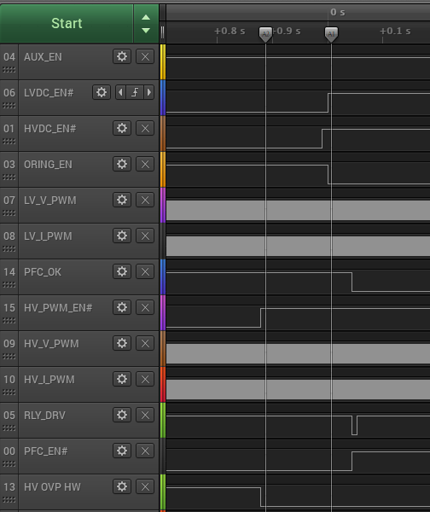
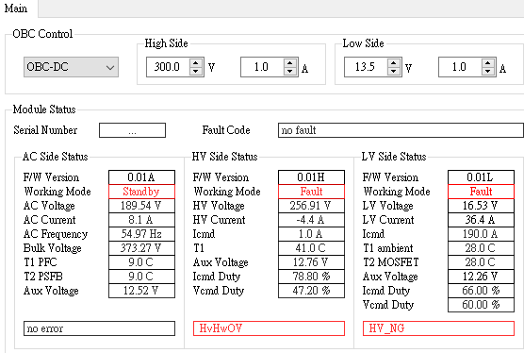
6.6KW HV OVP(HW) when OBC-DC

Slide 19
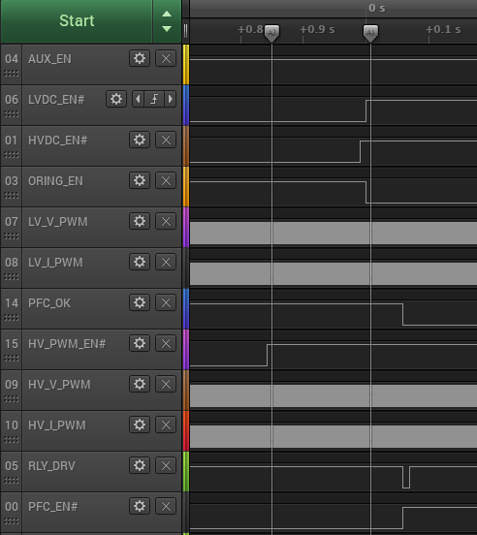
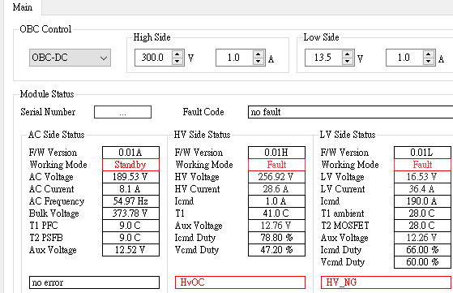
6.6KW HV OCP when OBC-DC

Slide 20
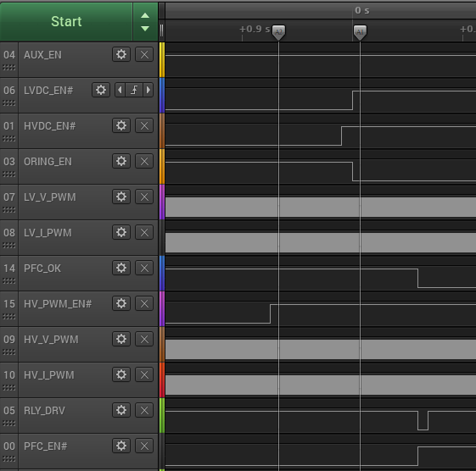
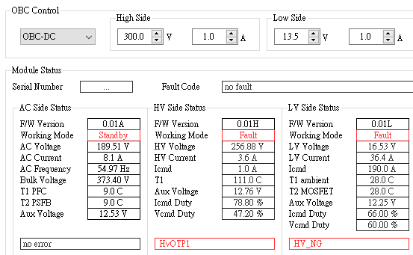
6.6KW HV OTP when OBC-DC

Slide 21
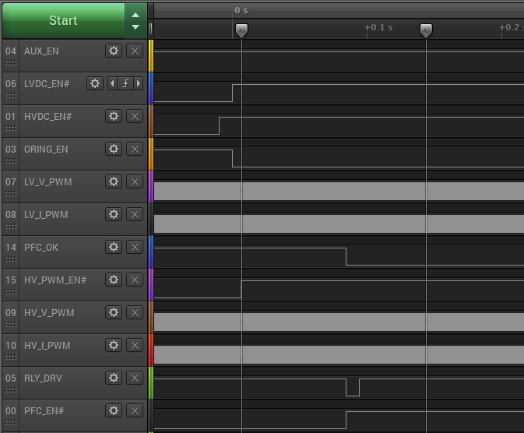
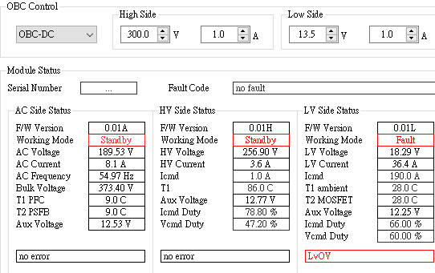
6.6KW LV OVP when OBC-DC
CAN Command
13.5V
CAN command
190A
CAN command
300V
CAN Command
24A

Slide 22
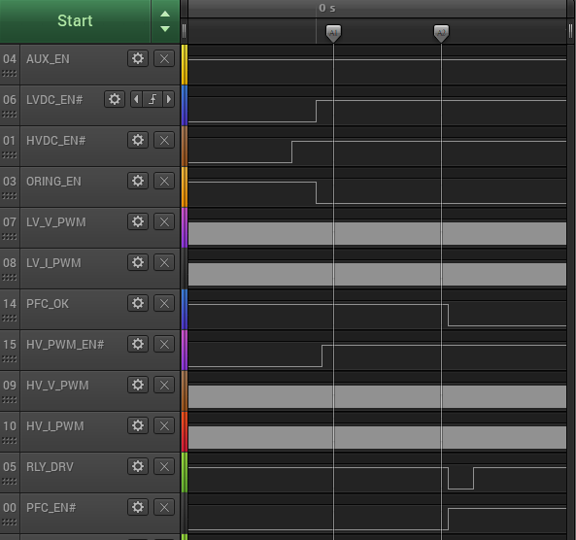
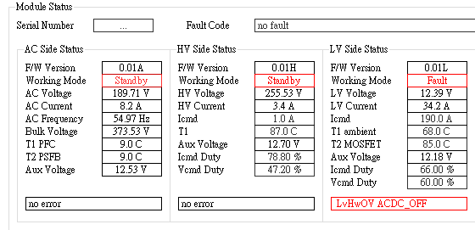
6.6KW LV OV(HW) when OBC-DC
CAN Command
13.5V
CAN command
190A
CAN command
300V
CAN Command
24A

Slide 23
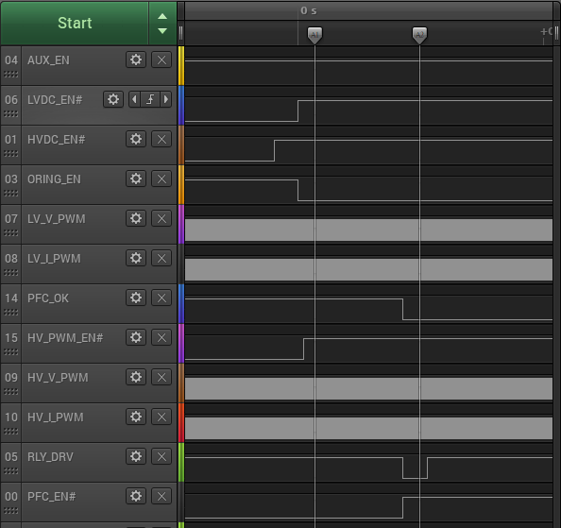
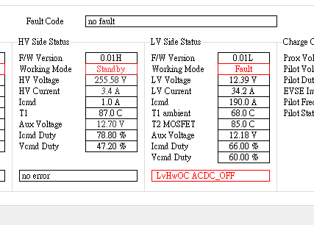
6.6KW LV OC(HW) when OBC-DC
CAN Command
13.5V
CAN command
190A
CAN command
300V
CAN Command
24A

Slide 24
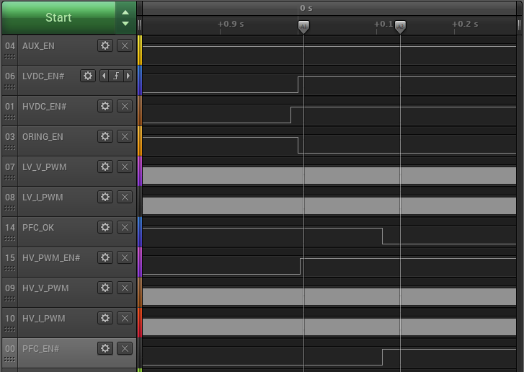
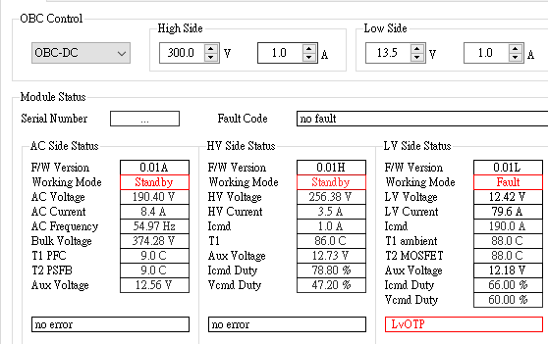
6.6KW LV OTP when OBC-DC
CAN Command
13.5V
CAN command
190A
CAN command
300V
CAN Command
24A

Slide 25
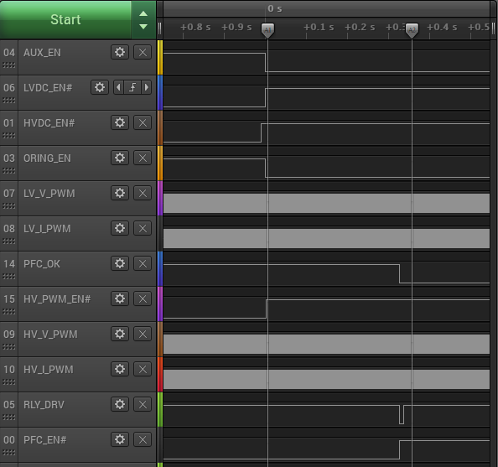
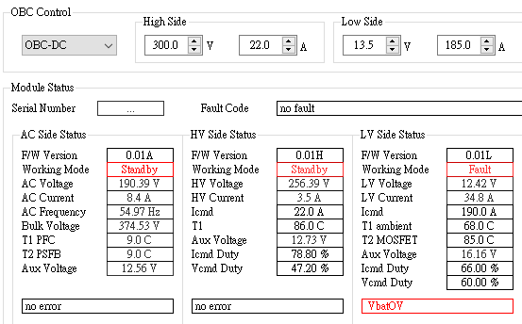
6.6KW Vbat OV when OBC-DC

Slide 26
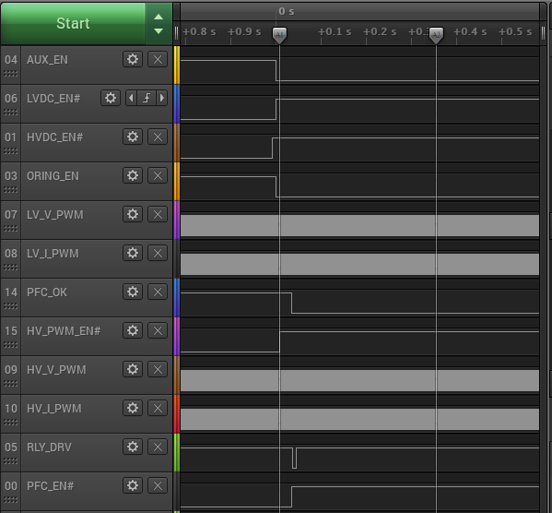
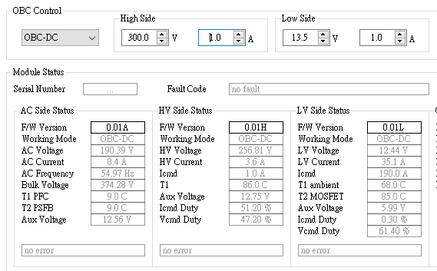
6.6KW Vbat UV when OBC-DC
LV MCU CAN BUS Off

Slide 27
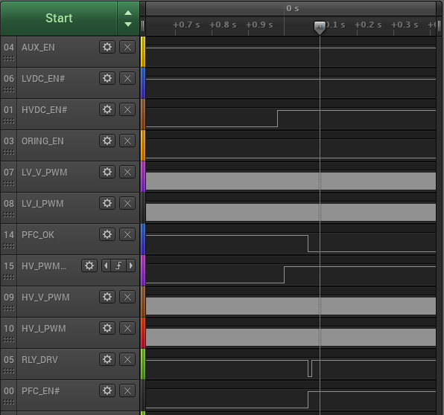
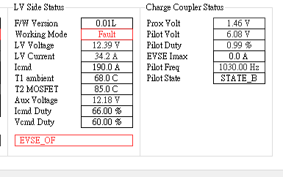
6.6KW Pilot over frequency when AC-DC

Slide 28
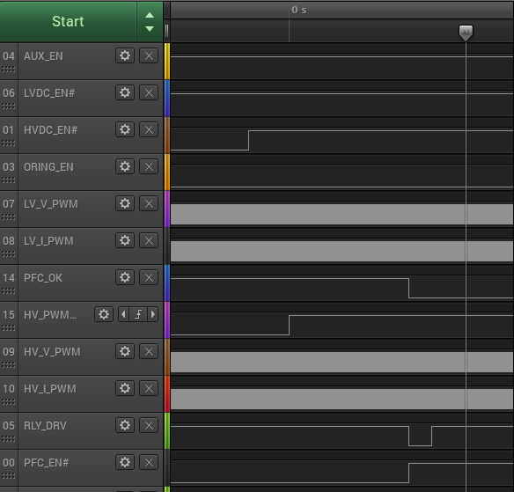
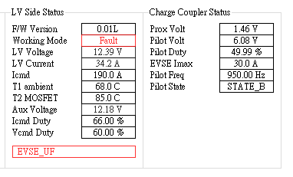
6.6KW Pilot under frequency when AC-DC

Slide 29
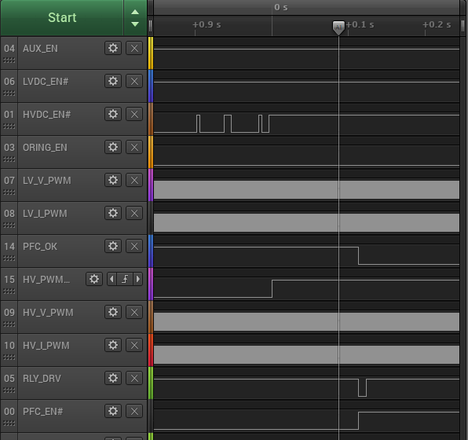
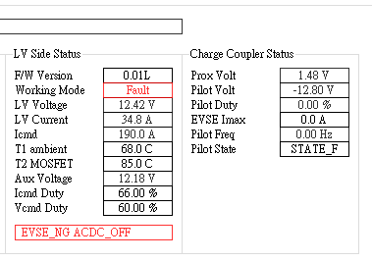
6.6KW Pilot error (-12V) when AC-DC

Slide 30
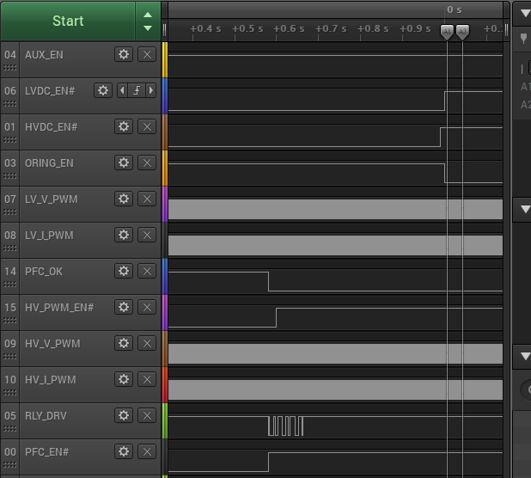
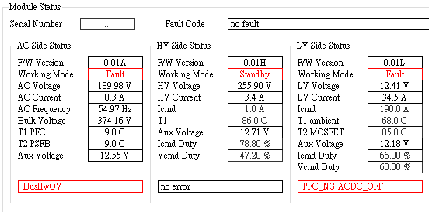
6.6KW Bulk OV(HW) when OBC-DC

Slide 31
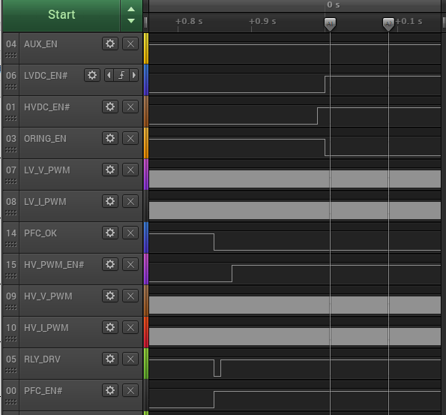
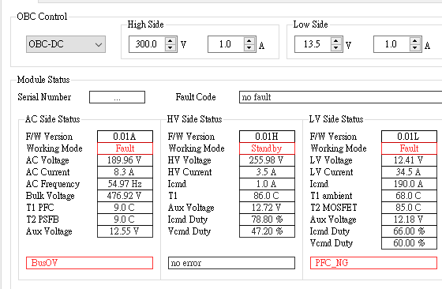
6.6KW Bulk OV when OBC-DC

Slide 32
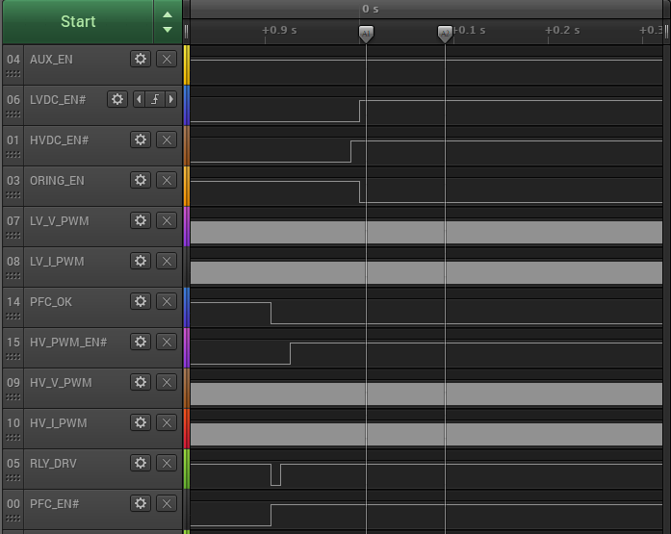
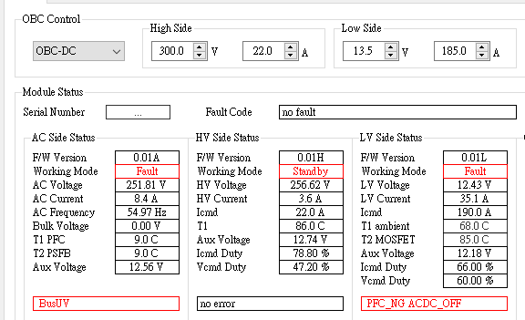
6.6KW Bulk UV when OBC-DC

Slide 33

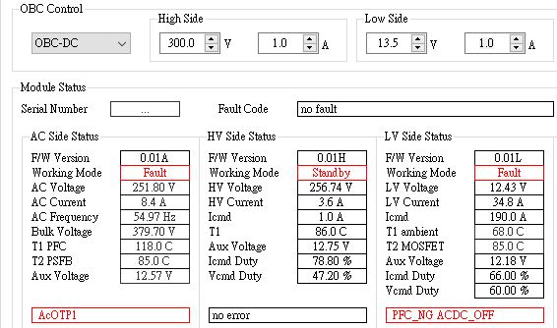
6.6KW PFC OTP1 when OBC-DC

Slide 34
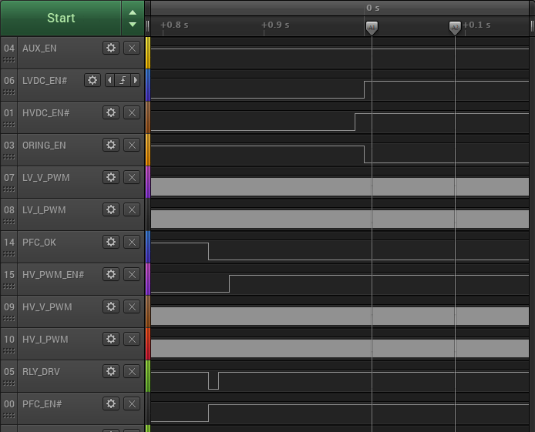

6.6KW PFC OTP2 when OBC-DC

Slide 35


6.6KW Grid OV when AC-DC

Slide 36


6.6KW Grid UV when AC-DC

Slide 37


6.6KW Grid over frequency when AC-DC

Slide 38


6.6KW Grid under frequency when AC-DC

