Slide 1
IBM University Engagement Project Submission
“Exploring the Power of Agentic AI with IBM Granite and LangFlow”

Slide 2

Project Title – Course Content Simplification Agent
Domain of Project – Education
Student Name | Recent Passport Photo | Email ID | Mobile number [WhatsApp]
Nilesh Indradev Yadav |  | nileshyadav2803@gmail.com | 8983856057

Slide 3
Problem Statement -
Problem Statement : Course Content Simplification Agent
The Challenge
Educational materials often vary in complexity and are not always accessible to learners with different levels of prior knowledge. Students may struggle to grasp key concepts due to jargon-heavy or overly advanced explanations in faculty notes and textbooks.
The Objective
Build an AI-powered agent that analyzes academic content and reframes the explanation based on the learner’s level – Beginner, Intermediate, or Expert. The solution should:
Level-Based Explanation – Explain the same course text in simple language that matches the chosen level.
Simple Input – User pastes the course text and writes “Level: Beginner / Intermediate / Expert” below it.
IBM Granite Model – Use IBM Granite on IBM watsonx.ai to generate the simplified explanation.
Inclusive Learning – Help learners with different prior knowledge understand the same content.

Slide 4
Proposed Solution -
Proposed Solution: Course Content Simplification Agent
The proposed solution is an interactive AI agent built using IBM Bob as the coding assistant, Python (Streamlit), and the IBM Granite model (ibm/granite-4-h-small) via the ibm-watsonx-ai SDK. It takes course text from the learner and explains it in simpler language based on the selected level.
Input – The user pastes the course text in the Streamlit app and selects a level – Beginner, Intermediate, or Expert – using the pill-style radio buttons.
Processing – The Python app calls the IBM watsonx.ai API using the ibm-watsonx-ai SDK. The Granite model follows a System Message that defines it as a Course Content Simplification agent.
Output – The Streamlit app streams the simplified explanation word-by-word and shows input, output, and total token counts below each response.
Overall, this solution makes academic content easier to understand for learners at every level, built with IBM Bob and Python in a clean, beginner-friendly setup.

Slide 5
Technology Used
IBM Bob – AI coding assistant used to build, debug, and review the Python app (app.py)
IBM Granite model – ibm/granite-4-h-small – For understanding the course text and writing the simplified explanation
IBM watsonx.ai – For running the Granite model (project: course-simplifier-agent)
IBM Cloud – Hosts the watsonx.ai project and Runtime service used by the agent
GitHub – For storing the project files (app.py, requirements.txt, .env.example, tests/test_app.py, README.md) and screenshots

Slide 6
Application Components Used -
1) Streamlit UI (app.py) – The web interface where the user pastes course text and selects a level (Beginner / Intermediate / Expert) using pill-style radio buttons.
2) ibm-watsonx-ai Python SDK – Sends the user input to IBM watsonx.ai with a System Message and streams the simplified explanation back to the UI.
3) Name of IBM Granite model – ibm/granite-4-h-small → writes the explanation in simple language for the chosen level.
4) Token Counter – After each response, the app displays input tokens, output tokens, and total tokens used for that request.
5) System Message – Instruction hardcoded in app.py that defines the model as a Course Content Simplification agent with Beginner, Intermediate, and Expert behaviour.

Slide 7
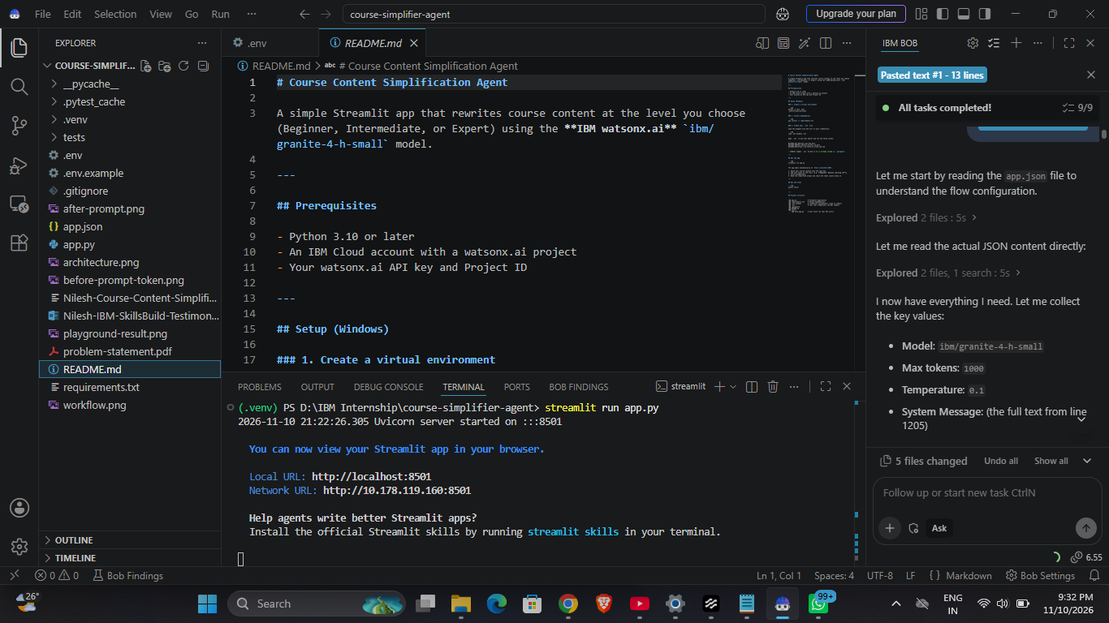
IBM Bob Workflow -

Slide 8
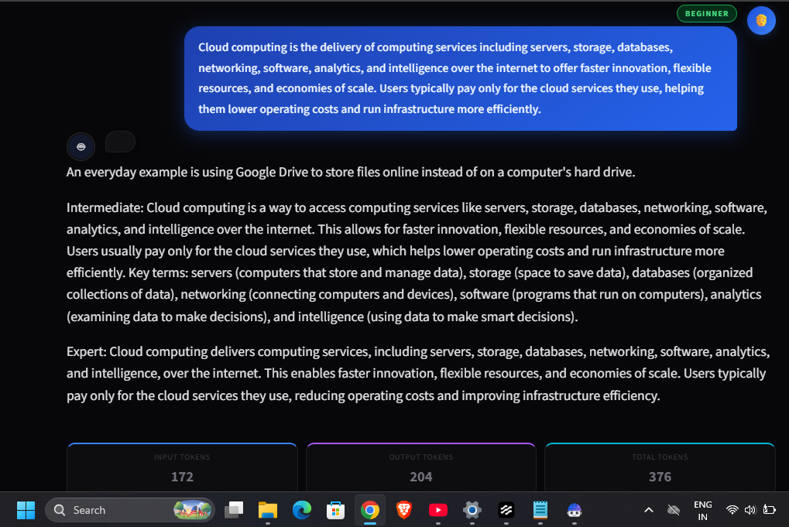
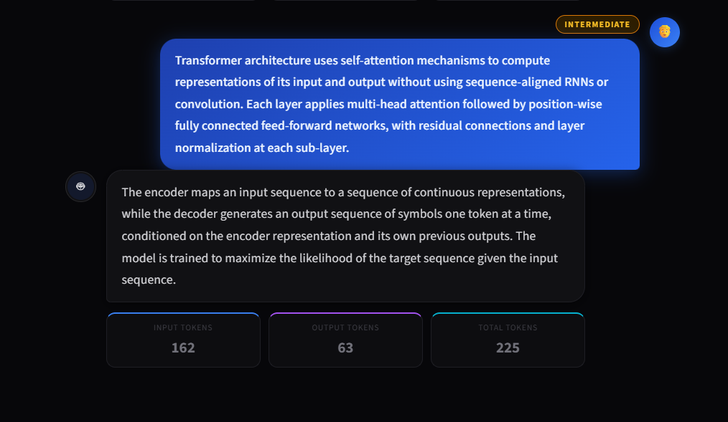
Architecture blueprint
Beginner and Intermediate level responses from the Streamlit app. The ibm-watsonx-ai SDK sends the course text to IBM Granite, which streams back the simplified explanation with input, output and total token counts.

Slide 9

Role of Agentic AI in the solution
Role of Agentic AI in Course Content Simplification Agent
Agentic AI lets the agent work as a goal-driven assistant instead of a simple search tool. Using IBM watsonx.ai and the IBM Granite model, it reads the course text, understands the level chosen by the learner, and decides how simple or detailed the explanation should be.
The agent follows a System Message that fixes its role and goal: make academic content easy to understand. It adapts the language and depth for Beginner, Intermediate, or Expert learners without any manual rewriting.
IBM Bob was used as the AI coding agent to generate, review, and debug the Python code. The Streamlit app connects the steps – user input, the ibm-watsonx-ai SDK, and the streamed output – so the whole task runs automatically from input to explanation.
Overall, Agentic AI makes the solution personalized, adaptive, and easy to scale for more learners and courses.

Slide 10
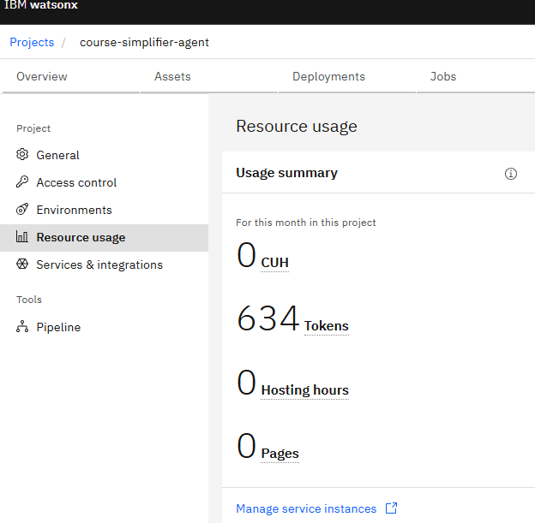
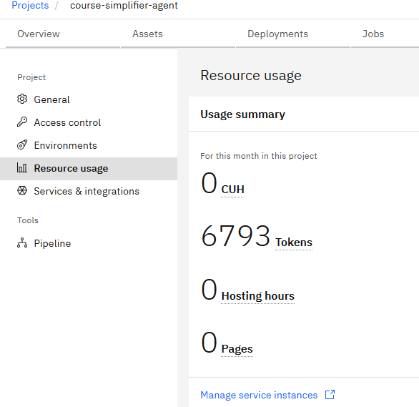
Token Usage
Total 6,793 tokens used after running multiple prompts via the Streamlit app
Before running the app – 634 tokens
After running the app – 6,793 tokens

Slide 11
Novelty and Uniqueness
The proposed Course Content Simplification Agent stands out by making academic content easy to understand for every learner level in one simple chat.
Level-Based Explanations – The same course text is explained differently for Beginner, Intermediate, and Expert learners.
Simple Input – No forms or settings; the learner pastes the text and writes the level below it.
Everyday Analogies – Hard concepts are explained with simple comparisons, e.g. cloud computing like renting a car instead of buying one.
Built with IBM Bob and Python – IBM Bob generated and reviewed the code; Streamlit keeps the UI simple and beginner-friendly with minimal setup.
Powered by IBM Granite – Runs on IBM watsonx.ai with efficient token usage (6,793 tokens in total across all test prompts in this session).
Inclusive Learning – Helps learners with different prior knowledge learn from the same material.
This makes the solution a simple, adaptive, and learner-friendly agent for personalized education.

Slide 12
Git Hub Link
Public GitHub Repository (with README):
https://github.com/nileshyadav2803/course-simplifier-agent
Files uploaded in the repository:
1) app.py 2) requirements.txt 3) .env.example 4) tests/test_app.py 5) README.md 6) problem-statement.pdf 7) project presentation (.pptx)
8) Screenshots: bob-workflow.png, Streamlit-app-beginner-mode.png, Streamlit-app-intermediate-mode.png, before-prompt-token-usage.png, after-prompt-token-usage.png

Slide 13
Future Scope
1. Multiple Language Support –
The agent can explain course content in regional languages such as Hindi and Marathi, so more students can learn in the language they are most comfortable with.
2. File Upload and Practice Questions –
Learners can upload notes or textbook pages directly, and the agent can also create short practice questions after each simplified explanation.

Slide 14
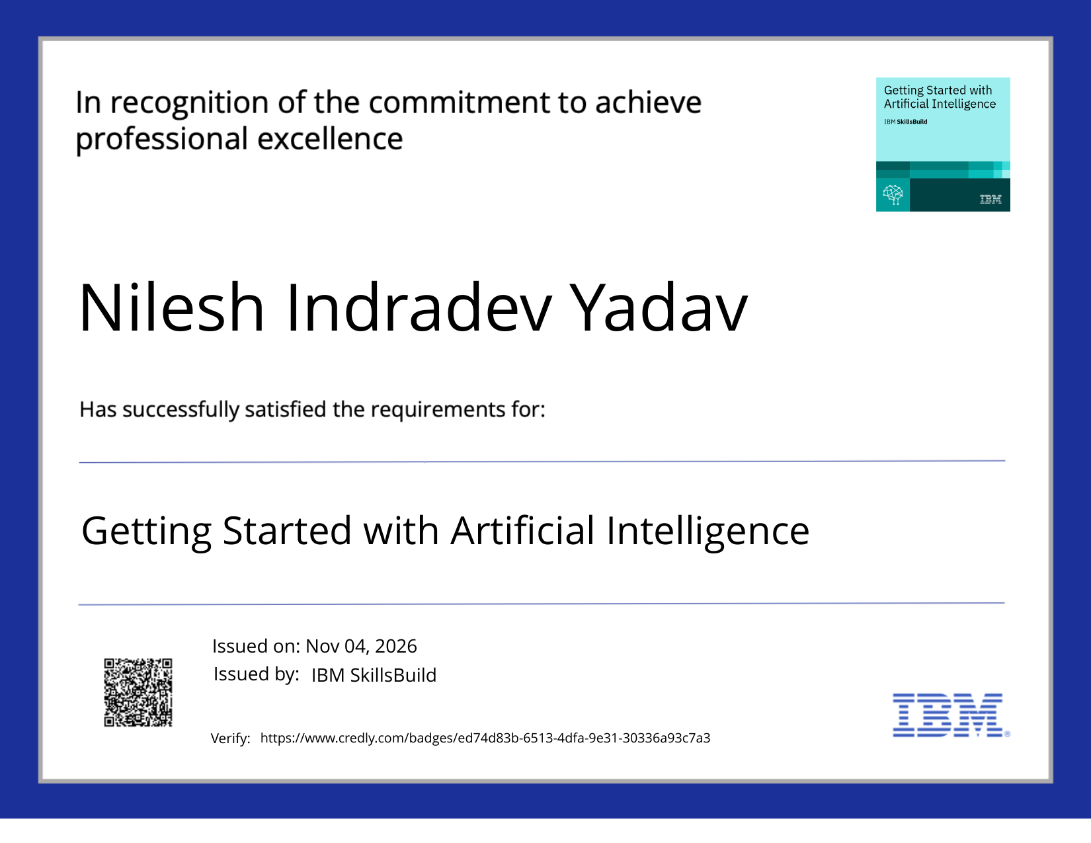
Certificates Earned:
Credly – Getting Started with Artificial Intelligence

Slide 15
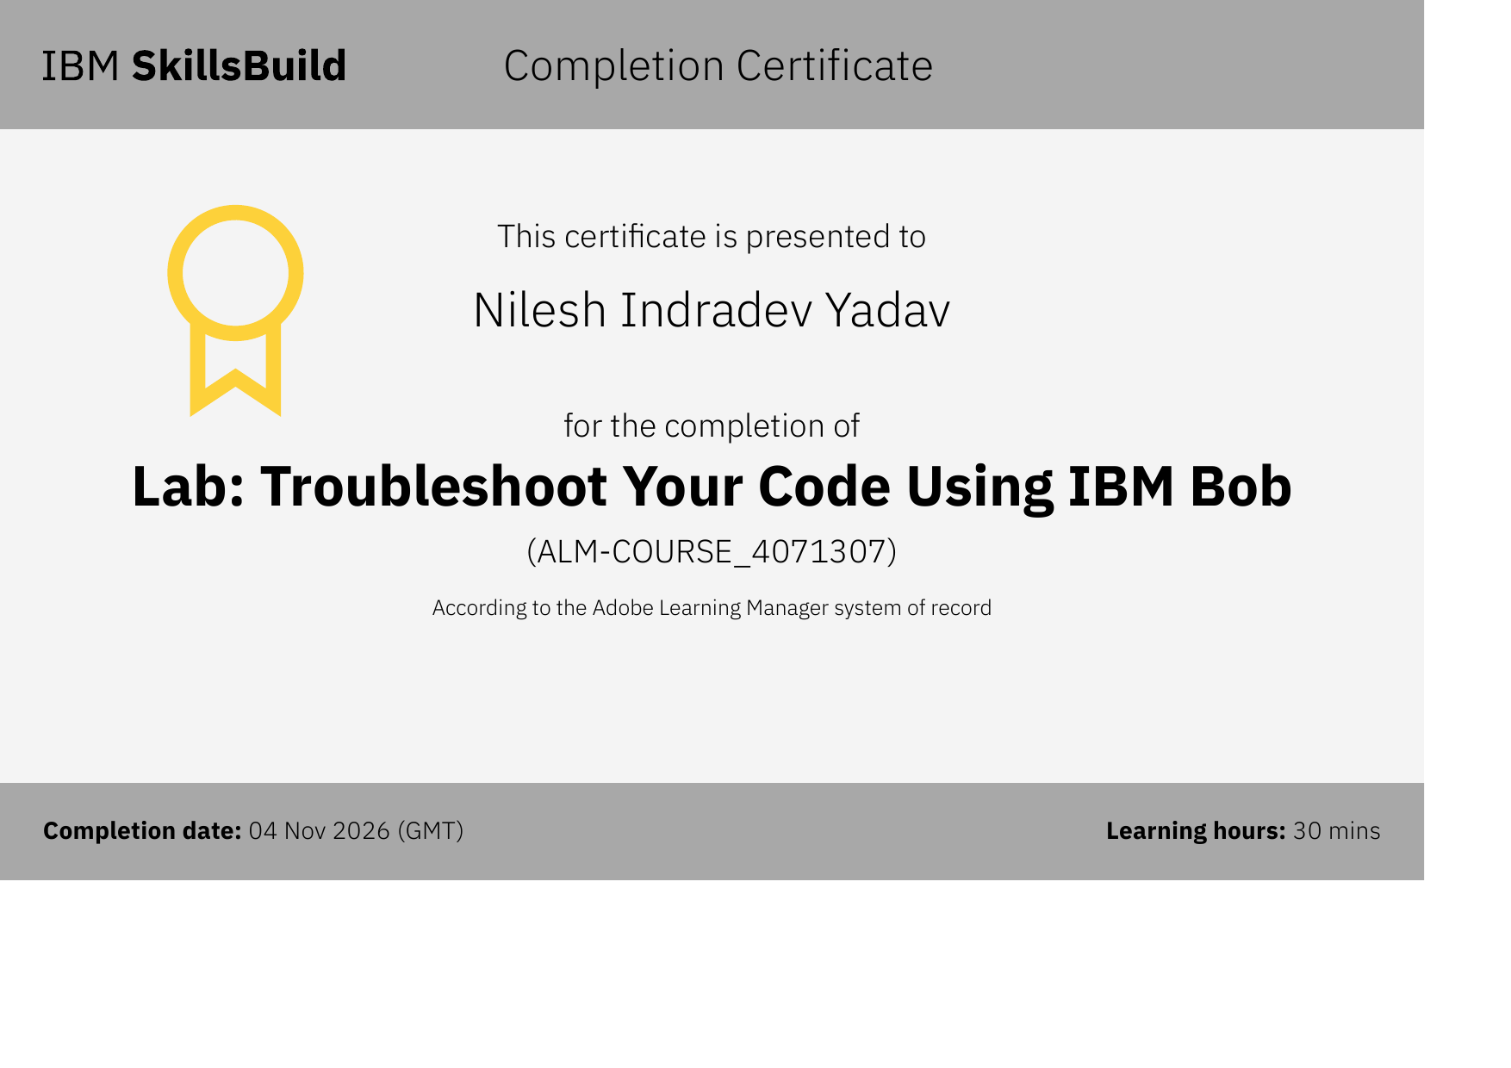
Certificates Earned:​
IBM Bob – Lab: Troubleshoot Your Code Using IBM Bob

Slide 16


