Slide 1
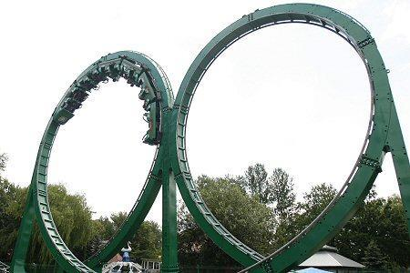
What’s the difference?
For loop
Each block
Same results right?

Slide 2

For Loops vs Each
For loop -
the iterator variable still lives
ugly!
1 other difference…
Gist: http://bit.ly/18TRh3n
Each loop-
iterator doesn't live
cleaner code
has syntactic sugar

