Slide 1

CUSTOM OPERATIONS SYSTEM · PROPOSAL
Built for the
San Francisco Merionettes
One unified platform — replacing SportsEngine, Signal, WhatsApp, fragmented Google Calendars, and scattered email.
PREPARED FOR SFM Board · Eileen Horng (President)
BY Nile Technologies · niletechnologies.com

Slide 2
CURRENT STATE
The operations stack today is fragmented.
SportsEngine
Wix
Google Calendar
Signal
WhatsApp + Email
Billing
Website (new)
Schedules · per coach
Coach ↔ Parents
Misc comms
Clunky · manual
Separate stack
Fragmented
No audit log
Missed messages
What this is costing the club
⚠
No formal attendance
⚠
Fragmented communication
⚠
No master calendar
Coaches mark on paper or memory · absences sent on Signal are never recorded.
Schedule changes spread across Signal, WhatsApp, email — some parents miss it.
Each coach has a personal Google Calendar — multi-child families check 2–3.
⚠
Manual billing
⚠
Data lives on personal phones
Competition fees + merch + dues entered by hand into SportsEngine.
If a coach leaves or breaks a phone, their calendar + parent groups are lost.
Nile Technologies · SF Merionettes Operations System · May 2026
2 / 17

Slide 3
PROPOSED SOLUTION
One platform · three role-tailored interfaces.
ADMIN
COACH
Board · Treasurer · Eileen
Emily · Heidi · Niloo · 13 coaches
Master schedule · billing · members · communications · reports.
SFM
Operations
Platform
One-tap attendance · skill notes · co-coach sync · parent chats.
PARENT
54 families · web on phone
Multi-child schedule · billing · absence requests · skill videos.
Nile Technologies · SF Merionettes Operations System · May 2026
3 / 17

Slide 4
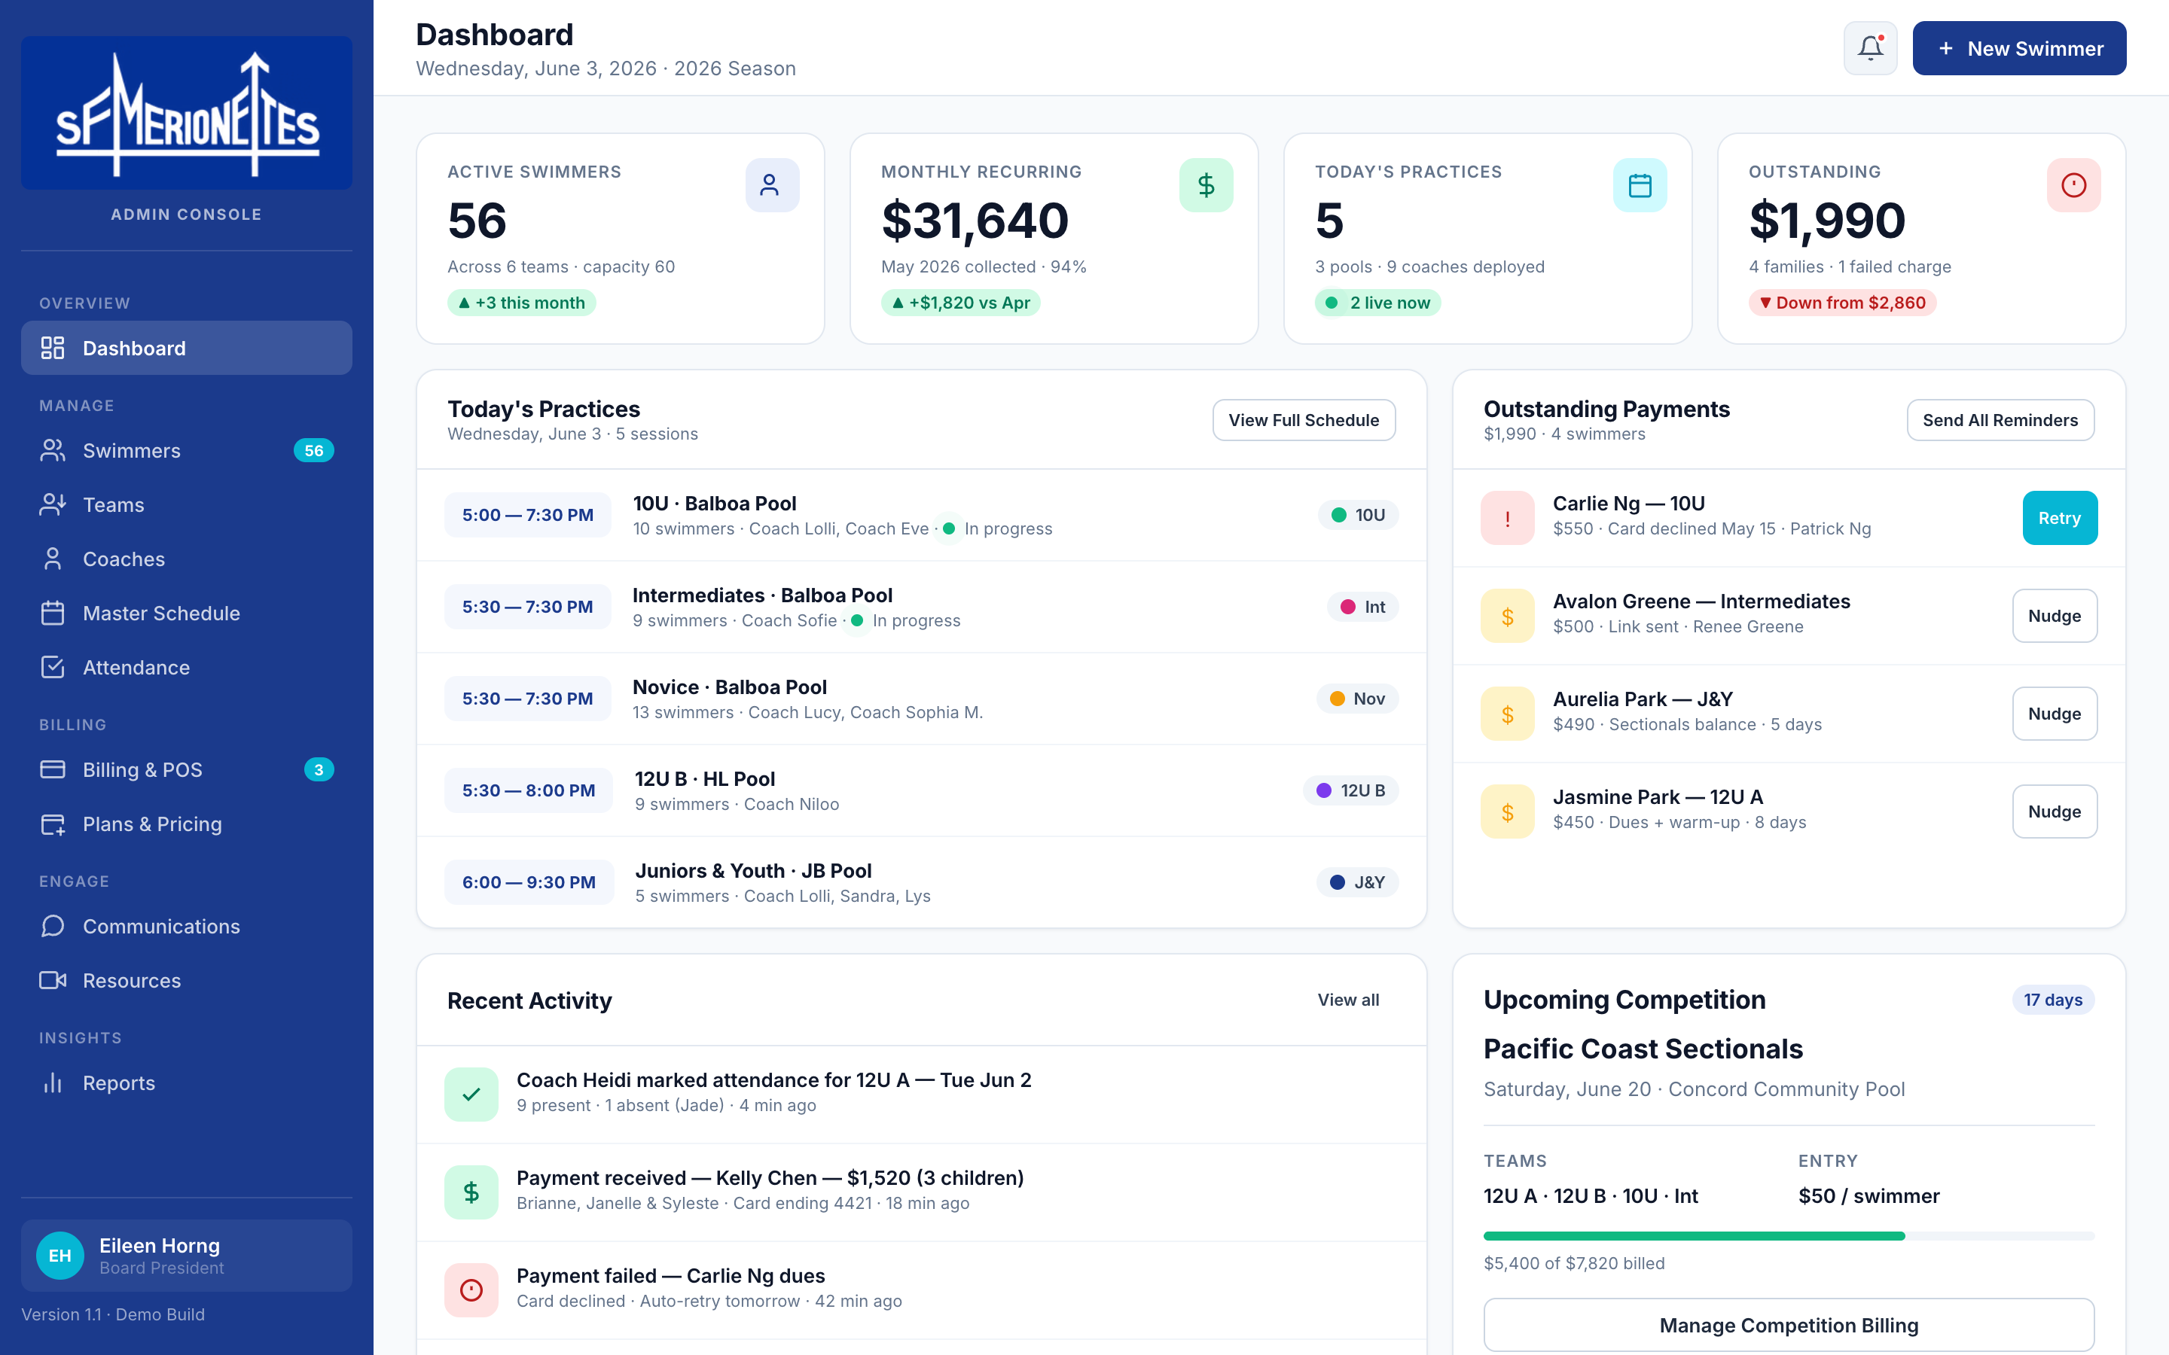
ADMIN CONSOLE · 1 OF 4
Eileen's home base — the entire club on one screen.
KEY FUNCTIONS
Live KPIs
56 swimmers · $31,640 MRR · today's 5 practices · $1,990 outstanding
Today snapshot
Every running session, coach, pool — visible at a glance.
Activity feed
Real-time roll-up of every action across the club.
Outstanding tracker
4 swimmers behind · one-click reminder / retry.
Competition status
Sectionals — fees billed vs. collected.
Nile Technologies · SF Merionettes Operations System · May 2026
4 / 17

Slide 5
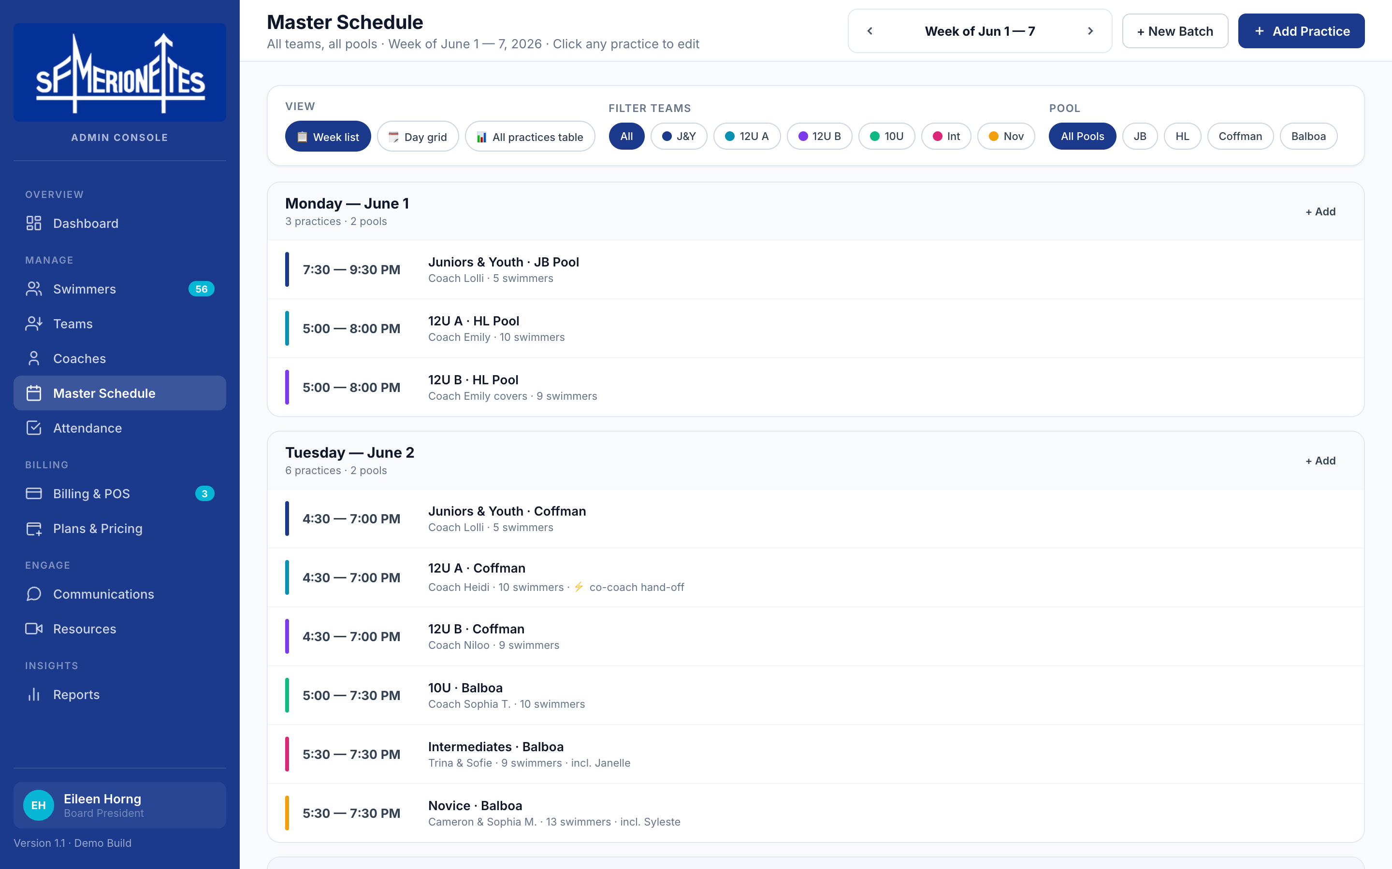
ADMIN CONSOLE · 2 OF 4
Master Schedule replaces every coach's Google Calendar.
SCHEDULE FUNCTIONS
One unified calendar
Mon → Sun · all 6 teams · all 4 pools (JB · HL · Coffman · Balboa).
Click any practice
Edit time, pool, coach · cancel with reason · auto-notify families.
Cancelled sessions
Stay visible with a one-tap Reschedule button.
Add Practice or New Batch
Single class additions vs. structured 4-step new-batch wizard.
Class-specific messages
Each practice has its own parent ↔ coach thread.
Nile Technologies · SF Merionettes Operations System · May 2026
5 / 17

Slide 6
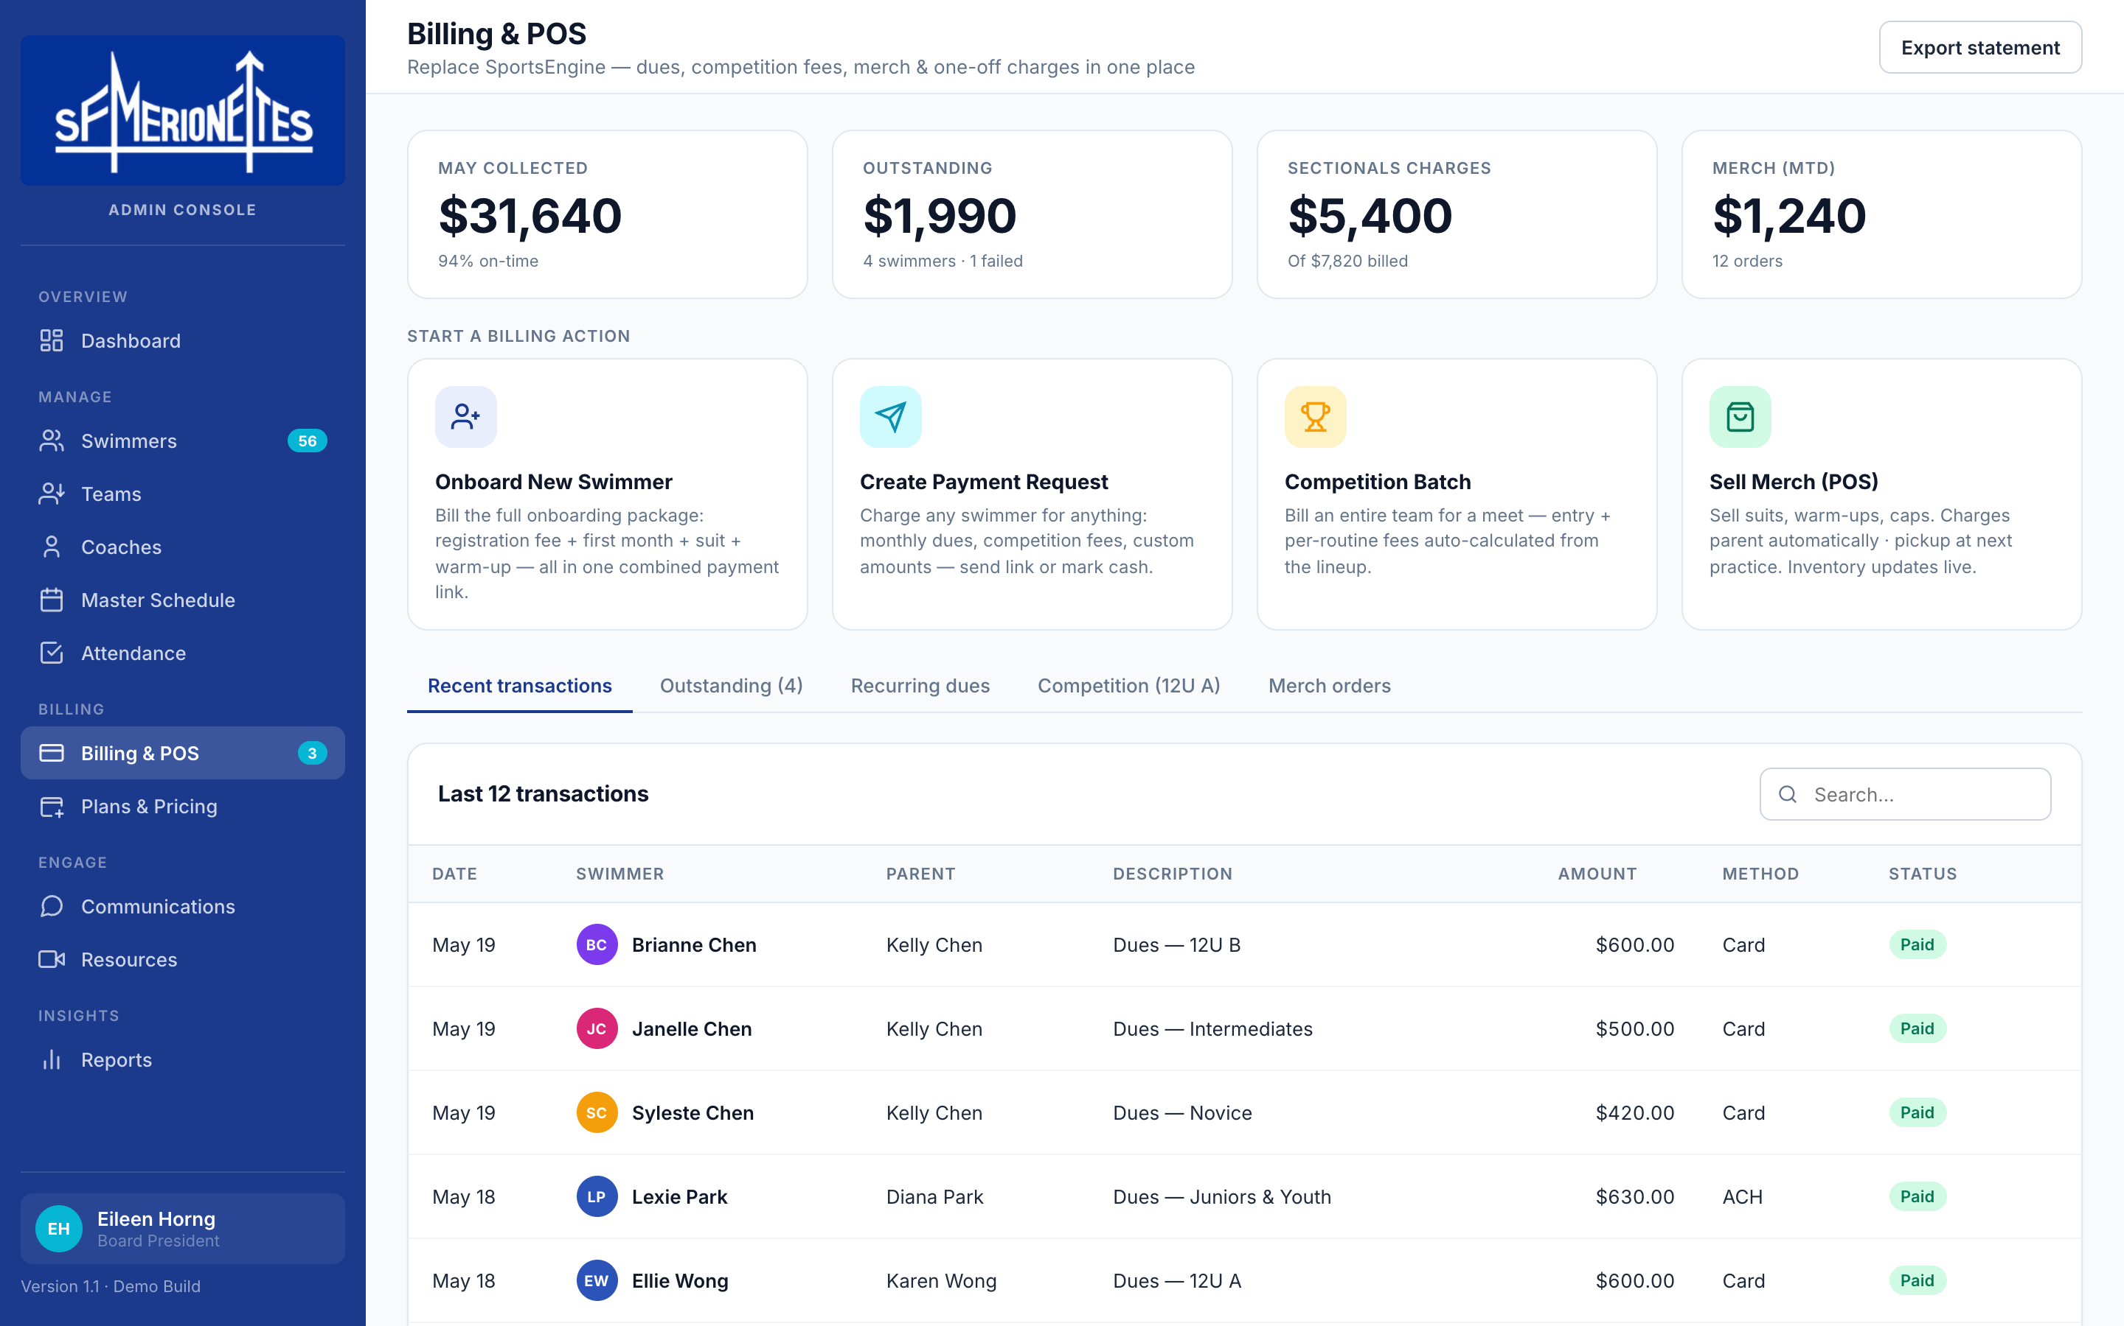
ADMIN CONSOLE · 3 OF 4
Billing & POS — replaces SportsEngine, supports every revenue stream.
BILLING FUNCTIONS
Recurring dues
Auto-bills all 56 swimmers on the 1st — no manual entry.
Competition charges
Entry + per-routine fees auto-calculated by team lineup.
Merch / POS
Sell suits, warm-ups, caps — pickup at next practice.
Onboarding bundle
Combine dues + reg fee + suit into one parent payment link.
Stripe-powered
Cards · ACH · cash · ~1–2% processing only · no platform fee.
Nile Technologies · SF Merionettes Operations System · May 2026
6 / 17

Slide 7
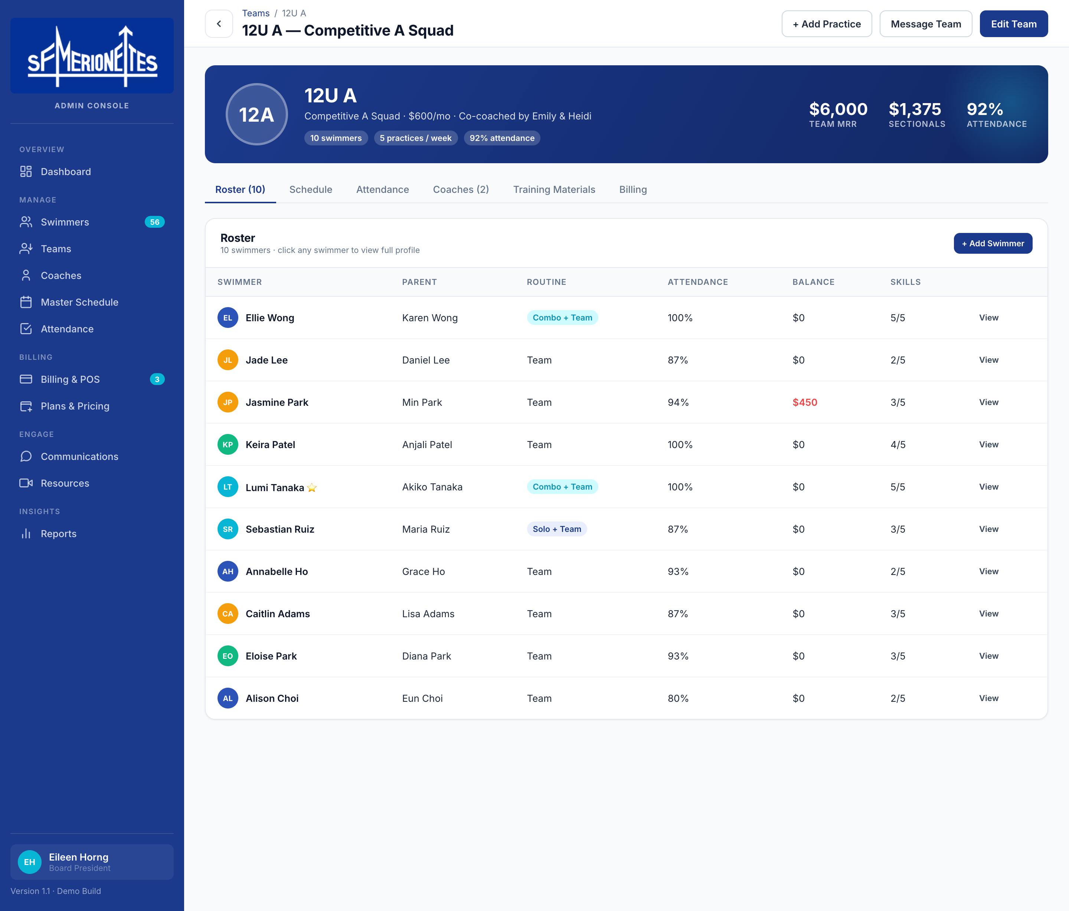
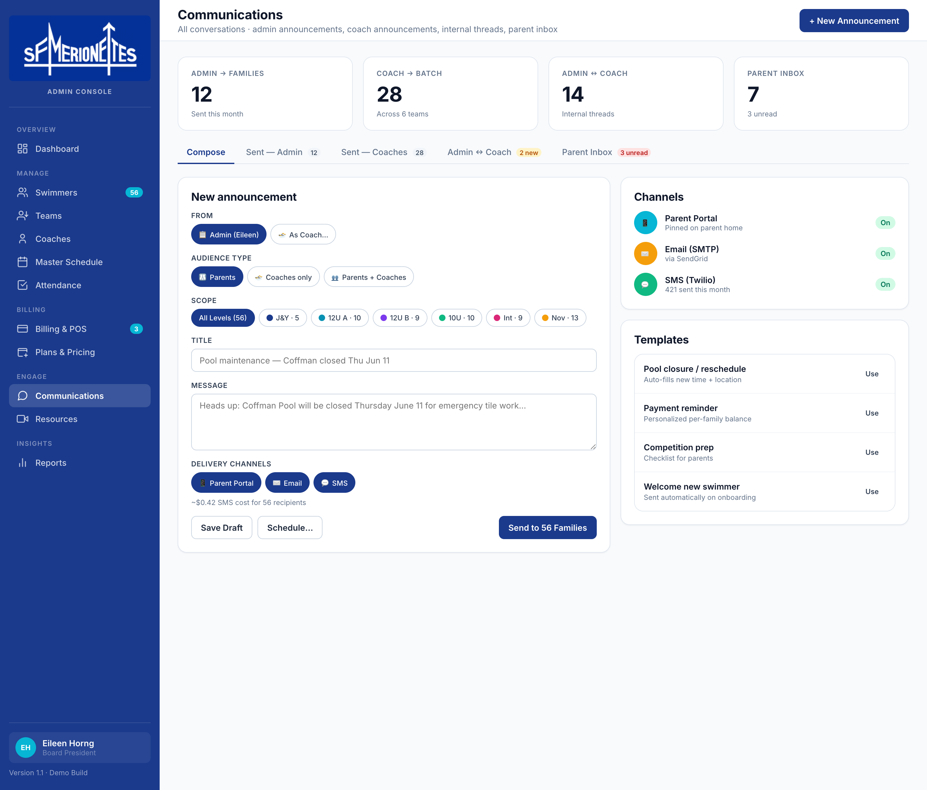
ADMIN CONSOLE · 4 OF 4
Team detail + categorized communications.
Team Detail · 12U A · 6-tab profile
Communications · categorized into 5 streams
Nile Technologies · SF Merionettes Operations System · May 2026
7 / 17

Slide 8
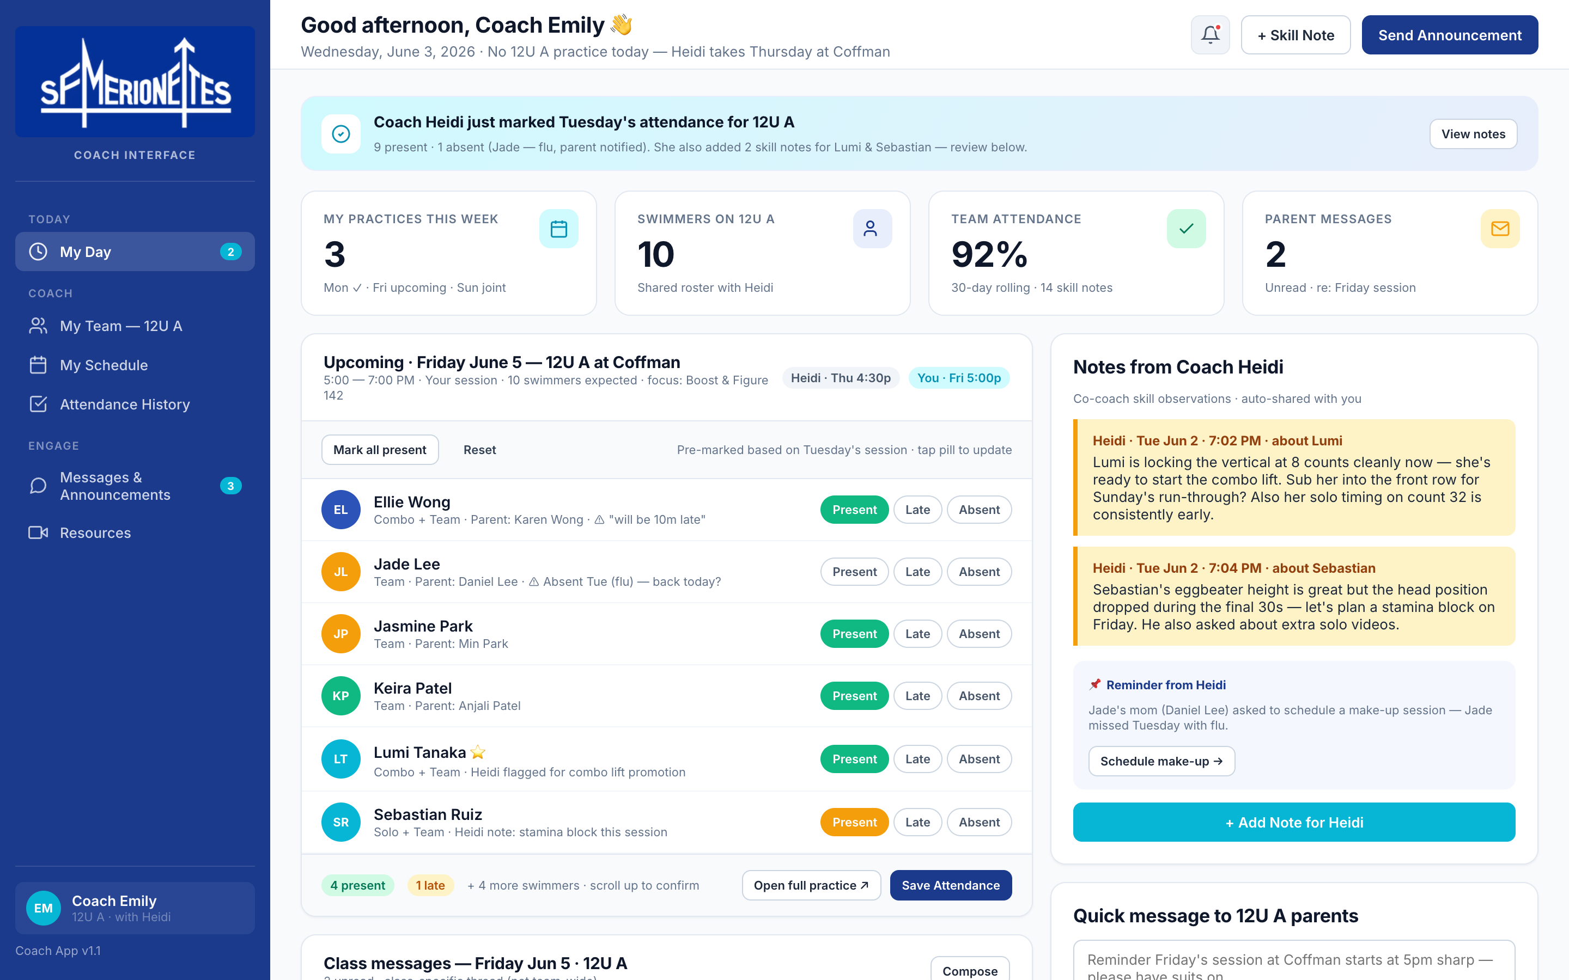
COACH INTERFACE · 1 OF 3
My Day — built around how coaches already co-coach.
COACH · DAILY VIEW
Co-coach sync
Heidi's attendance + notes appear live in Emily's view, and vice-versa.
One-tap attendance
Present / Late / Absent pills · roster pre-loaded for the next session.
Class messages
Parent messages tied to that specific practice show up here.
Quick send
One-tap announcement to that team's 10 families.
Today's other teams
See what every other coach is running across the club.
Nile Technologies · SF Merionettes Operations System · May 2026
8 / 17

Slide 9
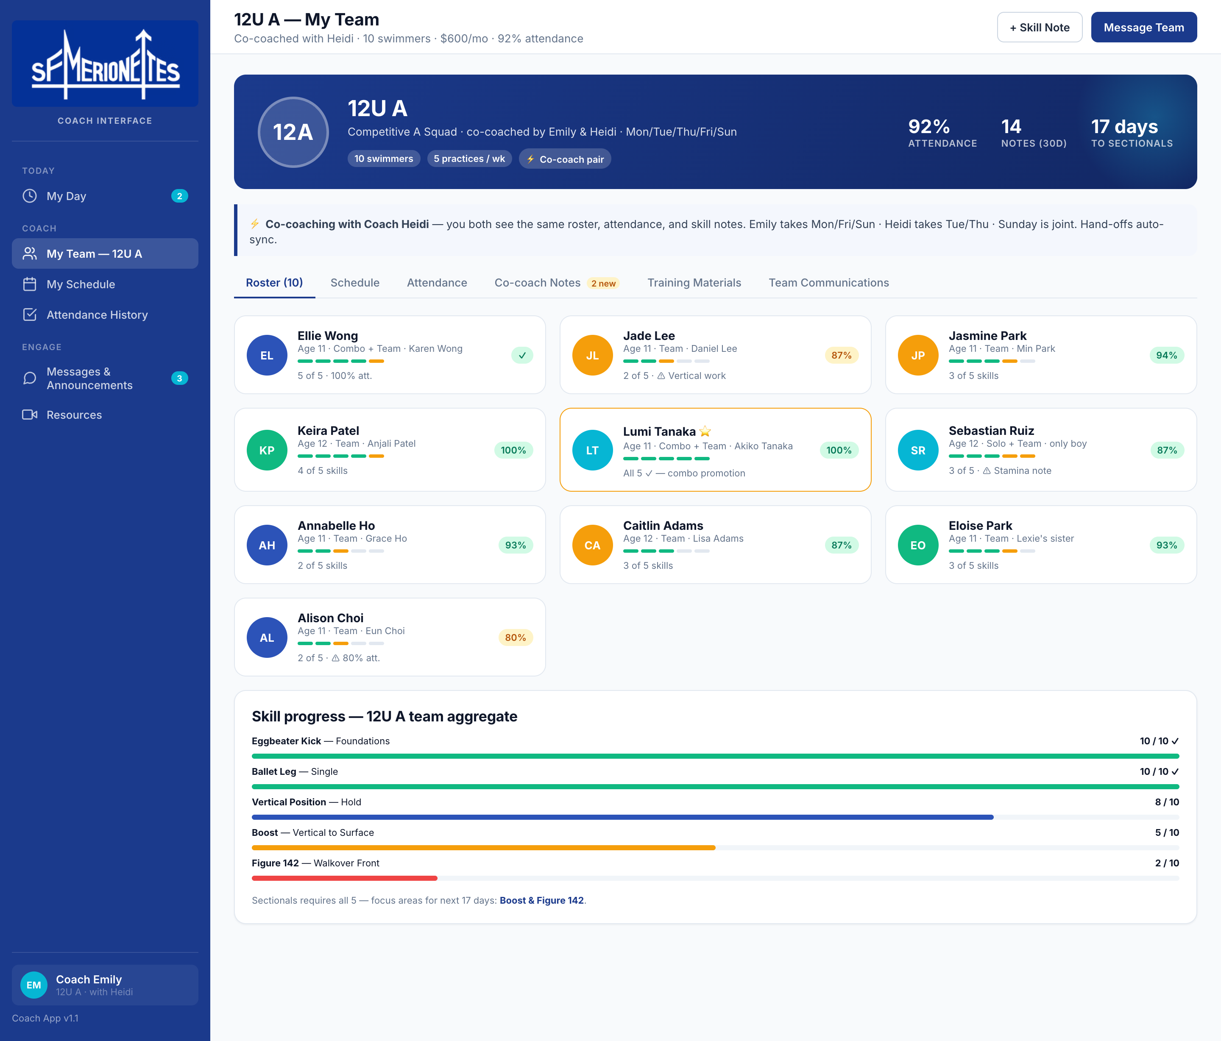
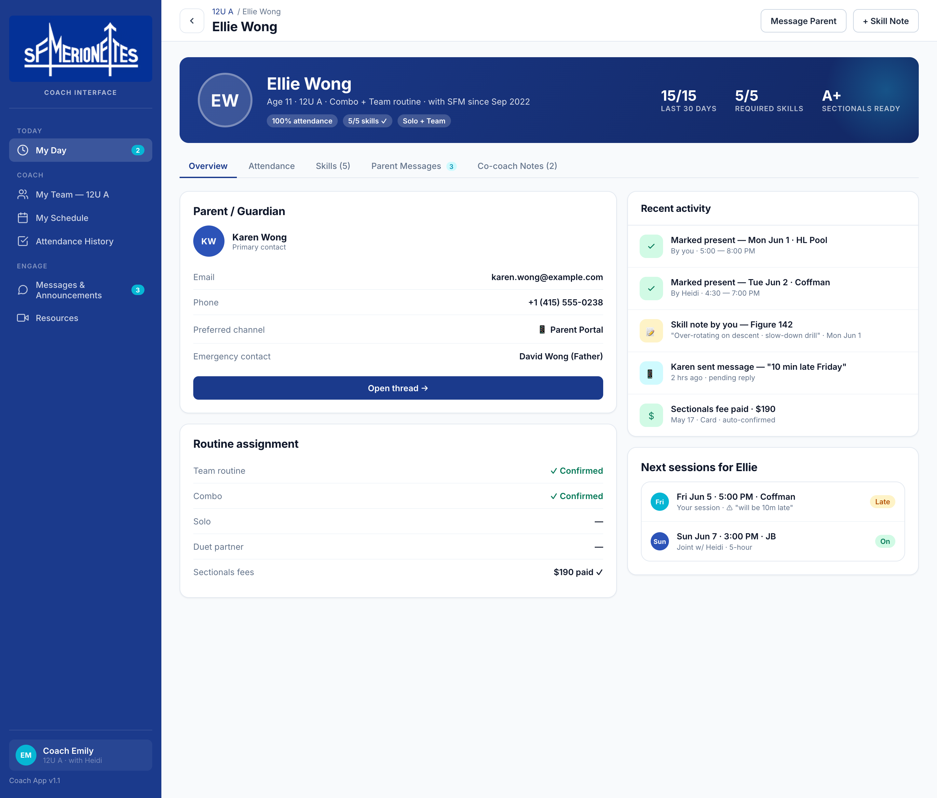
COACH INTERFACE · 2 OF 3
Team roster + per-swimmer skill, attendance & parent messages.
My Team · 12U A roster · skill bars per swimmer
Swimmer Profile · skills · parent thread · co-coach notes
Nile Technologies · SF Merionettes Operations System · May 2026
9 / 17

Slide 10
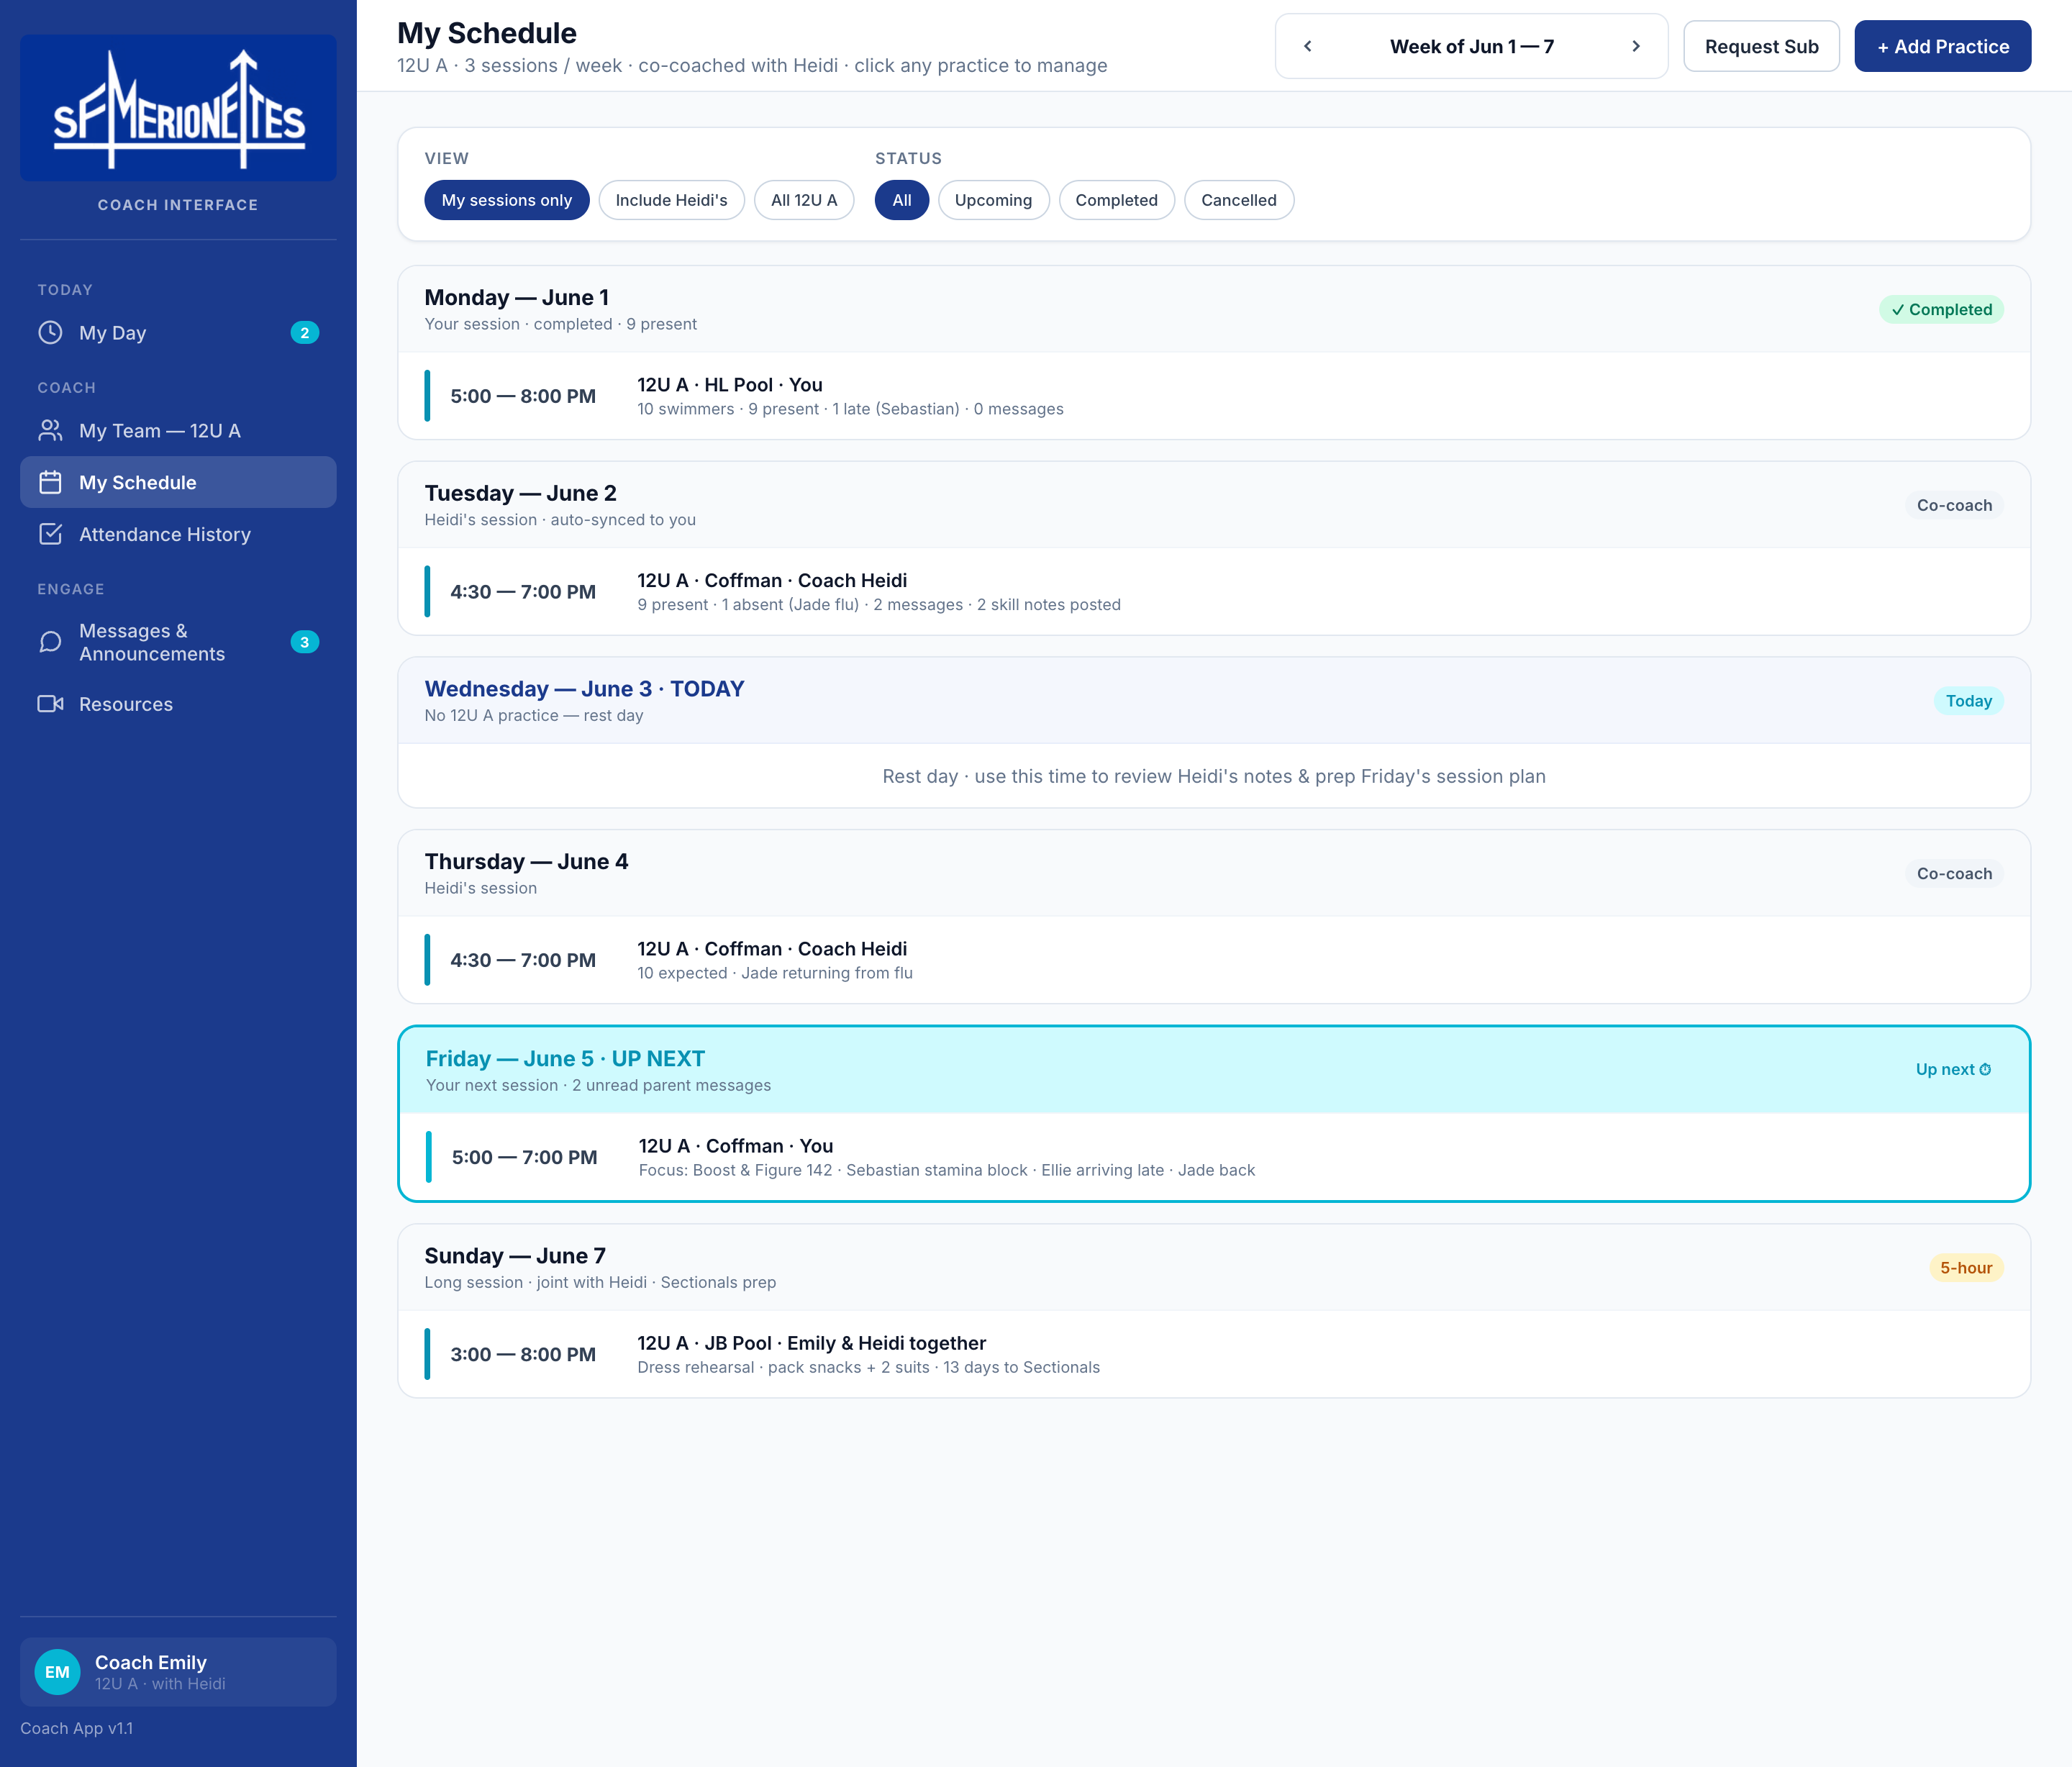
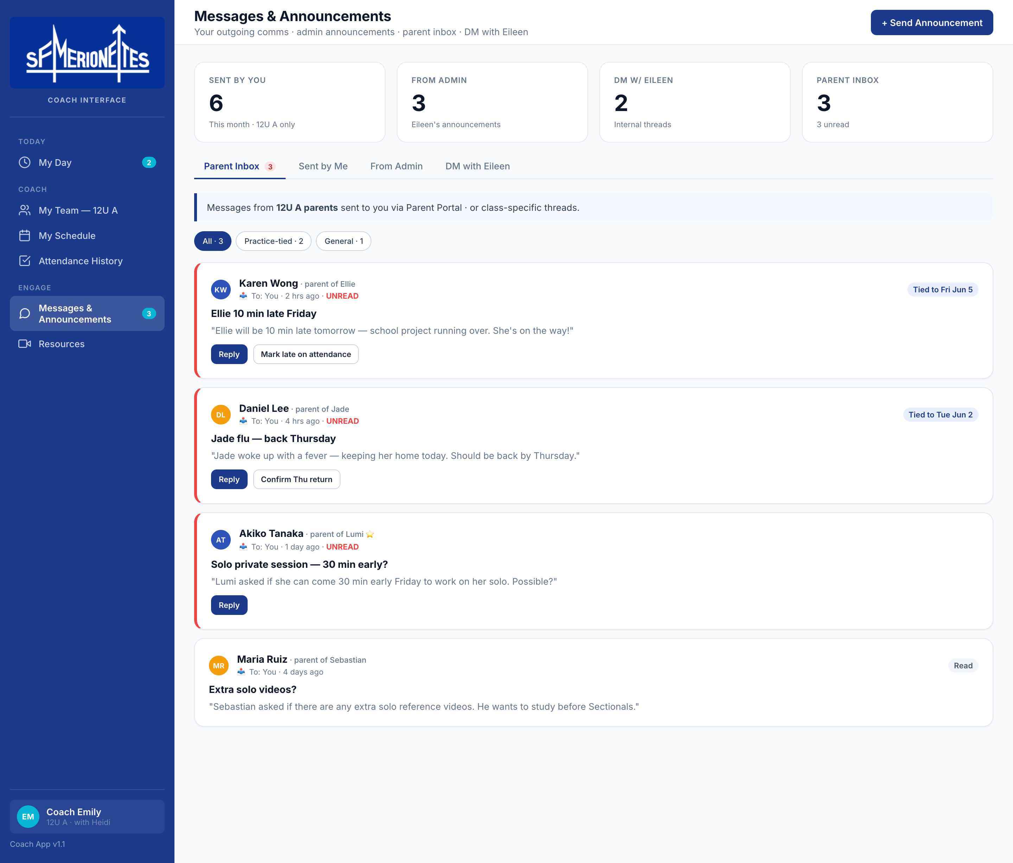
COACH INTERFACE · 3 OF 3
My schedule, parent inbox, and threads with admin.
My Schedule · my sessions vs. co-coach's · cancel + reschedule
Messages · parent inbox · DM with Eileen (Admin)
Nile Technologies · SF Merionettes Operations System · May 2026
10 / 17

Slide 11
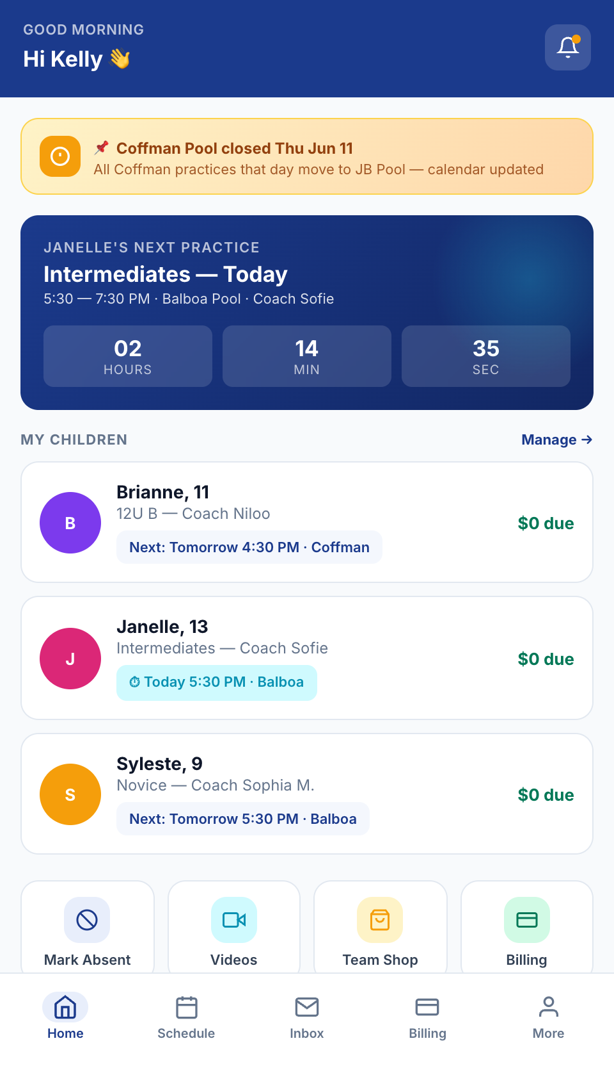
PARENT PORTAL · 1 OF 3
Built for families like Kelly's — 3 daughters, 3 different teams.
ONE LOGIN. ONE UNIFIED SCHEDULE. ONE BILL.
What parents can manage
Family dashboard
Combined schedule
All 3 children on the home screen · countdown to the next practice.
Mon → Sun across all teams · same-pool pickup tips.
One-tap absence
Per-child billing
Replaces the Signal message · coach notified instantly + auto-logged.
One family invoice rolling up Brianne · Janelle · Syleste.
Skill video library
Team shop
Coach assignments + USAAS link · watch on phone.
Order suits, jackets, caps · pickup at next practice.
Nile Technologies · SF Merionettes Operations System · May 2026
11 / 17

Slide 12
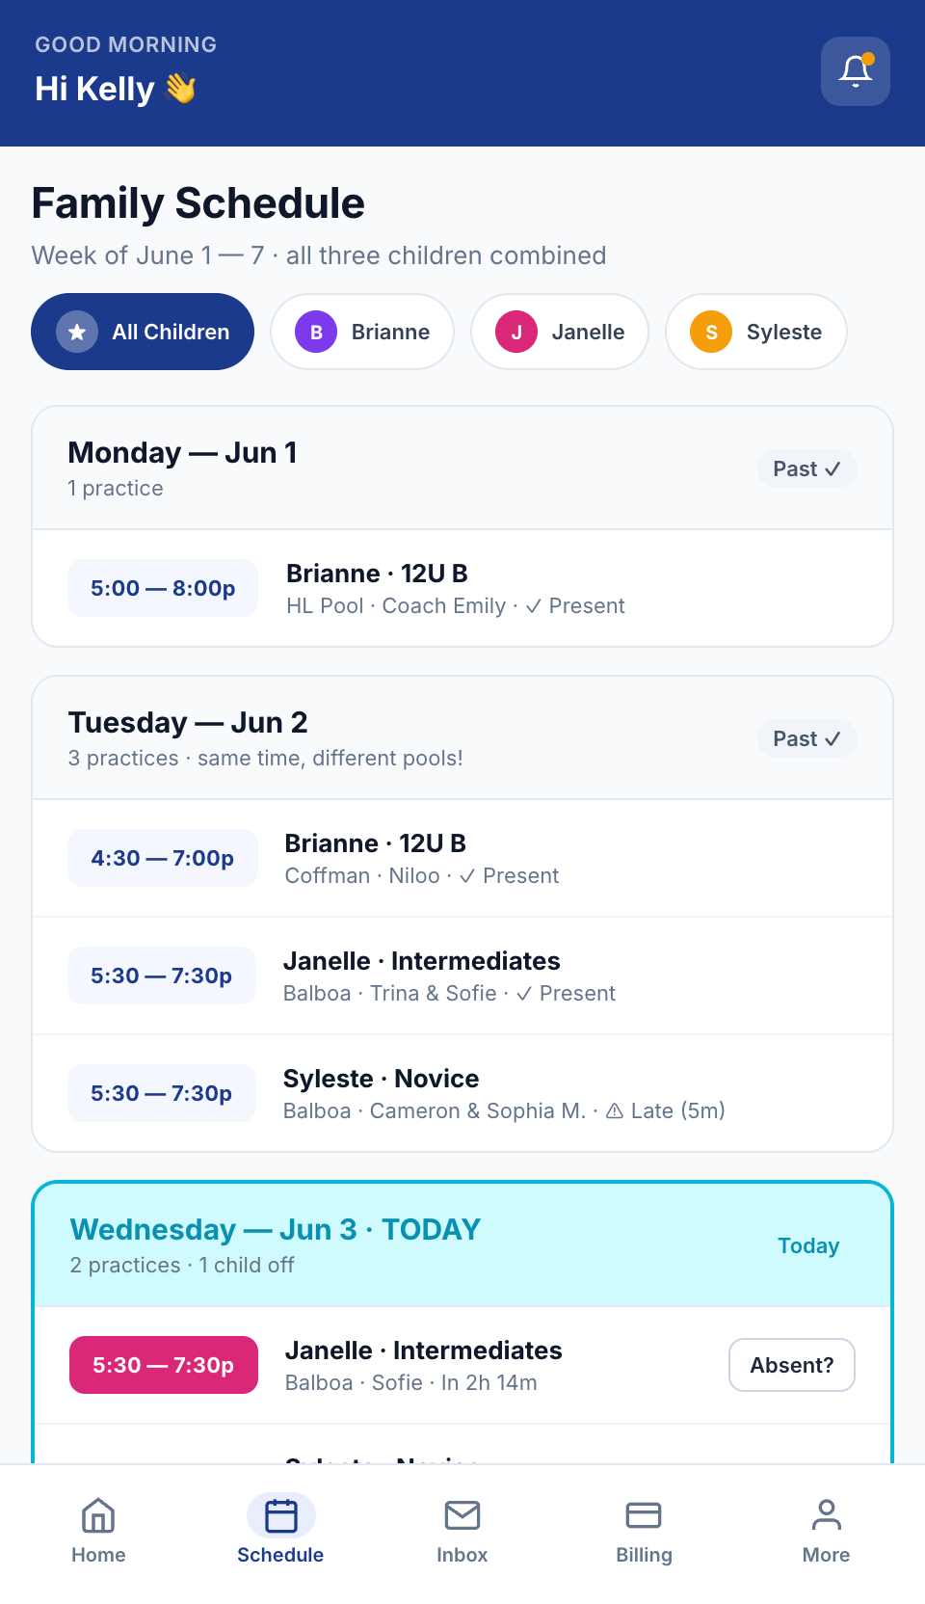
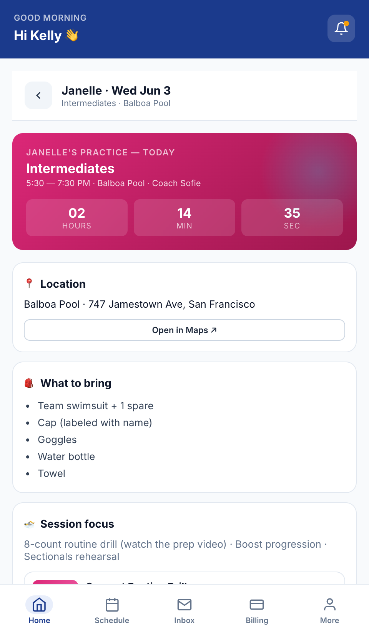
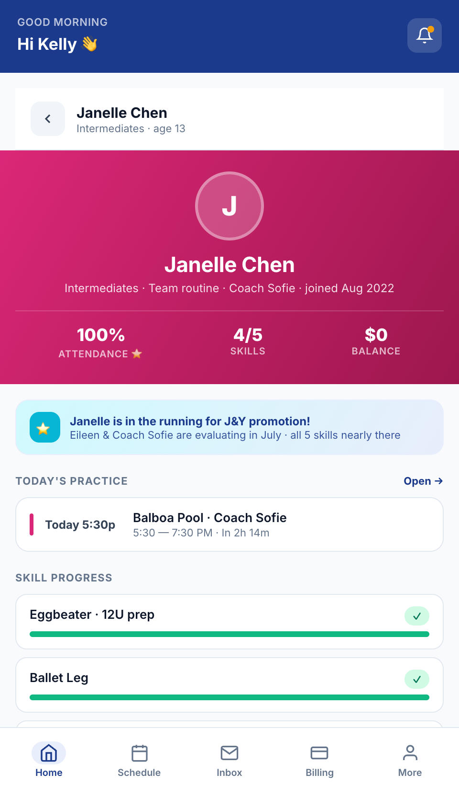
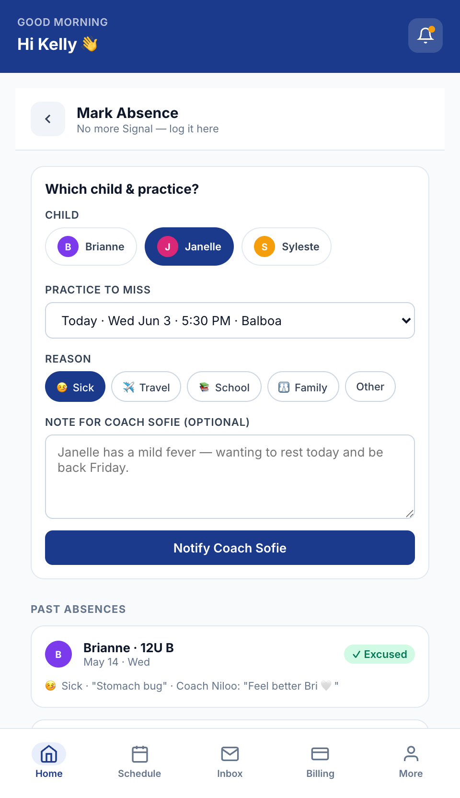
PARENT PORTAL · 2 OF 3
Drill into any practice · message any coach · see every child.
Family schedule
Mon → Sun · all children · filterable
Practice detail
What to bring · per-class messages
Child profile
Attendance · skills · billing · messages
Mark absent
Reason · note · coach notified instantly
Nile Technologies · SF Merionettes Operations System · May 2026
12 / 17

Slide 13
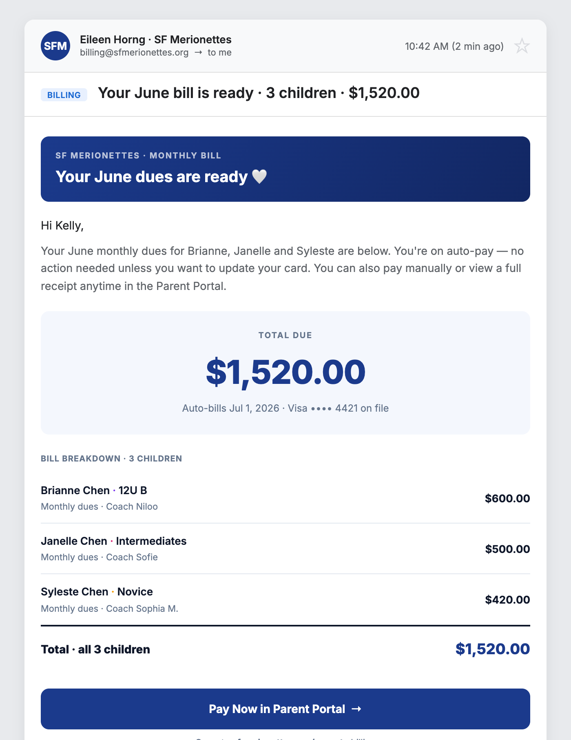
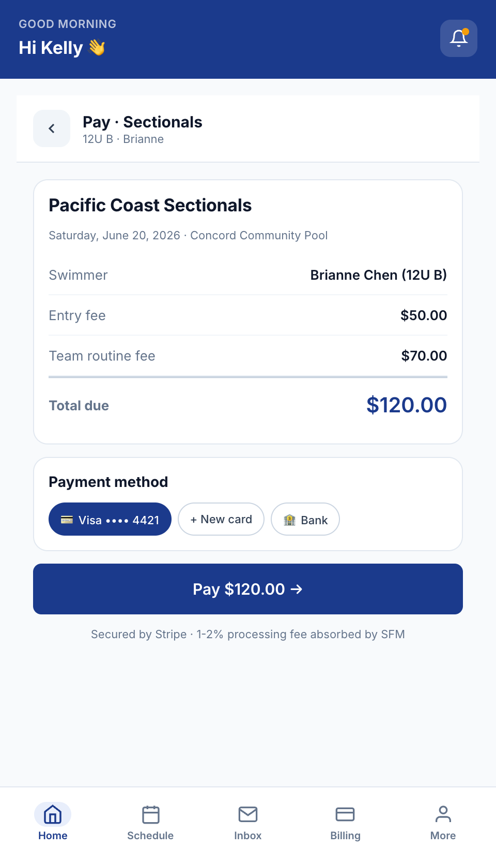
PARENT PORTAL · 3 OF 3
Billing — friendly email + one-tap portal payment.
HOW BILLING WORKS
1. Friendly email
Parents receive a clear, branded email with the bill broken down by child.
2. One-tap pay
PAY
NOW
The "Pay Now" button takes them straight to the Parent Portal · pre-filled.
3. Or pay anytime
Same view is also accessible directly on their phone — Billing tab.
4. Auto-pay default
Card on file auto-charges on the 1st — no action needed each month.
5. Receipts emailed
Portal payment screen
On every successful charge — itemized PDF + confirmation ID.
Monthly billing email · auto-sent
Nile Technologies · SF Merionettes Operations System · May 2026
13 / 17

Slide 14
BUILT FOR YOU · OWNED BY YOU
100% yours, end to end.
A proprietary system built specifically for SFM — and handed over completely on launch day. No subscription. No per-user fees. No revenue share. Ever.
TAILORED
NO REVENUE SHARE
FULL OWNERSHIP
NO LOCK-IN
Built around SFM's workflow
Zero ongoing platform fees
Source code & data are yours
Any developer can maintain it
Designed from scratch using your real team names, levels, schedules, coaches, and competition fee structure. Not a generic template adapted with workarounds.
After handover, the platform costs you nothing to run beyond standard cloud hosting (~$15/mo, your account) and Stripe's 1–2% gateway. We take no cut of dues or competition fees.
On launch day the complete codebase, database, deployment scripts, and brand assets are transferred to SFM. We retain nothing. You own every file.
Built on open-source standards (HTML · CSS · JavaScript · Node · PostgreSQL). Any developer who codes can read it, modify it, or host it elsewhere — without us.
Nile Technologies · SF Merionettes Operations System · May 2026
14 / 17

Slide 15
INVESTMENT OVERVIEW
One-time. Staggered. No surprises.
TOTAL INVESTMENT
STAGGERED PAYMENT SCHEDULE
$10,000 – $12,000
Four payments over the 3-month build
25%
Deposit
Project kickoff · scope locked
25%
Month 1
One-time. Final figure depends on scope-of-work confirmation.
Design + Admin Console core
WHAT'S INCLUDED
25%
Month 2
Three role interfaces — Admin · Coach · Parent
Stripe + Twilio integrations
Hosting setup on your cloud
Full source code + brand handover
3-month build · 60-day post-launch support
Coach + Parent Portal
25%
Month 3 · Launch
Final delivery + handover + training
Nile Technologies · SF Merionettes Operations System · May 2026
15 / 17

Slide 16
ABOUT US
Nile Technologies — 15 years building software.
A development partner you can rely on
THREE PRACTICE AREAS
Founded in 2011 by an ex-Oracle Senior Director, Nile started as an enterprise Oracle implementation partner. In 2016 we expanded into custom web & mobile development for small and mid-sized businesses worldwide. Today we're a 100-person team based in New Delhi — with the same founder-led care we started with.
Enterprise
1
Oracle implementation for large corporates (our origin practice).
2
Web & Mobile
Custom apps for SMBs, NGOs, startups — SFM falls here.
2011
100+
15 yrs
3
3
AI
Founded
Team in Delhi
Software dev
Business domains
Custom AI agents, chatbots, and assistants for businesses.
niletechnologies.com
Nile Technologies · SF Merionettes Operations System · May 2026
16 / 17

Slide 17
RELEVANT EXPERIENCE
We've built systems just like this — for clubs and schools.
YOUTH SPORTS · MARTIAL ARTS
APPOINTMENT-BASED FITNESS
MEMBERSHIP-BASED FITNESS
Shaolin Kung Fu Institute
Royal Personal Training
Member Gym Operations
1,000 students · 5 locations
Boutique studio · class packs
Recurring memberships
Multi-tier admin (master + per-location) · attendance · billing · skill tracking · parent portal. Closest to SFM in workflow.
Booking-based ops · client packs of 16/20 classes · POS · CRM with auto-renewal nudges for at-risk clients.
Schedules · batches · trainer assignment · POS for plan sales · attendance · inventory for retail merch — same DNA as SFM.
NEXT STEPS
Board approval → signed scope-of-work → 25% deposit → kickoff. Launch in Aug 2026 — ready for the fall season.
Aaditya Kapoor · Sanju Kapoor · niletechnologies.com

