Slide 1
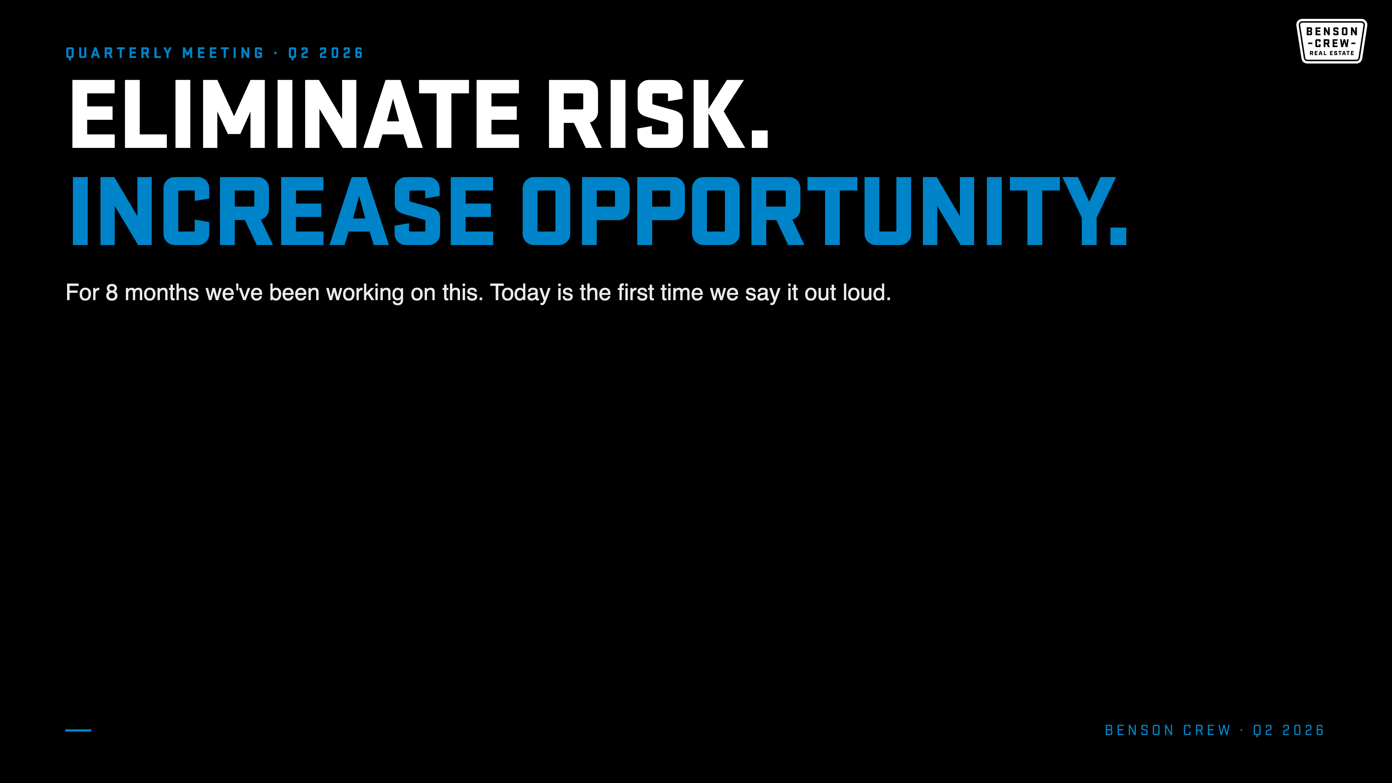
Notes:
Slide 1 · THESIS (0:00 to 0:45)
Open heavy. Let the words land.
"Four words."
[pause]
"Eliminate Risk. Increase Opportunity."
"For 8 months we've been building this team around those four words. Every investment we make. Every hire. Every tool. Every piece of training. Every system we ship. All of it rolls up to this."
"And today is the first time I'm saying it out loud to you."
"For the next 10 minutes I want to walk through what that actually means. For this team. For every one of you. And what we're doing next to make it sharper."

Slide 2
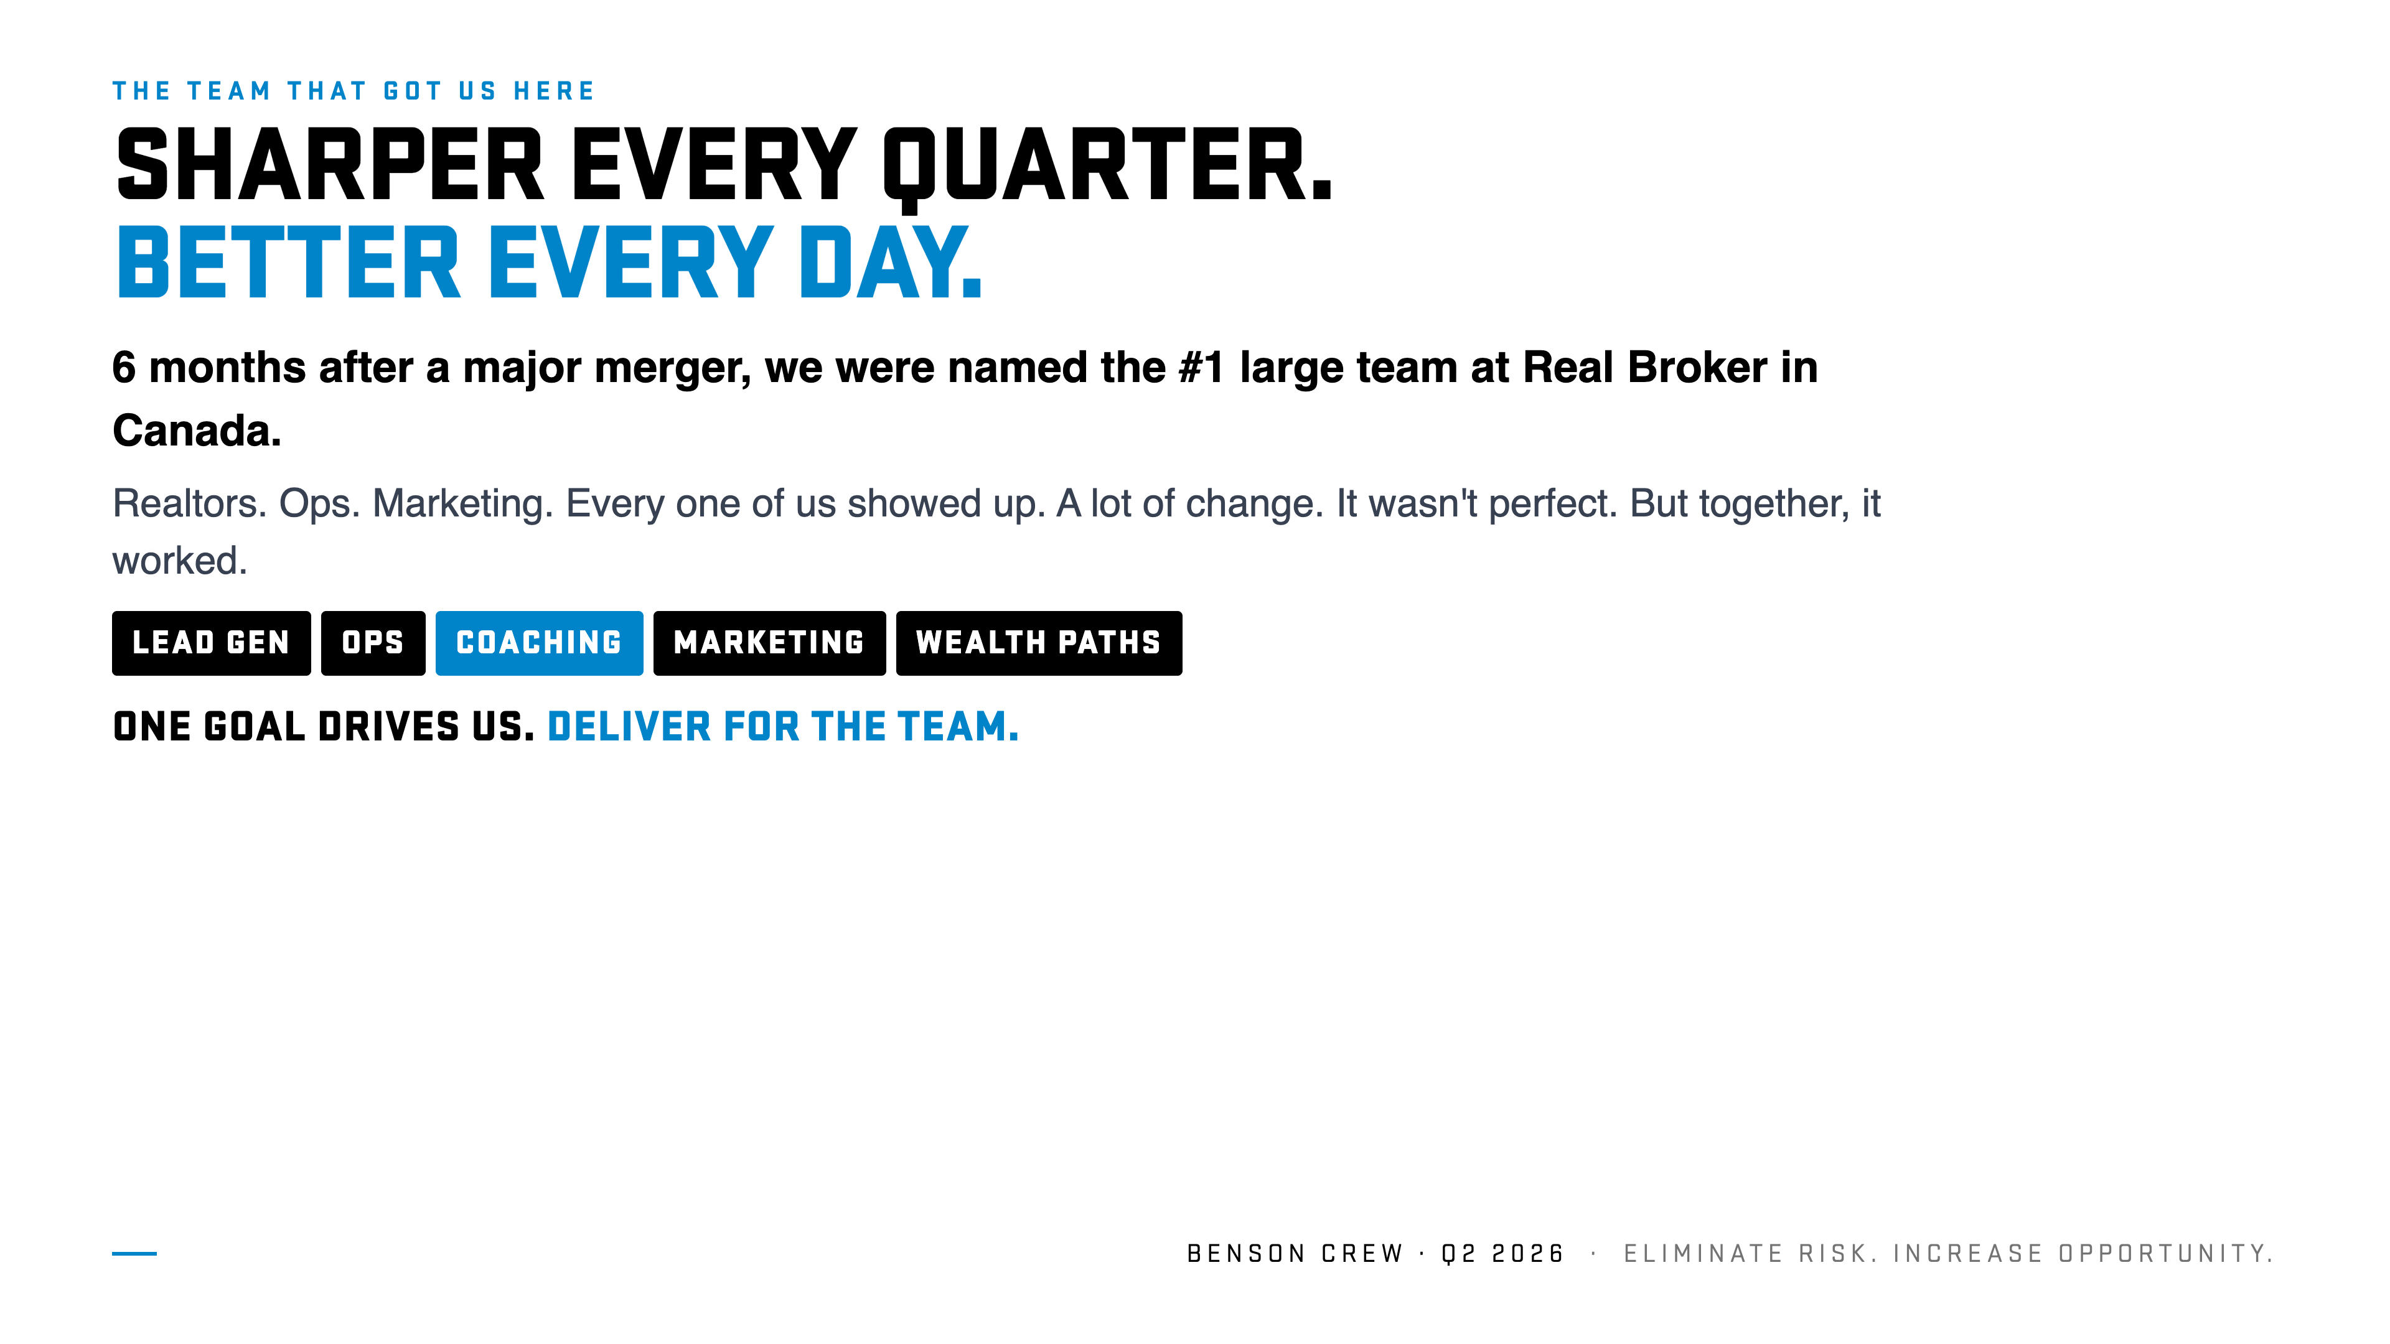
Notes:
Slide 2 · SHARPER EVERY QUARTER (0:45 to 2:15)
Open with recognition. Slow. Genuine.
"Before we get into what's next I want to take a second."
"Last quarter we were named the number one large team at Real Broker in Canada. 6 months. 6 months from a major merger to number one in the country."
"I want to recognize every single person who made that happen. The Realtors out there closing deals and taking care of clients. The Ops team keeping the engine running. Marketing building the brand that opens doors before we walk through them."
"Every one of you showed up. Through a lot of change. It wasn't perfect. Not at all. But together, it worked."
"And there's one goal that drives everything we do from here. Sharper every quarter. Better every day. Delivering for this team."
"Lead Gen. Ops. Coaching. Marketing. Wealth Paths. That's what gets sharper every quarter. That's what delivers for the team."

Slide 3
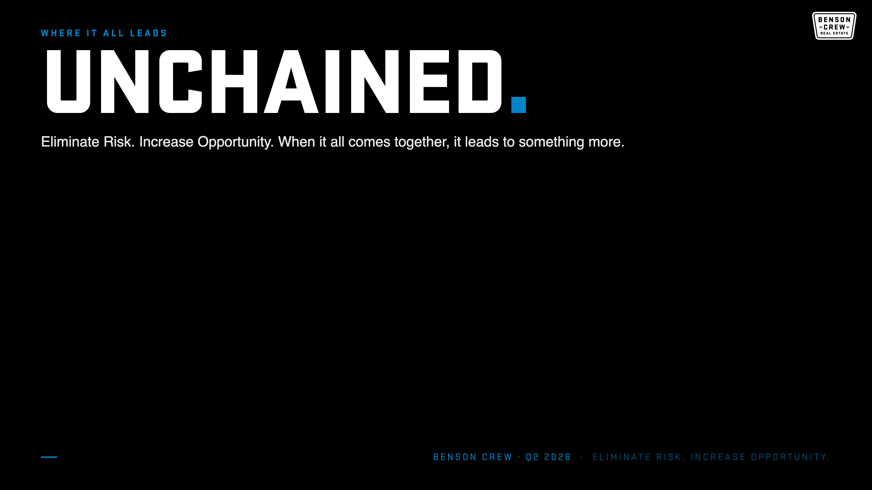
Notes:
Slide 3 · UNCHAINED (2:15 to 3:30)
Cause and effect. Personal pronouns.
"Eliminate Risk. Increase Opportunity."
[pause]
"When it all comes together, it leads to something more. It leads to becoming unchained."
"Unchained from admin. From compliance. From having to do everything yourself. Free to do the work only a great agent can do. Free to show up for the life you built this career for."
"That's what drives us every single day. Eliminate your risk. Increase your opportunity. Unchain you from the work that pulls you away from what moves the needle. Your time is yours. More growth. More family. More hobbies. More of the life you're building."

Slide 4
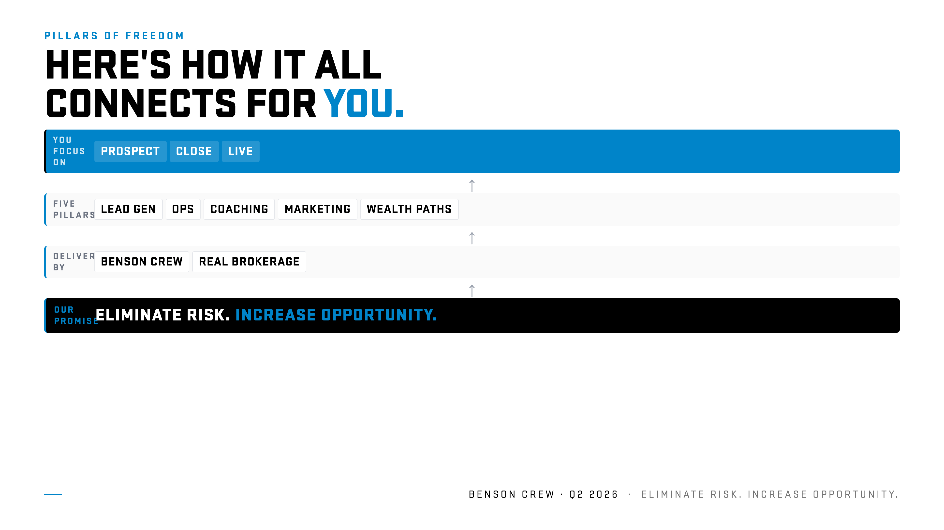
Notes:
Slide 4 · THE STACK (3:30 to 4:45)
Walk the stack bottom up.
"Here's how it all comes together. Read it from the bottom up."
"The promise. Every decision we make rolls up to four words. Eliminate Risk. Increase Opportunity."
"Delivered by two foundations. Benson Crew is the execution engine. Real Brokerage is the platform of possibility that powers us to do our business and drive new financial opportunities. Two pillars of freedom behind every move you make."
"Which gives you five pillars of support. Lead Gen. Ops. Coaching. Marketing. Wealth Paths. That's what Eliminate Risk and Increase Opportunity looks like when it's put to work for you."
"Which leaves you free to focus on the three things that matter."
[pause]
"Prospect. Close. Live."

Slide 5
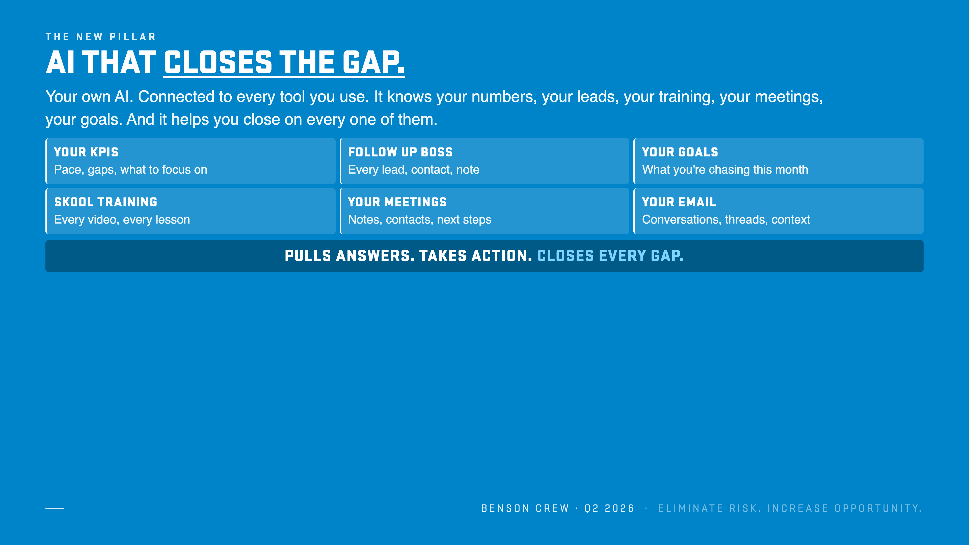
Notes:
Slide 5 · AI CLOSES THE GAP (4:45 to 7:00)
Magic slide. Slow down. Energy up.
"Here's the next pillar we're working on tirelessly right now. The AI pillar."
"Imagine this. Your own AI. And it knows every one of your numbers. Every lead in Follow Up Boss. Every training video in Skool. Every meeting you take. Every email thread. Every goal you set."
"Now imagine it's always running. Always looking ahead. Always asking the same question. Where is this agent's gap and how do I help them close it."
"That's what we're building. Your own AI. Connected to the tools we already use. It pulls up what you need, when you need it. It takes action in those tools for you. It closes gaps. And it helps you surpass your goals."
"Lead going cold? It nudges you. Deal has a problem? It flags it. Pace slipping? It surfaces strategies to close the gap. Helps you execute. Holds you accountable. Walking into a listing presentation? It preps the brief before you get there."
"You ask it anything, anytime. Phone, dashboard, Telegram. Wherever you work, AI works with you."

Slide 6
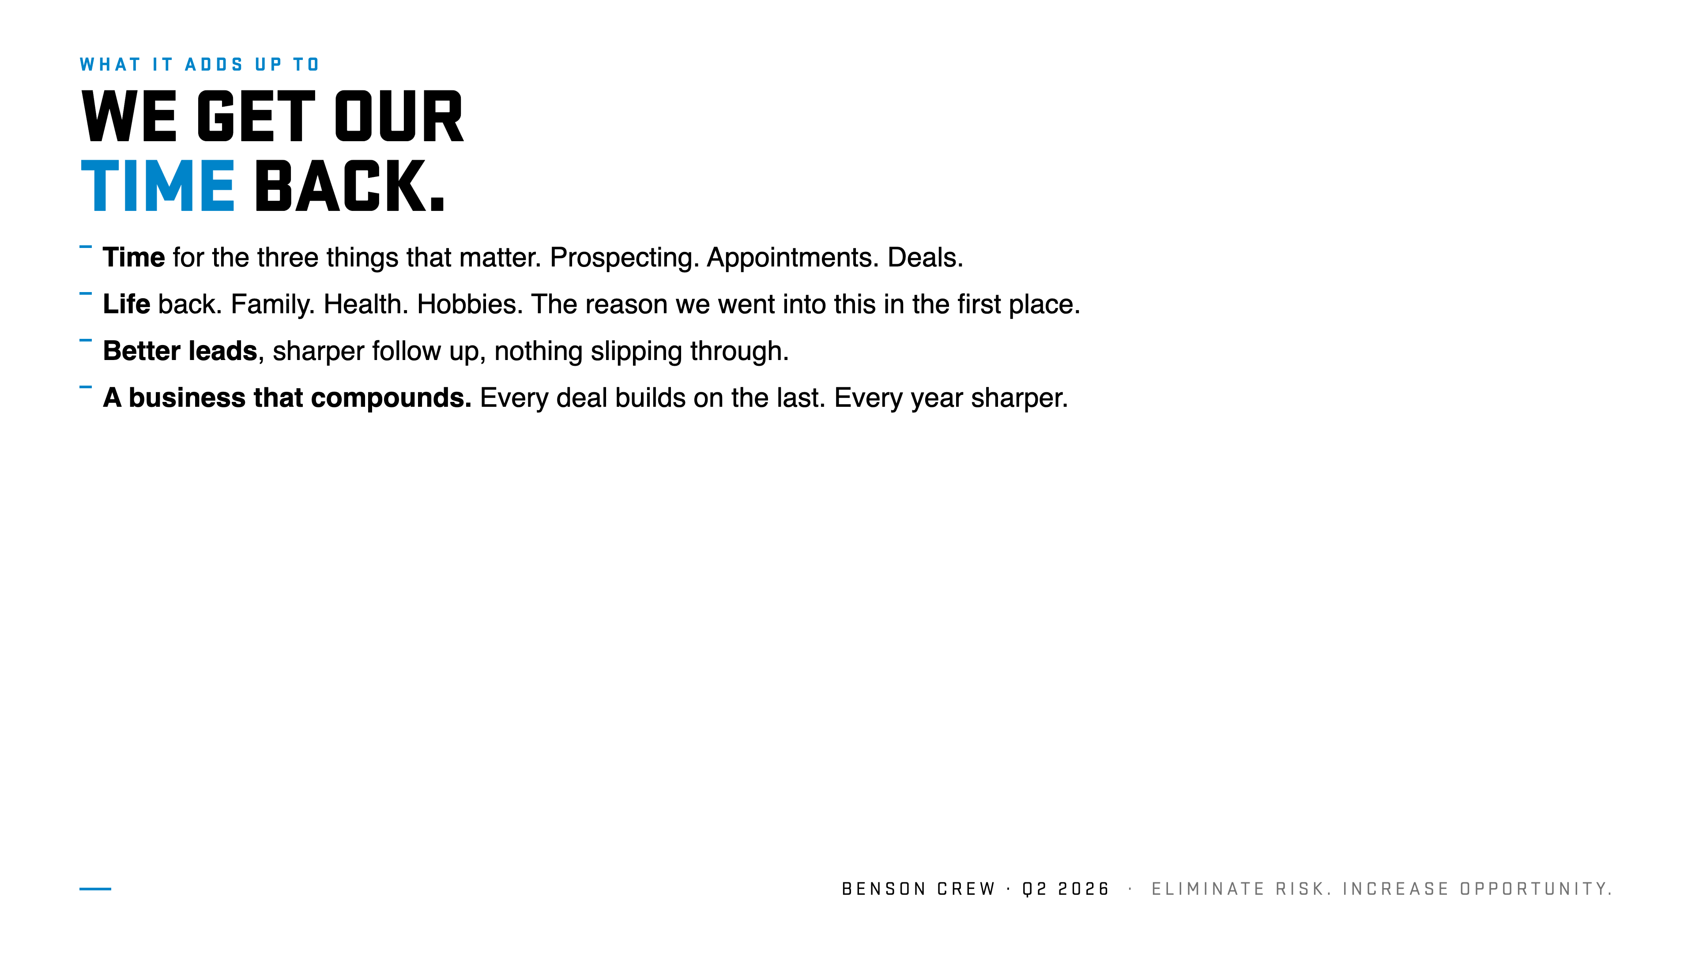
Notes:
Slide 6 · WHAT IT ADDS UP TO (7:00 to 8:30)
Personal. One team. First person plural. About selling homes.
"Stack it all together. What does it mean for us?"
"Time. Time for the three things that grow a business. And time for the reason we went into this in the first place. Family. Health. Hobbies. A life that isn't all work."
"Better leads. Sharper follow up. Cleaner numbers. A business that builds on itself. Every year sharper than the last."

Slide 7
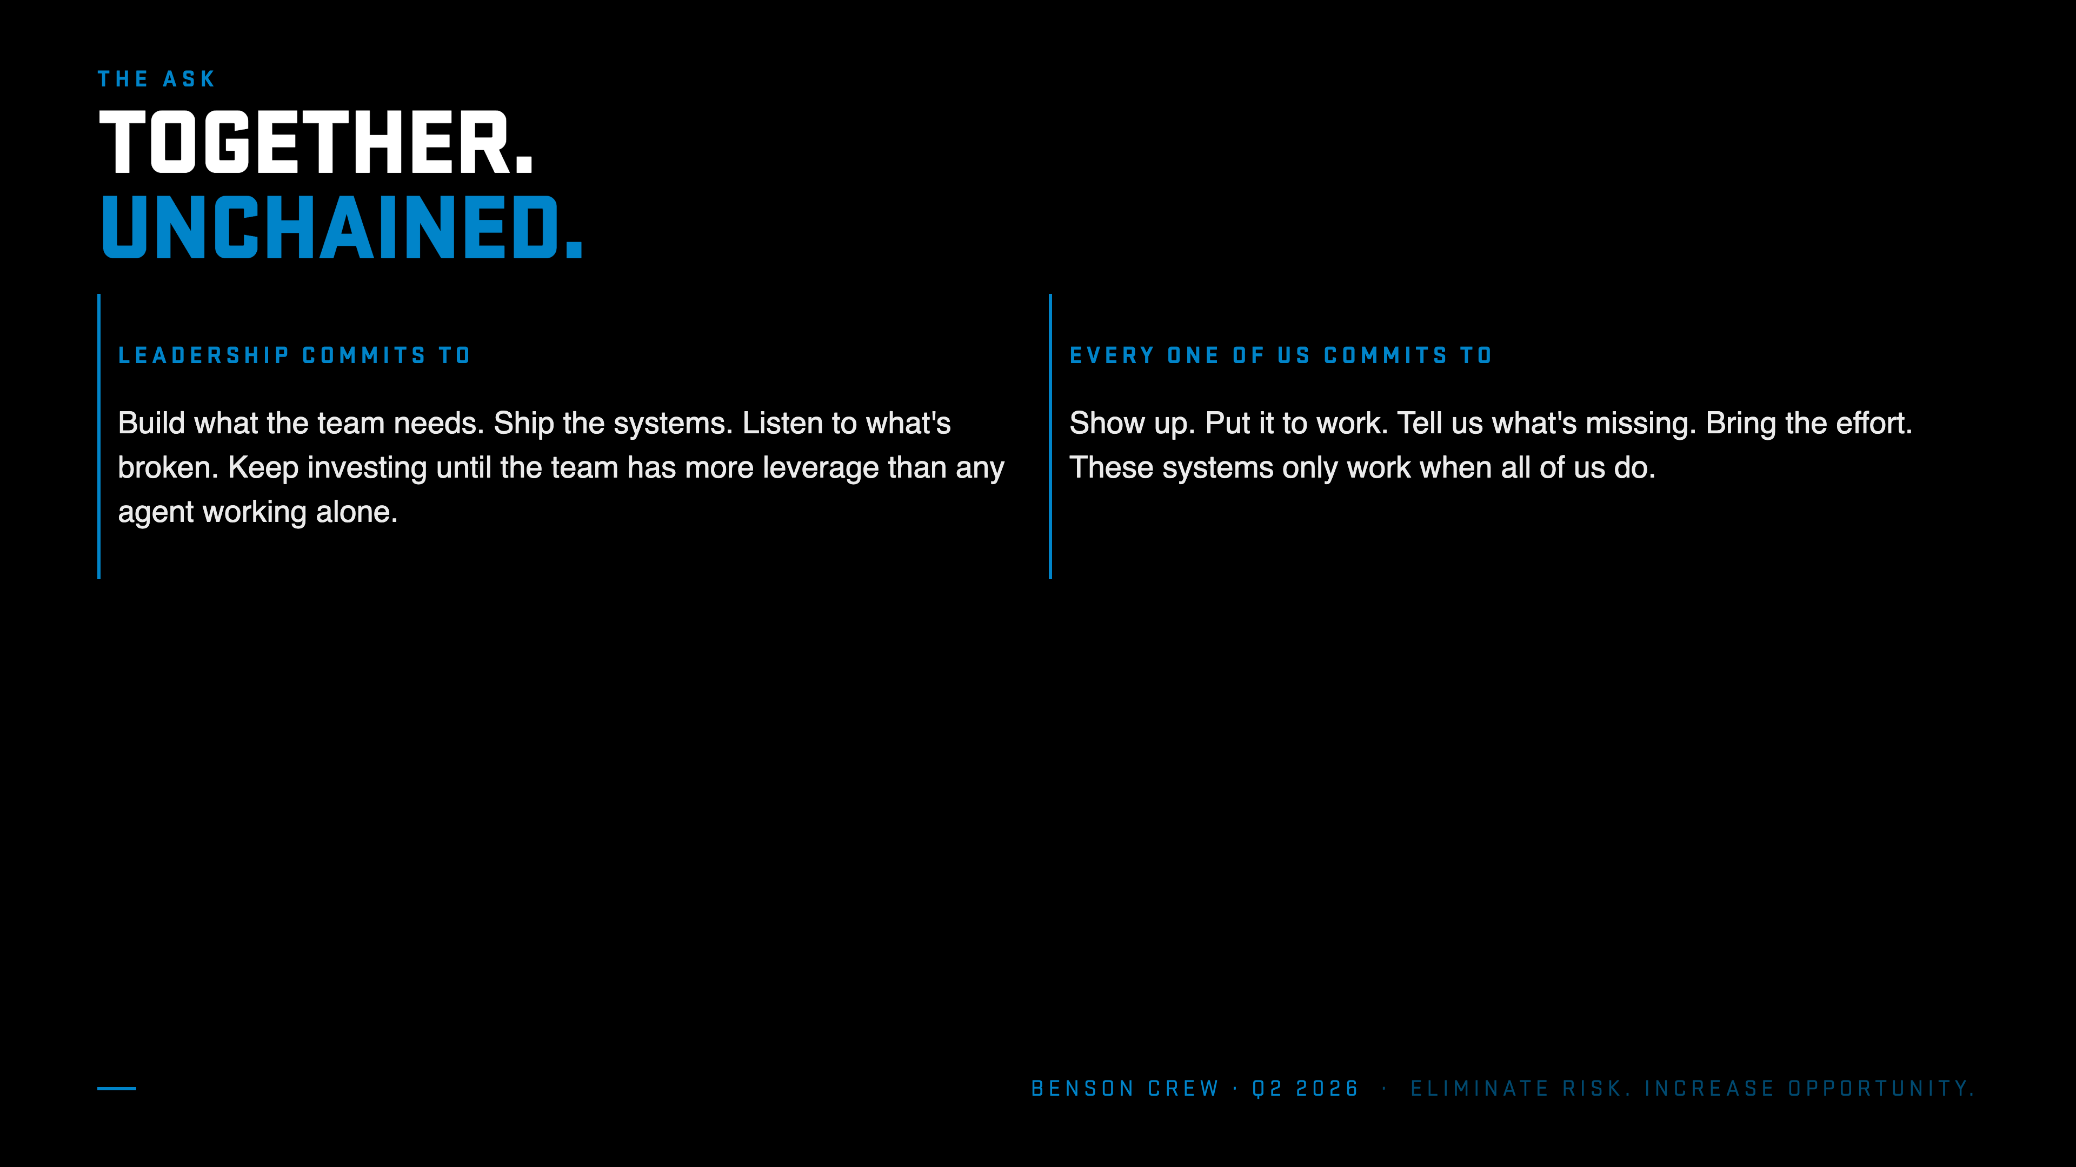
Notes:
Slide 7 · TOGETHER. UNCHAINED. (8:30 to 10:00)
Plain. Direct. No cringe.
"Going into Q2 we keep pushing."
"We keep building what the team needs. Shipping. Listening. Investing. Every tool, every system, every hire. All pointed at giving the team more leverage than any agent working alone."
"And it only works when every one of us keeps bringing it. Showing up. Putting it to work. Telling us what's missing."
"Thanks for everything you bring. Really looking forward to keep building this with all of you."

