Slide 1
CAPSTONE PROJECT
EMPLOYEE SALARY PREDICTION
Presented By:
Name: Nilima Kumari
College Name: CV Raman Global University, Bhubneswar, Odisha
Department: Btech in CSE (AI & ML)
AICTE Student ID: STU68387b2e69a811748532014

Slide 2
OUTLINE
Problem Statement
System Development Approach
Algorithm & Deployment (Step by Step Procedure)
Result
Conclusion
References

Slide 3
PROBLEM STATEMENT
Salary prediction is a critical task for HR departments to ensure fair and competitive compensation.
Variability in job roles, education, experience, and company attributes makes accurate prediction challenging.
The project aims to build a machine learning model to predict employee salaries.
Input features include experience, job title, education level, location type, and age.
The model is trained on a cleaned and updated employee salary dataset.

Slide 4
SYSTEM APPROACH
System requirements
OS: Windows 10/11, macOS, or any Linux-based system
Python Version: Python 3.9 or higher (recommended: Python 3.10+)
RAM: Minimum 4 GB (8 GB or more recommended for faster performance)
Disk Space: ~500 MB (including dataset, model files, and dependencies)
Library required to build the model
pandas Numpy joblib
matplotlib seaborn

Slide 5
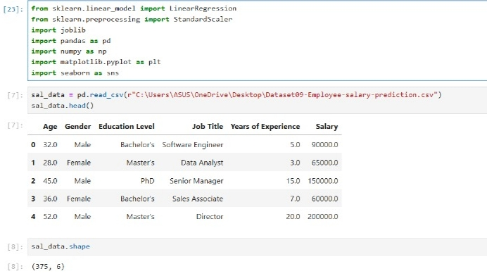
ALGORITHM & DEPLOYMENT
1. Data Collection
Import the employee dataset (updated_employee_salary_dataset.csv) containing job-related and personal
features.

Slide 6
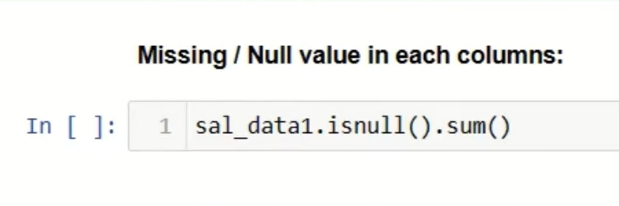
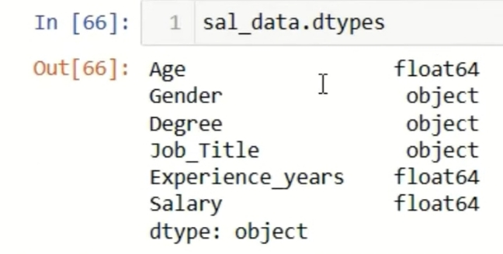
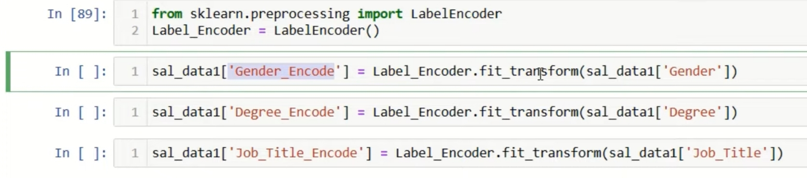
ALGORITHM & DEPLOYMENT
Data Preprocessing
Handle missing values, if any.
Encode categorical variables (e.g., job title, location, education level) using Label Encoding.
Features scaled using StandardScaler for better model performance.

Slide 7
ALGORITHM & DEPLOYMENT
Model Building
Applied Linear Regression as the prediction algorithm.
Trained model to learn relationship between features and salary.
Model Evaluation
Evaluate performance using metrics like Mean Absolute Error (MAE), R² Score, etc.
R² Score showed how well the model explained salary variation (e.g., R² = 0.89 → 89% accuracy).
Metrics confirmed the model performed well on test data.

Slide 8
ALGORITHM & DEPLOYMENT
Model Serialization
The trained Linear Regression model was serialized using the pickle library and saved as model.pkl
The fitted StandardScaler object used for input feature scaling was saved as scaler.pkl
Serialization ensures that the model and scaler can be reused later for making predictions without retraining

Slide 9
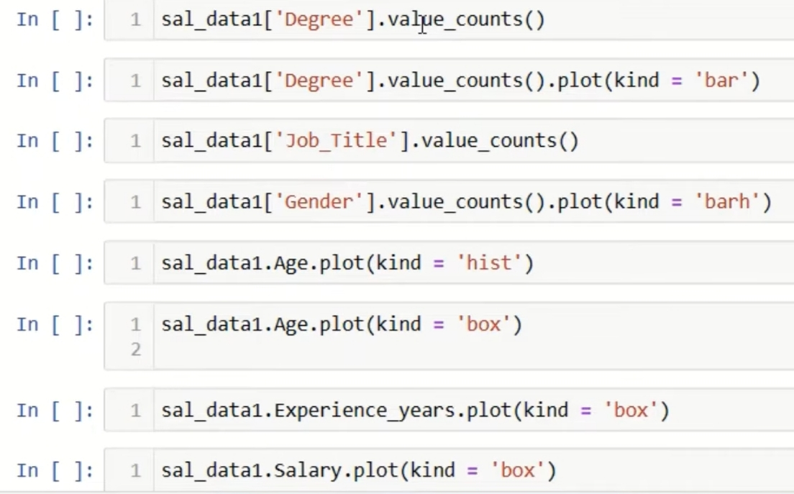
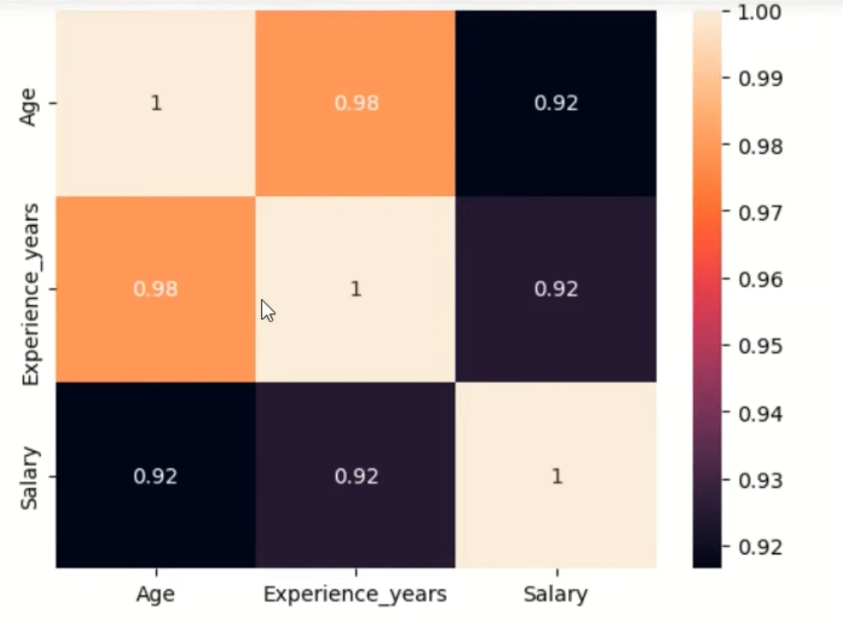
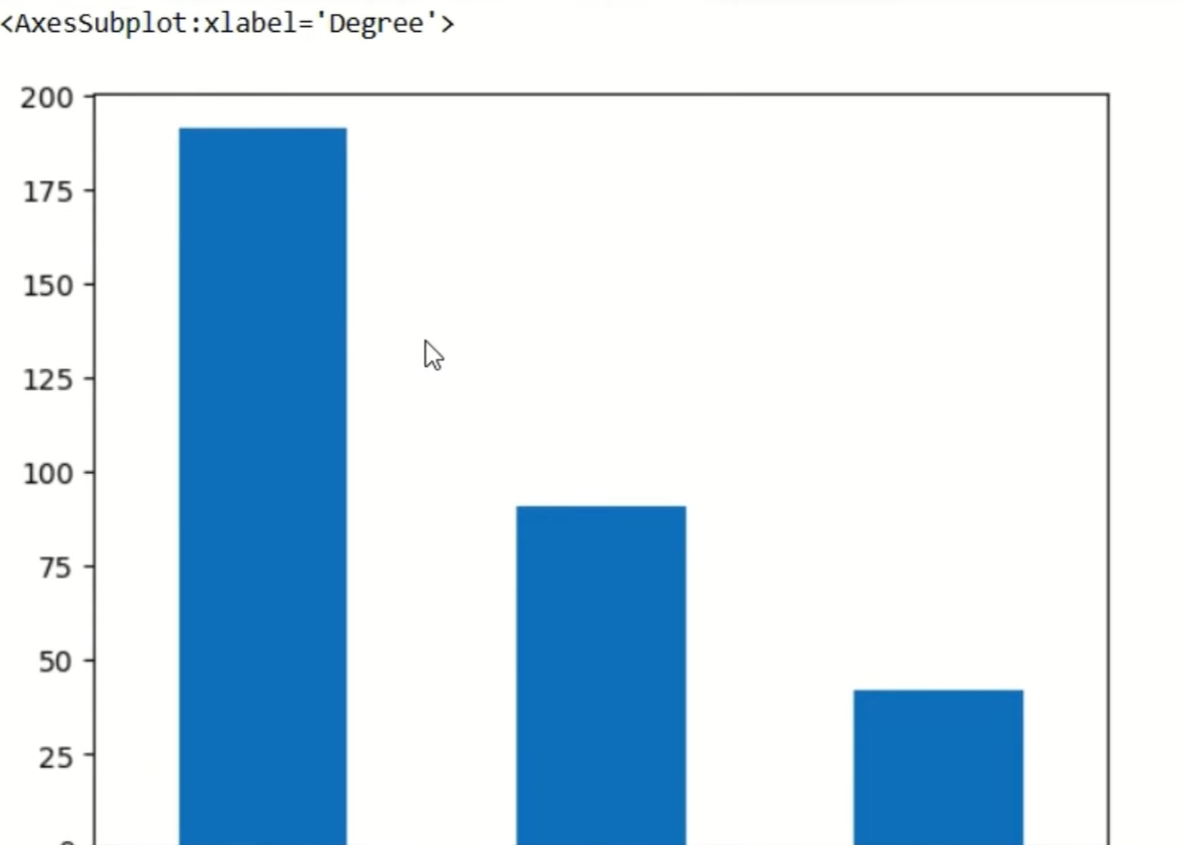
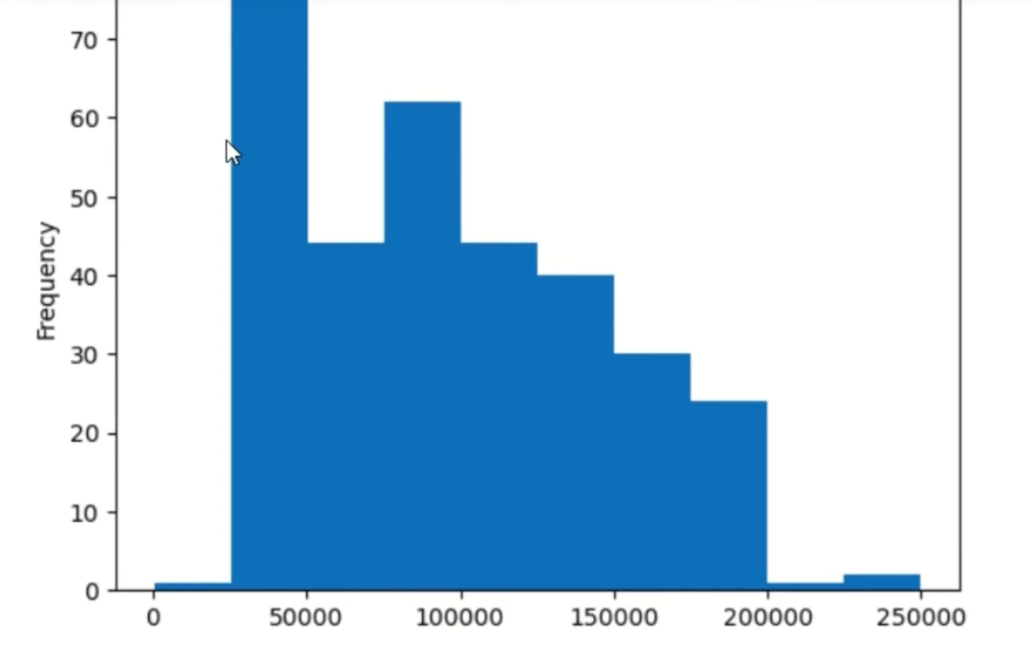
RESULT
Result and Graphs

Slide 10
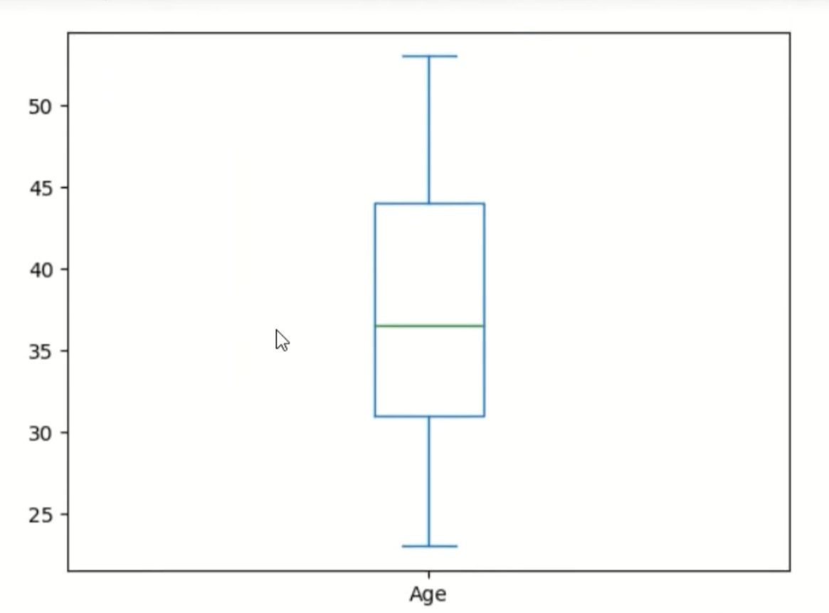
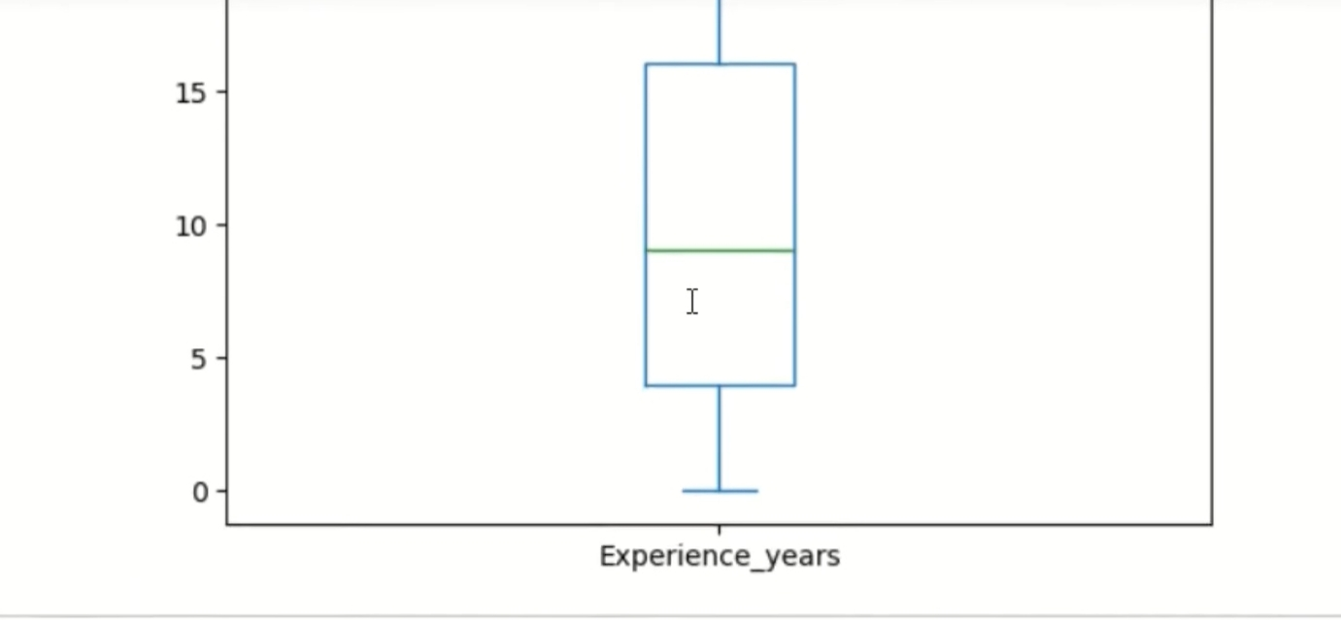
RESULT
Github Link :-https://github.com/nilimakumari0305

Slide 11
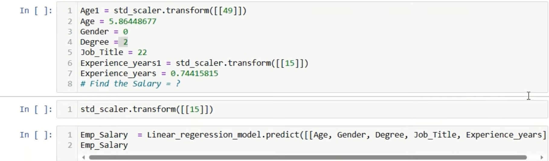
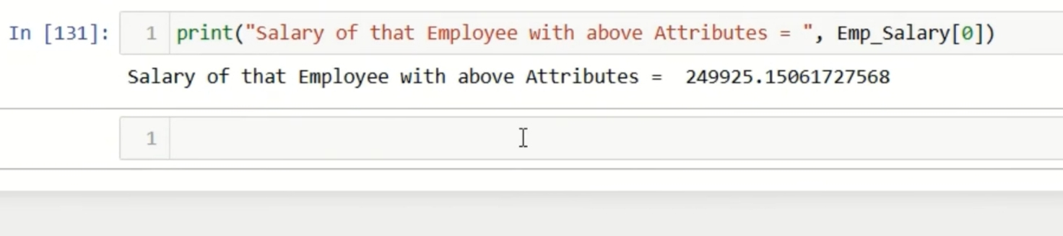
RESULT
Customize Prediction Result :-

Slide 12
CONCLUSION
The model was trained on a cleaned and updated dataset and achieved reliable performance metrics.A machine learning model was successfully developed to predict employee salaries based on key features such as age, gender, education level, job title, and years of experience.
Linear Regression was used as the predictive algorithm due to its simplicity and effectiveness for numerical predictions.
The model demonstrated good accuracy, as indicated by evaluation metrics such as R² score and RMSE.
Preprocessing techniques like encoding and feature scaling played a critical role in improving model performance.
The serialized model and scaler can be reused for future predictions on similar datasets.

Slide 13
REFERENCES
Pandas Documentation: Data analysis and manipulation tool https://pandas.pydata.org/docs/
NumPy Documentation: The fundamental package for scientific computing
https://numpy.org/doc/
Matplotlib Documentation: Visualization with Python https://matplotlib.org/stable/contents.html
IBM HR Analytics Employee Attrition & Performance Dataset. Kaggle. Retrieved from https://www.kaggle.com/datasets

Slide 14
THANK YOU

