Slide 1
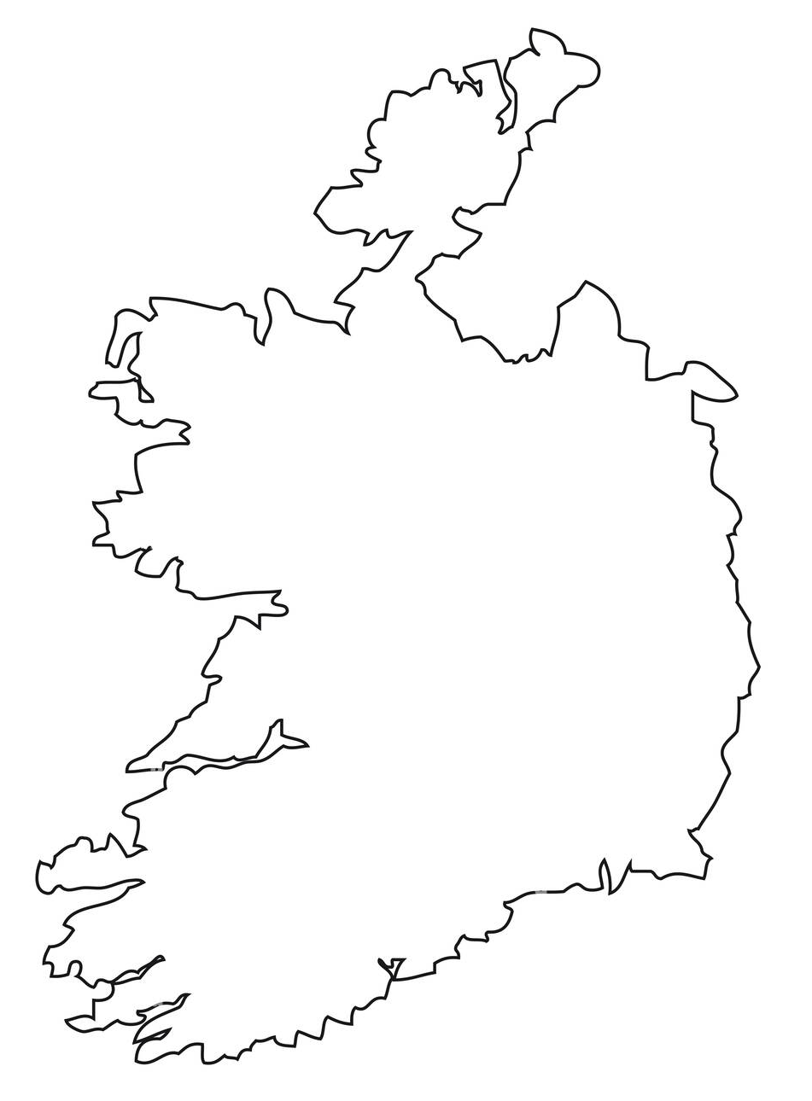
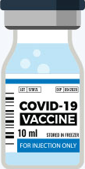




An investigation of the effects of lockdowns and COVID-19 vaccinations in Ireland
AGILE 2023 – Delft, The Netherlands
COVID-19
LOCKDOWN STAY HOME
Niloufar Pourshir Sefidi, Amin Shoari Nejad and Peter Mooney
Correspondence: niloufar.pourshirsefidi.2022@mumail.ie
Maynooth University, Ireland

Slide 2
COVID-19 Timeline in Ireland
March-2020
The WHO declares COVID-19 a pandemic
&
First public measures introduced
May-2021
The public measures lifted
Dec-2022
At the time of writing this paper: 8250 deaths from COVID-19
X
Feb-2020
The first case
Dec-2020
Vaccination program begins
Oct-2021
90% of the adult population are fully vaccinated

Slide 3


Research Motivation Research Goal
There is an ongoing debate between epidemiologists about the effectiveness of the pandemic measures and the efficacy of vaccines.
A gap in this type of research for Ireland
How many lives have been saved in different regions of Ireland as a result of the implementation of lockdowns and vaccination efforts between 2020 and 2022?
Impact: To inform the future development of evidence-based strategies for protecting people from contagious viruses such as COVID-19.
Were lockdowns necessary?
Are vaccines effective?

Slide 4
Proposed Research Approach
Modelling mortality in different counties of Ireland
Accounting for the effects of lockdowns and vaccination rates
Using the model, we create a counterfactual scenario assuming no lockdowns and no vaccinations

Slide 5

Variables
Ireland is divided into:
26 counties
85 towns
166 Local Electoral Areas
Temperature
Temperature is associated with mortality (Son et al., 2019)
Resolution: monthly from 2016 – 2022
All-causes mortality
Resolution: town level, monthly from 2016-2022
COVID-19 vaccination rate
Resolution: local electoral area (LEA), monthly cumulative rate since January 2021
Confirmed COVID-19 cases
Resolution: county level, daily since August 2020
Government Response Oxford Stringency Index
Measures the strictness of the lockdown-style policies that restrict people’s behaviors [0-100]
Resolution: country level, daily since January 2020
Merged data resolution:
Spatial: county level (26)
Temporal: monthly (79)
Notes:
January 2016 to august 2022
2016-2022 : we wantedthe model to learn from unrelated factors to covid and trend of mortality which can be affected by many other factors such as temperature.

Slide 6


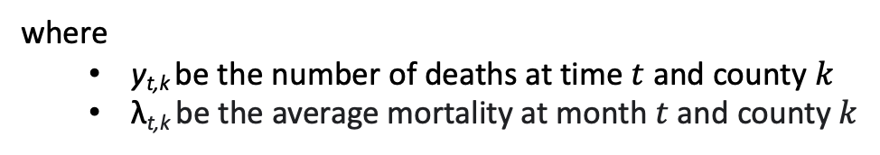
Modelling: Bayesian Hierarchical Poisson Regression model
We write the model as follows:
where
y_{t,k} be the number of deaths at time $t$ and county $k$
λ_{t,k} be the average mortality at month $t$ and county $k$
and is modelled as:
To account for the uncertainty in the number of cases in the first 7 months of the pandemic:
Notes:
We assume y is distributed from a poisson dist with lambda. We assume this average is connected to our variables with a log link func and we assume a linear model accounted for si….

Slide 7
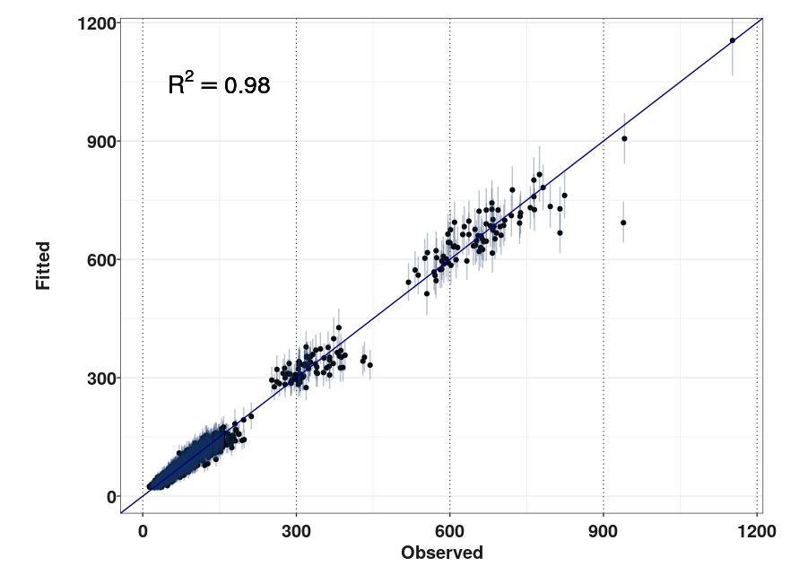
Results – Predicted vs Actual death count (2016-2022)
Notes:
The vertical lines indicate the 95% posterior predictive credible intervals

Slide 8
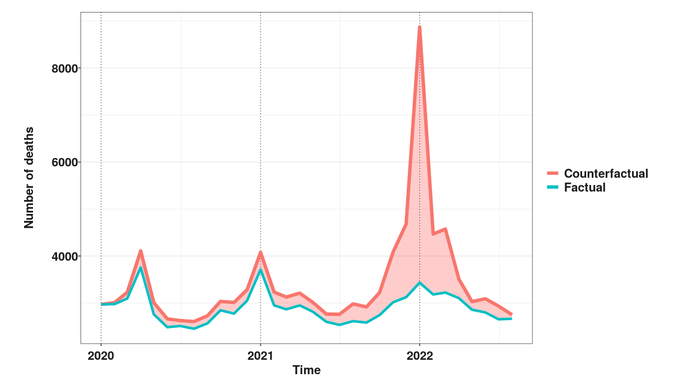
Results – Counterfactual vs Observed number of deaths (2020-2022)
Number of lives saved by lockdowns & vaccinations: 16876 with 95% CI of [13799-20140]

Slide 9
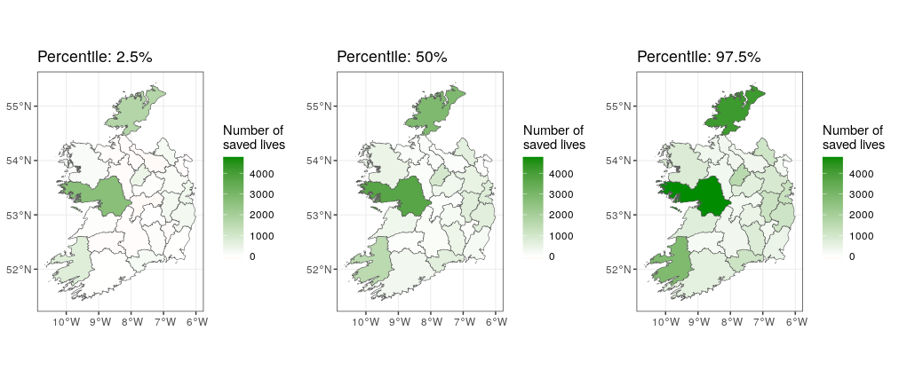
Results – Number of saved lives because of lockdowns & vaccinations
Notes:
Estimation percentile

Slide 10
Results – Number of saved lives because of lockdowns & vaccinations
Donegal
Galway
Kerry

Slide 11
Conclusions Future Work
The implementation of lockdown measures and a well-planned vaccination timeline in Ireland effectively reduced the number of deaths during the COVID-19 pandemic.
The number of saved lives peaked between September 2021 and May 2022, indicating a significant reduction in deaths possibly due to widespread vaccination, even in the absence of restrictive physical distancing measures compared to 2020.
Further research is needed to explore the effects of factors such as population density, demographics, and socioeconomic variables, to provide a broader context and deeper understanding of the observed variations.
Considering the application and testing of these findings in other regions and countries.

Slide 12

An investigation of the effects of lockdowns and COVID-19 vaccinations in Ireland
Ireland’s Excess mortality tracker App:

Slide 13
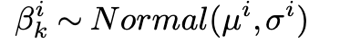
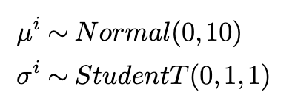

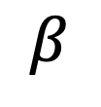
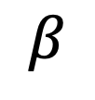
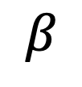
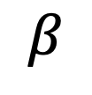
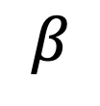
$$μ$$
$$β$$
$$β$$
$$β$$
$$β$$
$$β$$
$$β$$
Dublin
Kildare
Meath
. . . . . .
Galway
Sligo
Cork

