Slide 1
PID Controller for embedded Systems
BY:-
Cassie
Monica
Nilisha

Slide 2
Pre-requisites
3 Term Control
PID Controller Output
Proportional Controller
Integral Controller
Derivative Controller
Joining Them Together – PID Controller
Tuning
Limitations

Slide 3
Pre-requisites
A PID controller is a control loop feedback mechanism (controller) widely used in industrial control systems.
A PID controller calculates an error value as the difference between a measured process variable and a desired setpoint.
The controller attempts to minimize the error by adjusting the process through use of a manipulated variable.

Slide 4
3 Term Control
The PID controller algorithm involves three separate constant parameters :-
The Proportional Value denoted by P – present errors
The Integral Value denoted by I – past errors
The Derivative value denoted D – future errors

Slide 5
3 Term Control
By tuning the three parameters in the PID controller algorithm, the controller can provide control action designed for specific process requirements.
The proportional, integral, and derivative terms are summed to calculate the output of the PID controller.

Slide 6

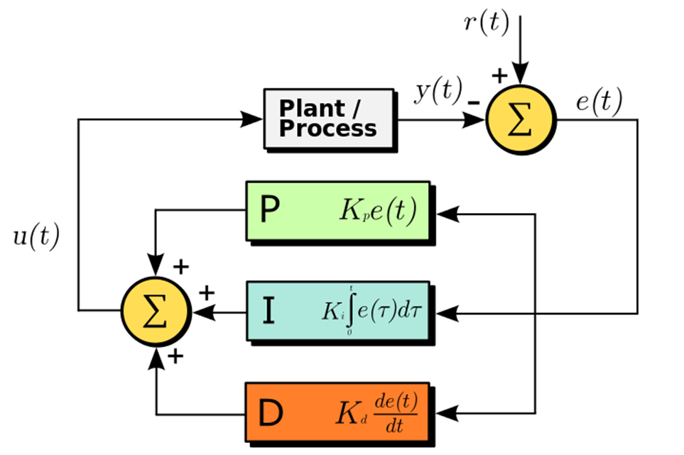
PID Controller Output
Where,
Kp: Proportional gain, a tuning parameter
Ki: Integral gain, a tuning parameter
Kd: Derivative gain, a tuning parameter
e: Error = SP - PV
t: Time or instantaneous time (the present)
tau: Variable of integration; takes on values from time 0 to the present t.

Slide 7
Proportional Controller
Proportional control is the easiest feedback control to implement.
A proportional controller is just the error signal multiplied by a constant and fed out to the drive.
The proportional term gets calculated with the following equation:

Slide 8
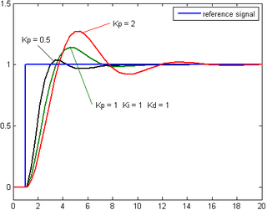
Proportional Controller
proportional gain too high => the system can become unstable
proportional gain is too low => the control action may be too small

Slide 9

Integral Controller
The integral term is proportional to both the magnitude of the error and the duration of the error.
It is merely an accumulated error signals encountered since startup and gives the accumulated offset that should have been corrected previously.
The integral term is given by:

Slide 10
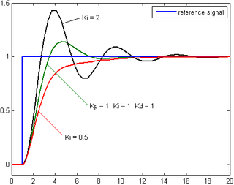
Integral Controller
Used to add long-term precision to a control loop.
The I controller is rarely used alone, but mostly in combination with the P or PD controller.
Ki = Too low - the steady state error is corrected very slowly
Ki = too high - the system becomes unstable and oscillates.
Notes:
When the system has already settled down with a small steady state error, the integral still continues to accumulate until the CV is large enough to bring the PV inline with SP.
The equations for PI controller are as follow:
Error = Set Point – Process Variable
Integral = Integral + Error
Control Variable = (Kp * Error) + (Ki * Integral

Slide 11

Derivative Controller
The derivative is the rate of change of the error.
Derivative = Error – Last Error
The derivative of the process error is calculated by determining the slope of the error over time and multiplying this rate of change by the derivative gain K_{d.}
The derivative term is given by:

Slide 12
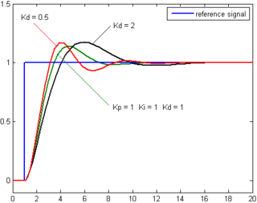
Derivative Controller
Predicts system behavior => improves settling time and stability of the system.
Negative values of derivative indicate an improvement (reduction) in the error signal.
The D controller is rarely used alone, but mostly in combination with the P or PI controller.
Notes:
For example, if the last error was 20 and the current error is 10, the derivative will be -10. When these negative values are multiplied with a constant, Kd, and are added to the output of the loop, it can slow down the system when approaching the target.
The equations for the PD controller are as follow:
Last Error = Error
Error = Set Point – Process Variable
Derivative = Error – Last Error
Control Variable = (Kp * Error) + (Kd * Derivative)

Slide 13
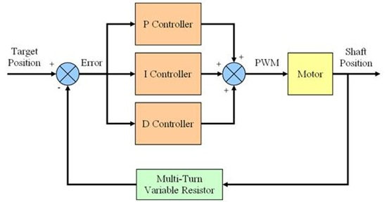
Joining Them Together – PID Controller

Slide 14
Joining Them Together – PID Controller
By joining the P, I and D controller, we can take the advantages of the combined benefits from each controller.
The P controller for fast system response
The I controller to correct the steady state error
The D controller to dampen the system and reduce overshoot.

Slide 15
Joining Them Together – PID Controller
The output of the loop is merely the sum of output from P, I and D controller.
The equations for the PID loop are illustrated below:
Control Variable = (Kp * Error) + (Ki * Integral) + (Kd * Derivative)

Slide 16
Tuning
PID controller is a simple yet effective control system widely used in industrial.
The process of tuning the PID parameters (Kp, Ki and Kd) is a continuous trial and error process.
There is no exact way to calculate the value for the parameters unless the whole system is mathematically modeled and simulated.
Experience is an important factor to get the optimum PID parameters based on the observation of the system behavior during the tuning process.

Slide 17
Limitations
PID controllers, when used alone, can give poor performance
The performance of PID controllers in non-linear systems (such as HVAC systems) is variable.
The fundamental difficulty with PID control is that it is a feedback system, with constant parameters, and no direct knowledge of the process, and thus overall performance is reactive and a compromise.

Slide 18
Thank You Questions??????

