Slide 1

Power-Aware SoC Test Optimization through Dynamic Voltage and Frequency Scaling
Vijay Sheshadri , Vishwani D. Agrawal, Prathima Agrawal
Dept. of Electrical and Computer Engineering
Auburn University, AL 36849, USA
Notes:
The slide guide is available in the following file:
slidesV16.2.ppt: PowerPoint, version 2003 format.
Note: We have saved this presentation in the older 2003 format, because PowerPoint 2003, 2007 and 2010 can read it.
For this year’s test conference we will use PowerPoint 2007 in our projection computers.

Slide 2
Outline
Introduction
Problem Statement
Heuristic Algorithms
  Preemptive test scheduling
  Non preemptive test scheduling
Results
Conclusion
10/7/2013
VLSI-SoC 2013

Slide 3
Introduction
Technology scaling has led to more cores and increased complexity in SoC devices.
  This has resulted in large test data volume, increased power consumption and long test times.
  Reducing test time while controlling power under specification is a major objective in SoC testing.
10/7/2013
VLSI-SoC 2013

Slide 4
Introduction
Typical approach: Test multiple cores simultaneously, but that causes
  High power consumption; power consumption in test mode can be higher than system mode! Therefore,
  Power aware test strategies needed for efficient power management.
10/7/2013
VLSI-SoC 2013

Slide 5
Introduction
Testing SoC – schedule core tests such that:
  No resource conflict among tests that must share available resources.
  Power consumption does not exceed given power budget.
Test schedule can be optimized for better power and resource management and a quicker overall test time.
10/7/2013
VLSI-SoC 2013

Slide 6
Problem Statement
Given an SoC with N core tests and a peak power budget, find a test schedule to:
  Test all cores
  Reduce overall test time
  Conform to SoC test power budget
Main idea introduced: Optimize test time by controlling voltage and frequency.
10/7/2013
VLSI-SoC 2013
Notes:
Or more formally *read*

Slide 7
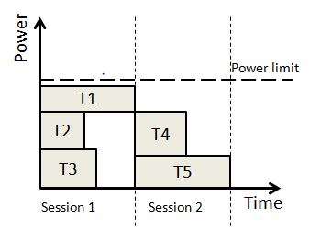
Simple Test Scheduling
Session-based test scheduling :
  Tests grouped into Test sessions.
Each block represents a core-test, with test time, t_{i} and test power, p_{i}
10/7/2013
VLSI-SoC 2013

Slide 8
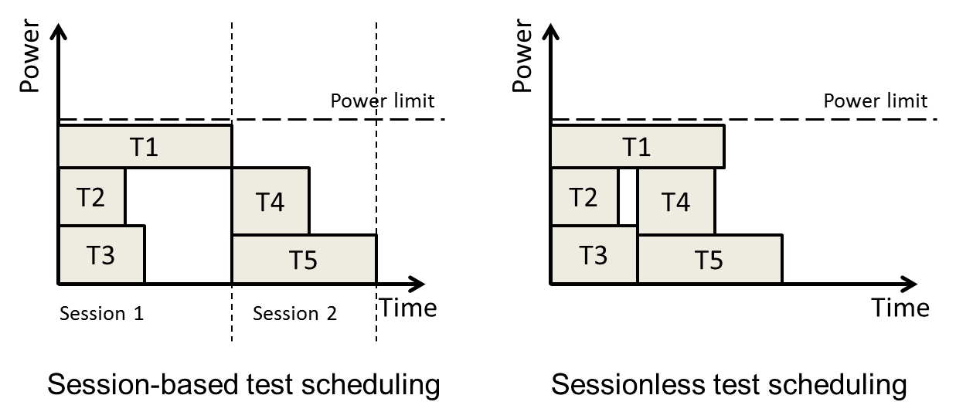
A Variation in Test Scheduling
Sessionless testing:
  New tests scheduled immediately after completion of old ones.
  No session boundaries.
  Reduced test time.
10/7/2013
VLSI-SoC 2013

Slide 9
Another Variation
Sessionless testing further divided into:
  Preemptive* – Test can be interrupted and restarted anytime.
  Can reduce test time, but
  May increase test complexity
  Non Preemptive – Tests are not interrupted.
Test ‘X’
Test ‘X1’
Test ‘X2’
Test time = t
Test time = t1
t2
(t1 + t2 = t)
* V. Iyengar and K. Chakrabarty, ”Precedence-Based, Preemptive and Power Constrained Test Scheduling for System-on-Chip,” Proc. VTS’02, pp 253-258
10/7/2013
VLSI-SoC 2013

Slide 10
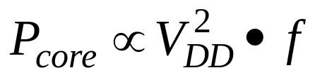
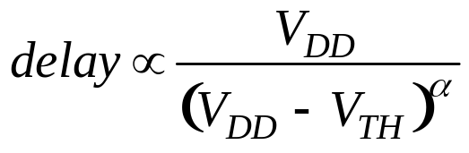
Core Frequency and Voltage
A core test has two constraints:
  Power Constraint:
  Structure constraint:
(Alpha power law*)
* T. Sakurai and A. R. Newton, “Alpha-Power Law MOSFET Model and its Applications to CMOS Inverter Delay and Other Formulas,” IEEE Journal of Solid-State Circuits, vol. 25, no. 2, pp. 584–594, Apr. 1990.
10/7/2013
VLSI-SoC 2013
Notes:
The core’s frequency is the minimum of the two constraints (i.e., power and structure constraint).
The critical path delay’s dependence on VDD is given by the alpha power law

Slide 11
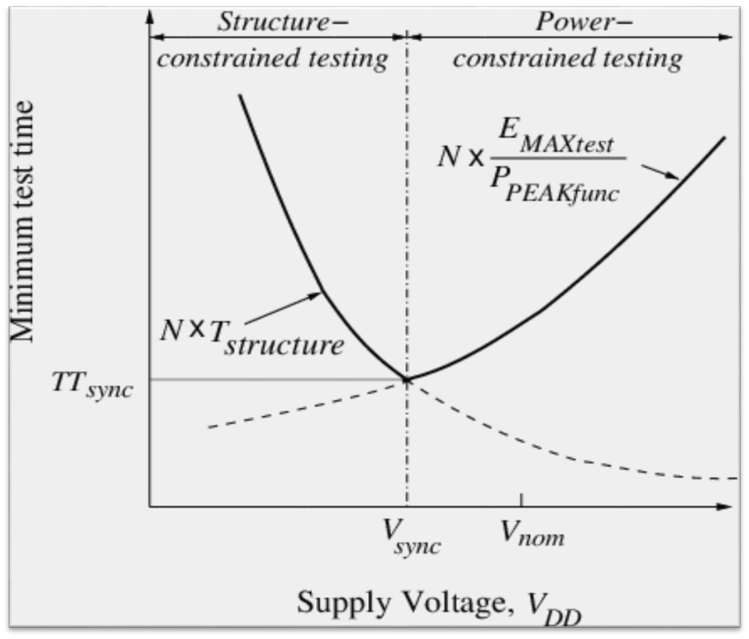
Optimum V_{DD} for a Core
P. Venkataramani , S. Sindia and V. D. Agrawal, “A Test Time Theorem and Its Applications,” Proc. 14th IEEE Latin-American Test Workshop, Apr. 2013.
10/7/2013
VLSI-SoC 2013
Notes:
Since test power is much higher than functional power, test clock is mostly power constrained (right-half of the plot)
Hence, both VDD a.nd frequency are needed to reduce test time

Slide 12
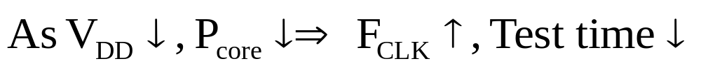
Influence of V_{DD} on Test time
Power constrained test:
Structure constrained test:
An optimal V_{DD} can balance the two constraints.
10/7/2013
VLSI-SoC 2013
Notes:
Two domains of testing can be identified. In the power constrained testing domain, the test clock rate is limited by the high power consumption in the core. Reducing VDD lowers the power and hence allows an increase in the frequency thereby reducing test time.
On the other hand, reducing VDD causes the path delay to increase and hence the clock has to be slowed down. This elongates the test time.
Hence an optimum VDD must be found to balance the two contrary phenomena.

Slide 13
This work:
Objective: To find the optimum VDD and frequency at which the test time is minimum.
Heuristic method for sessionless test scheduling.
  Both preemptive and non preemptive schemes possible.
Dynamic voltage and frequency scaling to lower test time.
10/7/2013
VLSI-SoC 2013
Notes:
In this work, we present a heuristic method for sessionless test scheduling, for both preemptive and non-preemptive approaches. Dynamic voltage and frequency scaling is made use of, to optimize the test time

Slide 14
Heuristic Algorithms
Exact methods such as ILP are NP-hard*
  Problem size grows quickly with number of cores
  Rapid increase in CPU time
Heuristic methods offer better alternative
  Often based on greedy approach
  Capable of near-optimal solutions
  Less CPU time than ILP method for larger SoC
* K. Chakrabarty, “Test Scheduling for Core-Based Systems,” Proc. IEEE/ACM ICCAD, Nov. 1999, pp.391–394.
10/7/2013
VLSI-SoC 2013
Notes:
The reason for adopting heuristics is because exact methods like ILP take increasingly large amount CPU effort to solve optimization problems as SoCs grow bigger.
Heuristics, on the other hand, take simple greedy steps which are iterated multiple times to improve the solution. These methods are capable of achieving near-optimal solutions and scale easily for larger SoCs

Slide 15
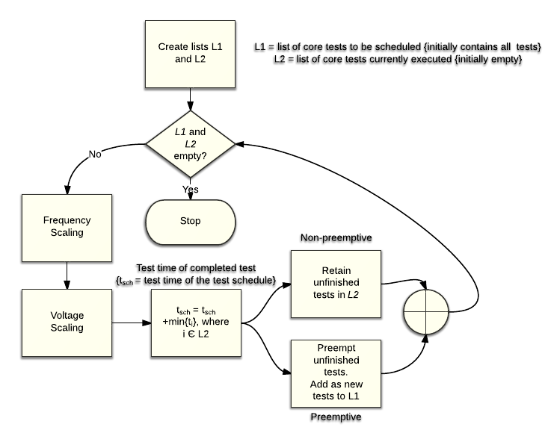
Heuristic for Sessionless Testing
10/7/2013
VLSI-SoC 2013
Notes:
This flowchart describes the algorithm. We initialize two lists: one list contains tests that need to be scheduled, second list contains the tests that are currently scheduled.
The idea is to add tests from the first list to the second one; each time a test is added, the algorithm performs frequency and voltage scaling. Then computes the overall test time. This process is repeated at the completion of each test, until all tests are scheduled.
For the non-preemptive case, after completion of a test, the other tests running concurrently are continued until completion. A new test maybe added in the place of the test that just completed.
In the preemptive case, however, once a test completes, the concurrently running tests are halted and the remaining parts of these tests are added back to the first list as new tests.

Slide 16
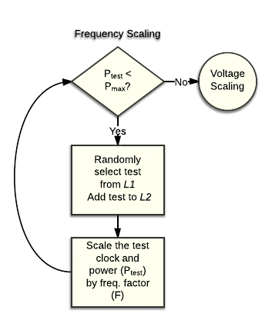
Heuristic for Sessionless Testing
10/7/2013
VLSI-SoC 2013
Notes:
In the frequency scaling procedure, tests are randomly selected from the first list and added to the second list (implying that the test has been scheduled). After each test is scheduled, the test clock and the cumulative test power are scaled by the frequency factor. This is repeated until the test power is close to the power budget.

Slide 17
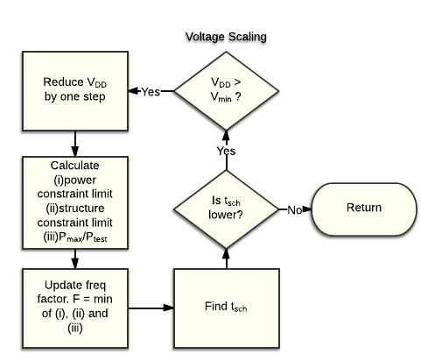
Heuristic for Sessionless Testing
10/7/2013
VLSI-SoC 2013
Notes:
The voltage scaling is done in steps. We start from the nominal value of VDD. As we reduce the VDD in steps, for each step, the algorithm computes the core’s frequency constraints and the test power. Based on these values, the frequency factor is updated. The overall test time is computed. If the test time has reduced, it implies that the test is in power-constrained testing domain. The above steps are again repeated.
If the test time has increased due to VDD reduction, it implies the test has transitioned into structure-constrained domain; this stops the voltage scaling procedure.

Slide 18
Heuristic for Sessionless Testing
Reference case, for comparison, obtained from Best-Fit Decreasing algorithm.
  This is also a sessionless test scheduling algorithm.
  Voltage and clock frequency fixed at nominal values.
  Algorithm description on the next slide.
10/7/2013
VLSI-SoC 2013
Notes:
For comparison, we create a reference case based on the Best-Fit decreasing approach for the bin packing problem. This algorithm also provides a sessionless test schedule. However, in this, the VDD and clock are fixed at their nominal values.

Slide 19
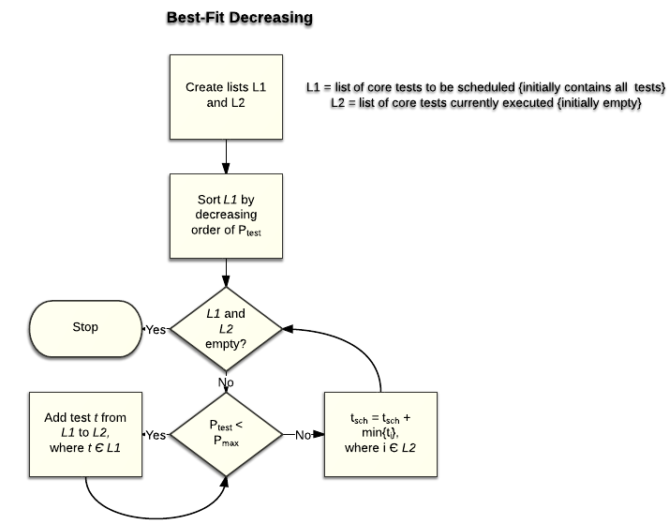
Heuristic for Sessionless Testing
10/7/2013
VLSI-SoC 2013
Notes:
Here again we initialize two lists: one list contains tests that need to be scheduled, second list contains the tests that are currently scheduled. The first list is sorted in decreasing order of test power. Tests are added from the first list to the second one until the test power is close to the power budget. This is repeated at the completion of each test until all tests are completed.

Slide 20
Experiments on ITC02 Benchmarks*
Initial data:
  For SoC: Maximum overall test power P_{max} (watts) for some nominal test voltage and frequency
  For each core: Test power (watts) and test time (in arbitrary units) if tested at nominal voltage and frequency, f_{i} maximum frequency factor allowed by critical path delay at nominal voltage, and maximum power (assumed P_{max} in these results)
Stopping criteria: No improvement on previous best solution for 10,000 consecutive runs.
Simulations performed on a Dell workstation with a 3.4 GHz Intel Pentium processor and 2GB memory.
* ITC 2002 SOC Benchmarking Initiative: http://www.extra.research.philips.com/itc02socbenchm
Power profile for benchmarks from: S. K. Millican and K. K. Saluja (http://homepages.cae.wisc.edu/~millican/bench/)
10/7/2013
VLSI-SoC 2013
Notes:
The experiments were conducted on ITC’02 benchmarks. The stopping criteria for the algorithm was that the best solution obtained so far would not improve over 10000 consecutive iterations.

Slide 21
Results: Reference Case
  Sessionless test time obtained by Best-Fit Decreasing algorithm. Voltage and frequency fixed at nominal values.
Benchmark | No. of cores | P_{max} | Test time
a586710 | 7 | 800mW | 14090716
h953 | 8 | 800mW | 122636
d695 | 10 | 400mW | 13301
g1023 | 14 | 400mW | 18084
p34392 | 19 | 400mW | 701684
t512505 | 31 | 400mW | 5344747
p93791 | 32 | 400mW | 139008
10/7/2013
VLSI-SoC 2013
Notes:
The table lists the results for the reference case.

Slide 22
Preemptive DVFS Scheduling
Benchmark | Test time {Ref. case} | Test time {Preemptive} | % Reduction | CPU time
a586710 | 14090716 | 7572316 | 46.26 | 1.99 sec
h953 | 122636 | 60805.62 | 50.42 | 2.33 sec
d695 | 13301 | 5264.61 | 60.42 | 2.96 sec
g1023 | 18084 | 8952.53 | 50.49 | 5.76 sec
p34392 | 701684 | 340527.9 | 51.47 | 6.12 sec
t512505 | 5344747 | 2953787 | 44.73 | 24.44 sec
p93791 | 139008 | 74582.87 | 46.35 | 37.93 sec
10/7/2013
VLSI-SoC 2013

Slide 23
Non-Preemptive DVFS Scheduling
Benchmark | Test time {Ref. case} | Test time {Non-preemptive} | % Reduction | CPU time
a586710 | 14090716 | 7582339 | 46.19 | 2.7sec
h953 | 122636 | 60805.62 | 50.42 | 1.67sec
d695 | 13301 | 5210.147 | 60.83 | 2.22sec
g1023 | 18084 | 8898.818 | 50.79 | 3.15sec
p34392 | 701684 | 340509 | 51.47 | 4.56sec
t512505 | 5344747 | 2940986 | 44.97 | 8.45sec
p93791 | 139008 | 73681.67 | 46.99 | 13.94sec
10/7/2013
VLSI-SoC 2013

Slide 24
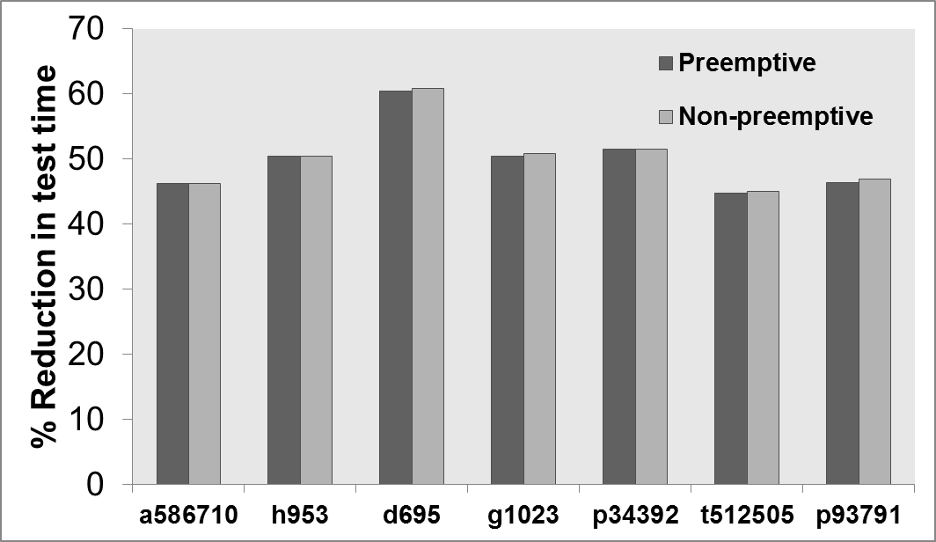
Test Time Reduction
Preemptive vs Non-preemptive
  Test time reduction with respect to reference case
10/7/2013
VLSI-SoC 2013
Notes:
From the plot, we can see that the preemptive and non-preemptive methods yielded almost same results.

Slide 25
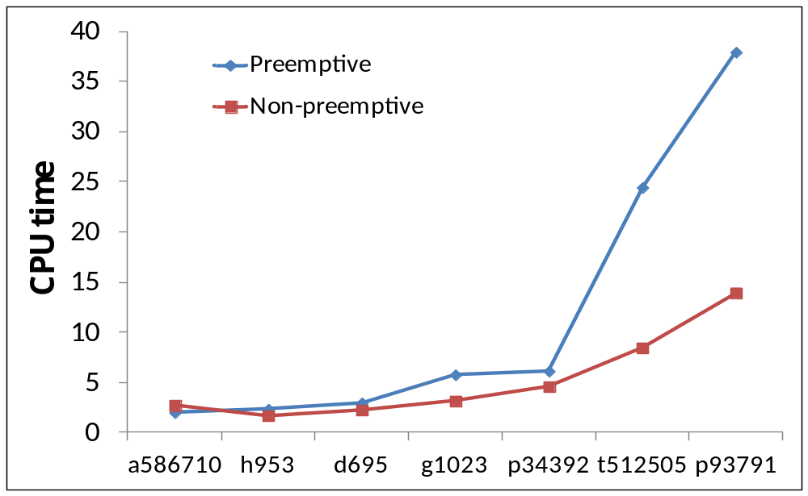
Algorithm Complexity
Preemptive vs. Non-preemptive
  Runtime of algorithm
10/7/2013
VLSI-SoC 2013
Notes:
The difference between them is seen in the runtime comparison. The preemptive strategy takes more time since each time tests are preempted they are treated as new tests thereby increasing the total number of core tests to be scheduled.

Slide 26
Conclusion
Heuristic methods for sessionless test scheduling presented.
  Employs dynamic voltage and frequency scaling to reduce test time.
  45-60% reduction in test time compared to session-based testing.
  Preemptive and non-preemptive strategies yield almost identical solutions.
    Preemptive strategy introduces extra complexity, leading to longer CPU times
10/7/2013
VLSI-SoC 2013

