Slide 1





NILMTK
An open source toolkit for
Non-Intrusive Load Monitoring
nilmtk.github.io

Slide 2
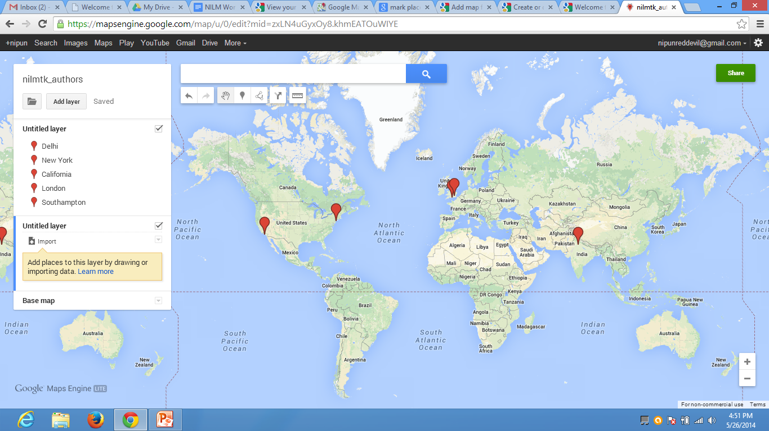


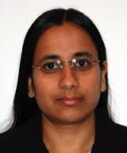





NILMTK Team
Haimonti
Dutta
Alex Rogers
Southampton
Nipun Batra
Oliver
Parson
IC
CCLS
Columbia
IIIT
Delhi
UCLA
Amarjeet Singh
Mani Srivastava
William
Knottenbelt
Jack Kelly
Notes:
Nipun & Amarjeet are at IIIT Delhi
Haimonti is at CCLS Columbia
Mani is at UCLA

Slide 3
Why does NILMTK exist?
disaggregation

Slide 4
Why does NILMTK exist?
disaggregation

Slide 5
Why does NILMTK exist?
load dataset
disaggregation

Slide 6
Why does NILMTK exist?
load dataset
diagnostics
disaggregation

Slide 7
Why does NILMTK exist?
load dataset
diagnostics
statistics
disaggregation

Slide 8
Why does NILMTK exist?
load dataset
diagnostics
statistics
preprocessing
disaggregation

Slide 9
Why does NILMTK exist?
load dataset
diagnostics
statistics
preprocessing
disaggregation
metrics

Slide 10
What can NILMTK do?

Slide 11
What can NILMTK do?
load dataset
diagnostics
statistics
preprocessing
disaggregation
metrics

Slide 12
What can NILMTK do?
load dataset
NILMTK v0.2 has importers for:
REDD, DataPort, iAWE, GREEND, AMPds, COMBED, ECO, HES, UK-DALE
Converts to standard data structures & standard names
diagnostics
statistics
preprocessing
disaggregation
metrics

Slide 13
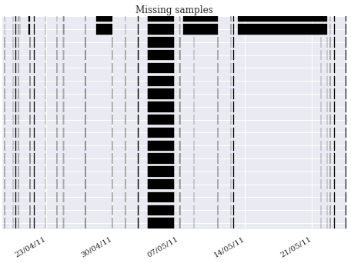
What can NILMTK do?
load dataset
NILMTK v0.2 has importers for:
REDD, WikiEnergy, iAWE, GREEND (others pending porting from v0.1)
Converts to standard data structures & standard names
diagnostics
Detect large gaps in data,
dropout rate (ignoring large gaps)
statistics
preprocessing
disaggregation
metrics

Slide 14
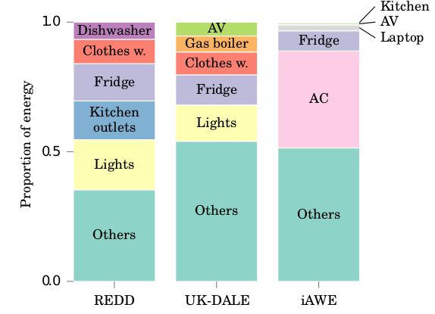
What can NILMTK do?
load dataset
NILMTK v0.2 has importers for:
REDD, WikiEnergy, iAWE, GREEND (others pending porting from v0.1)
Converts to standard data structures & standard names
diagnostics
Detect large gaps in data,
dropout rate (ignoring large gaps)
statistics
Proportion of energy submetered, on-durations per appliance,
total energy consumed, sample period
preprocessing
disaggregation
metrics

Slide 15
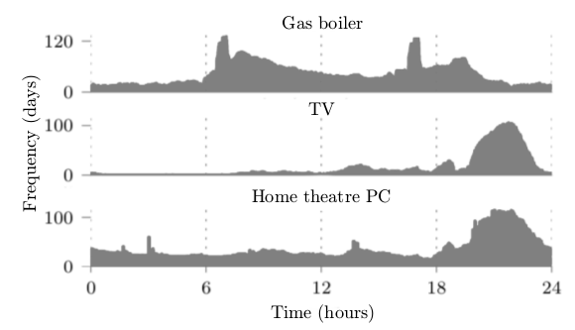
What can NILMTK do?
load dataset
NILMTK v0.2 has importers for:
REDD, WikiEnergy, iAWE, GREEND (others pending porting from v0.1)
Converts to standard data structures & standard names
diagnostics
Detect large gaps in data,
dropout rate (ignoring large gaps)
statistics
Proportion of energy submetered, on durations per appliance,
total energy consumed, sample period
preprocessing
disaggregation
metrics

Slide 16
What can NILMTK do?
load dataset
NILMTK v0.2 has importers for:
REDD, WikiEnergy, iAWE, GREEND (others pending porting from v0.1)
Converts to standard data structures & standard names
diagnostics
Detect large gaps in data,
dropout rate (ignoring large gaps)
statistics
Proportion of energy submetered, on durations per appliance,
total energy consumed, sample period
preprocessing
Resample, fill gaps, select time window, voltage normalisation,
detect gaps in mains and mask these out from appliances,
Remove appliances which contribute less than X% energy
disaggregation
metrics

Slide 17
What can NILMTK do?
load dataset
NILMTK v0.2 has importers for:
REDD, WikiEnergy, iAWE, GREEND (others pending porting from v0.1)
Converts to standard data structures & standard names
diagnostics
Detect large gaps in data,
dropout rate (ignoring large gaps)
statistics
Proportion of energy submetered, on durations per appliance,
total energy consumed, sample period
preprocessing
Resample, fill gaps, select time window, voltage normalisation,
detect gaps in mains and mask these out from appliances,
Remove appliances which contribute less than X% energy
disaggregation
Split data into train and test sets;
standard interface for disaggregation classes;
Disag algos; export / import learnt models to disk
metrics

Slide 18
What can NILMTK do?
load dataset
NILMTK v0.2 has importers for:
REDD, WikiEnergy, iAWE, GREEND (others pending porting from v0.1)
Converts to standard data structures & standard names
diagnostics
Detect large gaps in data,
dropout rate (ignoring large gaps)
statistics
Proportion of energy submetered, on durations per appliance,
total energy consumed, sample period
preprocessing
Resample, fill gaps, select time window, voltage normalisation,
detect gaps in mains and mask these out from appliances,
Remove appliances which contribute less than X% energy
disaggregation
Split data into train and test sets;
standard interface for disaggregation classes;
Disag algos; export / import learnt models to disk
metrics
Error in total energy assigned, fraction of total energy
assigned correctly, normalised error in assigned power,
RMS error in assigned power, confusion matrix,
TP/FP/FN/TN, precision, recall, F-score, Hamming loss

Slide 19
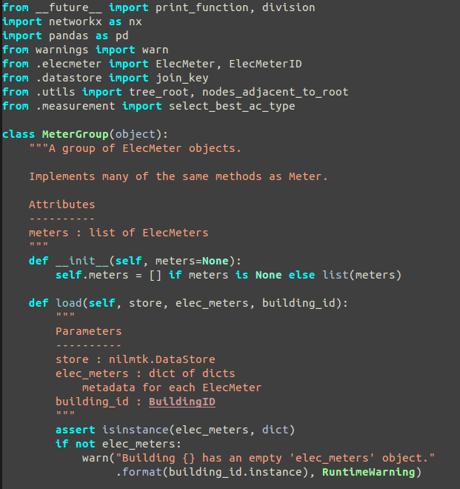
What is NILMTK?
Open source toolkit for NILM
Written in Python (2.7)

Slide 20
What is NILMTK?
Open source toolkit for NILM
Written in Python (2.7)
Project started in November 2013
v0.1 released Jan 2014
v0.2 released July 2014
NILMTK should play nicely with other tools (can import / export data as CSV or HDF5 from multiple points in NILMTK's pipeline)

Slide 21
Ultimate aims of NILMTK
Make our lives easier!
Reproducible research
Make it easier to compare NILM algorithms

Slide 22
What NILMTK isn't (yet)
A user-facing disaggregation tool
A web-scale disaggregation tool
NILMTK does not yet provide cutting-edge NILM algorithms
(Although we certainly plan to address these as NILMTK matures)

Slide 23
NILMTK development
nilmtk.github.io
@nilmtk
NILMTK is in its early stages
We warmly welcome:
  code contributions (fork; branch; modify; submit pull request)
  bug reports ;) (using the github issue queue)
Most development discussions happen on the github issue queue and email. Might move to a dev mailing list if there is demand.

Slide 24
NILMTK v0.2
Complete re-write
Cleaner object-orientated design
Handles arbitrarily large datasets
  Lazy loading (minimises memory usage)
  Out of core (OOC) processing
  Loads data in chunks
  Paves the way for distributed processing over multiple cores / machines
Rich metadata support...

Slide 25
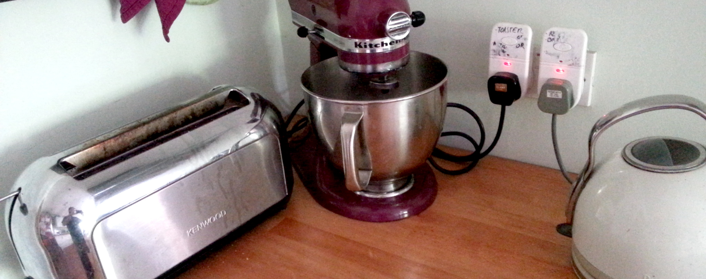
Metadata for Energy Disaggregation github.com/NILMTK/NILM_Metadata

Slide 26
Disaggregated energy datasets
More than 10 public datasets now available
Range from single home to hundreds of homes
No metadata schema

Slide 27
Datasets are complex
Many meters
Each connected to some number of appliances
Arbitrary wiring between meters
Different meter models
Specify details of appliances
Preprocessing applied to data
etc.

Slide 28
NILM Metadata schema
Schema has 2 components:
Schema for describing individual datasets
Dataset, buildings, meters, appliances, measurements
Common metadata about appliance types
Categories, priors, models of appliances, countries

Slide 29
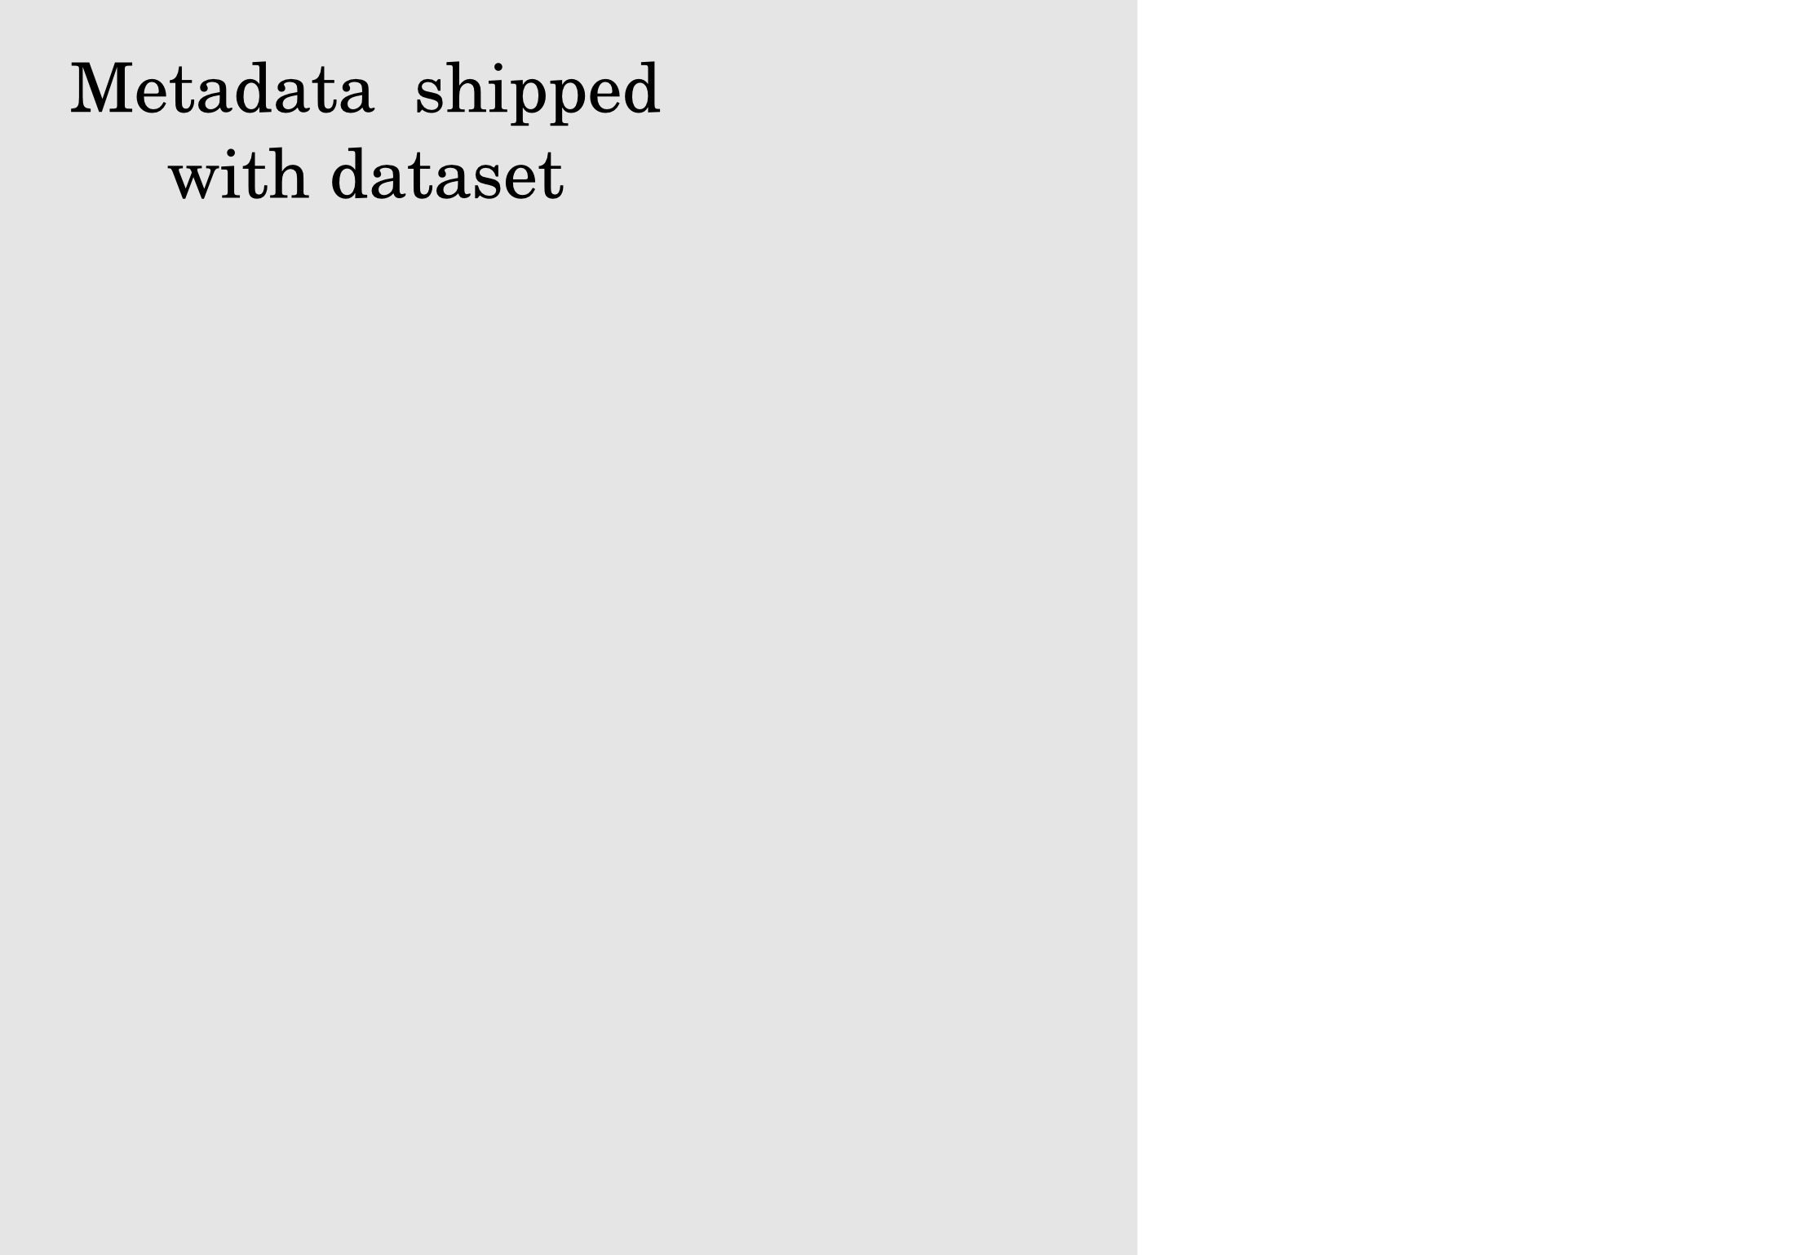

Slide 30
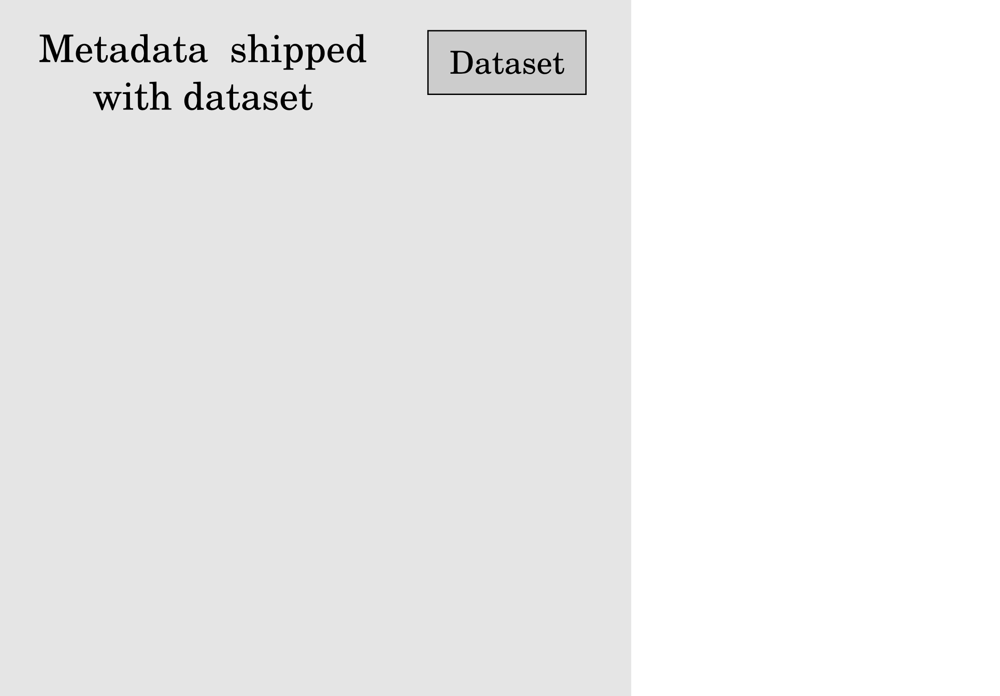

Slide 31
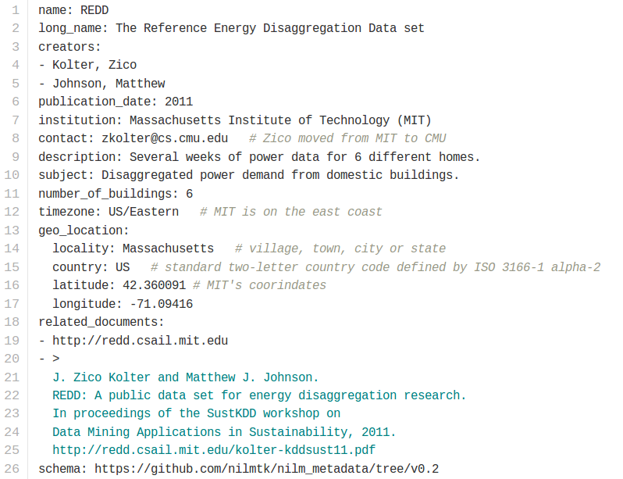
dataset.yaml

Slide 32
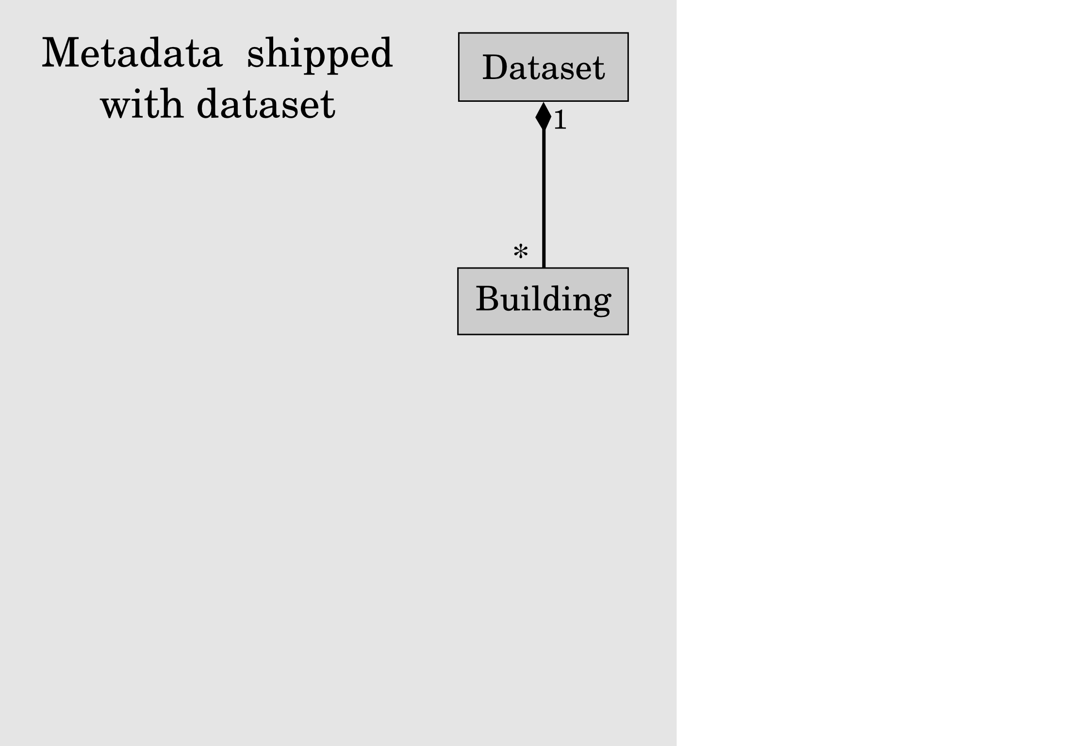

Slide 33
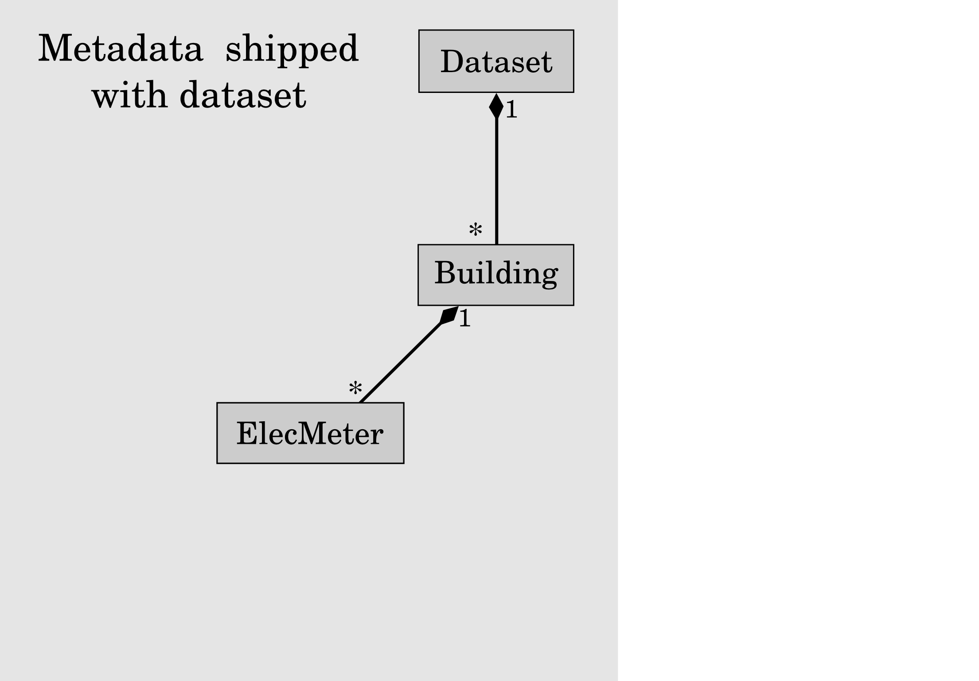

Slide 34
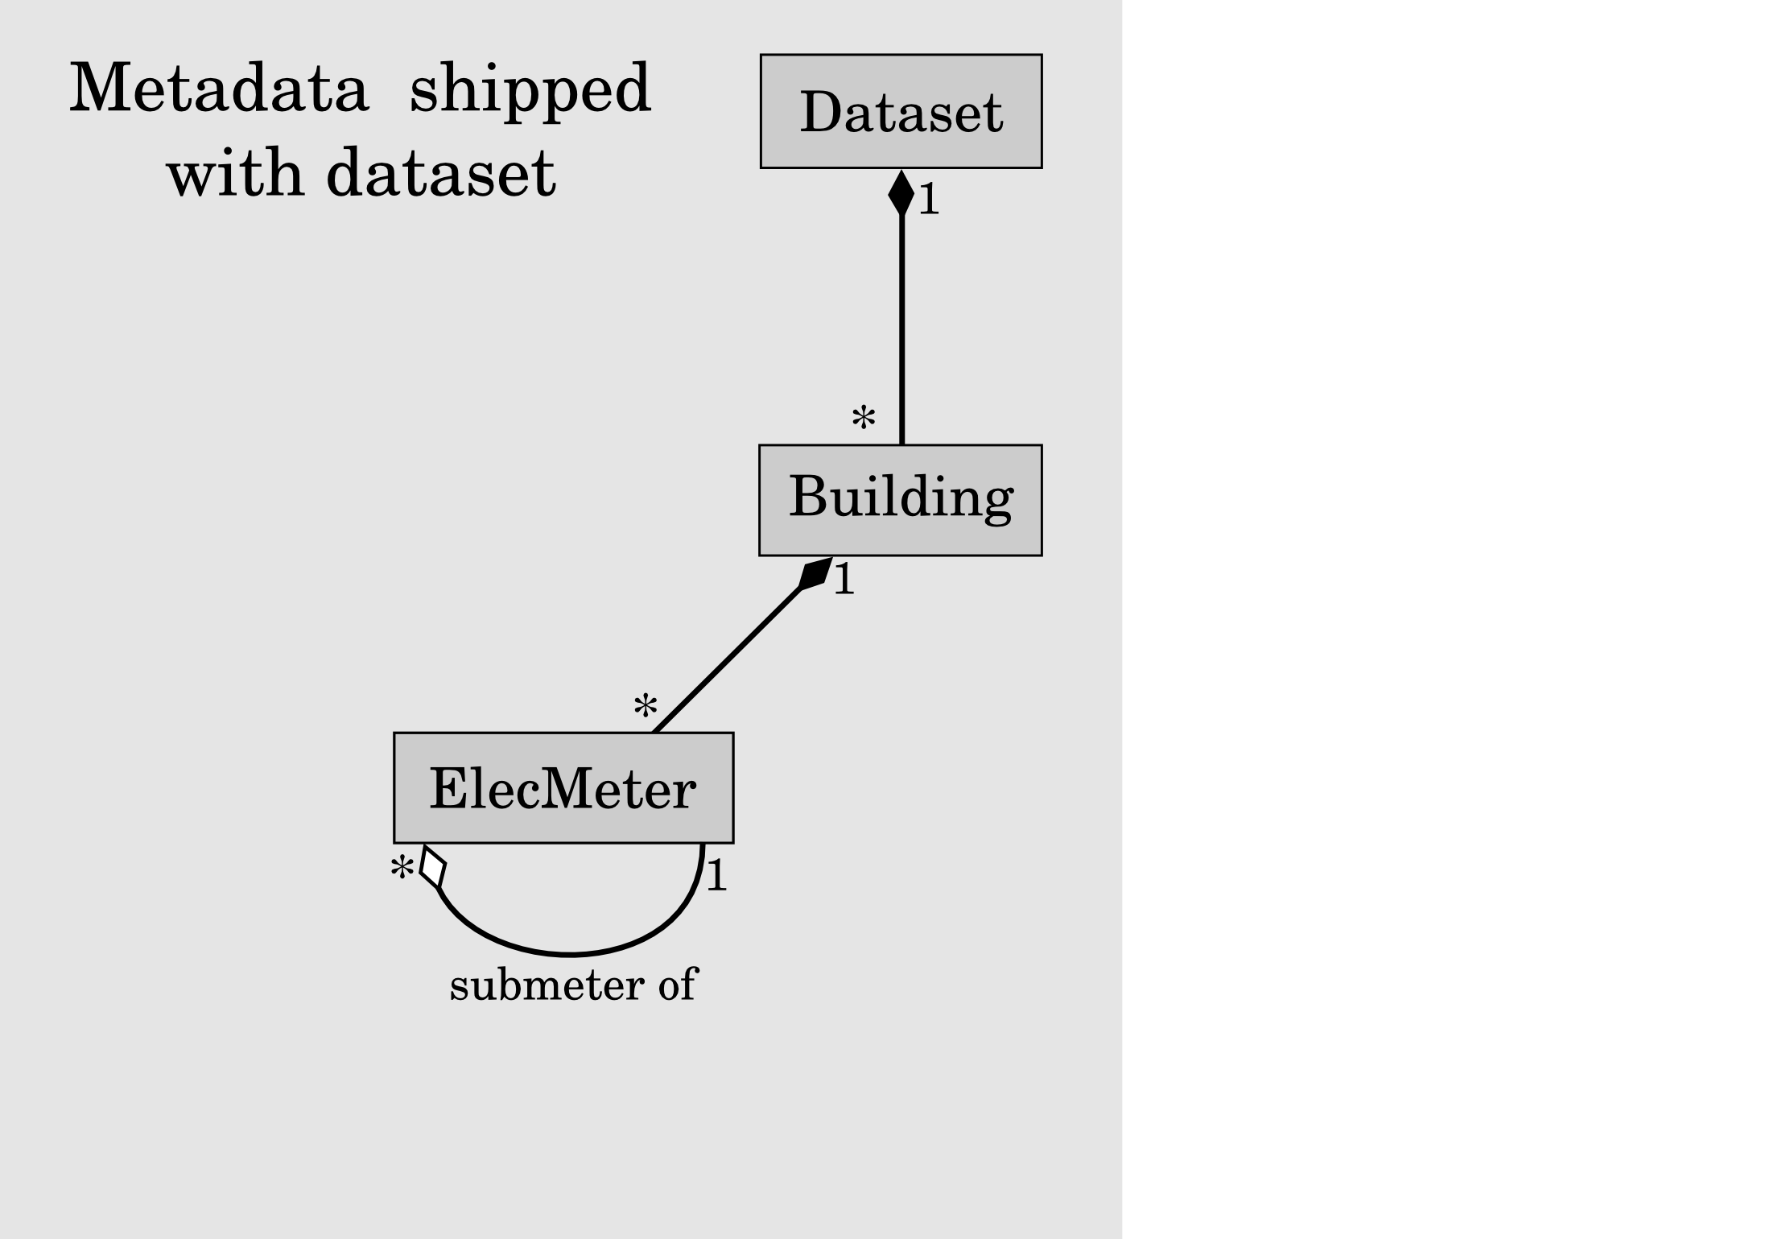

Slide 35
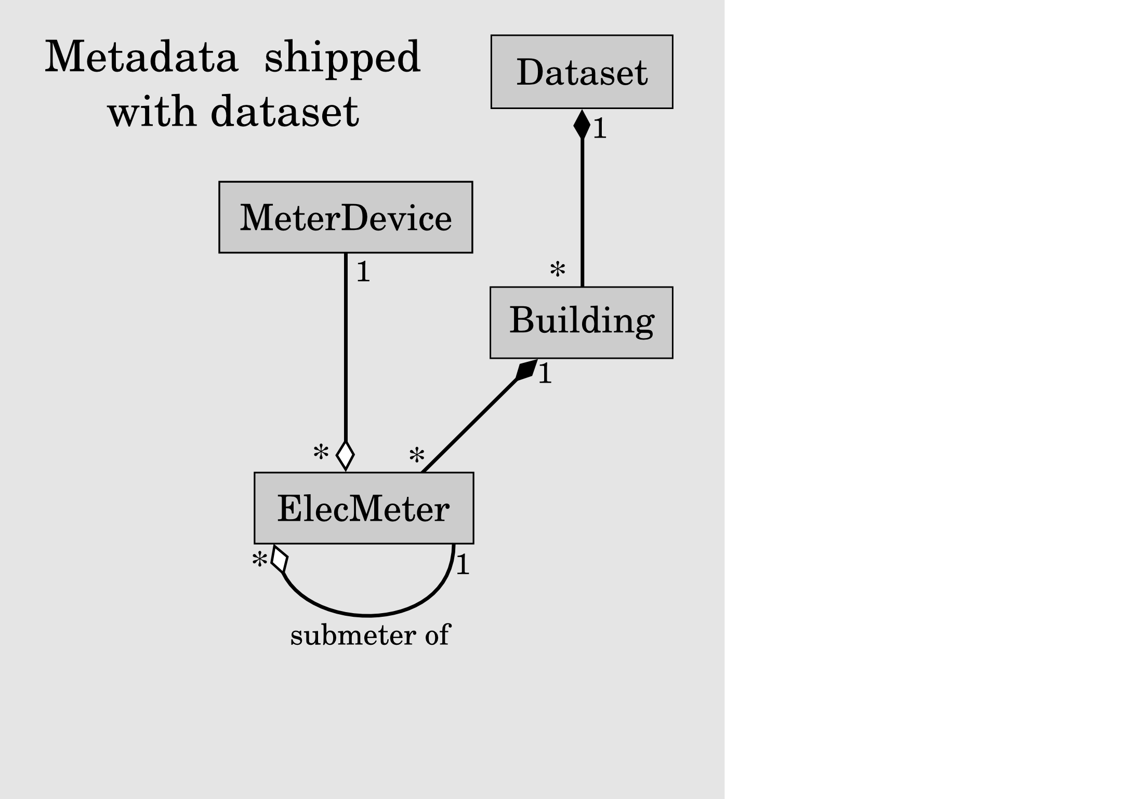

Slide 36
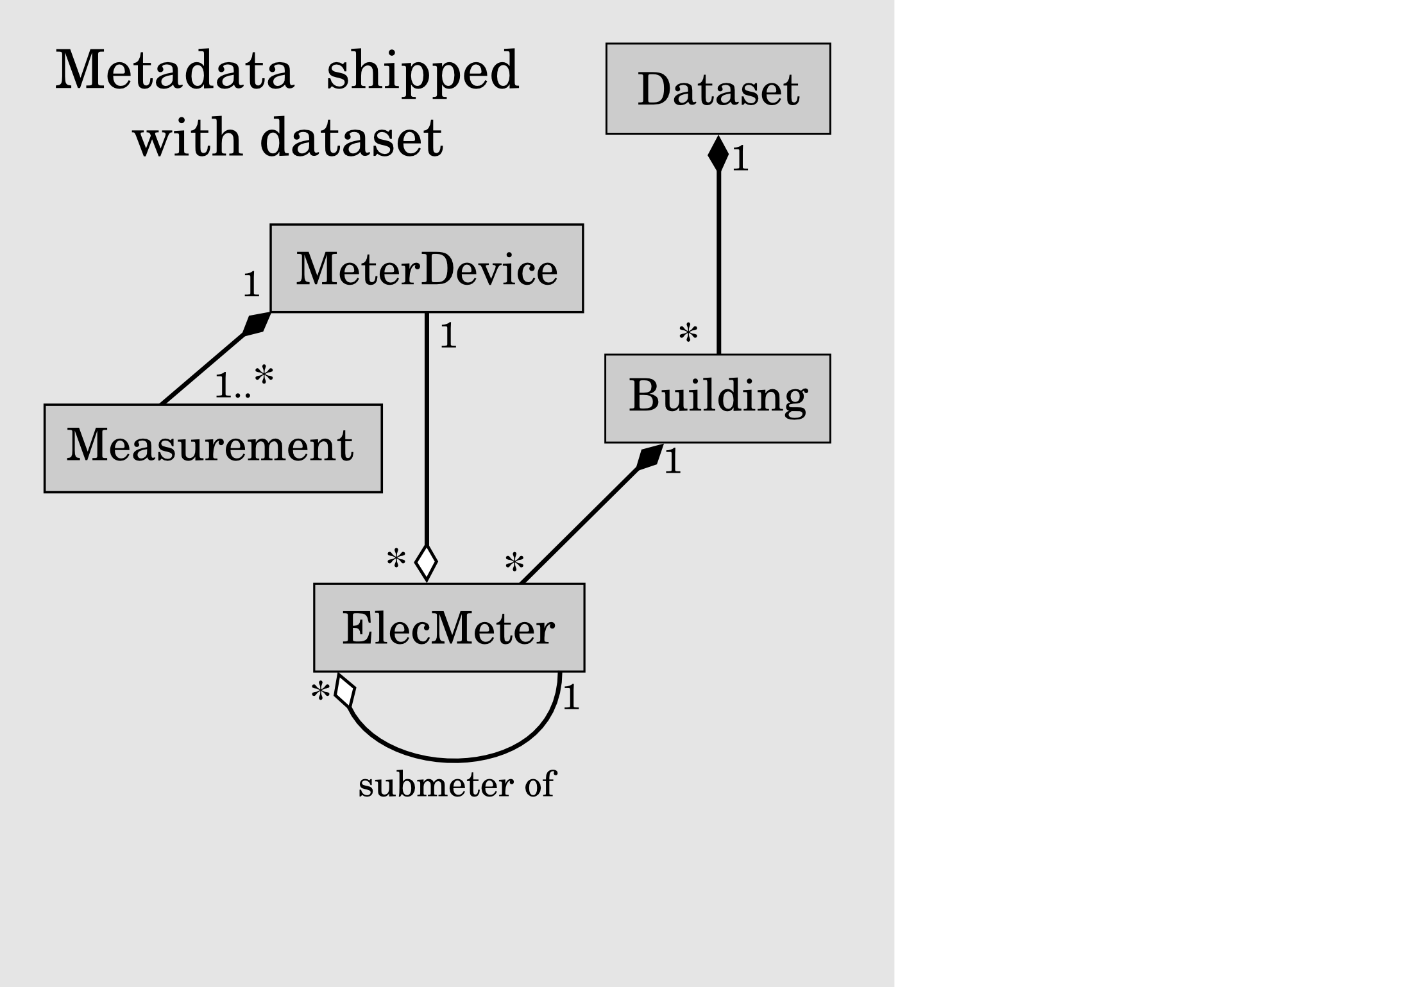

Slide 37
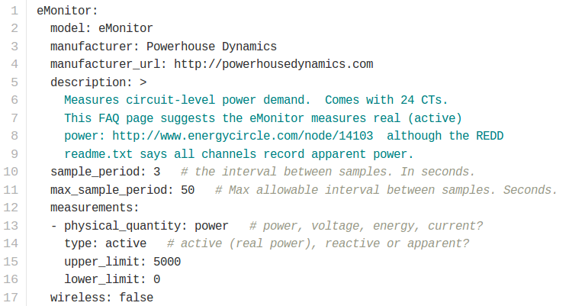
meter_devices.yaml

Slide 38
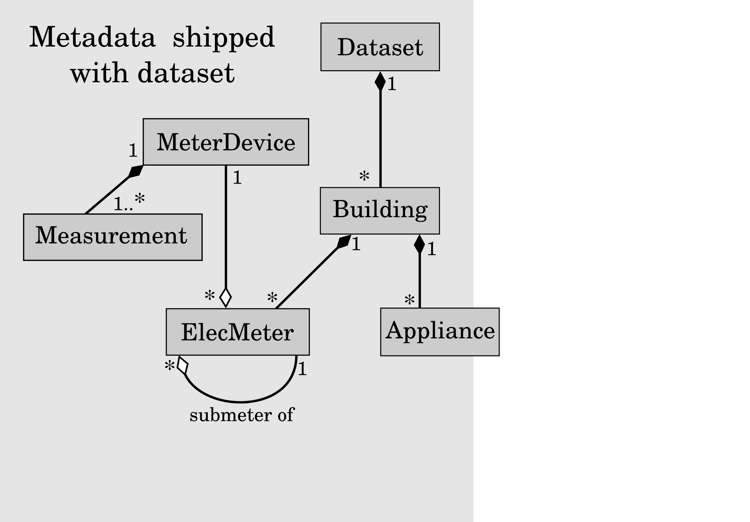

Slide 39
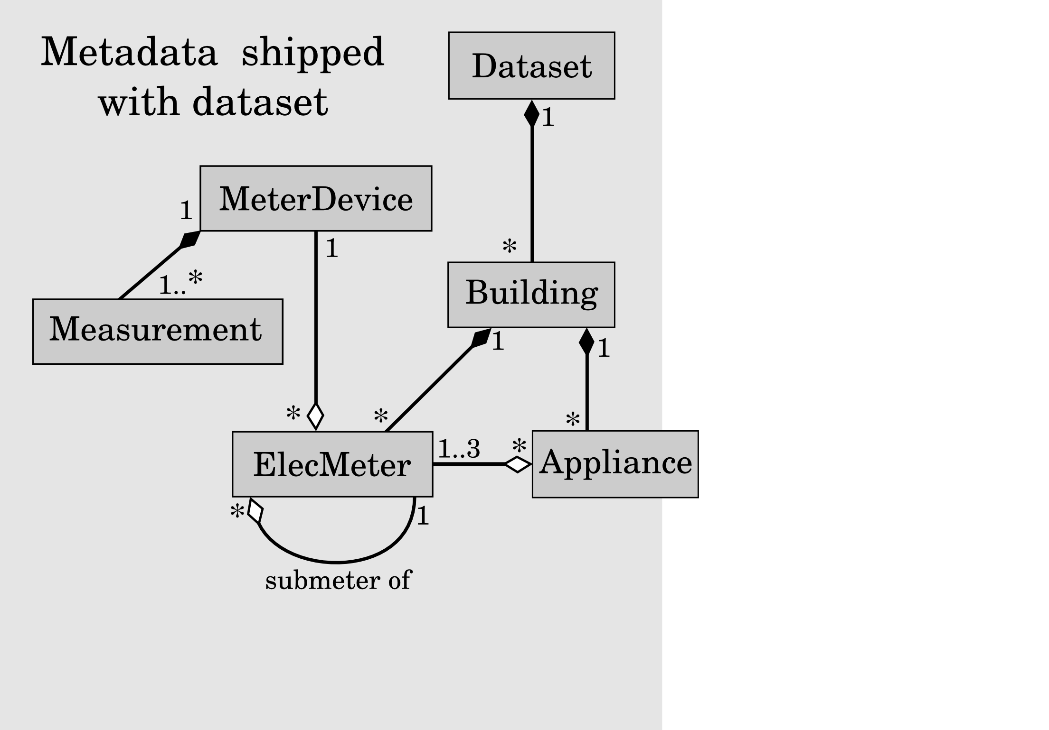

Slide 40
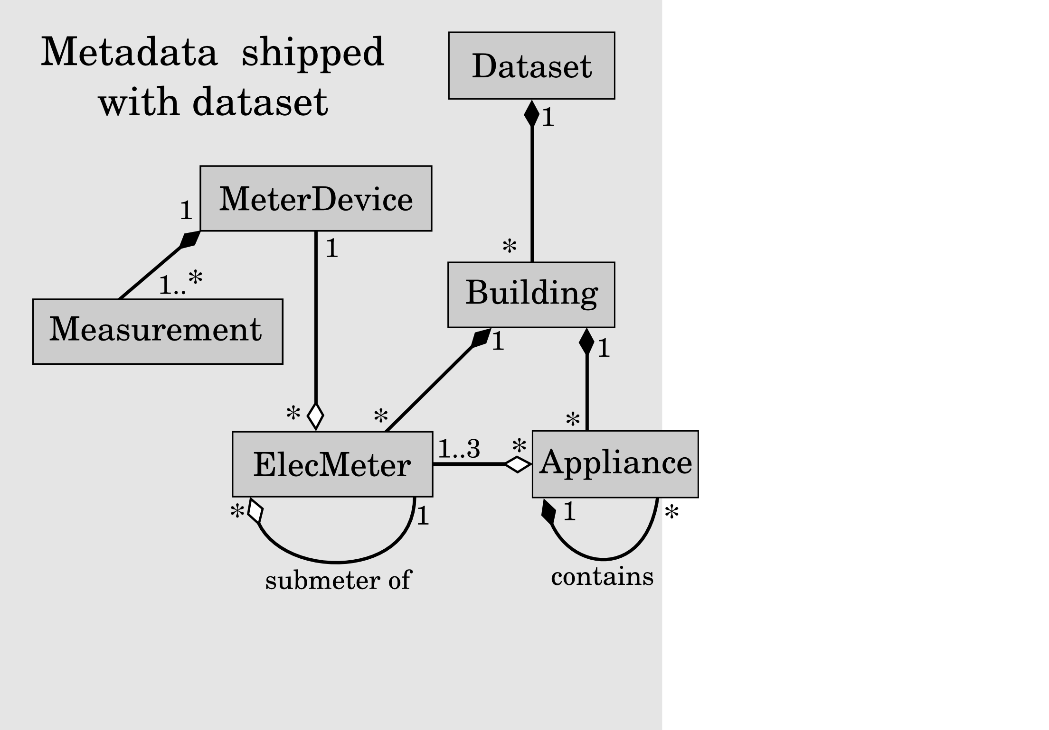

Slide 41
Example of an appliance containing other 'appliances'
# building1.yaml
appliances:
- type: washer dryer
instance: 1
meters: [10, 20]
components:
- type: motor
meters: [10]
- type: electric heating element
meters: [20]

Slide 42
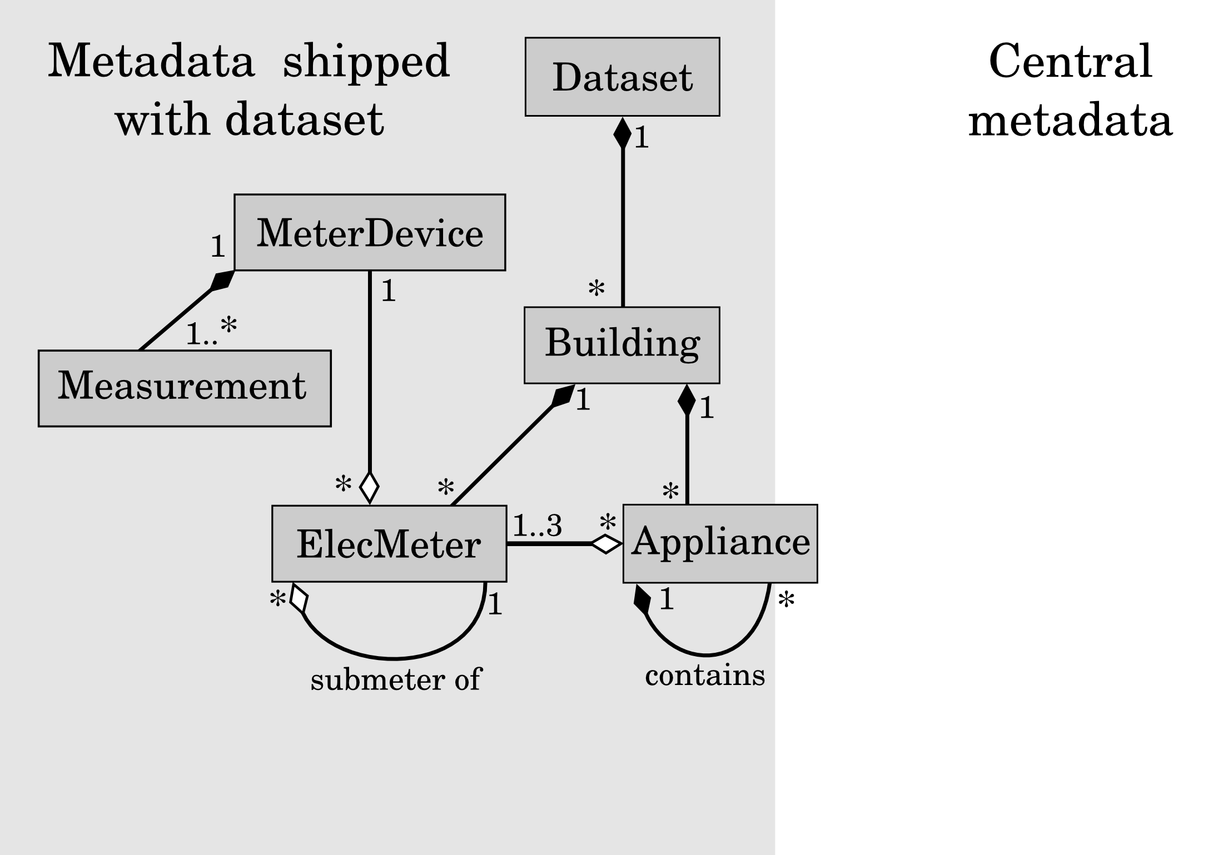

Slide 43
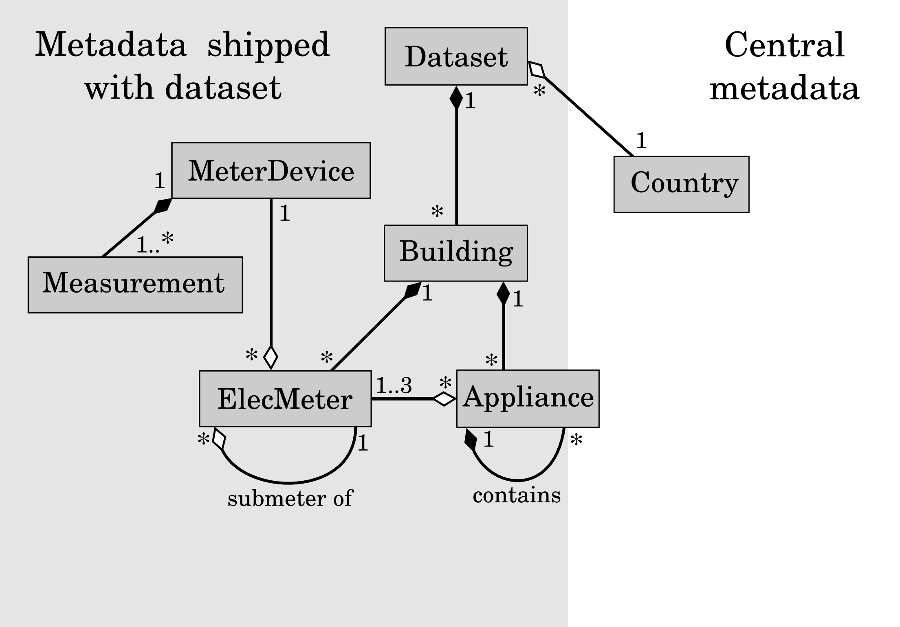

Slide 44
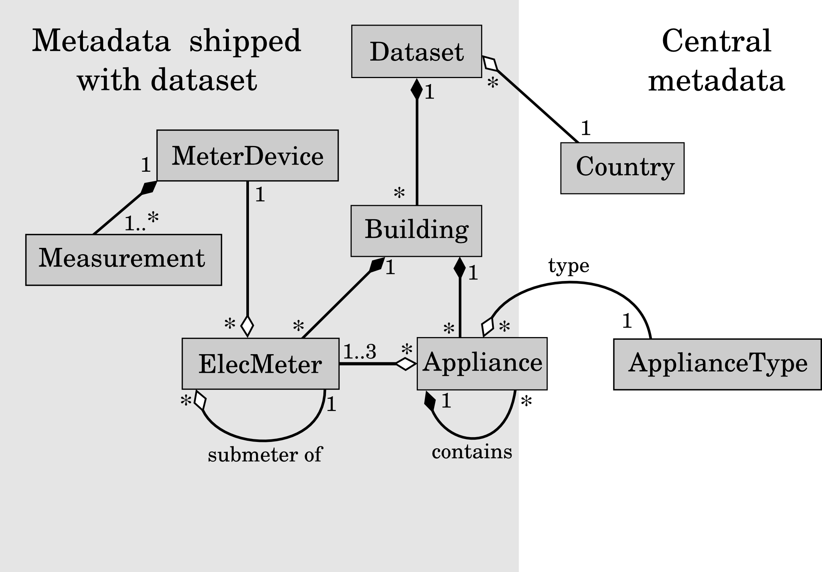

Slide 45
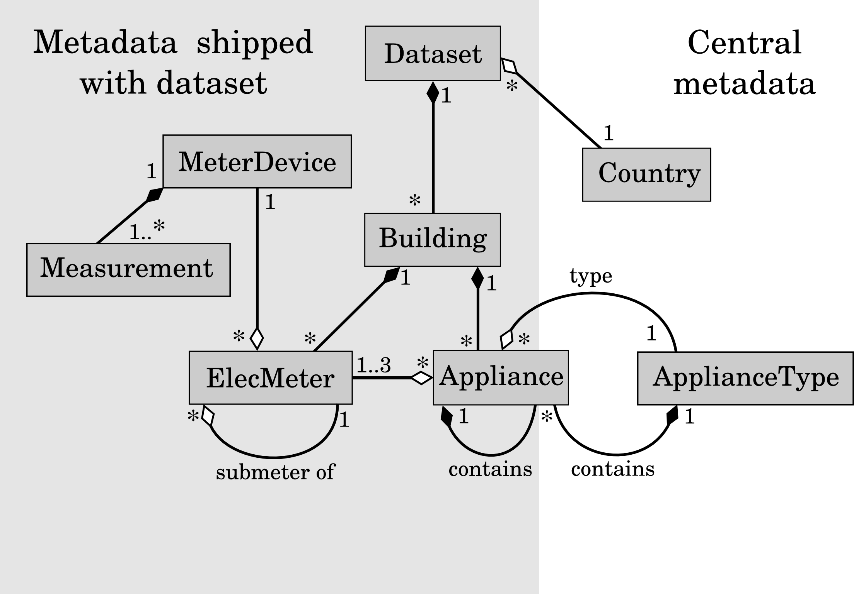

Slide 46
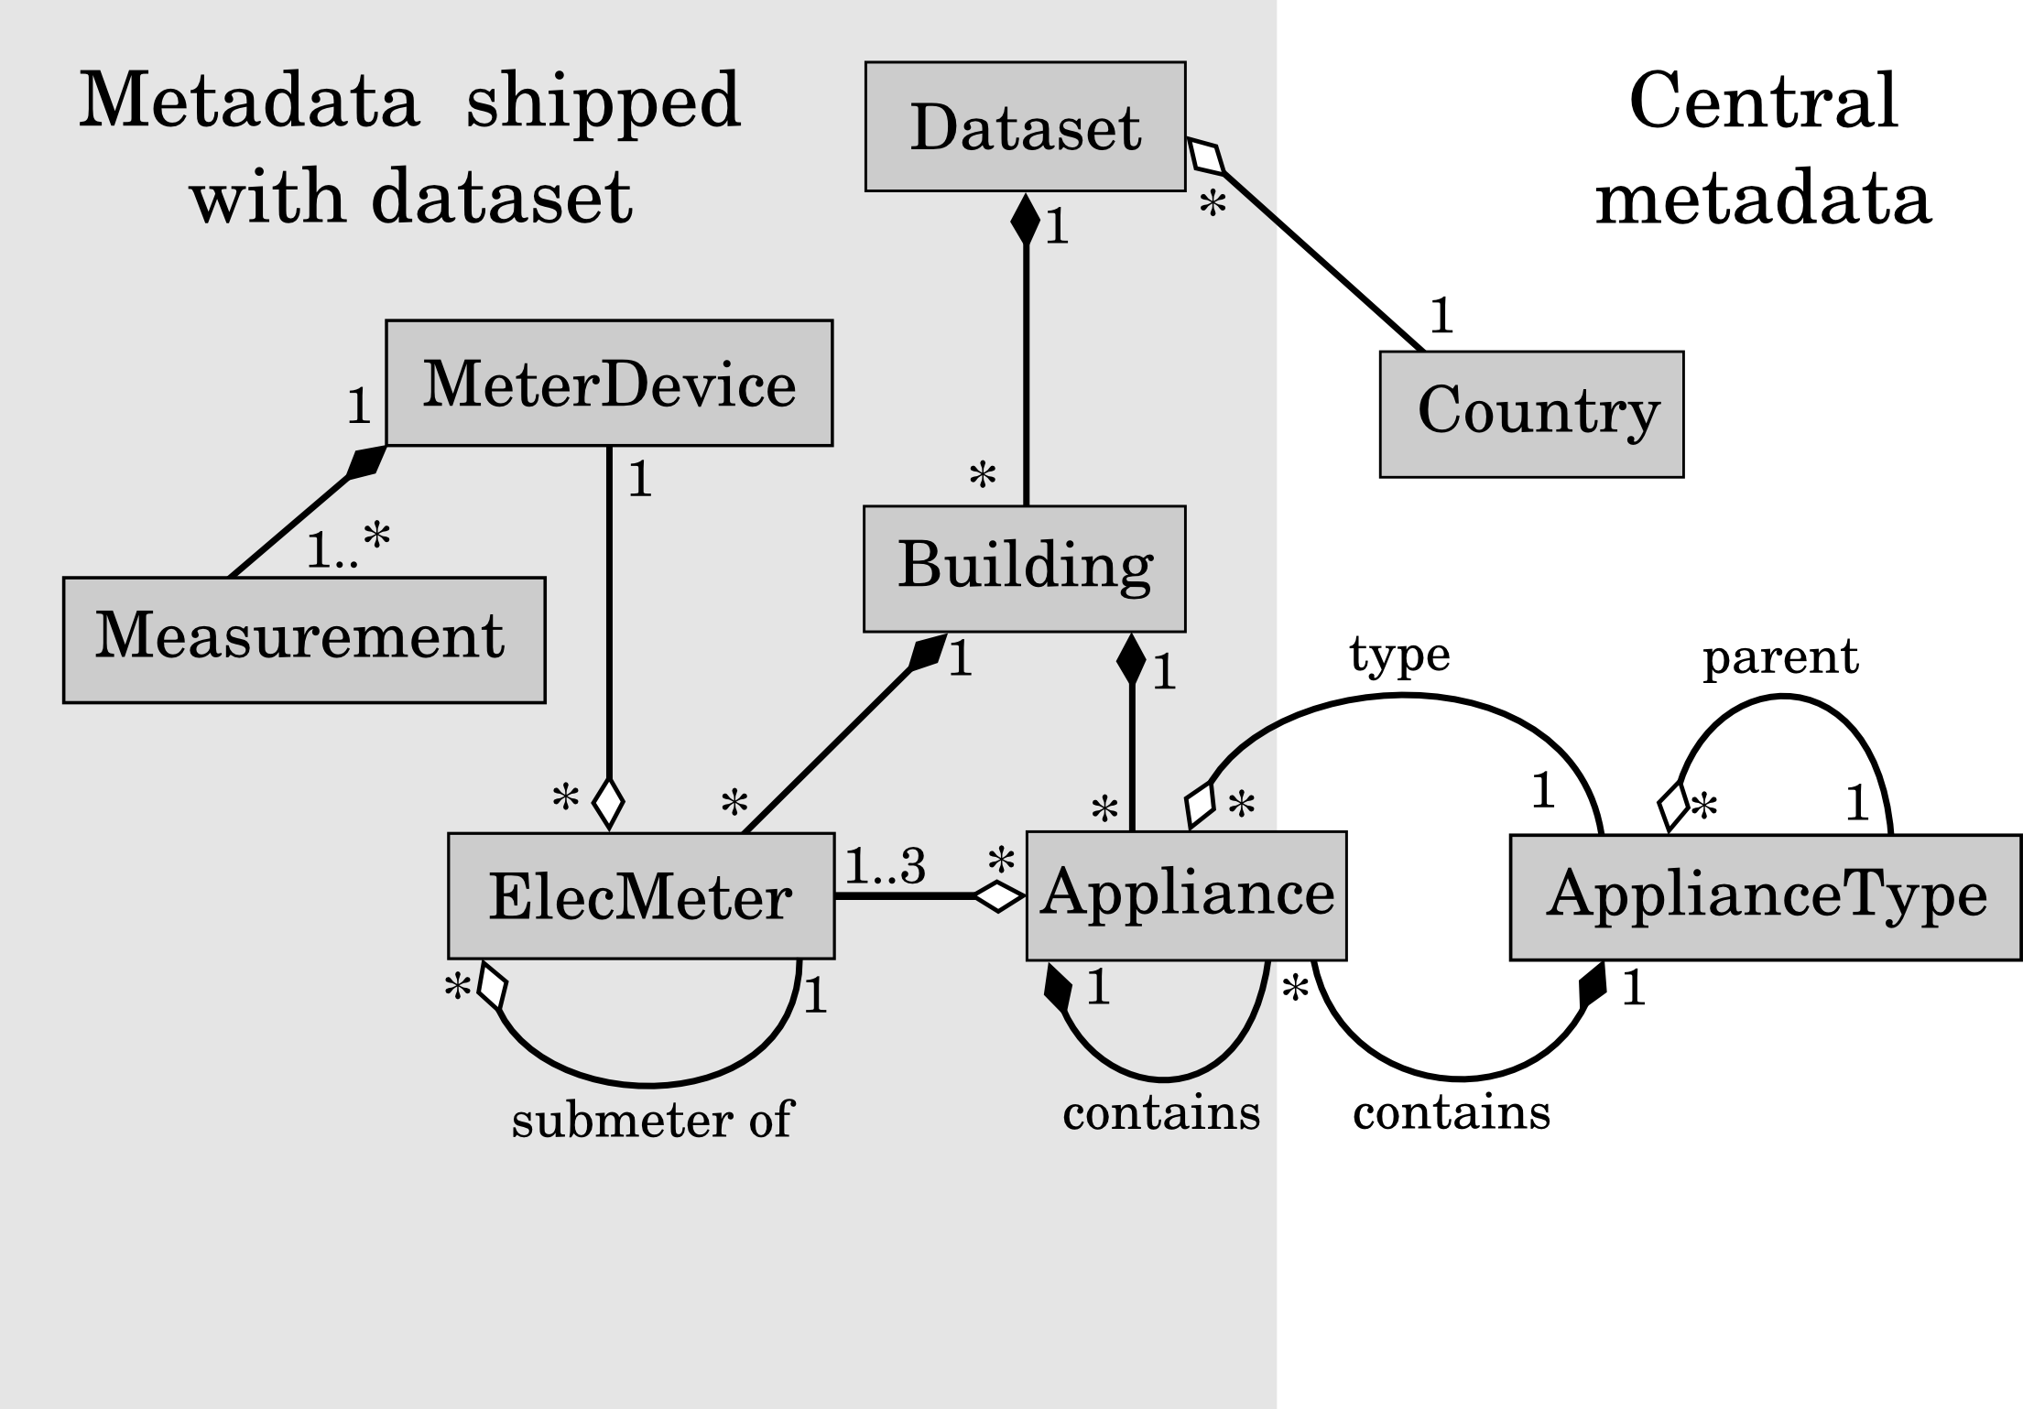

Slide 47
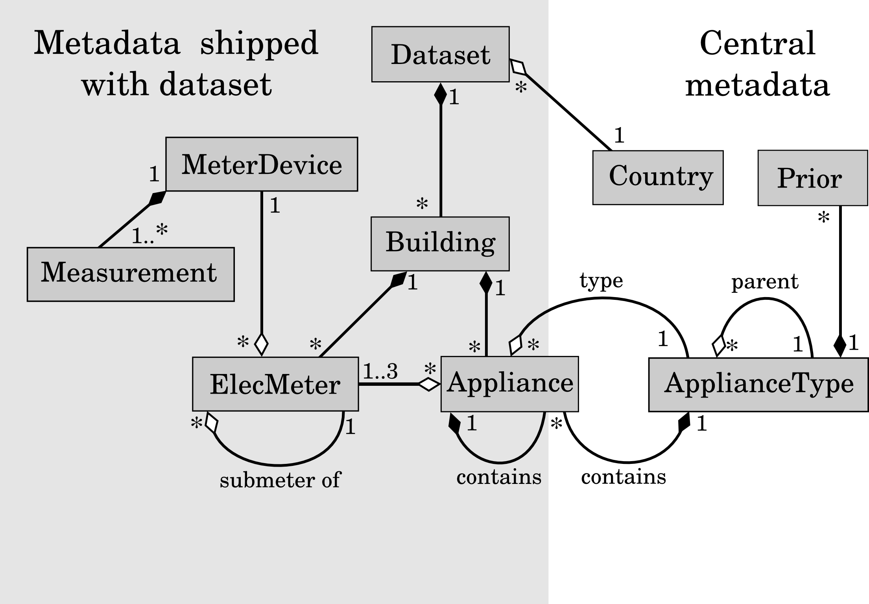

Slide 48
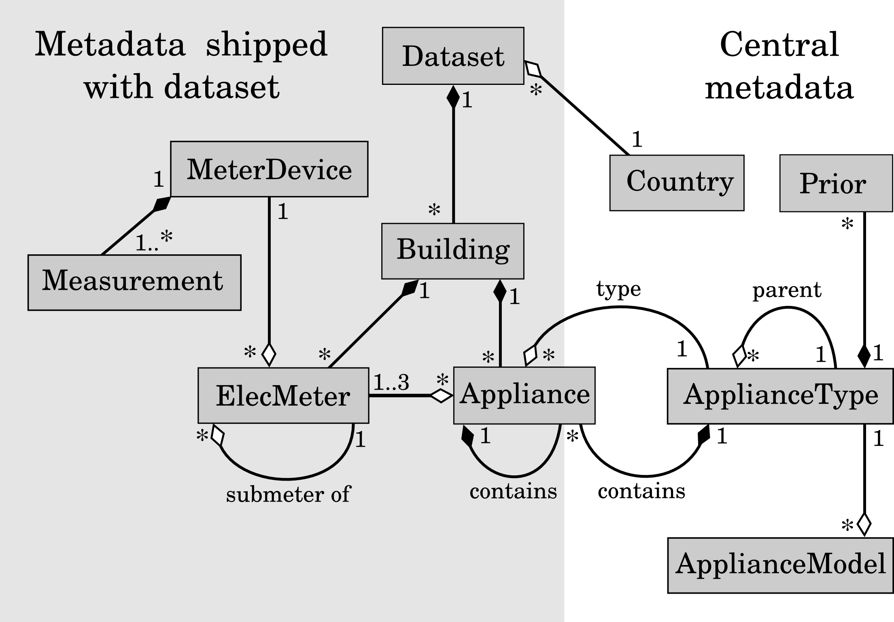

Slide 49
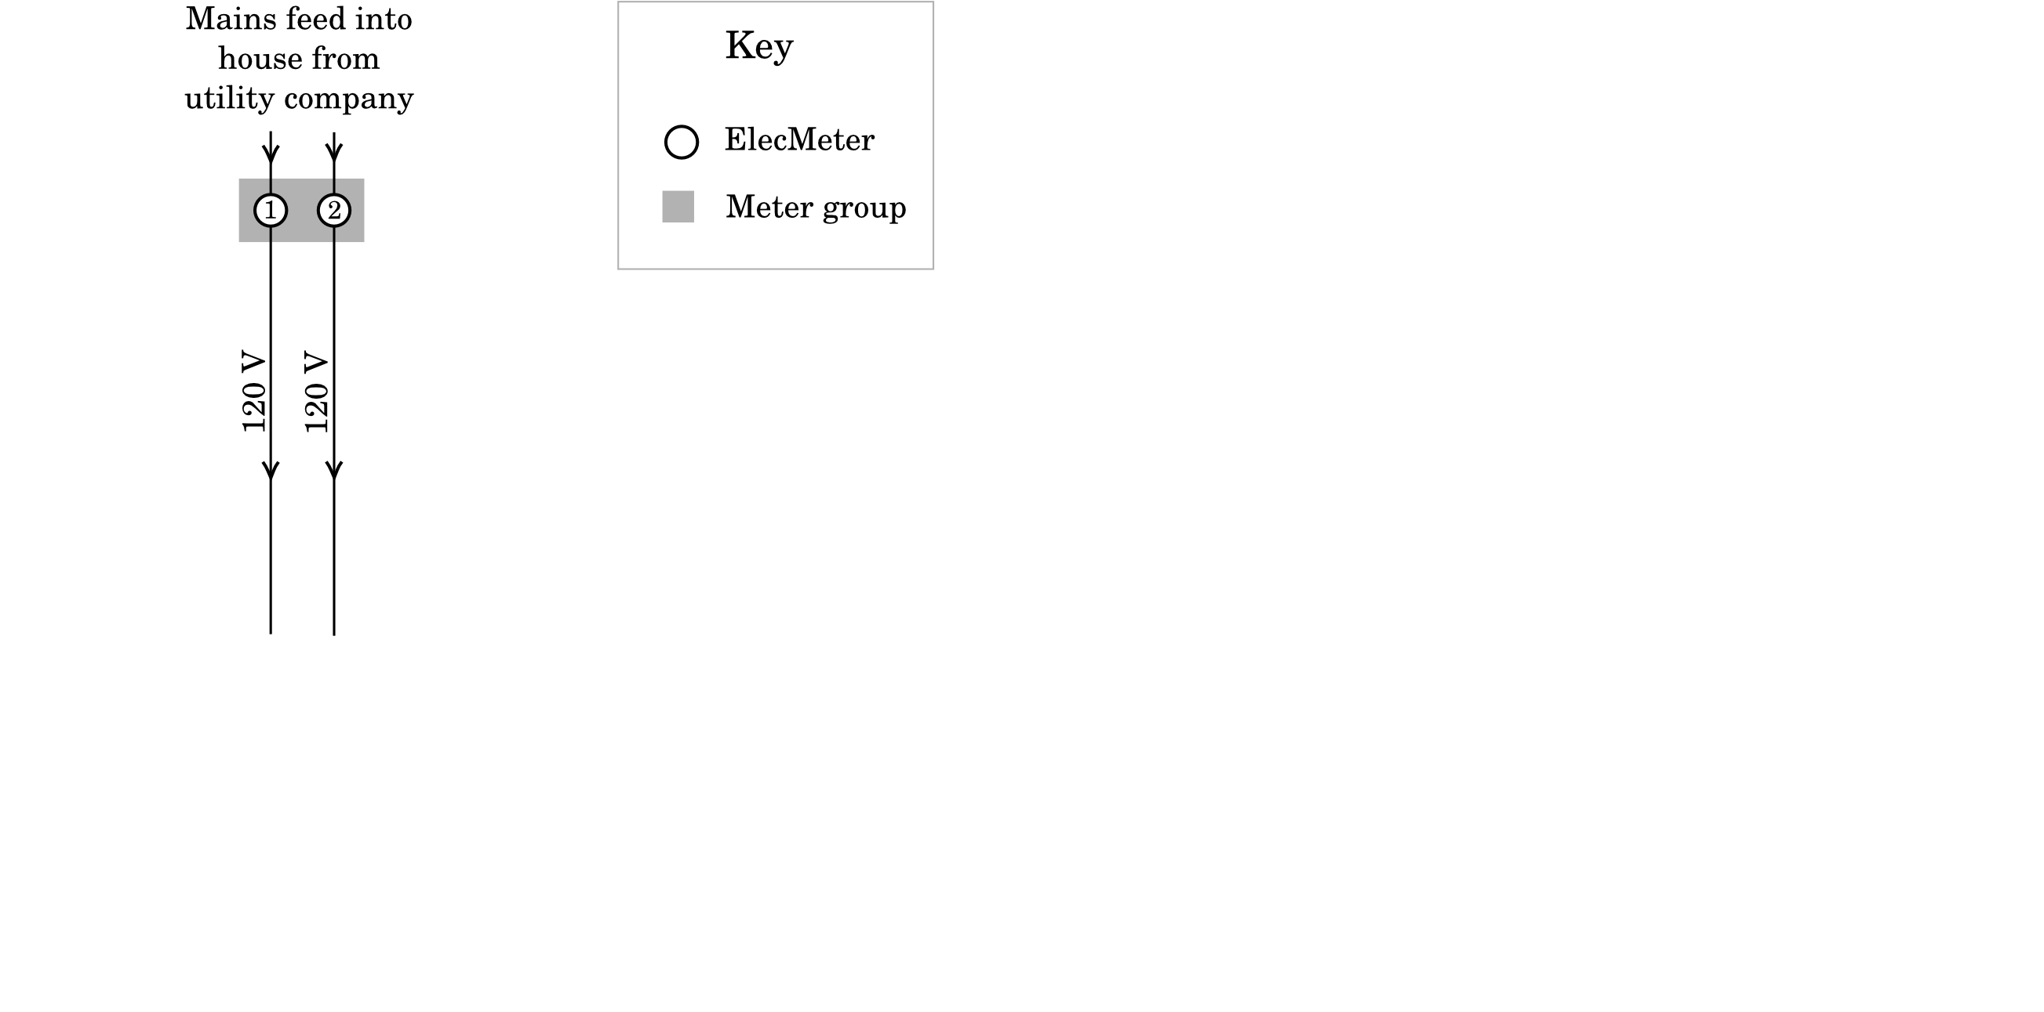
Example of dataset metadata

Slide 50
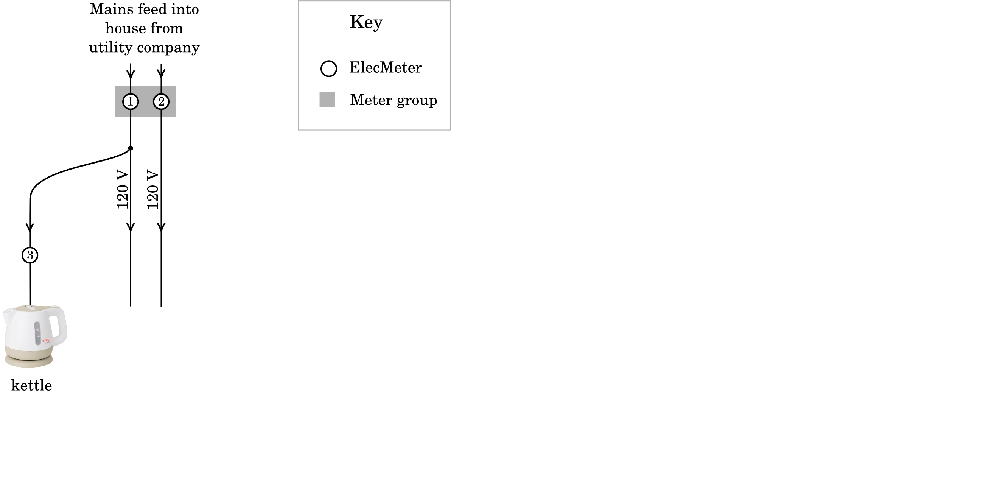
Example of dataset metadata

Slide 51
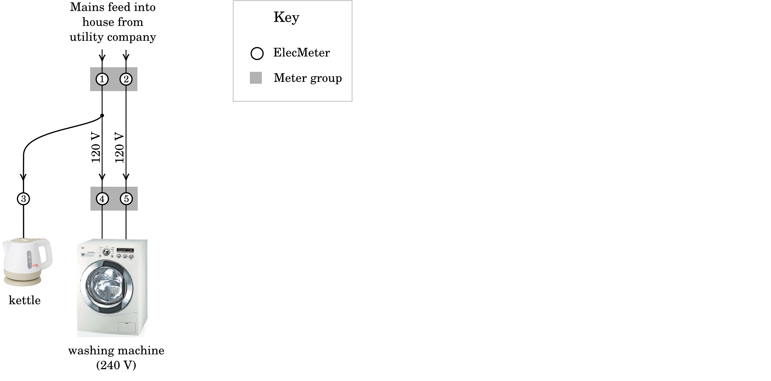
Example of dataset metadata

Slide 52
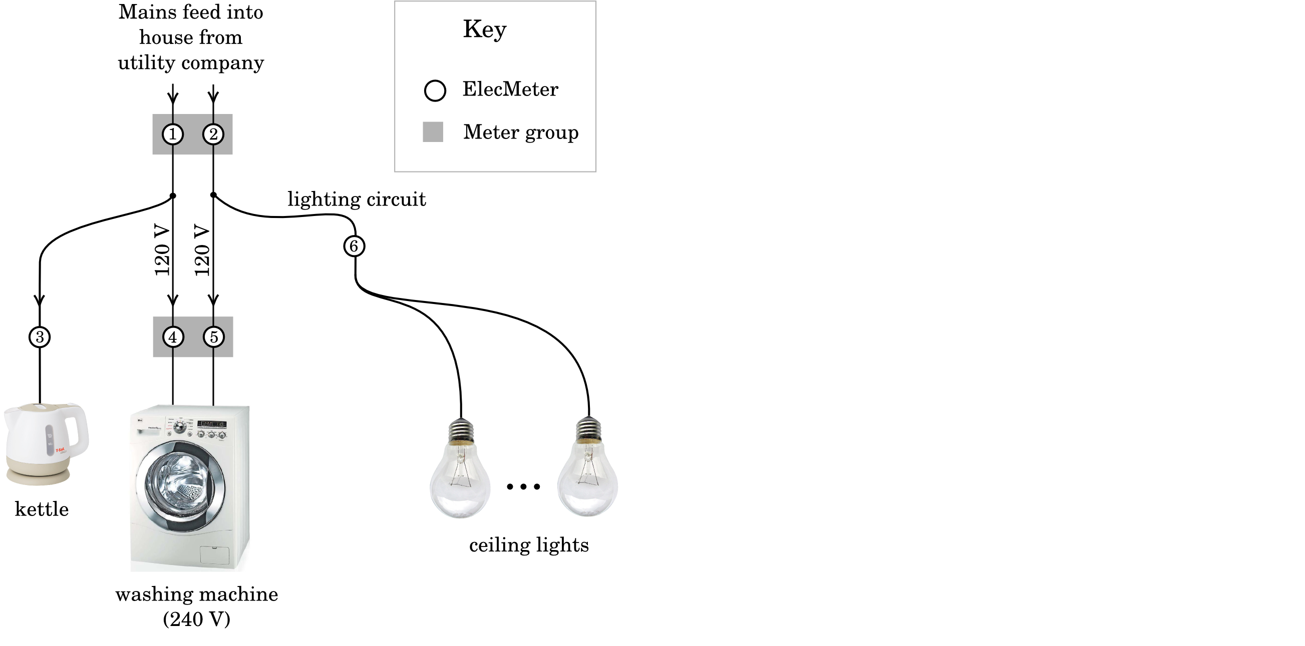
Example of dataset metadata

Slide 53
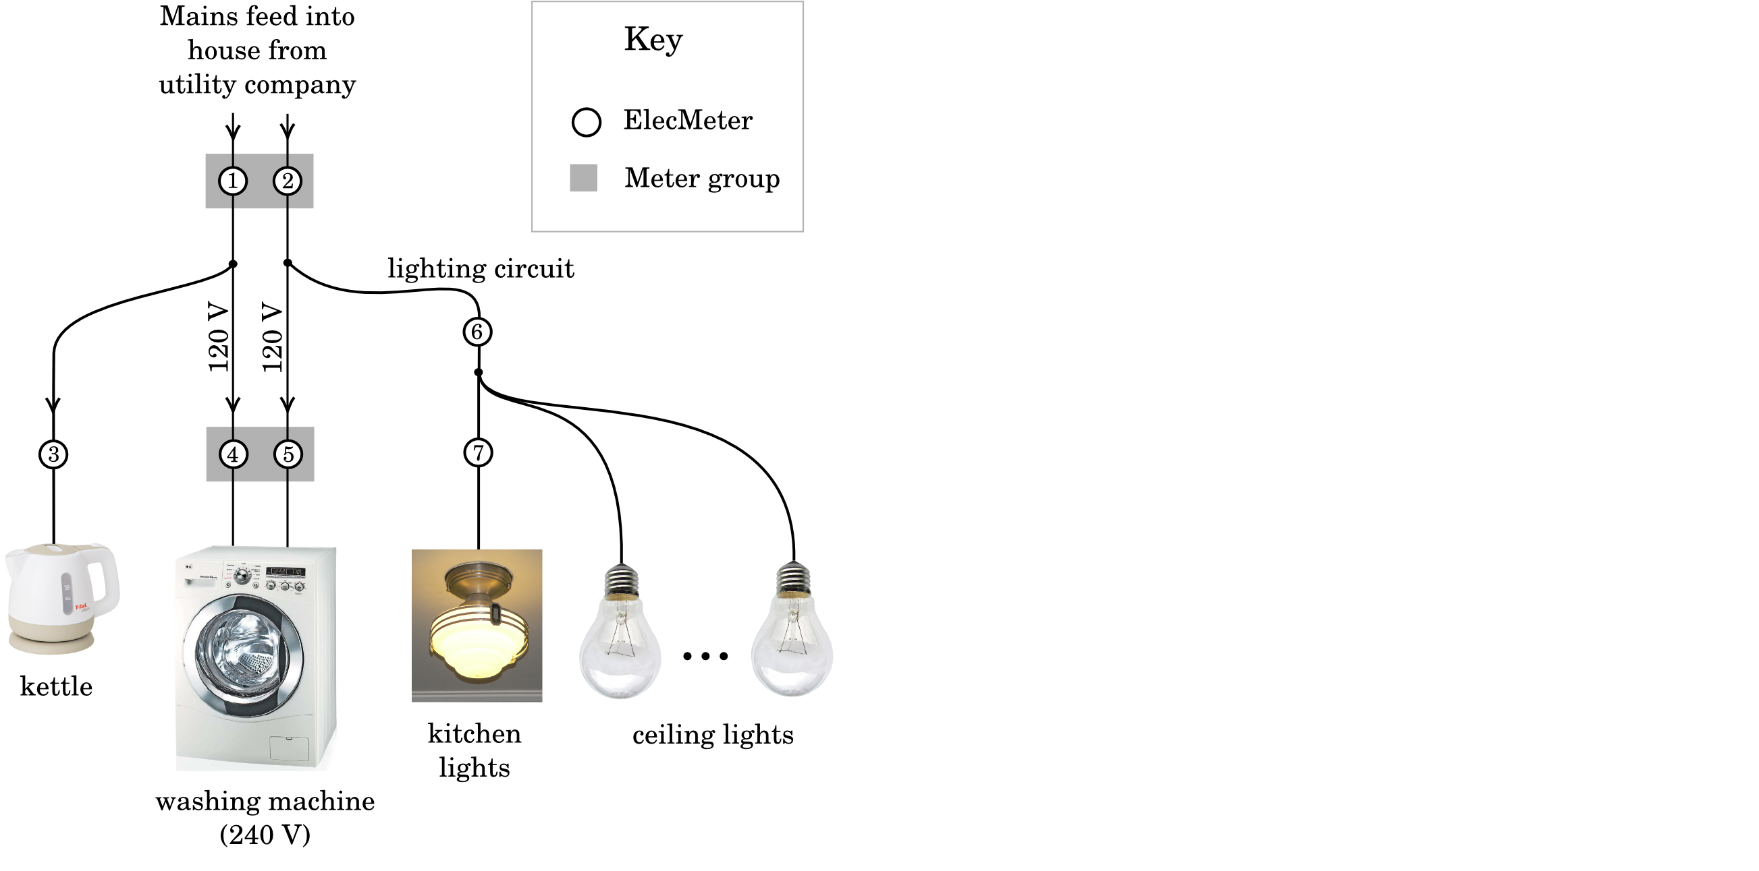
Example of dataset metadata

Slide 54
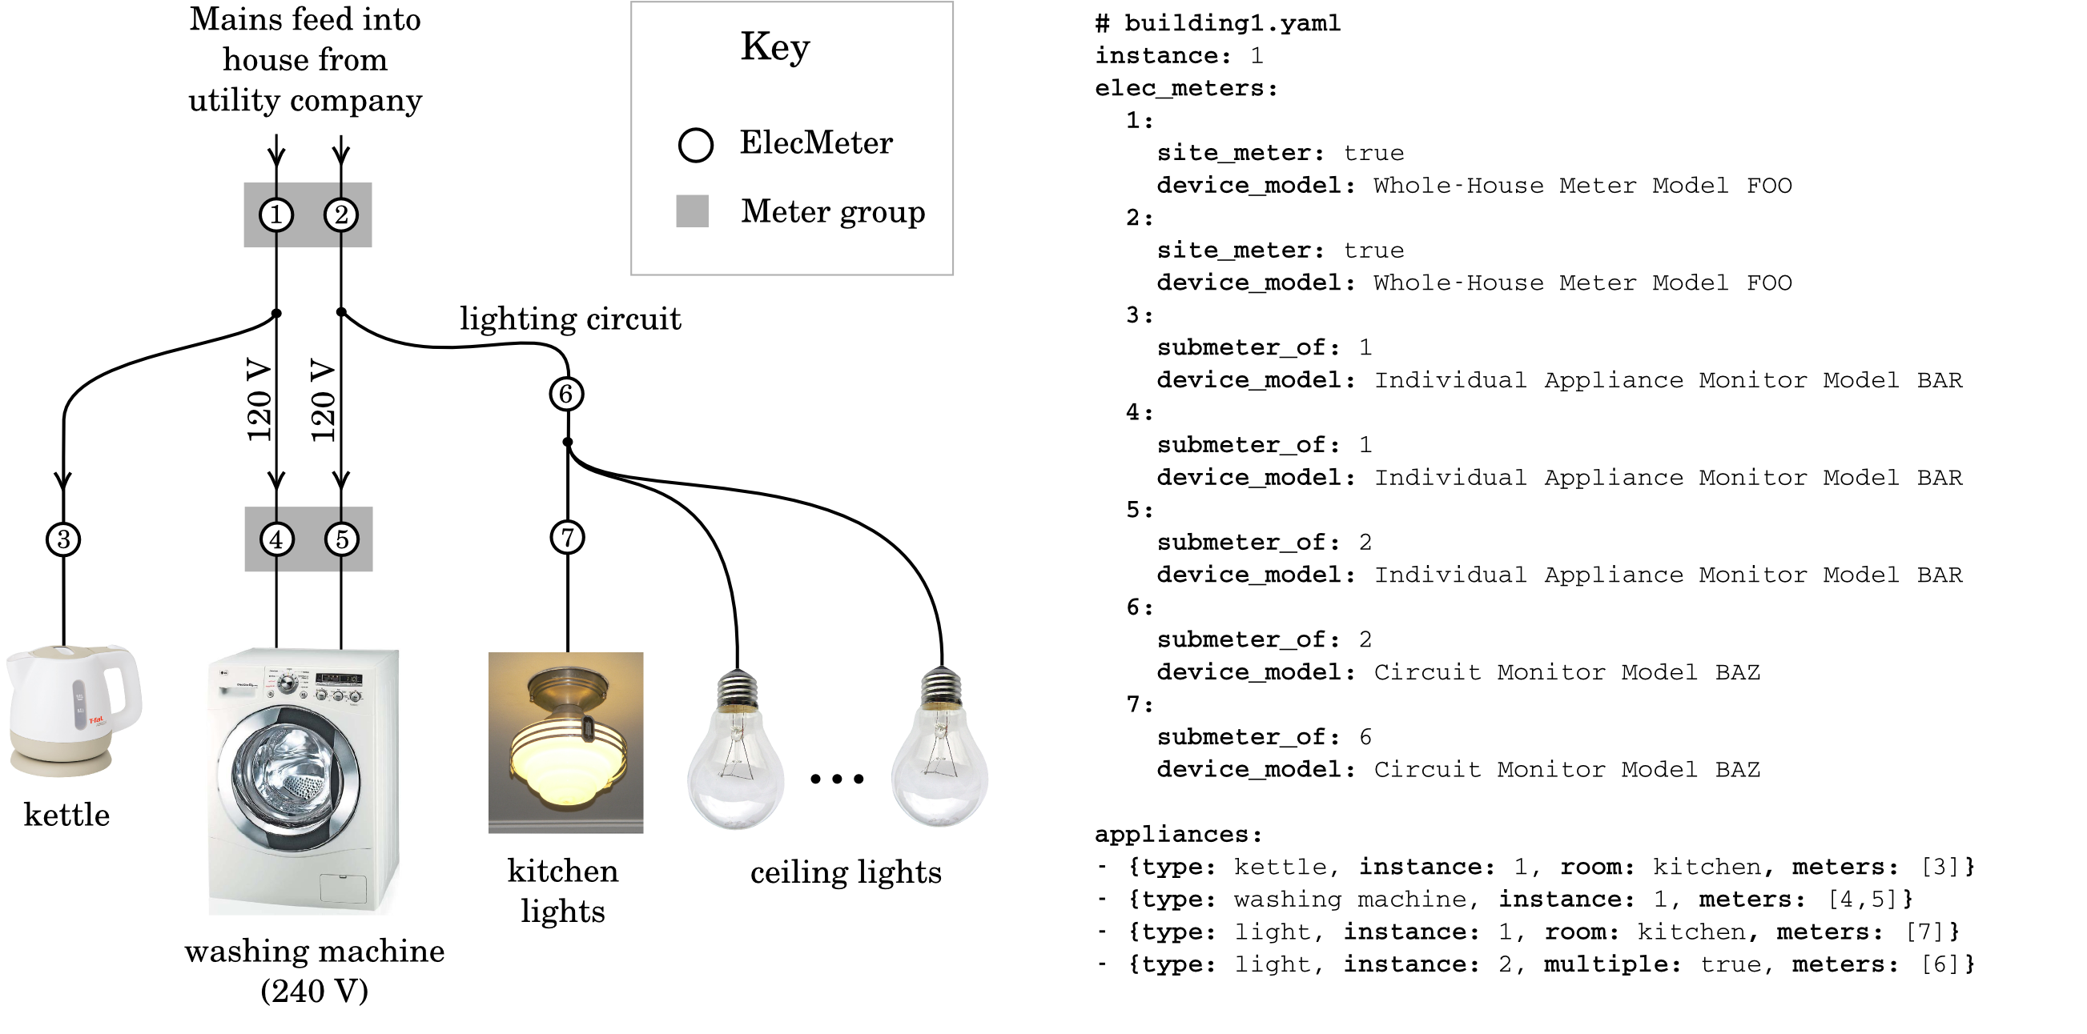
Example of dataset metadata

Slide 55
Example of dataset metadata

Slide 56
Example of dataset metadata

Slide 57
Example of dataset metadata

Slide 58
Example of dataset metadata

Slide 59
Example of dataset metadata

Slide 60
Example of dataset metadata

Slide 61
Example of dataset metadata

Slide 62
Example of dataset metadata

Slide 63
Example of dataset metadata

Slide 64
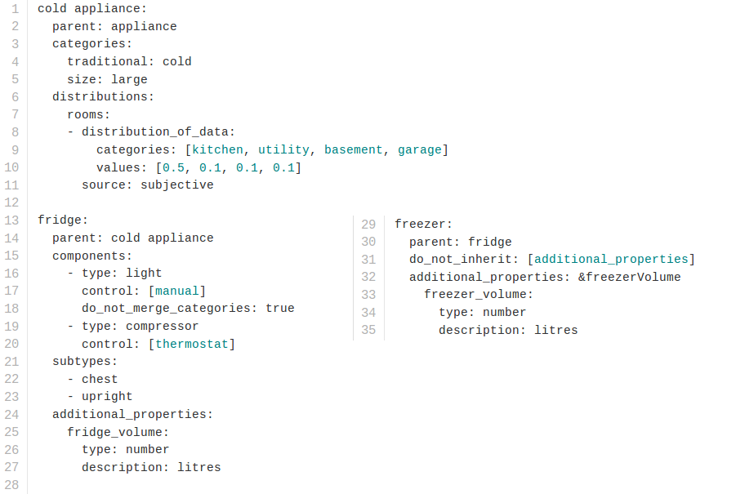
Example of central metadata

Slide 65
Currently missing from NILM Metadata
Wizard
Validator
Micro generation
Minimal version of schema

Slide 66
NILMTK's Architecture

Slide 67
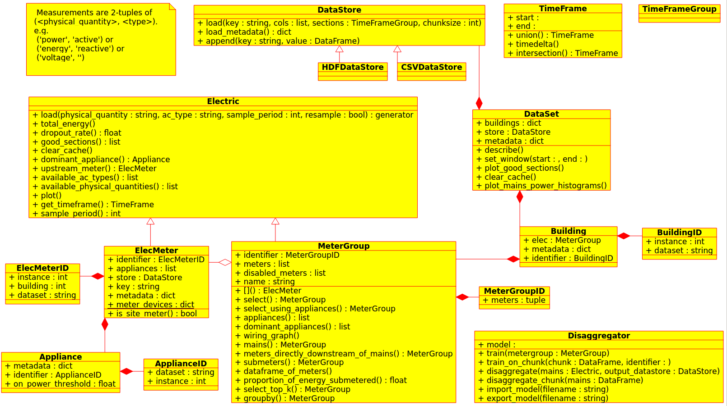

Slide 69
keys are of the form '/building1/elec/meter1'

Slide 77
NILMTK Roadmap
Write more docs(!)
More disaggregation algorithms:
  Grow from simple benchmark algos to state of the art algos
Long term: grow beyond being 'just' a research tool: become an open-source disaggregation tool for end-users & web applications

Slide 78
NILMTK Questions
Too monolithic? More 'unix philosophy' required?
Do we need to handle datasets too large to fit into mem? Modern machines have >=16GB of RAM.

