Slide 1


Slide 2
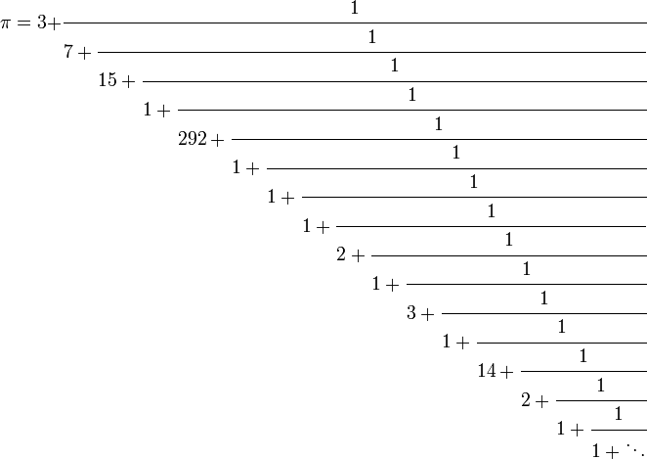

Slide 3
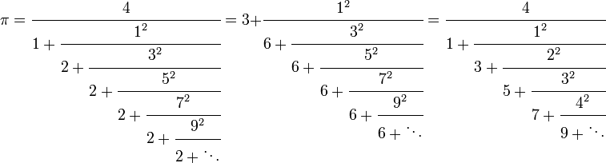

Slide 4
(0;1,1,1,1…)=.618…
1；1，1，…）=1.618。。。。

Slide 5
Normalized
representation of an irrational number is unique. (but not as simple as a division)

Slide 6
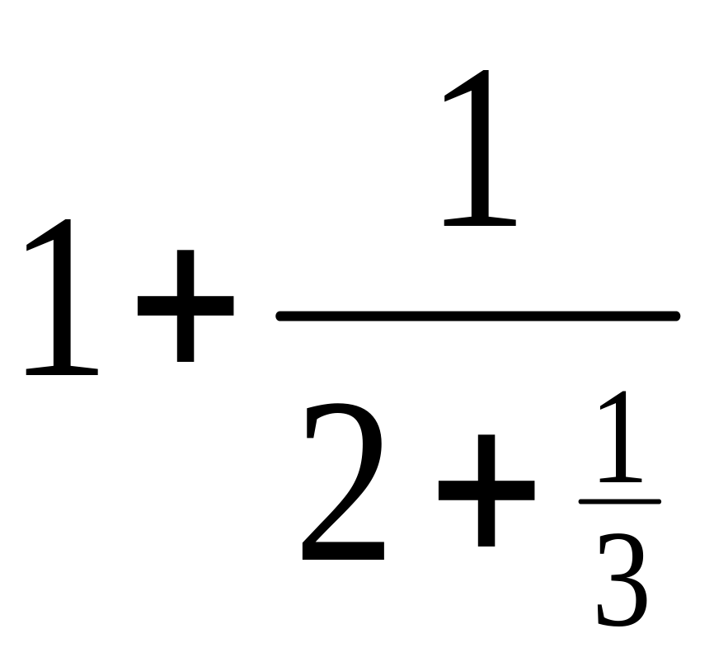
Convert a Fraction to Standard CF
10/7
  10/7=1…3
  7/3=2…1
  3/1=3…0
  =[1;2,3]

Slide 7
For Pi
  a0=3
  u1=[1/(pi-a0)]≈[7.0625], a1=7
  u2=[1/(u1-a1)] ≈ 15.9965, a2=15
  …
[3;7,15,1,292,1,1,…]

Slide 8
The continued fraction representation
finite if and only if the number is rational.

Slide 9
repeat if and only if it is of a quadratic irrational
  [1; 1, 1, 1, ...]=(sqrt(5)+1)/2
  [1; 2, 2, 2, ...]=sqrt(2)

Slide 10
Truncate
Truncating yields a rational approximation which is in a certain sense the best possible
  1/7 = 0.142857... at various places yields approximations such as 142/1000, 14/100, and 1/10.
  But clearly the best rational approximation is "1/7" itself

Slide 11
Truncate Pi
Truncating 3.1415926…
  31415/10000, 314/100.
The continued fraction representation of π [3; 7, 15, 1, 292, ...].
  3, 22/7, 333/106, 355/113, 103993/33102
The denominators of 314/100 and 333/106 are almost the same
  but the error is nineteen times as.
[3; 7, 15, 1] is more than one hundred times more accurate than 3.1416

Slide 12
 | Continued Fraction | Decimal
Neutrality to Radix
Shorter/Precision
Unique | For rational, take the shorter form For irrational, always unique | For rational, unique For irrational, .xxx9
Operation | 1/x, X vs Y | X+y

Slide 13
Operations

Slide 14
Reciprocal
The reciprocal of a positive (a0;a1;a2;。。。）
  (0;a0;a1;a2…), when a0>0
  (a1;a2;a3…), when a0=0

Slide 15
Comparison
static public int Compare(ContinuedFraction a, ContinuedFraction b)
{
if (a.floor > b.floor)
{
return 1;
}
if (a.floor < b.floor)
{
return -1;
}
if (a.denominatorFloors.Length<b.denominatorFloors.Length)
{
return -_compareDenominatorsLongToShort(ref b, ref a);
}
return _compareDenominatorsLongToShort(ref a, ref b);
}

Slide 16
static private int _compareDenominatorsLongToShort(ref ContinuedFraction a, ref ContinuedFraction b)
{
bool numeratorAlternated = false;
for (uint i = 0; i < a.denominatorFloors.Length; i++)
{
if (i < b.denominatorFloors.Length)
{
if (a[i] > b[i])
{
return numeratorAlternated ? 1 : -1;
}
if (a[i] < b[i])
{
return numeratorAlternated ? -1 : 1;
}
}
else// b[i]=+inf >a[i]
{
return numeratorAlternated ? -1 : 1;
}
numeratorAlternated = !numeratorAlternated;
}
return 0;
}

Slide 17
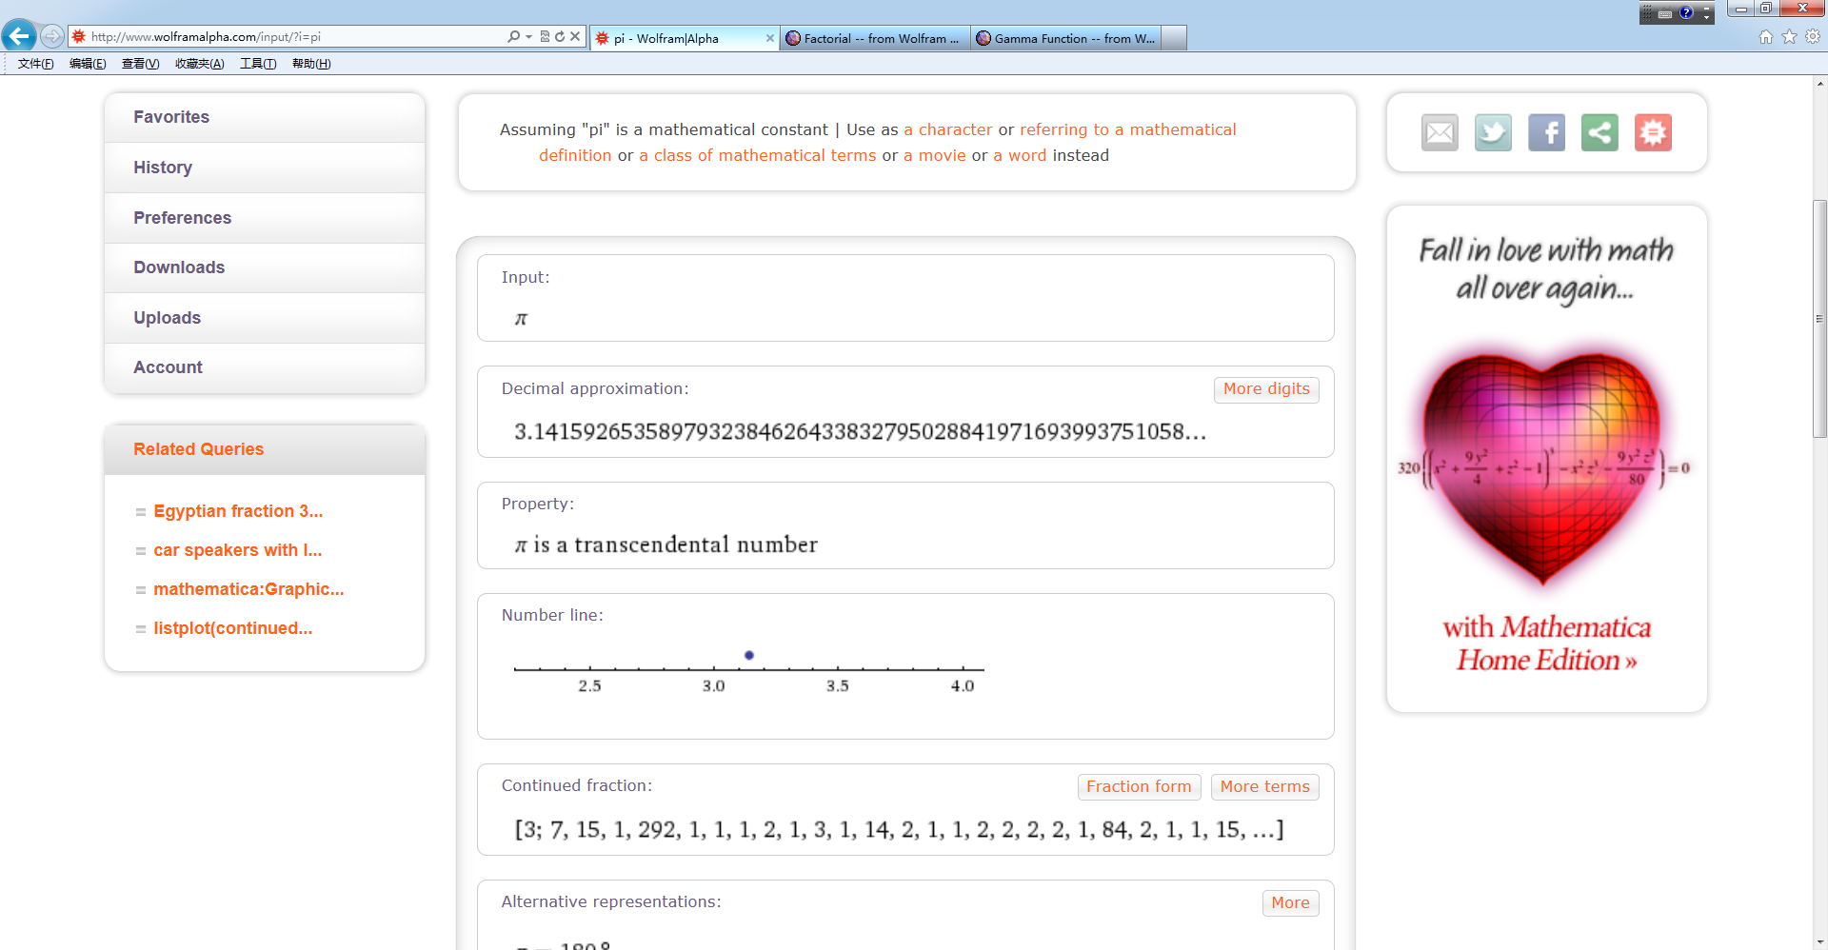

Slide 18


Slide 19
Floor
Ceiling
Truncate
  Floor for positive and ceiling for negative
Round
  Round(x,m)=round(x/m)*m
    E.g, scores are rounded by .5

Slide 20


Floor
Floor(x)=the least integer in [x,+inf)
Round towards -inf

Slide 21


Ceiling
Round towards +inf

Slide 22



Truncate
Round towards 0
0
0

Slide 23



Round
The midpoint, e.g., Round(3.5)
  =4
  =3 (depends on the preceding number)

Slide 24
round half up (or round half towards plus infinity),

Slide 25
What’s your favorite number?
3.14159265358979323846264338327950288
2.7182818…
1.414…..
.860333589…..
9801, 60481729
1024,1048576
.9973, 1.64485…, 1.9599….
Notes:
.9973=erf(3^2/sqrt(2))
Erf(1.64/sqrt(2))=.9
.95

