Slide 1
Copyright
All Rights Reserved by
wangyoutian@nilnul.com
©wangyoutian@nilnul.com

Slide 2
Notational Conventions
For Heading Slides:
  Background
    Hue: Red, Yellow, Green, Cyan, Blue, Magenta
      as in Iris
    Saturation decreases
    Brightness increases
  Color offset to Background
  Font size
    decreases
  Position
    Shifted right
Sideline slides are grey
Notes:
, the Greek goddess of the rainbow and a messenger of the gods

Slide 3
Notational Conventions
Unordered List Bullets
  Ordered by color and the bigness of colored area
  Font size decreases

Slide 4
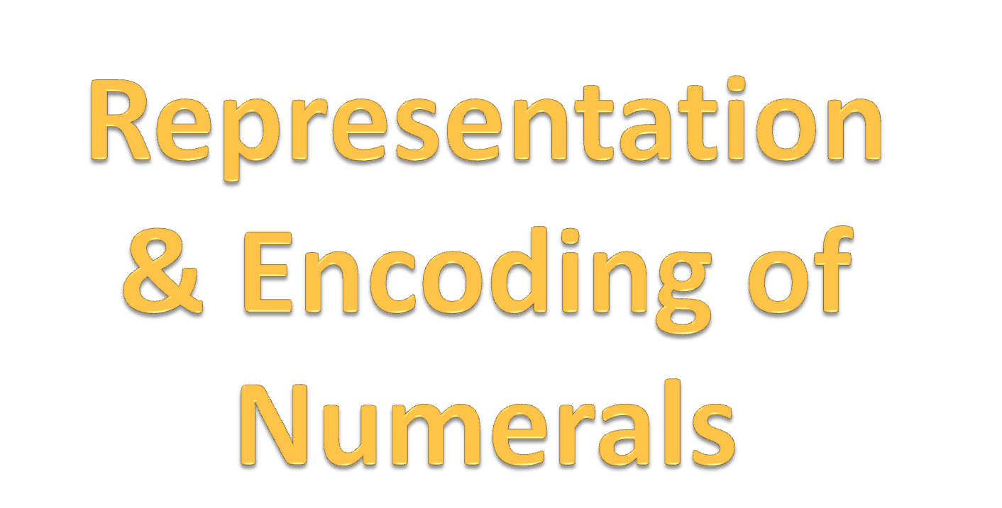
Info→data

Slide 5
Counting Number
Integer
Rational
Real

Slide 6


Slide 7
Natural number is sometimes referred to as
  unsigned integer
    Such as uint in C#
  counting number
    The number of elements
      The cardinality of a set

Slide 8
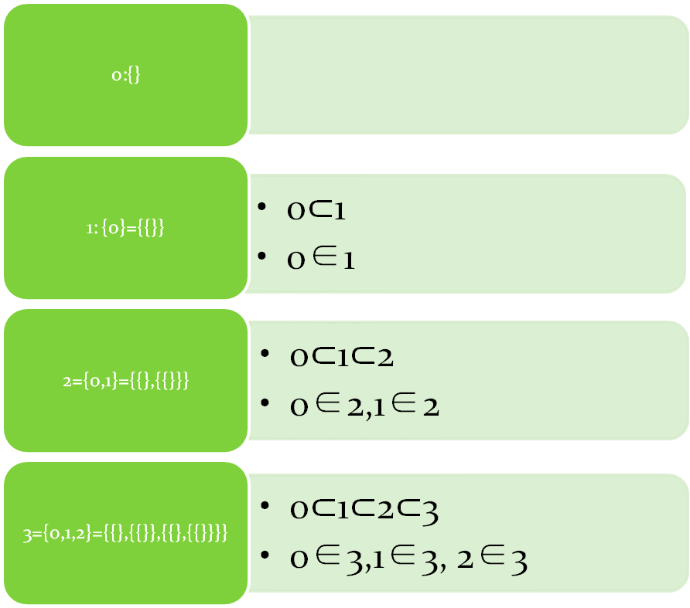
The cardinality of sets
⊂ vs <
  Order

Slide 9
0 is included
  Corresponding to nothing: {}
  0 is important in 101,10,…
  unsigned string of bits is initialized as 0

Slide 10

Radix

Slide 11
Base 10
日常生活中人们普遍采用十进制，十进制的特点是：
  ①有10个数码：0，1，2，3，4，5，6，7，8，9。
  ②“逢十进一”。
例如：(169．6)₁₀=1×10²+6×10¹+9×10⁰+6×10⁻¹
Possible cuz we have 10 digits at hand!

Slide 12
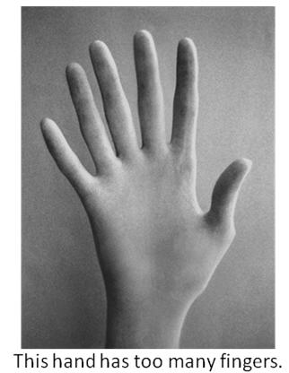
Then why do we have 10 fingers?
Notes:
Why not 2, as liked by computer
Why not 3, as the old Chinese saying goes, 3 fingers make a good catch of freshwater snails.

Slide 13
On counting up my fingers
I discover I have ten.
I'm not much good at maths
so I must count them all again.
This miracle of nature
I can't help but contemplate -
However could I count to ten
If I had only eight?

Slide 14
Base 2
二进制的特点是：
  ①有两个数码：0和l。
  ②“逢二进一”。
例如：(1010.1)₂=1×2³+0×2²+1×2¹+0×2⁰+l×2⁻¹

Slide 15
Base 2
计算机采用二进制主要有下列原因：
二进制只有0和1两个状态，技术上容易实现；
二进制数运算规则简单：
二进制数的0和1与逻辑代数的“真”和“假”相吻合，适合于计算机进行逻辑运算；
二进制数与十进制数之间的转换不复杂，容易实现。

Slide 16
(3)八进制数
八进制数的特点是：
①有8个数码：0，1，2，3，4，5，6，7。
②“逢八进一”。
例如：(133．3)₈=lx8²+3x8¹+3x8⁰+3×8⁻¹

Slide 17
(4)十六进制数
十六进制数的特点是：
①有16个数码：0，1，2，3，4，5，6，7，8，9，A，B，C，D，E，F。
②“逢十六进一”。
例如：(2A3.F)₁₆=2×16²+10×16¹+3×16⁰+15×16⁻¹

Slide 18
计算机中采用二进制数，二进制数书写时位数较长，容易出错。所以常用八进制、十六进制来书写。
  可以用最后一个字母来标识数制。例如36D、10101B分别标识十进制、二进制。
  也可以用别的表示法。如C#中，可以用0x85表示16进制的数。
  如果不特别指明，一般为10进制。

Slide 19
Other radix
12
  Easy split in 2,3,4
60
  Easy split in 2,3,4,5,6
Variable radix
  1981.2.3 14:00:23.00
Irrational radix
  e based, for example

Slide 20
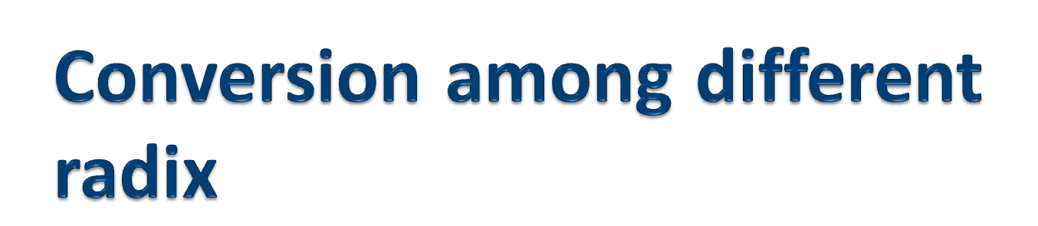

Slide 21
相互转换
十进制 → 二进制 ：除二求余
例：123d
  123d%2d=61d…1(d/b)
  61%2=30…1
  30%2=15…0
  15%2=7…1
  7%2=3…1
  3%2=1…1
  1%2=0…1
  0%2………
  So, 123d=1111011b

Slide 22
十进制 ← 二进制 ：权值相加
  1111011b
  =1*2^6+1*2^5+1*2^4+1*2^3+0*2^2+1*2^1+1*2^0
  =64+32+16+8+0+2+1
  =123

Slide 23
Hex vs Binary
For a hex a[n]a[n-1]…a[0] to a binary, Just expand each a[i] to four binary digits.
  Vice versa.
E.g.
  Hex: A08F
  Binary: 1010 0000 1000 1111

Slide 24


Slide 25
Fixed length
byte
  E.g., byteString(5)=0000 0101
ushort
Uint
ulong

Slide 26
To n-bit string
S(x,n) or S(x) if n is known
  if x in [0,2^n), then
    Converting x to binary strings, prepending 0 if necessary
  overflow if x not in [0,2^n)
E.g. for it to store in byte
  S(3,8)=0000 0011
  S(345), overflowed ‘cuz 345 not in [0,2^8)

Slide 27
To value
V(binary string of fixed length n)
E.g.
  V(11010000)=128+64+16=208
  V(0101)=5

Slide 28
Varied len
BigInteger

Slide 29
Construct
10^100
10000!

Slide 30


Slide 31
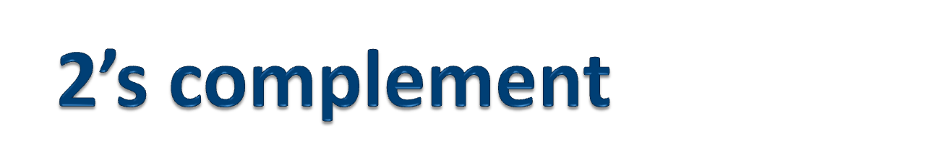
补码

Slide 32

4-bit string example
0000
0001
…
0111
1000
1001
…
1111
[0,1,…,7]
[8,9,…,15]
0
the ≡ (%16) bijection between [0,16) and [-8,8)
[-8,-7,…,-1]
[0,1,…,7]
0

Slide 33
ToString
n-bit string representation of i:
  S2(i,n)=
  {
    S(i), if i ∈ [0,2^（n-1）)
    S(2^n+i), if i ∈[-2^(n-1),0)
    overflow, otherwise
  }
e.g.
  S2(-5,4)=1011
  S2(11,4) overflow
  S2(3,4)=0011

Slide 34
The leftmost bit
The first bit of negative number is always 1. The first bit of positive number is always 0

Slide 35
To Value
V2(2’s complement binary string s)=
  V(s), if the leftmost bit is 0
  V(s)-16, if the leftmost bit is 1
E.g.
  V2(0101)=5
  V2(1101)=V(1101)-16=-3

Slide 36
ToValue the second way
V2(s of length n=k+1)=
  -s[k]*2^k+s[k-1]*2^(k-1) +s[k-2]*2^(k-2)+…+s[0]*2^0
Proof:
  if the leftmost bit is 0, that’s the same as in the first way.
  If the leftmost bit is 1, then it =
    (s[k]*2^k-2^n)+s[k-1]*2^(k-1) + s[k-2] * 2^(k-2)+…+s[0]*2^0
    This is also the same as resulted from the first way

Slide 37
ToValue the 3rd way
V2(s of length n)=
  V(s) if the leftmost bit is 0
  -(V(~(s))+1) if the leftmost bit is 1
    Note ~ means bitwise not
Proof:
-(V(~s)+1)=-(
  V( S(
    V(11…1)-V(s) //11…1 has n of 1’s
  ) )+1
)
=-(V(11…1)-V(s)+1)
=-((V(11…1)+1)-V(s))=-(2^n-V(s))=V(s)-2^n
=the result per 1st way
E.g.
  V2(1101)=-(V(0010)+1)=-3

Slide 38
Check overflow in addition
1111 (carry)
0111 (7)
+ 1011 (-5)
============
0010 (2)
0001 (carry)
1001 (-7)
+ 0101 (5)
============
1110 (-2)
The leftmost two carries
  0***+1***
  0***+0*** overflows if c[n-1]=1 (Two negative become positive)
  1***+1*** overflows if c[n-1]=0 (Two positives become negative )
0000 (carry)
0100 (4)
+ 0011 (3)
=============
0111 (7)
0111 (carry)
0111 (7)
+ 0011 (3)
=============
1010 (−6) invalid!
1111 (carry)
1111 (-1)
+ 1011 (-5)
=============
1010 (-6)
1000 (carry)
1100 (-4)
+ 1011 (-5)
=============
0111 (7) Invalid!

Slide 39
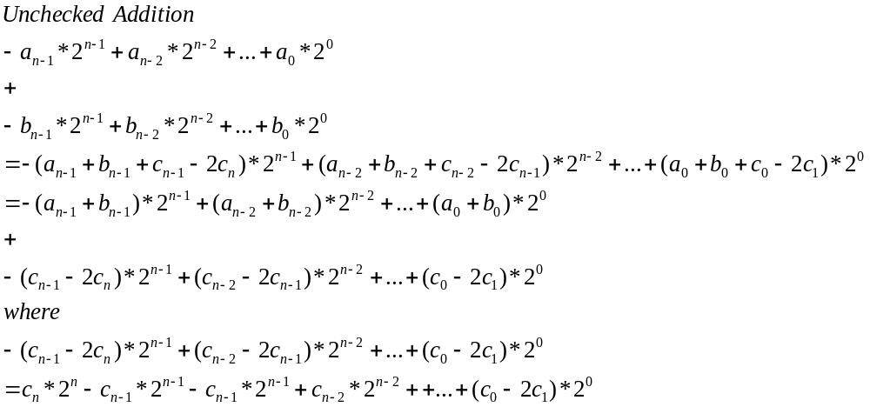
Unchecked Addition
-a_{n-1}2^{n-1}+a_{n-2}*2^{n-2}+a_{n-3}*2^{n-3}+…+a₀*2⁰+
-b_{n-1}2^{n-1}+b_{n-2}*2^{n-2}+b_{n-3}*2^{n-3}+…+c₀*2⁰
=
-(a_{n-1}+b_{n-1}+c_{n-1}-2c_{n})2^{n-1}+(a_{n-2}+b_{n-2}+c_{n-2}-2c_{n-1})2^{n-2}+(a_{n-3}+b_{n-3}+c_{n-3}-2c_{n-2})2^{n-1} +…+(a₀+b₀+c₀-2c₁)2⁰
=
-(a_{n-1}+b_{n-1})2^{n-1}+(a_{n-2}+b_{n-2})2^{n-2}+(a_{n-3}+b_{n-3})2^{n-3} +…+(a₀+b₀)2⁰+
c_{n}2^{n}-c_{n-1}2^{n-1}-c_{n-1}2^{n-1}+c_{n-2}2^{n-2}-c_{n-2}2^{n-2}+c_{n-3}2^{n-3} +…-c₁2¹+c₀2⁰
^{Where} c_{n}2^{n}-c_{n-1}2^{n-1}-c_{n-1}2^{n-1}+c_{n-2}2^{n-2}-c_{n-2}2^{n-2}+c_{n-3}2^{n-3} +…-c₁2¹+c₀2⁰
=c_{n}2^{n}-c_{n-1}2^{n}=(c_{n}-c_{n-1})2^{n}

Slide 40


Slide 41
Definition
  Fraction
    Standardized
Decimal
  Fraction vs Decimal

Slide 42
OOP representation of Number
3 / 8= 3/8
  Represent (in Rational) what’s not able to be represented (in Integer)

Slide 43


Slide 44
Fraction

Slide 45
OOP representation of Number
class Fraction{
  BigInteger denominator;
  BigInteger numerator;
}

Slide 46
Standardized and simplified
A fraction n/m is simplified and standardized if
  m is positive integer
  n is integer normalized;
    (-0)/1=(0)/1=0/1
  n is coprime to m
E.g.
  0/1
  2/1
  1/1
  -3/8
  -17/9
Counter Example
  2/4 , 1/0,-0/1

Slide 47
How to simplify:Find GCD by Euclidean Algorithm
uint Eval(uint a,uint b) {
return a <= b ? _EvalSmallFirst(a, b) : _EvalSmallFirst(b, a);
}
uint _EvalSmallFirst(uint smaller,uint bigger) {
if (smaller==0)
{
return bigger;
}
return _EvalSmallFirst(bigger % smaller, smaller);
}
Note: gcd(0,0)=0

Slide 48


Simplified Fraction as a standard
Rational
Representation
Simplified Fraction
Content
Bijection between simplified fraction and rationals

Slide 49
Simplified Fraction as a standard
Addition
Subtraction
Sign and Comparison and Order
Multplication
…

Slide 50
Decimal

Slide 51
Fraction to Decimal

Slide 52
3/7表示成10进制小数
怎样用十进制小数表示3/7?
  3/7 =.a[-1]a[-2]…
  3/7 * 10 =a[-1].a[-2]…
  So a[-1]=[3/7*10]
  Similarly we can get a[-i]
3/7=(4+2/7)/10
      2/7=20/7/10=(2+6/7)/10
      6/7=60/7/10=(8+4/7)/10
      4/7=40/7/10=(5+5/7)/10
      5/7=50/7/10=(7+1/7)/10
      所以：3/7= .428571……

Slide 53
.3表示为2进制
.3=(0+.6)/2=0………. .6
.6=(1+.2)/2=1…………. .2
.2=(0+.4)/2=0………… .4
.4=(0+.8)/2=0………………. .8
.8=(1+.6)/2=1…………. .6
.6= =(1+.2)/2=1…………. .2
So .3=.010011001……

Slide 54
Infinite recurring decimals
3/7 不能表示成有限的十进制小数
.3=3/10=3/(2*5)
  不能表示成2进制有限小数
    假设可以，则a/2+b/4+…= 3/(2*5). 这是不可能的。（同乘以2^n，n足够大，左边为整数，右边为小数）。
if coprime(n,m) and m is factored to p1^q[1]*p2^q[2]*…p[k]^q[k], then n/m can be converted to finite decimal only if the radix is factored including all the p[i]

Slide 55
Decimal to Fraction

Slide 56
Decimal to fraction
.010011001……
=.01001+.01001*2^-4+.01001*2^-4*2^-4+…
=.01001/(1-2^-4)=3/10
Notes:
S[n]=a0(1- q^n)/ (1-q)

Slide 57
Euler’s theorem
if n and a are coprime positive integers, then
a^T(n)=1 (mod n)
Where T(n) is Euler's totient function.
So for a>1,
if n is not coprime to a,
b/n/ *1/gcd(n,a)
E.g., 4/15 = (4/3)*2/(5*2)=(2+2/3)*1/10
=(2+ 2 *33 / (10^2-1) ) /10= 2.66…/10=.266…
Notes:
T(n)=n*Product(1-1/p, for all prime | n)
Note that 5=6^4-1, but 5=6-1

Slide 58
Base 10:
  0.123123…= 0.123/(1-10^3)=123/999
  0.0123123…=0.0123/(1-10^3)=123/999 / 10
Base 2:
  0.1001 1001 1001 …=0.1001b/(1-2^4)=1001b/1111b
  0.01001 1001 …=0.01001b /(1-2^4)=1001b/1111b /10b=9/15 /2=3/10

Slide 59
Stardard

Slide 60
0.999… (base 10)=1=1.0000000
0.1111…(base 2)=1=1.00000
To Standard
  0, not 0.0; 1, not 1.0000
  1, the shorter not 0.111…(base 2) which is longer
  What digits are recurring must be noted, in shortest form. (Infinite to finite)
    0.3, not 0.33

Slide 61
Decimal vs Fraction as a standard
Addition, Subtraction, Comparison
  Decimal > Fraction
Conversion among different radix
  Fraction>Decimal
Fraction is shorter in general and pertinent to the definition

Slide 62


Slide 63
Line the rationals as simplified fraction (+-)n/m one by one, ordered by
  n+m
  n
  Sign
0/1,1/1,-1/1,1/2,-1/2,2/1,-2/1,1/3,-1/3,3/1,-3/1,1/4,-1/4,2/3,-2/3,3/2,-3/2,4/1,-4/1,…

Slide 64
Rational Countable
Rational
Counting Numbers
Bijection exists
  There might be more than one bijection here

Slide 65
Significance of Countability
You can iterate thru a collection by mapping its key to natural number.
You can only assign an index on a countable set
Notes:
Natural number is defined recurringly. Infact it’s the cannonical recurrence. So any recurring have to be able to be mapped to natural numbers.

Slide 66
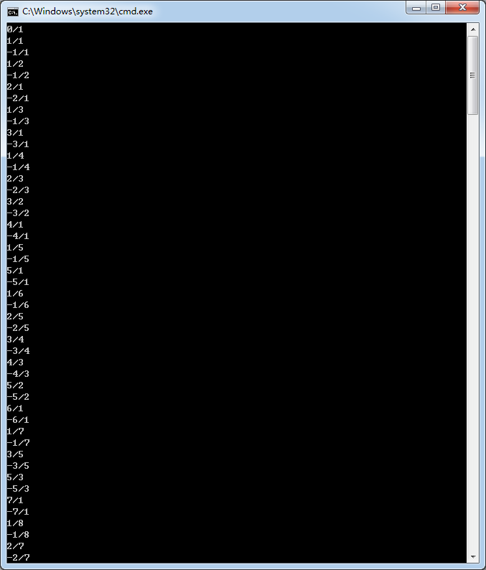
IEnumerable<Fraction> Enumerate()
{
yield return new Fraction(0, 1);
for (BigInteger sum = 2; ; sum++)
{
BigInteger num;
for ( num = 0; num < sum; num++)
{
BigInteger den = sum - num;
//is j, i-j coprime
if (BigInteger.GreatestCommonDivisor(num,den)==1)
{
yield return new Fraction(num,den);
yield return new Fraction(-num, den);
}
}
}
}
Notes:
With this function is given, Given any rational number, this function will stop in finite steps till it reaches that number.
First give the number, then the program will stop at a time pursuant to the number given. X→time is finite
First give the program, no matter how long it runs , another number can be given that’s not in there. Time→ -x
The latter always has the upperhand.

Slide 67
Given any rational number, this function will stop in finite steps till it reaches that number.
No matter how long the program runs , another number can be given that’s not in there.
He who deals later always has the upper hand.

Slide 68


Slide 69
UnCountable
Real Number is uncountable
  Irrational number is uncountable

Slide 70
Proof by contradiction
0.a11 a12 a13 a14…
0.a21 a22 a23 a24…
…
Where can 0.a11 a22 a33…(here a11=~a11,…) be put? Nowhere!
Notes:
Order all reals in [0,1).
‘cuz [0,1) is uncoutable, so real is uncountable.
0.1111111111111111111111111… is not included.
0.0111111111111111111111111… is 0.100000000000……
0.001111111111111111111111… is 0.010000000000000…
0.01001111111111111111111… is 0.010100000000000000000.
That is, if for some n, a[-n] =0, a[-n-1]……are all 1’s, then it’s rewritten as 0.a[-1]a[-2]…a[-n]+1.

Slide 71
Representation
Decimal
  Finite
  Infinite
    Recurring
    Unrecurring
Fraction
  Continued Fraction

Slide 72


Slide 73





45/16
2+1/(16/13)
2+1/(1+1/(13/3))
2+1/(1+1/(4+1/(3/1)))
3+1/(1+1/(4+1/3))

Slide 74
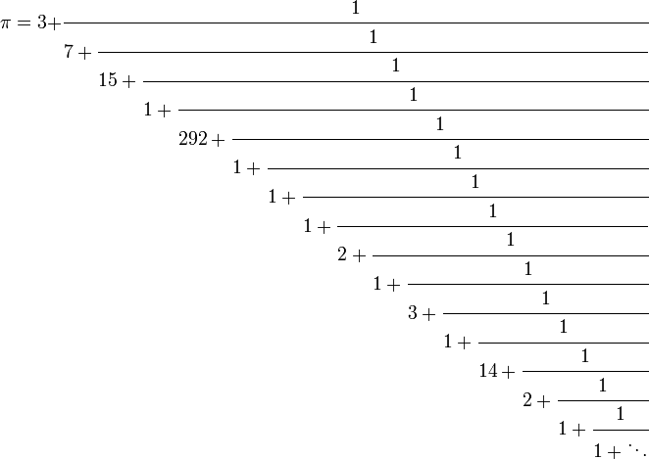

Slide 75
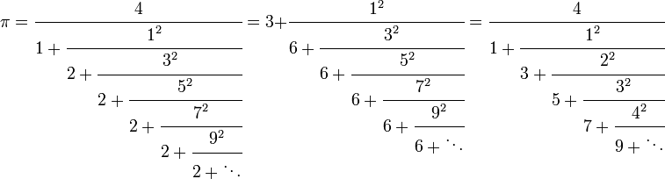

Slide 76
(0;1,1,1,1…)=.618…
1；1，1，…）=1.618。。。。

Slide 77
Normalized
rational number has unique continued fraction representation.
  not [a₀; a₁, ... a_{n - 1}, a_{n} - 1, 1].
  But [a₀; a₁, ... a_{n - 1}, a_{n}]
representation of an irrational number is unique. (but not as simple as a division)

Slide 78
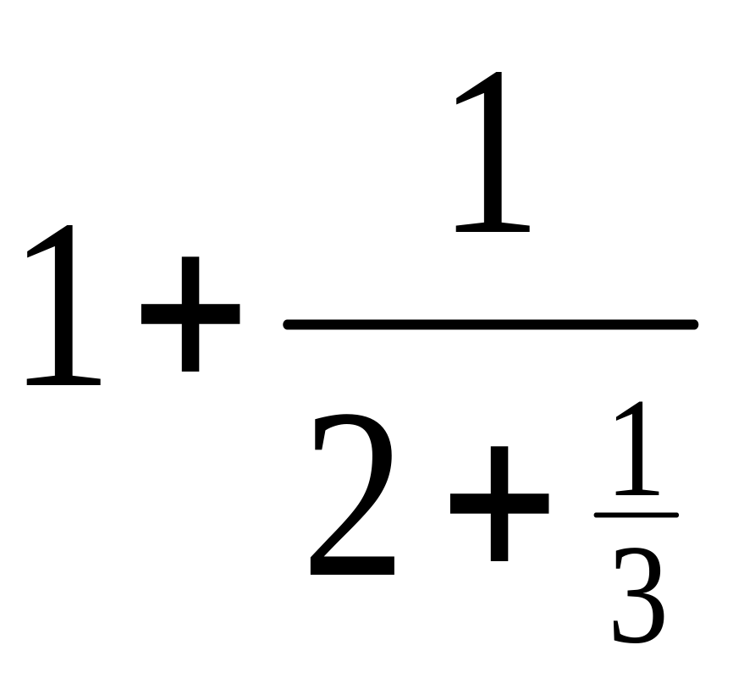
Convert a Fraction to Standard CF
10/7
  10/7=1…3
  7/3=2…1
  3/1=3…0
  =[1;2,3]

Slide 79
For Pi
  a0=3
  u1=[1/(pi-a0)]≈[7.0625], a1=7
  u2=[1/(u1-a1)] ≈ 15.9965, a2=15
  …
[3;7,15,1,292,1,1,…]

Slide 80
The continued fraction representation
finite if and only if the number is rational.
"simple" rational numbers are usually short.

Slide 81
repeat if and only if it is of a quadratic irrational
  [1; 1, 1, 1, ...]=(sqrt(5)+1)/2
  [1; 2, 2, 2, ...]=sqrt(2)

Slide 82
Truncate
Truncating yields a rational approximation which is in a certain sense the best possible
  1/7 = 0.142857... at various places yields approximations such as 142/1000, 14/100, and 1/10.
  But clearly the best rational approximation is "1/7" itself

Slide 83
Truncate Pi
Truncating 3.1415926…
  31415/10000, 314/100.
The continued fraction representation of π [3; 7, 15, 1, 292, ...].
  3, 22/7, 333/106, 355/113, 103993/33102
The denominators of 314/100 and 333/106 are almost the same
  but the error is nineteen times as.
[3; 7, 15, 1] is more than one hundred times more accurate than 3.1416

Slide 84
 | Continued Fraction | Decimal
Neutrality to Radix
Shorter/Precision
Unique | For rational, take the shorter form For irrational, always unique | For rational, unique For irrational, .xxx9
Operation | 1/x, X vs Y | X+y

Slide 85
Operations

Slide 86
Reciprocal
The reciprocal of a positive (a0;a1;a2;。。。）
  (0;a0;a1;a2…), when a0>0
  (a1;a2;a3…), when a0=0

Slide 87
Comparison
static public int Compare(ContinuedFraction a, ContinuedFraction b)
{
if (a.floor > b.floor)
{
return 1;
}
if (a.floor < b.floor)
{
return -1;
}
if (a.denominatorFloors.Length<b.denominatorFloors.Length)
{
return -_compareDenominatorsLongToShort(ref b, ref a);
}
return _compareDenominatorsLongToShort(ref a, ref b);
}

Slide 88
static private int _compareDenominatorsLongToShort(ref ContinuedFraction a, ref ContinuedFraction b)
{
bool numeratorAlternated = false;
for (uint i = 0; i < a.denominatorFloors.Length; i++)
{
if (i < b.denominatorFloors.Length)
{
if (a[i] > b[i])
{
return numeratorAlternated ? 1 : -1;
}
if (a[i] < b[i])
{
return numeratorAlternated ? -1 : 1;
}
}
else// b[i]=+inf >a[i]
{
return numeratorAlternated ? -1 : 1;
}
numeratorAlternated = !numeratorAlternated;
}
return 0;
}

Slide 89
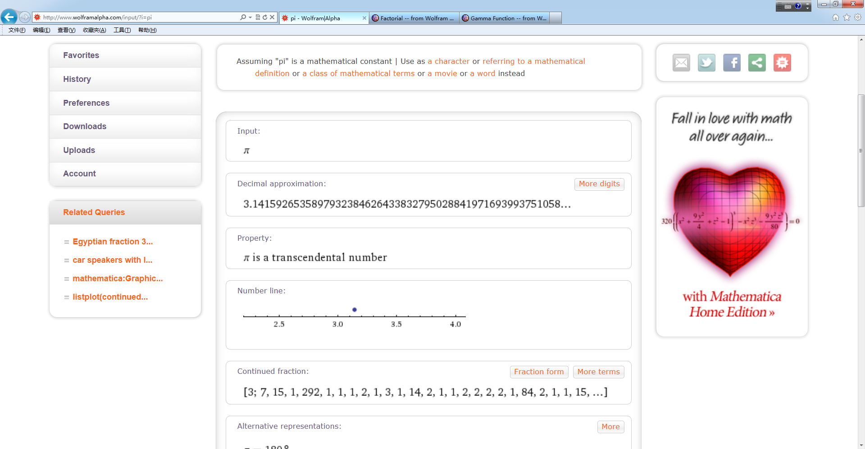

Slide 90


Slide 91
Other Representation of Number
Exponential
  -1.8e-3
Floating/Double
  Not conforming to real op’s

Slide 92


Slide 93
Floor
Ceiling
Truncate
  Floor for positive and ceiling for negative
Round
  Round(x,m)=round(x/m)*m
    E.g, scores are rounded by .5

Slide 94
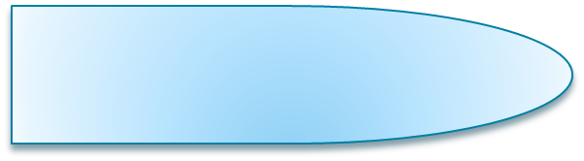

Floor
Floor(x)=the least integer in [x,+inf)
Round towards -inf

Slide 95
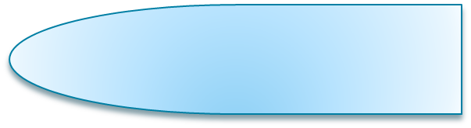

Ceiling
Round towards +inf

Slide 96



Truncate
Round towards 0
0
0

Slide 97



Round
The midpoint, e.g., Round(3.5)
  =4
  =3 (depends on the preceding number)

Slide 98
round half up (or round half towards plus infinity),

Slide 99
What’s your favorite number?
3.14159265358979323846264338327950288
2.7182818…
1.414…..
.860333589…..
9801, 60481729
1024,1048576
.9973, 1.64485…, 1.9599….
Notes:
.9973=erf(3^2/sqrt(2))
Erf(1.64/sqrt(2))=.9
.95

Slide 100
Assignment
1. Give the binary representation of .1(base 10)

Slide 101
The End
Thanks

Slide 102

反码

Slide 103
E.g., for 4-bit coding
  -5➔1101 vs 5➔0101
  U1(-5)=(2^n-1)+|-5|
Range: −(2^{N−1}−1) to 2^{N−1}−1.
  There are two 0’s

Slide 104
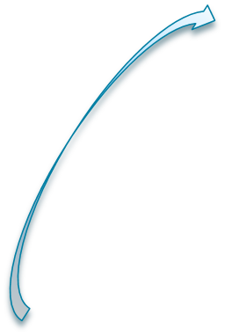





vs 2’s complement
For a negative M=-5 encoded in 4-bit:
  2’s complement encoding: U2=
    2^n+M=2^(n-1)+{[2^(n-1)-1]-|M|}+1=
    1000+[(111-101)+1]=1 011
  1’s complement encoding: U1=
    2^(n-1)+|M|=1 101
Complement to each other
最高位为1
M的无符号编码
Complement to each other

