Slide 1

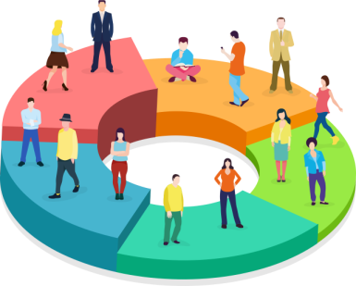
CUSTOMER SEGMENTATION AND ADVERTISEMENT
Presented by - Group 3
Ranu Pal
Nilofar Naaz
Dolan Ghosh
Yugantar Maiti
Sayan Saha
Mentor – Dr. Dipankar Sarkar Co-Mentor – Prof. Soumya Paul
Notes:
© Copyright Showeet.com – Creative & Free PowerPoint Templates

Slide 2

AGENDA
01
Introduction
07
Elbow Method
13
K-Means Scatter Plot
02
Abstract
08
Block Diagram
14
Advertising Procedure
03
Keywords
09
Software Requirement Specification
15
Advertisement Demo
04
RFM Model
10
Working Principle
16
Future Scope
11
RFM Distribution Plot
Conclusion
05
Clustering Mechanism
17
06
K-Means Clustering
12
Elbow Method for Optimal K
18
References
Photo credit: T0nymix via Pixabay (Creative Commons Zero license)
Notes:
© Copyright Showeet.com – Creative & Free PowerPoint Templates

Slide 3
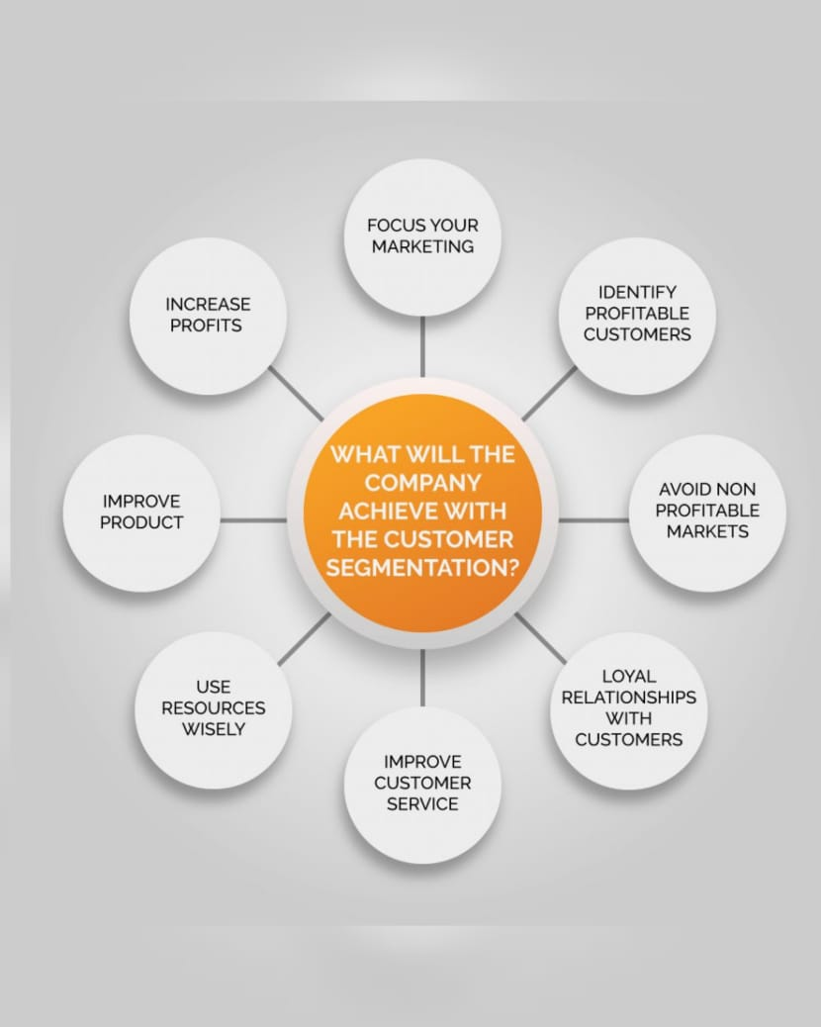
INTRODUCTION
Customer segmentation is the practice of dividing a company’s customers into groups that reflect similarity among customers in each group.
The goal of segmenting customers is to decide how to relate to customers in each segment in order to maximize the value of each customer to the business.
Its easier for companies to send those customers special offer.
Photo credit: T0nymix via Pixabay (Creative Commons Zero license)
Notes:
© Copyright Showeet.com – Creative & Free PowerPoint Templates

Slide 4
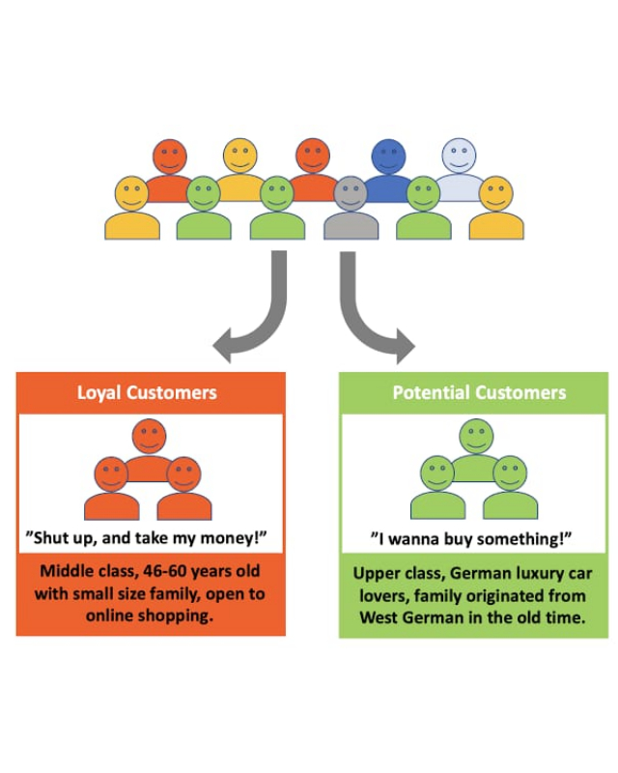
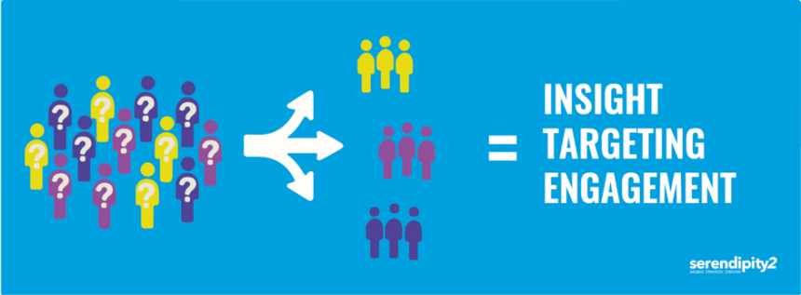
ABSTRACT
Customers segmentation is the process of dividing a broad customer into sub group based on some type of common characteristics.
The aim of segmentation is to identify high income segment that is those segment that are likely to be the most profitable or growth potential.
So that these can be selected for special attention or targeted customer.
Photo credit: T0nymix via Pixabay (Creative Commons Zero license)
Notes:
© Copyright Showeet.com – Creative & Free PowerPoint Templates

Slide 5
KEYWORDS
RFM Model
K – Means Clustering
Elbow Method
Photo credit: T0nymix via Pixabay (Creative Commons Zero license)
Notes:
© Copyright Showeet.com – Creative & Free PowerPoint Templates

Slide 6
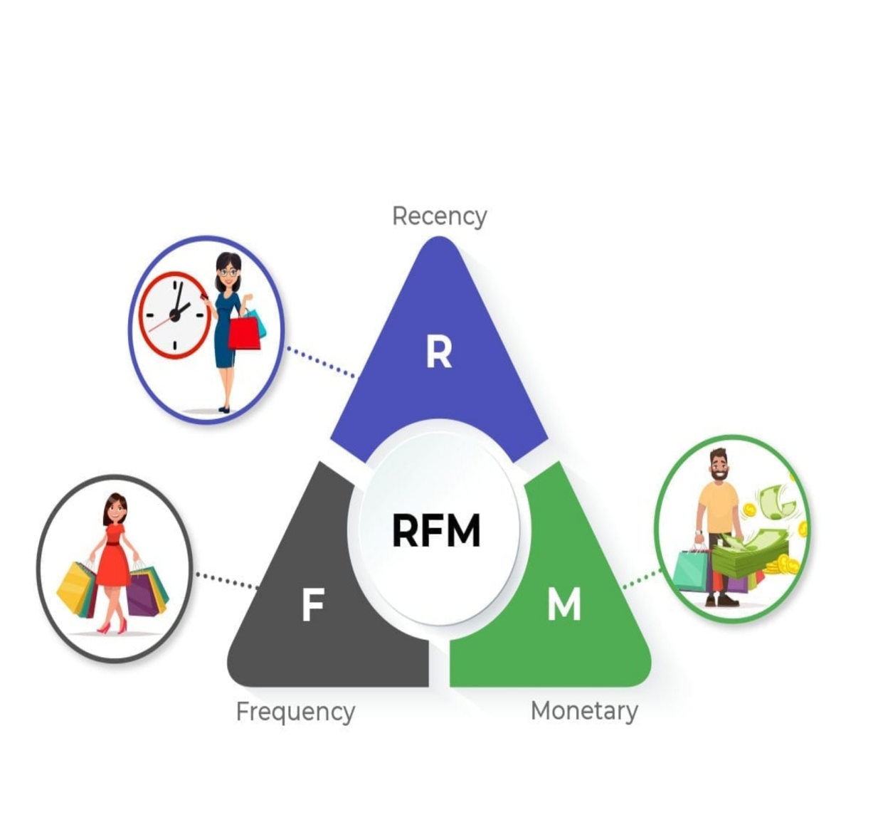
RFM MODEL
RFM(Recency , Frequency, Monetary) value is a marketing analysis tool used to identify a company's or an organization's best customers by using certain measures.
The RFM model is based on three quantitative factors –
Recency : How recently a customer has made a purchase.
Frequency: How often a customer makes a purchase.
Monetary Value: How much money a customer spends on purchases.
Photo credit: T0nymix via Pixabay (Creative Commons Zero license)
Notes:
© Copyright Showeet.com – Creative & Free PowerPoint Templates

Slide 7
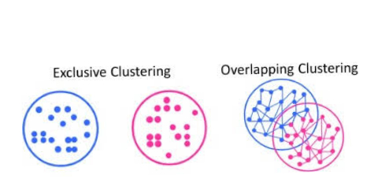
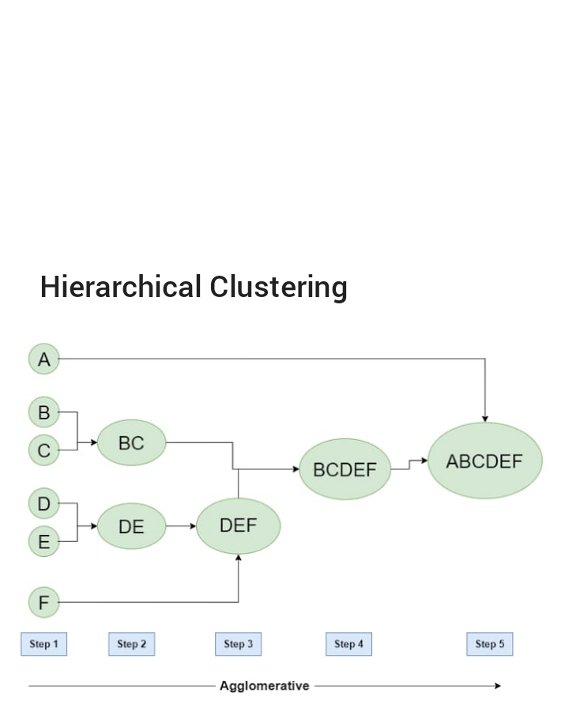
CLUSTERING MECHANISM
“CLUSTERING” is the process dividing the dataset into group consisting of similar data point.
Point in the same group are as similar as possible.
Points in different group are as different as possible.
Types of Clustering :
1. Exclusive Clustering 2. Overlapping Clustering 3. Hierarchical Clustering
Photo credit: T0nymix via Pixabay (Creative Commons Zero license)
Notes:
© Copyright Showeet.com – Creative & Free PowerPoint Templates

Slide 8
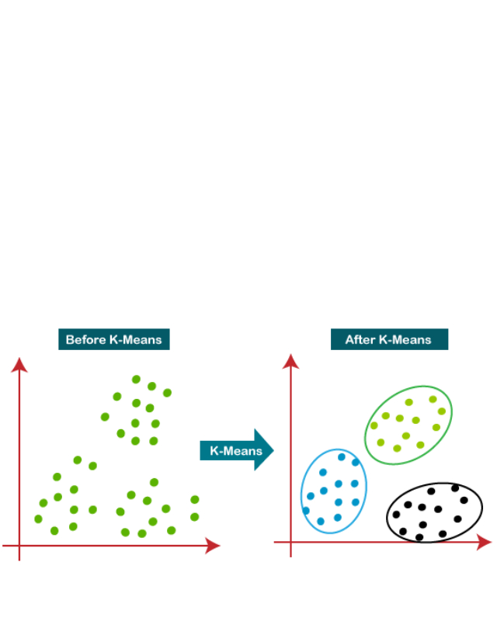
K-MEANS CLUSTERING
“K-Means” is a clustering algorithm whose main goal is to group similar element what data point in a cluster. Step-1: Mean value Step-2: Find nearest value of Mean and put in Cluster Step-3: repeat 1 and 2 until will get same Mean
Photo credit: T0nymix via Pixabay (Creative Commons Zero license)
Notes:
© Copyright Showeet.com – Creative & Free PowerPoint Templates

Slide 9
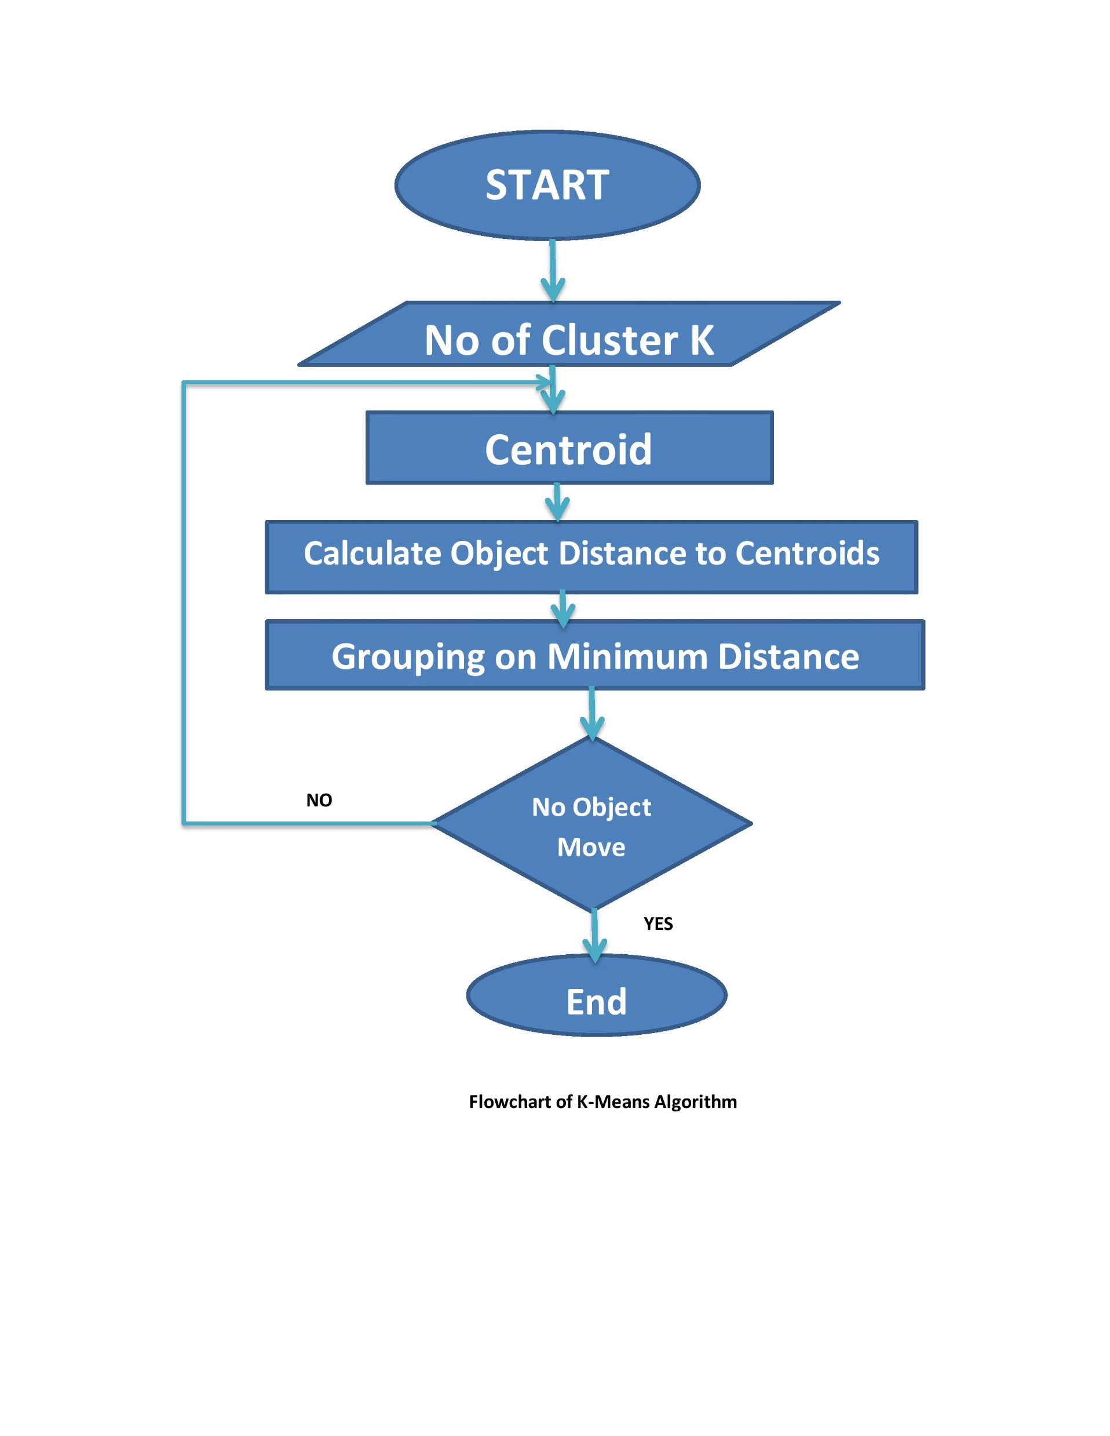
FLOWCHART OF K-MEANS ALGORITHm
Photo credit: T0nymix via Pixabay (Creative Commons Zero license)
Notes:
© Copyright Showeet.com – Creative & Free PowerPoint Templates

Slide 10
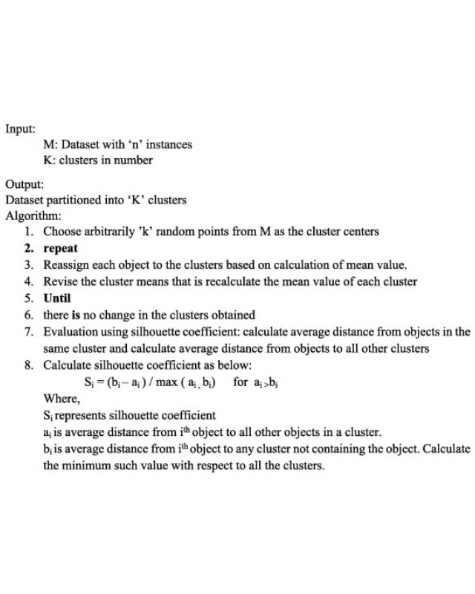
K-MEANS ALGORITHM
Photo credit: T0nymix via Pixabay (Creative Commons Zero license)
Notes:
© Copyright Showeet.com – Creative & Free PowerPoint Templates

Slide 11
K-MEANS ALGORITHM WITH AN EXAMPLE
K-means algorithm with an example: data set k= {2,3,4,10,11,12,20,25,30} find 2 cluster, so cluster=2, let M1=4, M2=12 k1={2,3,4}, K2={10,11,12,20,25,30} M1=(9/3)=3, M2=(108/6)=18 K1= {2,3,4,10} , k2={11.12,20,25,30) M1=4.75(5), M2=19.6(20) K1=(2,3,4,10,11,12} , K2={20,25,30} M1=7 , M2=25 K1={2,3,4,10,11,12} , K2={20,25,30} M1=7, M2=25 Now, we are getting same mean. So we have to stop New Cluster k1= {2,3,4,10,11,12} k2={20,25,30}
Photo credit: T0nymix via Pixabay (Creative Commons Zero license)
Notes:
© Copyright Showeet.com – Creative & Free PowerPoint Templates

Slide 12
HOW WILL WE FIND K?
For deciding the value of k, we have to use hit and trail method. Starting from k=1
k=1 worst case scenario
2. Now try with k=2, k=2 is still better than k=1 (Total variation)
3. Now try with k=4, Each time we increase the cluster the variation decreases , no of cluster=no of data points then that case the variation =0
Total variation in k=4 is less than k=3
Photo credit: T0nymix via Pixabay (Creative Commons Zero license)
Notes:
© Copyright Showeet.com – Creative & Free PowerPoint Templates

Slide 13
ELBOW METHOD
In cluster analysis, the elbow method is a heuristic used in determining the number of clusters in a data set.
The method consists of plotting the explained variation as a function of the number of clusters, and picking the elbow of the curve as the number of clusters to use.
The same method can be used to choose the number of parameters in other data-driven models, such as the number of principal components to describe a data set.
Photo credit: T0nymix via Pixabay (Creative Commons Zero license)
Notes:
© Copyright Showeet.com – Creative & Free PowerPoint Templates

Slide 14
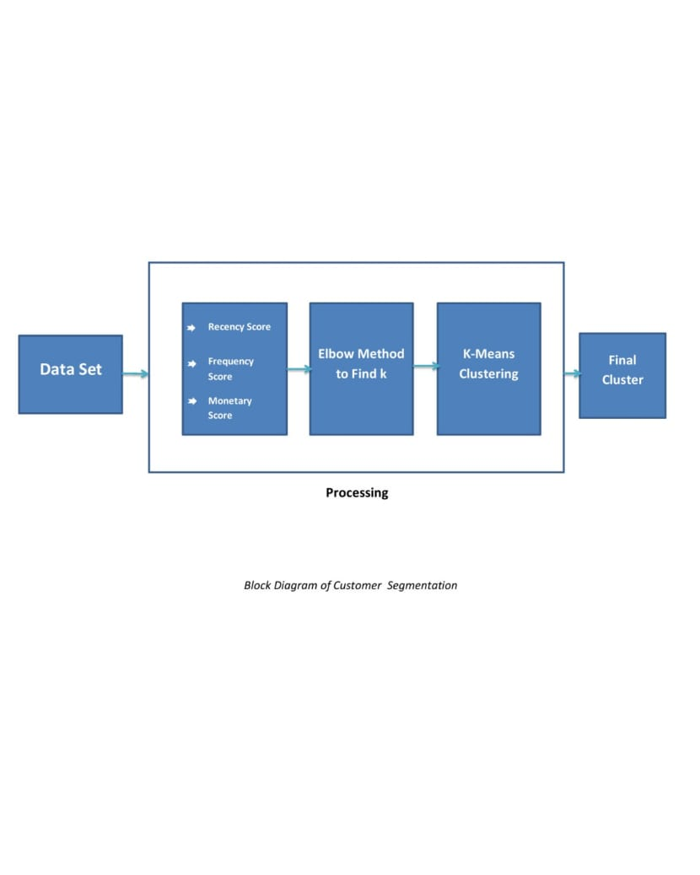
BLOCK Diagram of Proposed scheme
Photo credit: T0nymix via Pixabay (Creative Commons Zero license)
Notes:
© Copyright Showeet.com – Creative & Free PowerPoint Templates

Slide 15
SOFTWARE REQUIREMENT SPECIFICATION
Scikit-learn (formerly scikits learn and also known as sklearn) is a free software machine learning library for the Python programming language.
Seaborn is a Python data visualization library based on matplotlib. It provides a high-level interface for drawing attractive and informative statistical graphics.
Numpy (pronounced (NUM-pai) or sometimes (NUM-pee)) is a library for the Python programming language, adding support for large, multi-dimensional arrays and matrices, along with a large collection of high-level mathematical functions to operate on these arrays. Languages used: Python.
pandas is a software library written for the Python programming language for data manipulation and analysis.
Matplotlib is a plotting library for the Python programming language and its numerical mathematics extension NumPy.
Anaconda and Jupyter notebook are the software applications used for executing python code.
Photo credit: T0nymix via Pixabay (Creative Commons Zero license)
Notes:
© Copyright Showeet.com – Creative & Free PowerPoint Templates

Slide 16
WORKING Principle
Customers have to be clustered into segments to provide information to support decision makers in achieving a business objective. The data to be captured and grouped, depends on the business objective.
The information extracted from a customer segment has to represent an individual customer.
According to the k means values of after clustering, each group will then receive ads. In the form of offers and gift cards through their corresponding emails and phone numbers.
Photo credit: T0nymix via Pixabay (Creative Commons Zero license)
Notes:
© Copyright Showeet.com – Creative & Free PowerPoint Templates

Slide 17
Result analysis
Recency Distribution Plot
Frequency Distribution Plot
Monetary Distribution Plot
Elbow Method for Optimal K
K-Means Scatter Plot
Photo credit: T0nymix via Pixabay (Creative Commons Zero license)
Notes:
© Copyright Showeet.com – Creative & Free PowerPoint Templates

Slide 18
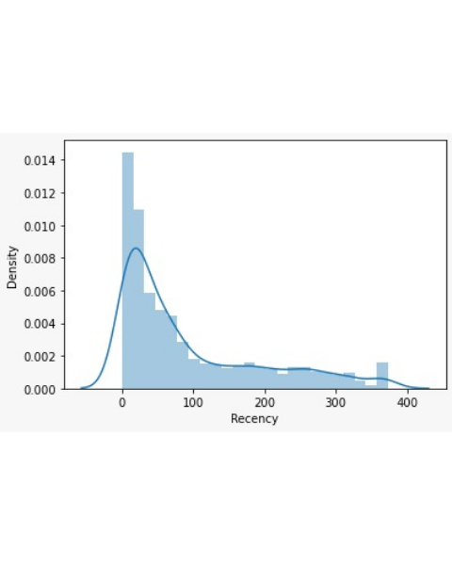
Recency distribution plot
#Recency distribution plot
import seaborn as sns
x = RFMScores['Recency’]
ax = sns.distplot(x)
Photo credit: T0nymix via Pixabay (Creative Commons Zero license)
Notes:
© Copyright Showeet.com – Creative & Free PowerPoint Templates

Slide 19
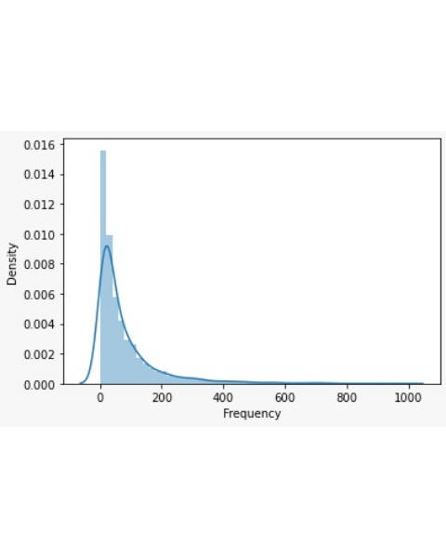
Frequency distribution plot
#Frequency distribution plot, taking observations which have frequency less than 1000
import seaborn as sns
X = RFMScores.query('Frequency < 1000')['Frequency’]
ax = sns.distplot(x)
Photo credit: T0nymix via Pixabay (Creative Commons Zero license)
Notes:
© Copyright Showeet.com – Creative & Free PowerPoint Templates

Slide 20
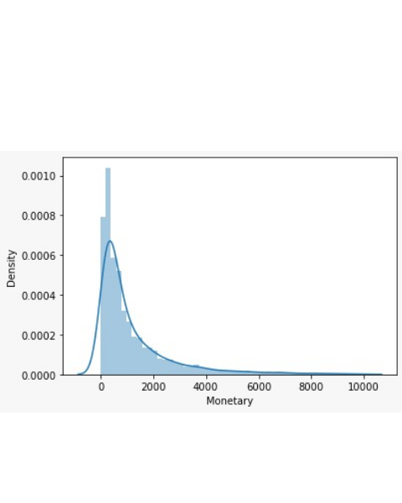
Monetary distribution plot
#Monateray distribution plot, taking observations which have monetary value less than 10000
import seaborn as sns
x = RFMScores.query('Monetary < 10000')['Monetary’]
ax = sns.distplot(x)
Photo credit: T0nymix via Pixabay (Creative Commons Zero license)
Notes:
© Copyright Showeet.com – Creative & Free PowerPoint Templates

Slide 21
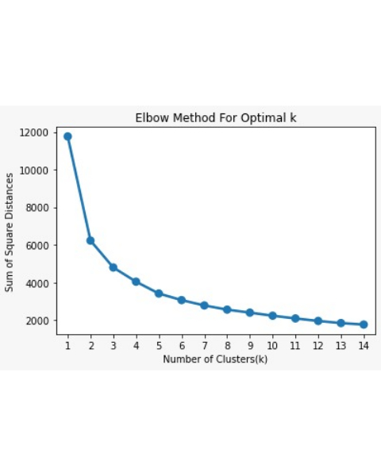
ELBOW METHOD FOR OPTIMAL K
#CODE
from sklearn.cluster import Kmeans
sum_of_sq_dist = {}
for k in range(1,15): km = KMeans(n_clusters= k, init= 'k-means++’, max_iter=1000)
km = km.fit(Scaled_Data)
sum_of_sq_dist[k] = km.inertia_
#Plot the graph for the sum of square distance values and
Number of Clusters
sns.pointplot(x = list(sum_of_sq_dist.keys()),
y = list(sum_of_sq_dist.values()))
plt.xlabel('Number of Clusters(k)’)
plt.ylabel('Sum of Square Distances’)
plt.title('Elbow Method For Optimal k')
plt.show()
Photo credit: T0nymix via Pixabay (Creative Commons Zero license)
Notes:
© Copyright Showeet.com – Creative & Free PowerPoint Templates

Slide 22
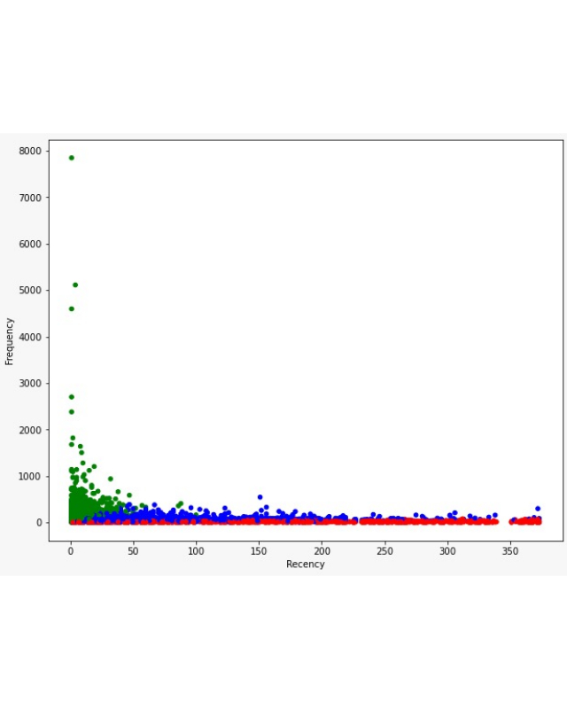
K-MEANS scatter plot
#CODE
from matplotlib import pyplot as plt
plt.figure(figsize=(7,7))
#Scatter Plot Frequency Vs Recency
Colors = ["red", "green", "blue"]
RFMScores['Color’] = RFMScores['Cluster’].
map(lambda p: Colors[p])
ax = RFMScores.plot(
kind="scatter", x="Recency", y="Frequency",
figsize=(10,8),
c = RFMScores['Color’]
)
Photo credit: T0nymix via Pixabay (Creative Commons Zero license)
Notes:
© Copyright Showeet.com – Creative & Free PowerPoint Templates

Slide 23
Advertising procedure
#CODE
import pandas as pd
import smtplib
SenderAddress = "<Email Address of sender>“
password = "password of sender“
e = pd.read_excel("email.xlsx")
emails = e['email'].values
server = smtplib.SMTP("smtp.gmail.com", 587)
server.starttls()
server.login(SenderAddress, password)
msg = "Hello this is a email form python“
subject = "Hello world“
body = "Subject: {}\n\n{}".format(subject,msg)
for email in emails:
server.sendmail(SenderAddress, email, body)
server.quit()
Step 1 : Open the sender’s Gmail
account.
Step 2 : Click on the profile picture and
select “Manage your Google
account”.
Step 3 : Under “Security” section Click
on “Less Secure App Access”.
Step 4 : Grant the allowance by turning
it OFF .
Step 5 : Install Pandas and run the
following code.
Photo credit: T0nymix via Pixabay (Creative Commons Zero license)
Notes:
© Copyright Showeet.com – Creative & Free PowerPoint Templates

Slide 24
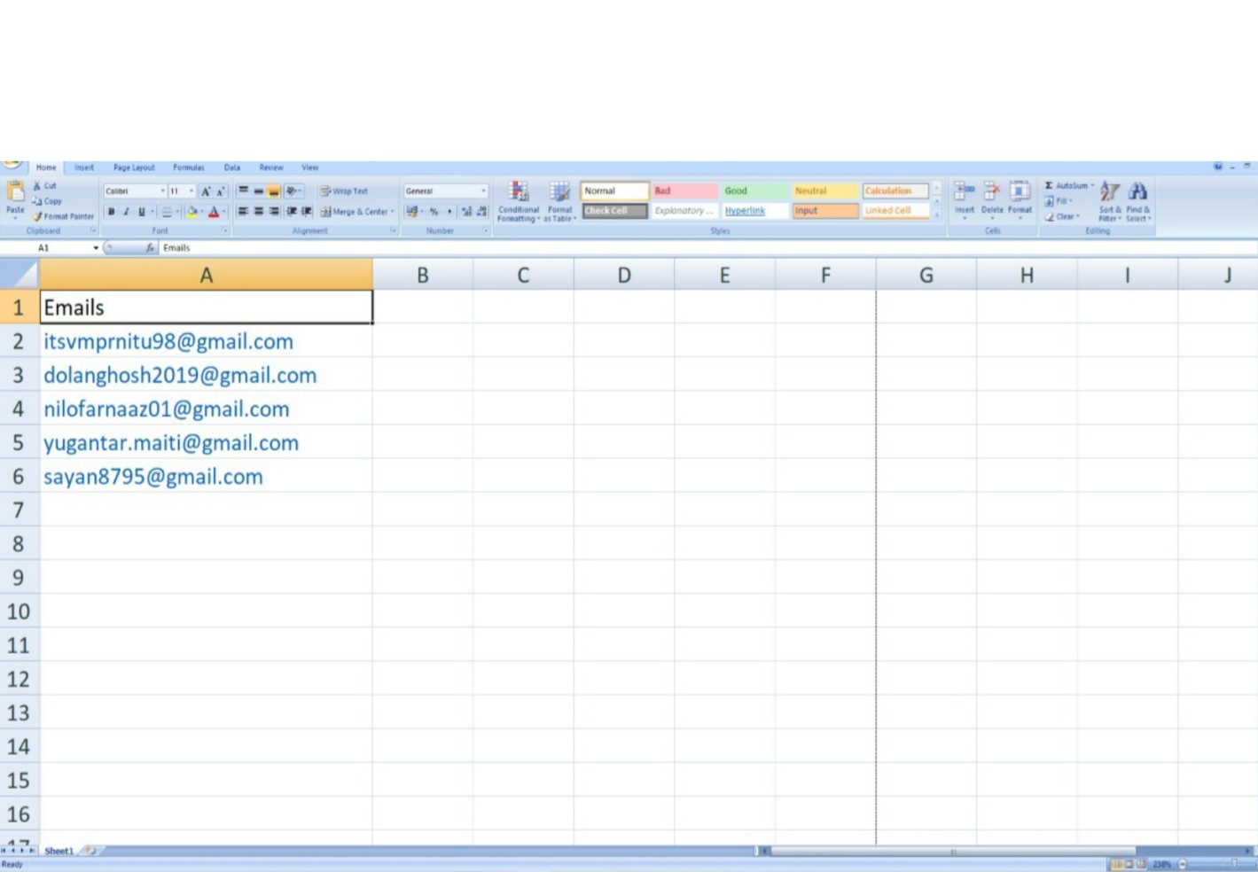
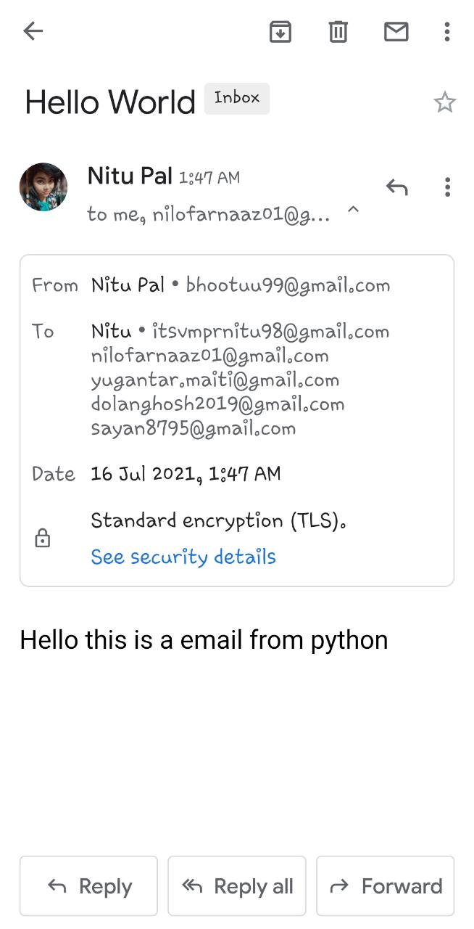
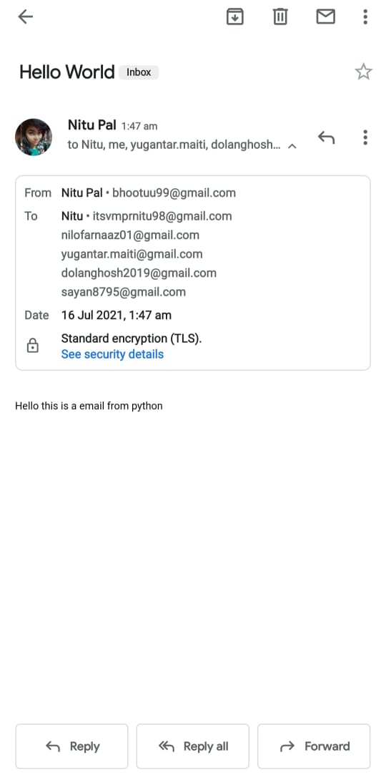
ADVERTISEMENT DEMO
Sender’s Email Screenshot
Receiver’s Email Screenshot
Email List Screenshot
Photo credit: T0nymix via Pixabay (Creative Commons Zero license)
Notes:
© Copyright Showeet.com – Creative & Free PowerPoint Templates

Slide 25
FUTURE SCOPE
If we properly manage the best current customer segmentation process, however, the impact it can have on every part of our organization — sales, marketing, product development, customer service, etc. — is immense.
Our business will possess stronger customer focus and market clarity, allowing it to scale in a far more predictable and efficient manner.
Ultimately, that means no longer needing to take on every customer that is willing to pay for our product or service, which will allow us to instead hone in on a specific subset of customers that present the most profitable opportunities and efficient use of resources.
That is critical for every business, of course, but at the expansion stage, it can often be the difference between incredible success and certain failure.
Photo credit: T0nymix via Pixabay (Creative Commons Zero license)
Notes:
© Copyright Showeet.com – Creative & Free PowerPoint Templates

Slide 26
conclusion
The underlying principle of customer segmentation is that the product and services needs individual of customers differ.
Customer segmentation involves the grouping of customers together with the aim of better satisfying their needs whilst maintaining economies of scale.
Photo credit: T0nymix via Pixabay (Creative Commons Zero license)
Notes:
© Copyright Showeet.com – Creative & Free PowerPoint Templates

Slide 27
references
Bottcher, M., Spott, M.D. Nauck, & Kruse, R. (2009). Mining changing customer segments in dynamic markets. Expert Systems with Applications, 36, 155–164.
Chetna Sethi and Garima Mishra, “A Linear PCA based hybrid K-Means PSO algorithm for clustering large dataset,” International Journal of Scientific & Engineering Research, Volume 4, Issue 6, June-2013, pp.1559-1566.
M. A. Syakur, B. K. Khotimah, E. M. S. Rochman, and B. D. Satoto, “Integration K-Means Clustering Method and Elbow Method for Identification of the Best Customer Profile Cluster,” in IOP Conference Series: Materials Science and Engineering, p. 12017, Surabaya, Indonesia, 2018, IOP Publishing.
N. Bouhmala, A. Viken, J. B. Lonnum, “Enhanced Genetic Algorithm with K-Means for the Clustering Problem”, International Journal of Modeling and Optimization, pp. 150-154, 2015.
Tapas Kanungo, David M. Mount, Nathan S. Netanyahu, Christine D. Piatko, Ruth Silverman, and Angela Y. Wu, “An Efficient k-Means Clustering Algorithm: Analysis and Implementation”, IEEE Transactions On Pattern Analysis And Machine Intelligence, Vol. 24, No. 7, July 2002.
Wei et al. , A review of the application of RFM model, African Journal of Business Management Vol. 4(19), pp. 4199-4206 (2010)
Photo credit: T0nymix via Pixabay (Creative Commons Zero license)
Notes:
© Copyright Showeet.com – Creative & Free PowerPoint Templates

Slide 28
GOOD MARKETING makes the company look smart GREAT MARKETING makes the customers feel smart
Notes:
© Copyright Showeet.com – Creative & Free PowerPoint Templates

Slide 29
Notes:
© Copyright Showeet.com – Free PowerPoint Templates

