Slide 1

Name:I.Nilofer Nisha
Student ID:au951221104030
College Name : Jp College of engineering

Slide 2

VOTING WEB APPLICATION USING
DJANGO FRAMEWORK

Slide 3
PROJECT OVERVIEW
Our project harnesses Django's robust framework to launch a versatile voting web application, enabling users to effortlessly create polls, vote, and view instant results.
Tailored for a broad spectrum of uses, from community decisions to entertainment votes, it showcases our adept use of Django to build secure, user-friendly interfaces.
This initiative not only underscores our technical prowess but also our dedication to enhancing participatory decision-making.

Slide 4
VOTING APPLICATION
Our voting application offers a streamlined platform for conducting a variety of polls, from community decisions to entertainment preferences, enabling users to cast votes and see results in real time.
Built with a focus on user engagement and security, it ensures a transparent and accessible voting process for all participants.
This innovative tool is designed to facilitate democratic engagement and decision-making across diverse groups, fostering a participatory culture in any setting.

Slide 5
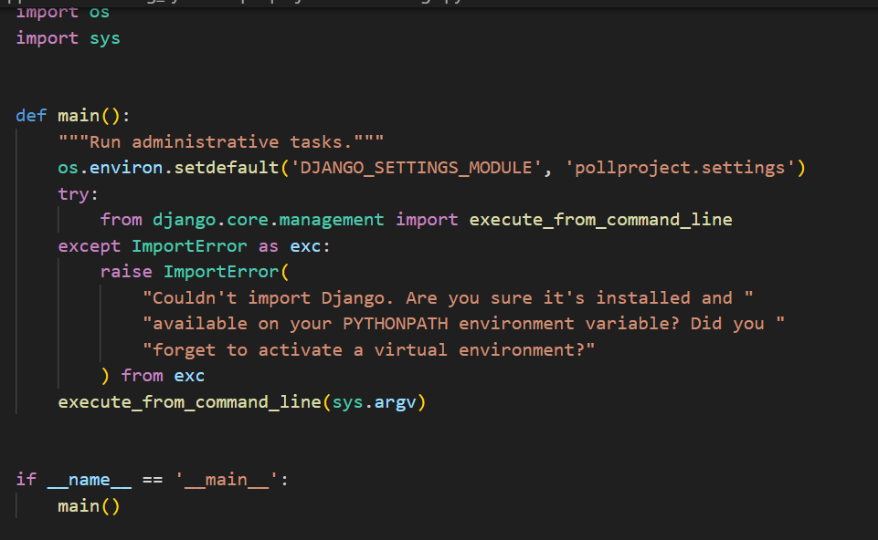
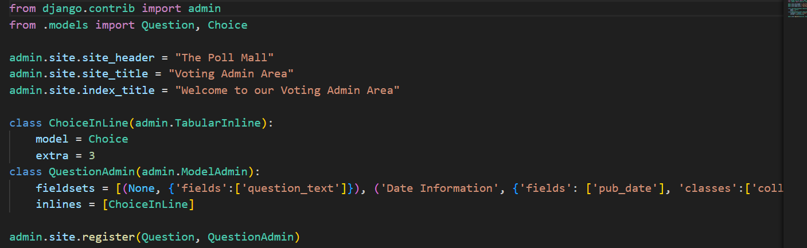
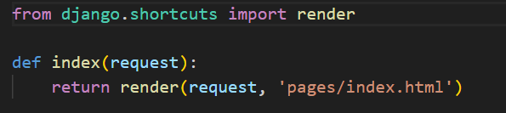
CODE

Slide 7
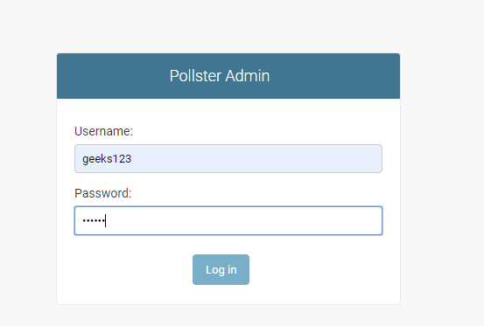
Output

Slide 8
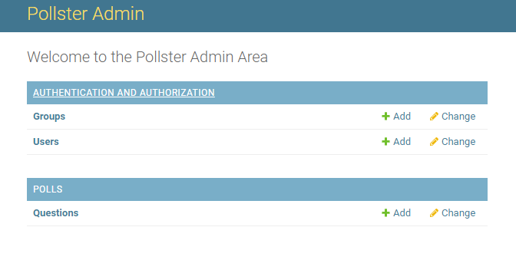
Output

Slide 9
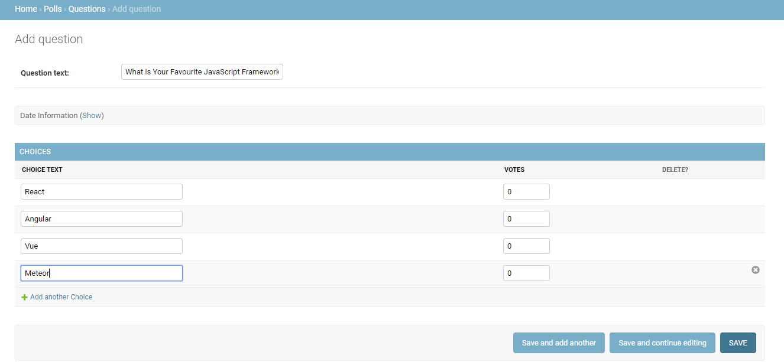
Output

Slide 10
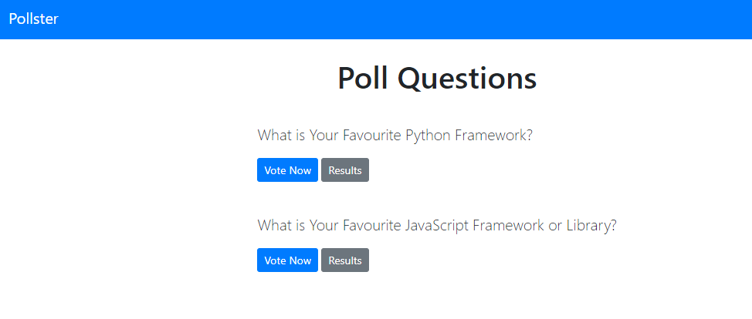
Output

Slide 11
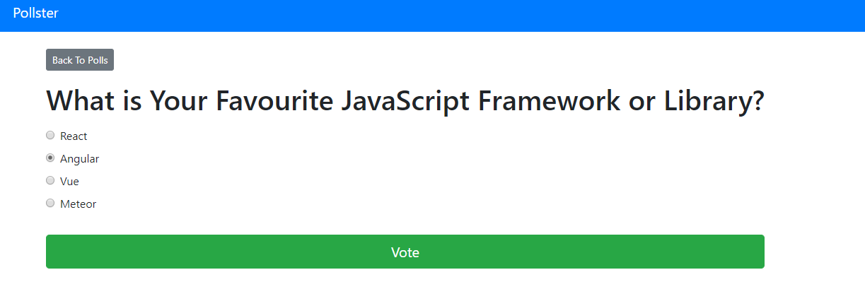
Output

Slide 12
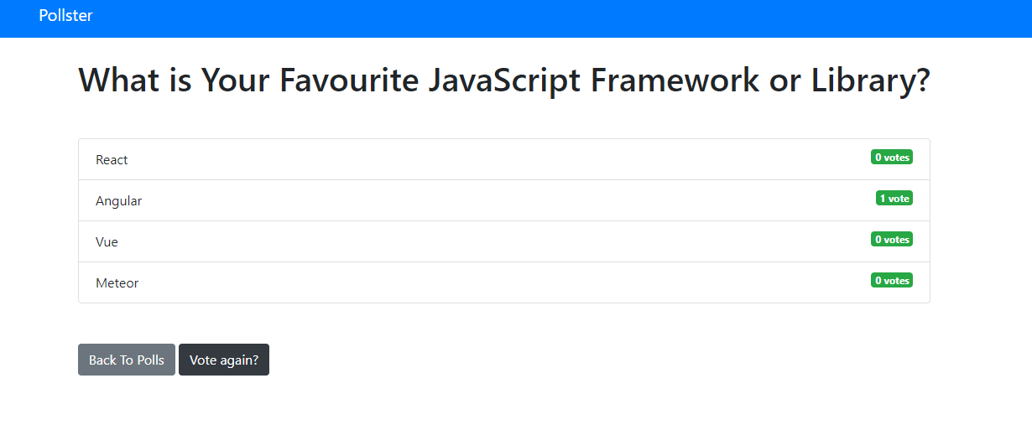
Output

Slide 13
Thank you

