Slide 1

Flight Delay Prediction
By Christian, Jan and Niklas
https://www.tunisair.com/de

Slide 2
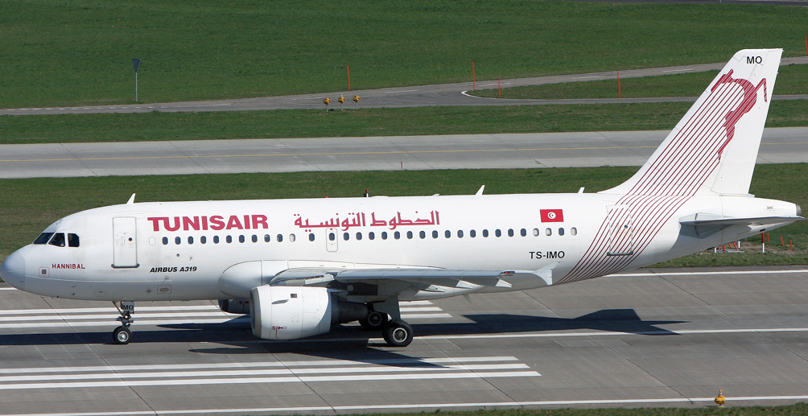
Table of contents
Introduction of our client
Dataset
Exploratory data analysis
Results
Conclusion

Slide 3
Tunisair
National airline of Tunesia
Founded 1948
Main base: Tunis-Carthage International Airport
Current fleet of 28 aircrafts (mostly Boeing and Airbus)
Source: Wikipedia

Slide 4
Business Trend
 | 2016 | 2017 | 2018
Number of employees | 3,579 | 3,765 | -
Number of passengers (in million) | 3.0 | 3.5 | 3.8
Passenger load factor (in %) | - | 74.4 | 74.5
Number of aircraft (at year end) | 29 | 29 | 28
Source: Wikipedia

Slide 5
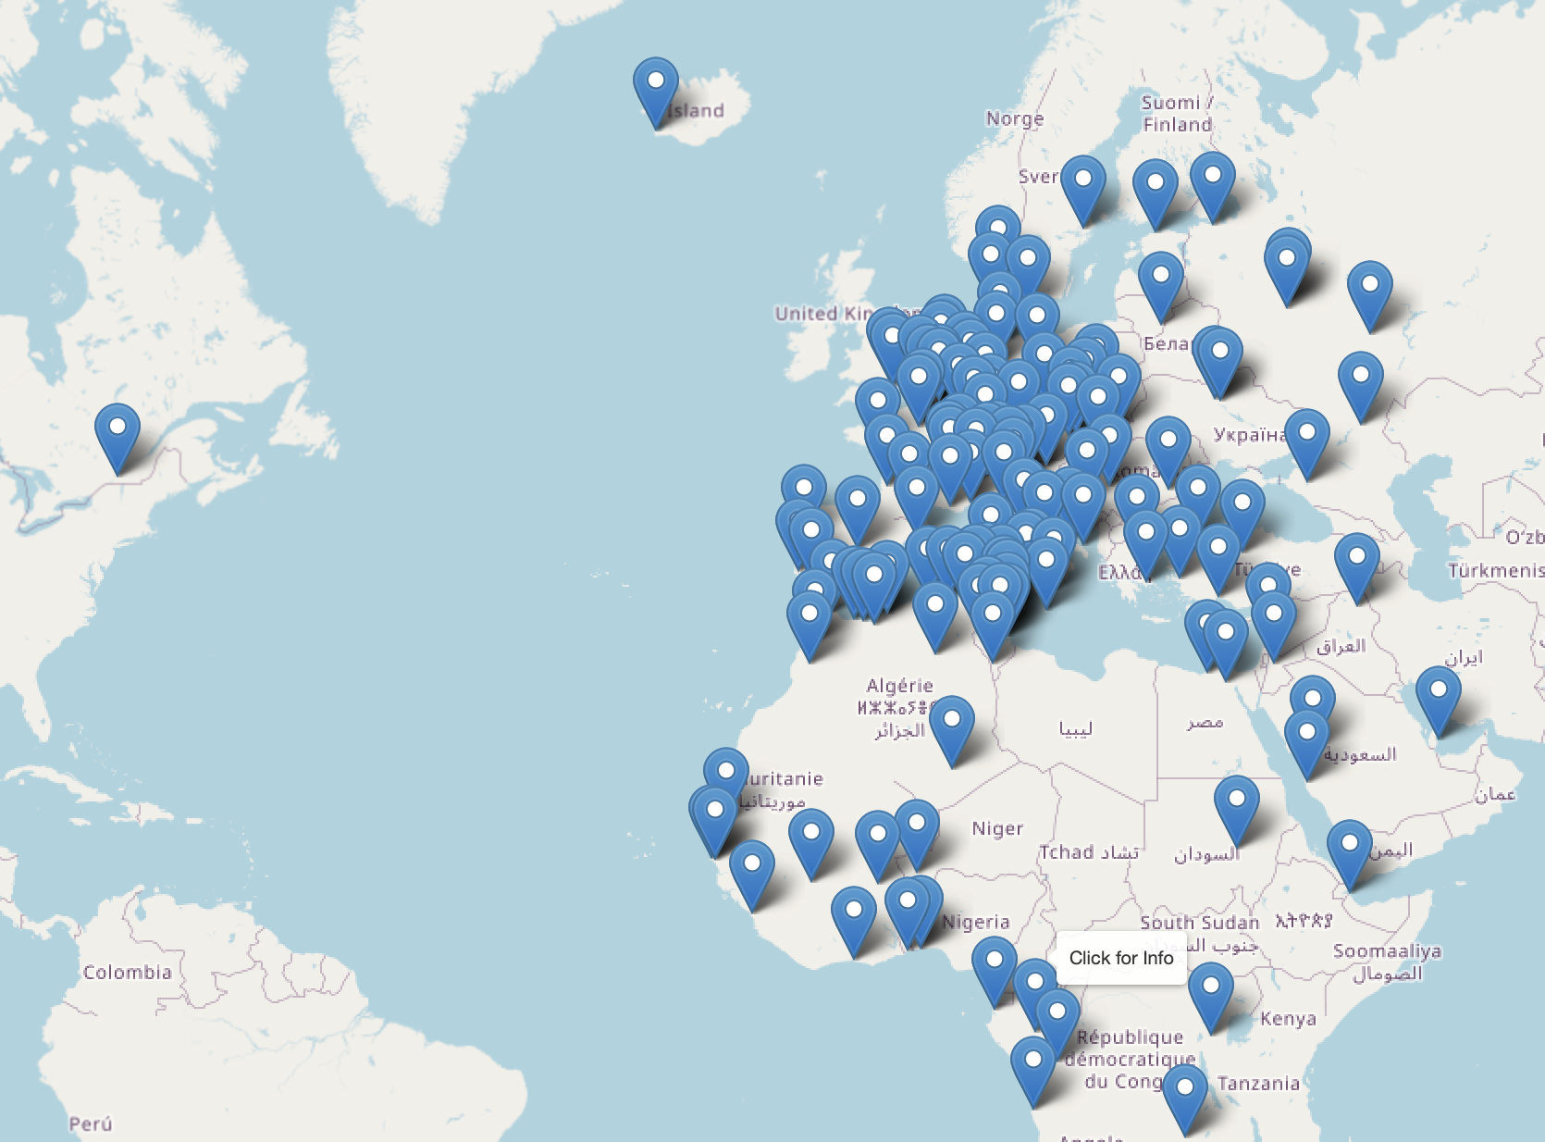
Destinations based on dataset
4 continents
130 destinations
415 routes

Slide 6
Dataset
107833 flights divided in 10 parameters
Dataset ranges from January 2016 to December 2018
No missing values in the dataset
Around 130 airports are served
68 aircrafts used

Slide 7
Structure of the dataset
Column | Description
ID | Row ID
DATOP | Operation date
FLITID | Flight ID
DEPSTN | Departure destination
ARRSTN | Arrival destination
STD | Scheduled departure time
STA | Scheduled arrival time
STATUS | Status of the flight
AC | Aircraft registration and type
target | Delay time
Status:
ATA
DEP
SCH
RTR
DEL
Notes:
Arrival and Departure airport in unique three-letter IATA Identifier
AC is a combination of Type and aircraft registration number

Slide 8
Exploratory data analysis (EDA)
Removed delay outliers (> 4h)
Status RTR not considered
Focused on top 10 most frequent airports (departure/arrival)
Considered the departure hour as a parameter
After EDA we used 48729 flights to predict delay in minutes
Notes:
RTR = Return flight, start and target the same

Slide 9
The given basemodel
Hypothesis:
All flights with a departure time between 7 am and 10 am have a delay of 15 minutes

Slide 10
Impactful drivers based on the linear regression model
Most impactful drivers:
Least impactful drivers:
Value | Driver
103.87 | Aircraft type 345
33.66 | Aircraft type 343
26.89 | Status delivery
24.14 | Status scheduled
20.56 | Aircraft type 31B
Value | Driver
0.31 | Scheduled dep. time 10 am
0.43 | Aircraft type 332
0.44 | Scheduled dep. time 1 am
0.56 | Scheduled dep. time 9 am
1.02 | Scheduled dep. time 4 am

Slide 11
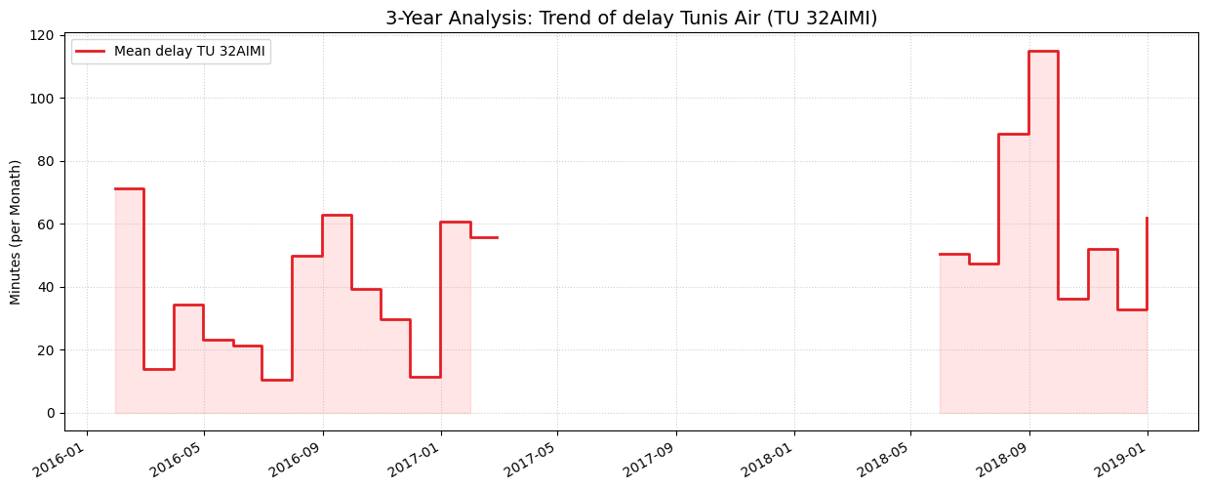
Aircraft TU 32AIMI

Slide 12
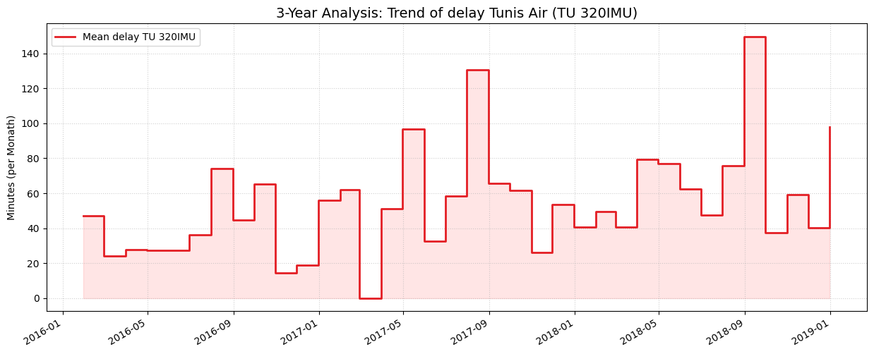
Aircraft TU 320IMU

Slide 13
Evaluation metric
 | Root mean squared error [min] | R squared [-]
Baseline Model | 50.4 | -0.29
Linear Regression | 39.76 | 0.16
Elastic Net | 40.65 | 0.16
Random Forest | 39.29 | 0.17
XGBoost | 38.79 | 0.16
Notes:
Now we are getting to the evaluation part.
As we can see in the table we used different models and two metrics to compare the models.
The first one is the root mean squared error calculated in minutes. What does it mean?
It‘s a value which tells us how much our calculated delay differs from the actual delay of the flight in average.
The second one is the r squared value, it’s a metric for how good our model is.
Normally the r squared value is between 0 and 1.
But as you can see in the baseline model we got a negative value for the baseline model.
That means that the model is worse than the average value.
We started with baseline model. As already mentioned the given baseline model consider the hypothesis that every flight with a departure time between 7 and 10 am has a delay of 15 min, all other flights don‘t have a delay
Then
Was besagt der RSME Wert aus?: Es ist präziser zu sagen, dass der RMSE die durchschnittliche Abweichung (Fehlerspanne) deiner Vorhersage von den tatsächlichen Werten beschreibt, nicht die Verteilung der Werte selbst. In deinem Beispiel Verspätung: Wenn dein Modell einen RMSE von 5 Minuten hat, bedeutet das vereinfacht: Deine Vorhersagen liegen im Schnitt etwa 5 Minuten neben der echten Verspätung.
Negativer R squared value: Ein negatives 𝑅2 bedeutet schlichtweg, dass dein Modell schlechter ist als der Durchschnittswert der Daten.

Slide 14
Conclusion
Recommendation: Consider more parameters for the model
More detailed data (e.g. general weather data) may improve the flight delay predictions
Keep in mind that not every delay can be influenced by the airline, see pie chart on the right
Source: Eurocontrol (2018)
Notes:
Common Drivers for Delays (2018)
45-49 % Airlines:
Technical Defects -> aircraft or type
Missing Crews -> aircraft
Delayed arrival -> aircraft, airport_dep, airport_arrival
30-35 % Air Traffic Control (ATC)
Capacity Bottlenecks in the air or the ground
10 % Weather
Thunderstorms, snow, …
Other matters
Strikes, passenger problems, security checks

Slide 15

Now it is time for questions
https://github.com/nilorenz/ml-project-flight-delay-tunisair

Slide 16
Sources:
https://www.eurocontrol.int/sites/default/files/2019-06/prr-2018.pdf, last access 07.04.2026
https://www.eurocontrol.int/sites/default/files/2019-11/nm-annual-network-operations-report-2018-main-report.pdf, last access 07.04.2026
https://en.wikipedia.org/wiki/Tunisair, last access 07.04.2026

