Slide 1
Information Retrieval and Web Search
Lecture 1: Boolean retrieval

Slide 2
Syllabus
Boolean retrieval
Vocabulary, Dictionary and Indexing
Scoring, term weighting & the vector space model
Computing scores in a complete search system
Evaluation in information retrieval
Relevance feedback & query expansion
Probabilistic information retrieval
Language models for information retrieval
Text classification & Naive Bayes
Vector space classification
Support vector machines
Learning to rank
Flat and Hierarchical clustering
Matrix decompositions & latent semantic indexing
Web search basics
Web crawling and indexes

Slide 3
Information Retrieval
Information Retrieval (IR) is finding material (usually documents) of an unstructured nature (usually text) that satisfies an information need from within large collections (usually stored on computers).

Slide 4
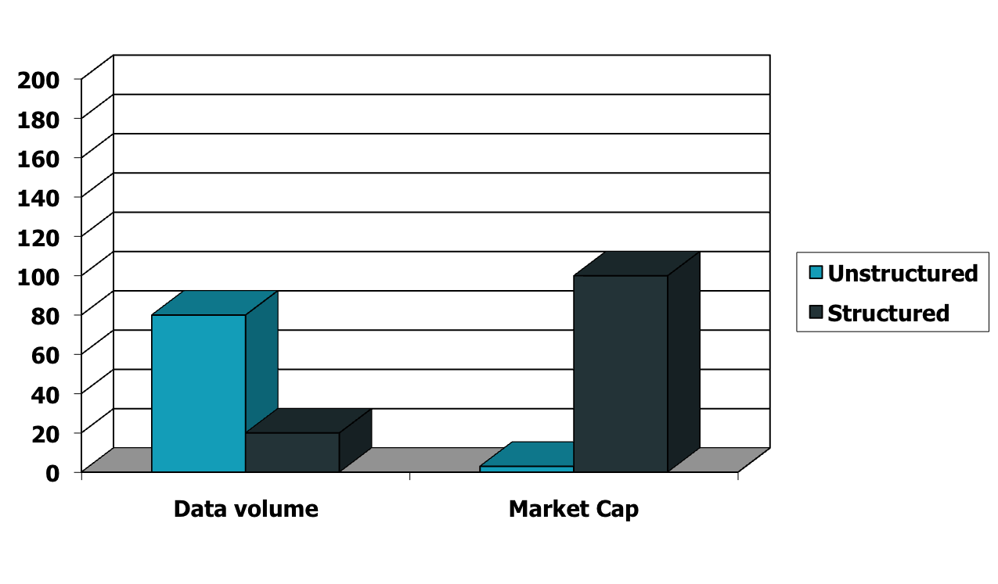
Unstructured (text) vs. structured (database) data in 1996

Slide 5

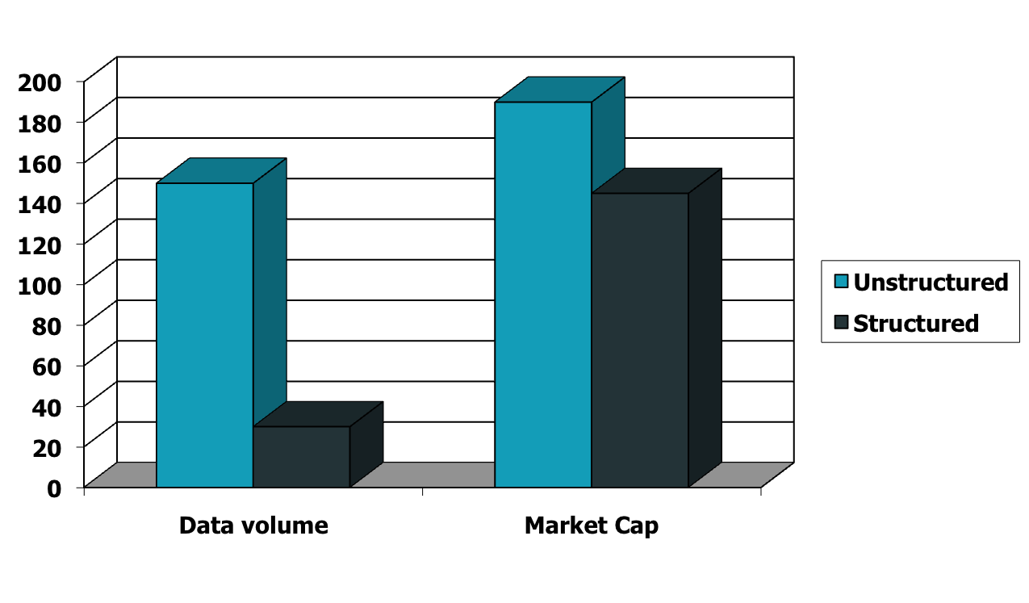



Unstructured (text) vs. structured (database) data in 2009

Slide 6
Unstructured data in 1680
Which plays of Shakespeare contain the words Brutus AND Caesar but NOT Calpurnia?
One could grep all of Shakespeare’s plays for Brutus and Caesar, then strip out lines containing Calpurnia?
Why is that not the answer?
  Slow (for large corpora)
  NOT Calpurnia is non-trivial
  Other operations (e.g., find the word Romans near countrymen) not feasible
  Ranked retrieval (best documents to return)
    Later lectures
Notes:
Grep is line-oriented; IR is document oriented.

Slide 7
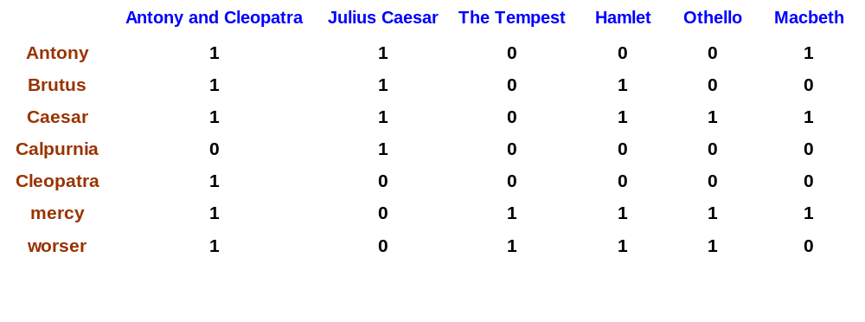
Term-document incidence
Sec. 1.1
1 if play contains word, 0 otherwise
Brutus AND Caesar BUT NOT Calpurnia

Slide 8
Incidence vectors
So we have a 0/1 vector for each term.
To answer query: take the vectors for Brutus, Caesar and Calpurnia (complemented) ➔ bitwise AND.
110100 AND 110111 AND 101111 = 100100.

Slide 9
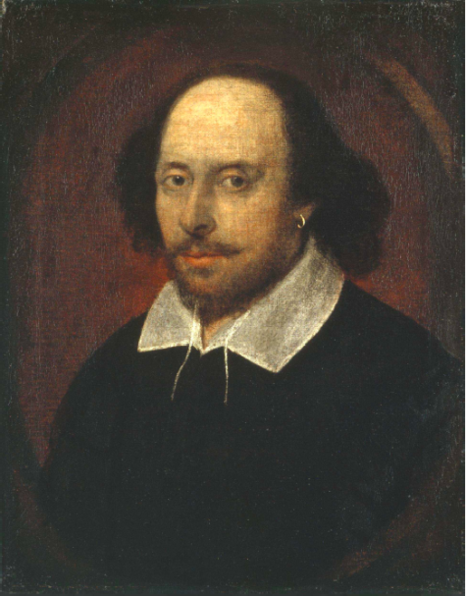
Answers to query
Antony and Cleopatra, Act III, Scene ii
Agrippa [Aside to DOMITIUS ENOBARBUS]: Why, Enobarbus,
When Antony found Julius Caesar dead,
He cried almost to roaring; and he wept
When at Philippi he found Brutus slain.
Hamlet, Act III, Scene ii
Lord Polonius: I did enact Julius Caesar I was killed i' the
Capitol; Brutus killed me.

Slide 10
Basic assumptions of Information Retrieval
Collection: Fixed set of documents
Goal: Retrieve documents with information that is relevant to the user’s information need and helps the user complete a task

Slide 11

The classic search model
TASK
Get rid of mice in a politically correct way
Misconception?
Info Need
Info about removing mice
without killing them
Mistranslation?
Verbal form
How do I trap mice alive?
Misformulation?
Query
mouse trap
SEARCH
ENGINE
Query
Refinement
Results
Corpus

Slide 12
How good are the retrieved docs?
Precision : Fraction of retrieved docs that are relevant to user’s information need
Recall : Fraction of relevant docs in collection that are retrieved
More precise definitions and measurements to follow in later lectures

Slide 13
Bigger collections
Consider N = 1 million documents, each with about 1000 words.
Avg 6 bytes/word including spaces/punctuation
  6GB of data in the documents.
Say there are M = 500K distinct terms among these.

Slide 14
Can’t build the matrix
500K x 1M matrix has half-a-trillion 0’s and 1’s.
But it has no more than one billion 1’s.
  matrix is extremely sparse.
What’s a better representation?
  We only record the 1 positions.
Why?

Slide 15
Inverted index
For each term t, we must store a list of all documents that contain t.
  Identify each by a docID, a document serial number
Can we use fixed-size arrays for this?
Brutus
1
2
4
11
31
45
173
174
Caesar
1
2
4
5
6
16
57
132
Calpurnia
2
31
54
101
What happens if the word Caesar is added to document 14?

Slide 16
Inverted index
We need variable-size postings lists
  On disk, a continuous run of postings is normal and best
  In memory, can use linked lists or variable length arrays
    Some tradeoffs in size/ease of insertion
Posting
Brutus
1
2
4
11
31
45
173
174
Caesar
1
2
4
5
6
16
57
132
Calpurnia
2
31
54
101
Dictionary
Postings
Sorted by docID (more later on why).
Notes:
Linked lists generally preferred to arrays
Dynamic space allocation
Insertion of terms into documents easy
Space overhead of pointers

Slide 17





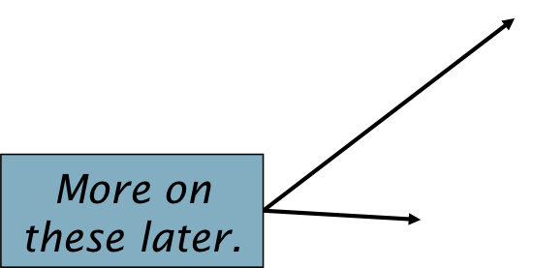
Inverted index construction
Documents to
be indexed
Friends, Romans, countrymen.
Tokenizer
Token stream
Friends
Romans
Countrymen
Linguistic modules
friend
roman
countryman
Modified tokens
Indexer
friend
2
4
roman
1
2
Inverted index
countryman
13
16

Slide 18

Indexer steps: Token sequence
Sequence of (Modified token, Document ID) pairs.
Doc 1
Doc 2
I did enact Julius
Caesar I was killed
i' the Capitol;
Brutus killed me.
So let it be with
Caesar. The noble
Brutus hath told you
Caesar was ambitious

Slide 19

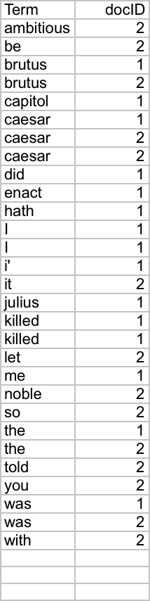
Indexer steps: Sort
Sort by terms
  And then docID
Core indexing step

Slide 20

Indexer steps: Dictionary & Postings
Multiple term entries in a single document are merged.
Split into Dictionary and Postings
Doc. frequency information is added.
Why frequency?
Will discuss later.

Slide 21
Where do we pay in storage?
Lists of docIDs
Terms and counts
Later in the course:
How do we index efficiently?
How much storage do we need?
Pointers

Slide 22
The index we just built
How do we process a query?
  Later - what kinds of queries can we process?
Today’s focus

Slide 23
Query processing: AND
Consider processing the query:
  Brutus AND Caesar
  Locate Brutus in the Dictionary;
    Retrieve its postings.
  Locate Caesar in the Dictionary;
    Retrieve its postings.
  “Merge” the two postings:
2
4
8
16
32
64
128
Brutus
1
2
3
5
8
13
21
34
Caesar

Slide 24
The merge
Sec. 1.3
Walk through the two postings simultaneously, in time linear in the total number of postings entries
2
2
4
4
8
8
16
16
32
64
128
32
64
128
Brutus
2
8
1
Caesar
1
2
2
3
5
5
8
8
13
13
21
21
34
3
34
If list lengths are x and y, merge takes O(x+y) operations.
Crucial: postings sorted by docID.

Slide 25

Intersecting two postings lists
(a “merge” algorithm)

Slide 26
Query optimization
What is the best order for query processing?
Consider a query that is an AND of n terms.
For each of the n terms, get its postings, then AND them together.
Brutus
2
4
8
16
32
64
128
Caesar
1
2
3
5
8
16
21
34
Calpurnia
13
16
Query: Brutus AND Calpurnia AND Caesar

Slide 27
Query optimization example
Process in order of increasing freq:
  start with smallest set, then keep cutting further.
This is why we kept
document freq. in dictionary
Brutus
2
4
8
16
32
64
128
Caesar
1
2
3
5
8
16
21
34
Calpurnia
13
16
Execute the query as (Calpurnia AND Brutus) AND Caesar.

Slide 28
More general optimization
e.g., (madding OR crowd) AND (ignoble OR strife)
Get doc. freq.’s for all terms.
Estimate the size of each OR by the sum of its doc. freq.’s (conservative).
Process in increasing order of OR sizes.

Slide 29
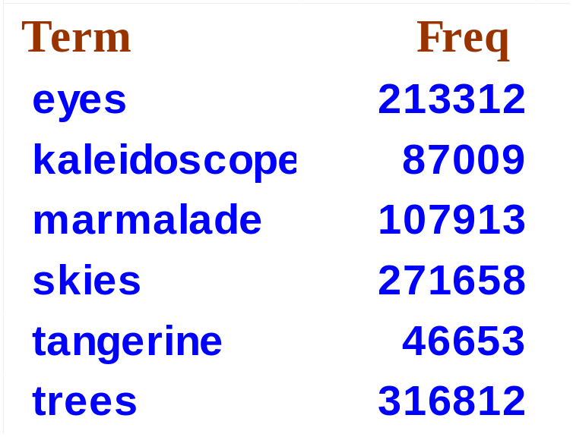
Exercise
Recommend a query processing order for
(tangerine OR trees) AND
(marmalade OR skies) AND
(kaleidoscope OR eyes)

Slide 30
Boolean queries:
More general merges
Exercise: Adapt the merge for the queries:
Brutus AND NOT Caesar
Brutus OR NOT Caesar
Can we still run through the merge in time O(x+y)?
What can we achieve?

