Slide 1
Lecture 8: Evaluation

Slide 2
This lecture
Sec. 6.2
How do we know if our results are any good?
Evaluating a search engine
Benchmarks
Precision and recall
Results summaries:
Making our good results usable to a user
2

Slide 3
EVALUATING SEARCH ENGINES
Notes:
3

Slide 4
Measures for a search engine
Sec. 8.6
How fast does it index
Number of documents/hour
(Average document size)
How fast does it search
Latency as a function of index size
Expressiveness of query language
Ability to express complex information needs
Speed on complex queries
Uncluttered UI
Is it free?
4
Notes:
4

Slide 5
Measures for a search engine
Sec. 8.6
All of the preceding criteria are measurable: we can quantify speed/size
we can make expressiveness precise
The key measure: user happiness
What is this?
Speed of response/size of index are factors
But blindingly fast, useless answers won’t make a user happy
Need a way of quantifying user happiness
5

Slide 6
Measuring user happiness
Sec. 8.6.2
Issue: who is the user we are trying to make happy?
Depends on the setting
Web engine:
User finds what they want and return to the engine
Can measure rate of return users
User completes their task – search as a means, not end
See Russell http://dmrussell.googlepages.com/JCDL-talk-June-2007-short.pdf
eCommerce site: user finds what they want and buy
Is it the end-user, or the eCommerce site, whose happiness we measure?
Measure time to purchase, or fraction of searchers who become buyers?
6

Slide 7
Measuring user happiness
Sec. 8.6.2
Enterprise (company/govt/academic): Care about “user productivity”
How much time do my users save when looking for information?
Many other criteria having to do with breadth of access, secure access, etc.
7

Slide 8
Happiness: elusive to measure
Sec. 8.1
Most common proxy: relevance of search results
But how do you measure relevance?
We will detail a methodology here, then examine its issues
Relevance measurement requires 3 elements:
A benchmark document collection
A benchmark suite of queries
A usually binary assessment of either Relevant or Nonrelevant for each query and each document
Some work on more-than-binary, but not the standard
8

Slide 9
Evaluating an IR system
Sec. 8.1
Note: the information need is translated into a query
Relevance is assessed relative to the information need not the query
E.g., Information need: I'm looking for information on whether drinking red wine is more effective at reducing your risk of heart attacks than white wine.
Query: wine red white heart attack effective
You evaluate whether the doc addresses the information need, not whether it has these words
9

Slide 10
Standard relevance benchmarks
Sec. 8.2
TREC - National Institute of Standards and Technology (NIST) has run a large IR test bed for many years
Reuters and other benchmark doc collections used
“Retrieval tasks” specified
sometimes as queries
Human experts mark, for each query and for each doc, Relevant or Nonrelevant
or at least for subset of docs that some system returned for that query
10

Slide 11
Unranked retrieval evaluation: Precision and Recall
Sec. 8.3
Precision: fraction of retrieved docs that are relevant = P(relevant|retrieved)
Recall: fraction of relevant docs that are retrieved = P(retrieved|relevant)
Precision P = tp/(tp + fp)
Recall R = tp/(tp + fn)
 | Relevant | Nonrelevant
Retrieved | tp | fp
Not Retrieved | fn | tn
11

Slide 12
Should we instead use the accuracy measure for evaluation?
Sec. 8.3
Given a query, an engine classifies each doc as “Relevant” or “Nonrelevant”
The accuracy of an engine: the fraction of these classifications that are correct
(tp + tn) / ( tp + fp + fn + tn)
Accuracy is a commonly used evaluation measure in machine learning classification work
Why is this not a very useful evaluation measure in IR?
12
Notes:
12

Slide 13
Why not just use accuracy?
Sec. 8.3
How to build a 99.9999% accurate search engine on a low budget….
People doing information retrieval want to find something and have a certain tolerance for junk.
Snoogle.com
Search for:
0 matching results found.
13
Notes:
13

Slide 14
Precision/Recall
Sec. 8.3
You can get high recall (but low precision) by retrieving all docs for all queries!
Recall is a non-decreasing function of the number of docs retrieved
In a good system, precision decreases as either the number of docs retrieved or recall increases
This is not a theorem, but a result with strong empirical confirmation
14
Notes:
14

Slide 15
Difficulties in using precision/recall
Sec. 8.3
Should average over large document collection/query ensembles
Need human relevance assessments
People aren’t reliable assessors
Assessments have to be binary
Nuanced assessments?
Heavily skewed by collection/authorship
Results may not translate from one domain to another
15
Notes:
15

Slide 16
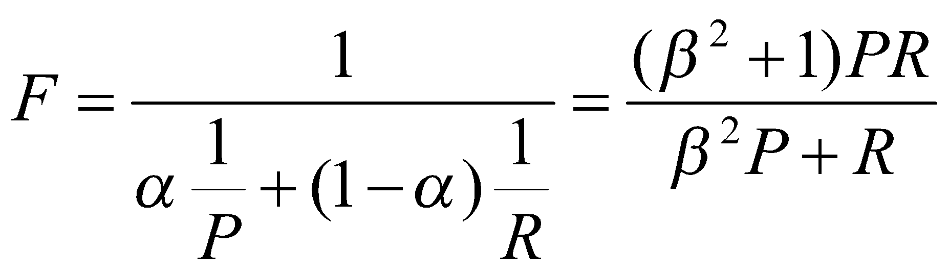
A combined measure: F
Sec. 8.3
Combined measure that assesses precision/recall tradeoff is F measure (weighted harmonic mean):
People usually use balanced F₁ measure
i.e., with β = 1 or α = ½
Harmonic mean is a conservative average
See CJ van Rijsbergen, Information Retrieval
16
Notes:
16

Slide 17
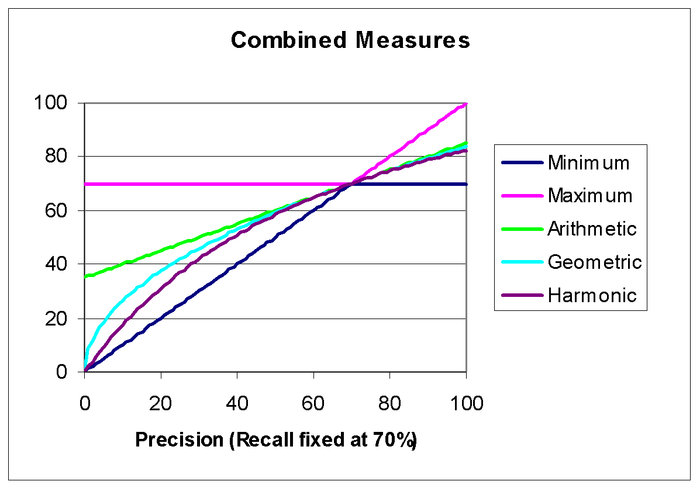
F₁ and other averages
Sec. 8.3
17
Notes:
17

Slide 18
Evaluating ranked results
Sec. 8.4
Evaluation of ranked results:
The system can return any number of results
By taking various numbers of the top returned documents (levels of recall), the evaluator can produce a precision-recall curve
18
Notes:
18

Slide 19
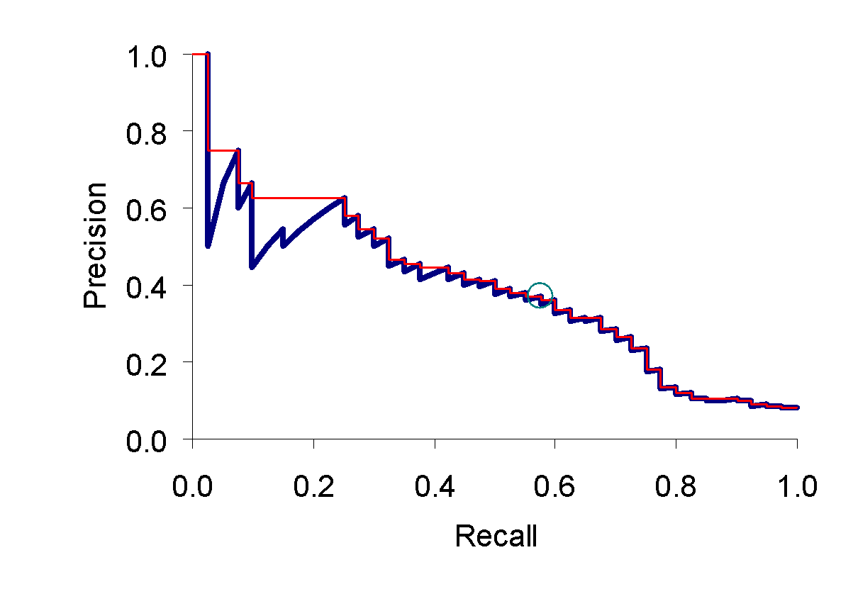
A precision-recall curve
Sec. 8.4
19
Notes:
19

Slide 20
Averaging over queries
Sec. 8.4
A precision-recall graph for one query isn’t a very sensible thing to look at
You need to average performance over a whole bunch of queries.
But there’s a technical issue:
Precision-recall calculations place some points on the graph
How do you determine a value (interpolate) between the points?
20
Notes:
20

Slide 21
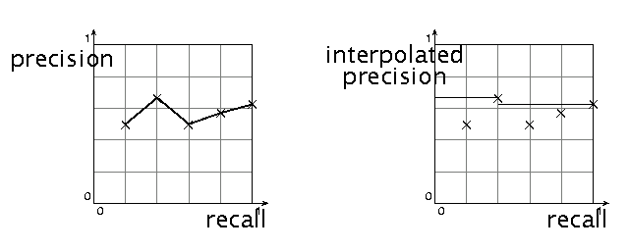
Interpolated precision
Sec. 8.4
Idea: If locally precision increases with increasing recall, then you should get to count that…
So you max of precisions to right of value
21
Notes:
21

Slide 22
Evaluation
Sec. 8.4
Graphs are good, but people want summary measures!
Precision at fixed retrieval level
Precision-at-k: Precision of top k results
Perhaps appropriate for most of web search: all people want are good matches on the first one or two results pages
But: averages badly and has an arbitrary parameter of k
11-point interpolated average precision
The standard measure in the early TREC competitions: you take the precision at 11 levels of recall varying from 0 to 1 by tenths of the documents, using interpolation (the value for 0 is always interpolated!), and average them
Evaluates performance at all recall levels
22
Notes:
22

Slide 23
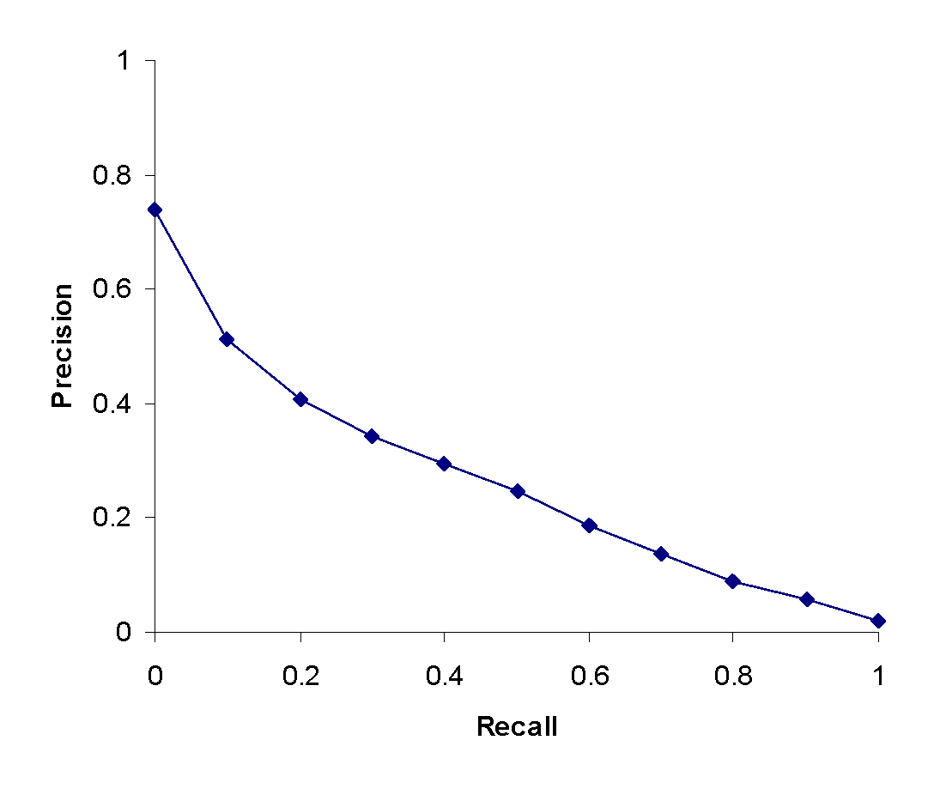
Typical (good) 11 point precisions
Sec. 8.4
SabIR/Cornell 8A1 11pt precision from TREC 8 (1999)
23
Notes:
23

Slide 24
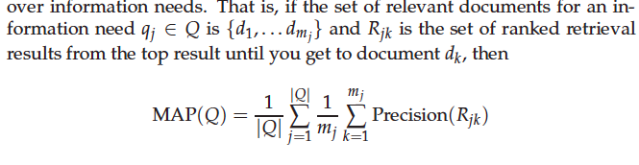
Yet more evaluation measures…
Sec. 8.4
Mean average precision (MAP)
Average of the precision value obtained for the top k documents, each time a relevant doc is retrieved
Avoids interpolation, use of fixed recall levels
MAP for query collection is arithmetic ave.
Macro-averaging: each query counts equally
24
Notes:
24

Slide 25
Yet more evaluation measures…
Sec. 8.4
Precision@k
Unstable, not possible to average
R-precision
If have known (though perhaps incomplete) set of relevant documents of size Rel, then calculate precision of top Rel docs returned
Perfect system could score 1.0.
25
Notes:
25

Slide 26
Yet more evaluation measures…
Break-Point: When precision and recall is same. R-precision is same as break-point.
Precision at K
Measures factor in precision at all recall level, that is measuring precision at all low level of retrieved level
Advantage : Does not require any estimate of the size of the set of relevant documents
Disadvantage: It is the least stable of the commonly used evaluation measures and that it does not average well

Slide 27
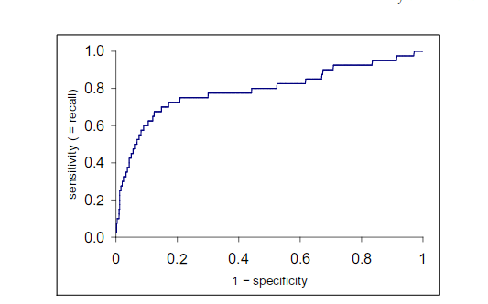
ROC curve

Slide 28


ROC : Receiver Operating Characteristics
ROC curve : Sensitivity vs (1- specificity)
Sensitivity : True positive rate
Specificity : True negative rate
Cumulative gain:
Where is the graded relevance of the result at position i.

Slide 29
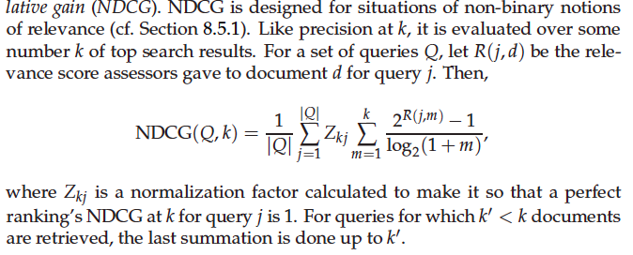
NDCG

Slide 30
Variance
Sec. 8.4
For a test collection, it is usual that a system does crummily on some information needs (e.g., MAP = 0.1) and excellently on others (e.g., MAP = 0.7)
Indeed, it is usually the case that the variance in performance of the same system across queries is much greater than the variance of different systems on the same query.
That is, there are easy information needs and hard ones!
30
Notes:
30

Slide 31
CREATING TEST COLLECTIONS FOR IR EVALUATION
Notes:
31

Slide 32
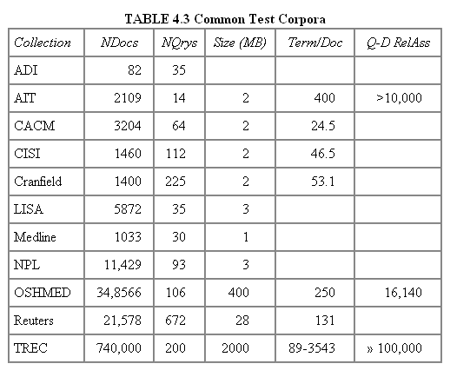
Test Collections
Sec. 8.5
32
Notes:
32

Slide 33
From document collections to test collections
Sec. 8.5
Still need
Test queries
Relevance assessments
Test queries
Must be germane to docs available
Best designed by domain experts
Random query terms generally not a good idea
Relevance assessments
Human judges, time-consuming
Are human panels perfect?
33
Notes:
33

Slide 34
Unit of Evaluation
Sec. 8.5
We can compute precision, recall, F, and ROC curve for different units.
Possible units
Documents (most common)
Facts (used in some TREC evaluations)
Entities (e.g., car companies)
May produce different results. Why?
34
Notes:
34

Slide 35
Kappa measure for inter-judge (dis)agreement
Sec. 8.5
Kappa measure
Agreement measure among judges
Designed for categorical judgments
Corrects for chance agreement
Kappa = [ P(A) – P(E) ] / [ 1 – P(E) ]
P(A) – proportion of time judges agree
P(E) – what agreement would be by chance
Kappa = 0 for chance agreement, 1 for total agreement.
35
Notes:
35

Slide 36
Kappa Measure: Example
Sec. 8.5
P(A)? P(E)?
Number of docs | Judge 1 | Judge 2
300 | Relevant | Relevant
70 | Nonrelevant | Nonrelevant
20 | Relevant | Nonrelevant
10 | Nonrelevant | Relevant
36
Notes:
36

Slide 37
Kappa Example
Sec. 8.5
P(A) = 370/400 = 0.925
P(nonrelevant) = (10+20+70+70)/800 = 0.2125
P(relevant) = (10+20+300+300)/800 = 0.7878
P(E) = 0.2125^2 + 0.7878^2 = 0.665
Kappa = (0.925 – 0.665)/(1-0.665) = 0.776
Kappa > 0.8 = good agreement
0.67 < Kappa < 0.8 -> “tentative conclusions” (Carletta ’96)
Depends on purpose of study
For >2 judges: average pairwise kappas
37
Notes:
37

Slide 38
TREC
Sec. 8.2
TREC Ad Hoc task from first 8 TRECs is standard IR task
50 detailed information needs a year
Human evaluation of pooled results returned
More recently other related things: Web track, HARD
A TREC query (TREC 5)
<top>
<num> Number: 225
<desc> Description:
What is the main function of the Federal Emergency Management Agency (FEMA) and the funding level provided to meet emergencies? Also, what resources are available to FEMA such as people, equipment, facilities?
</top>
38
Notes:
38

Slide 39
Standard relevance benchmarks: Others
Sec. 8.2
GOV2
Another TREC/NIST collection
25 million web pages
Largest collection that is easily available
But still 3 orders of magnitude smaller than what Google/Yahoo/MSN index
NTCIR
East Asian language and cross-language information retrieval
Cross Language Evaluation Forum (CLEF)
This evaluation series has concentrated on European languages and cross-language information retrieval.
Many others
39
Notes:
39

Slide 40
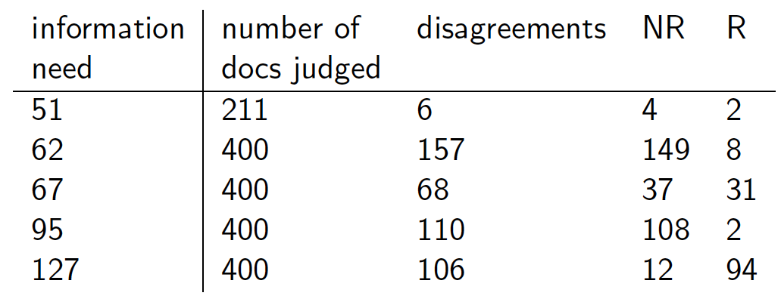
Interjudge Agreement: TREC 3
Sec. 8.5
40
Notes:
40

Slide 41
Impact of Inter-judge Agreement
Sec. 8.5
Impact on absolute performance measure can be significant (0.32 vs 0.39)
Little impact on ranking of different systems or relative performance
Suppose we want to know if algorithm A is better than algorithm B
A standard information retrieval experiment will give us a reliable answer to this question.
41
Notes:
41

Slide 42
Critique of pure relevance
Sec. 8.5.1
Relevance vs Marginal Relevance
A document can be redundant even if it is highly relevant
Duplicates
The same information from different sources
Marginal relevance is a better measure of utility for the user.
Using facts/entities as evaluation units more directly measures true relevance.
But harder to create evaluation set
See Carbonell reference
42
Notes:
42

Slide 43
Can we avoid human judgment?
Sec. 8.6.3
No
Makes experimental work hard
Especially on a large scale
In some very specific settings, can use proxies
E.g.: for approximate vector space retrieval, we can compare the cosine distance closeness of the closest docs to those found by an approximate retrieval algorithm
But once we have test collections, we can reuse them (so long as we don’t overtrain too badly)
43
Notes:
43

Slide 44
Evaluation at large search engines
Sec. 8.6.3
Search engines have test collections of queries and hand-ranked results
Recall is difficult to measure on the web
Search engines often use precision at top k, e.g., k = 10
. . . or measures that reward you more for getting rank 1 right than for getting rank 10 right.
NDCG (Normalized Cumulative Discounted Gain)
Search engines also use non-relevance-based measures.
Clickthrough on first result
Not very reliable if you look at a single clickthrough … but pretty reliable in the aggregate.
Studies of user behavior in the lab
A/B testing
44
Notes:
44

Slide 45
A/B testing
Sec. 8.6.3
Purpose: Test a single innovation
Prerequisite: You have a large search engine up and running.
Have most users use old system
Divert a small proportion of traffic (e.g., 1%) to the new system that includes the innovation
Evaluate with an “automatic” measure like clickthrough on first result
Now we can directly see if the innovation does improve user happiness.
Probably the evaluation methodology that large search engines trust most
In principle less powerful than doing a multivariate regression analysis, but easier to understand
45
Notes:
45

Slide 46
RESULTS PRESENTATION
Sec. 8.7
46
Notes:
46

Slide 47
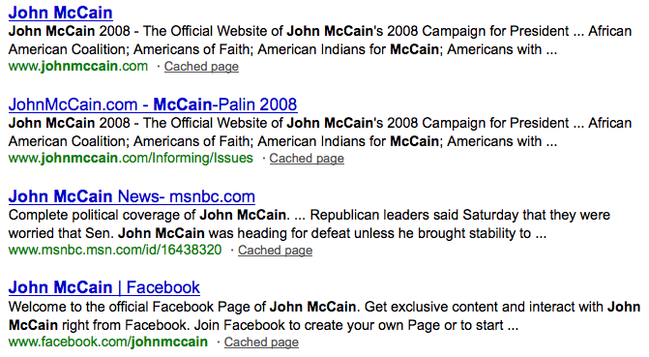
Result Summaries
Sec. 8.7
Having ranked the documents matching a query, we wish to present a results list
Most commonly, a list of the document titles plus a short summary, aka “10 blue links”
47
Notes:
47

Slide 48
Summaries
Sec. 8.7
The title is often automatically extracted from document metadata. What about the summaries?
This description is crucial.
User can identify good/relevant hits based on description.
Two basic kinds:
Static
Dynamic
A static summary of a document is always the same, regardless of the query that hit the doc
A dynamic summary is a query-dependent attempt to explain why the document was retrieved for the query at hand
48
Notes:
48

Slide 49
Static summaries
Sec. 8.7
In typical systems, the static summary is a subset of the document
Simplest heuristic: the first 50 (or so – this can be varied) words of the document
Summary cached at indexing time
More sophisticated: extract from each document a set of “key” sentences
Simple NLP heuristics to score each sentence
Summary is made up of top-scoring sentences.
Most sophisticated: NLP used to synthesize a summary
Seldom used in IR; cf. text summarization work
49
Notes:
49
Topic is TREC topic
Judged is number of documents that human assessors judged
Diff is the number that they disagreed on.
NR and R are whether those were eventually classified as relevant or nonrelevant.

Slide 50






Dynamic summaries
Sec. 8.7
Present one or more “windows” within the document that contain several of the query terms
“KWIC” snippets: Keyword in Context presentation
50
Notes:
50

Slide 51
Techniques for dynamic summaries
Sec. 8.7
Find small windows in doc that contain query terms
Requires fast window lookup in a document cache
Score each window wrt query
Use various features such as window width, position in document, etc.
Combine features through a scoring function – methodology to be covered Nov 12th
Challenges in evaluation: judging summaries
Easier to do pairwise comparisons rather than binary relevance assessments
51
Notes:
51

Slide 52

Quicklinks
For a navigational query such as united airlines user’s need likely satisfied on www.united.com
Quicklinks provide navigational cues on that home page
52
Notes:
52

Slide 53


53
Notes:
Not very reliable if you look at a single clickthrough (you may
realize after clicking that the summary was misleading and the
document is nonrelevant) . . .
53

Slide 54
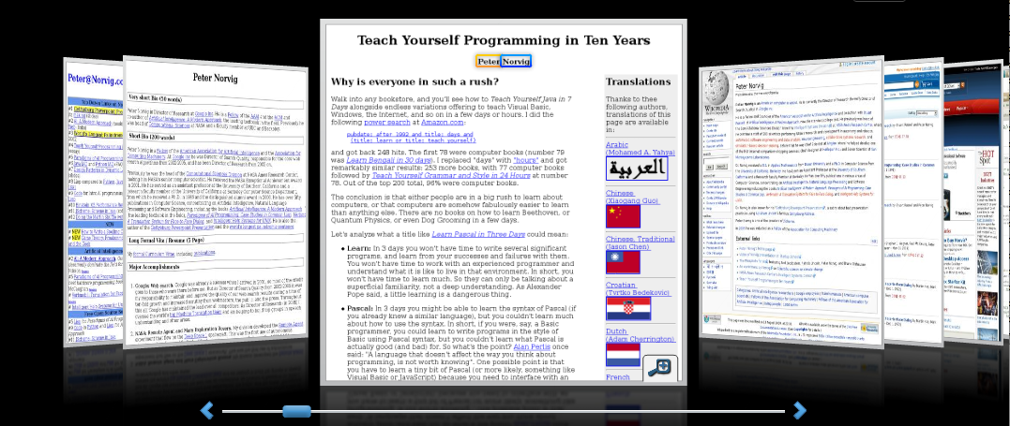
Alternative results presentations?
An active area of HCI research
An alternative: http://www.searchme.com / copies the idea of Apple’s Cover Flow for search results
(searchme recently went out of business)
54
Notes:
54

Slide 55
Resources for this lecture
IIR 8
MIR Chapter 3
MG 4.5
Carbonell and Goldstein 1998. The use of MMR, diversity-based reranking for reordering documents and producing summaries. SIGIR 21.
55
Notes:
55

