Slide 1
An overview of Gnutella

Slide 2
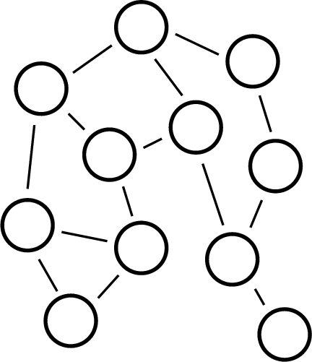
A generic view of a P2P network
object1
object2
peer
peer
No central authority.
Notes:
Gnutalla networks are dumb.
Just a bunch of nodes connected together with 3 or 4 connections each
What’s the only way they can communicate??
- They have to asked their neighbours – and then ask their neighbours to ask their neighbours
- peers provide client-side interfaces for issuing queries and viewing search results AND accept search queries from other peers
Due to its distributed nature, a network of Gnutella nodes is highly fault-tolerant i.e. operation of the network will not be interrupted if a subset go offline.

Slide 3
What is Gnutella?
Gnutella is a protocol for distributed search
peer-to-peer comm
decentralized model
No third party lookup
Two stages:
Join Network … later
Use Network, I.e discover / search other peers
Notes:
Gnutalla networks are dumb.
Just a bunch of nodes connected together with 3 or 4 connections each
What’s the only way they can communicate??
- They have to asked their neighbours – and then ask their neighbours to ask their neighbours
- peers provide client-side interfaces for issuing queries and viewing search results AND accept search queries from other peers
Due to its distributed nature, a network of Gnutella nodes is highly fault-tolerant i.e. operation of the network will not be interrupted if a subset go offline.

Slide 4
History
The Gnutella network is a fully distributed
alternative to the centralized Napster.
Initial popularity of the network was spurred
on by Napster's threatened legal demise in
early 2001. This growing surge in popularity
revealed the limits of the initial protocol's scalability.
In early 2001, variations on the protocol improved
the scalability. Instead of treating every user
as client and server, some users were treated
as "ultrapeers", routing search requests and
responses for users connected to them.

Slide 5
Gnutella Jargon
Servent: A Gnutella node. Each servent is both a server and a client.
2 Hops
Hops: a hop is a pass through an intermediate node
1 Hop
client
TTL: how many hops a packet can go before it dies
(default setting is 7 in Gnutella)

Slide 6
Gnutella Scenario
Step 0: Join the network
Step 1: Determining who is on the network
  "Ping" packet is used to announce your presence on the network.
  Other peers respond with a "Pong" packet.
  Also forwards your Ping to other connected peers
  A Pong packet also contains:
    an IP address
    port number
    amount of data that peer is sharing
    Pong packets come back via same route
Step 2: Searching
  Gnutella "Query" ask other peers if they have the file you desire A Query packet might ask, "Do you have any content that matches the string ‘Double Helix"?
  Peers check to see if they have matches & respond (if they have any matches) & send packet to connected peers
  Continues for TTL
Step 3: Downloading
  Peers respond with a “QueryHit” (contains contact info)
  File transfers use direct connection using HTTP protocol’s GET method
Notes:
Step 1: Determining who is on the network
A "Ping" packet is used to announce your presence on the network. When another computer hears your Ping it will respond with a "Pong" packet. It will also forward your Ping packet to other computers to which it is connected and, in response, they too will send back Pong packets. Each Ping and Pong packet contains a Globally Unique Identifier (GUID). A Pong packet also contains an IP address, port number, and information about how much data is being shared by the computer that sent the Pong. Pong packets are not necessarily returned directly to the point of origin, instead they are sent from computer to computer via the same route as the initial Ping. After sending a Ping to one computer you will start receiving many Pong responses via that one computer. Now that the Pong packets have told you who your active peers are, you can start making searches.
Step 2: Searching
Gnutella is a protocol for distributed search. Gnutella "Query" packets allow you to search by asking other computers if they are sharing specific content (and have an acceptably fast network connection). A Query packet might ask, "Do you have any content that matches the string ‘Homer"? This question is sent to all the computers that sent you Pong packets. Each of these computers does two things. First, each computer checks to see if it has any content that matches the search string. In this case it looks to see if there are any files in a specified directory marked "sharable to the outside world" that have the letters "Homer" in its complete file path. Second, each computer sends your Query packet on to all the computers to which it is connected. These computers check their directories and send your Query packet to all their connected computers. This process continues until you run out of computers to ask or until the Query packet gets too old and times out. This last detail is important because without a pre-defined Time To Live (TTL) the Query packet could get bounced around for a very long time, potentially forever. Most servents, including Toadnode, allow you to adjust the TTL. GUIDs in each packet are used to make sure that the same message does not get passed to the same computer again and again, creating a loop.
Step 3: Downloading
By the time you are ready to download, the question you asked in your Query packet has been distributed to a huge number of computers. Each computer has checked its shared information and determined if it is sharing anything that matches "Homer". Let us say that three computers that received your Query packet have a match for "Homer". The last two packet descriptors, called "QueryHit" and "Push" are responsible for content delivery. Each of the three computers will send you a QueryHit packet via the same delivery route, computer-to-computer, that the Query packet originally traveled. The QueryHit packet contains the IP address and GUID of the computer that has the data as well as information about the file that matched your query.
When you receive a QueryHit packet your servent software will display the name of the file for you and give you the option to download. File transfers use the HTTP protocol’s GET method directly between your computer and the computer that has the file you want. Normally, your computer will initiate the HTTP connection to the computer that has the file. Occasionally, due to a firewall, you will be unable to initiate a connection directly to the computer that has the file you want. In these cases the "Push" packet is used. The Push packet allows a message to be delivered to the computer that has the file you would like to download via the route that the QueryHit packet originally traveled, except in reverse. The Push packet tells this computer that you would like to download a file but cannot manage to initiate an HTTP connection. This computer then becomes the initiator, attempting to connect directly to you, which often is possible because the firewall between the machines is only limiting connections initiated from outside the firewall.

Slide 7
Remarks
Simple idea , but lacks scalability, since query flooding wastes bandwidth.
Sometimes, existing objects may not be located due to limited TTL.
Subsequently, various improved search strategies have been proposed.

Slide 8
Searching in Gnutella
The topology is dynamic, I.e. constantly changing. How do
we model a constantly changing topology? Usually, we begin
with a static topology, and later account for the effect of churn.
Modeling Static topology (measurements provide useful inputs)
Random graph
Power law graph

Slide 9
Random graph: Erdös-Rényi model
A random graph G(n, p) is constructed by starting with
a set of n vertices, and adding edges between pairs of
nodes at random. Every possible edge occurs independently
with probability p.
Q. Is Gnutella topology a random graph?

Slide 10
Gnutella topology
Gnutella topology is actually a power-law graph.
(Also called scale-free graph)
What is a power-law graph?
The number of nodes with degree k = c.k ^{- r}
(Contrast this with Gaussian distribution where the number of nodes
with degree k = c. 2 ^{- k. )}
________________
Many graphs in the nature exhibit power-law characteristics.
Examples, world-wide web (the number of pages that have k in-links
Is proportional to k ⁻ ²), The fraction of scientific papers that receive k
citations is k ^{-3 etc.}

Slide 11
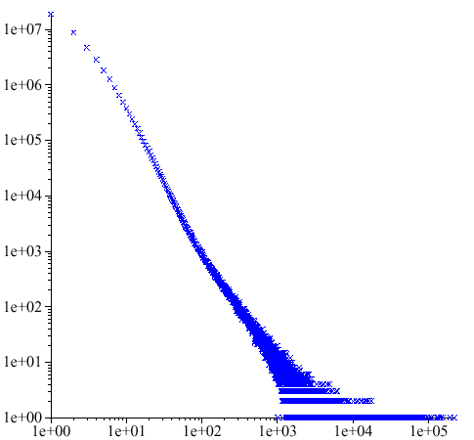
AT&T Call Graph
How many telephone
numbers receive calls from k
different telephone numbers?
# of telephone numbers
from which calls were made
# of telephone numbers called
4

Slide 12
Gnutella network
power-law link distribution
data
10
2
power-law fit
τ
= 2.07
10
1
proportion of nodes
10
0
10
0
10
1
number of neighbors
summer 2000,
data provided by Clip2
5

Slide 13
A possible explanation
Nodes join at different times.
The more connections a node has, the more likely
it is to acquire new connections (“Rich gets richer”).
Popular webpages attract new pointers.
It has been mathematically shown that such a growth
process produces power-law network
7

Slide 14
Search strategies
Flooding
Random walk /
- Biased random walk/
- Multiple walker random walk
(Combined with)
One-hop replication /
Two-hop replication
k-hop replication

Slide 15
On Random walk
Let p(d) be the probability that a random walk on a d-D lattice returns to the origin. In 1921, Pólya proved that,
(1) p(1)=p(2)=1, but
(2) p(d)<1 for d>2
There are similar results
on two walkers meeting
each other via random walk

Slide 16
Search via random walk
Existence of a path does
not necessarily mean that
such a path can be discovered
Notes:
Gnutella networks are dumb.
Just a bunch of nodes connected together with 3 or 4 connections each
What’s the only way they can communicate??
- They have to asked their neighbours – and then ask their neighbours to ask their neighbours
- peers provide client-side interfaces for issuing queries and viewing search results AND accept search queries from other peers
Due to its distributed nature, a network of Gnutella nodes is highly fault-tolerant i.e. operation of the network will not be interrupted if a subset go offline.

Slide 17
Search via Random Walk
Search metrics
Delay = discovery time in hops
Overhead = total distance covered by the walker
Both should be as small as possible.
For a single random walker, these are equal.
K random walkers is a compromise.
For search by flooding, if delay = h then
overhead = d + d² + … + d^{h} where
d = degree of a node.

Slide 18
A simple analysis of random walk
Let p = Population of the object. i.e. the fraction of nodes hosting the object
T = TTL (time to live)
Hop count h | probability
1 | p
2 | (1-p).p
3 | (1-p)².p
T | (1-p)^{T-1}.p

Slide 19
A simple analysis of random walk
Expected hop count E(h) =
1.p + 2.(1-p).p + 3(1-p)².p + …+ T.(1-p)^{T-1}.p
= 1/p. (1-(1-p)^{T}) - T(1-p)^{T}
With a large TTL, E(h) = 1/p, which is intuitive.
With a small TTL, there is a risk that search will time out before an existing object is located.

Slide 20
K random walkers
Assume they all k walkers start in unison. Probability that none could
find the object after one hop = (1-p)^{k}. The probability. that none succeeded after k hops = (1-p)^{kT.} So the probability that at least one walker succeeded is 1-(1-p)^{kT.} A typical assumption is that the search is abandoned as soon as at least one walker succeeds
Expected overhead = 1-(1-p)^{T-1} - T. (1-p)^{T-1} . k
p
As k increases, the overhead increases, but the delay decreases. There is a tradeoff.

Slide 21
Increasing search efficiency
Major strategies
Biased walk utilizing node degree heterogeneity.
Utilizing structural properties like random graph, power-law graphs, or small-world properties
Topology adaptation for faster search
Introducing two layers in the graph structure using supernodes

Slide 22
One hop replication
Each node keeps track of the indices of the files belonging to its
immediate neighbors. As a result, high capacity / high degree nodes
can provide useful clues to a large number of search queries.
Where is

Slide 23
Biased random walk
P=5/10
P=2/10
P=3/10
Each node records the degree of the neighboring nodes. Search
easily gravitates towards high degree nodes that hold more clues.

Slide 24
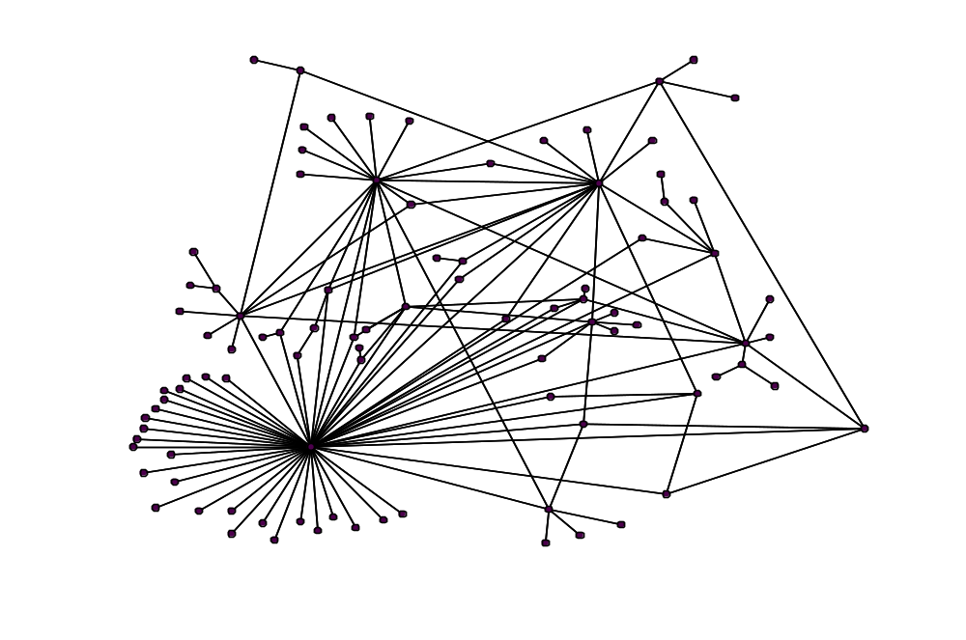
power-law graph
number of
nodes found
94
67
63
54
2
6
1
Deterministic biased walk
9

Slide 25
The KaZaA approach
Where is
ABC?
download
ABC
Supernode
Supernode
Powerful nodes (supernodes) act as local index servers, and
client queries are propagated to other supernodes. Two-layered
architecture.

