Slide 1
Challenges, Design and Analysis of a Large-scale P2P-VoD System
Yan Huang∗, Tom Z. J. Fu#, Dah-Ming Chiu#, John C. S. Lui and Cheng Huang∗
∗{galehuang, ivanhuang}@pplive.com, Shanghai Synacast Media Tech.
#{zjfu6, dmchiu}@ie.cuhk.edu.hk, The Chinese University of Hong Kong
cslui@cse.cuhk.edu.hk, The Chinese University of Hong Kong
ACM SIGCOMM 2008

Slide 2
Outline
P2P overview
An architecture of a P2P-VoD system
Performance metrics
Measurement results and analysis
Conclusions

Slide 3
P2P Overview
Advantages of P2P
  Users help each other so that the server load is significantly reduced.
  P2P increases robustness in case of failures by replicating data over multiple peers.
P2P services
  P2P file downloading : BitTorrent and Emule
  P2P live streaming : Coolstreaming, PPStream and PPLive
  P2P video-on-demand (P2P-VoD) : Joost, GridCast, PFSVOD, UUSee, PPStream, PPLive...

Slide 4
P2P-VoD System Properties
Less synchronous compared to live streaming
  Like P2P streaming systems, P2P-VoD systems also deliver the content by streaming, but peers can watch different parts of a video at the same time.
Requires more storage
  P2P-VoD systems require each user to contribute a small amount of storage (usually 1GB) instead of only the playback buffer in memory as in the P2P streaming system.
Requires careful design of mechanisms for
  Content Replication
  Content Discovery
  Peer Scheduling

Slide 5
P2P-VoD system
Servers
  The source of content
Trackers
  Help peers connect to other peers to share the content
Bootstrap server
  Helps peers to find a suitable tracker
Peers
  Run P2P-VoD software
  Implement DHT(Dynamic Hash Table)
Other servers
  Log servers : log significant events for data measurement
  Transit servers : help peers behind NAT boxes

Slide 6
Design Issues To Be Considered
Segment size
Replication strategy
Content discovery
Piece selection
Transmission Strategy
Others:
  NAT and Firewalls
  Content Authentication

Slide 7
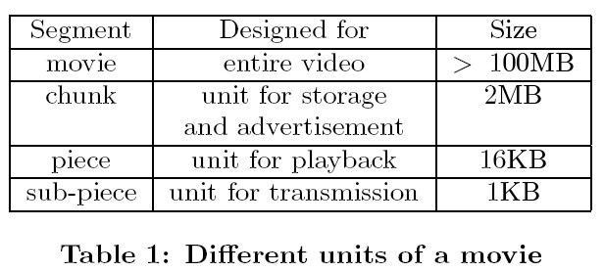
Segment Size
What is a suitable segment size?
  Small
    More flexibility of scheduling
    But larger overhead
      Header overhead
      Bitmap overhead
      Protocol overhead
  Large
    Smaller overhead
    Limited by viewing rate
Segmentation of a movie in PPLive’s VoD system

Slide 8
Replication Strategy
Goal
  To make the chunks as available to the user population as possible to meet users’ viewing demand
Considerations
  Whether to allow multiple movies be cached
    Multiple movie cache (MVC) - more flexible for satisfying user demands
      PPLive uses MVC
    Single movie cache (SVC) - simple
  Whether to pre-fetch or not
    Improves performance
    Unnecessarily wastes uplink bandwidth
    In ADSL, upload capacity is affected if there is simultaneous download
    Dynamic peer behavior increases risk of wastage
      PPLive chooses not to pre-fetch

Slide 9
Replication Strategy(Cont.)
  Remove chunks or movies?
    PPLive marks entire movie for removal
  Which chunk/movie to remove
    Least recently used (LRU) –Original choice of PPLive
    Least frequently used (LFU)
    Weighted LRU:
      How complete the movie is already cached locally?
      How needed a copy of movie is ATD (Available To Demand)
        ATD = c/n
        where, c = number of peers having the movie in the cache, n = number of peers watching the movie
        The ATD information for weight computation is provided by the tracker.
        In current systems, the average interval between caching decisions is about 5 to 15 minutes.
        It improves the server loading from 19% down to a range of 11% to 7%.

Slide 10
Content Discovery
Goal : discover the content they need and which peers are holding that content with the minimum overhead.
Trackers
  Used to keep track of which peers have the movie
  User informs tracker when it starts watching or deletes a movie
Gossip method
  Used to discover which chunks are with whom
  Makes the system more robust
DHT
  Used to automatically assign movies to trackers
  Implemented by peers to provide a non-deterministic path to trackers
    Originally DHT is implemented by tracker nodes

Slide 11
Piece Selection
Which piece to download first
  Sequential
    Select the piece that is closest to what is needed for the video playback
  Rarest first
    Select the rarest piece help speeding up the spread of pieces, hence indirectly helps streaming quality.
  Anchor-based
    When a user tries to jump to a particular location in the movie, if the piece for that location is missing then the closest anchor point is used instead.
PPLive gives priority to sequential first and then rarest-first

Slide 12
Transmission Strategy
Goals
  Maximize (to achieve the needed) downloading rate
  Minimize the overheads, dud to duplicated transmissions and requests
Strategies
  A peer can work with one neighbor at a time.
  Request the same content from multiple neighbors simultaneously
  Request the different content from multiple neighbors simultaneously, when a request times out, it is redirected to a different neighbor; PPLive uses this scheme
    For playback rate of 500Kbps, 8~20 neighbors is the best; playback rate of 1Mbps, 16~32 neighbors is the best.
    When the neighboring peers cannot supply sufficient downloading rate, the content server can always be used to supplement the need.

Slide 13
Other Design Issues
NAT
  Discovering different types of NAT boxes
    Full Cone NAT, Symmetric NAT, Port- restricted NAT…
  About 60%-80% of peers are found to be behind NAT
Firewall
  PPLive software carefully pace the upload rate and request rate to make sure the firewalls will not consider PPLive peers as malicious attackers
Content authentication
  Authentication by message digest or digital signature

Slide 14
Measurement Metrics
User behavior
  User arrival patterns
  How long they stayed watching a movie
  Used to improve the design of the replication strategy
External performance metrics
  User satisfaction
  Server load
  Used to measure the system performance perceived externally
Health of replication
  Measures how well a P2P-VoD system is replicating a content
  Used to infer how well an important component of the system is doing

Slide 15
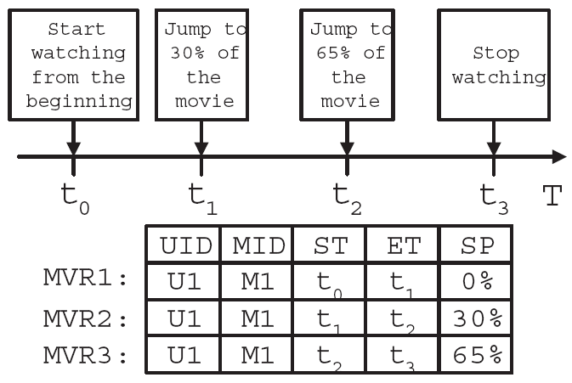
User Behavior-MVR (Movie Viewing Record)
Figure 1: Example to show how MVRs are generated

Slide 16

User Satisfaction
Simple fluency
  Fraction of time a user spends watching a movie out of the total viewing time (waiting and watching time for that movie)
  Fluency F(m,i) for a movie m and user i
  R(m, i) : the set of all MVRs for a given movie m and user i
  n(m, i) : the number of MVRs in R(m, i)
  r : one of the MVRs in R(m, i)
  BT : Buffering Time, ST : Starting Time, ET : Ending Time, and SP : Starting Position

Slide 17
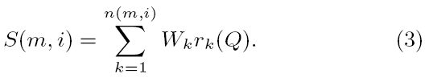

User Satisfaction (Cont1.)
User satisfaction index
  Considers the quality of the delivery of the content
  r(Q) : a grade for the average viewing quality for an MVR r

Slide 18


User Satisfaction (Cont2.)
In Fig. 1, assume there is a buffering time of 10 (time units) for each MVR. The fluency can be computed as:
Suppose the user grade for the three MVR were 0.9, 0.5, 0.9 respectively. Then the user satisfaction index can be calculated as:
Estimate/Infer User Satisfaction

Slide 19
Health of Replication
Health index : use to reflect the effectiveness of the content replication strategy of a P2P-VoD system.
The health index (for replication) can be defined at 3 levels:
  Movie level
    The number of active peers who have advertised storing chunks of that movie
    Information about that movie collected by the tracker
  Weighted movie level
    Considers the fraction of chunks a peer has in computing the index
    If a peers stores 50 percent of a movie, it is counted as 0.5
  Chunk bitmap level
    The number of copies of each chunk of a movie is stored by peer
    Used to compute other statistics
      The average number of copies of a chunk in a movie, the minimum number of chunks, the variance of the number of chunks.

Slide 20
Measurement
All these data traces were collected from 12/ 23/2007 to 12/29/2007
Log server : collect various sorts of measurement data from peers.
Tracker : aggregate the collected information and pass it on to the log server
Peer : collect data and do some amount of aggregation, filtering and pre-computation before passing them to the log server
We have collected the data trace on 10 movies from the P2P-VoD log server
Whenever a peer selects a movie for viewing, the client software creates the MVRs and computes the viewing satisfaction index, and these information are sent to the log server
Assume the playback rate is about 380kbps
To determine the most popular movie, we count only those MVRs whose starting position (SP) is equal to zero (e.g., MVRs which view the movie at the beginning)
  Movie 2 is the most popular movie with 95005 users
  Movie 3 is the least popular movie with 8423 users

Slide 21
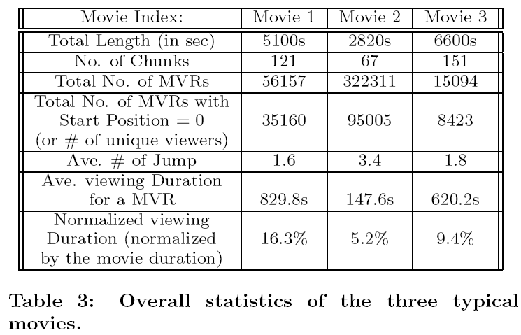
Statistics on video objects
Overall statistics of the 3 typical movies

Slide 22
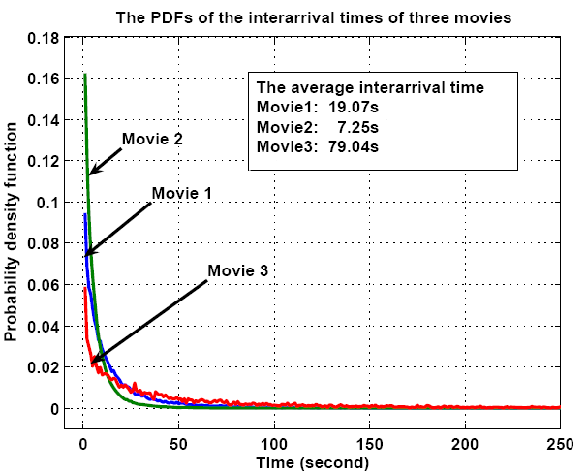
Statistics on user behavior (1) : Interarrival time distribution of viewers
Interarrival times of viewers : the differences of the ST fields between to consecutive MVRs

Slide 23
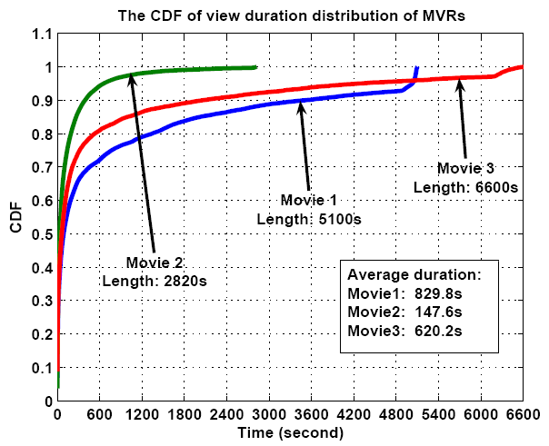
Statistics on user behavior (2) : View duration distribution
Very high percentage of MVRs are of short duration (less than 10 minutes).
This implies that for these 3 movies, the viewing stretch is of short duration with high probability.

Slide 24
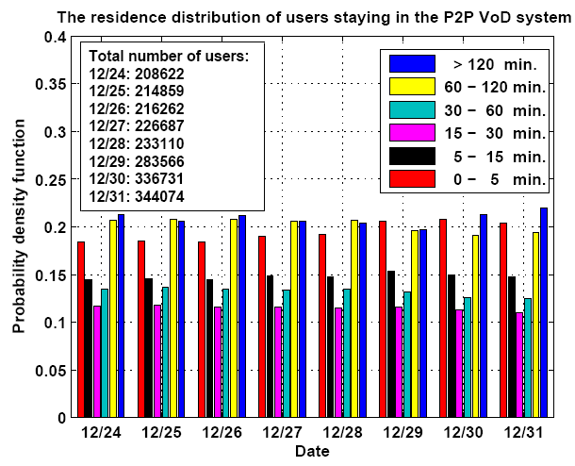
Statistics on user behavior (3) : Residence distribution of users
There is a high fraction of peers (over 70%) which stays in the P2P-VoD system for over 15 minutes, and these peers provide upload services to the community.

Slide 25
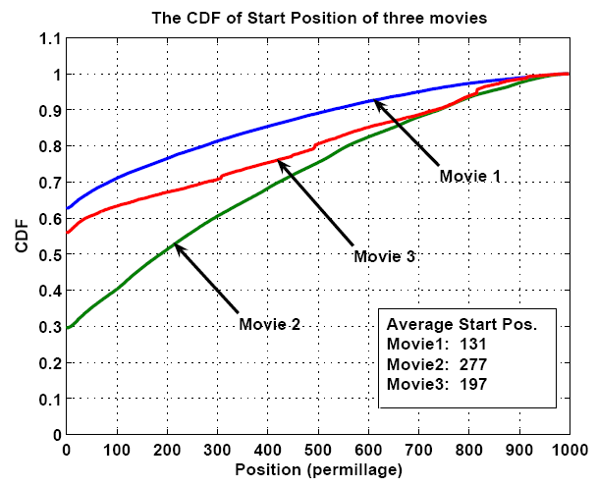
Statistics on user behavior (4): Start position distribution
Users who watch Movie 2 are more likely to jump to some other positions than users who watch Movie 1 and 3

Slide 26
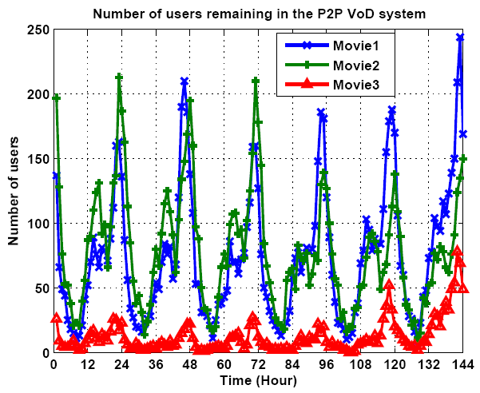
Statistics on user behavior (5): Number of viewing actions
The total number of viewing activities (or
MVRs) at each sampling time point.
“daily periodicity” of user behavior. There are two daily peaks, which occur at around 2:00 P.M. and 11:00 P.M.
Figure 7: Number of viewing actions at each hourly sampling point (6 days measurement).

Slide 27
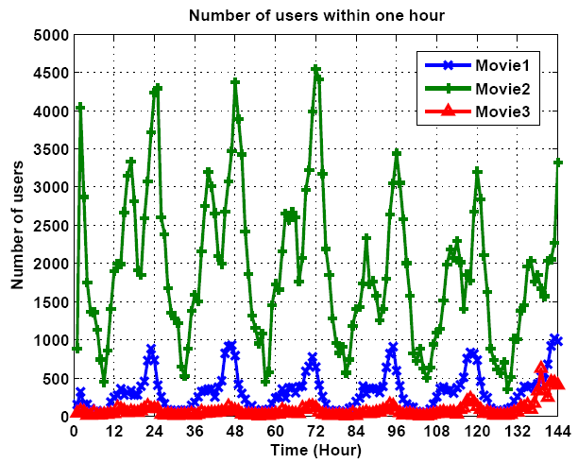
Statistics on user behavior (5): Number of viewing actions(Cont.)
The total number of viewing activities (or MVRs) that occurs
between two sampling points.
“daily periodicity” of user behavior. There are two daily peaks, which occur at around 2:00 P.M. and 11:00 P.M.
Figure 8: Total number of viewing actions within each sampling hour(6 days measurement).

Slide 28
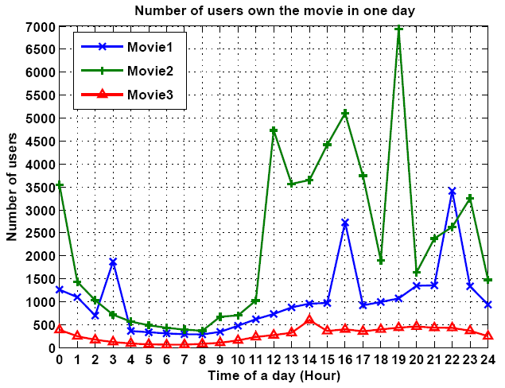
Health index of Movies (1): Number of peers that own the movie
Health index : use to reflect the effectiveness of the content replication strategy of a P2P-VoD system.
Owning a movie implies that the peer is still in the P2P-VoD system.
Movie 2 being the most popular movie.
The number of users owning the movie is lowest during the time frame of 5:00 A.M. to 9:00 A.M.
Figure 9: Number of users owning at least one chunk of the movie at different time points.

Slide 29
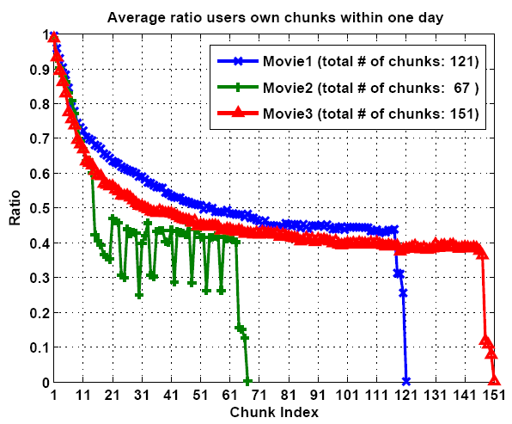

Health index of Movies (2)
Average owning ratios for different chunks
If OR_{i}(t) is low, it means low availability of chunk i in the system.
The health index for “early” chunks is very good.
Many peers may browse through the beginning of a movie.
The health index is still acceptable since at least 30% of the peers have those chunks.
Figure 10: Average owning ratio for all chunks in the three movies.

Slide 30
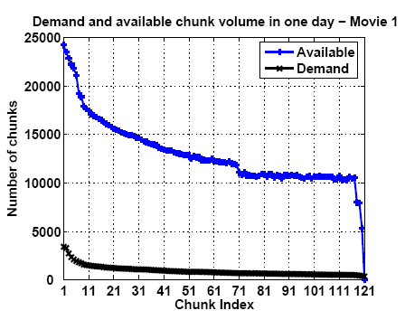
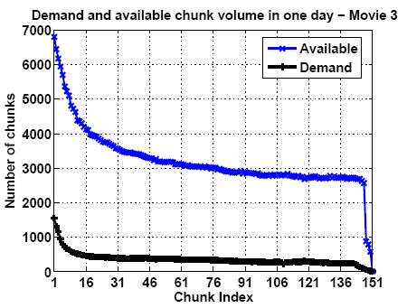
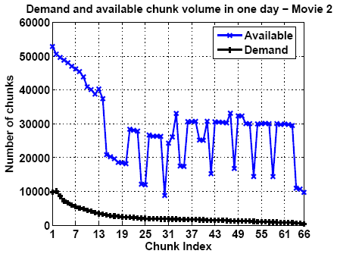
Health index of Movies (3)
The health index for these 3 movies are very good since the number of replicated chunk is much higher than the workload demand.
The large fluctuation of the chunk availability for Movie 2 is due to the high interactivity of users.
(c) Users tend to skip the last chunk of the movie.
Chunk availability and chunk demand
Figure 11: Comparison of number replicated chunks and chunk demand of 3 movies in one day (from 0:00 to 24:00 January 6, 2008).

Slide 31
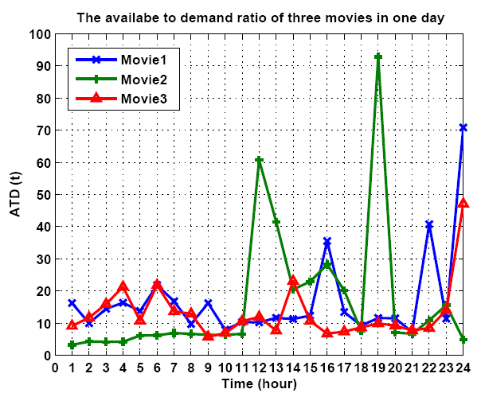

Health index of Movies (4): ATD (Available To Demand) ratios
To provide good scalability and quality viewing, ATDi(t) has to be greater than 1. In here, ATDi(t) ≥ 3 for all time t.
2 peaks for Movie 2
at 12:00 or 19:00.
Figure 12: The ratio of the number of available chunks to the demanded chunks within one day.

Slide 32
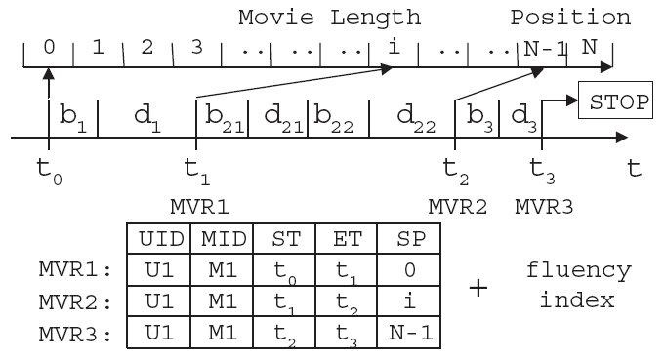
User Satisfaction Index (1)
User satisfaction index is used to measure the quality of viewing as experienced by users.
  A low user satisfaction index implies that peers are unhappy and these peers may choose to leave the system.
Generating fluency index
  F(m, i) is computed by the client software
  The client software reports all MVRs and the fluency F(m, i) to the log server when-
    The STOP button is pressed
    Another movie is selected
    The user turns off the P2P-VoD software

Slide 33
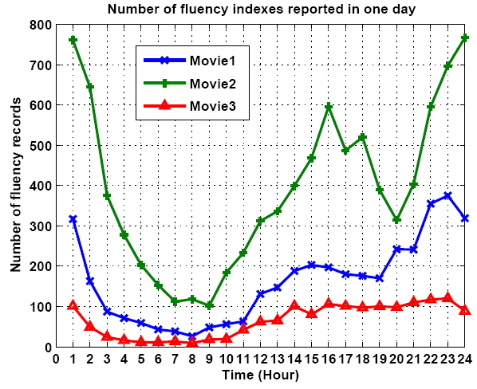
User Satisfaction Index (2)
The number of fluency records
  A good indicator of the number of viewers of the movie
The number of viewers in the system at different time points.
Figure 15: Number of fluency indexes reported by users to the log server.

Slide 34
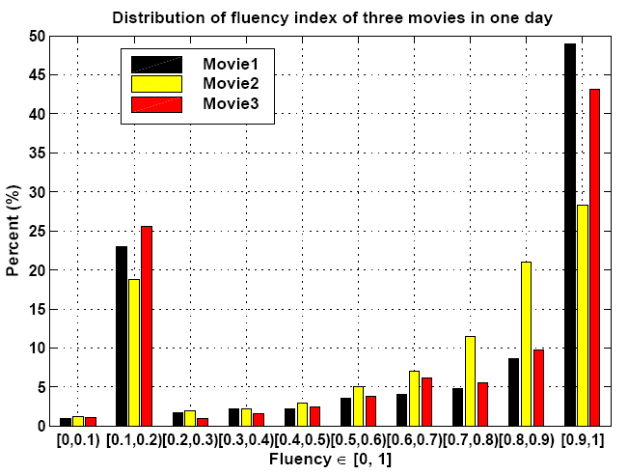
User Satisfaction Index (3): The distribution of fluency index
Good viewing quality: fluency value greater than 0.8
Poor viewing quality:
value less than 0.2
High percentage of fluency indexes whose values are greater than 0.7.
Around 20% of the fluency indexes are less than 0.2. There is a high buffering time (which causes long start-up latency) for each viewing operation.
Figure 16: Distribution of fluency index of users within a 24-hour period.

Slide 35
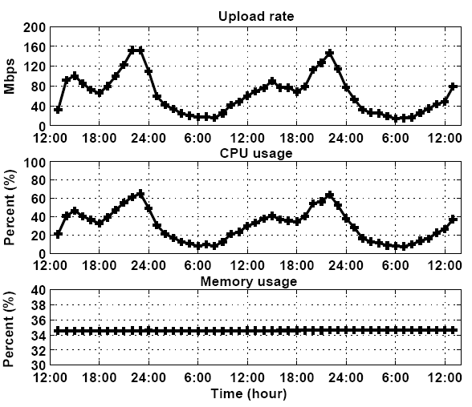
Server Load
The server upload rate and CPU utilization are correlated with the number of users viewing the movies.
P2P technology helps to reduce the server’s load.
The server has implemented the memory-pool technique which makes the usage of the memory more efficient. (The memory usage is very stable)
Figure 18: Server load within a 48-hour period.

Slide 36
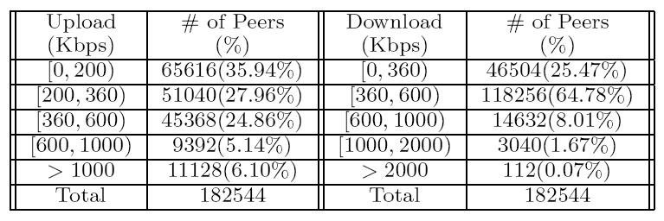
Server Load(Cont.)
Table 4: Distribution of average upload and download rate in one-day measurement period.
Measure on May 12, 2008.
The average rate of a peer downloading from the server is 32Kbps and 352Kbps from the neighbor peers.
The average upload rate of a peer is about 368Kbps.
The average server loading during this one-day measurement period is about 8.3%.

Slide 37
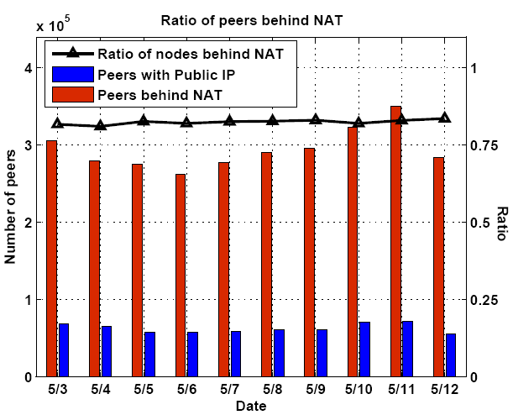
NAT Related Statistics
Figure 19: Ratio of peers behind NAT boxes within a 10-day period.

Slide 38
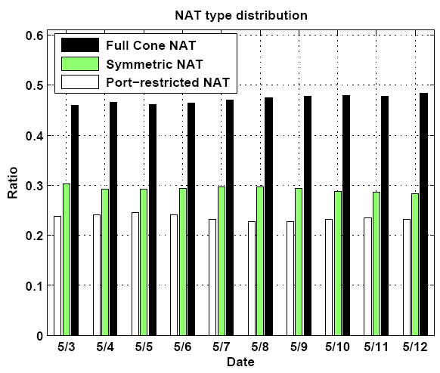
NAT Related Statistics(Cont.)
Figure 20: Distribution of peers with different NAT types within a 10-day period.

Slide 39
Conclusions
We present a general architecture and important building blocks of realizing a P2P-VoD system.
  Performing dynamic movie replication and scheduling
  Selection of proper transmission strategy
  Measuring User satisfaction level
Our work is the first to conduct an in-depth study on practical design and measurement issues deployed by a real-world P2P-VoD system.
We have measured and collected data from this real-world P2P-VoD system with totally 2.2 million independent users.

Slide 40
References
[13] Y. Guo, K. Suh, J. Kurose, and D. Towsley. P2cast: peer-to-peer patching scheme for vod service. In Proceedings of the 12th ACM International World Wide Web Conference (WWW), Budapest, Hungary, May 2003.
[14] A. A. Hamra, E. W. Biersack, and G. Urvoy-Keller. A pull-based approach for a vod service in p2p networks. In IEEE HSNMC, Toulouse, France, July 2004.
[15] X. Hei, C. Liang, Y. Liu, and K. W. Ross. A measurement study of a large-scale P2P iptv system. IEEE Transactions on Multimedia, 9(8):1672–1687, December 2007.
[16] A. Hu. Video-on-demand broadcasting protocols: a comprehensive study. In Proceedings of IEEE INFOCOM’01, Anchorage, AK, USA, April 2001.
[17] C. Huang, J. Li, and K. W. Ross. Can internet video-on-demand be profitable? In Proceedings of ACM SIGCOMM’07, Kyoto, Japan, August 2007.
[18] R. Kumar, Y. Liu, and K. W. Ross. Stochastic fluid theory for p2p streaming systems. In Proceedings of IEEE INFOCOM’07, May 2007.
[22] Y. Zhou, D. M. Chiu, and J. C. S. Lui. A simple model for analyzing p2p streaming protocols. In Proceedings of IEEE ICNP’07, October 2007.

