Slide 1
The BitTorrent Protocol

Slide 2
What is BitTorrent?
Efficient content distribution system using
file swarming. Usually does not perform
all the functions of a typical p2p system,
like searching.

Slide 3
BitTorrent traffic
CacheLogic estimated (around 2003 or so0 that BitTorrent
Traffic accounts for roughly 35% of all traffic on the Internet.

Slide 4
File sharing
To share a file or group of files, a peer first
creates a .torrent file, a small file that contains
metadata about the files to be shared, and
Information about the tracker, the computer
that coordinates the file distribution.
Peers first obtain a .torrent file, and then connect
to the specified tracker, which tells them from which
other peers to download the pieces of the file.

Slide 5

BT Components
On a public domain site, obtain .torrent file. for example:
  http://bt.LOR.net
  http://bt.HarryPotter.com/
Web Server
The Lord of Ring.torrent
Harry Potter.torrent
Transformer.torrent

Slide 6
File sharing
Large files are broken into pieces of size between
64 KB and 1 MB
1
2
3
4
5
6
7
8

Slide 7





BT: publishing a file
Harry Potter.torrent
Bob
Web Server
Tracker
Downloader:
A
Seeder:
B
Downloader:
C

Slide 8
The .torrent file
The URL of the tracker
Pieces <hash1, hash 2,…, hash n>
Piece length
Name of the file
Length of the file

Slide 9
The Tracker
IP address, port, peer id
State information (Completed or Downloading)
Returns a random list of peers

Slide 10
Tracker protocol
communicates with clients via HTTP/HTTPS
client GET request
  info_hash: uniquely identifies the file
  peer_id: chosen by and uniquely identifies the client
  client IP and port
  numwant: how many peers to return (defaults to 50)
  stats: bytes uploaded, downloaded, left
tracker GET response
  interval: how often to contact the tracker
  list of peers, containing peer id, IP and port
  stats: complete, incomplete

Slide 11
Peer wire protocol
implemented directly on top of TCP
messages
  handshake (maybe with bitfield)
  keep-alive
  choke / unchoke
  interested / not interested
  have (advertisement of a newly acquired piece)
  request / piece
  cancel (only used in “endgame mode”)
  port (used in tracker-less mode)

Slide 12
BitTorrent Lingo
Seeder = a peer that provides the complete file.
Initial seeder = a peer that provides the initial copy.
Leecher
Initial seeder
One who is downloading
(not a derogatory term)
Leecher
Seeder

Slide 13
Simple example
{1,2,3,4,5,6,7,8,9,10}
Seeder: A
{}
{1,2,3}
{1,2,3,5}
{}
{1,2,3}
{1,2,3,4}
{1,2,3,4,5}
Downloader C
Downloader B

Slide 14
Basic Idea
Initial seeder chops file into many pieces.
Leecher first locates the .torrent file that directs it to a tracker, which tells which other peers are downloading that file. As a leecher downloads pieces of the file, replicas of the pieces are created. More downloads mean more replicas available
As soon as a leecher has a complete piece, it can potentially share it with other downloaders. Eventually each leecher becomes a seeder by obtaining all the pieces, and assembles the file. Verifies the checksum.

Slide 15
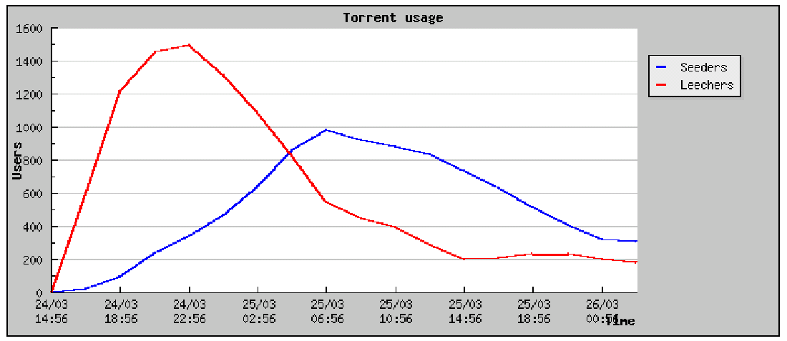
Operation

Slide 16
Pieces and Sub-Pieces
A piece is broken into sub-pieces ... typically 16KB in size
Until a piece is assembled, only download the sub-pieces of that piece only
This policy lets pieces assemble quickly

Slide 17
Pipelining
When transferring data over TCP, always have several requests pending at once, to avoid a delay between pieces being sent. At any point in time, some number, typically 5, are requested simultaneously.
Every time a piece or a sub-piece arrives, a new request is sent out.
Notes:
DOUBT

Slide 18
Piece Selection
The order in which pieces are selected by different peers is critical for good performance
If an inefficient policy is used, then peers may end up in a situation where each has all identical set of easily available pieces, and none of the missing ones.
If the original seed is prematurely taken down, then the file cannot be completely downloaded! What are “good policies?”

Slide 19
BT: internal Chunk Selection mechanisms
Strict Priority
  First Priority
Rarest First
  General rule
Random First Piece
  Special case, at the beginning
Endgame Mode
  Special case

Slide 20
Random First Piece
Initially, a peer has nothing to trade
Important to get a complete piece ASAP
Select a random piece of the file and download it

Slide 21
Rarest Piece First
Determine the pieces that are most rare among your peers, and download those first.
This ensures that the most commonly available pieces are left till the end to download.

Slide 22
Endgame Mode
Near the end, missing pieces are requested from every peer containing them. When the piece arrives, the pending requests for that piece are cancelled.
This ensures that a download is not prevented from completion due to a single peer with a slow transfer rate.
Some bandwidth is wasted, but in practice, this is not too much.

Slide 23
BT: internal mechanism
Built-in incentive mechanism (where all the magic happens):
  Choking Algorithm
  Optimistic Unchoking

Slide 24
Choking
Choking is a temporary refusal to upload. It is one of BitTorrent’s most powerful idea to deal with free riders (those who only download but never upload).
Tit-for-tat strategy is based on game-theoretic concepts.

Slide 25
Choking
Reasons for choking:
  Avoid free riders
  Network congestion
A good choking algorithm
caps the number of simultaneous
uploads for good TCP performance.
Avoids choking and unchoking
too quickly.
Alice
Choked
Choked
Bob

Slide 26
More on Choking
Peers try out unused connections once in a while to find out if they might be better than the current ones (optimistic unchoking).

Slide 27
Optimistic unchoking
A BitTorrent peer has a single “optimistic unchoke” to which it uploads regardless of the current download rate from it. This peer rotates every 30s
Reasons:
  To discover currently unused connections are better than the ones being used
  To provide minimal service to new peers

Slide 28
Upload-Only mode
Once download is complete, a peer has no download rates to use for comparison nor has any need to use them. The question is, which nodes to upload to?
Policy: Upload to those with the best upload rate. This ensures that pieces get replicated faster, and new seeders are created fast

Slide 29
Questions about BT
Which features contribute to the efficiency of BitTorrent?
What is the effect of bandwidth constraints?
Is the Rarest First policy really necessary?
Must nodes perform seeding after downloading is complete?
How serious is the Last Piece Problem?
Does the incentive mechanism affect the performance much?

