Slide 1
Mobile Ad-hoc Pastry (MADPastry)
Niloy Ganguly

Slide 2
Problem of normal DHT in MANET
No co-relation between overlay logical hop and physical hop
  Low bandwidth, power collision, transmission error
Mobility of node
  Ad hoc routing protocols have to (re-) establish routes frequently.
In order to guarantee routing convergence and consistency, DHTs have to periodically maintain their routing tables.

Slide 3
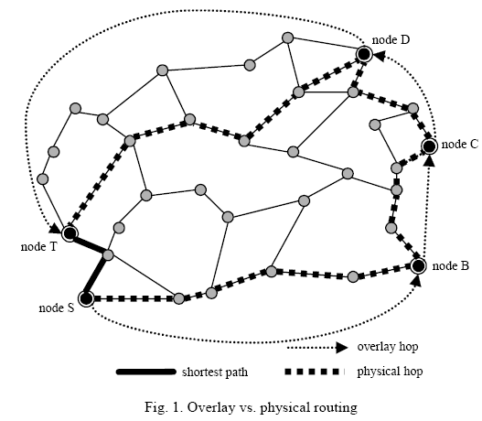
Solution
MADPastry integrates the reactive ad hoc routing protocol AODV and the application layer DHT Pastry to provide light-weight and scalable indirect routing functionality at the network layer.

Slide 4
Overlay Stretch: the ratio between the physical route length traveled during an overlay key lookup compared to the direct physical path from the source to the eventual target node
Standard DHT can lead to a large overlay stretch

Slide 5
Overview of Pastry
Each node in the Pastry peer-to-peer overlay network is assigned a 128-bit node identifier (nodeId).
Pastry can route to the numerically closest node to a given key in less than [log₂b N] when N is the total number of nodes in the network (b is typically 4, a network parameter)

Slide 6
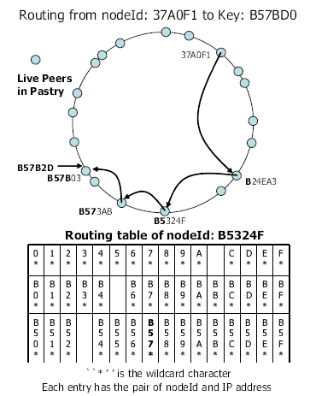
Routing
Each Pastry node maintains a routing table, a neighborhood set and a leaf set.
The Pastry’s routing table consists of log₂b N rows each of which has 2^{b}−1 entries
nth row has entries whose nodeIds share the first n − 1 digits with the present node’s nodeId

Slide 7
The leaf set L is a set of nodes with the L/2 numerically closest larger nodeIds, and the L/2 nodes with numerically closest smaller nodeIds, relative to the present node’s nodeId.
The neighborhood set M contains the nodeIds and IP addresses of the M nodes that are closest (according the proximity metric)

Slide 8
Cluster
Physical Cluster: Community of nodes in proximity. They share a common prefix of overlay id.
Cluster Formation:
  divide the overlay id space into equal-sized segments
  Randomly generate a landmark key for every segments
  Node id closest to landmark key is selected as cluster head

Slide 9
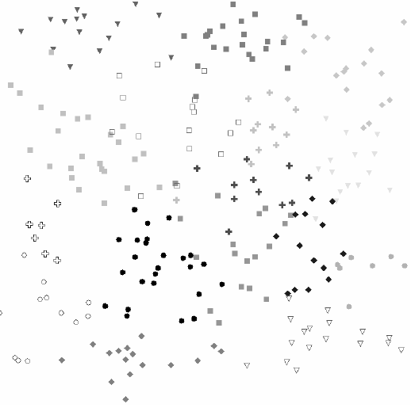
Cont..
  Cluster head sends beacon at regular interval.
  New node joins to a cluster adopting cluster head overlay id prefix from which it first gets beacon.
  It changes cluster if it gets any closest cluster ( according to physical hop) by changing its overlay id.

Slide 10
To search a key, each node forwards the query to the node which has the nodeId sharing one more digit with the key based on the routing table.
If there is no appropriate entry, the node forwards the query to the node in the neighbor or leaf set which has the nodeId sharing at least one more bit with the key.

Slide 11
MADPastry Routing Information
Three items
  Pastry routing table
  Pastry leaf set
  AODV routing table
The standard Pastry routing table consists of [log₂b N] rows with (2^{b}-1) entries each.
The MADPastry routing table consists of [log₂b K] rows with (2^{b}-1) entries each.
This will reduce maintenance overhead and storage but increase bound on the number of overlay hops

Slide 12
Pastry Leaf Set. The standard Pastry leaf set contains L entries: the L/2 numerically closest (in terms of their overlay id) smaller nodes and the L/2 numerically closest larger nodes.
MADPastry maintains only two nodes left and right.

Slide 13
AODV Routing Table. To carry out a concrete overlay hop, a MADPastry node also maintains a standard AODV routing table. It includes for specific physical destinations the next (physical) hop address as well as for each such route a sequence number.

Slide 14
Routing
When a MADPastry node receives a request packet
  The node could be the target (i.e. the physical destination) of an overlay hop. In this case, the node needs to determine the next overlay hop. For this purpose, it will consult its Pastry routing table to find a node that would increase the matching key prefix by one or its leaf set to find a node that is numerically closer to the key than the current node is. This corresponds to standard Pastry routing.

Slide 15
  The node could be an intermediate node on the physical path of an overlay hop that is being carried out. Now, the node would behave like a regular AODV node. It would consult its AODV routing table to determine the next physical hop on the route toward the destination of this overlay hop and then forward the packet on.

Slide 16
  To minimize the routing traffic, any such intermediate node on the physical path of an overlay hop inspects the destination of the overlay hop. If the intermediate node's own overlay id already happens to be numerically closer to the packet's key than that of the overlay hop's actual destination, it will "intercept" the packet.

Slide 17
An interesting question arises when the physical route to carry out an overlay hop is unknown
A node selects the next overlay destination from its Pastry routing table or leaf set, but there is no (valid) route information in its AODV routing table for that destination.
An intermediate node on the physical path of a current overlay hop might not have a (valid) next hop entry in its AODV routing table to forward the packet.

Slide 18
Solution
To avoid network-wide broadcasts whenever possible, MADPastry tries to leverage its cluster locality in such cases.
If the node that has no (valid) information on how to continue the path of an overlay hop is already in the target cluster (i.e. shares a common prefix with the packet's destination), it will not issue an AODV-style route discovery for the destination. Instead, it will broadcast the overlay packet itself within the confines of its cluster.
Due to the physical locality in MADPastry clusters, that broadcast is very likely to stay in a limited region of the network. Otherwise, if the node is not in the target cluster, it will queue the packet and start a regular AODV expanding ring broadcast to discover a route to the packet's destination.

Slide 19
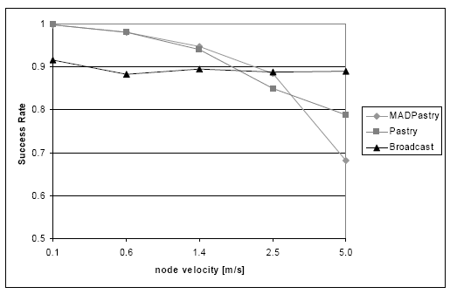

Slide 20
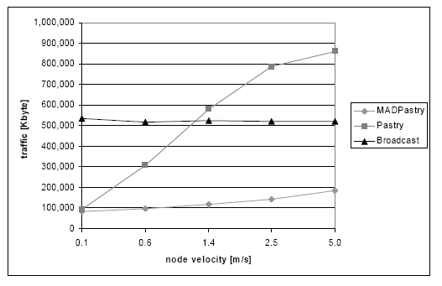

Slide 21
Reference
MADPastry: A DHT Substrate for Practicably Sized MANETs: Proc. of ASWN, 2005

