Slide 1
An Introduction to PowerTutor
(http://ziyang.eecs.umich.edu/projects/powertutor/)

Slide 2
Introduction
PowerTutor is an application for Google phones that displays the power consumed by major system components such as CPU, network interface, display, and GPS receiver and different applications.
The application allows software developers to see the impact of design changes on power efficiency.
Application users can also use it to determine how their actions are impacting battery life.
PowerTutor generally provides power consumption estimates within 5% of actual values.

Slide 3
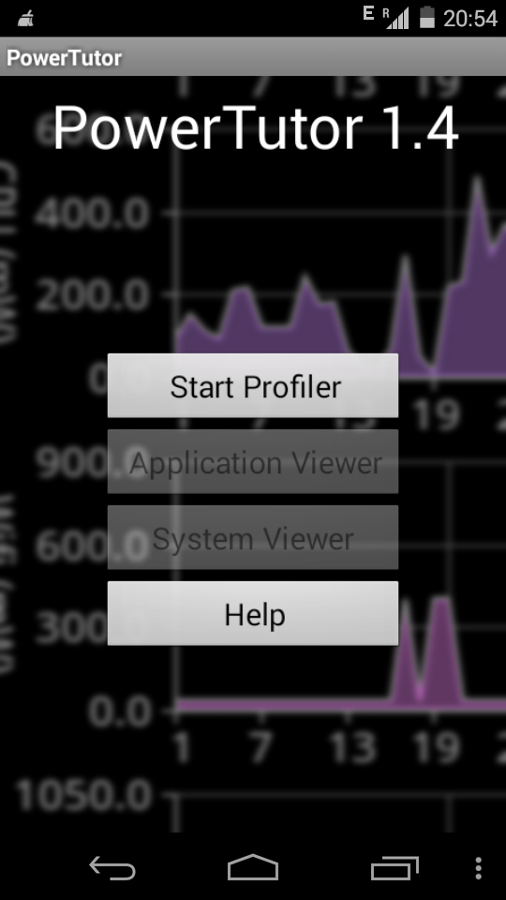

Slide 4
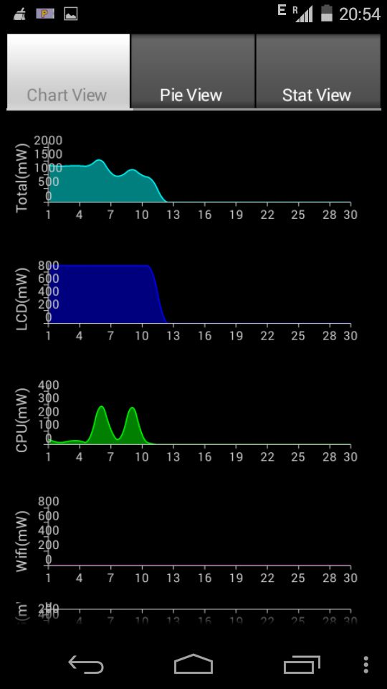
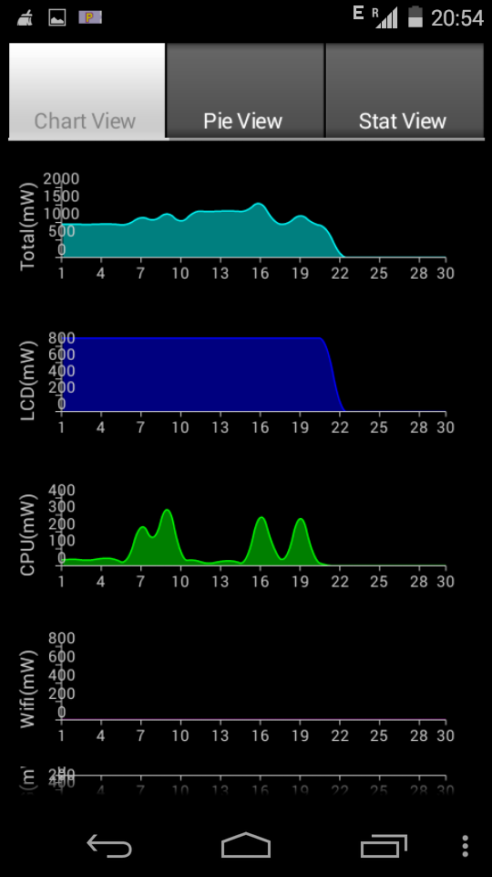
Select “Start Profiler”
Then select “System Viewer”
Plots showing Energy consump-tions of various components with time
TIME

Slide 5
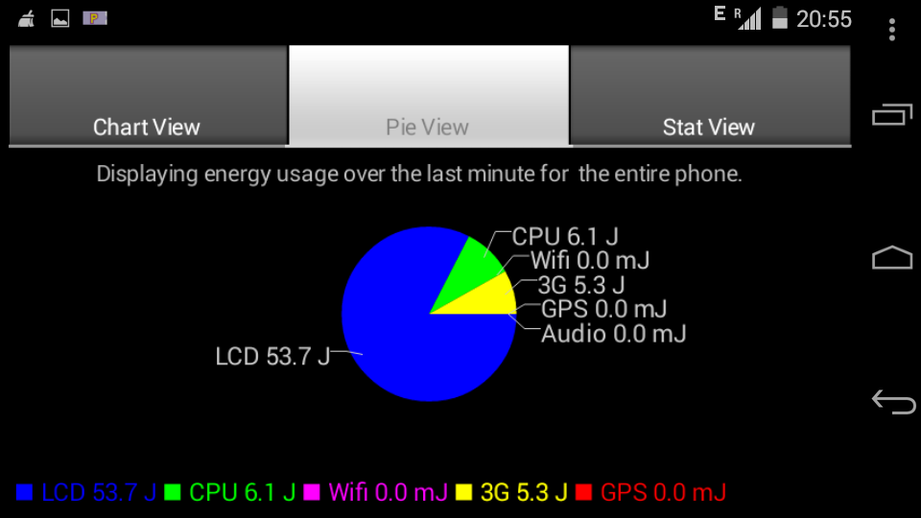
Pie-View

Slide 6
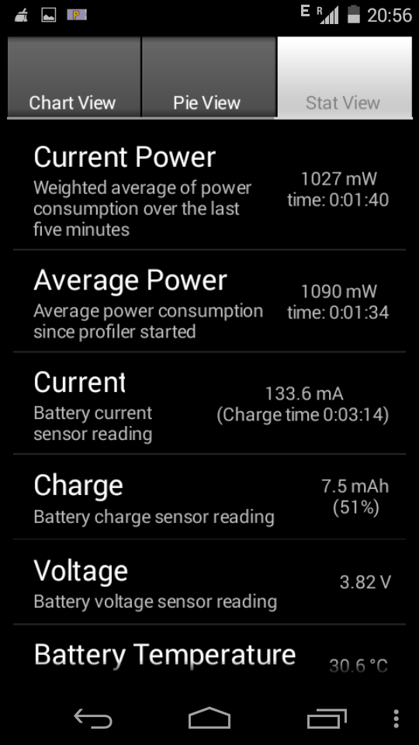
Stat-View

Slide 7
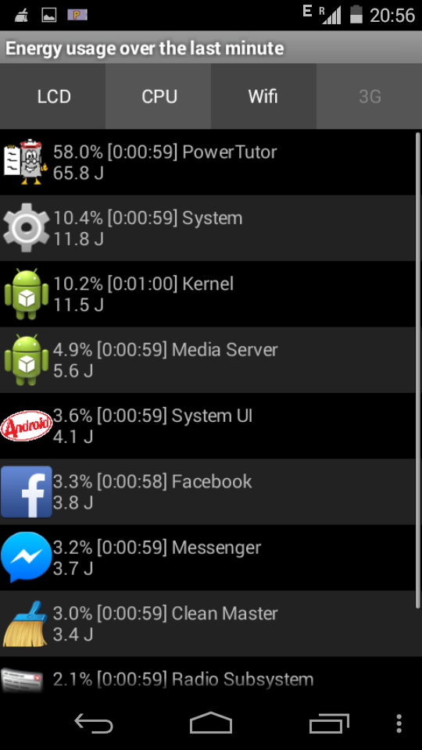
Go Back And Click on “Application Viewer”
Gives APP –wise Power usage

Slide 8
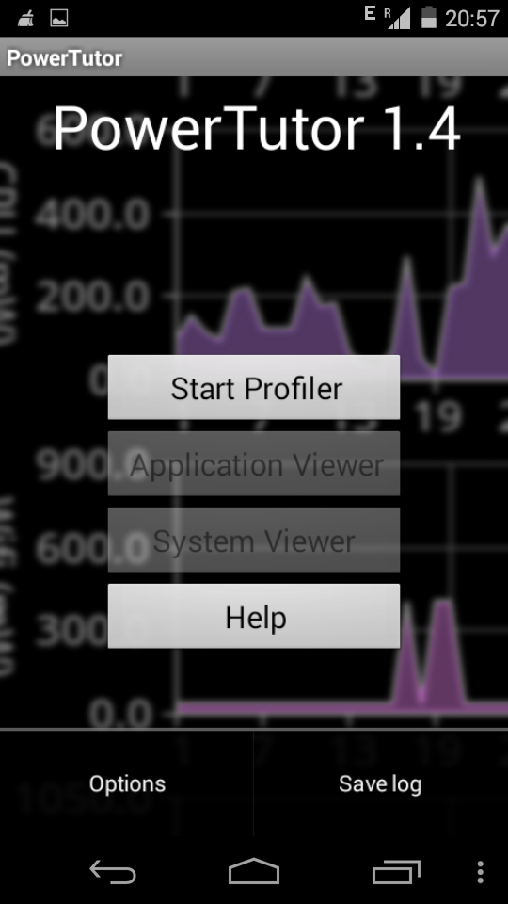
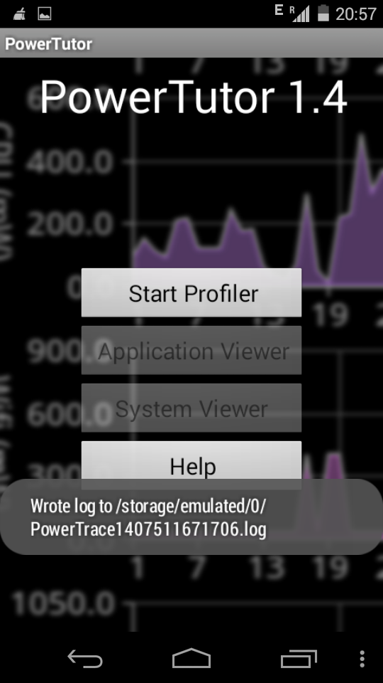
Saving the Log
Stop Profiler & click on “Save Log”

Slide 9
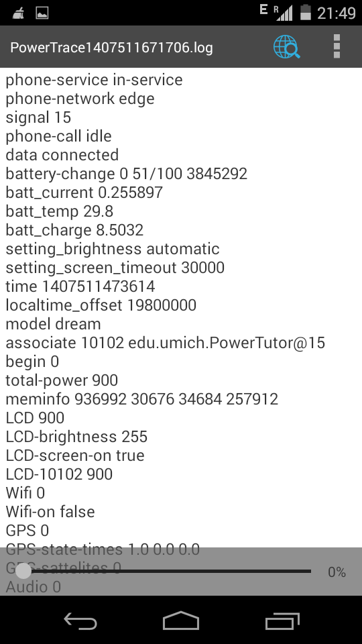
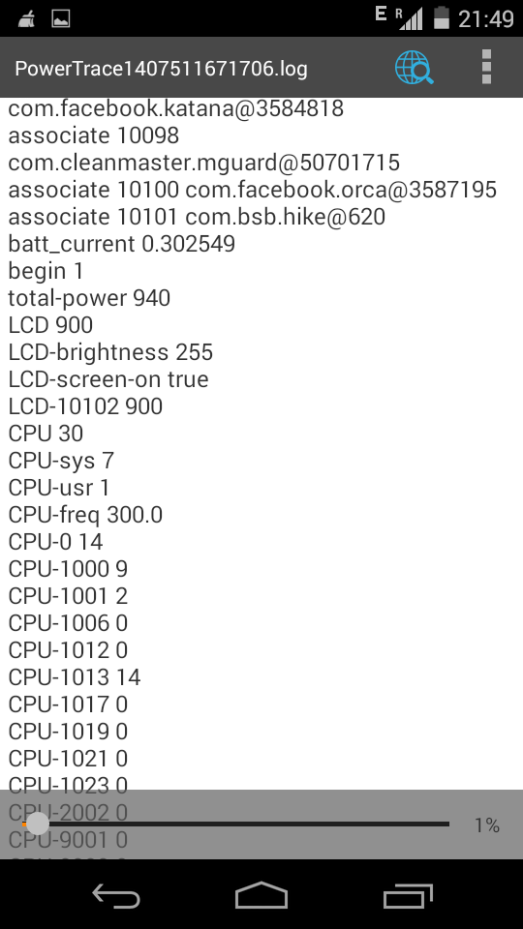
Log Contains Details of Power usage at each time-unit
begin 0,
begin 1
are the time-stamps

