Slide 1
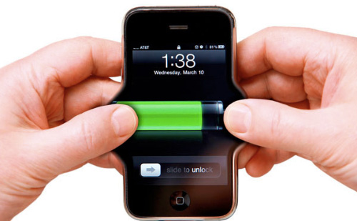
Introduction to Smartphone Energy Management

Slide 2
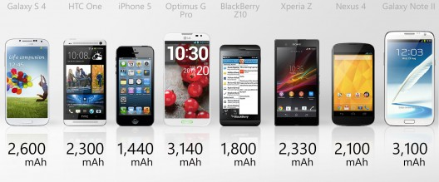
Issue 1/2
Rapid expansion of wireless services, mobile data and wireless LANs
Greatest limitation: finite power supplies

Slide 3
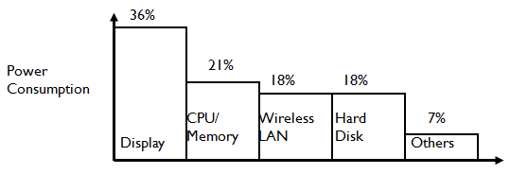
Issue 2/2
Typical example of power consumption from a mobile device:
36% Display
21% CPU/memory
18% Wireless
interface
18% Hard drive
Goal
Incorporate energy conservation at all layers of protocol stack

Slide 4
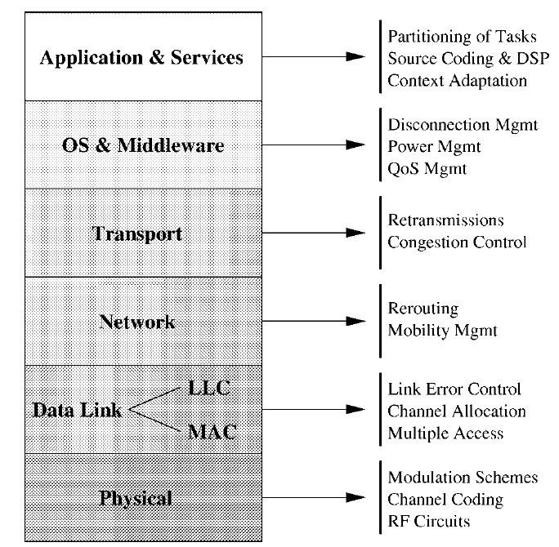
Energy Efficiency Research in Protocol Stack

Slide 5
Two different perspectives
Increase battery capacity
Increase capacity while restricting weight
However battery technology hasn’t experienced significant advancement in the past 30 years
Decrease of energy consumed
Run CPU at lower clock rate, lower voltages
Flash memory (SD (Secure Digital) Memory Card)

Slide 6
Datalink Layer Battery Management
Lazy Packet Scheduling: Reduce the power ⇒ Increase the transmission time
Battery-Aware MAC Protocol: Packets carry remaining charge. Lower back off interval for nodes with higher charge

Slide 7
Network Layer Battery Management
Goal: Increase the lifetime of the network
Shaping: If battery charge becomes below threshold, stop next transmission allowing battery to recover
Battery Energy Efficient (BEE) Routing Protocol: Minimize energy and use max battery charge

Slide 8
Sources of Power Consumption
Two types
Communication related
Computation related
Tradeoff between them

Slide 9
Communication related
Three modes:
Transmit
Receive
Standby
Example:
Proxim RangeLAN2 2.4 GHz 1.6 Mbps PCMCIA card 1.5W transmit, 0.75W receive, 0.01W standby
Turnaround between transmit and receive typically takes 6 to 30 microseconds
Optimize the transceiver usage

Slide 10
Power Management Modes
Power consumption is always an issue with Mobile Devices.
There are 3 modes of power for Cisco NIC cards:
Constant Awake Mode (CAM)
Mode is best when power is not an issue such as when AC power is available to the device. Default mode
Power save mode (PSM)
Mode is used when power conservation is the utmost importance. The wireless NIC card will go to ‘sleep’ after a period of inactivity & periodically awake to retrieve buffered data from the AP.
Fast power save mode (FastPSM)
Combination of CAM & PSPM For clients who switch between AC & DC power.
Notes:
Self explanatory

Slide 11
Computation related
Usage of CPU, main memory and disk
Data compression techniques for reduction of packet length increase power consumption

Slide 12
General Guidelines and Mechanisms 1/5
Reduce collisions in MAC
Retransmissions lead to power consumption and delays
Cannot be completely eliminated due to user mobility and varying set of mobiles
Change typical broadcast mechanism
802.11: Receiver keeps track of channel status through constant monitoring

Slide 13
General Guidelines and Mechanisms 2/5
Turnaround between transmit and receive mode spends time and power
Allocate contiguous slots for transmission or reception
Request multiple transmission slots with a single reservation packet
Computation of transmission schedule should be relegated to base station

Slide 14
General Guidelines and Mechanisms 3/5
Scheduling algorithm may additionally consider battery power level
Allow mobile to re-arrange allocated slots under low-power conditions
At link layer:
Avoid transmissions when channel conditions are poor
Combine ARQ (Automatic Repeat Request) and FEC (Flow & Error Control) mechanisms

Slide 15
General Guidelines and Mechanisms 4/5
Energy efficient routing protocols
Ensure all nodes equally deplete their power level
Avoid routing through nodes with lower battery power
Requires mechanism for dissemination of node battery power
Periodicity of routing updates can be reduced
May result in inefficient routes

Slide 16
General Guidelines and Mechanisms 5/5
OS level
Suspension of specific sub-unit (disk, memory, display etc.) when detect prolonged inactivity

Slide 17
Summary
Battery Management: idling increases the capacity of the battery
Transmission Power Management: Time/Signal Strength vs. Power tradeoff
System Power Management: Put system/components to sleep whenever possible

