Slide 1
Automatically Characterizing Places with Opportunistic CrowdSensing using Smartphones
Yohan Chon et.al. UbiComp '12

Slide 2
CrowdSense@Place(CSP)
A framework that exploits a previously untapped resource – opportunistically captured images and audio clips from smartphones – to link place visits with place categories (e.g., store, restaurant).
CSP combines signals based on location and user trajectories (using WiFi/GPS) along with various visual and audio place “hints” mined from opportunistic sensor data.

Slide 3
Why CSP?
Awareness of user location underpins many popular and emerging mobile applications, including local search, point-of-interest recommendation services, navigation, and geo-tagging for photographs and tweets.
If we can automatically characterize places by linking them with attributes, such as place categories (e.g., “clothing store,” “gym”) or likely associated user activities (e.g., “eating,” “work”), we can realize powerful location- and context-based scenarios.
Not always possible to accurately know which place a user is based purely on the location estimate.

Slide 4
Overview
CSP relies on opportunistically collected images and audio clips crowdsourced from smartphone users.
CSP users install smartphone application that exploits intermittent opportunities throughout the day to sample microphone and camera.
CSP extracts hints from the environment using a variety of image and audio based classifiers.
The output from these classifiers are merged with location based signals from WiFi and GPS sensors to segment user trajectories into separate place visits.

Slide 5
Place characteristics are learnt using topic-models.
Topics learned from the model correspond approximately to a place category, with individ-ual places represented as a weighted combination of place categories.
Automatically characterize previously unseen places by inferring the topic distribution for the new place and assign category based on dominant topic.

Slide 6
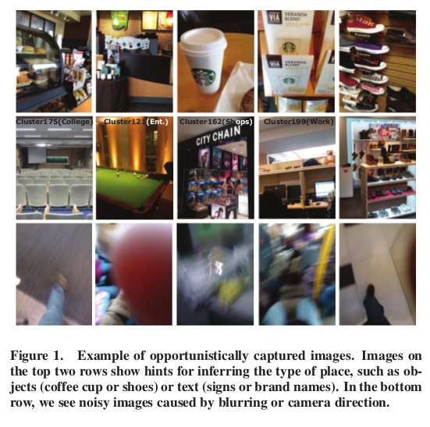
Leveraging rich visual and acoustic place hints
Different places, such as restaurants, stores, homes, and workplaces often contain a variety of visual and acoustic clues that allow people to intuitively understand a surprising amount about a location, even if they have never been there before.

Slide 7
Images are frequently blurry or capture unhelpful scenes
audio clips frequently contain too much background noise to be intelligle or simply capture silence.
CSP currently overcomes this problem with simple brute force: users collectively capture large volumes of both image and audio data daily and repeatedly visit places that are important to them

Slide 8
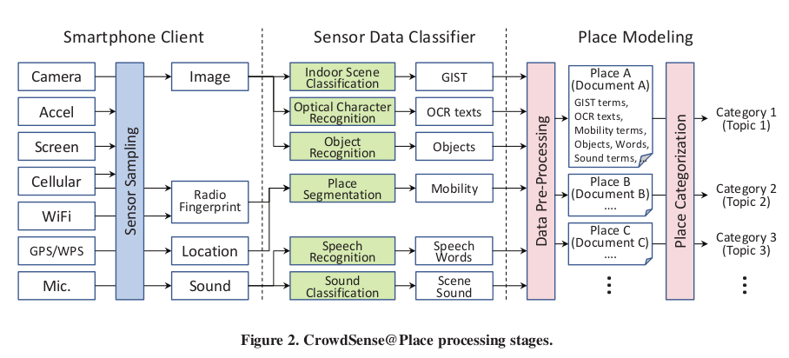
Crowdsense@place

Slide 9
CSP is split between two software components
  a smartphone application
  offline server-side processing of collected data.
The smartphone application operates as a background service that
  recognizes places using radio fingerprinting of nearby wi-fi access points
  opportunistically captures captures images and audio clips at this location
Based on hints about place category mined from this collected data, and combined with data collected by other users, CSP can automatically determine the type of place (e.g., restaurant) without user intervention

Slide 10
Smartphone client
CSP client performs the following functions-
  place segmentation using Wifi fingerprints and GPS
  opportunistic crowd sensing which gathers image and audio sensor data
  privacy configuration

Slide 11
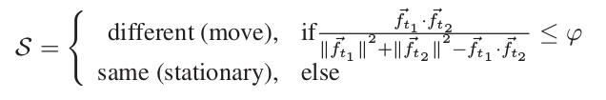
Place segmntation
  smartphone client regularly performs wifi scans to identify nearby Wifi access points.
  If a Wifi fingerprint is encountered that is unlike those previouly seen, a new place is assumed to have been discovered.

Slide 12
Sensor sampling
  sampling occurs after a small random delay once the user starts an application or uses an important phone function
  Data quality is highly variable and often poor
  client maintains a coarse sampling budget of a fixed number of images and audio clips that is reset during prolonged periods of charging

Slide 13
Privacy
  All data is forced to reside on the smartphone for at least 24 hours, during which time, users can delete any data they are uncomfortable with CSP using.
  Users can also pause data collection for an upcoming time interval if they anticipate sensitive events occuring.

Slide 14
Sensor data classifiers
Optical Character recognition
  mine written text found in posters or signs
Indoor scene classification
  extract GIST features from training image
  images are clustered using k-means clustering based on these features
  On receiving a new image determine how close an image is to each cluster after the features are extracted

Slide 15
Object recognition
  recognize variety of everyday objects observed withn places
  CSP adopts examplar-svm approach
Speech recognition
  capture place hints found in conversation of people
Sound classification
  recognize simple acoustic events that occur in background

Slide 16
Place modeling
Data Pre-processing
  CSP builds documents, one for each distinct place a user visits
  All data collected at a particular place is mined to extract a series of terms, which can then be assigned to a document associated with that place
  Terms come in two varieties
    Classifier terms
    Mobility terms

Slide 17
Place categorization
  CSP employs Labeled Latent Dirichlet Allocation(L-LDA) to categorize places using the documents and terms generated from the crowd-sourced data.
  A separate L-LDA model is trained for each place category and can be used to infer the category of new, previouly unseen places.

Slide 18
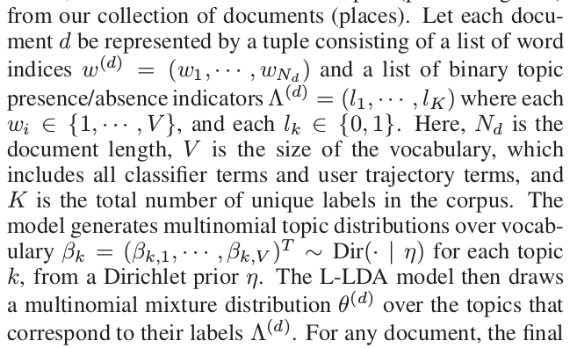
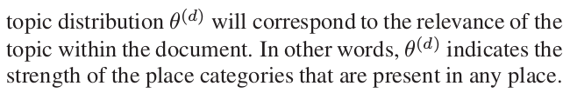
L-LDA

Slide 19
Evaluation
Multi-country deployment using Android smartphones that include 1241 distinct places
36 users living in five locations around the world
  22% images are blurred or completely black
Metrics
  Accuracy
  distribution of place category topics.
  accuraccy=# of correctly recognized places/# of places

Slide 20
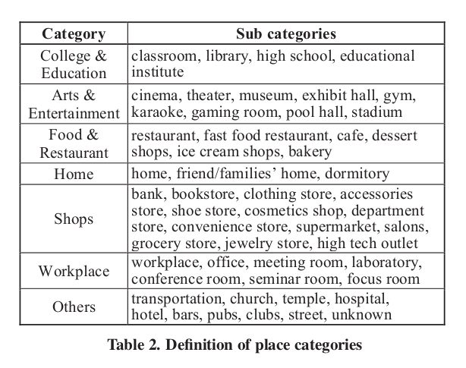
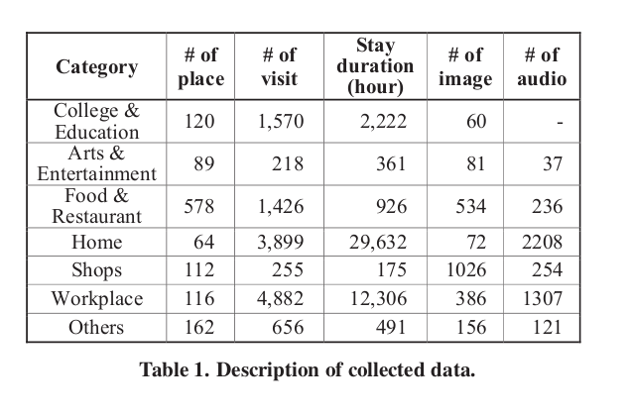

Slide 21
Baselines
  GPS
    Foursquare search API
  Mobility
    Similar to CSP but topics are built using only user trajectory information

Slide 22
Parameters and implementation
  crowd sensing client using Android SDK 1.5
  wifi scanning intervals are 10 seconds
  CSP backend is implemented in Microsoft Azure

Slide 23
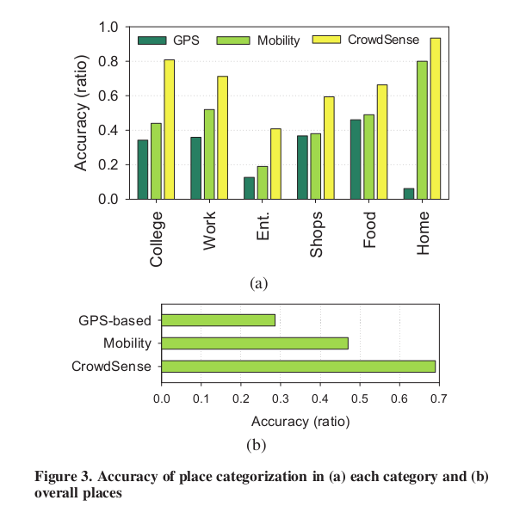
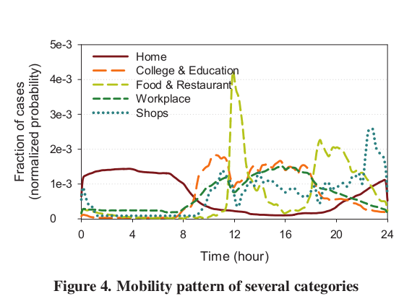
Place categorization

Slide 24
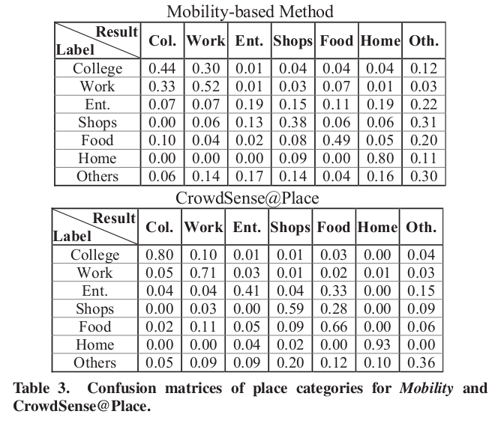

Slide 25
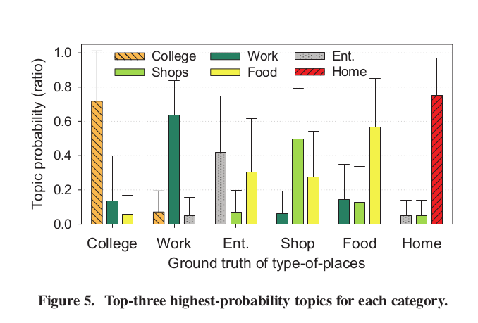
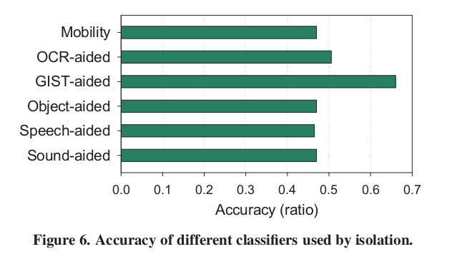

Slide 26
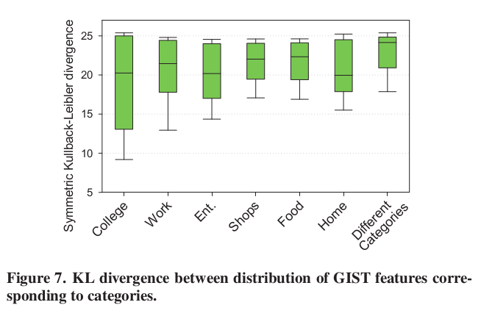
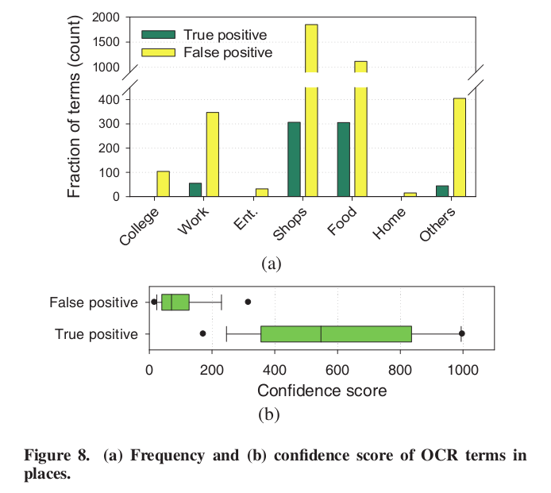

Slide 27
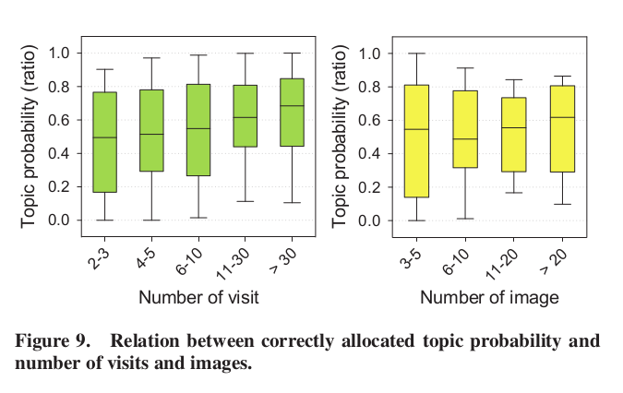

Slide 28
Limitations and future work
Finer place categorization
Privacy
Activity vs Place category

Slide 29
Thank you!!

