Slide 1

Towards Mobile Phone Localization without War-Driving
Ionut Constandache, Romit Roy Choudhury, Injong Rhee

Slide 2
Location is an IP address
for content delivery
Notes:
So, it is as if Location is an IP address in the physical world to which content gets delivered.

Slide 3
Location-Based Applications (LBAs)
Examples:
  Location-based recommendations, geo-tagging
  GeoLife: shopping list when near a grocery store
  TrafficSense: real-time traffic conditions
Location expresses context of user
  Facilitates content delivery

Slide 4
Is GPS the solution?
Pros: Good accuracy Cons: Poor battery lifetime
Is GSM the solution?
Pros: Long battery lifetime Cons: Poor accuracy

Slide 5
What about WiFi Localization?
E.g., SkyHook:
Basic Idea:
Several trucks war-drive a place
Create Radio map = <Location: WiFi IDs>
Distribute map to phones
Phone user goes to war-driven region, overhears WiFi IDs
Reverse Look Up IDs against radio map
Obtains location

Slide 6
Is Skyhook the solution?
Middle Ground
Lower Accuracy than GPS, Longer Battery lifetime
Better Accuracy than GSM, Shorter Battery lifetime
but …

Slide 7
Is Skyhook the solution?
Middle Ground
Lower Accuracy than GPS, Longer Battery lifetime
Better Accuracy than GSM, Shorter Battery lifetime
but …
At the cost of:
  Degraded location accuracy: walking paths ~ 60m
  Reliance on infrastructure (APs)
  War-driving ($$ + carbon footprint)
  “NYTimes: Skyhook fleet 500 trucks/drivers”

Slide 8
Contents
CompAcc
Evaluation
Limitations and Future Work
Conclusion
Notes:
In the rest of the talk I’ll introduce surround sense which overcomes the dividing wall problem and provides accurate logical localization

Slide 9
Contents
CompAcc
Evaluation
Limitations and Future Work
Conclusion

Slide 10
Goals
No War-Driving
  Cannot drive walking paths (campus, parks, …)
  Expensive / Environment unfriendly
No reliance on WiFi infrastructure
  Rural regions / developing countries
Good accuracy (~GPS)
Improve energy-efficiency
  Better than Skyhook, GPS

Slide 11

CompAcc: Basic Idea
Direction(compass) + Displacement(accelerometer) = User’s directional trail
Directional Trail
Notes:
Directional trail = user displacement and direction for the past few seconds. For this case the directional trail will show forward displacement followed by displacement in the right direction.

Slide 12
CompAcc: Basic Idea
Direction(compass) + Displacement(accelerometer) = User’s directional trail
Compute path signatures
  Derived from a local electronic map (Google Maps)
…
Path Signature
Notes:
We compute also path signatures based on a digital map.
Path signatures are similar to directional trails only that they are recorded based on map information and not mobile phone sensors
A path signature contains the absolute compass readings at different displacements.
While the user is walking on a straight segment we estimate his location based on displacement.

Slide 13
CompAcc: Basic Idea
Direction(compass) + Displacement(accelerometer) = User’s directional trail
Compute path signatures
  Derived from a local electronic map (Google Maps)
Compare directional trail with path signatures
  Best match provides the user location
Directional Trail
…
Path Signature
Notes:
To infer turns we match the directional trail with the path signature and the best match gives the location of the user in the new direction.

Slide 14
Correct location errors at turns
Directional Trail
…
Path Signature
Notes:
To correct for this errors we slide the directional trail forward and backward to reposition the user.
Thus, a turn provides a natural way of resetting the error.

Slide 15
Correct location errors at turns
Directional Trail
…
Path Signature
Directional Trail
…
Path Signature
Notes:
To correct for this errors we slide the directional trail forward and backward to reposition the user.
Thus, a turn provides a natural way of resetting the error.

Slide 16

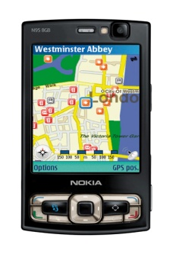
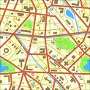


Architecture
Tile
Database
1. Initial location GPS:
(lat X, long Y)
Tile
3. Obtain paths in the user vicinity
6. Current location
(lat A, long B)
2. Report initial location
(lat X, long Y)
Initial location
Directional trail
4. Direction
(Compass)
Current location
5. Displacement
(Accelerometer)
CompAcc

Slide 17
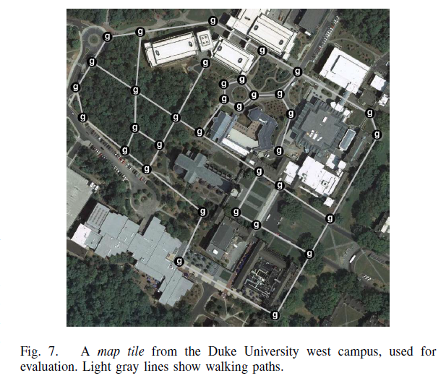
Sample Tile:

Slide 18
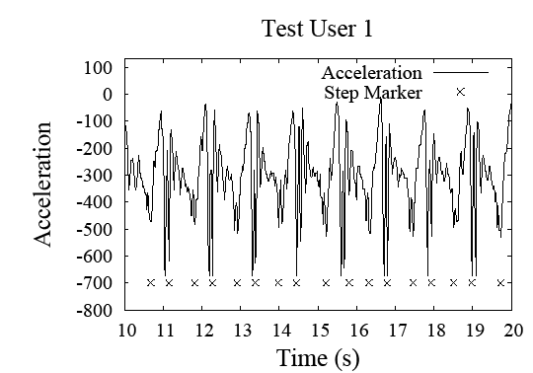
Directional trail: displacement
Accelerometer based step count
displacement = step_count * step_size

Slide 19
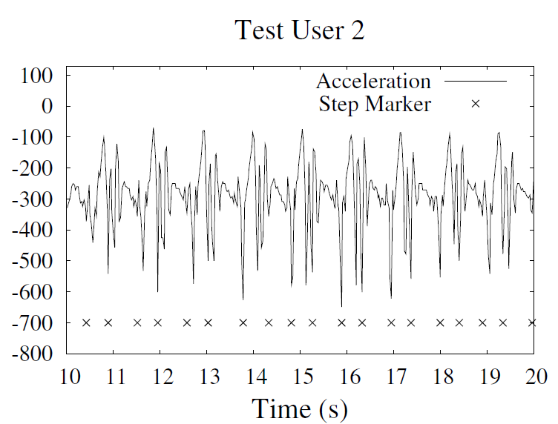
Directional trail: displacement
Accelerometer based step count
displacement = step_count * step_size

Slide 20
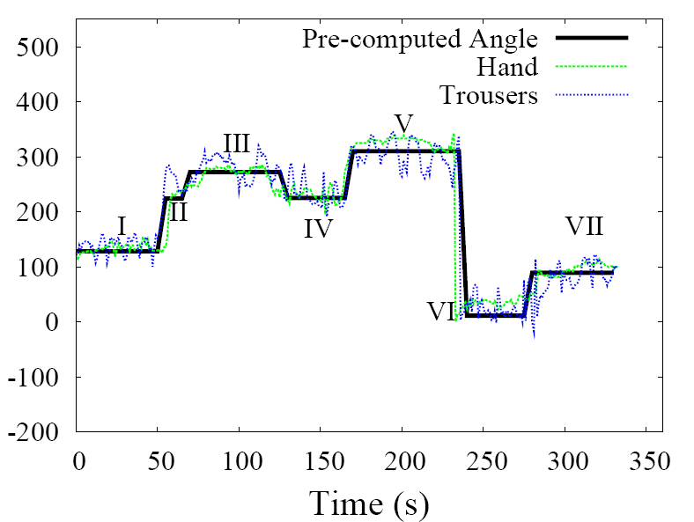

Directional trail: direction

Slide 21
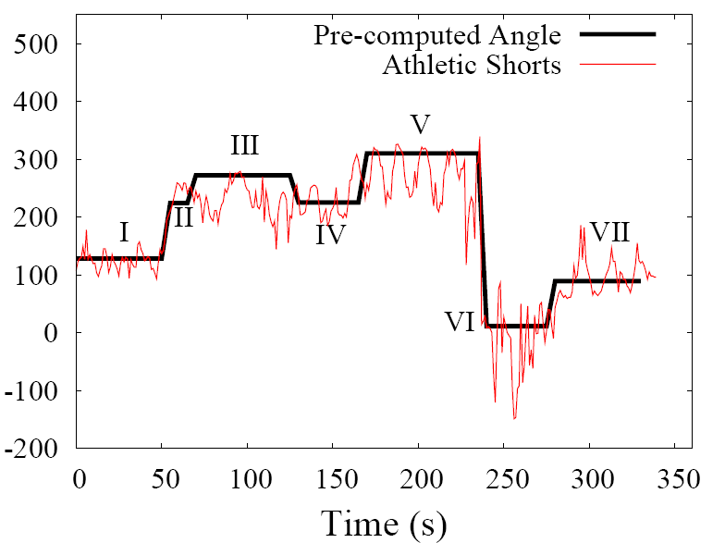
Directional trail: direction

Slide 22
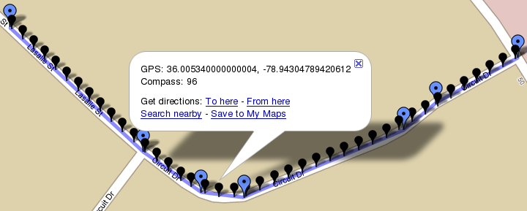
Path Signature
Extract from Google Maps
Geodesic formulas

Slide 23
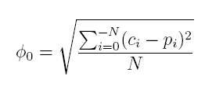
Matching Directional Trail with Path Signatures
Directional Trail
Path Signature
Dissimilarity Metric:
c_{i} = compass readings
p_{i} = path computed direction
N = directional trail size

Slide 24
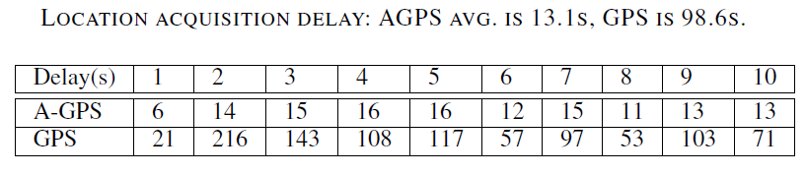
Fallback Mechanism: A-GPS
What if the dissimilarity metric is large?
  Trigger A-GPS

Slide 25
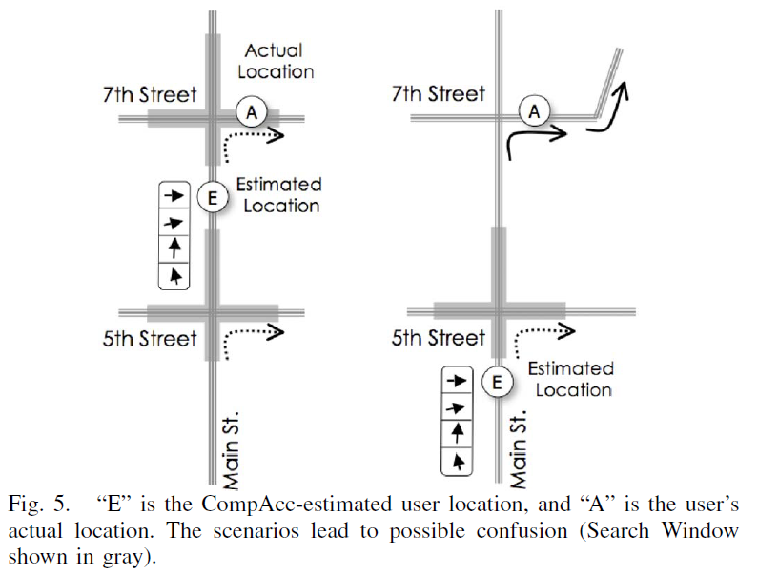

Slide 26
Fallback Mechanism
7th Street
A
5th Street
Estimated
Location
E
Main St.

Slide 27
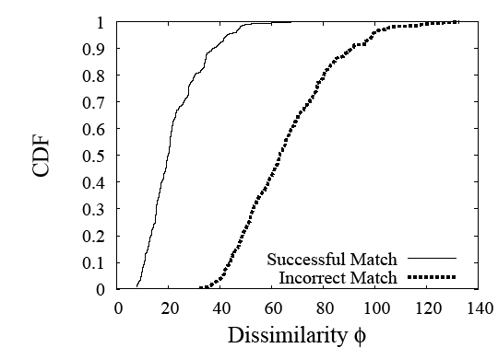
Fallback Mechanism
7th Street
A
5th Street
Estimated
Location
E
Main St.

Slide 28
Contents
CompAcc
Evaluation
Limitations and Future Work
Conclusion

Slide 29
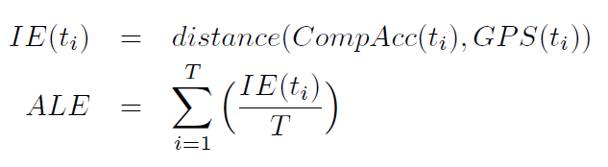
Results
Compared 3 localization schemes
  CompAcc
  Skyhook
  Wifi-War-Walk (We war-droved walking paths in campus)
Metrics
Instantaneous Error = distance(estimated, real)
Average Localization Error (ALE) = Average Instantaneous Error

Slide 30
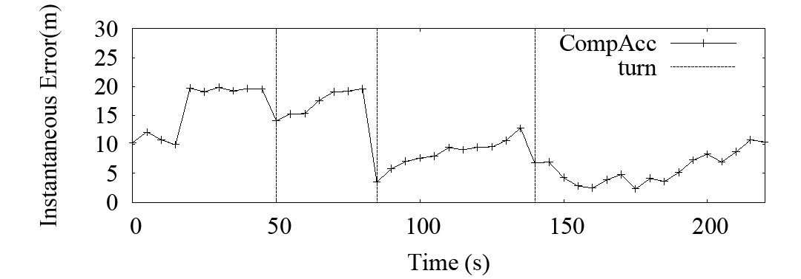
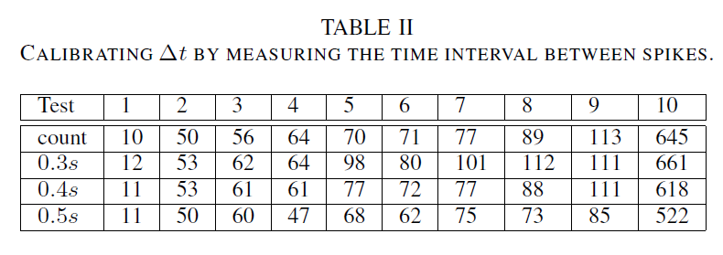
CompAcc Instantaneous Error

Slide 31
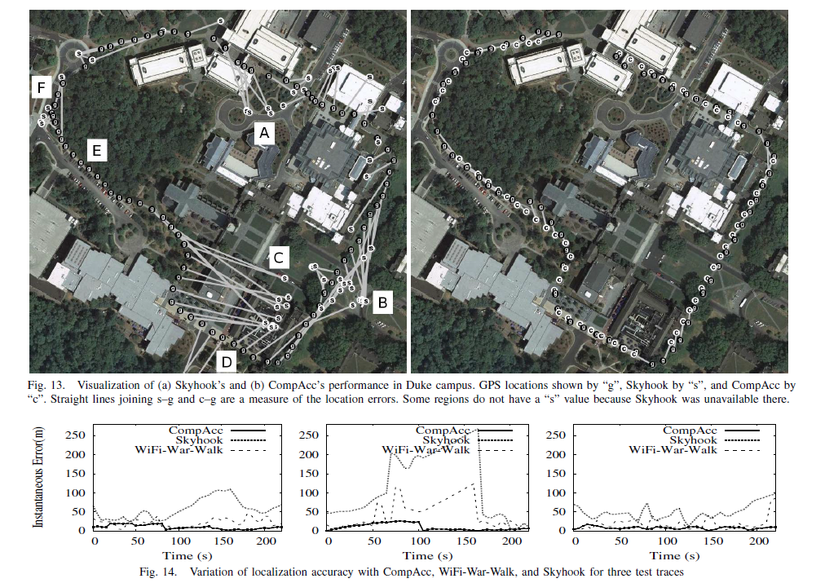

Slide 32
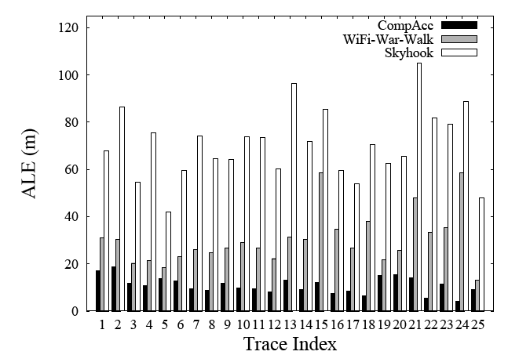
Results
Average ALE
GPS: 10m
CompAcc: 11m
WiFi-War-Walk: 30m
Skyhook: 70m
Energy
GPS: 10h
CompAcc: 23h
WiFi-War-Walk:16h
Skyhook:16h

Slide 33
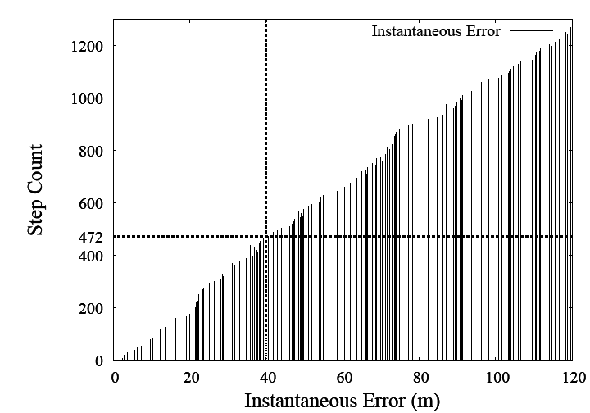
Directional trail: displacement
Step count/displacement accuracy

Slide 34
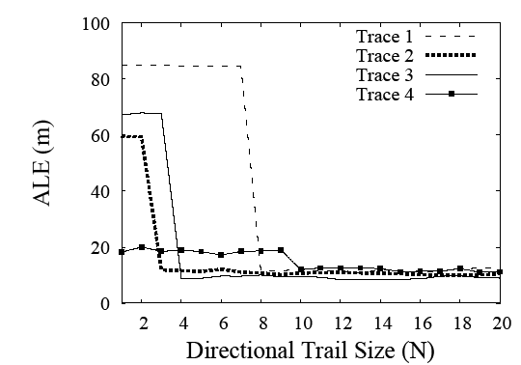
Trail/Path Size

Slide 35
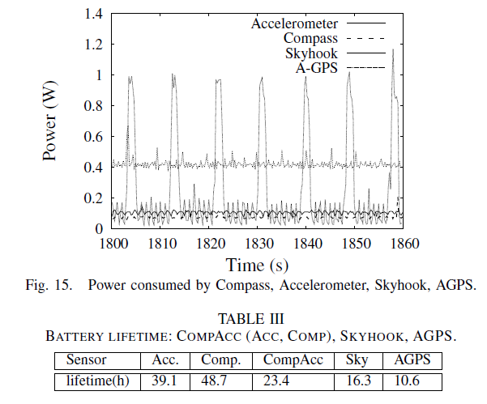

Slide 36
Contents
CompAcc
Evaluation
Limitations and Future Work
Conclusion

Slide 37
Limitations and Future Work
Map Generation
  Manually mark footpaths
User Position Estimated along the Path
  Apply particle filters to accommodate wide roads
Multiplexing between Localization Methods
  Hand-off to Skyhook/GPS when driving
  Extend to vehicular movement

Slide 38
Contents
CompAcc
Evaluation
Limitations and Future Work
Conclusion

Slide 39
CompAcc
Today’s localization technologies limited
  Energy- Efficiency
  Coverage/Accuracy
  Rely on simple localization mechanism
  Need: Compass, Accelerometer and Maps
Evaluation results:
  ALE: 11m
  Battery: 23h
CompAcc scales to any mapped part of the world
Notes:
Today’s the are physical cannot distinguish logical
Ambience enough info
Phones sensor to harness this ambience through sensors fingerprint -> get location
Scale to any part of the world there is ambience there …

Slide 40
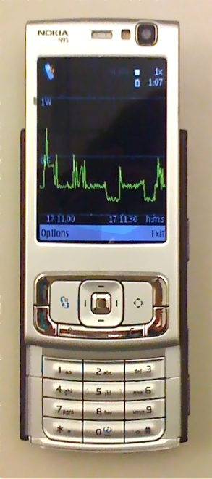
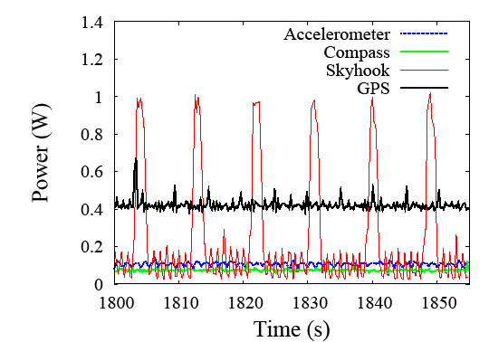
Advantages
No war-driving
No reliance on WiFi infrastructure
  Maps available ubiquitously
Improves battery lifetime
  GPS ~10h
  Skyhook ~16h
  Accelerometer ~ 39h
  Compass ~48h

