Slide 1
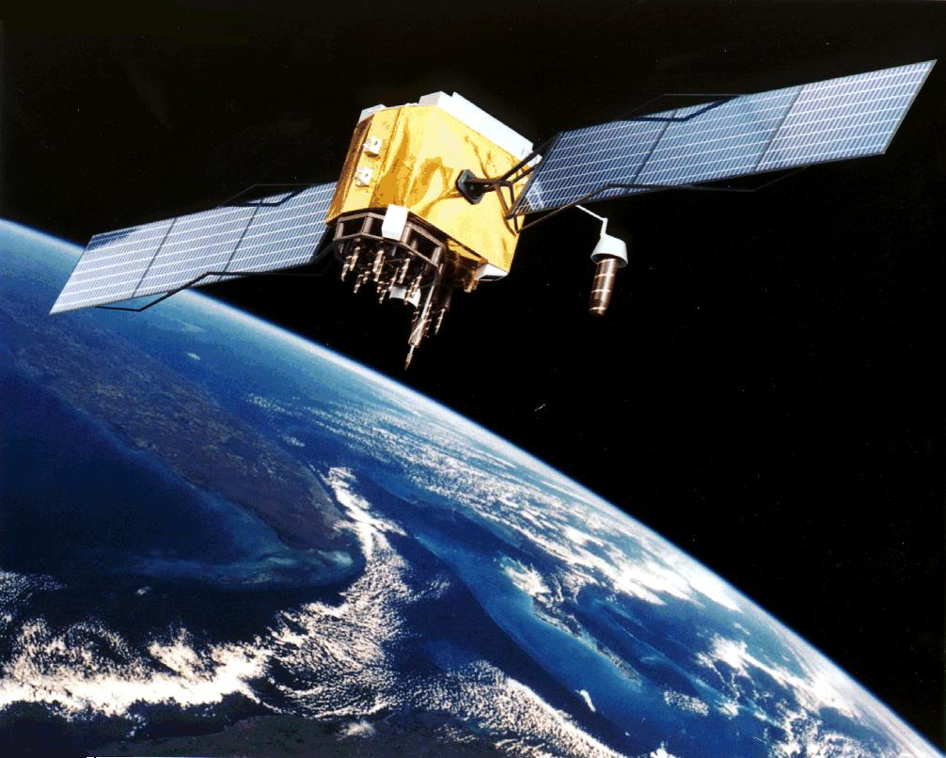
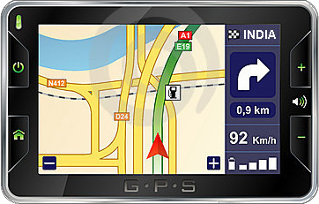
Introduction To Localization

Slide 2

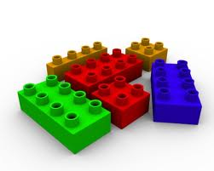
Two Research Threads
Mobile Computing
(top down)
Localization
Activity/Gesture
Smart Content
Psychological Computing
Application
Security
Transport
Network
MAC / Link
PHY/MAC Protocols
Battery Life
Localization
Sensor Assisted Networks
PHY
Wireless Networking
(bottom up)

Slide 3

Smartphone Positioning Systems:
The problem space

Slide 4
Motivation
Sudden growth in smartphone industry
Localization technology caught unprepared
Industry viewing location as “address” for content delivery

Slide 5
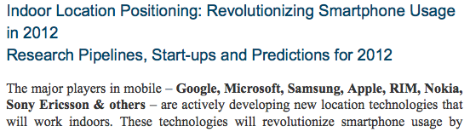

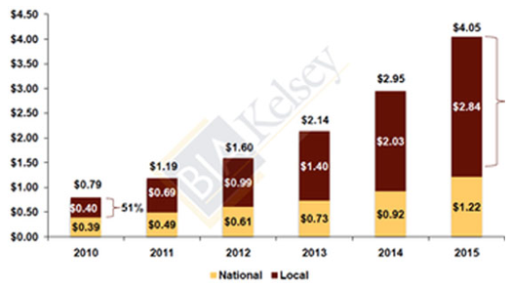
Motivation
Sudden growth in smartphone industry
Localization technology caught unprepared
Industry viewing location as “address” for content delivery
“I firmly believe location will be the cornerstone
of most successful applications of the foreseeable
future” – R. Lynch, CEO, Verizon
Notes:
The sudden growth in the smartphone industry has caught many technologies unprepared. Localization is one of them.
And this is not at all surprising … the booming app industry has realized that location exposes a lot of information about the user’s activities … her context … and detecting her location can be invaluable to delivering content and services. Hinged on this,
Next slide
The location based app industry is booming … targeted advertising is at $690 million now, and projected to be 3 billion by 2015 … Google Microsoft Qualcomm intel Apple are very keen on localization and are actively pursuing it … the technology start-up market is poised… and perhaps Verizon’s CEO, Richard Lynch, summarized this well by saying, location will be the cornerstone of most successful apps in the foreseeable future …
Next slide
The natural question then is … isn’t today’s location technology, say GPS, adequate? And the answer is in the negative. GPS is great for the purposes of driving directions on your car … but is not equipped to handle the wide-range of application specific needs. Let’s look at a few example apps to see this.
…
========================= Rough text below ==================================
The hope that GPS chips in a mobile device will take care of the location requirement was too optimistic. The rapidly growing apps suddenly sees location as a very rich
The last concerted effort was in 1993 when the last GPS satellite was launched … since then there has been hardly a need to make big jumps.
And now, a 2.84B dollar industry is developing on location based ads … my students who work on localization are being showered with internships/jobs by Microsoft, Google, Apple, Intel, Qualcomm … everyone wants localization … and Richard Lynch summarized the situation well – location is the cornerstone of most successful apps in the foreseeable future.
Natural question is why is location such a big deal … its simply because location encapsulates a lot of contextual information about a user … if you know someone is inside a restaurant, it’s a lot of information about that person’s mood, activity, next steps … you can even find that its raining heavy at the restaurant, by treating location as a key to search Internet databases …
And now, with a 2.84B ad industry on location based adds, Google, Microsoft, Apple, Qualcomm, and other giants heavily getting into mobile services, and Verizon CEO declaring that location is the cornerstone of next gen apps, its not fun. The iPhone app store already hosts 5000 LBAs, Android has 1500, and this is only the tip of the iceberg … a class of apps waiting to be unleashed … waiting for enabling technologies in localization. For instance,
Believe it or not, we saw this coming … and we started working on this since 2007.
However, these are simple apps … just the tip of the iceberg … a class of sophisticated apps waiting to be unleashed. For instance,

Slide 6
Isn’t today’s technology,
such as GPS, adequate?

Slide 7





Apps
Reminders when passing a library
Targeted ads in Starbucks, Wal-mart
Information about paintings in museums
Access files only from this room
Walking directions in shopping malls
Notes:
Say why each of these apps cannot be unleashed today …

Slide 8
Apps
Reminders when passing a library
Targeted ads in Starbucks, Wall-mart
Information about paintings in museums
Access files only from this room
Walking directions in shopping malls
.
.
Information about visible objects (augmented reality)
Notes:
Say why each of these apps cannot be unleashed today …

Slide 9




$7.8M
I wonder how much it costs to live there!
207 Coast Road

Slide 10


Enabling Technology
Apps
Localization

Slide 11
Enabling Technology
Apps
Localization
1. Outdoor Continuous
2. Indoor Semantic
3. High Precision Indoor
4. Object localization

Slide 12
Enabling Technology
Constraints
Accuracy
Energy
Calibration
Infrastructure
Apps
Localization
1. Outdoor Continuous
2. Indoor Semantic
3. High Precision Indoor
4. Object localization

Slide 13
Enabling Technology
Constraints
Accuracy
Energy
Calibration
Infrastructure
Apps
Localization
1. Outdoor Continuous
2. Indoor Semantic
3. High Precision Indoor
4. Object localization
Software
Hardware
GPS
WiFi
Inertial / Mag. Sensors
Camera
Mic.

Slide 14
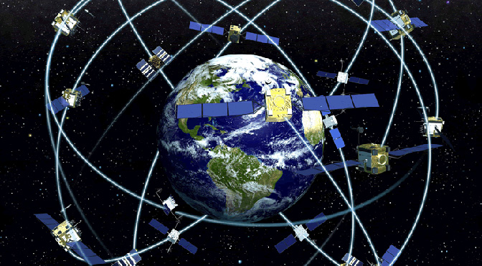
Global Positioning System

Slide 15
Global Positioning System
Worldwide radio-navigation system formed from a constellation of 24 satellites and their ground stations.
GPS uses these "man-made stars" as reference points to calculate positions accurate to a matter of meters.
With advanced forms of GPS you can make measurements to better than a centimetre
Notes:
GPS Satellites
Name: NAVSTAR
Manufacturer: Rockwell International
Altitude: 10,900 nautical miles
Weight:1900 lbs (in orbit)
Size:17 ft with solar panels extended
Orbital Period: 12 hours
Orbital Plane: 55 degrees to equitorial plane
Planned Lifespan: 7.5 years
Current constellation: 24 Block II production satellites
Future satellites: 21 Block IIrs developed by Martin Marietta.
Ground Stations (also known as the "Control Segment")
These stations monitor the GPS satellites, checking both their operational
health and their exact position in space. The master ground station transmits
corrections for the satellite's ephemeris constants and clock offsets back to the
satellites themselves. The satellites can then incorporate these updates in the
signals they send to GPS receivers.
There are five monitor stations: Hawaii, Ascension Island, Diego Garcia,
Kwajalein, and Colorado Springs.

Slide 16
Global Positioning System
GPS receivers have been miniaturized to just a few integrated circuits and so are becoming very economical.
That makes the technology accessible to virtually everyone.
These days GPS is finding its way into cars, boats, planes, construction equipment, movie making gear, farm machinery, and laptop computers.

Slide 17
Four Primary Functions of GPS
Position and coordinates.
The distance and direction between any two waypoints, or a position and a waypoint.
Travel progress reports.
Accurate time measurement.
Notes:
The Four Basic Functions of the GPS
The primary functions of the GPS fall into four categories:
1) Position and waypoint coordinates. Using the GPS a receiver can provide position or waypoint information for its current location or for any remote location on the earth, and display that information in a variety of coordinates.
2) The distance and direction between a receiver’s position and a stored waypoint, or between two remote waypoints.
3) Velocity reports: Distance to and between waypoints; tracking to a waypoint; heading (direction of travel); speed; estimated time of arrival.
4) Accurate time measurement: GPS has become the universal timepiece, allowing any two receivers (as well as any two clocks or watches) to be precisely synchronized to each other anywhere in the world.

Slide 18
GPS works in three logical steps
The basis of GPS is "triangulation" from satellites.
To "triangulate," a GPS receiver measures distance using the travel time of radio signals.
To measure travel time, GPS needs very accurate timing which it achieves with some tricks.
Along with distance, you need to know exactly where the satellites are in space.
High orbits and careful monitoring are the secret.
Finally you must correct for any delays the signal experiences as it travels through the atmosphere.

Slide 19
What a satellite transmits
A GPS signal contains three different bits of information
ID to identify which satellite is transmitting information.
Ephemeris data which contains information about the status, current date and time
Almanac data which tell the receiver where each GPS satellite should be at any time throughout the day

Slide 20
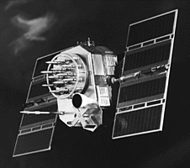
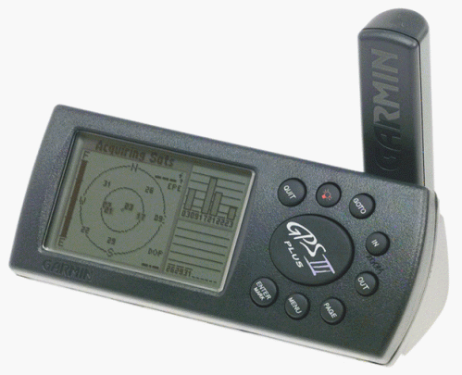
Position is Based on Time
Signal leaves satellite at time “T”
T
Signal is picked up by the receiver at time “T + 3”
T + 3
Distance between satellite and receiver = “3 times the speed of light”
Notes:
Receiver Position is Based on Time
The Global Positioning System allows a GPS receiver to determine its position by using a simple formula: Velocity x Time = Distance
GPS satellites continuously transmit digital radio pulses at precise, known times. So by measuring the exact instant when the pulses arrive, the receiving GPS equipment can determine the distance to each satellite. But there’s a problem. The clocks on board the satellites are all extremely accurate, while the clock in the GPS receiver is not. So a GPS receiver calculates what are called pseudo-ranges (“false” ranges), which are approximate calculated distances (as a measurement of time) to every satellite the receiver has acquired.
Eventually, in order for the GPS receiver to determine a precise position it will have to get its own clock synchronized with the satellite clocks. A clock error in the GPS receiver of as little as a few nanoseconds (billionths of a second) can translate into a position error on the ground of as much as 300 meters. (More about this later.)
For example, if a GPS satellite transmits its signal at precisely T+ 0 nanoseconds, travels at 186,000 miles per second (light speed) to the earth, and arrives at the receiver at precisely T+ 645,160 nanoseconds later, then the signal traveled 12,000 miles (12,000 miles at 186,000 miles per second = 64.516 milliseconds, or 645,160 nanoseconds). The receiver does this for every satellite signal it acquires, tracking each satellite’s code by its unique pseudo random noise (PRN) number. This example was presented without introducing any errors into the signal or its path to the GPS receiver. More about that later.

Slide 21
Signal From One Satellite
The receiver is somewhere on this sphere.
Notes:
How a Receiver Determines Its Position
Traveling at the speed of light each satellite PRN signal takes a brief, but measurable amount of time to reach a GPS receiver. The difference between when the signal is sent and the time it is received, multiplied by the speed of light, enables a GPS receiver to accurately calculate the distance between it and each satellite, provided that several factors are met.
Those factors are:
Good satellite signal lock by the GPS receiver (already covered)
A minimum of four satellite signals (discussed next)
Good satellite geometry (discussed later)
When a GPS receiver is turned on it immediately begins searching the sky for satellite signals. If the receiver already has a curent almanac (such as one acquired on a previous outing), it speeds up the process of locating the first satellite signal. Eventually it locates and acquires its first signal. Reading this signal the receiver collects the Navigation Message. If the receiver does not have a current almanac, or was moved more than 300 miles while turned off, it must collect a new almanac, which will take about 12-13 minutes after the first satellite signal is acquired. Why the need for a new almanac if the receiver is moved more than 300 miles while turned off? Beyond 300 miles from its last used location the receiver is presumed to be using different GPS satellites, and therefore should download a new almanac to reflect the new PRN codes. If the receiver is turned on and collecting satellite signals while moving over 300 miles, its almanac is automatically updated.
In the above graphic, the GPS receiver calculates a rough location somewhere on this three dimensional sphere, which is actually thousands of miles in diameter. All the receiver can really do at this point is collect system data and search for more satellites.

Slide 22
Signals From Two Satellites
Notes:
How a Receiver Determines Its Position (cont.)
In a perfect world, where both satellite and receiver clocks were perfectly synchronized with each other, an accurate position could be determined from just two satellites. However, most receivers are incapable of calculating an accurate position using just two satellites. The dot in the example represents the approximate location of where the receiver thinks it is based on the information provided by two satellites. At least now the receiver knows that it is somewhere at the intersection of those two satellite signals. But that’s the only improvement in its position calculations.
The satellite signal spheres should intersect at precisely the receiver’s location, but don’t because the clock in the GPS receiver isn’t yet synchronized with GPS Time. So the receiver estimates a “pseudo-range” to each satellite.

Slide 23
Three Satellites (2D Positioning)
Notes:
How a Receiver Determines Its Position (cont.)
Three satellites can provide only a two-dimensional (2D) position. Without manually entering the receiver’s exact elevation (most GPS receivers don’t allow elevation to be entered manually), the rendered 2D position may be off by several kilometers on the ground. If the exact elevation of the GPS receiver is known, entering that elevation into a receiver with this capability replaces the need for a fourth satellite signal to allow a receiver to triangulate a precise position. The receiver essentially uses elevation in lieu of a fourth satellite, and makes the appropriate adjustments to trilaterate a reasonably good 3D position.
But without manual elevation correction most GPS receivers must rely on a fourth satellite to provide the final clock correction information necessary to calculate a 3D position. Until a fourth satellite signal is acquired the receiver will not be able to determine x and y horizontal, and z vertical positioning (a true 3D position). This is because the fourth satellite signal is used by the receiver not to provide more position data, but, rather, the final time correction factor in its ranging calculations.
As a rule, 2D positions should always be avoided whenever possible. Use 2D positioning only when a 3D position is not possible, but be aware of the horizontal error inherent in any 2D position. The inability of a GPS receiver to triangulate a 3D position may be due to a variety of factors, including user error, poor satellite geometry, and harsh landscape conditions (tall buildings, canyons, and dense tree cover among others). As will be shown later in the course, all GPS receivers provide some means for informing the user which mode they are operating in. It’s up to the user to be aware of the errors associated with 2D positioning.

Slide 24
Triangulating Correct Position
Notes:
How a Receiver Determines Its Position (cont.)
Unfortunately, accessing only two or three satellite signals, the clock in the GPS receiver cannot yet be synchronized precisely with GPS Time. The pseudo-range spheres (the diagram here shows only two satellites for simplification), as interpreted by the GPS receiver, will either be just a little too large (if the receiver’s clock is running faster than GPS Time) or too small (if the receiver’s clock is slower than GPS Time). The spheres will not intersect with each other. In this example, the “do not” could be the false pseudo-range position if the GPS receiver’s clock is running faster than GPS Time, or the dot is the position if the receiver’s clock is slower than GPS Time. For the purpose of this example, we’ll pretend that the receiver’s clock is running a little fast, so the dot is the true location.

Slide 25
Three Dimensional (3D) Positioning
Notes:
How a receiver determines its position (cont.)
For a GPS receiver to achieve three-dimensional (3D) positioning it needs to acquire four or more satellite signals. A 3D position is comprised of X and Y (horizontal), Z (vertical) positions, and precise time (not varying more than a few hundred nanoseconds). The receiver’s processor uses the fourth satellite pseudo-range as a timing cross check to estimate the discrepancy in its own ranging measurements and calculate the amount of time offset needed to bring its own clock in line with GPS Time (recall the radio station and record player simultaneously playing the same song). Since any offset from GPS Time will affect all its measurements, the receiver uses a few simple algebraic calculations to come up with a single correction factor that it can add or subtract from all its timing measurements that will cause all the satellite spheres to intersect at a single point (x, y, and z).
That time correction synchronizes the receiver's clock with GPS Time. Now the receiver essentially has atomic clock accuracy with the time correction factor needed to achieve precise 3D positioning. The pseudo-ranges calculated by the GPS receiver will correspond to the four pseudo-range spheres surrounding the satellites, causing the four spheres to intersect at precisely the receiver’s location (the dot in the diagram).

Slide 26
Triangulation/trilateration
Two spheres intersect at a circle and three spheres intersect at two points.
Distance calculation-
If received time t and transmit time ti then distance is c*(t-ti) where c is the speed of light
4 satellites are used

Slide 27
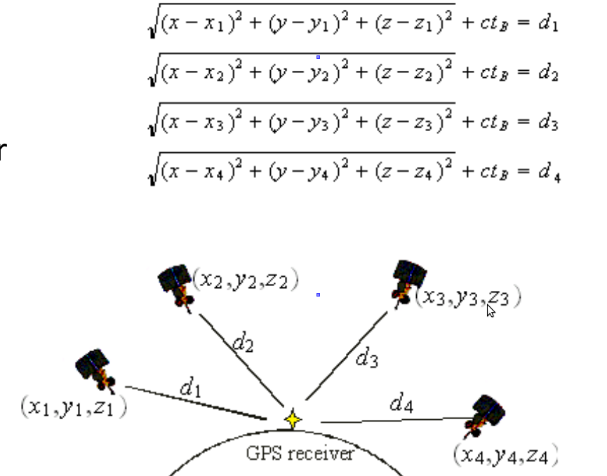
xi,yi,zi are the coordinates of a satellite i
di is the distance from satellite i
tB is the clock offset
Triangulate position based on the data.

Slide 28
Timing
How can you measure the distance to something that's floating around in space?
We do it by timing how long it takes for a signal sent from the satellite to arrive at our receiver.

Slide 29
Timing
In a sense, the whole thing boils down to
Velocity (60 mph) x Time (2 hours) = Distance (120 miles)
In the case of GPS we're measuring a radio signal so the velocity is going to be the speed of light or roughly 186,000 miles per second.
The problem is measuring the travel time.

Slide 30
Timing
The timing problem is tricky.
First, the times are going to be awfully short.
If a satellite were right overhead the travel time would be something like 0.06 seconds.
So there is a need for a really precise clocks.
Measuring travel time
Satellites and receivers use something called a "Pseudo Random Code"
Notes:
Suppose there was a way to get both the satellite and the receiver to start
playing "The Star Spangled Banner" at precisely 12 noon. If sound could reach us from space (which, of course, is ridiculous) then standing at the receiver we'd hear two versions of the Star Spangled Banner, one from our receiver and one from the satellite.
These two versions would be out of sync. The version coming from the
satellite would be a little delayed because it had to travel more than 11,000
miles.
If we wanted to see just how delayed the satellite's version was, we could start
delaying the receiver's version until they fell into perfect sync.
The amount we have to shift back the receiver's version is equal to the travel
time of the satellite's version. So we just multiply that time times the speed of
light and BINGO! we've got our distance to the satellite.

Slide 31
Pseudo Random Noise Code
Time Difference
Satellite PRN
Receiver PRN
Notes:
How A GPS Receiver Determines Its Position
Each satellite transmits what’s called a Navigation Message, which is downloaded by GPS receivers. The NAV Message the following information: GPS constellation status (all the satellites) satellite ephemeris and health data (individual satellites), GPS Time and UTC time transfer parameters, and ionosphere interference correction parameters. The GPS currently uses two frequencies to accomplish data transmission, L1 and L2. The NAV Message and coarse acquisition information are provided on the L1 frequency. Another frequency (L3) is planned for the next generation of satellites to enhance position and navigation precision of GPS receivers.
The pseudo random noise (PRN) code is a fundamental part of the GPS. It's a very complicated digital code unique to each satellite. It’s a complex sequence of "on" and "off" digital pulses (see the diagram). The signal looks like random electrical noise (similar to the “snow” you might see on a TV), but is actually a very precise code. Hence the name “pseudo-random noise.”
When a GPS receiver acquires a GPS signal it examines the satellite’s incoming PRN and begins generating a matching digital signal to mimic the satellite’s signal. The receiver matches each satellite’s PRN code with an identical copy of the code contained in the receiver’s database. Its next task is to try and determine how long ago the signal was generated by the satellite. But there’s a problem. As explained earlier, each satellite is equipped with atomic clocks; clocks which are constantly monitored for accuracy by the Master Control Station. The GPS receiver on the other hand is equipped only with a single digital clock comparable to a cheap wrist watch. The only way for the receiver to calculate an accurate position is if it can accurately measure the precise travel time of the satellite radio signal. A discrepancy of just a few nanoseconds between satellite and receiver will translate into a large position error on the ground.
So the GPS receiver uses a clever technique to calculate the precise time it took for the GPS signal to reach it. By shifting its own generated copy of the satellite’s PRN code in a matching process, and by comparing this shift with its own internal clock, the receiver can calculate how long it took the signal to travel from the satellite to itself. By comparing the time difference between the two, and multiplying that time by the 186,000 miles per second travel speed of the signal, the receiver can roughly determine the distance separating it from the satellite. This process is repeated with every satellite signal the receiver locks on to.
The distance between satellite and receiver derived from this method of computing distance is called a pseudo-range (“false range”) because the receiver’s clock is not synchronized with the satellites clocks. Pseudo-range is subject to several error sources, such as delays caused by the atmosphere, and multipath interference. More about that later.
Here’s a simplified example of how a GPS receiver synchronizes itself to GPS Time for precise positioning. Imagine that the GPS satellite PRN signal is a song being broadcast by a radio station. The GPS receiver is a record player which is playing the same song, but it’s not synchronized to the broadcast song. Both songs are playing, but at different places in the song and at different speeds. By speeding up or slowing down the turntable, the two songs can be precisely matched. They become synchronized. Similarly, the GPS receiver synchronizes its digital signal to match that of each satellite’s signal.
Once the receiver has its internally generated PRN code in synch with the satellite’s code it can determine a pseudo-range distance to the satellite. It does this for every satellite signal it receives. As will be explained later, under ideal conditions four satellites are used to calculate a precise position.
Since GPS Time is one of the most important components of the System, it’s important to understand what GPS Time actually is. GPS Time is measured in weeks and seconds from 24:00:00, January 5, 1980 and is adjusted to within one microsecond of Universal Coordinated Time (UTC). Universal Coordinated Time is the international standard for time, and is tied to the earth’s rotation. Because of this it must be periodically adjusted to compensate for the slowing of the earth’s rotation – these adjustments are called leap seconds. But because GPS Time has no leap seconds, it is not adjusted, which puts it ahead of UTC time by several seconds. Universal Coordinated Time is computed from GPS Time using the UTC correction parameters sent by the Master Control Station to the satellite constellation as part of the navigation message. At the transition between 23:59:59 UTC on June 30, 1997 and 00:00:00 UTC on July 1, 1997, UTC time was retarded one additional second, putting GPS Time ahead of UTC time by thirteen seconds. A GPS receiver will use the GPS Time to UTC time correction parameter to provide the user with UTC time on the receiver’s display.
It’s important to note that setting an incorrect time zone in a GPS receiver has no effect on the receiver’s ability to provide an accurate position. An incorrect time zone merely provides different time on a receiver’s display, not inaccurate time.

Slide 32
What Time is it Anyway?
Universal Coordinated Time
Greenwich Mean Time
GPS Time - 13*
Zulu Time
Local Time: AM and PM (adjusted for local time zone)
Military Time (local time on a 24 hour clock)
* GPS Time is currently ahead of UTC by 13 seconds.
Notes:
So What Time is it Anyway?
Universal Time Coordinated (UTC) is the same as Greenwich Mean Time (GMT), which runs through Greenwich, England - hence its name. It’s also known as “Zulu” time (a term used mostly by pilots and the military). Greenwich, England is where east meets west for both time zones and latitude and longitude coordinates. The world is broken down into 24 time zones of one hour each. Universal Time Coordinated is the “official” time standard recognized by most of the world, and it forms the basis for GMT and Zulu time.
Midnight in Greenwich, England is 0000 hours UTC and Zulu (and 0000 hours + 13 seconds in GPS Time!). Each time zone east of Greenwich adds one hour, and each time zone west of Greenwich subtracts an hour. Most of the United States practices Daylight Saving Time (DST) during spring and summer, which adds one hour to each U.S. time zone. The rest of the year is referred to as Standard Time. When it’s midnight in Greenwich, it’s five hours (or five time zones) behind on the eastern seaboard of the U.S. during Standard Time (7:00 PM), or four hours (or four time zones) behind Greenwich during Daylight Saving Time (8:00 PM).
Universal Time Coordinated is not military time. Military time is simply using a 24 hour clock to represent local time. For example, 1800 hours in military time is 6:00 p.m. local time. But 1800 hours Zulu time (or UTC time, or Greenwich Time) is 6:00 p.m. in Greenwich, England.
Presented another way, 1800 hours in military time in Boise, Idaho (6:00 p.m. local) is 2400 hours in UTC time during Mountain Daylight Saving Time, or 0100 hours during Mountain Standard Time (Boise lies in the seventh time zone behind Greenwich). But if it’s 9:00 AM (0900 military time) in Boise, and you tell someone that you will meet them at a pub at 1600 Zulu (assuming Standard Time), then you had better hurry because 0900 Mountain Standard Time is 1600 Zulu Time!
Some points to remember about time:
UTC, GMT and Zulu time are all the same, and refer to local official time set in Greenwich, England. All other time zones must add or subtract hours to convert UTC, GMT and Zulu to local time.
Military time is nothing more than local time converted to a 24 hour clock (2:00 p.m. is 1400 hours, and so on).
UTC time is the “official” time for the entire world, and is kept by a number of observatories around the world (the U.S. Naval Observatory is one – http://tycho.usno.navy.mil).
The Global Positioning System operates on GPS Time, which is UTC time plus approximately 13 seconds (periodic adjustments in leap seconds may vary the number of seconds).
The following chart shows different time offsets for various cities. All times shown assume Standard Time, but the last column provides Daylight Saving Time (DST) conversion for that city. Remember, Daylight Saving Time occurs only in spring and summer, and most of the world does not subscribe to it.
Place Local Time Military (local) UTC, GMT, Zulu Time Zone Local DST Offset
Greenwich, UK 12:00 p.m. 1200 hours 0000 hours 0 offset 0
Tallahassee, FL 7:00 p.m. 1900 hours 0000 hours -5 hours -4 hours (8:00 p.m.)
Tallahassee, FL 11:00 a.m. 1100 hours 1600 hours -5 hours -4 hours (12:00 p.m.)
Joshua Tree, CA 2:00 a.m. 0200 hours 1000 hours -8 hours -7 hours (03:00 a.m.)
Joshua Tree, CA 10:30 p.m. 2230 hours 0630 hours* -8 hours -7 hours (11:30 p.m.)
Paris, FR** 4:00 p.m. 1600 hours 1500 hours +1 hour -1 hour (3:00 p.m.)
* 0630 (or 6:30 a.m.) the next day.
** Paris lies east of Greenwich by one hour, so time is added rather than subtracted. But DST is not affected.
Note: all GPS receivers perform position calculations using GPS Time. But the time shown on a receiver’s screen is UTC time (currently 13 seconds behind GPS Time). According to the Garmin Company, their receiver clocks usually vary from ½ to 1 second from true UTC time if a current almanac is loaded in the receiver.

Slide 33
Timing
Distance to a satellite is determined by measuring how long a radio signal takes to reach us from that satellite.
To make the measurement we assume that both the satellite and our receiver are generating the same pseudo-random codes at exactly the same time.
By comparing how late the satellite's pseudo-random code appears compared to our receiver's code, we determine how long it took to reach us.
Multiply that travel time by the speed of light and you've got distance.
Notes:
If measuring the travel time of a radio signal is the key to GPS, then our stop
watches had better be darn good, because if their timing is off by just a
thousandth of a second, at the speed of light, that translates into almost 200
miles of error!
Atomic Clocks are on board the sattelites
Atomic clocks don't run on atomic energy. They get the name because they
use the oscillations of a particular atom as their "metronome." This form of
timing is the most stable and accurate reference man has ever developed.
If our receivers needed atomic clocks (which cost upwards of $50K to $100K)
GPS would be a lame duck technology. Nobody could afford it.
Luckily the designers of GPS came up with a brilliant little trick that lets us get by with much less accurate clocks in our receivers. This trick is one of the key elements of GPS and as an added side benefit it means that every GPS receiver is essentially an atomic-accuracy clock.

Slide 34
Errors in GPS signals
Signal multipath
Receiver clock errors
Orbital errors
Number of satellites visible
Satellite geometry/shading

Slide 35
Intentional Error
The U.S. government is intentionally degrading its accuracy in a policy called "Selective Availability" or "SA” and the idea behind it is to make sure that no hostile force can use GPS to make accurate weapons.
Basically the DoD introduces some "noise" into the satellite's clock data which, in turn, adds noise (or inaccuracy) into position calculations. The DoD may also be sending slightly erroneous orbital data to the satellites which they transmit back to receivers on the ground as part of a status message.
Together these factors make SA the biggest single source of inaccuracy in the system.
Military receivers use a decryption key to remove the SA errors and so they're much more accurate.
Notes:
Typical Error in Meters (per satellite) Standard GPSDifferential GPS
Satellite Clocks 1.5 0
Orbit Errors 2.5 0
Ionosphere 5.0 0.4
Troposphere 0.5 0.2
Receiver Noise 0.3 0.3
Multipath 0.6 0.6
SA 30 0
Typical Position Accuracy
Horizontal 50 1.3
Vertical 78 2.0
3-D 93 2.8

Slide 36
Differential GPS - DGPS
Used for applications where GPS accuracy is not enough
In a typical DGPS application
There is a reference receiver (base receiver) at an exactly known location
And there are other receivers (rover receivers) that can receive the correction signals sent by the base receiver.

Slide 37
Differential GPS
Differential GPS or "DGPS" can yield measurements good to a couple of meters in moving applications and even better in stationary situations.
That improved accuracy has a profound effect on the importance of GPS as a resource.
With it, GPS becomes more than just a system for navigating boats and planes around the world.
It becomes a universal measurement system capable of positioning things on a very precise scale.

Slide 38
Differential GPS
The satellites are so far out in space that the little distances we travel here on earth are insignificant.
So if two receivers are fairly close to each other, say within a few hundred kilometres, the signals that reach both of them will have travelled through virtually the same slice of atmosphere, and so will have virtually the same errors

Slide 39
Differential GPS - DGPS

Slide 40
Differential GPS - DGPS
Since the exact location of the reference station is known it can calculate the distances to satellites accurately
It compares these distances with its own solutions as a GPS
Calculates corrections from these measurements
Sends these corrections to the rover receivers from a different frequency than the GPS frequencies.

Slide 41
Differential GPS - DGPS
Transmission is usually over a FM channel
The rover receivers are able to receive these corrections and they use them to correct their solutions
Corrections are valid within a certain range
Referance and rover receivers must have the same satellites in view

Slide 42
The idea is simple.
Put the reference receiver on a point that's been very accurately surveyed and keep it there.
This reference station receives the same GPS signals as the roving receiver but instead of working like a normal GPS receiver it attacks the equations backwards.
Instead of using timing signals to calculate its position, it uses its known position to calculate timing. It figures out what the travel time of the GPS signals should be, and compares it with what they actually are.
The difference is an "error correction" factor.
The receiver then transmits this error information to the roving receiver so it can use it to correct its measurements.
Notes:
Since the reference receiver has no way of knowing which of the many
available satellites a roving receiver might be using to calculate its position,
the reference receiver quickly runs through all the visible satellites and
computes each of their errors.
Then it encodes this information into a standard format and transmits it to the
roving receivers.
It's as if the reference receiver is saying: "OK everybody, right now the signal
from satellite #1 is ten nanoseconds delayed, satellite #2 is three nanoseconds
delayed, satellite #3 is sixteen nanoseconds delayed...." and so on.
The roving receivers get the complete list of errors and apply the corrections
for the particular satellites they're using.

